Slide 1
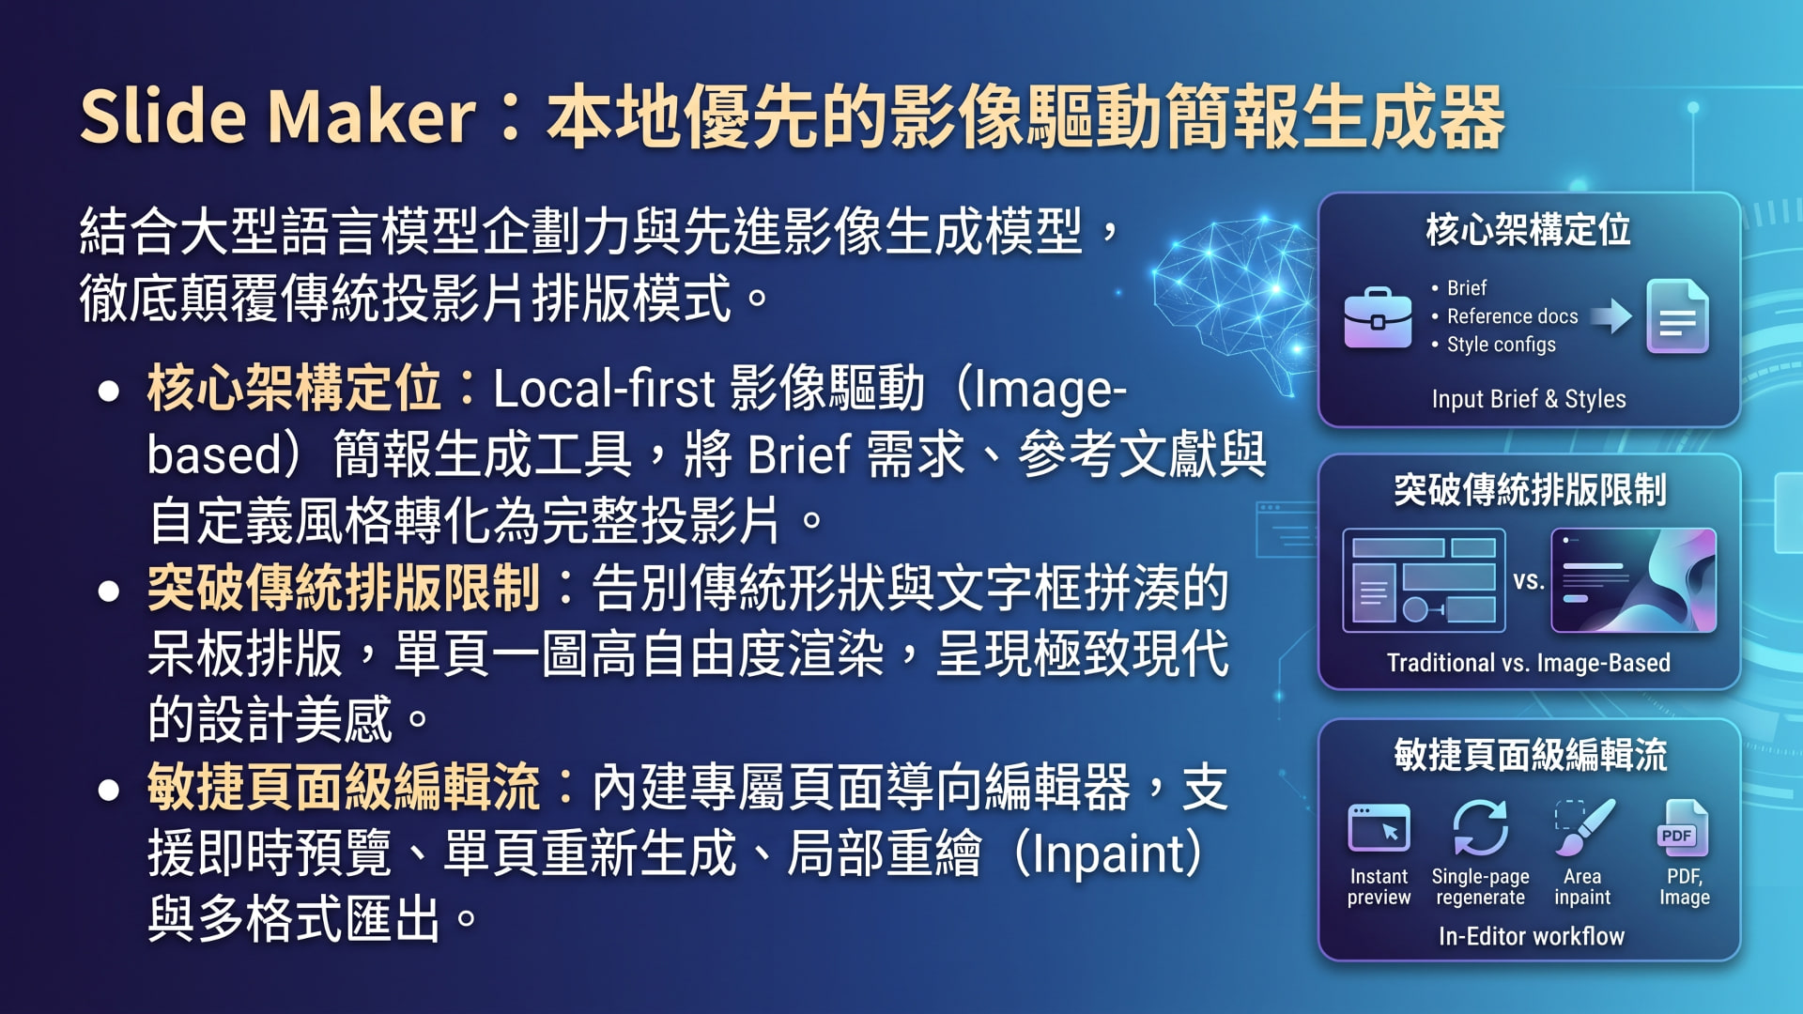
Notes:
GitHub - fdsf53451001_slide-maker_ Local-first image-based slide generator — Express server + React editor + pluggable image providers.md — chunk:1 — https://github.com/fdsf53451001/slide-maker

Slide 2

Notes:
GitHub - fdsf53451001_slide-maker_ Local-first image-based slide generator — Express server + React editor + pluggable image providers.md — chunk:1 — https://github.com/fdsf53451001/slide-maker

Slide 3
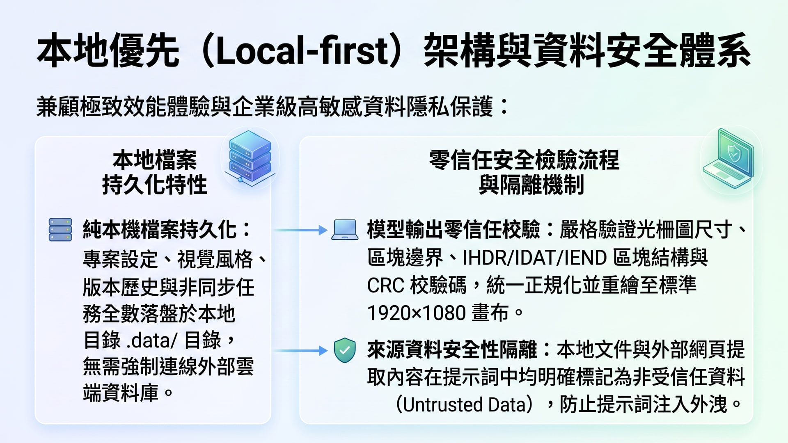
Notes:
GitHub - fdsf53451001_slide-maker_ Local-first image-based slide generator — Express server + React editor + pluggable image providers.md — chunk:1 — https://github.com/fdsf53451001/slide-maker

Slide 4

Notes:
GitHub - fdsf53451001_slide-maker_ Local-first image-based slide generator — Express server + React editor + pluggable image providers.md — chunk:1 — https://github.com/fdsf53451001/slide-maker

Slide 5
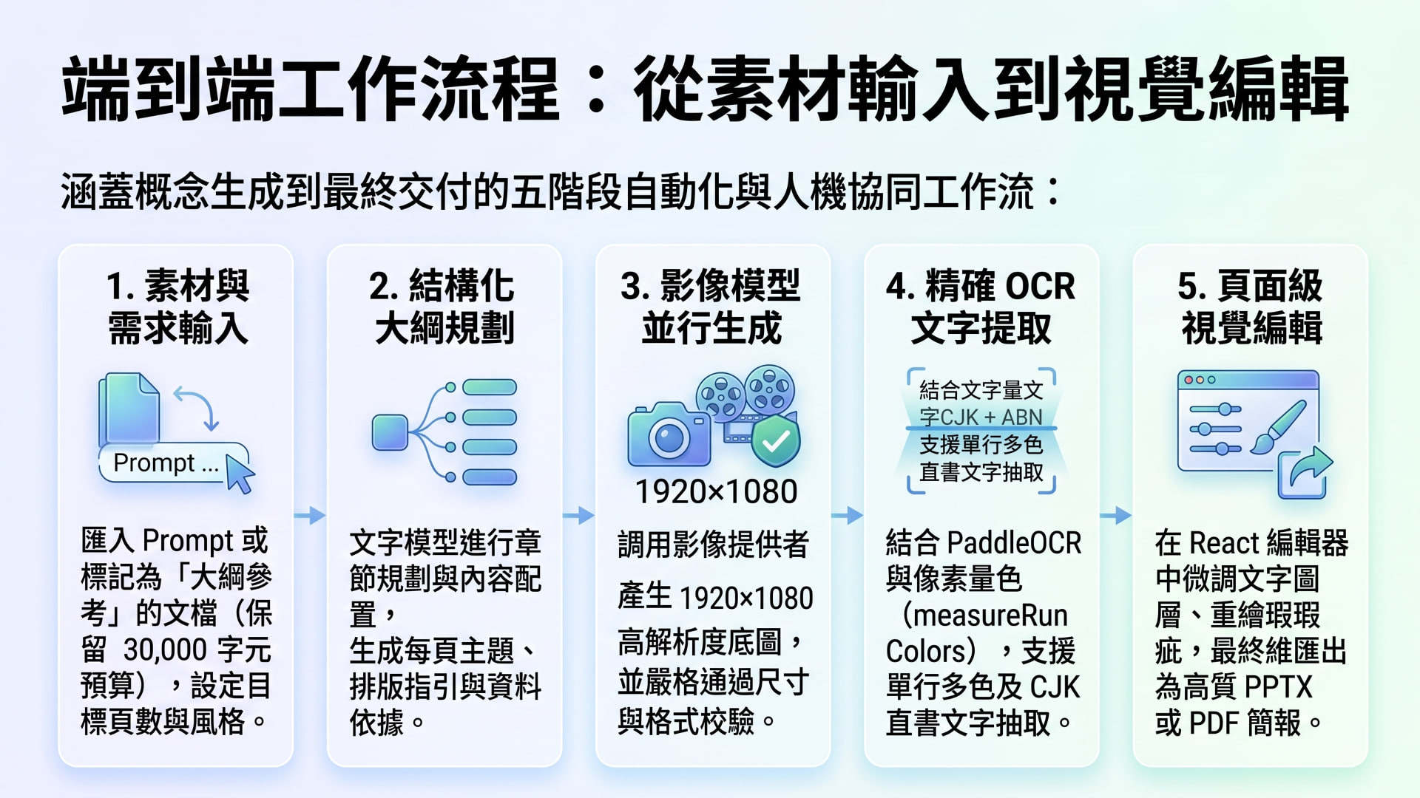
Notes:
GitHub - fdsf53451001_slide-maker_ Local-first image-based slide generator — Express server + React editor + pluggable image providers.md — chunk:1 — https://github.com/fdsf53451001/slide-maker

Slide 6

Notes:
GitHub - fdsf53451001_slide-maker_ Local-first image-based slide generator — Express server + React editor + pluggable image providers.md — chunk:1 — https://github.com/fdsf53451001/slide-maker

