Slide 1
0 Prefetching on every chip
On-chip core increases faster than memory bandwidth
To hide memory bottleneck using large-size caches, multithreading and prefetching
Prefetching does not incur a large area/energy penalty can boost serial applications
“Prefetching is now used in nearly all high-performance commercial processors, such as AMD Opteron, IBM Power8, Intel Xeon, and Oracle Sparc M7.”^{[1]}
[1]Mittal S (2016) A survey of recent prefetching techniques for processor caches. ACM Comput Surv CSUR 49(2):1–35. https://doi.org/10.1145/2907071

Slide 2
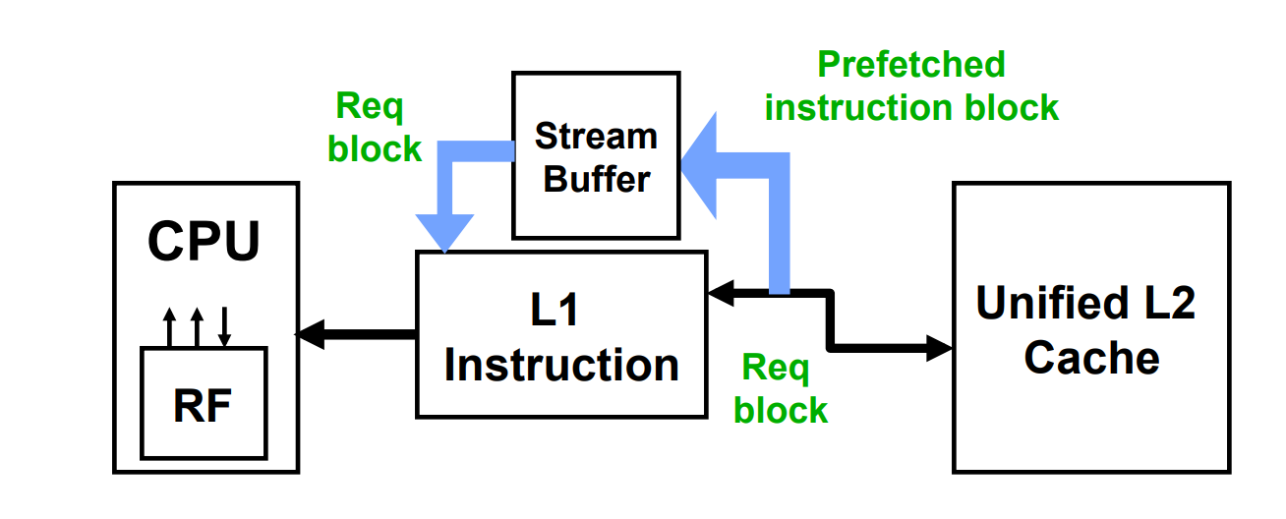
1 Prefetching on Alpha AXP 21064
Hardware Instruction Prefetcher
AXP 21064
Released in ISSCC 1992
Best microprocessor after IBM Power2
The prototype of Sunway Bluelight Supercomputer (probably)
CPU : request block[i]
-> if miss{
fetch block[i] in L1 cache
prefetch block[i+1] in Stream Buffer
}
CPU : execute block[i] -> next block
-> miss in L1 but hit in Buffer{
move block[i] from buffer to L1 cache
prefetch block[i+2] in Stream Buffer
}
Image credit: Berkeley cs152 L07

Slide 3
2 Prefetching on IBM Power
Hardware data Prefetcher
Strided Prefetch (used in modern Intel processor)
If observe(
sequence of accesses to block[b], b+N, b+2N){
fetch block[b+3N] etc.
IBM Power 5 [2003] supports eight independent streams of strided prefetch per processor, prefetching 12 lines ahead of current access
Prefetch-on-miss
If miss block[i] {
fetch block[i] & block[i+1]
}
One Block Lookahead
No matter whether miss block[i] {
fetch block[i] & block[i+1]
}
Information credit: Berkeley cs152 L07

Slide 4
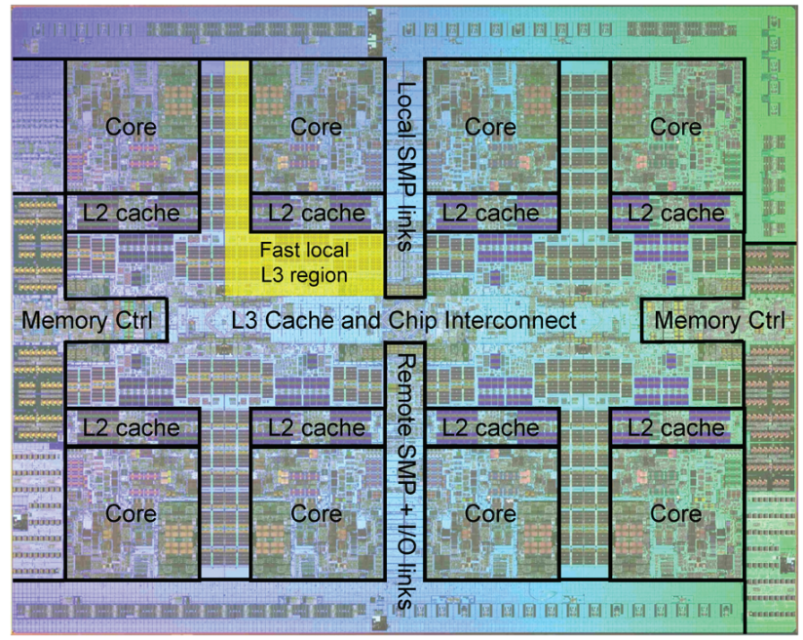
2 Prefetching on IBM Power
Hardware data Prefetcher + Customize
POWER7 includes a programmable prefetch engine
Used for prefetch consecutive data blocks and those separated by a non-unit stride
Is provided to customers with a default prefetch setting
If needed, the default setting can be override manually
POWER7 processor
Eight-core chip
Each core can run up to four threads
2×32KB L1 caches + 1×256KB L2 cache
An on-chip 32MB L3 cache
Die photo of the IBM POWER7 chip Image credit: Berkeley CS252 sp17

Slide 5
2 Prefetching on IBM Power
Hardware data Prefetcher + Customize
POWER7 prefetcher
Programmable and allow user to set different parameter including
prefetch depth: how many lines in advance to prefetch
prefetch on stores: whether to prefetch store operations
stride-N: whether to prefetch streams with a stride larger than one cache block
When using adaptive prefetching: the processor will gain:
2.7X speed up in single-threaded Workloads
30% speed up in Multi-programmed Workloads^{[2]}
[2] V. Jiménez, R. Gioiosa, F. J. Cazorla, A. Buyuktosunoglu, P. Bose and F. P. O'Connell, "Making data prefetch smarter: Adaptive prefetching on POWER7," 2012 21st International Conference on Parallel Architectures and Compilation Techniques (PACT), Minneapolis, MN, USA, 2012, pp. 137-146.

Slide 6
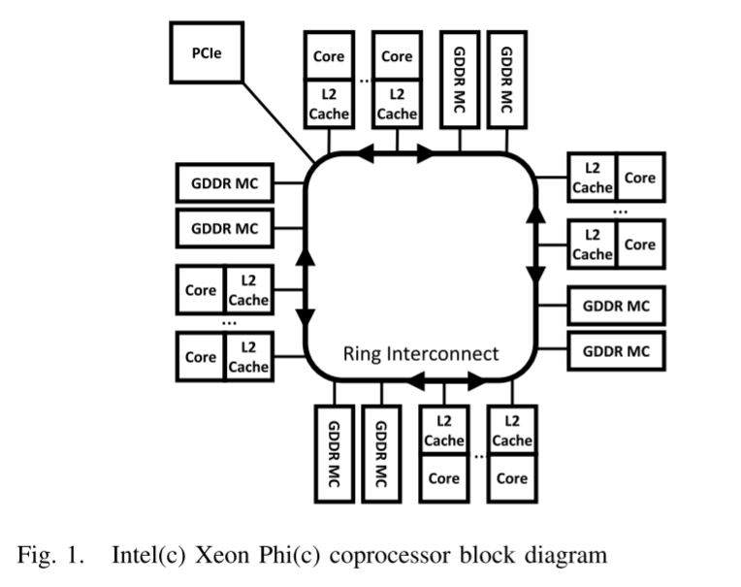
3 Prefetching on Intel Xeon Phi^{[3]}
3.1 Xeon Phi
based on Intel’s Many Integrated Core (MIC) architecture
57 to 61 simple, in-order cores
512KB L2 cache per core, and 6-16GB of GDDR5 memory
sit on a ring network
thread-level parallelism
four hardware contexts (threads)
512-bit wide vector registers
same code can be compiled for the Xeon Phi or a regular x86 CPU with no code changes
[3]D. Guttman, M. T. Kandemir, Meenakshi Arunachalam, and Vlad Calina. 2015. Performance and energy evaluation of data prefetching on intel Xeon Phi.(ISPASS)

Slide 7
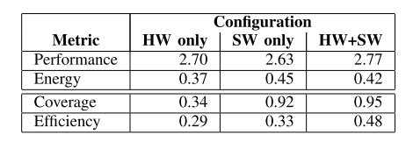
3 Prefetching on Intel Xeon Phi^{[3]}
3.2 Self-Adaptive hw prefetching
When complier is in an optimization of two or higher like(02 03)
Software prefetching on!
Still flexible for programmer to interfere manually
If sw prefetching can{ prefetch for the majority of the access reduce L2 demand misses } the hw prefetcher will not even get triggered very aggressively i.e.,hw prefetcher will throttle itself
[3]D. Guttman, M. T. Kandemir, Meenakshi Arunachalam, and Vlad Calina. 2015. Performance and energy evaluation of data prefetching on intel Xeon Phi.(ISPASS)

Slide 8
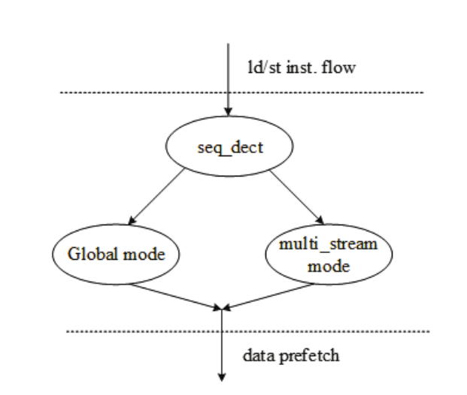
4 Prefetching on XuanTie C910^{[4]}
Powerful hardware prefetching (self-called)
Muli-mode and Multi-stream -Pattern matching the data streams -Global Prefetch Mode -Multi-Stream Prefetch Mode
Both Virtual and Physical Address Prefetching
Configurable Prefetch Capacity
[4]C. Chen et al., "Xuantie-910: A Commercial Multi-Core 12-Stage Pipeline Out-of-Order 64-bit High Performance RISC-V Processor with Vector Extension : Industrial Product," 2020 ACM/IEEE 47th Annual International Symposium on Computer Architecture (ISCA)

Slide 9
Acknowledgements
[1] Mittal S (2016) A survey of recent prefetching techniques for processor caches. ACM Comput Surv CSUR 49(2):1–35. https://doi.org/10.1145/2907071
[2] V. Jiménez, R. Gioiosa, F. J. Cazorla, A. Buyuktosunoglu, P. Bose and F. P. O'Connell, "Making data prefetch smarter: Adaptive prefetching on POWER7," 2012 21st International Conference on Parallel Architectures and Compilation Techniques (PACT), Minneapolis, MN, USA, 2012, pp. 137-146.
[3] D. Guttman, M. T. Kandemir, Meenakshi Arunachalam, and Vlad Calina. 2015. Performance and energy evaluation of data prefetching on intel Xeon Phi.(ISPASS)
[4]C. Chen et al., "Xuantie-910: A Commercial Multi-Core 12-Stage Pipeline Out-of-Order 64-bit High Performance RISC-V Processor with Vector Extension : Industrial Product," 2020 ACM/IEEE 47th Annual International Symposium on Computer Architecture (ISCA)
[5] UCB material derived from course CS152
[6] UCB material derived from course CS252
[7] B. Falsafi and T. F. Wenisch. 2014. Primer on Hardware Prefetching. Morgan 8 Claypool.

