Slide 1
Research
(MICRO 21’ )
Twig: Profile-Guided BTB Prefetching for Data Center Applications
Du Yuhang 2024.05.11

Slide 2
Modern Data Center
Deep Software Stacks Complex application logic + Diverse libraries + Numerous kernel modules -> result in multi-megabyte instruction footprints -> easily exhaust typical on-chip cache -> suffer from significant frontend stalls
Fetch Directed Instruction Prefetching (FDIP)
Significant Branch Target Buffer (BTB) misses

Slide 3
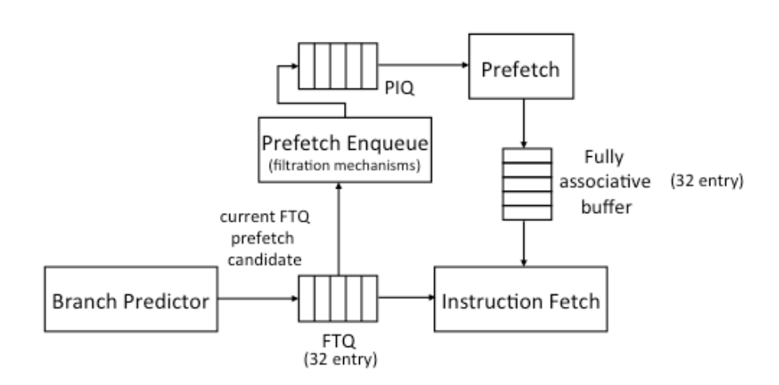
FDIP
Introduces a queue containing the addresses of I-cache lines
prefetches I-cache lines based on the queue contents to avoid instruction fetch stalls
allows the branch prediction unit and the instruction fetch engine to operate independently with high efficiency
Widely used in modern processors including Apple m2
Image credits: A primer on hardware prefetch

Slide 4
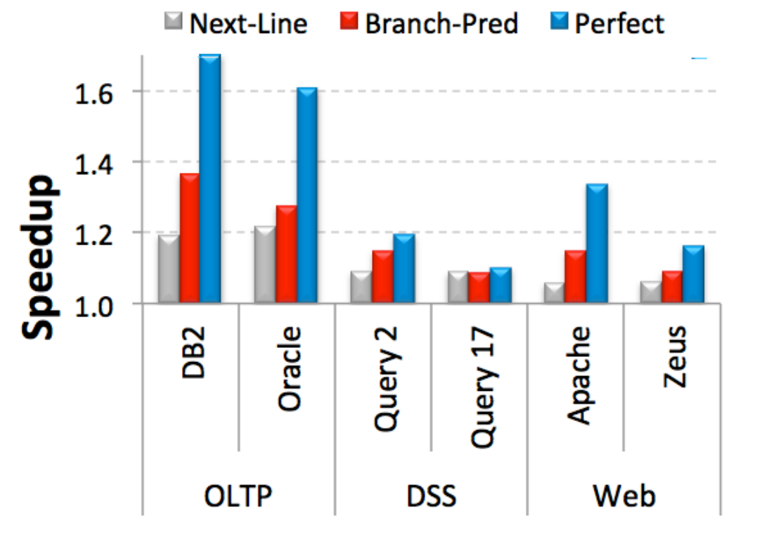
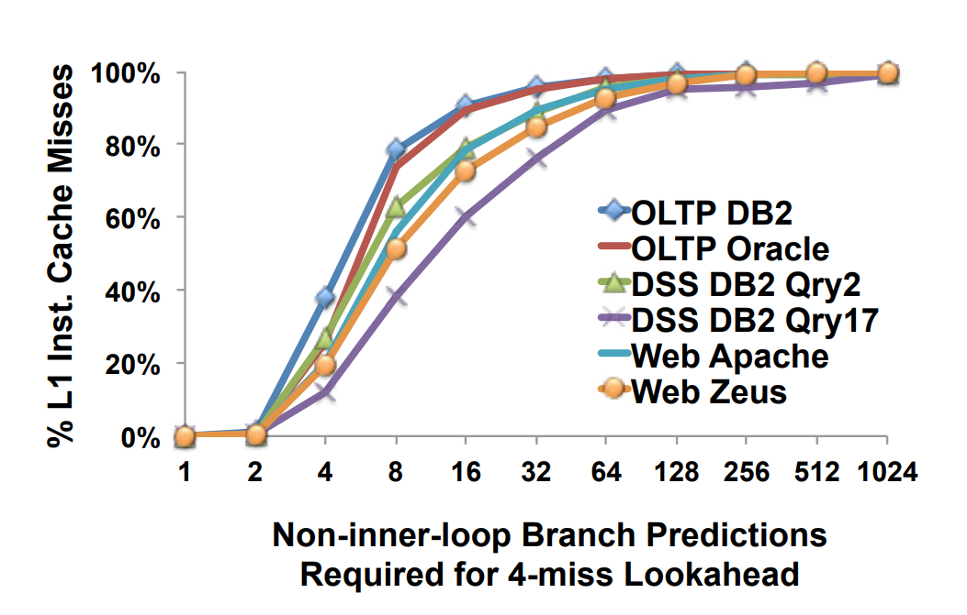
FDIP

Slide 5
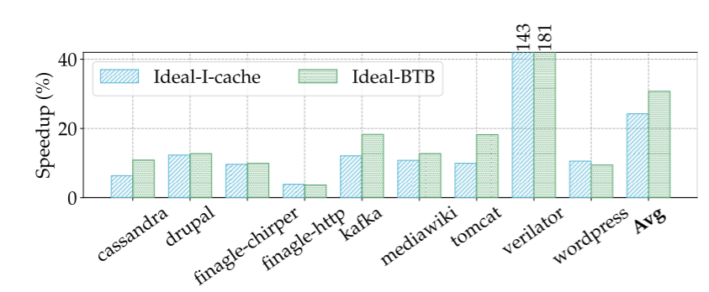
FDIP
What stops FDIP from eliminating all frontend stalls?

Slide 6
Twig
large number of BTB misses, which is typical for data center applications, hurts FDIP’s effectiveness.
Twig introduces two key techniques: Software BTB prefetching BTB prefetch coalescing.
Achieves an average of 20.86% (2%-145%) performance speedup and outperforms the state-of-the-art BTB prefetching technique by 19.82%.

Slide 7
Software BTB prefetching
Identifies the PC and target of every direct branch instruction for an application by examining its binary
Leverages the program’s dynamic execution profile to find the branch PCs causing a large number of BTB misses
Modifies the application binary to prefetch corresponding BTB entries in a timely manner
Reduces this storage overhead by storing the prefetch-to-branch-offset instead of the entire absolute address

Slide 8
BTB prefetch Coalescing
Stores the addresses of the branch instruction and the target as key-value pairs in memory
Introduces the brcoalesce instruction that takes the address of a key-value pair as a parameter and prefetches the corresponding entry to the BTB
Achieves a majority of the performance benefit with just an 8-bit bitmask

Slide 9
Think More
There is no instruction prefetch mechanism in xuantie c910 ->we need test the latency(stall) caused by the stalls due to miss in BTB
->if high->it is necessary to implement an instruction prefetch ->if low->may SOTA instruction prefetch be a way to improve the overall performance
->to be updated in our final report……

Slide 10
Reference
[1] Computer Architecture: A Quantitative Approach (sixth edition)
[2] A primer on hardware prefetch
[3] Tanvir Ahmed Khan, et al 2021. Twig: Profile-Guided BTB Prefetching for Data Center Applications. In MICRO-54
[4] C. Chen et al., "Xuantie-910: A Commercial Multi-Core 12-Stage Pipeline Out-of-Order 64-bit High Performance RISC-V Processor with Vector Extension : Industrial Product," 2020 ACM/IEEE 47th Annual International Symposium on Computer Architecture (ISCA),
[5] Arthur Perais et al. MICRO '23: Proceedings of the 56th Annual IEEE/ACM International Symposium on Microarchitecture October 2023Pages 240–253https://doi.org/10.1145/3613424.3623774

