Slide 1

Notes:
The last comment block of each slide will be treated as slide notes. It will be visible and editable in Presenter Mode along with the slide. [Read more in the docs](https://sli.dev/guide/syntax.html#notes)

Slide 2

Notes:
Here is another comment.

Slide 3


Slide 4


Slide 5


Slide 6
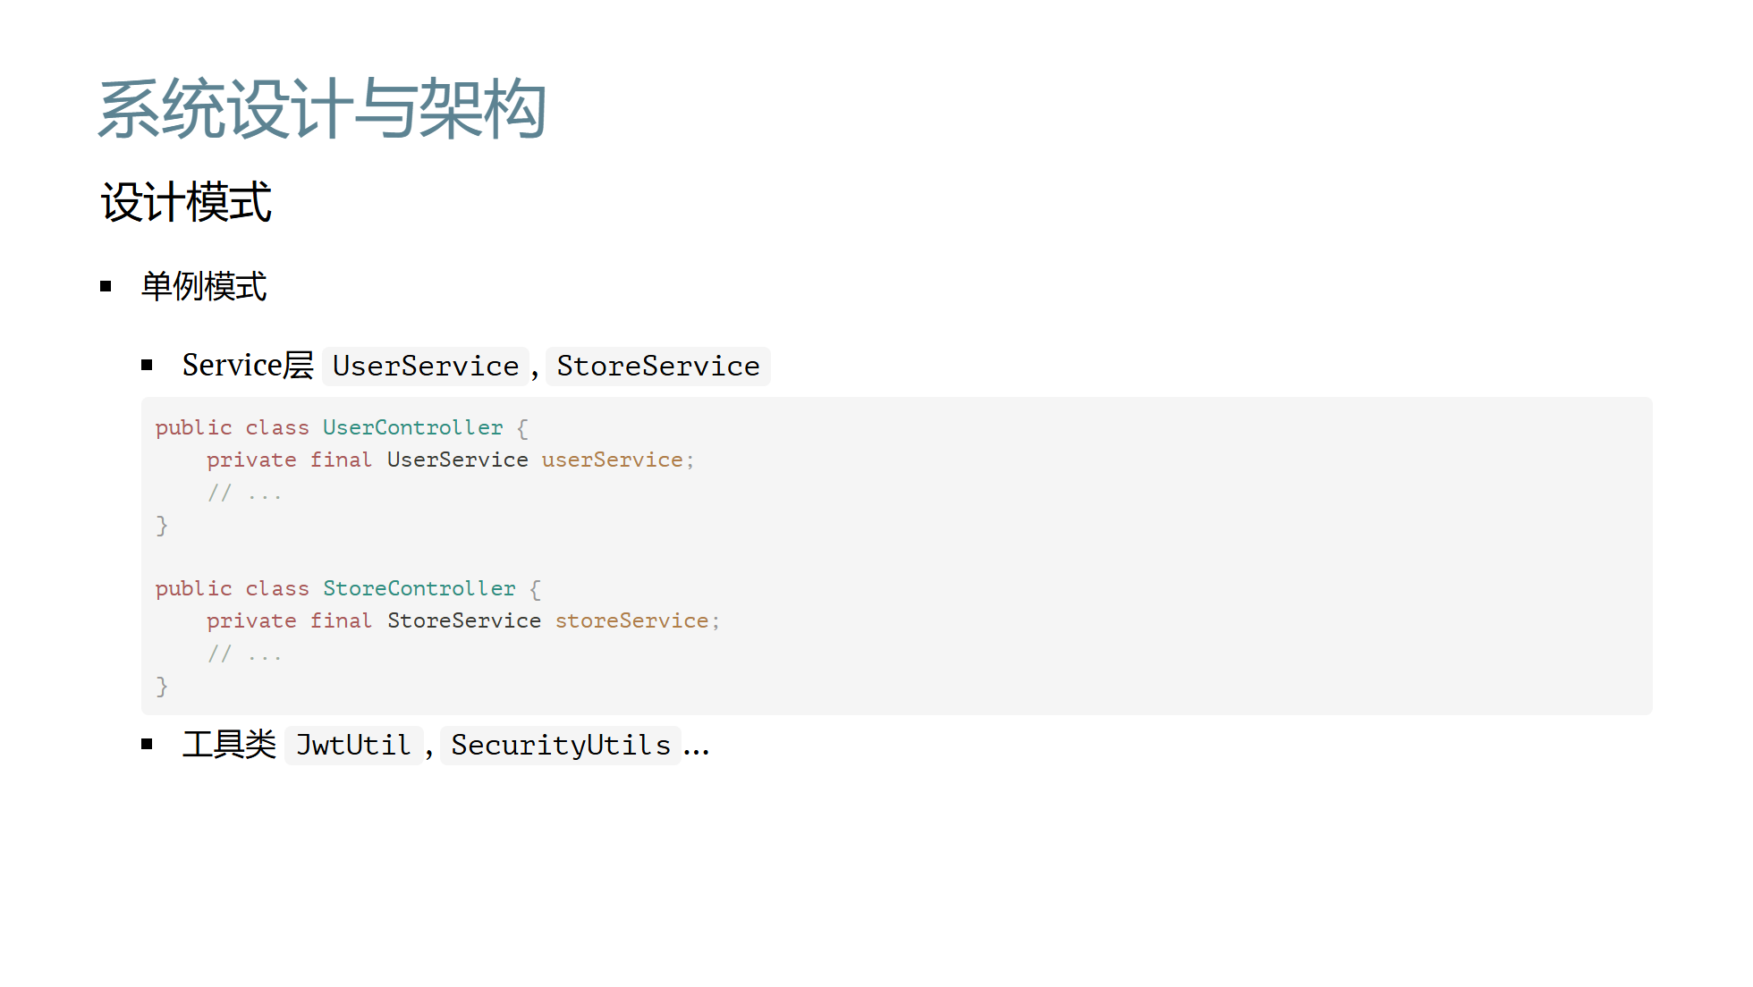

Slide 7
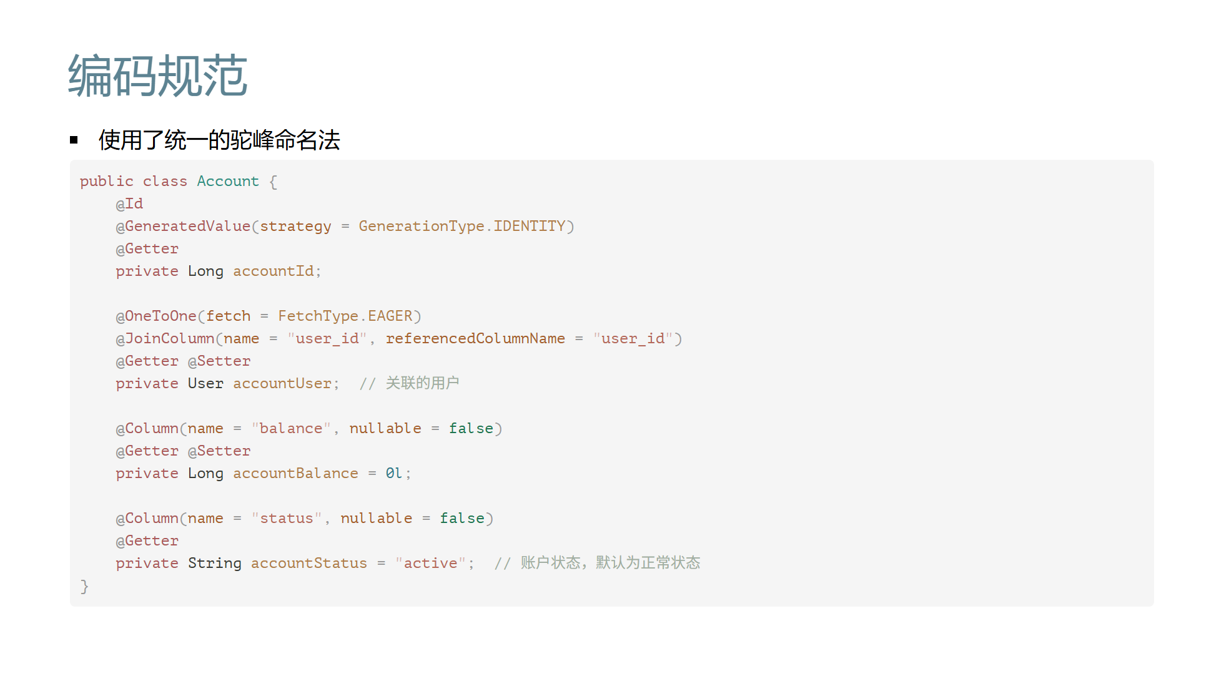

Slide 8
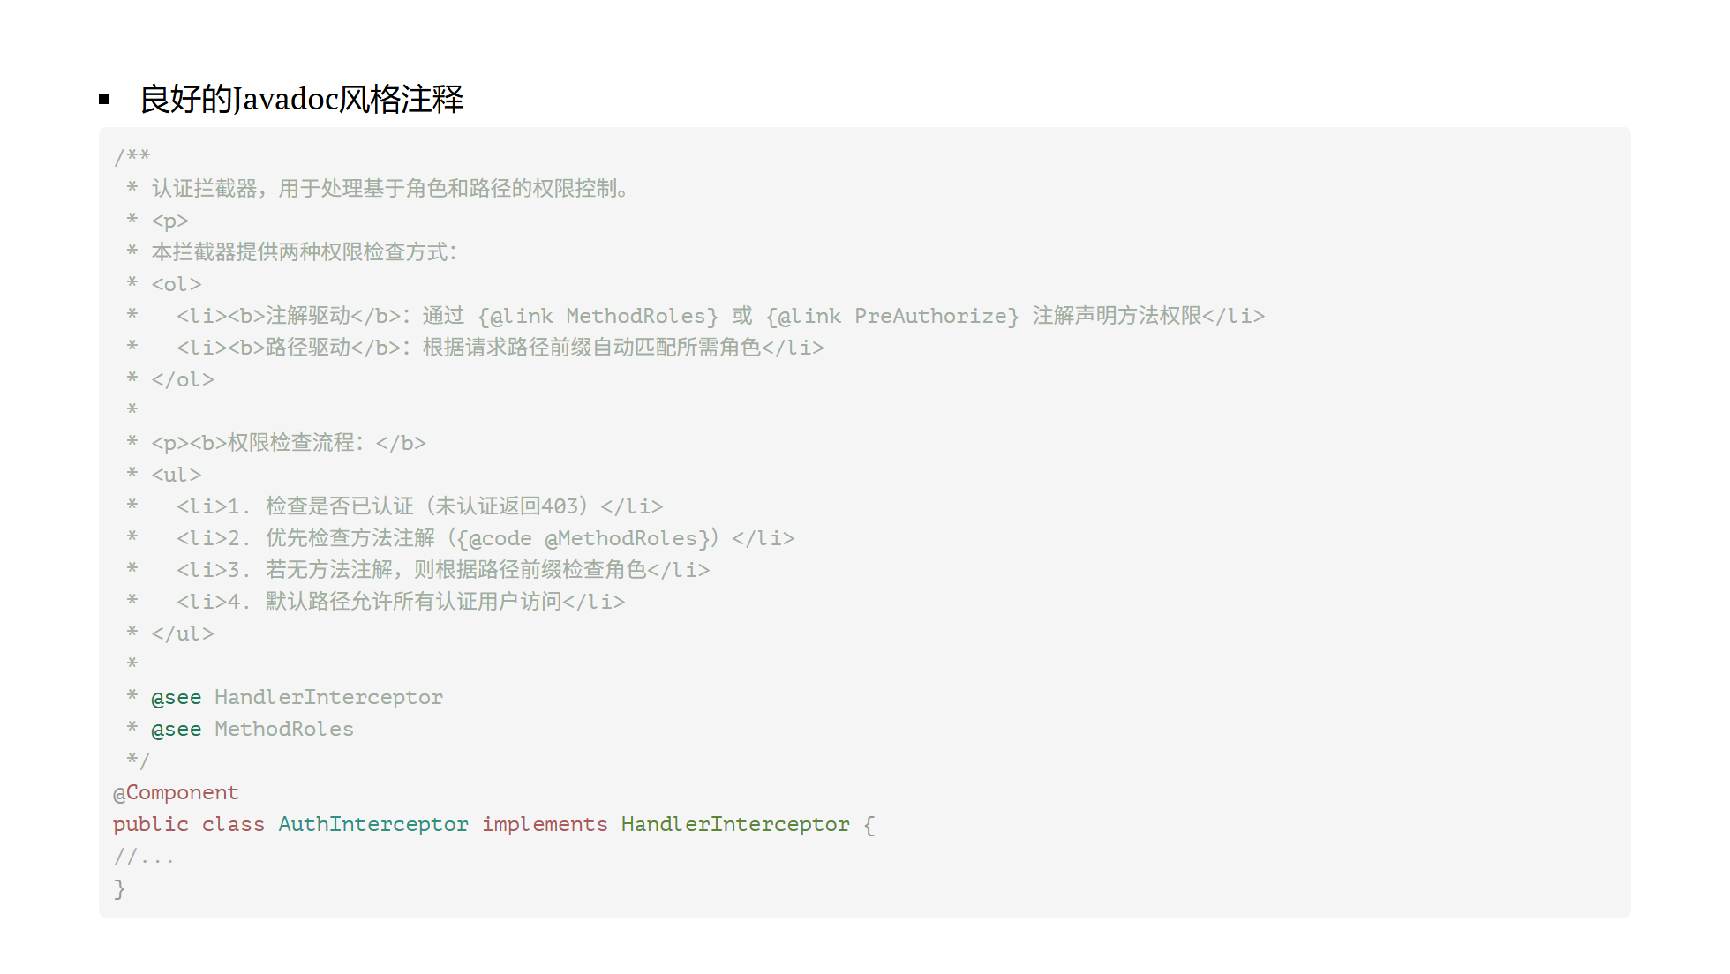

Slide 9
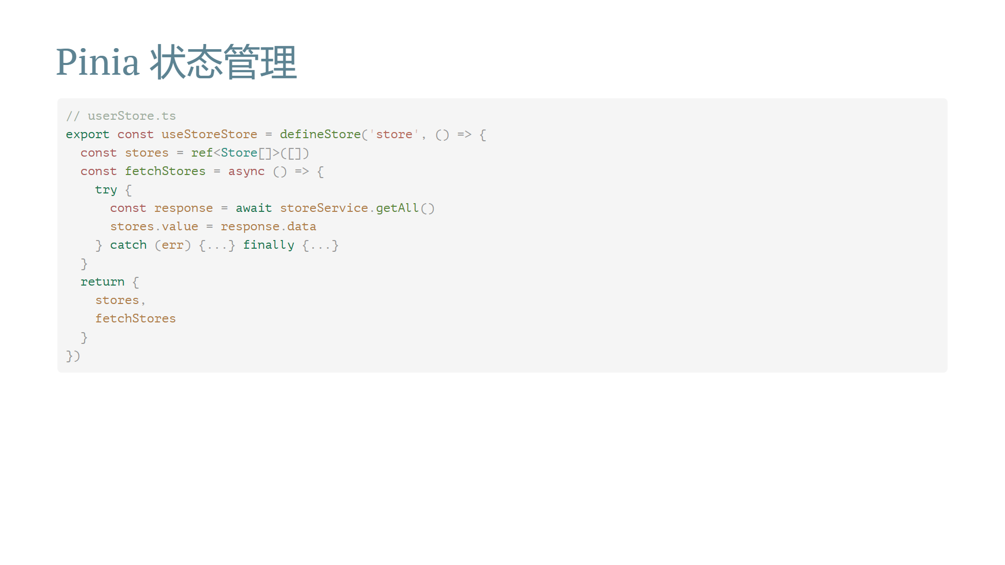

Slide 10
