Slide 1
Tugboat scheduling optimization
Florida IBM Qiskit Fallfest Hackathon @ FAU
October 17 & 18 2026
Rene Bordas
Ryan Bullock
Francesca Dumary
Melinoë Elizondo
Team Binary Pandas

Slide 2
Problem Definition & Relevance
Who has the problem, why it is hard, and where quantum fits
The problem
Why quantum
Who: tug operators in tidal ports
Constraints: tide windows, wind, crew rest
Trade-off: reserve tugs for contract jobs vs. win spot jobs
Today: planned by hand, daily
Impact: ~$2M per tug per year
Why: interacting yes/no choices that grow exponentially, solvable on gate-based or annealing hardware
Limits: noisy hardware, too few qubits
Reality: classical solvers handle it today
Future: big ports, many weather scenarios, fault-tolerant hardware

Slide 3
Workflow
From the business problem to results on real quantum hardware
1
2
3
4
5
6
Business problem
QUBO
QAOA
Local simulation
Hardware test
Compared results
Tugs, ships, wind, tides and crews
Every port rule becomes a penalty
A quantum circuit built from the QUBO
Tune and test on a laptop
60 runs on IBM quantum computers
Hardware vs. simulator vs. random

Slide 4
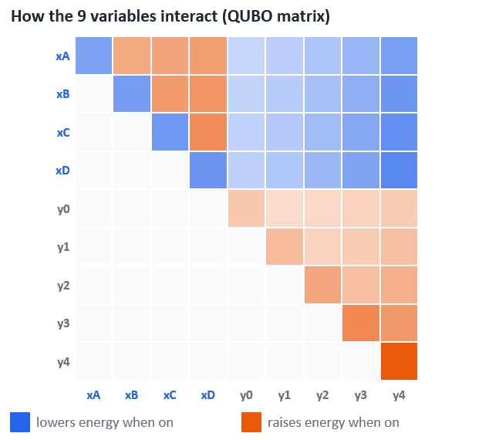
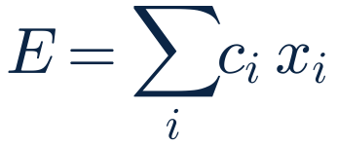
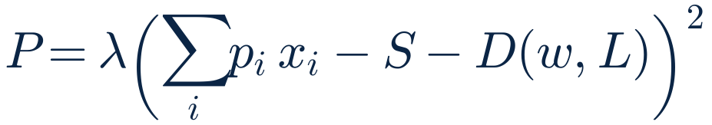
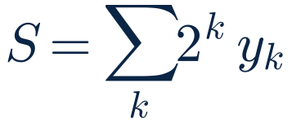
Our tug problem written as a QUBO
Quadratic Unconstrained Binary Optimization, choosing the fewest tugs that can cover the ship needs
ENERGETIC COST
Cost of every tug sent out
PENALTY
Punishes any plan short of the pull the wind and ship size demand
SLACK
Lets the tugs pull more than needed without penalty
x: tug sent (1 or 0) · c: tug cost · p: tug pulling power · D: pull needed at wind speed w for ship length L · y: slack bits · λ: penalty weight

Slide 5
How QAOA finds the best tug plan
Quantum Approximate Optimization Algorithm, on IBM gate-based hardware
1
2
3
4
Start Everywhere
Score Everything
Mix it All
Repeat & Measure
The qubits hold every possible tug plan at once.
The QUBO cost layer marks good plans and bad ones.
Plans interfere: good ones grow, bad ones cancel.
Each round tilts the odds toward the best plan.
Our test case has 262,144 possible plans; one round (p = 1) was enough to find the best one.

Slide 6
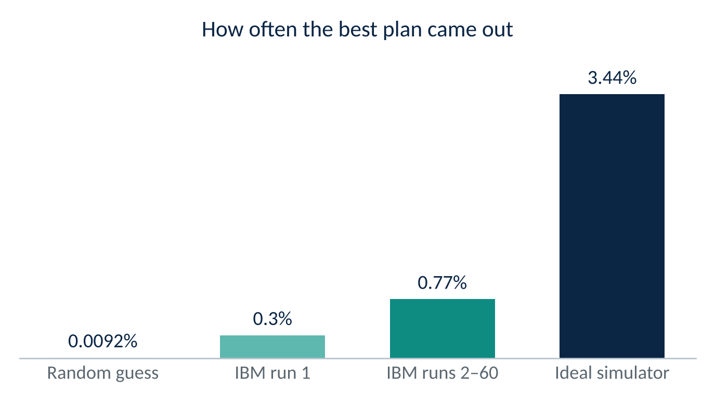
It works, on a small test case
4 tugs, 4 ships, 12 kn wind · 18 qubits · 60 runs on IBM quantum hardware
60/60
IBM runs found the best plan
85×
better than random guessing
Seconds
for a classical laptop, which still wins at this size
Runs 2–60 average 0.77% ± 0.14%, steady from run to run: 2.6× run 1. Hardware noise keeps it below the ideal simulator.

Slide 7
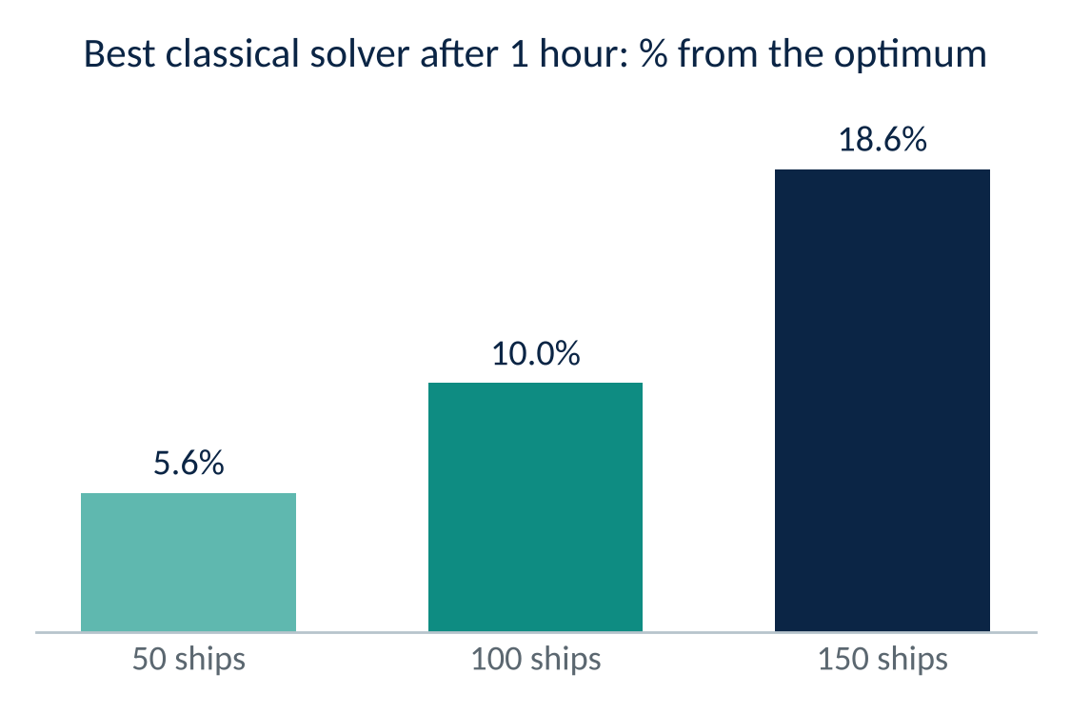
The hard problem: where classical breaks down
A real port day has many moving parts at once
1
Many ships
50 to 150 ships to move over 1 to 3 days
2
Tugs of different power
Mixed fleets, combined to meet each ship's needs
3
Many time slots
Every move placed in 10-minute slots
4
Changing tides
The tide sets which ships may enter, and when
5
Geopolitical risk
Research solver, 24 tugs, 1-hour limit; it still cannot prove the best plan. A standard solver could not solve these at all (Jia et al. 2021). Tides and risk are not even in that model yet.
Outside dangers to bringing a ship into port

Slide 8
The next steps
Road to quantum
Daily loop after the switch
Collect: historical schedules, weather, tides, crews
Benchmark: OR-Tools optimum vs. manual plan, in $
Verify quantum: QAOA matches the optimum on small cases
Forecast: ML predicts arrivals, confirmations, tug demand
Plan daily: forecasts feed the optimizer, the planner approves
Switch: move to QC once it consistently performs better
Forecast: ML predicts arrivals, confirmations, tug demand
Build: forecasts plus tides, weather and crews become the day’s problem
Solve: a QC optimizer finds the best plan (OR-Tools as fallback)
Check: a rule check confirms no rule is broken
Approve: the planner signs off, and the plan goes out
Re-plan: re-solve in minutes when wind or confirmations change

