Slide 1
GREEN v2
Abdoul Gadiri Diallo
Frederic Dutheil
Rory O'Grady
Vann Lam

Slide 2
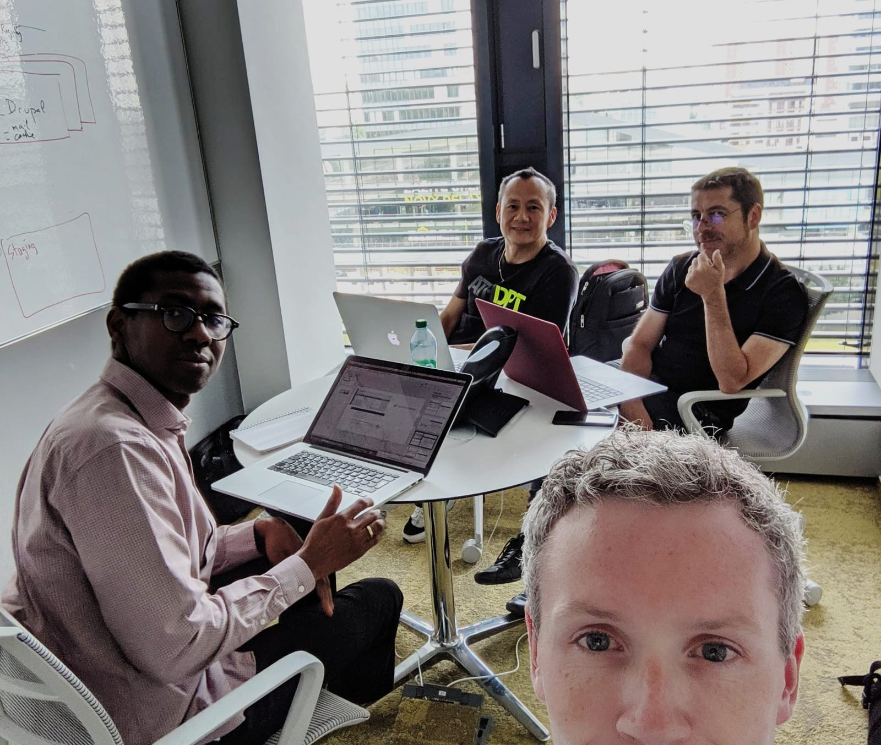
OUR TEAM
Exec Sponsor:
Marty van de Korput
Contacts:
Olaf Kuilboer
Steve Lievens
Frederic Dutheil
Vann Lam
Abdoul Diallo
MVP
stuff
Rory O’Grady

Slide 3
Project Context
Client requires CMS-as-a-Service
Drupal is the CMS technology of choice
Many competitors in this space; mostly open source
With CMS-aaS we must provide a DevOps solution
Dependencies with Drupal: LAMP stack and Caching
End goal: To provide the fastest solution to get new content into Production
Notes:
The overall goal for this client is to provide a Drupal content management system as a service
Drupal for this client depends on MySQL, a CDN, and a Caching component
Our competition is significant – there are many open source players in this field
The team believe the best chance of being successful with the client is to be the best technical solution – providing the fastest mechanism to get new content rolled out

Slide 4
Functional requirements
Separate environments for:
Dev;
Test;
Production;
Site must be hosted on public cloud;
Site must be accessible globally;
Code deployment can be done using FTP/SFTP;
Content distribution using CDN;
SMTP setup to facilitate email communication to support “Contact Us” function in the website;

Slide 5
Non-functional requirements
Security:
Enterprise grade firewalling;
DDOS protection;
Availability:
High Availability of the infrastructure platform;
Scalability:
Scalable infrastructure with possible future expansion of the website.
Infrastructure support for services around DNS mapping and Certificate installation.

Slide 6
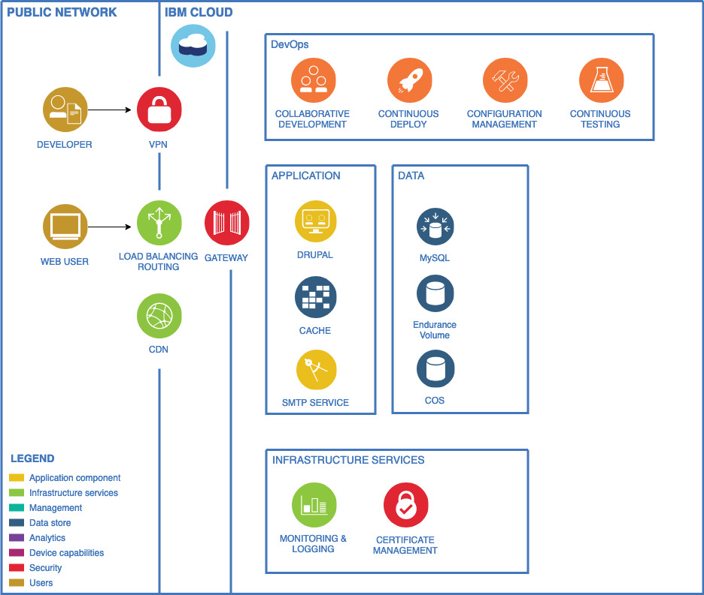
Logical architecture
Edge services provided
CDN for static content;
Cloud Internet Services
Application : Drupal Container
IBM Cloud
IAM for users/resources security management
IBM Kubernetes Service (IKS) for application components
Continious Delivery Service
Gateways for network security
Site administrators and Content Managers will access the site via a management VPN.
Endurance volume for persistence data (Drupal meta-data via MySQL)
MySQL database (used for its DbaaS Regional resiliency)
Cloud Objet Storage for static content and Regional resiliency
TLS Certificate management;

Slide 7
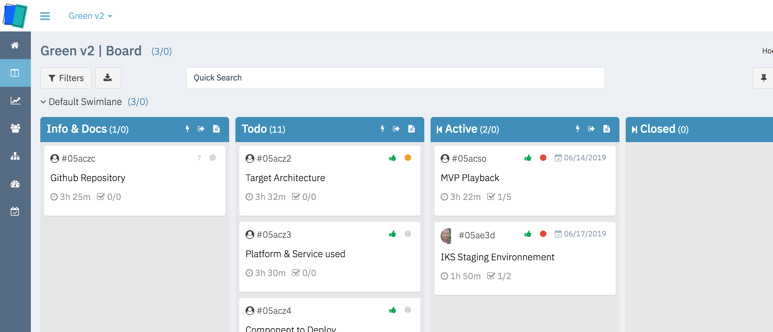
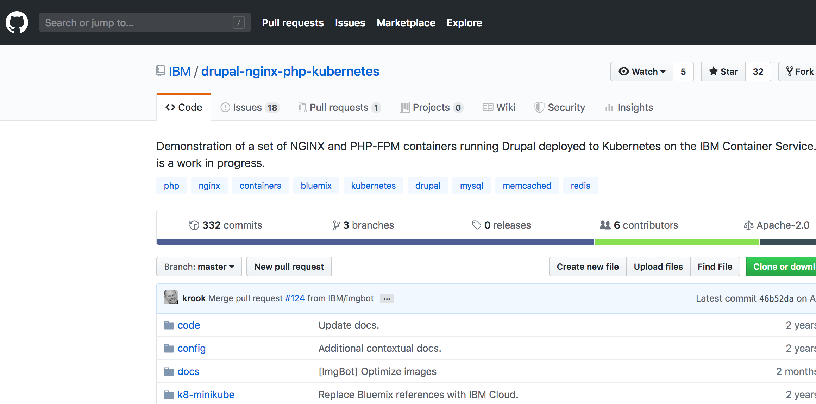
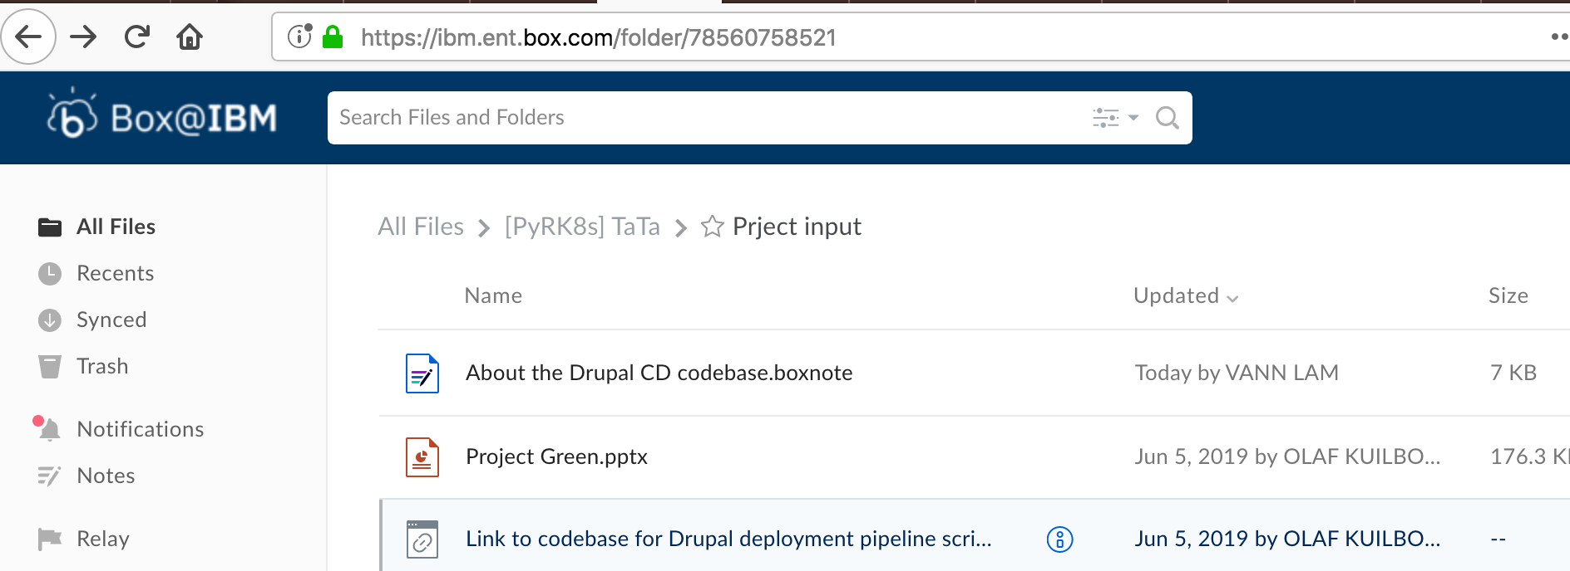
High level Project Planning
Due date August 2nd 2019
-
Week 1 Architecture Technical validation of Staging environment setup and configuration Documentation | Week2 Toolchain integration for staging Final architecture Production installation and config Documentation
Week 3 - TBD - Documentation | Week 4 - TBD - Documentation
Week 5 - TBD - Documentation | Week 6 - TBD - Rehearsals - Documentation

Slide 8


