Slide 1
Gradual Fine-Tuning for Low-Resource Domain Adaptation
Haoran Xu, Seth Ebner, Mahsa Yarmohammadi, Aaron White, Benjamin Van Durme, Kenton Murray
Dec. 2020

Slide 2
Roadmap
Background
Methods
Experiments
Conclusion

Slide 3
Background: Fine-Tuning
Fine-tuning a pre-trained model is usually better than training from scratch.
People would like to fine-tune pre-trained models to improve the performance of models in some specific tasks.
Example 1:
Specific Task Model
e.g., sentiment analysis, machine translation
Pre-trained BERT
Randomly initialized embedding
Replace

Slide 4
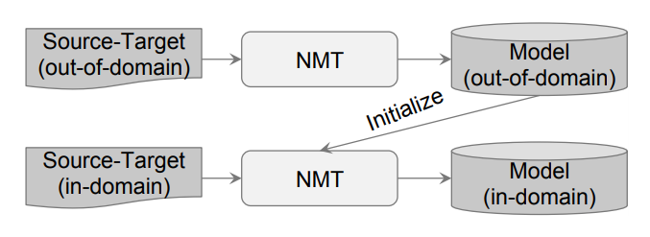
Background: Fine-Tuning
Example 2: Domain Adaptation for Neural Machine Translation (Chu et al., 2017)

Slide 5
Methods: Gradual Fine-tuning
Fine-tuning stage is often performed in one-step: the pretrained model is directly trained on the in-domain data.
Trained by in-domain data
Trained by out-of-domain data (maybe include in-domain data)
Fine-tuning
Pre-trained Model
Trained by some out-of-domain + in-domain data
Trained by in-domain data
Fine-tuning
Fine-tuning
😀
We found that the model performs better if it is eased toward the target domain rather than abruptly shifting to it.
Gradual fine-tuning: a model is iteratively trained to convergence on data whose distribution progressively approaches that of the in-domain data.

Slide 6
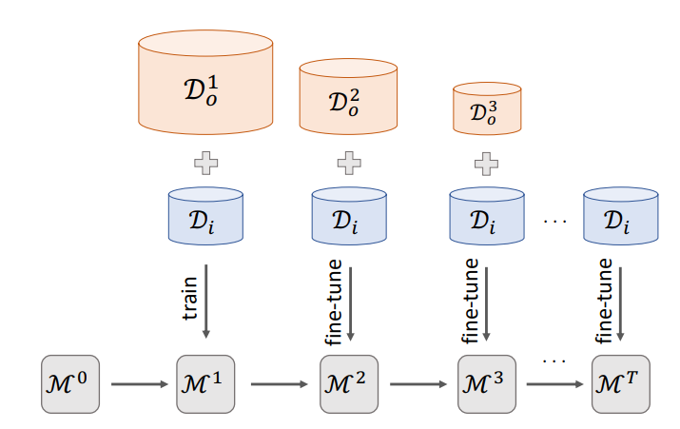
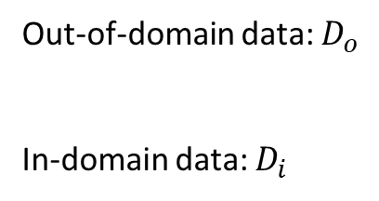
Methods: Gradual Fine-tuning
Inspired by curriculum learning (Bengio et al., 2009), we begin by training the model on data that contains a mix of out-of-domain and in-domain instances, and then increase the concentration of target domain data in each fine-tuning step.
Out-of-domain data: $D_{o}$
In-domain data: $D_{i}$

Slide 7
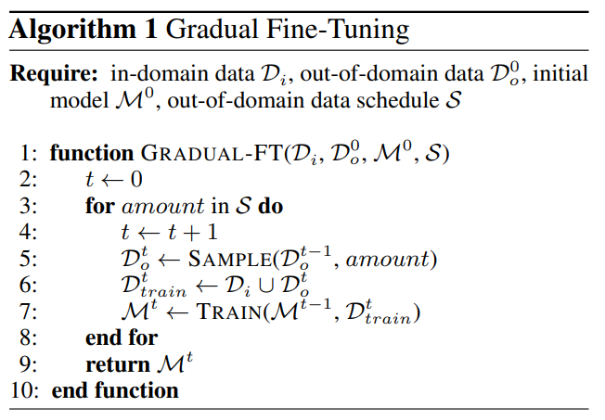
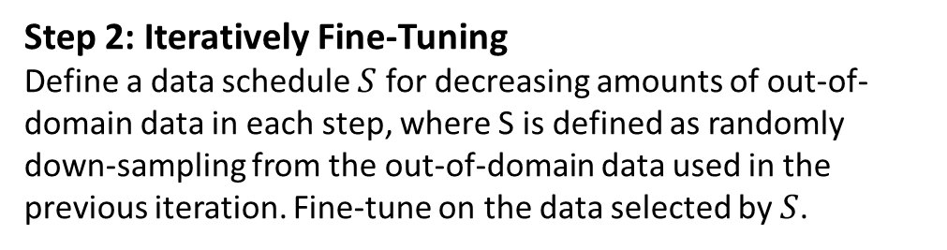
Methods: Gradual Fine-tuning
Step 1: Mixed Domain Training
Find out out-of-domain data (mapped into the same format as the in-domain data) and concatenate with in-domain data to form a mixed domain dataset. Portions of the target task schema corresponding to fields not available in the out-of-domain data could be masked in the mapped data.
Step 2: Iteratively Fine-Tuning
Define a data schedule $S$ for decreasing amounts of out-of-domain data in each step, where S is defined as randomly down-sampling from the out-of-domain data used in the previous iteration. Fine-tune on the data selected by $S$.
Step 3: Fine-Tune on only in-domain data

Slide 8
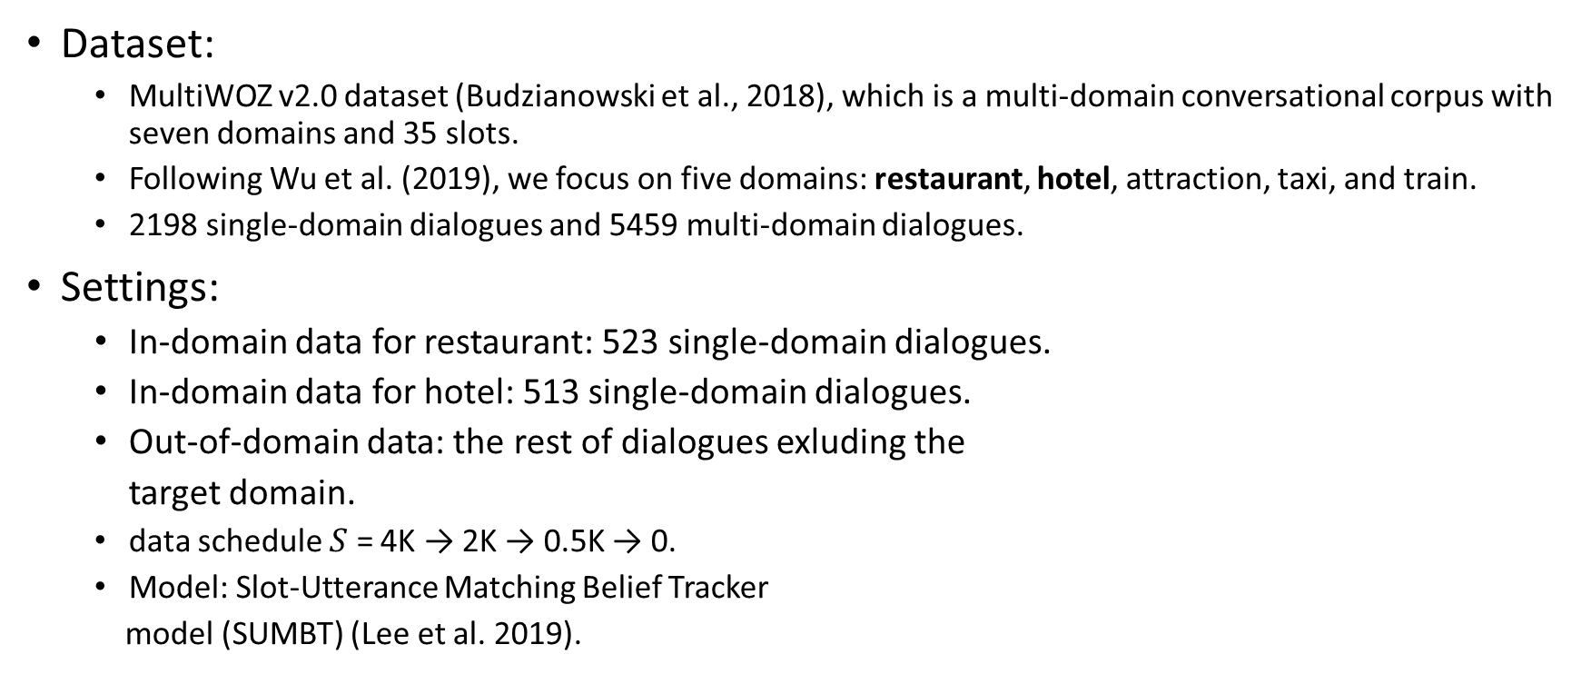
Experiments: Dialogue State Tracking
Dataset:
MultiWOZ v2.0 dataset (Budzianowski et al., 2018), which is a multi-domain conversational corpus with seven domains and 35 slots.
Following Wu et al. (2019), we focus on five domains: restaurant, hotel, attraction, taxi, and train.
2198 single-domain dialogues and 5459 multi-domain dialogues.
Settings:
In-domain data for restaurant: 523 single-domain dialogues.
In-domain data for hotel: 513 single-domain dialogues.
Out-of-domain data: the rest of dialogues exluding the
target domain.
data schedule $S$ = 4K → 2K → 0.5K → 0.
Model: Slot-Utterance Matching Belief Tracker
model (SUMBT) (Lee et al. 2019).
Target Domain
4K
2K
0.5K

Slide 9
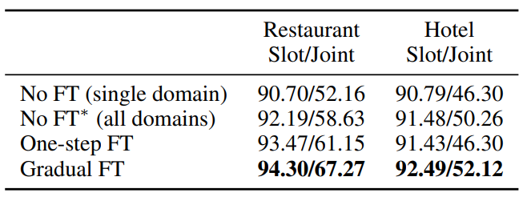
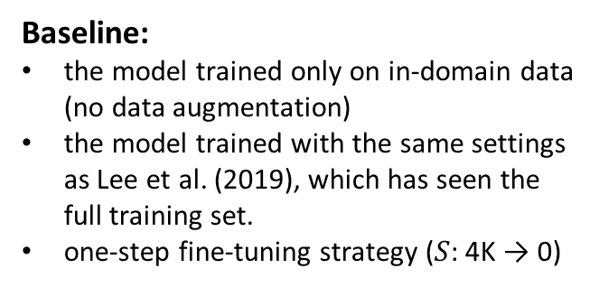
Experiments: Dialogue State Tracking
Results
Baseline:
the model trained only on in-domain data (no data augmentation)
the model trained with the same settings as Lee et al. (2019), which has seen the full training set.
one-step fine-tuning strategy ($S$: 4K → 0)
Metric:
Slot accuracy: the accuracy of predicting each slot separately.
Joint accuracy: the percentage of turns in which all slots are predicted correctly.

Slide 10
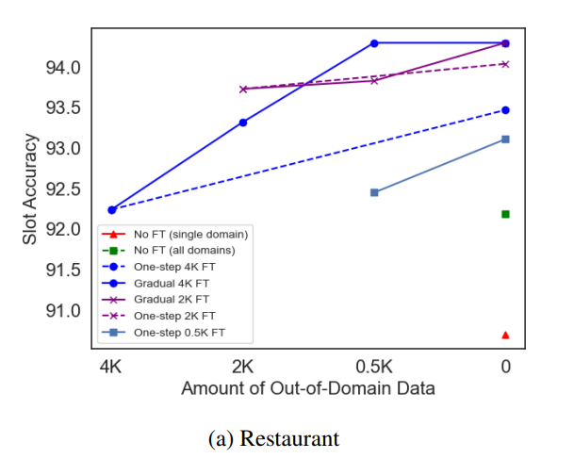
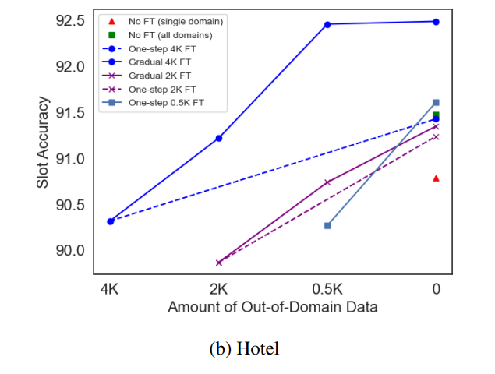
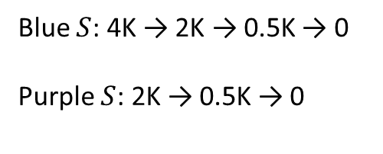
Experiments: Dialogue State Tracking
Results
Blue $S$: 4K → 2K → 0.5K → 0
Purple $S$: 2K → 0.5K → 0

Slide 11
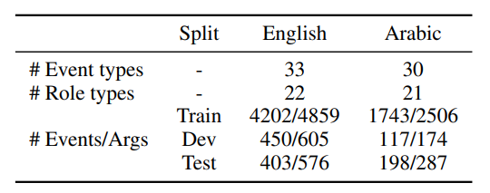
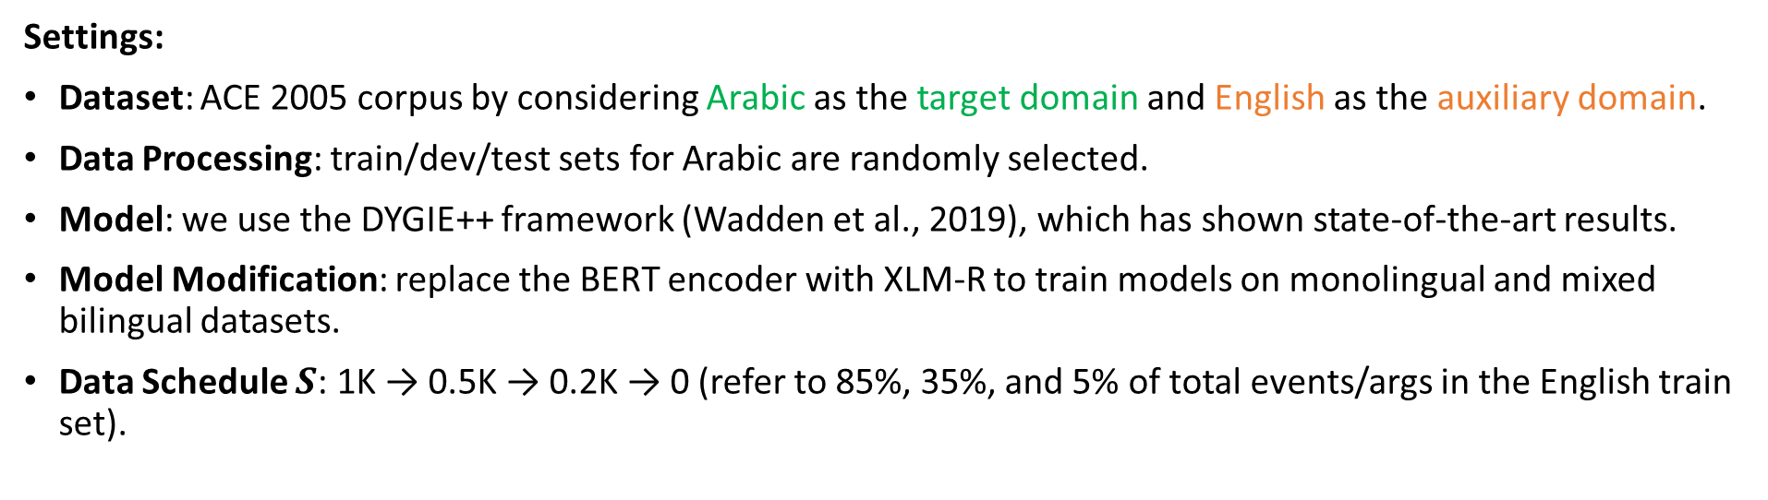
Experiments: Event Extraction
Event extraction involves predicting event triggers, event arguments, and argument roles.
Settings:
Dataset: ACE 2005 corpus by considering Arabic as the target domain and English as the auxiliary domain.
Data Processing: train/dev/test sets for Arabic are randomly selected.
Model: we use the DYGIE++ framework (Wadden et al., 2019), which has shown state-of-the-art results.
Model Modification: replace the BERT encoder with XLM-R to train models on monolingual and mixed bilingual datasets.
Data Schedule $S$: 1K → 0.5K → 0.2K → 0 (refer to 85%, 35%, and 5% of total events/args in the English train set).

Slide 12
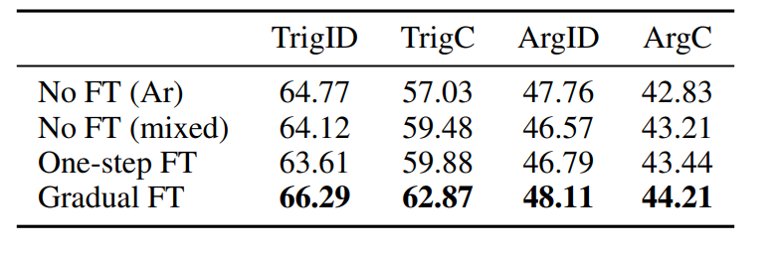
Experiments: Event Extraction
Baseline:
trained only on Arabic data
trained on mixed data (Arabic + 1K English data)
trained on mixed data plus one-step fine-tuning.
Metric:
TrigID: a trigger is correctly identified if its offsets find a match in the ground truth,
TrigC: and it is correctly classified if their event types match.
ArgID: An argument is correctly identified if its offsets and event type find a match in the ground truth,
ArgC: and it is correctly classified if their event roles match.

Slide 13
Conclusion
Improvement: gradual finetuning outperforms standard one-step fine-tuning and can substantially improve the performance of models.
Easy to implement: gradual fine-tuning can be straightforwardly applied to an existing codebase without changing the model architecture or learning objective.

Slide 14
Thank you!

Slide 15
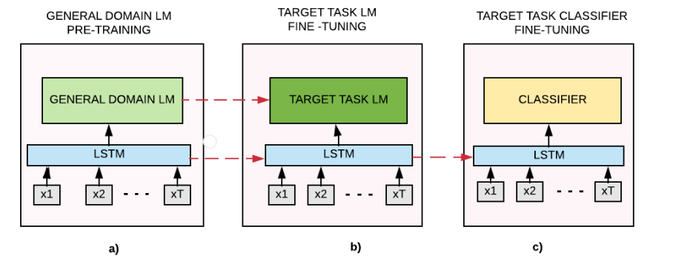
Background: Fine-Tuning
Example 2: Claim Detection (Chakrabarty et al., 2019)

Slide 16
Experiments: Dialogue State Tracking
Dialogue state tracking (DST): estimating at each dialogue turn the probability distribution over slot-values enumerated in an ontology.
Example:
Ontology:
"restaurant-price range": [
"expensive",
"cheap",
],
"restaurant-area": [
"south",
"north",
"east",
"west",
]
Dialogues:
Person 1: where do we eat tonight?
Person 2: Let’s go a noodle restaurant in the east of Chinatown.
Person 1: Does it cheap?
Person 2: Yes!
Slots:
"restaurant-price range": cheap
"restaurant-area": east

