Slide 1
The Importance of Being Parameters: An Intra-Distillation Method for Serious Gains
Haoran Xu, Philipp Kohen, Kenton Murray
Johns Hopkins University
To appear @EMNLP 2022

Slide 2

Introduction
Question: Do we overlook possible contribution of redundant parameters?
Pruning method have demonstrated the ability to remove redundant parameters without sacrificing model performance.
Oppositely, we argue that redundant parameters can be properly trained to make beneficial contributions.
Accuracy 0.95 → 0.94
Accuracy 0.95 → 0.98
Notes:
....
What will happen if we make the red parameters become more useful? Is it possible to increase the performance after we make them become more important? So, here, we want to encourage the contribution of redundant parameters.

Slide 3
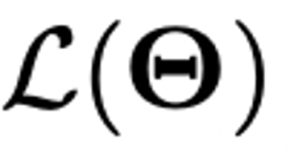
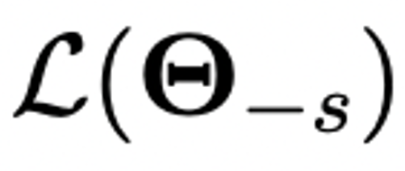

Introduction
Definition of parameter contribution:
We define the contribution of a subset of parameters 𝚯_{s} by its impact on the loss magnitude when the parameters are zeroed-out, which is called sensitivity or importance score widely used in pruning.
Notes:
Here we define the parameter contribution, here we define.......
For example, when no parameter is zeroed or pruned, we output a loss based on all parameters L_theta. (press) If we want to calculate the sensitivity of red parameters theta_s, we zeroed out them, and compute a new loss without red parameters. (press) The sensitivity of red parameters is defined by the aboslute value of difference between two losses. Without red parameters, the bigger difference two losses have, the more important the red parameters are.

Slide 4
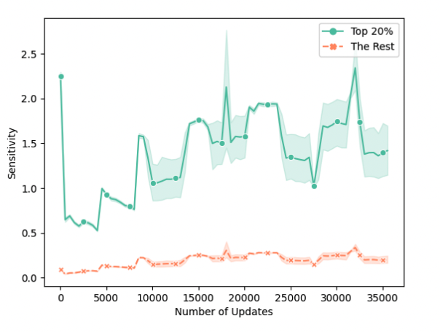
Introduction
Goal: Balance the contribution of all parameters and encourage all of them to contribute equally
Contribution of parameters show a great deal of variety. Pruning usually keep top 20% most-sensitive parameters without performance drop….
We want to reduce the large contribution gap and no parameters is redundant.
Notes:
As we said, we want to see how redudant parameters can contribute. Our goal is more in general.........
However, contribution of parameters shows a great deal of variety. Usually, pruning methods only keep top 20% most important without performance drop. So, here, for a machine translation task, we track the average sensitivity of top 20% important parameters, in the green color, and the rest 80% least important parameters, in the orange color. We track them for the whole training processing in a machine translation task. x-axis is number of updates and y-axis is sensitivity. We can see that there is a large contribution gap for between the top20% most-sensitive parameters and the rest 80% parameters.

Slide 5
A Case Study on Knowledge Distillation
What methods that we know can balance the parameter contribution?
A well-known method: knowledge distillation.
min diff(student, target) + diff(student, teacher)
We here investigate a special case of knowledge distillation: self-distillation
Ordinary knowledge distillation: Teacher is high-capacity and student is compact.
Self-distillation: teacher and student are the same architecture.
Notes:
Before introducing our methods, what other methods we know...
A well known method that people may not notice

Slide 6
A Case Study on Knowledge Distillation
Iterative self-distillation:
Model 1
distill
Model 2
distill
Model 3
Model 1 is a teacher for Model 2
Model 2 is a new teacher for Model 3
Notes:
......
......
It has shown that self-distillation can improve the model generlization performance.

Slide 7
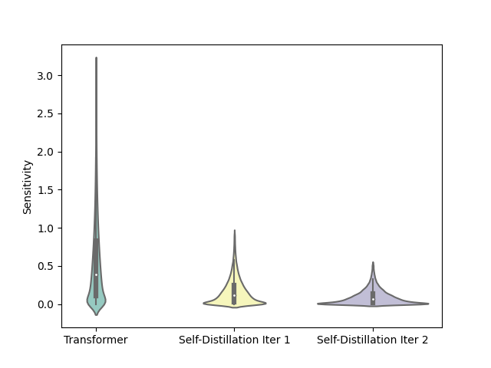
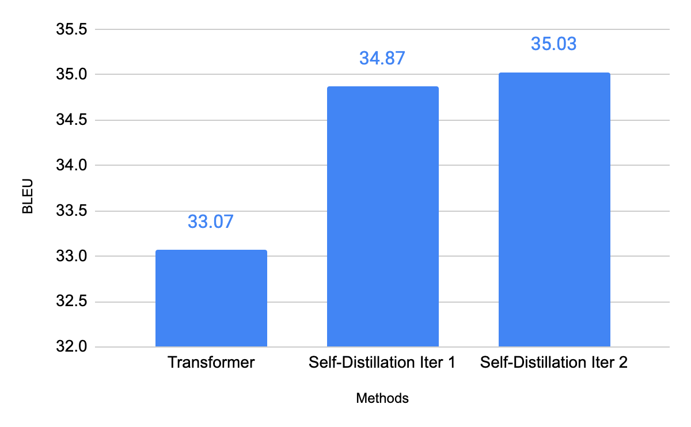
A Case Study on Knowledge Distillation
A preliminary experiment on a translation task: IWSLT’14 German→English
BLEU results
Sensitivity Distribution
Top 20% most sensitive parameters
Notes:
Let's study the effectiveness of self-distillation in MT. We conduct preliminary experiment on a IWSLT'14 Germen->English task.
The blue bar on the left, is the BLEU score of the model 1, which the first teach model trained from scratch. And on the right side, we use violin plot to visualize the sensitivity (or we say contribution) distribution of all parameters. This plot shows the distribution and density of sensitivity. For example, the sensitivity of 20% most-sensitive parameters are very large, while the rest of them are crowded near 0.

Slide 8
A Case Study on Knowledge Distillation
A preliminary experiment on a translation task: IWSLT’14 German→English
BLEU results
Sensitivity Distribution
Notes:
After the first round of self-distillation, we find that the model performance is highly improved. It is surprising, because two models use the same number of parameters and the same architecture. When we look back to its parameter sensitivity distribution, distribution becomes more balanced and concentrated.

Slide 9
A Case Study on Knowledge Distillation
A preliminary experiment on a translation task: IWSLT’14 German→English
BLEU results
Sensitivity Distribution
Notes:
Then, with another round of self-distillation, where the student becomes a new teacher to distill the third model. We also see a better model performance and the parameter sensitivity distribution becomes more balanced again.

Slide 10
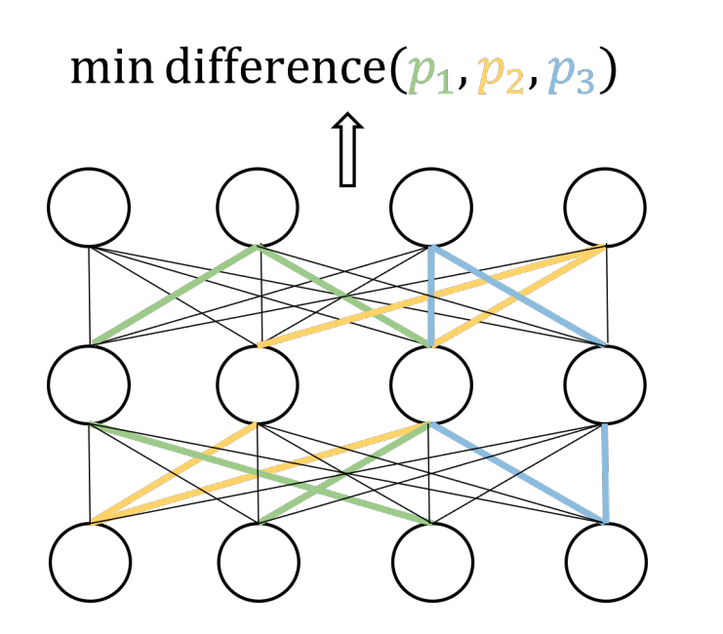
Proposed Method: Intra-Distillation
we propose a general method to balance the parameter sensitivity (contribution) to improve the model performance.
Intra-Distillation: For the same input, we pass the model multiple times and minimize their difference. Each time we disable different subsets of parameters.
Notes:
This motivates us to propose a general method to balance the parameter sensitivity......
We called it intra-distillation. For the same input...

Slide 11


Proposed Method: Intra-Distillation
Why intra-distillation works?
Pass $i$
Pass $j$
Two passes activate different subset of parameters

Slide 12
Proposed Method: Intra-Distillation
Why intra-distillation works?
Pass $i$
Pass $j$
Both pass use the same red parameters

Slide 13
Proposed Method: Intra-Distillation
Why intra-distillation works? (see math theory details in the paper!)
Pass $i$
Pass $j$
Green parameters are different in two passes
Minimize the output of two passes, we could approximate minimizing the contribution difference between two green parameters because we want them to do the same thing for the same inputs.

Slide 14
Proposed Method: Intra-Distillation
Task-Agnostic Implementation: Intra-distillation can be applied to any deep learning tasks.
One may notice that it is similar to the objective of knowledge distillation:
L_{original_task} + ɑ · L_{intra-distillation}
ɑ is a hyperparameter to control the strength of intra-distillation
task loss
min difference
min diff(student, target) + diff(student, teacher)
Notes:
Intra-distillation is a task-agnostic method that can be applied to any methods.

Slide 15
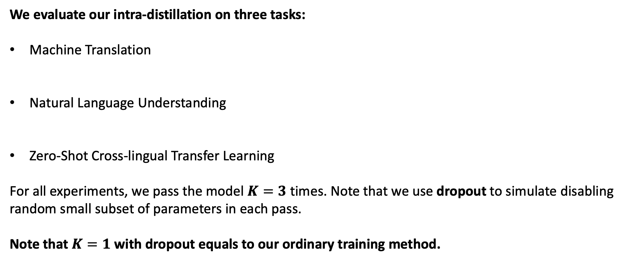
Experiments
We evaluate our intra-distillation on three tasks:
Machine Translation
Natural Language Understanding
Zero-Shot Cross-lingual Transfer Learning
For all experiments, we pass the model $K=3$ times. Note that we use dropout to simulate disabling random small subset of parameters in each pass.
Note that $K=1$ with dropout equals to our ordinary training method.

Slide 16
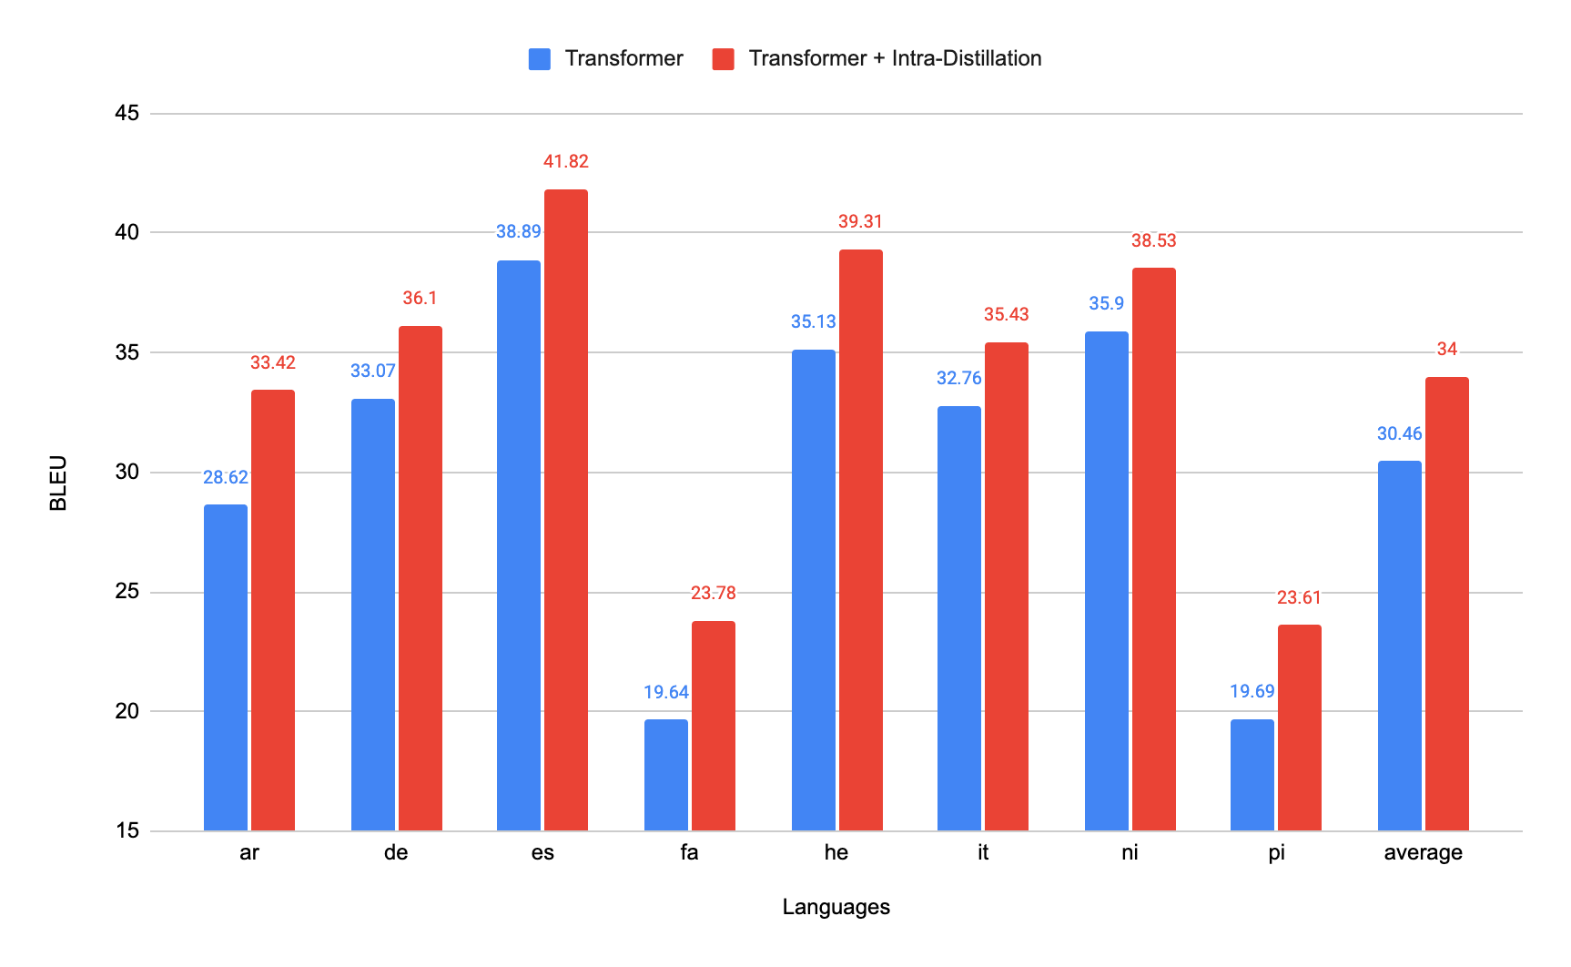
Experiments
Machine Translation:
Low-resource scenario: 8 English-centric language pairs from IWSLT’14 (xx→en), 89K-160K data

Slide 17
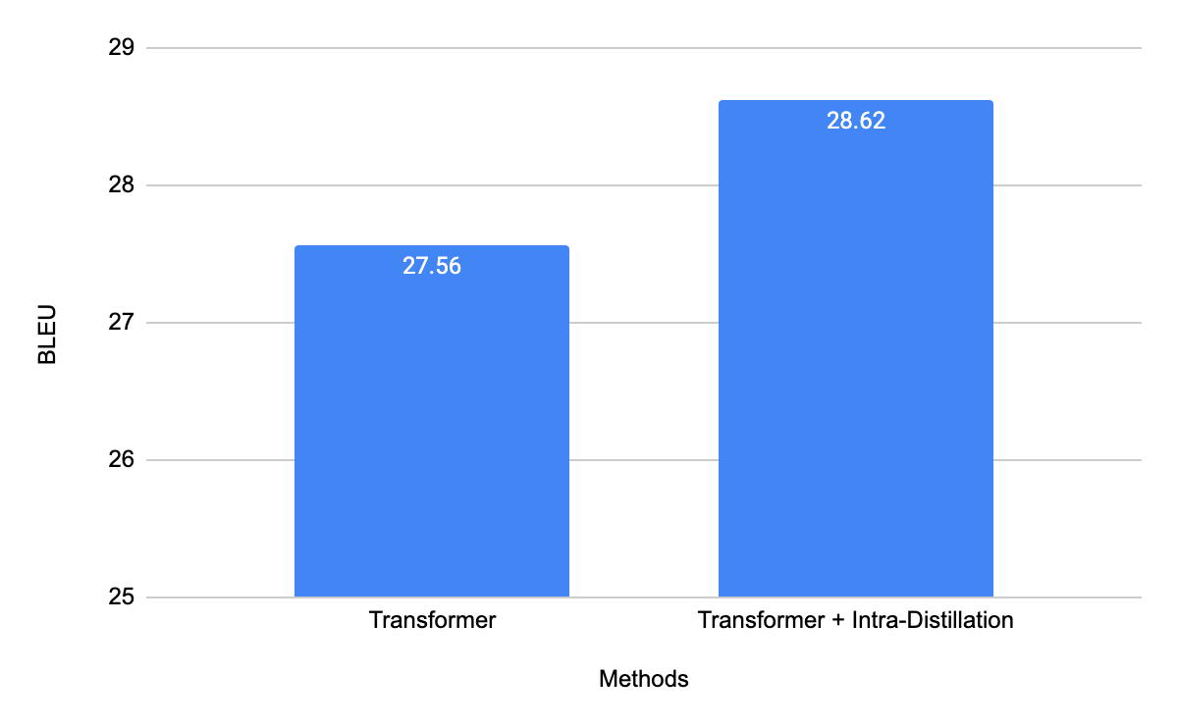
Experiments
Machine Translation:
Low-resource scenario: 8 English-centric language pairs from IWSLT’14 (xx→en), 89K-160K data
High-resource scenario: WMT’17 en→de, 4.5M data

Slide 18
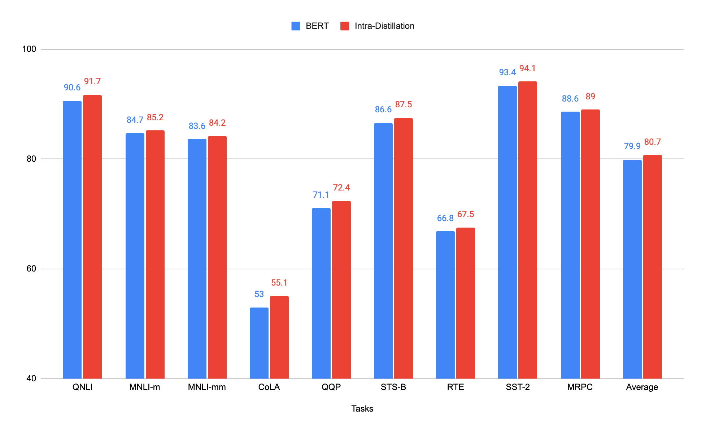
Experiments
Natural Language Understanding
Fine-tune BERT base model on each task of GLUE

Slide 19
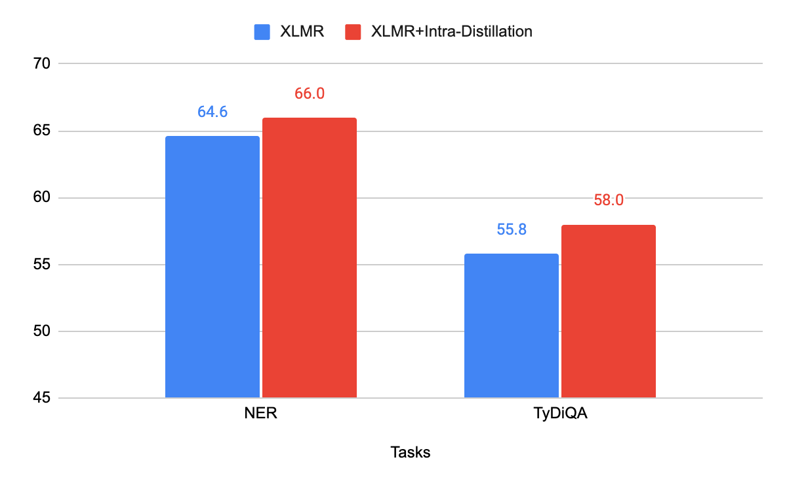
Experiments
Zero-Shot Cross-Lingual Transfer Learning
Low-level task: NER task from Xtreme-R benchmark (48 languages)
High-level task: TydiQA (9 languages)
We fine-tune XLM-R to conduct both tasks and report averaged results on all languages.

Slide 20
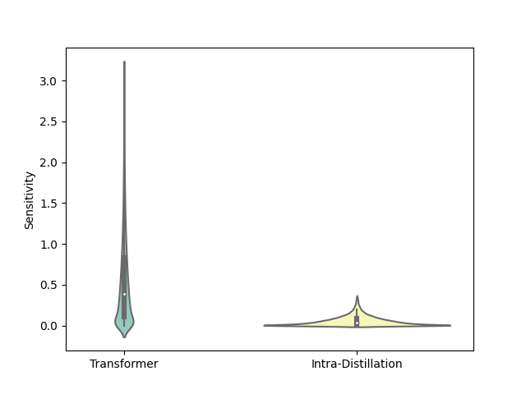
Analysis
Big gains for three tasks, but is contribution of parameters more balanced actually?
Intra-Distillation
Iterative Self-Distillation
Notes:
Read first line
Taking IWSLT'14 de->en MT task as study objective, we visualize the sensitivity distribution before and after intra-distillation. The contribution will be highly balanced after intra-distillation.

Slide 21
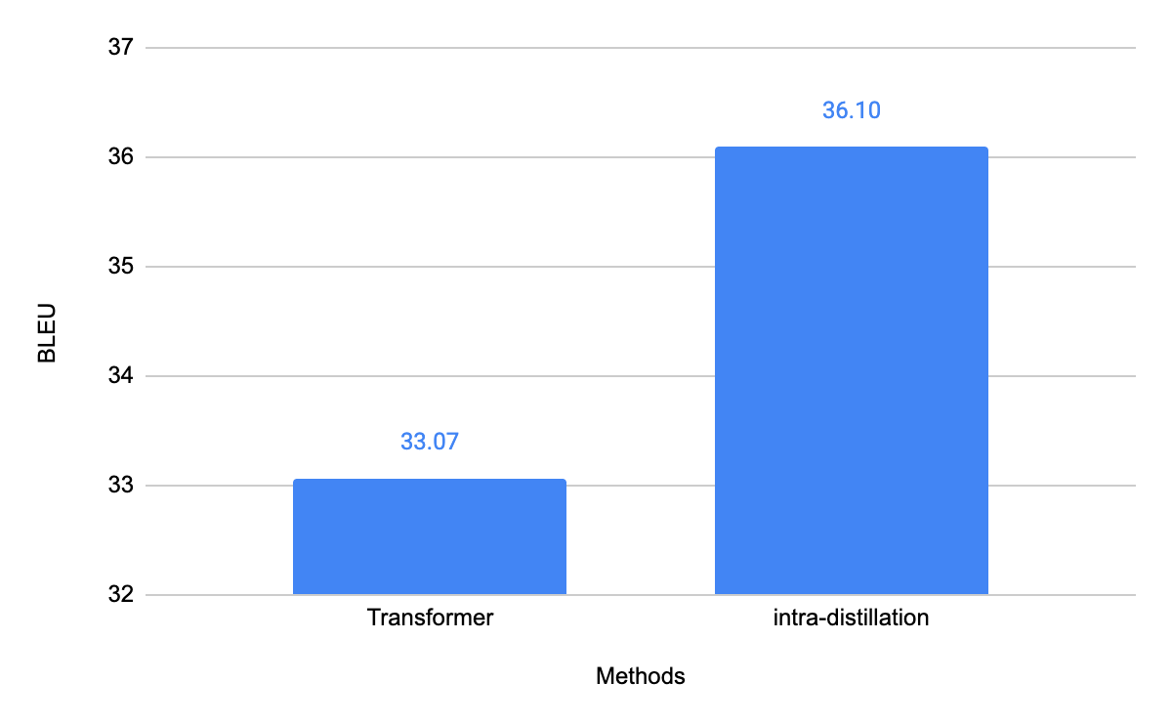
Analysis
Big gains for three tasks, but is contribution of parameters more balanced actually?
Intra-Distillation
Iterative Self-Distillation
Notes:
Read first line
Taking IWSLT'14 de->en MT task as study objective, we visualize the sensitivity distribution before and after intra-distillation. The contribution will be highly balanced after intra-distillation.

Slide 22
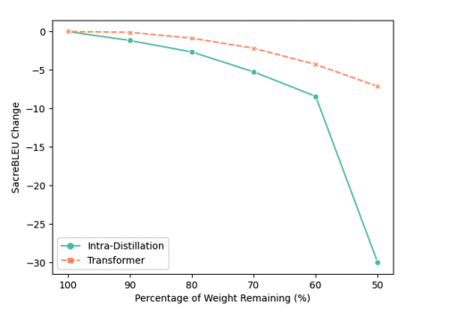
Analysis
How important are those least-sensitive parameters now?
Pruning begins with the least-sensitive parameters
Intra-distilled model without lower-sensitive parameters degenerates much faster now!
Notes:
How important are those east-sensitive parameters now?
(press) We can prune beginning with the least-sensitive parameters. After pruning the same number of least-sensitive parameters, a faster performance drop means the more importance of those least-sensitive parameters.
(press )We still consider IWSLT'14 de->en as consistent study objective. As shown in this figure, the x-axis is percentage of weight remaining and y-axis is the BLEU change. Green curve is the model after intra-distillation and orange curve is oridianry transformer model. After pruning the same number of parameters, intra-distilled mode drops much faster, which means intra-distillation makes the least-sensitive parameters become more important.

Slide 23
Conclusion
We use balanced parameter contribution to explain the success of self-distillation
We propose a task-agnostic method, intra-distillation, to highly balance the sensitivity (contribution) of model parameters and leads to significantly better generalization performance.
Wide-ranging experiments show the effectiveness of intra-distillation.

Slide 24
Thank you!

Slide 25
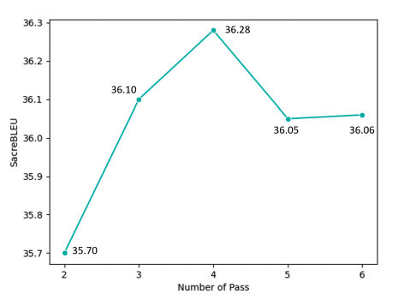
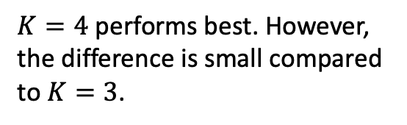
Appendix: Effect of number of passes
We examine the impact of the number of model passes $K$. Continue to previous experiments, we take IWSLT’14 de→en as our study objective.
$K=4$ performs best. However, the difference is small compared to $K=3$.

Slide 26
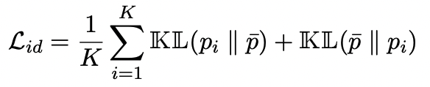
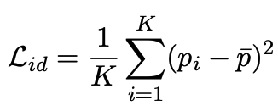
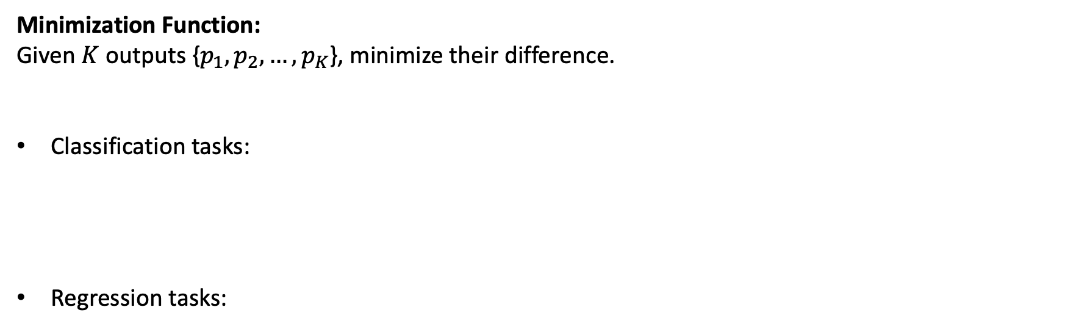
Appendix: Minimization Function
Minimization Function:
Given $K$ outputs {$p_{1},p_{2}, …,p_{K}$}, minimize their difference.
Classification tasks:
Regression tasks:
Notes:
We have different minimization function for different types of tasks.........

Slide 27

Appendix: Sensitivity Approximation
After first-order Taylor expansion:
Degree of contribution balance: We define the degree of contribution balance to be simply evaluating the standard deviation of all parameter sensitivity.

Slide 28
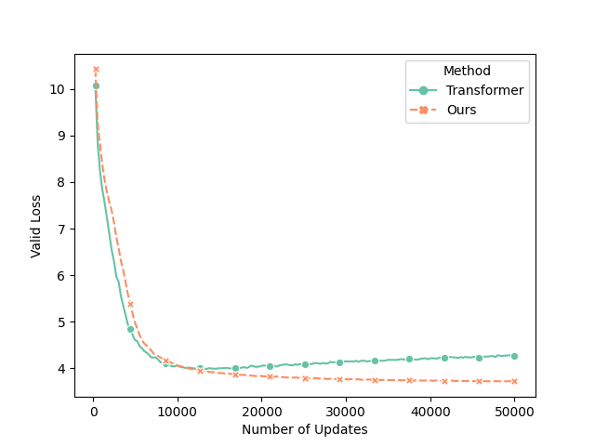
Appendix: Adaptive Intra-Distillation
We notice that intra-distillation loss objective will slow down the convergence speed.
For instance, in IWSLT’14 German→English experiment:
Converge slower at the beginning

Slide 29
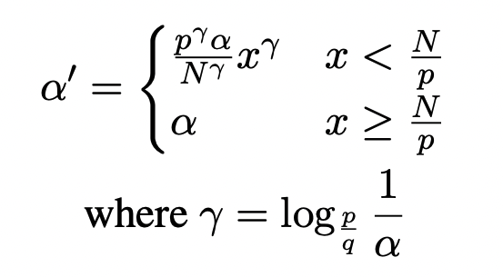
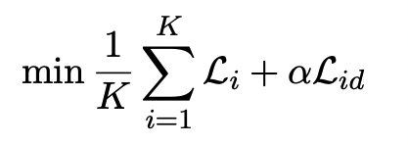
Appendix: Adaptive Intra-Distillation
We notice that intra-distillation loss objective will slow down the convergence speed.
Here, we design an adaptative α algorithm that makes α small at the beginning of training and then becomes large afterwards to accelerate the convergence speed

Slide 30
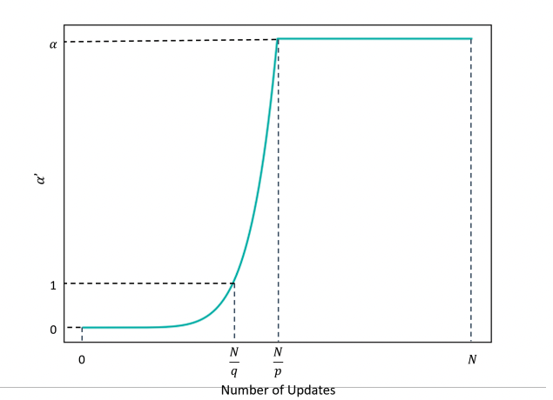
Appendix: Adaptive Intra-Distillation
We notice that intra-distillation loss objective will slow down the convergence speed.
Here, we design an adaptative α algorithm that makes α small at the beginning of training and then becomes large afterwards to accelerate the convergence speed

Slide 31
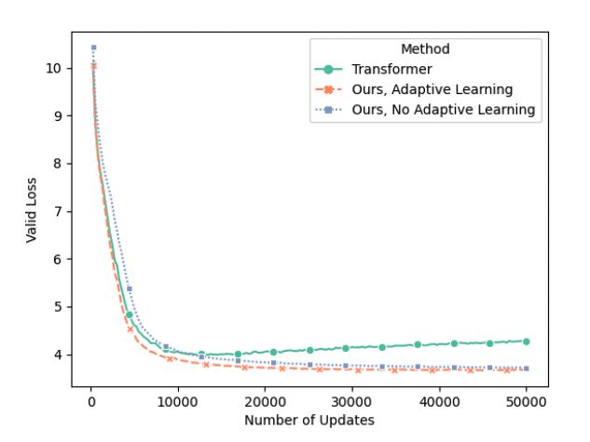
Appendix: Adaptive Intra-Distillation
Setting a proper p, q to the task, e.g., $p=5, q=10$ in IWSLT’14 German→English
Intra-distillation now converges faster with adaptive learning!

