Slide 1
VAE based Unsupervised Text Style Transfer with Pivot Words Enhancement Learning
Intern: Haoran Xu
Manager: Cynthia Lu
Mentors: Chengyuan Ma and Zhongkai Sun

Slide 2
Menu
Introduction
Related Works & Background
Proposed Method
Experiments
Conclusion

Slide 3
Introduction

Slide 4
Introduction
Text Style Transfer Definition:
Text style transfer aims to rephrase the input text in the desired style while preserving its original content, which could benefit various downstream applications such as text polishing, natural language understanding.
Examples
Sentiment Transfer:
they were dry and truly tasteless. → they were tasty and truly delicious.
Formality Transfer:
u ’ll find a man who really deserves u one day → you will find a man who really deserves you one day.
Code-Switching Transfer:
submarino amarillo de los Beatles → la cancion yellow submarine de los beatles
Notes:
说style transfer definition的时候说sentiment transfer， 讲sentiment 例子

Slide 5
Introduction
Motivation
Help Alexa enable code-switching settings on device and reduce the misunderstanding of code-switching utterances
Enrich the response style of Alexa
Challenges:
Lack of parallel data → Unsupervised Methods
Low-resource clean data
Notes:
看一下patent

Slide 6
Related Works & Background

Slide 7
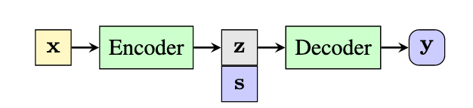
Related Works & Background
What previous popular research did?
Pros:
latent representation brings better interpretability
Cons:
It is difficult to judge the quality of disentanglement
Due to the limited capacity of vector representation, the latent representation is hard to capture the rich semantic information
Theoretically disentanglement has been proved that totally separating features is not viable in unsupervised learning.^{[5]}
1. Disentanglement^{[1]-[4]}
Content Features
Style Features
[1] Disentangled Representation Learning for Non-Parallel Text Style Transfer
[2] Style transfer from non-parallel text by cross alignment
[3] Style transfer in text: Exploration and evaluation
[4] Toward controlled generation of text
[5] Challenging Common Assumptions in the Unsupervised Learning of Disentangled Representations
Notes:
第三句讲，

Slide 8
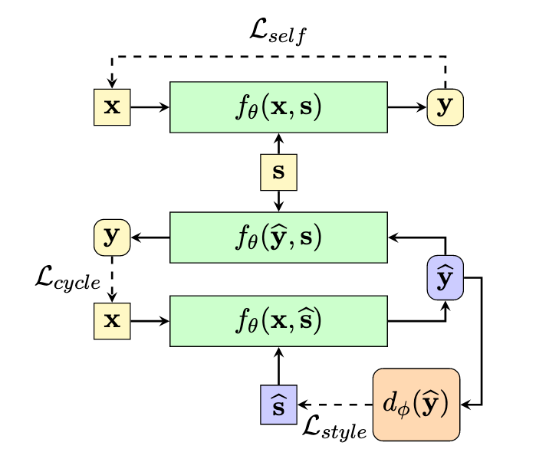
Related Works & Background
AutoEncoder, for content preservation
2. Rewrite the Style Attribute^{[1],[2]}
Pros:
No manipulating latent representation and only using extra style information along with a text representation.
Cons:
Cannot adjust the style strength.
Training is hard to converge and unstable.
Adversarial Training, for learning rewriting the style attribute
[1] Style Transformer: Unpaired Text Style Transfer without Disentangled Latent Representation
[2] Multiple-attribute text rewriting
Notes:
第一句takeaway, 第二句相关，第三句总结

Slide 9
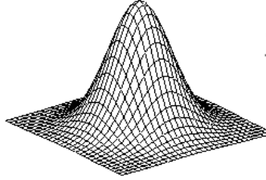
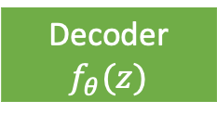




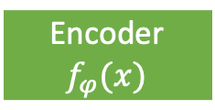
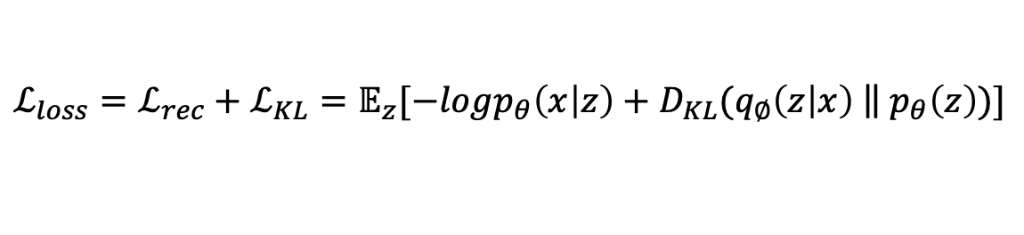


Related Works & Background
Variational Autoencoder (VAE):
$$u_{z|x }$$
$$x$$
Encoder
$$f_{φ}(x)$$
Decoder
$$f_{θ}(z)$$
$$y$$
VAE:
Z
Sample $z$
$$Σ_{z|x }$$
$$𝒩(u_{z|x },Σ_{z|x })$$
$${ℒ_{loss}=ℒ_{rec}+ℒ_{KL}=𝔼}_{z}[−logp_{θ}\left(x | z\right)+D_{KL}(q_{∅}\left(z | x\right) \left\|{ p}_{θ}\left(z\right)\right.)]$$
Notes:
颜色 中间highlight
结构中间中间 高维的
针对前面的distanglement 解决这个问题
去掉Lrec

Slide 10
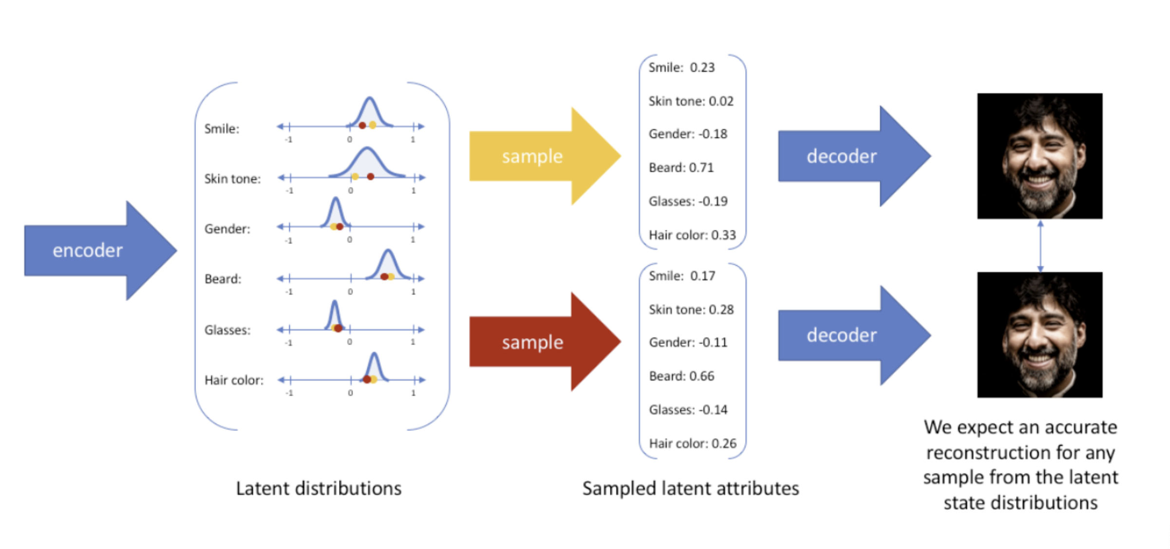
Related Works & Background

Slide 11
Proposed Method

Slide 12
Proposed Method
Stage 1: VAE + Style Embedding Training
Stage 2: Pivot Word Masking Training

Slide 13

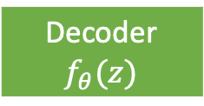



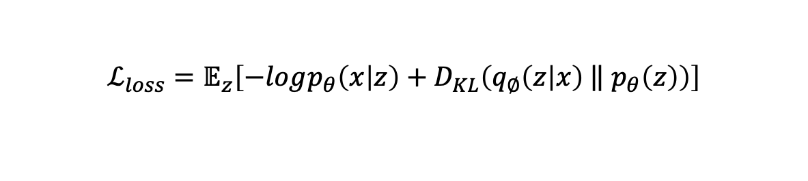


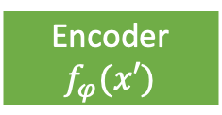



Proposed Method: VAE+Style Embedding
Take sentiment transfer as an example:
If input is 🙃, the target distance $d$ should be [1, 0]
Random initialized
🙃
$$S_{0}$$
$$[cos\left(S_{0}, z\right), cos(S_{1}, z)]$$
🙂
$$S_{1}$$
Pre-trained Encoder
Multi-layer Transformer
$$u_{z|x }$$
Multi-layer Transformer
$$x$$
$$x′$$
Encoder
$$f_{φ}(x′)$$
Sample $z$
Decoder
$$f_{θ}(z)$$
$$y$$
Z
$$Σ_{z|x }$$
🙃
🙃
🙂
🙂
$${ℒ_{loss}=𝔼}_{z}\left[−logp_{θ}\left(x | z\right)+D_{KL}\left(q_{∅}\left(z | x\right) \left\|{ p}_{θ}\left(z\right)\right.\right)\right]$$
Notes:
Style embdding j讲一个case
重点是style embeddings 如何update

Slide 14


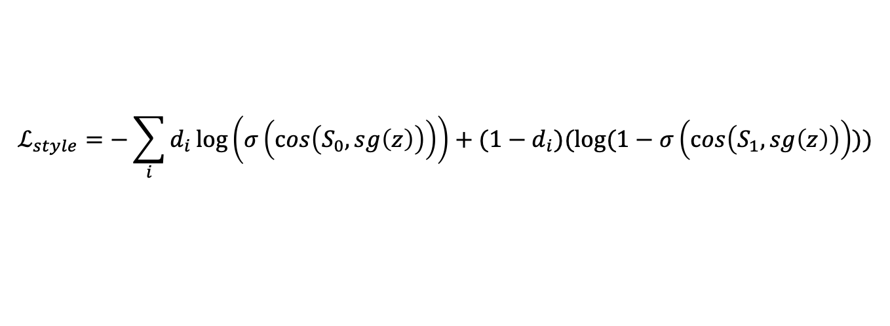

Proposed Method: VAE+Style Embedding
Take sentiment transfer as an example:
If input is 🙃, the target distance $d$ should be [1, 0]
Random initialized
🙃
$$S_{0}$$
$$[cos\left(S_{0}, sg\left(z\right)\right), cos(S_{1}, sg(z))]$$
🙂
$$S_{1}$$
$sg$: stop gradient
Pre-trained Encoder
Multi-layer Transformer
$$u_{z|x }$$
Multi-layer Transformer
$$x$$
$$x′$$
Encoder
$$f_{φ}(x′)$$
Sample $z$
Decoder
$$f_{θ}(z)$$
$$y$$
Z
$$Σ_{z|x }$$
🙃
🙃
🙂
🙂
$$ℒ_{style}=−\sum_{i}{d_{i}\log\left(σ\left(cos\left(S_{0}, sg\left(z\right)\right)\right)\right)+(1−d_{i})(log⁡(1−σ\left(cos\left(S_{1}, sg\left(z\right)\right)\right)))}$$
$${ℒ_{loss}=𝔼}_{z}\left[−logp_{θ}\left(x | z\right)+D_{KL}\left(q_{∅}\left(z | x\right) \left\|{ p}_{θ}\left(z\right)\right.\right)\right]$$
Notes:
Style embdding j讲一个case
重点是style embeddings 如何update

Slide 15
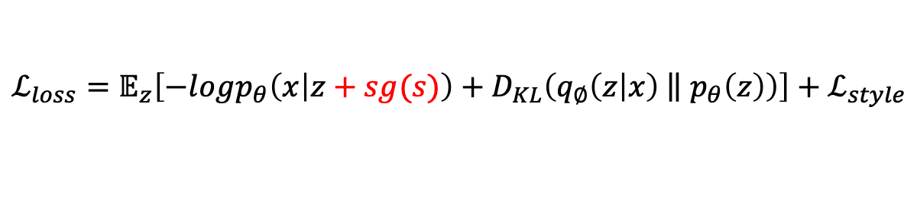
Proposed Method: VAE+Style Embedding
Take sentiment transfer as an example:
If input is 🙃, the target distance $d$ should be [1, 0]
Random initialized
🙃
$$S_{0}$$
$$[cos\left(S_{0}, sg\left(z\right)\right), cos(S_{1}, sg(z))]$$
🙂
$$S_{1}$$
$sg$: stop gradient
Pre-trained Encoder
Multi-layer Transformer
$$u_{z|x }$$
Multi-layer Transformer
$$x$$
$$x′$$
Encoder
$$f_{φ}(x′)$$
Sample $z$
Decoder
$$f_{θ}(z)$$
$$y$$
Z
$$Σ_{z|x }$$
🙃
🙃
🙂
🙂
$$ℒ_{style}=−\sum_{i}{d_{i}\log\left(σ\left(cos\left(S_{0}, sg\left(z\right)\right)\right)\right)+(1−d_{i})(log⁡(1−σ\left(cos\left(S_{1}, sg\left(z\right)\right)\right)))}$$
$${ℒ_{loss}=𝔼}_{z}\left[−logp_{θ}\left(x | z+sg(s)\right)+D_{KL}\left(q_{∅}\left(z | x\right) \left\|{ p}_{θ}\left(z\right)\right.\right)\right]+ℒ_{style}$$
Notes:
Style embdding j讲一个case
重点是style embeddings 如何update

Slide 16
Proposed Method: VAE+Style Embedding
Inference step:
Only modify the latent feature!
🙃
$$S_{0}$$
🙂
$$S_{1}$$
Pre-trained Encoder
Multi-layer Transformer
$$u_{z|x }$$
Multi-layer Transformer
$$x$$
$$x′$$
Encoder
$$f_{φ}(x′)$$
Sample $z$
Decoder
$$f_{θ}(z)$$
$$y$$
Z
$$Σ_{z|x }$$
🙃
🙂
🙂
🙃
If input is 🙃, $z^{′}=z+ ( − )$
If input is 🙂, $z^{′}=z+ ( − )$

Slide 17


Proposed Method: VAE+Style Embedding
Inference step:
Only modify the latent feature!
🙃
$$S_{0}$$
🙂
$$S_{1}$$
Pre-trained Encoder
Multi-layer Transformer
$$u_{z|x }$$
Multi-layer Transformer
$$x$$
$$x′$$
Encoder
$$f_{φ}(x′)$$
Sample $z$
Decoder
$$f_{θ}(z)$$
$$y$$
Z
$$Σ_{z|x }$$
🙃
🙂
🙂
🙃
If input is 🙃, $z^{′}=z+w( − )$
If input is 🙂, $z^{′}=z+w( − )$
$$z^{′}=z+w\left({(−1)}^{𝟙(s=1)}S_{0}+{(−1)}^{𝟙(s=0)}S_{1}\right)$$
where$𝟙(∙)$is the indicator function

Slide 18
Proposed Method: Pivot Word Masking Training
Some entity names or prepositions (non-pivot words) may not require a rewrite. We only need to rewrite words which can determine the style of the sentence (pivot words).
e.g. I am disappointed with the restaurant.
I am happy with the restaurant.
Thus, we propose pivot word masking training to enforce the model to focus on pivot words.
Notes:
参考patent
不要问句， 什么事pviot word, non-pivot

Slide 19

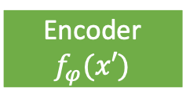
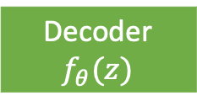







Proposed Method: Pivot Word Masking Training
🙃
$$S_{0}$$
🙂
$$S_{1}$$
Pre-trained Encoder
Multi-layer Transformer
$$u_{z|x }$$
Multi-layer Transformer
$$x$$
$$x′$$
Encoder
$$f_{φ}(x′)$$
Sample $z$
Decoder
$$f_{θ}(z)$$
$$y$$
Z
$$Σ_{z|x }$$
I am <mask> with the restaurant.
I am disappointed with the restaurant.
Pivot Word Masking
I am disappointed with the restaurant.
Notes:
Style embedding 灰白

Slide 20

Proposed Method: Pivot Word Masking Training
Frozen! We don’t train style embeddings in this step because masked sentences don’t contain style information
🙃
$$S_{0}$$
🙂
$$S_{1}$$
Pre-trained Encoder
Multi-layer Transformer
$$u_{z|x }$$
Multi-layer Transformer
$$x$$
$$x′$$
Encoder
$$f_{φ}(x′)$$
Sample $z$
Decoder
$$f_{θ}(z)$$
$$y$$
Z
$$Σ_{z|x }$$
I am <mask> with the restaurant.
I am disappointed with the restaurant.
Pivot Word Masking
$${ℒ_{loss}=𝔼}_{z}\left[−logp_{θ}\left(x | z+s\right)+D_{KL}\left(q_{∅}\left(z | x\right) \left\|{ p}_{θ}\left(z\right)\right.\right)\right]$$
I am disappointed with the restaurant.
Notes:
Style embedding 灰白

Slide 21
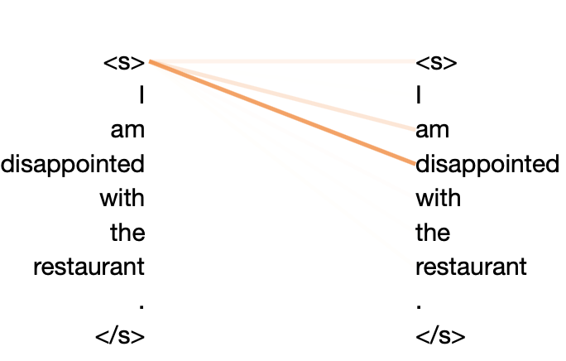
Proposed Method: Pivot Word Masking Training
How to derive pivot words?
We utilize attention weights to describe the importance of words!
🙂
?
🙃
Linear Layer & Softmax
Classifier
f_{<s>} = w₁f_{<s>}+ w₂f_{I} + w₃f_{am} + w₄f_{disappointed}
f_{<s>}
f_{<s>} = w₁f_{<s>}+ w₂f_{I} + w₃f_{am} + w₄f_{disappointed}
Attention weights
Pre-Trained Encoder
<s>
I
am
disappointed…
Notes:
Classification表示

Slide 22
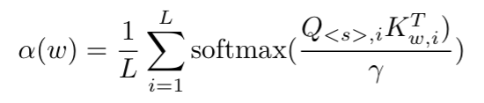
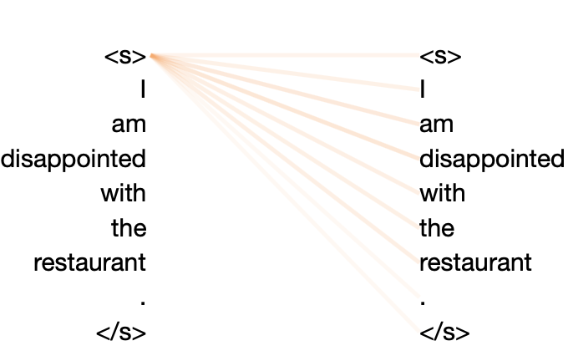


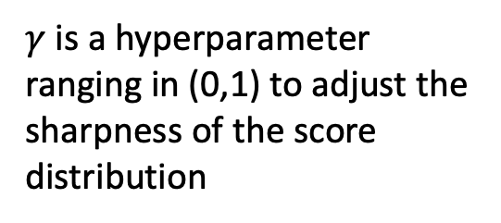



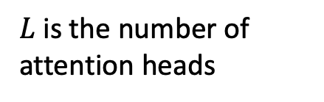

Proposed Method: Pivot Word Masking Training
Formally speaking, the formula of an attention weight of a word $w$ can be written as follows
$γ$ is a hyperparameter ranging in (0,1) to adjust the sharpness of the score distribution
$L$ is the number of attention heads
$Q,K$ are query and key matrices.
Multiple heads!
<s>
$$γ=0.03$$
I
Pre-Trained Encoder
am
Pre-Trained Encoder
Pre-Trained Encoder
$$Q_{<s>}$$
disappointed
$$K^{T}$$
$$γ=0.003$$

Slide 23
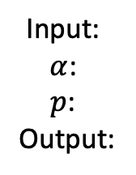
Proposed Method: Pivot Word Masking Training
Pivot Word Masking Scheme:
Based on the formula, every token in the sentence can have an attention weight $α_{i}$. We also assign a random number $p_{i}\sim$ uniform[0,1]. A word will be masked if $p_{i}<α_{i}$.
Input:
$α$:
$p$:
Output:
<s> I am disappointed with the restaurant </s>
0.01 0.01 0.1 0.8 0.02 0.02 0.02 0.02
0.6 0.7 0.2 0.4 0.1 0.2 0.9 0.2
<s> I am <mask> with the restaurant </s>

Slide 24
Proposed Method: Pivot Word Masking Training
Inference step is still the same!
Only modify the latent feature!
🙃
$$S_{0}$$
🙂
$$S_{1}$$
Pre-trained Encoder
Multi-layer Transformer
$$u_{z|x }$$
Multi-layer Transformer
$$x$$
$$x′$$
Encoder
$$f_{φ}(x′)$$
Sample $z$
Decoder
$$f_{θ}(z)$$
$$y$$
Z
$$Σ_{z|x }$$
🙃
🙂
🙂
🙃
If input is 🙃, $z^{′}=z+w( − )$
If input is 🙂, $z^{′}=z+w( − )$
$$z^{′}=z+w\left({(−1)}^{𝟙(s=1)}S_{0}+{(−1)}^{𝟙(s=0)}S_{1}\right)$$
where$𝟙(∙)$is the indicator function

Slide 25
Experiments

Slide 26
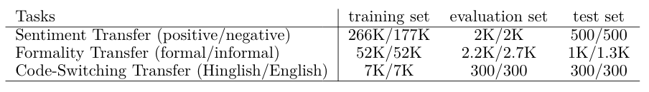
Experiments
Three style transfer experiments:
Sentiment Style Transfer (Yelp)
Formality Style Transfer (GYAFC)
Hindi to Hinglish Code-Switching Style Transfer (LinCE^{[1]})
Notes:
Animation highlight 7K

Slide 27
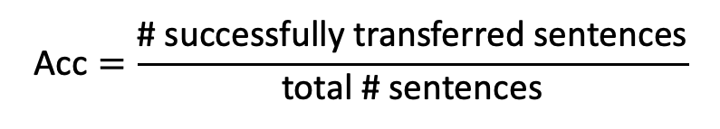
Experiments
Evaluated by a classifier
Evaluation Metrics:
Accuracy (Acc): (higher is better)
Perplexity (PPL): PPL(w) = P(w)^{-1/N} (lower is better)
Evaluated by GPT2 for sentiment and formality transfer
Evaluated by LSTM language model^{[1]} for code-switching transfer
Self-BLEU: BLEU scores between transferred sentences and original sentences. (higher is better)
Ref-BLEU: BLEU scores between transferred sentences and reference sentences. (higher is better)
$$\text{Acc}=\frac{\text{\#} \text{successfully} \text{transferred} \text{sentences}}{\text{total} \text{\#} \text{sentences}}$$
[1] A Deep Generative Model for Code-Switched Text
Notes:
Commoly formally used for style transfer
用公式表达，标记用classifier.
Higher better, lower better

Slide 28


Experiments: Sentiment Transfer
Classifier itself has 97.6% accuracy
$$z^{′}=z+w\left({(−1)}^{𝟙(s=1)}S_{0}+{(−1)}^{𝟙(s=0)}S_{1}\right)$$
Effect of $w:$
 | Acc | PPL | Self-BLEU | Ref-BLEU
Raw test data | 2.4% | 23.40 | 100 | 31.84
Human reference | 74.1% | 27.40 | 31.84 | 100
Ours (stage 1, w = 2) | 63.3% | 29.74 | 63.48 | 26.29
Ours (stage 1, w = 3) | 82.2% | 33.63 | 48.62 | 22.72
Ours (stage 1, w = 4) | 91.7% | 38.35 | 37.10 | 18.5
better
worse
worse
worse
Notes:
Better worse, 颜色

Slide 29

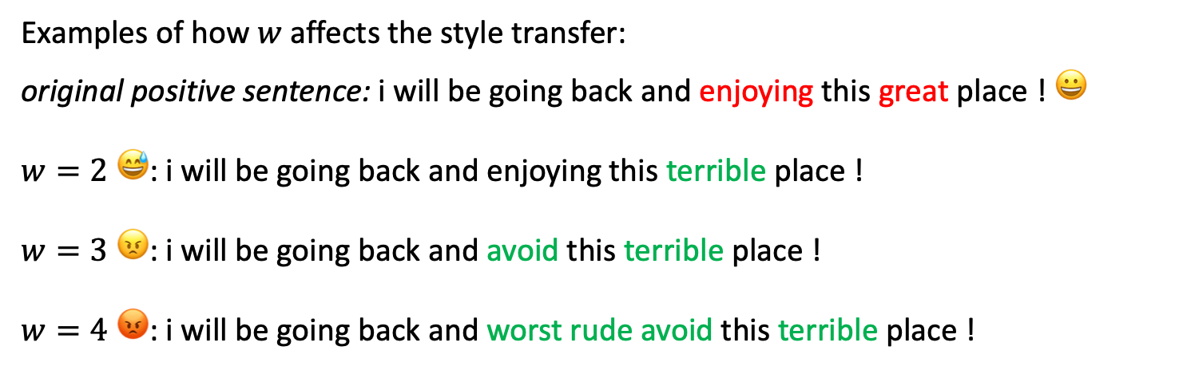

Experiments: Sentiment Transfer
Effect of $w:$
$$z^{′}=z+w\left({(−1)}^{𝟙(s=1)}S_{0}+{(−1)}^{𝟙(s=0)}S_{1}\right)$$
Examples of how $w$ affects the style transfer:
original positive sentence: i will be going back and enjoying this great place ! 😀
$w=2$ 😅: i will be going back and enjoying this terrible place !
$w=3$ 😠: i will be going back and avoid this terrible place !
$w=4$ 😡: i will be going back and worst rude avoid this terrible place !

Slide 30
Experiments: Sentiment Transfer
 | Acc | PPL | Self-BLEU | Ref-BLEU
Raw test data | 2.4% | 23.40 | 100 | 31.84
Human reference | 74.1% | 27.40 | 31.84 | 100
Ours (stage 1, w = 2) | 63.3% | 29.74 | 63.48 | 26.29
Ours (stage 2, w = 1.35) | 64.1% | 27.97 | 63.00 | 27.52
Ours (stage 1, w = 3) | 82.2% | 33.63 | 48.62 | 22.72
Ours (stage 2, w = 1.75) | 83.0% | 29.24 | 53.63 | 25.57
Ours (stage 1, w = 4) | 91.7% | 38.35 | 37.10 | 18.5
Ours (stage 2, w = 2) | 91.1% | 30.78 | 47.76 | 23.97

Slide 31
Experiments: Sentiment Transfer
Compared with previous methods
 | Acc | PPL | Self-BLEU | Ref-BLEU
Raw test data | 2.4% | 23.40 | 100 | 31.84
Human reference | 74.1% | 27.40 | 31.84 | 100
Cross Alignment(Shen, 2017)^{[1]} | 74.0% | 42.91 | 20.74 | 9.06
Delete & Retrieve (Li, 2018)^{[2]} | 87.5% | 40.66 | 36.75 | 5.99
Style Transformer (Dai, 2019)^{[3]} | 83.9% | 43.60 | 63.14 | 28.29
Ours (stage 2, w = 2) | 91.1% | 30.78 | 47.76 | 23.97
[1] Style Transfer from Non-Parallel Text by Cross-Alignment
[2] Delete, Retrieve, Generate:A Simple Approach to Sentiment and Style Transfer
[3] Style Transformer: Unpaired Text Style Transfer without Disentangled Latent Representation
Notes:
animiation一个一个来， 一个数字一个框

Slide 32
Experiments: Sentiment Transfer
Examples of positive -> negative outputs:
Original: steve was professional and found exactly the right unit to fit in our space .
Style transformer^{[1]}: nobody was unfriendly and found exactly the right unit to fit in our space .
Ours: steve was horrible and only fit the wrong space to find in our unit .
Human: steve was totally unprofessional and did n't find any fit that would be good for us .
Examples of negative -> positive outputs:
Original: the place has obviously gone downhill over the years .
Style transformer^{[1]}: the place has consistently gone handful over the years .
Ours: the place has greatly improved over the years .
Human: the place has obviously improved over the years .
[1] Style Transformer: Unpaired Text Style Transfer without Disentangled Latent Representation
Notes:
讲一个

Slide 33
Experiments: Formality Transfer
 | Acc | PPL | Self-BLEU | Ref-BLEU
Raw test data | 14.25% | 31.74 | 100 | 26.01
Human reference | 82.31% | 28.05 | 26.01 | 100
Ours (stage 1, w = 2) | 42.1% | 28.98 | 47.32 | 17.50
Ours (stage 1, w = 3) | 62.35% | 30.54 | 41.46 | 16.28
Ours (stage 1, w = 4) | 80.9% | 31.90 | 33.82 | 14.19
Notes:
提一嘴

Slide 34
Experiments: Formality Transfer
 | Acc | PPL | Self-BLEU | Ref-BLEU
Raw test data | 14.25% | 31.74 | 100 | 26.01
Human reference | 82.31% | 28.05 | 26.01 | 100
Ours (stage 1, w = 2) | 42.1% | 28.98 | 47.32 | 17.50
Ours (stage 2, w = 1.5) | 43.95% | 26.84 | 45.01 | 18.07
Ours (stage 1, w = 3) | 62.35% | 30.54 | 41.46 | 16.28
Ours (stage 2, w = 2.25) | 67% | 28.85 | 39.16 | 17.49
Ours (stage 1, w = 4) | 80.9% | 31.90 | 33.82 | 14.19
Ours (stage 2, w = 3.1) | 81.0% | 30.78 | 32.68 | 15.84

Slide 35
Experiments: Formality Transfer
Compared with previous methods
 | Acc | PPL | Self-BLEU | Ref-BLEU
Raw test data | 14.25% | 31.74 | 100 | 26.01
Human reference | 82.31% | 28.05 | 26.01 | 100
Cross Alignment(Shen, 2017)^{[1]} | 65.35 | 13.66 | 2.21 | 1.57
Delete & Retrieve (Li, 2018)^{[2]} | 53.85 | 29.70 | 31.38 | 11.71
Style Transformer (Dai, 2019)^{[3]} | 56.05 | 48.72 | 71.60 | 24.67
Ours (stage 2, w = 3.1) | 81.0% | 30.78 | 32.68 | 15.84
[1] Style Transfer from Non-Parallel Text by Cross-Alignment
[2] Delete, Retrieve, Generate:A Simple Approach to Sentiment and Style Transfer
[3] Style Transformer: Unpaired Text Style Transfer without Disentangled Latent Representation
Notes:
选一个 一个数字一个数字讲 总结： 我们比他们的好

Slide 36
Experiments: Formality Transfer
Examples of formal -> informal outputs:
Original: you should pursue an active life and not waste my time .
Style transformer^{[1]}: you all beat an active life and not waste my time .
Ours: you should pick ur life and not waste my time .
Human: get a life and do n't waste mine .
Examples of informal -> formal outputs:
Original: ask her out or tell her u like or admire her .
Style transformer^{[1]}: ask her out or tell her is like or admire her .
Ours: ask her out or inform her that you like her .
Human: you should ask her out or tell you that you like or admire her .
[1] Style Transformer: Unpaired Text Style Transfer without Disentangled Latent Representation

Slide 37
Experiments: Code-Switching Transfer
No human reference!
 | Acc | PPL | Self-BLEU | Ref-BLEU
Raw test data | 0.3% | 11.79 | 100 | -
Ours (stage 1, w = 0.5) | 41.3% | 22.57 | 38.72 | -
Ours (stage 1, w = 0.75) | 66.67% | 29.91 | 24.30 | -
Ours (stage 1, w = 1) | 80.9% | 31.90 | 16.70 | -

Slide 38
Experiments: Code-Switching Transfer
 | Acc | PPL | Self-BLEU | Ref-BLEU
Raw test data | 0.3% | 11.79 | 100 | -
Ours (stage 1, w = 0.5) | 41.3% | 22.57 | 38.72 | -
Ours (stage 2, w = 0.5) | 44.7% | 22.65 | 39.11 | -
Ours (stage 1, w = 0.75) | 66.67% | 29.91 | 24.30 | -
Ours (stage 2, w = 0.75) | 68.70% | 30.02 | 26.42 | -
Ours (stage 1, w = 1) | 81.30% | 35.30 | 16.70 | -
Ours (stage 2, w = 1) | 82.30% | 30.53 | 16.88 | -

Slide 39
Experiments: Code-Switching Transfer
Compared with previous methods
 | Acc | PPL | Self-BLEU
Raw test data | 0.3% | 11.79 | 100
Human reference | - | - | -
Style Transformer (Dai, 2019)^{[1]} | 99.3% | 601.45 | 3.47
Random Replace (Qin 2020) ^{[2]}, 15% | 1.02% | 213.24 | 69.09
Ours (stage 2, w = 0.75) | 68.70% | 30.02 | 26.42
[1] Style Transfer from Non-Parallel Text by Cross-Alignment
[2] CoSDA-ML: Multi-Lingual Code-Switching Data Augmentation for Zero-ShotCross-Lingual NLP
Notes:
拿一个讲， 把讲的数字一个个讲

Slide 40
Experiments: Code-Switching Transfer
Example results for Hindi-Hinglish code-switching style transfer:
Hindi: कया आपको एनीमशन फिलम पसद ह ? (Do you like animation movies?)
Transferred (ours): क्या तुम्हे एनीमशन movie पसंद हैं ? (Do you like animation movies?)
Style Transformer^{[1]}: क्या आपको दोनों movie पसंद हें ? (Do you like both the movies?)
Random Replace^{[2]}: what आपको एनीमशन फिलम पसद ह ? (What you like animation movies?)
Hindi: कया यह काफी नया ह या कछ साल पराना ह ? (Is this quite new or is it a few years old?)
Transferred (ours): क्या यह काफी new हैं या तोडा old हैं ? (Is it quite new or broken old?)
Style Transformer^{[1]}: क्या यह काफी नया हैं या ने साल हार्ड हो ? (Is it new enough or are the years hard?)
Random Replace^{[2]}: कया this quite newer ह या कछ साल पराना ह ? (Is this quite newer or a few years old?)
[1] Style Transfer from Non-Parallel Text by Cross-Alignment
[2] CoSDA-ML: Multi-Lingual Code-Switching Data Augmentation for Zero-Shot Cross-Lingual NLP
Notes:
放一个

Slide 41
Experiments: Code-Switching Transfer
Hindi: म सहमत ह ! यह बहत दखी था , लकिन यह भी , जसा कि एक समीकषक इस काफी <unk> बिटवरट <unk> डालता ह । मझ यकीन नही था कि अत म कस महसस किया जाए ।
(I agree! It was so sad, but also, as one reviewer puts it quite <unk> bittersweet <unk>. I was not sure how to feel so.)
Transferred (ours): i agree ! यह बहुत sad था , जैसे एक reviewer ने कहा हैं यह काफ़ी " bittersweet " हैं , मैं sure नहीं था की end मैं कैसा feel करू .
(i agree! It was so sad, as one reviewer said, it's quite "bittersweet", I wasn't sure how to feel at the end.)
Style Transformer^{[1]}: movie की हैं . (of movie.)
Randomly replace^{[2]}: म सहमत ह ! this बहत दखी had , but this even , जसा कि एक समीकषक this plenty <unk> बिटवरट <unk> डालता ह । मझ यकीन no had कि अत म tight महसस किया jaye ।
(I agree! Had seen this a lot, but this even, as one reviewer puts this plenty bittersweet . I didn't believe that I felt so tight jaye.)
[1] Style Transfer from Non-Parallel Text by Cross-Alignment
[2] CoSDA-ML: Multi-Lingual Code-Switching Data Augmentation for Zero-Shot Cross-Lingual NLP

Slide 42
Conclusion

Slide 43
Conclusion
We successfully propose a VAE + style embeddings model architecture to realize the flexibility of the target style injected for text style transfer
Expanding upon our proposed model, we introduce pivot words masking training to further improve the model by focusing on the pivot words.
We show the wide applicability of our model compared with previous methods.
Notes:
跟语言无关， 各种task

Slide 44
Thank You!

Slide 45


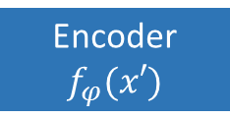








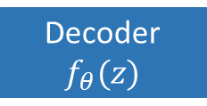

$$s_{1}$$
…
I am disappointed with the restaurant.
$$s_{k−1}$$
$$x$$
$$s_{k}$$
Pre-trained Language Model
Multi-layer Transformer
$$u_{z|x }$$
Latent Distribution
Multi-layer Transformer
Pivot Word Masking
$$x′$$
Encoder
$$f_{φ}(x′)$$
Sample $z$
Decoder
$$f_{θ}(z)$$
$$y$$
$$Z$$
I am <mask> with the restaurant.
$$Σ_{z|x }$$
I am disappointed with the restaurant.
$$ℒ_{vae}$$
Notes:
Style embdding j讲一个case
重点是style embeddings 如何update

Slide 46












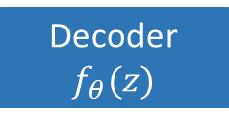

$$s_{1}$$
…
$$ℒ_{style}$$
$$s_{k−1}$$
$$s_{k}$$
Pre-trained Language Model
Multi-layer Transformer
$$u_{z|x }$$
Latent Distribution
Multi-layer Transformer
$$x$$
$$x′$$
Encoder
$$f_{φ}(x′)$$
Sample $z$
Decoder
$$f_{θ}(z)$$
$$y$$
$$Z$$
$$Σ_{z|x }$$
$$ℒ_{vae}$$

