Slide 1
Zero-Shot Cross-Lingual Dependency Parsing through Contextual Embedding Transformation
Haoran Xu, Philipp Koehn
Dec. 2020

Slide 2
Roadmap
Background
Methods
Experiments
Conclusion

Slide 3
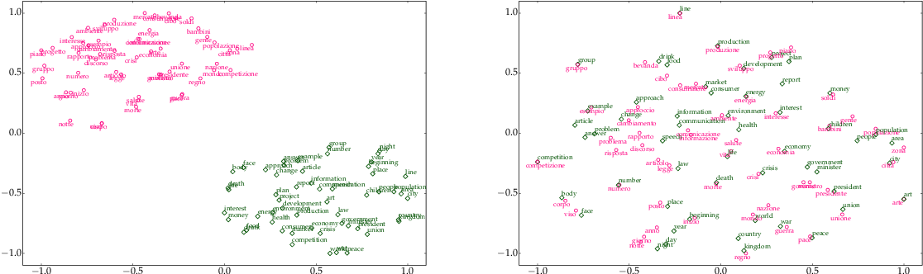
Background
Mikolov et al. (2013b) first noticed that pre-trained word vectors have similar topology structures across different languages. Therefore, word embeddings can be aligned by a simple linear mapping.

Slide 4
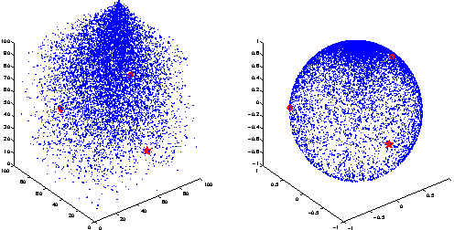
Background
Xing et al. (2015) showed that space alignment can be improved with orthogonal restriction.
Some supverised methods: Artetxe et al., 2016; Zhang et al., 2019, etc.
Some unsupverised methods: Miceli Barone, 2016; Zhang et al., 2017; Conneau et al. , 2018, etc.

Slide 5

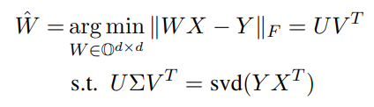

Background
Denote $X∈R^{d×N}$as the word embedding matrix for a source language, and $Y$ as the word embedding matrix for a target language:
With the orthogonal restriction, i.e., $W^{T}W =I$., the problem can be solved by Procrustes approach:

Slide 6
Background
Cross-lingual word embeddings facilitates model transfer between languages by providing a semantic shared embedding space, such as Schuster et al.(2019), Kondratyuk and Straka (2019).
Target Language Embeddings
Source Language Embeddings
Specific Task Model
Transformation

Slide 7
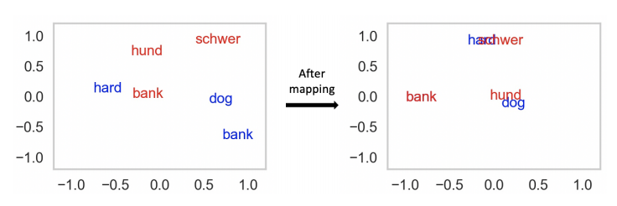
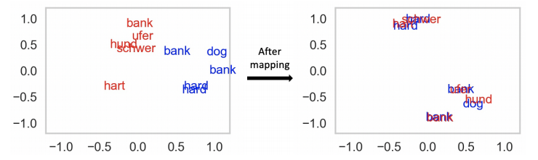
Methods: Overview
Previous Mapping methods:
Static word-level embedding mapping
Use static dictionary and do not consider context
Our methods:
Contextual sense-level embedding mapping
Derive embedding alignment from parallel corpora
Explore the properties of contextual embeddings

Slide 8
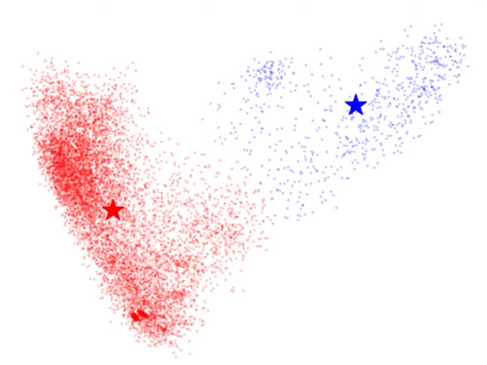
Methods: Why sense-level?
To mitigate representation bias problem: word-level embedding vectors of multi-sense words tend to be closer to the vectors that represent their main meaning in the semantic space. This phenomenon brings up a drawback that multi-sense word vectors are difficult to accurately represent any one of their senses
sense-level vector: meaning of “shore”
sense-level vector: financial meaning
word-level vector: only reflects the majority meaning (financial meaning)

Slide 9
Methods: Preprocessing
We first apply Fast Align (Dyer et al., 2013) , a log-linear reparameterization of IBM Model 2 , to the parallel corpus to obtain the aligned token pairs.
E.g., I really like eating apples ↔ Me gusta mucho comer manzanas
0-0, 2-1, 1-2, 3-3, 4-4
Then, every parallel sentences will have aligned indices.

Slide 10
Methods: Contextual Representation
...
...
emb 1
emb 2
emb N
emb 1
emb 2
emb N
Source Language BERT
Target Language BERT
...
token N
...
token N
token 1
token 2
token 1
token 2

Slide 11
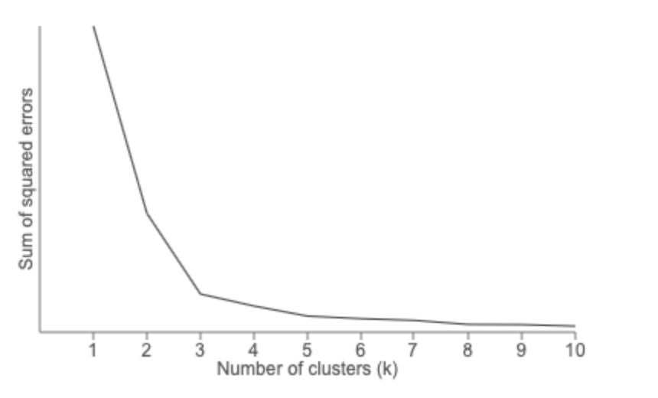


Methods: Sense-Level Alignment
How to find the transformation matrix W?
$$w$$
$$=$$
sense 2
sense 1
sinn 2
sinn 1
How to find the number of clusters?
Find maximum curvature

Slide 12


Methods: Anisotropy
Contextual embeddings always hold anisotropic property, i.e., they are not uniformly distributed in the space and gather toward a narrow range of orientations.
Ideal mapping:
coche
Real mapping
coche
banco
banco
$$\hat{W}$$
$$\hat{W}$$
banco
banco
bank
bank
coche
coche
car
car

Slide 13
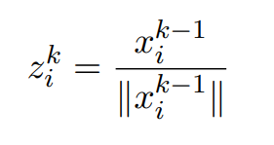
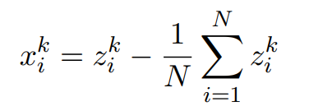
Methods: Anisotropy
It is unrealistically to control spaces in the same attribute (an)isotropic degree to build the isometric spaces, but we can enforce the space to be isotropic − Iterative Normalization
We let $x_{i}^{0}$ denote the initial embedding for word (sense) $i$. For every word (sense), embedding vectors are firstly enforced to be normalized to a unit length in the $k_{th}$ iteration:
Then, we make it be zero-mean:
We repeat the two steps above until convergence.

Slide 14
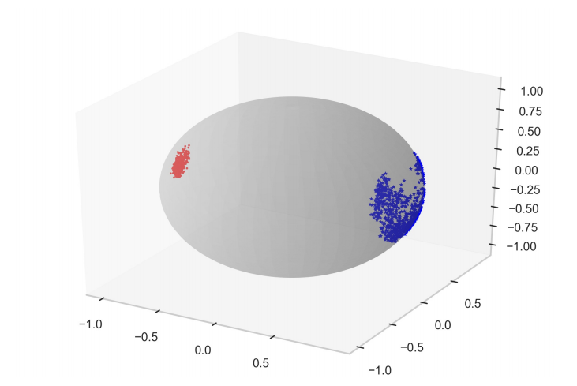
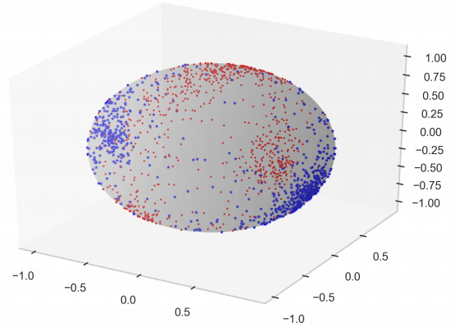


Methods: Anisotropy
coche
Examples of effectiveness of iterative normalization:
banco
banco
$$\hat{W}$$
banco
bank
bank
coche
After
banco
coche
$$\hat{W}$$
car
car
coche
After

Slide 15
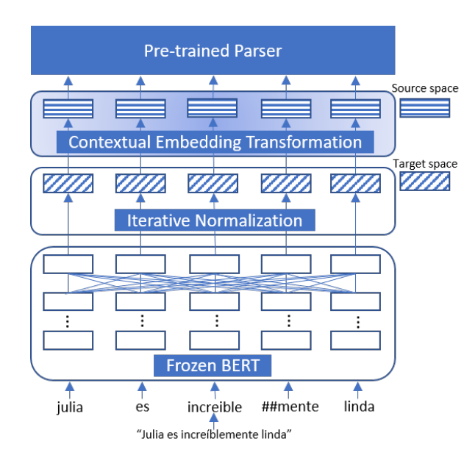
Methods: Zero-Shot Transfer
Workflow of zero-shot transfer processes:
To the source space
To near-isotropic space
Contextual Embedding

Slide 16
Experiments: Zero-Shot Dependency Parsing
Basic Settings
Zero-shot transfer learning task on 6 languages from 4 language families: es (Spanish), pt (Portuguese), ro (Romanian), pl (Polish), fi (Finnish), el (Greek).
1M parallel sentences for each language pair.
Parser: deep biaffine model from Dozat and Manning (2016).
Comparison
Baseline: 1) multilingual fastText aligned by the RCSLS method (Joulinet al., 2018; Bojanowski et al., 2017).
2) mBERT (Devlin et al., 2019).

Slide 17
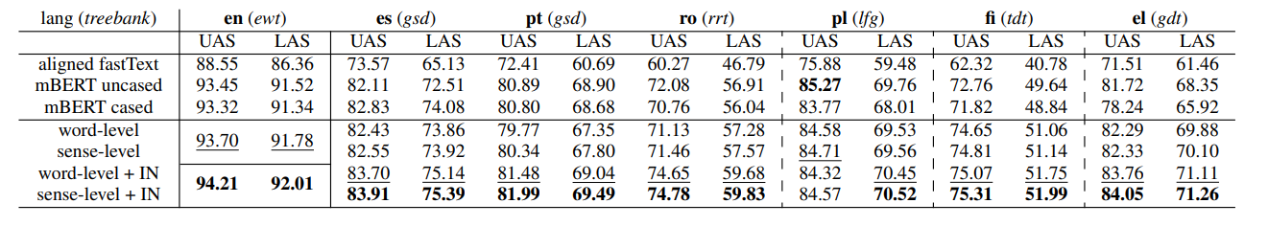
Experiments: Zero-Shot Dependency Parsing
Results:
en = English, es = Spanish, pt = Portuguese, ro = Romanian, pl = Polish, fi = Finnish, el = Greek.

Slide 18
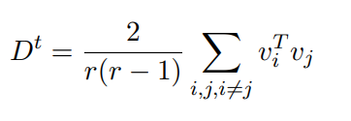
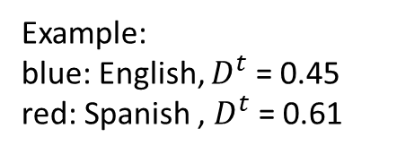
Experiments: Zero-Shot Dependency Parsing
How to measure the degree of (an)isotropy?
$v_{i} ,v_{j}$ are normalized vectors in the space, $r$ is the number of randomly selected vectors. Therefore, $D^{t}$ represents the average cosine similarity between all selected normalized vectors.
Example:
blue: English, $D^{t}$ = 0.45
red: Spanish , $D^{t}$ = 0.61

Slide 19
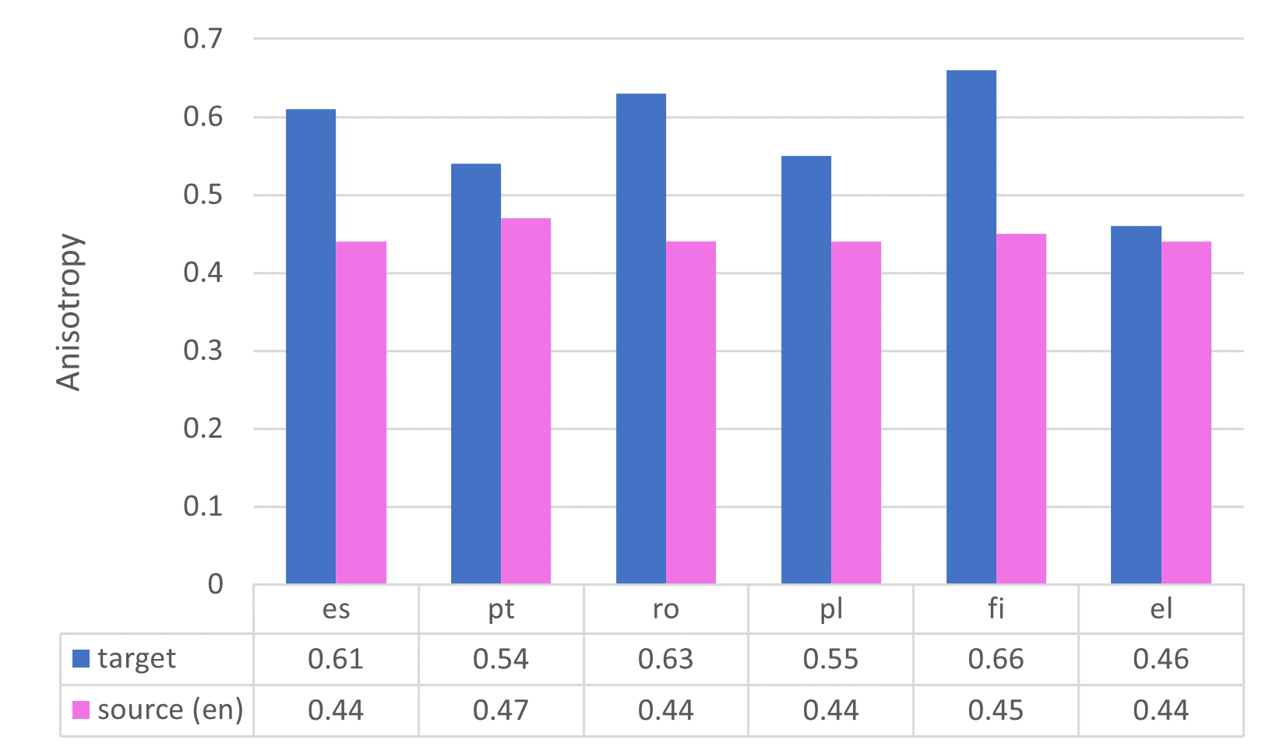
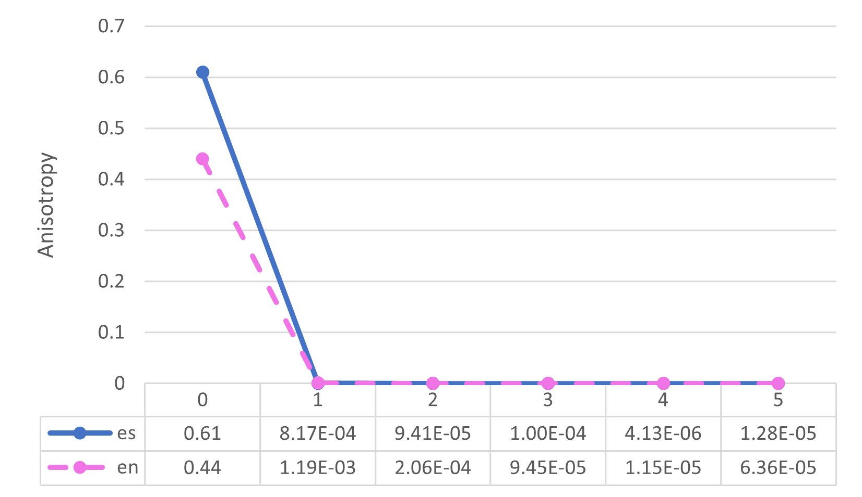
Experiments: Zero-Shot Dependency Parsing
How anisotropic degree drops by iterative normalization?

Slide 20
Conclusion
Contextual embeddings aligned by parallel corpus can build more high-quality mapping compared with static embeddings.
Sense-level mapping is better than word-level mapping by mitigating the representation bias problem.
Various degrees of anisotropy hurt the performance of mapping, and iterative normalization can alleviate it by enforcing contextual embeddings to be isotropic.

Slide 21
Thank you !

