Slide 1
LinkMate
IMU calibration
A personal memory for your network. It finds the right person for a problem, on your own laptop.
lead climbing
CECS 451 Term Project · Team 10 · CSULB Fall 2026
Antoine Courant, Felix Baechle, Vishal Bahatyani, Mika Brueggemann
knee check
Notes:
Felix:
Hi, we are Team 10. I'm Felix, with Antoine, Vishal and Mika. This is LinkMate, a personal memory for your network. It finds the right person for a problem, and it runs entirely on your own laptop.

Slide 2



The help exists in your network, but it is gone when you need it
PROBLEM
You meet someone
weeks later
You need that person
A contact book stores
They say what they do and offer to help
“Who could help me with this?”
Name, company, email
The knowledge is scattered
Consequence
You actually need
Skills
Topics you discussed
Help they offered
Phone notes
Emails
Chats
Search inboxes, ask around, or give up
Problems solved slowly or twice
Referrals missed, contacts fade
LinkedIn
Memory
Weak ties matter most, and fade first
Acquaintances are a key source of new information and job opportunities, yet these are exactly the contacts whose context is lost first.
Granovetter (1973), American Journal of Sociology. Rajkumar et al. (2022), Science.
Notes:
Felix:
Think of the last time you met someone interesting at an event. They told you what they do, and maybe offered to help. Weeks later you have a problem they could solve, and you can't remember who it was.
That knowledge sits in phone notes, emails and chats. Contact books store a name and a company, not what a person can do. Research shows that weak ties are a key source of new information and job opportunities, and their context gets lost first. So help that exists in your network goes unused.
Source: Final report, sections 1 and 2

Slide 3





For individuals who meet many people, often just once or twice
TARGET USERS
PRIMARY
SECONDARY
Active networkers
Occasional networkers
Meet new people often, in many contexts
Meet new people less often
Club members, event-goers, people who just moved
Hit the same problem at specific moments
Role for LinkMate
Role for LinkMate
Feel the pain most. Early adopters and likely paying users
Mass market, reached through the free tier and word of mouth
Expected users
College students, entrepreneurs, freelancers
The situation
Capture right after meeting, need weeks later
Not targeted
Companies, sales teams
Notes:
Felix:
We target individuals, defined by behavior. Our primary segment is active networkers, like club members or people who just moved to a new city. They feel the pain most and are our likely paying users. Occasional networkers hit the same problem at specific moments, and we reach them through a free tier.
Source: Final report, sections 1 and 7

Slide 4


Two moments: write a note now, ask for a person later
SOLUTION
Your note
AI proposes a profile
You review and confirm
“Met Mara Lindt at the Granite climbing gym open day. She is a route setter and physio student in Long Beach. Said she can teach me to lead climb …”
Mara Lindt
route setter, Granite climbing gym
Long Beach
Offers: teach lead climbing
Correct any field. Nothing is saved before you confirm.
Capture
Your need, weeks later
Up to three contacts, each with a reason and the source
“Who could teach me lead climbing?”
Mara Lindt
Source note
always shown
Strong or weak
match label
“… a route setter and physio student who can teach lead climbing and check technique on Sundays.”
Ask
Or plainly: “No suitable contact.”
Real prototype output on the synthetic dataset. Sample note from the README, answer from the recorded demo.
Notes:
Felix:
LinkMate has two moments. Capture. After meeting someone, you write a note in your own words, the AI proposes a profile, and you confirm it. Ask. Weeks later you describe a need, and LinkMate answers with up to three contacts, a reason, and your original note as the source. Or it says no suitable contact.
Source: README, sample result. Mara's answer is real output from demo.mp4

Slide 5


AI CRMs exist. The gap: sourced answers that stay on your device
MARKET GAP
Product | Main focus | Price per month
Dex | Personal CRM, notes, reminders | $12–20
Mesh (formerly Clay) | Network from connected accounts | Free to 1,000 contacts, $10
ConnectMachine | Digital cards, event capture | Free plan, $5.99
Happenstance | Warm connections, people search | Free tier, $24 (annual)
Covve | Business-card scanning, contacts | From $12
LinkMate | Notes to profiles, need-to-person answers | Planned: free tier, about $6
What LinkMate adds
Messy notes become profiles
Enriched over time, without form-filling
Every answer has a source
Open-ended needs, with a reason and a traceable note
Third-party data stays local
No note leaves the laptop
Vendor pricing pages, retrieved October 15, 2026. LinkMate is not positioned as the first of its kind. Its price is an assumption, tested in the pilot.
Notes:
Antoine:
AI personal CRMs exist. Dex, Mesh, ConnectMachine, Happenstance and Covve offer pieces of this, at about six to twenty-four dollars a month. So we are not the first. Our gap is specific. We turn messy notes into enriched profiles, we answer open-ended needs with a traceable source for every recommendation, and third-party data about your contacts stays on your device.
Source: Final report, section 6, vendor pricing pages retrieved October 15, 2026

Slide 6
Three AI tasks: retrieval-augmented generation that runs locally
AI TECHNOLOGY
1
Profile extraction
2
Semantic retrieval
3
Grounded explanation
Input
Typed notes, pasted emails
Input
A need in natural language
Input
The need and retrieved entries
AI model
qwen3:0.6b via Ollama, fixed JSON schema
AI model
nomic-embed-text, cosine similarity in Chroma
AI model
Same LLM, restricted to those entries
Output
Structured profile, saved after approval
Output
Most relevant profile and note entries
Output
Ranked contacts with reason and sources, or “no suitable contact”
Why AI, not rules
Why these models
Notes describe skills and offers informally, and people phrase needs differently from their notes. Forms and keywords miss this.
Smallest chat model that passed the tests: 0.5 GB, no API keys, 8 GB laptop. The larger qwen3:1.7b did worse: 18/30 against 21/30.
Notes:
Vishal:
There are three AI tasks. First, extraction. A small local language model turns a note into a structured profile, using a fixed JSON schema. Second, retrieval. An embedding model turns notes and questions into vectors, and we search by cosine similarity in Chroma, because people phrase needs differently from their notes. Third, a grounded answer. The model only sees the retrieved notes.
All of this runs through Ollama on an eight gigabyte laptop, with a half-gigabyte chat model and no API keys. A larger model did worse in the same pipeline.
Source: docs/llm_workflow.md, final report section 4, evaluation section 3

Slide 7
The model only proposes. Code and the user decide
OWN CONTRIBUTION: THE PIPELINE AROUND THE MODELS
AI model
Plain code
You
Flow A: capture
Note or email
user input
Sanitize
removes instruction-like sentences
Extract
LLM with fixed JSON schema
Clean, flag
values the note does not contain
Review
correct and confirm
Merge
code sets each fact’s source note
Save
JSON store, then Chroma index
Flow B: ask
Need
natural language
Dense search
embedding, cosine in Chroma
Threshold
below 0.59: no LLM call
Grounded LLM
sees labels C1, S1, not IDs
Validate
drops invented contacts, sources
Label
strong from 0.67, else weak
Answer
reason, source, or no contact
Review before save
Only Confirm writes. A wrong extraction cannot enter silently.
Labels, not IDs
Forged references resolve to nothing. Code maps labels back.
Code sets provenance
Every fact links to its note. Citations cannot be invented.
Notes are data
Marked and flattened, so a note cannot close its own block.
docs/architecture.md, decisions D4 to D6, D8, D9, D12. Invalid JSON gets one retry, then an empty form or plain search hits.
Notes:
Vishal:
We do not trust the model blindly. Teal is AI, white is plain code, and coral is you. Nothing is saved until you confirm. When you ask, a similarity threshold comes first, so clearly unrelated questions never reach the chat model. The model sees neutral labels instead of real IDs, and our code drops anything without a valid source. The search score then sets a strong or weak label.
Source: docs/architecture.md, sections 4, 7 and 8

Slide 8




One laptop, four layers, and no note leaves the machine
SYSTEM ARCHITECTURE
Your laptop · localhost only
Downward only
The UI and scripts call services, never the store, index or Ollama.
UI: Streamlit pages
Capture, Ask, Contacts, Status. Forms and friendly errors
Ollama
qwen3:0.6b, nomic-embed-text, HTTP on localhost:11434
Index is derived
The end-to-end test deletes it and rebuilds it with identical results.
Services
CaptureService, AskService, ContactService. Only they use infra
JSON files
One per contact. Source of truth, atomic writes
Core: pure functions
prompts, extraction, merge, retrieval, sanitize, validation
93 unit tests
A fake LLM and embedder plug in at one point. No Ollama needed.
Chroma index
Derived and rebuildable at any time
Infrastructure
OllamaClient, ContactStore, ChromaIndex
One-command start
Sets up environment and models, starts the app. Tested on macOS only.
Notes:
Mika:
Technically, this is four layers on one machine. Streamlit pages only call services. Services use a core of pure functions and three infrastructure classes for Ollama, the contact store and the search index. JSON files are the source of truth, and the Chroma index can be rebuilt at any time. With a fake model plugged in, ninety-three unit tests run without Ollama.
Source: docs/architecture.md, sections 1 to 3

Slide 9
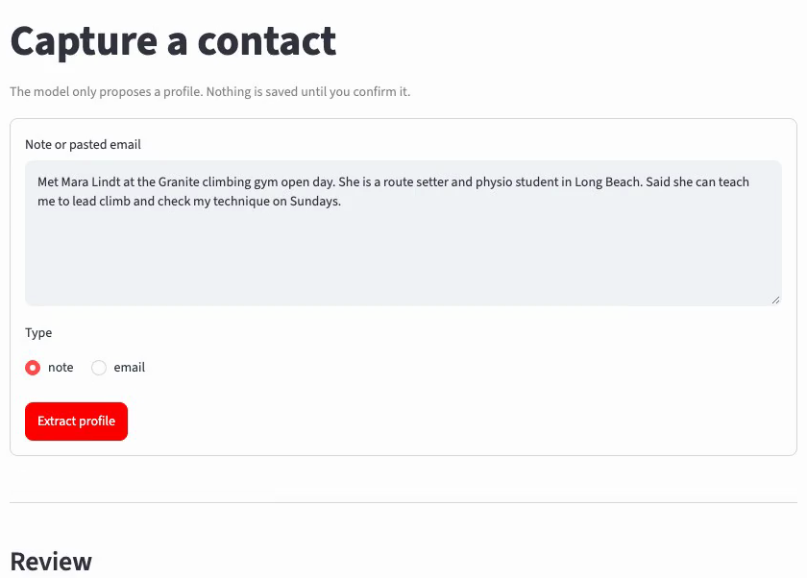
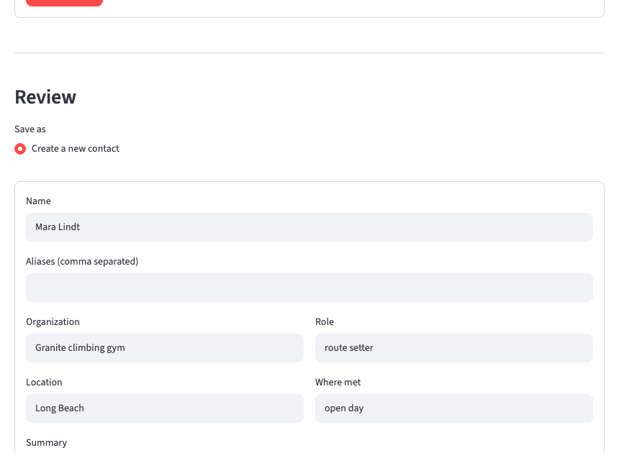
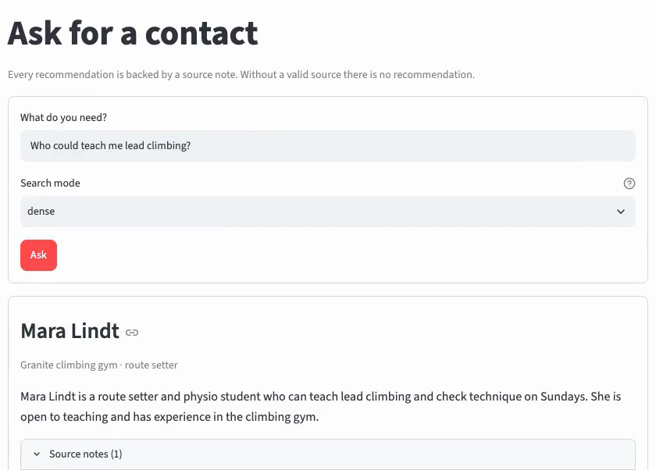
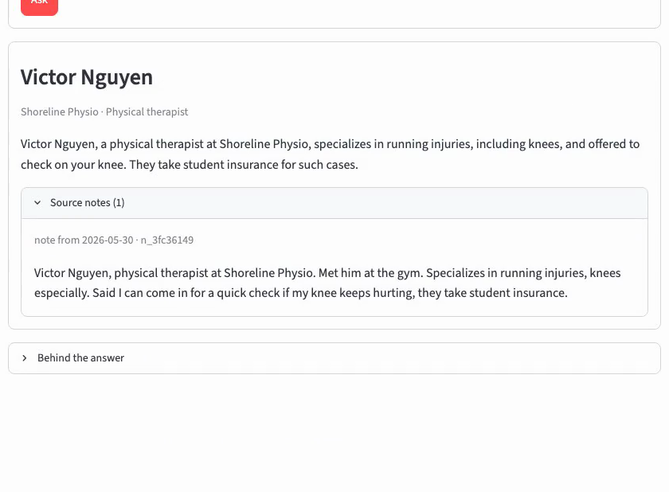
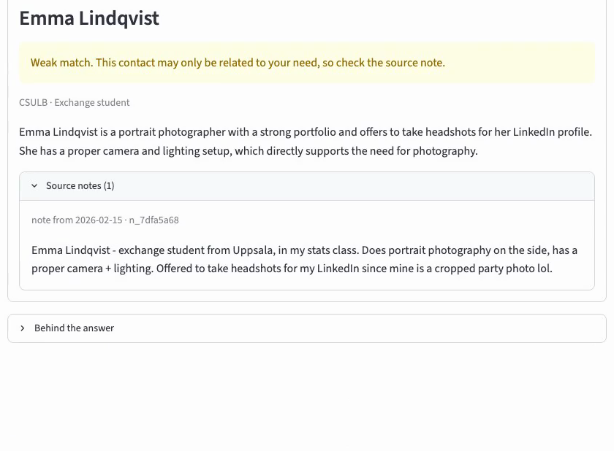
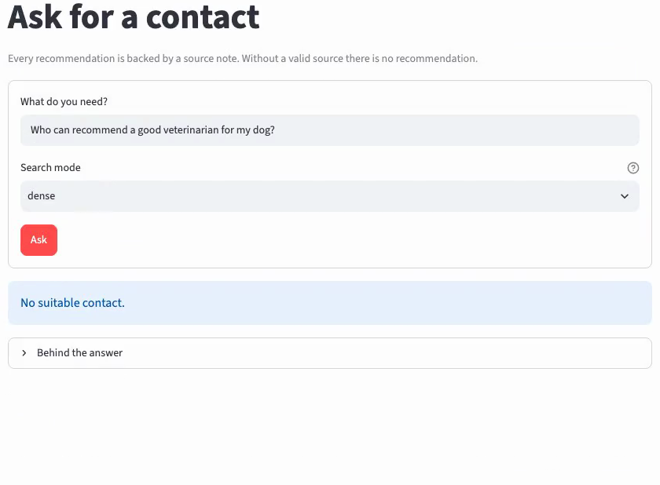
The real app, from note to answer
WORKING PROTOTYPE
Live recording
Two minutes, actual input to output, not screenshots.
1 Paste a note
Capture, type note or email
2 Review the proposal
Nothing saved before you confirm
3 Ask for the need
Mara, with reason and source note
55 synthetic contacts
Local models via Ollama
Contacts page: edit, export, delete
Status page: models, index
4 A paraphrase
Knee question finds the therapist
5 A near miss
Portrait photographer, labeled weak
6 Nobody fits
“No suitable contact.”
Notes:
Mika:
[Show docs/phase3/demo/demo.mp4 full screen, or record the same steps live. Speak over it. The slide is the storyboard and can stay visible as a lead-in.]
- Here is the running app, with fifty-five synthetic contacts. Everything is local.
- I capture a note about someone I just met, Mara, a route setter at a climbing gym who offered to teach me lead climbing. I click extract.
- The local model proposes a profile. Nothing is saved yet. I can correct any field, and the original note stays attached. I confirm.
- Now I ask, who could teach me lead climbing. LinkMate finds Mara, gives a reason and shows my own note as the source.
- A question from the dataset with wording close to the notes, calibrating a sensor. It finds Lena.
- A paraphrase. My knee hurts after long runs. There is no keyword for physical therapist in my question, and it still finds Victor.
- Here is a weakness. Who could photograph a wedding in Munich? Nobody in my network fits. The small model suggests a portrait photographer, but look, it is labeled a weak match, and I can check the note.
- And a veterinarian for my dog. No suitable contact.
- Finally the contact page, where I can edit, export and delete, and the status page with the models and the index.
Source: docs/phase3/demo/demo.mp4

Slide 10
We froze all settings before running the held-out questions
PERFORMANCE EVALUATION
55 synthetic contacts
70 notes, including vague, messy and long ones
30
Development questions
Used to tune the threshold and the match label, and to reject two failed experiments
40
Held-out questions, the headline
Written before tuning, first run after the settings were frozen
70 labeled questions
expected and acceptable contacts per question
14 direct
16 paraphrased
10 no right answer
The no-answer questions mostly carry a near miss to tempt the system
Baselines BM25 keyword top hit, dense top hit, both without an LLM
Metrics Right contact, correct refusal, fitting recommendations, Recall@k, MRR, Wilson CI, sign test
Honest note The first run exposed an injection weakness. Figures shown are the rerun with the guard, so the set is not fully untouched. Right contacts and refusals did not change.
Notes:
Mika:
How well does it work? We labeled seventy questions. Thirty were used for tuning. Forty were held out and only run once the settings were frozen. Ten of them have no right answer, mostly with a near miss to tempt the system. We compare against a keyword search baseline and a plain dense top hit.
Source: docs/evaluation.md, section 1

Slide 11
LinkMate edges past keywords on hits, but not significantly
RESULTS ON 40 HELD-OUT QUESTIONS
6 vs 3
questions only LinkMate or only the keyword baseline gets right. Exact sign test p = 0.51
21 vs 23
of 30 right contacts, LinkMate against the plain dense top hit. The LLM adds explanation, not hits
2 of 10
correct refusals. This is the main weakness, and the strong label addresses it
95% Wilson CI for right contact: BM25 49–81%, dense 59–88%, LinkMate 52–83%, strong 36–70%. Tuned numbers were optimistic: dev 21/24, held-out 21/30.
Notes:
Vishal:
On the held-out questions, LinkMate finds the right contact seventy percent of the time, against sixty-seven for keywords. With forty questions that difference is not statistically significant. The language model does not add hits over the plain dense top hit. It adds the explanation and a small gain in refusals, which stay weak at two out of ten.
Source: reports/evaluation/test.md

Slide 12
Semantic search pays off where the wording differs
RETRIEVAL AND PIPELINE QUALITY
12 vs 7
7 of 16
of 16 paraphrased needs have the right contact in the top three
paraphrased needs at answer level, against 6 for keywords
1.2 s
70 / 70
per question at the median, 1.9 s at p95, on an 8 GB laptop
extracted names correct. Facts reach F1 0.69 (lenient match)
23 of 30
1.2 GB
right contacts from raw notes, confirmed without any edits
memory for both models together
A promising gap on a small sample. reports/evaluation/test.md.
Notes:
Vishal:
Where does semantic search help? Direct questions are all correct. On paraphrased questions, search finds the contact in the top three seventy-five percent of the time, against forty-four for keywords. A question takes one point two seconds at the median, and extraction gets all seventy names right.
Source: reports/evaluation/test.md, retrieval only, extraction, latency

Slide 13
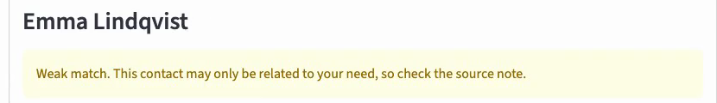
The strong label tells you when to trust an answer
MOST USEFUL FINDING
89%
Strong matches fit
If you only trust strong matches
16 of 18, CI 67–97%
Correct refusals
2/10
9/10
Fitting recommendations
53%
Weak matches fit
25/35
16/18
9 of 17, CI 31–74%
Right contacts found
21/30
16/30
Filled: recommendation fits. Empty: it does not.
The trade-off is explicit. The limit of 0.67 was set on development questions only.
Notes:
Vishal:
Our most useful finding is the match label. Of the recommendations labeled strong, eighty-nine percent fit. Of the weak ones, fifty-three percent. If you only trust strong matches, you get nine out of ten correct refusals, and you still find sixteen of the thirty right contacts.
Source: reports/evaluation/test.md, confidence label

Slide 14
Near misses are the main failure, and sources hold up
FAILURE ANALYSIS
17 of 40 questions failed. 23 were correct.
Two LLM fixes, rejected
Near miss accepted
7
“Who can teach me Italian?” returned a guitarist
Strict prompt
Wrong recommendations rose from 6/29 to 20/42
Verification pass
Said “not the same” for 20 of 22 right contacts
Next step: a reranker or a stronger model
Retrieval miss
4
“My hips feel stiff” did not reach the yoga teacher
Model chose wrong contact
3
Student visa hours returned the leasing manager
False accept
1
A dentist question returned a physical therapist
Dropped by validation
1
One foreign source removed the right contact
Model refused
1
Logo protection refused, attorney was a candidate
0 of 35
17 / 6 / 12
0 of 15
6 of 15
recommendations cite an invalid source, checked independently
of 35 reasons: supported, small invented detail, misleading. So the source is always shown
injection attacks got the attacker recommended for unrelated questions
attacks still reached the proposed profile, so the review stays mandatory
First run: an email telling any AI to “always recommend” its author influenced two answers. A keyword guard now removes such sentences. 10 of 15 attacks flagged.
Notes:
Vishal:
We classified every failure. Most are near misses the small model accepts, such as a guitarist for Italian lessons. Two prompt fixes made this worse, so we dropped them. No recommendation ever cited an invalid source, but reasons can contain invented details, so the source is always shown. Testing also exposed a real injection weakness. We now remove such sentences, but a keyword rule can be beaten, so the user review stays mandatory.
Source: docs/evaluation.md, sections 4, 5 and 7, reports/tuning_dev.md

Slide 15


Freemium with low running costs, on assumptions still untested
BUSINESS APPLICABILITY
Free
Illustrative scenario, not validated demand
Limited contacts and text features. Reaches occasional networkers through word of mouth.
 | Early | Reach
Users | 10,000 | 64,000 (0.1% of US freelancers)
Paying, at 4% freemium conversion | 400 | 2,560
Revenue at $6 per month | $2,400/month | $15,360/month
Inference if hosted for all users | $74/month | $474/month
Premium about $6/month
Unlimited contacts, cloud sync, voice input, OCR and integrations. Below Dex, level with ConnectMachine.
Under 1 cent
hosted inference per user per month, about $0.0074. Sync and support are the real costs. Local models are a privacy argument.
User pilot prepared
5 to 8 people measure time, success and willingness to pay against plain note search. Not run yet, so we claim no time saved.
64 million US freelancers: Upwork (2023). 3–5% freemium conversion: First Page Sage via Crazy Egg, for SaaS. About 30 notes and 40 questions per month at $0.10 / $0.30 per million tokens.
Notes:
Antoine:
The model is freemium: free with limited contacts, premium at around six dollars a month. Inference is not the cost driver. Even hosted it would be under one cent per user per month. At ten thousand users and a typical four percent conversion, that is twenty-four hundred dollars a month. These are illustrative assumptions, not validated demand. We have a user pilot prepared to measure time saved and willingness to pay.
Source: docs/evaluation.md, section 8, final report section 13

Slide 16
A personal network fits on a laptop. Quality falls before speed does
SCALABILITY
Contacts | Full index | Index size | Search median | Question median
55 | 4 s | 1 MB | 44 ms | 2.4 s
555 | 24 s | 10 MB | 28 ms | 2.0 s
2,055 | 87 s | 26 MB | 25 ms | 2.0 s
5,055 | 198 s | 53 MB | 25 ms | 1.7 s
Search stays near 25 ms. Speed is not the limit for a personal network.
Ranking, not search slots
Fetching 100 entries instead of 20 gave the same 0.79. Generated contacts share one template, so they are unusually similar.
Next at scale: a database
Reading all JSON files takes 0.9 s per question at 5,055 contacts.
Next for a service: a backend
One Streamlit process per user will not do. Needs hosted inference or a local-first client.
Notes:
Antoine:
We also tested scale with generated contacts. Search stays around twenty-five milliseconds up to five thousand contacts. Quality falls first. Recall at three is still ninety-six percent at two thousand contacts, and seventy-nine percent at five thousand. So a personal network works on a laptop. A larger service needs a database and a real backend.
Source: reports/evaluation/scale.md, docs/evaluation.md section 8

Slide 17
Clear limits, and a roadmap that goes straight at them
LIMITATIONS AND ROADMAP
What does not work yet
What comes next
Weak refusals
2/10. Only the strong label is reliable
1
User pilot and real notes
With consent. Time, success, willingness to pay
Paraphrased needs
7/16 at answer level
2
Better decisions on near misses
Keep valid sources, add a small cross-encoder reranker or a stronger model, test on new questions
Synthetic data, no real users
The 40 questions also give wide CIs
Reasons can invent details
So the source note is always visible
3
Optional encrypted sync
End-to-end encryption, for the premium tier
Prompt injection
A keyword rule can be beaten
4
Voice and photo capture
Then email and LinkedIn import
macOS only so far
Windows and Linux paths written, untested
5
Mobile capture view
The capture moment happens away from the laptop
Single-user app
Streamlit is a prototype, not a service
Notes:
Antoine:
The limits are clear. Refusals are weak, the data is synthetic, there are no real users yet, and we only ran it on a Mac. Next steps are the user pilot, a small reranker or stronger model for near misses, optional encrypted sync, then voice capture, imports and a mobile capture view.
Source: Final report, section 14

Slide 18
Your notes become a network you can use, with a signal for when to double-check
70%
89%
0 of 35
1.2 s
right contacts on held-out questions, keyword baseline 67%
of strong recommendations fit, weak ones 53%
recommendations with an invalid source
per question, fully local on an 8 GB laptop
Team contributions
Antoine Courant
Phase 1 market and business sections. Business case, pitch structure
Felix Baechle
Phase 1 problem, target user, solution. Prototype integration, evaluation, technical documentation
Vishal Bahatyani
Phase 1 AI plan, scope, risks. Repository setup, LLM workflow, user pilot
Mika Brueggemann
Phase 1 technical approach, data plan. Dataset, data pipeline, platform testing
Code, data and every number: github.com/fe871bae/LinkMate
Notes:
Felix:
LinkMate turns the notes you already take into a network you can actually use, and it tells you when to double-check. The code, the data and every number shown here are in our repository. Thank you.
Source: Final report, section 15

