Slide 1


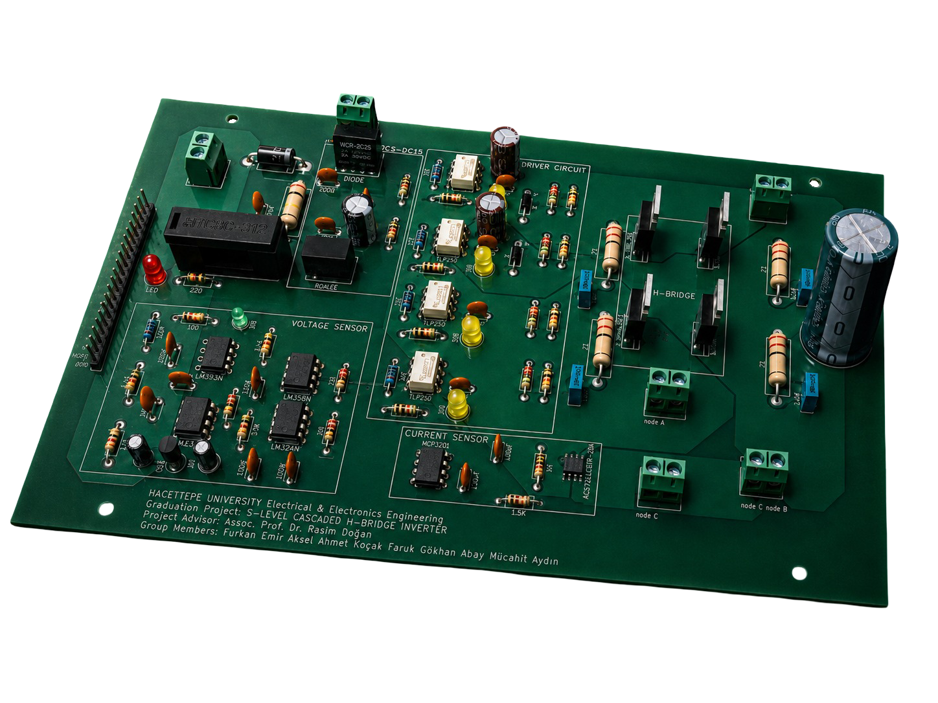
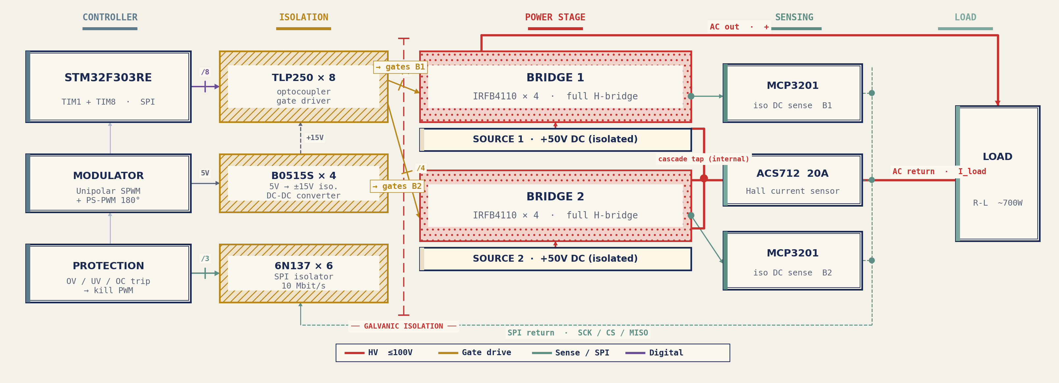
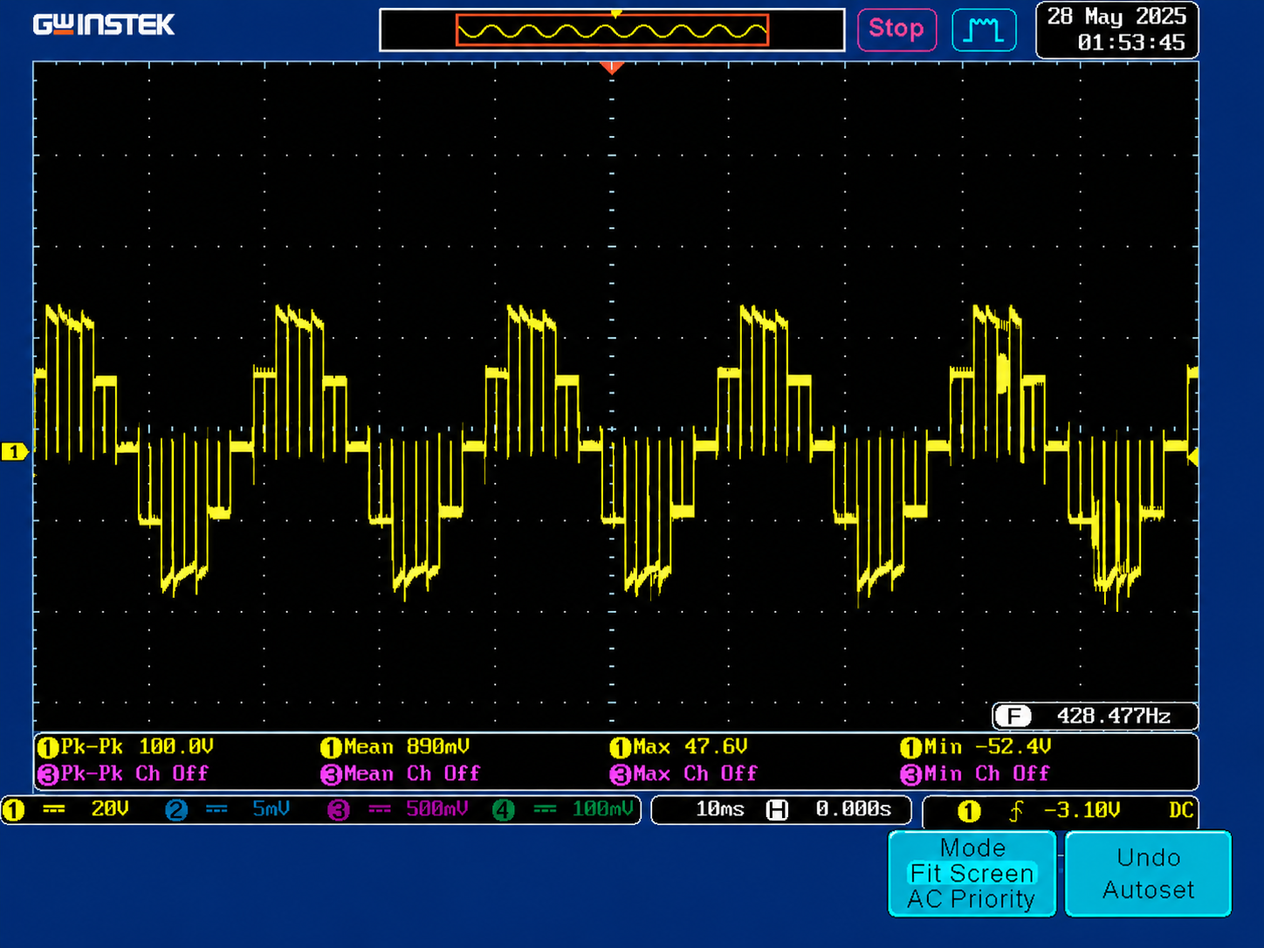
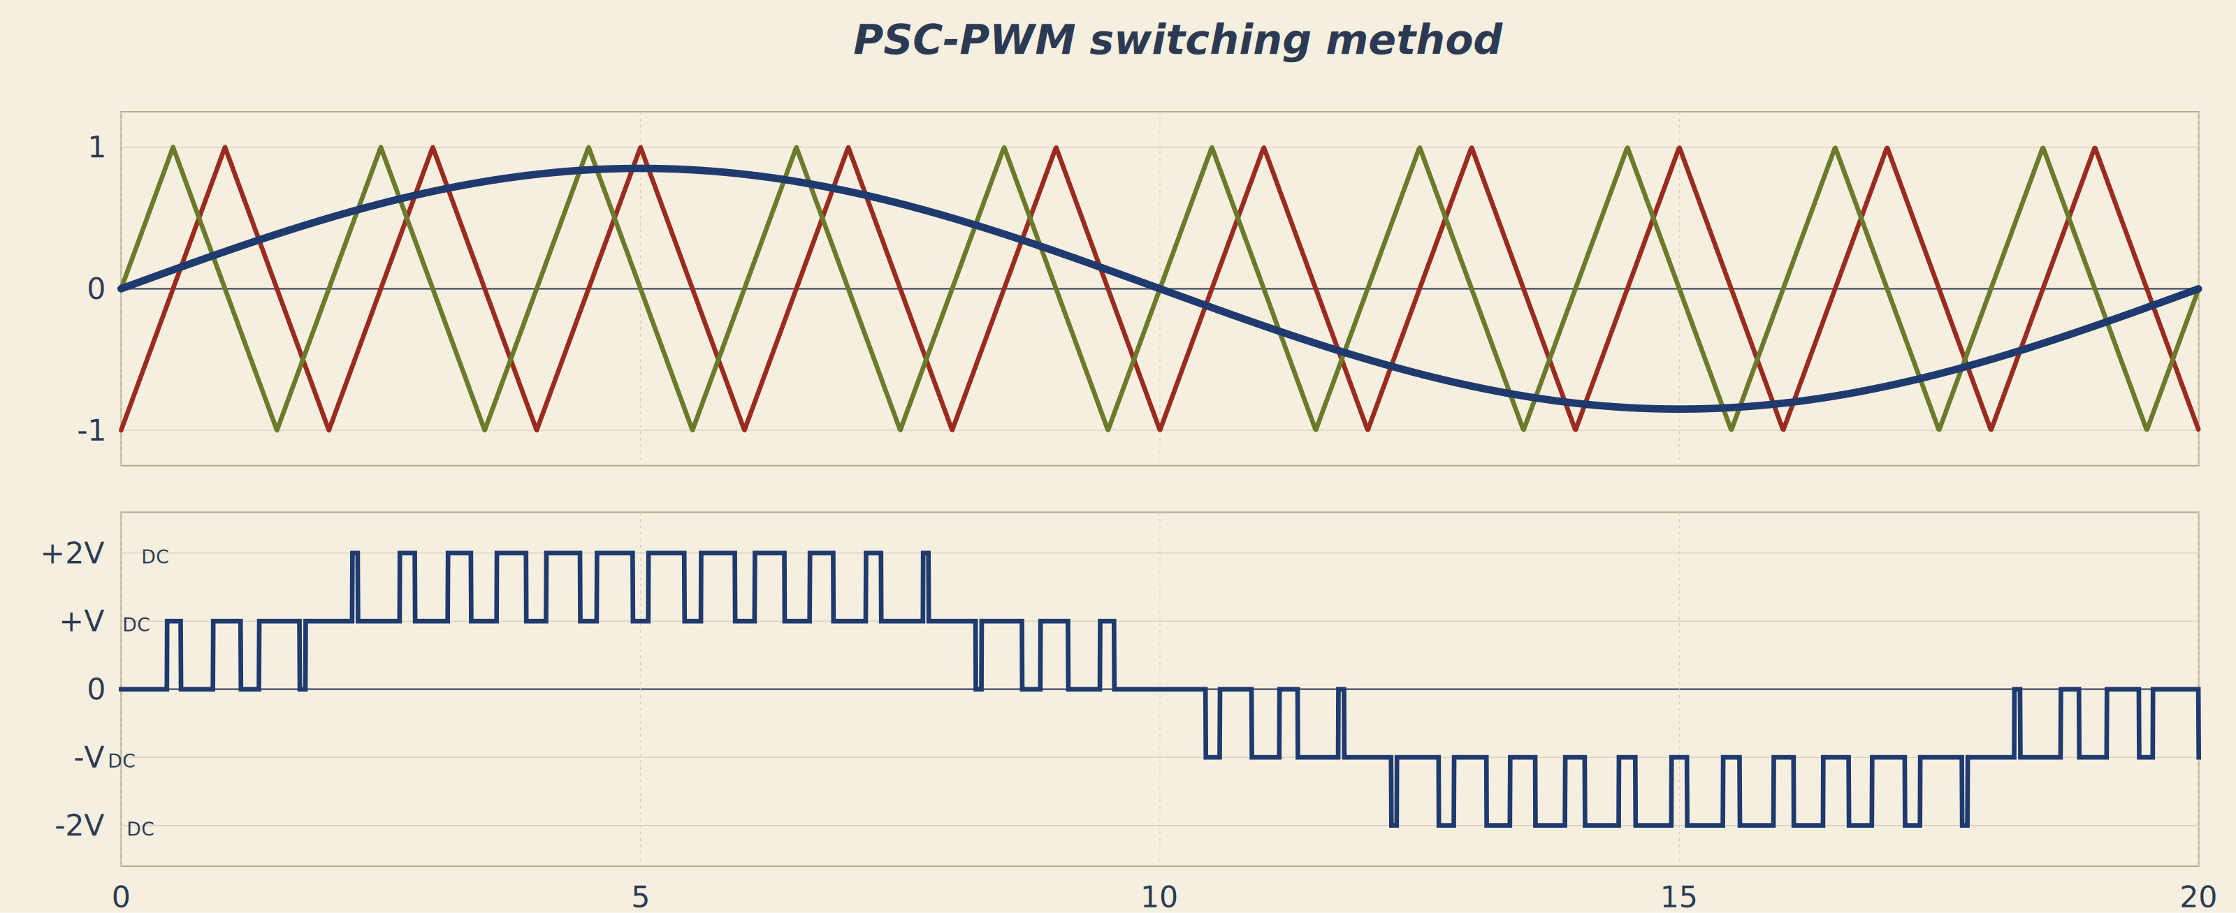
ELE 401 / 402 · GRADUATION PROJECT · 2025–2026
5-LEVEL CASCADED H-BRIDGE
MULTILEVEL INVERTER
with PWM-based control & isolated multi-channel sensing
Furkan Emir AKSEL · Ahmet KOÇAK · Mücahit AYDIN · Faruk Gökhan ABAY
Supervisor: Assoc. Prof. Dr. Rasim DOĞAN
THE HARDWARE
Two cascaded
Single-bridge modules.
V peak AC
MOSFETs
±100
8
% Measured THD
W output
< 5
~700
IMAGE 01 · HARDWARE OVERVIEW
02
IMAGE 02 · TOPOLOGY OVERVIEW
SYSTEM ARCHITECTURE
01
04
06
INTRODUCTION
PROTECTION SYSTEM
RESULTS & DISCUSSION
This project presents a single-phase 5-level Cascaded H-Bridge multilevel inverter designed to deliver roughly 700 W of clean AC. Two cascaded H-bridges, each fed from an independent 50 V isolated DC source, sum their outputs into a stepped sinusoid that approaches ±100 V peak.
Compared to a conventional 2-level inverter, the multilevel topology produces a smoother voltage waveform with substantially lower harmonic distortion. This reduces the size of the output filter, lowers electromagnetic interference and matches the rules naturally with renewable sources.
Fault
Detection
Short circuit
15 A fuse blows
Overcurrent
ACS712 + ADC
Shoot-through
PWM dead-time
Under/overvolt.
Isolated MCP3201
Voltage spike
1.5KE62A TVS
Reverse polarity
1N5408 + fuse
05
MODULATION STRATEGY
The scope captures confirm correct cascading: five distinct levels per fundamental cycle and a clean high-side gate drive across the full duty range. Isolated sensing kept the STM32 safe through every injected fault, and phase-shifted PWM balanced switching events across both bridges.
Future work: closed-loop current control for grid-tie phase locking, scaling to higher bus voltages with additional cascaded modules.
03
POWER STAGE
• Two full H-bridges are connected in series.
• Each bridge uses four IRFB4110 MOSFETs.
• TLP250 optocouplers drive and isolate each gate.
• Bootstrap supply supports high-side switching.
• TVS and snubber reduce switching stress.
• Both bridges use the same sinusoidal reference.
• Bridge 2 carrier is shifted by 90°.
• Switching events are interleaved between bridges.
• The series output produces five voltage levels.
Modular two-board cascade extends naturally to N-level by adding identical bridge modules end-to-end.
REFERENCES [1] IEEE 519-2022 [2] M. H. Rashid, Power Electronics, 4th ed. [3] Infineon IRFB4110 [4] Toshiba TLP250 [5] Microchip MCP3201
ACKNOWLEDGEMENTS Hacettepe University, Faculty of Engineering, Department of Electrical and Electronics Engineering · ELE 401/402 · 2025–2026

