Slide 1
CMSC 330: Organization of Programming Languages
Introduction

Slide 2

Nick Feamster
feamster@cs.umd.edu http://www.cs.umd.edu/~feamster/ http://connectionmanagement.org/
AV Williams, 4th Floor (soon MC2)
Research: Network security and operations
Goal: Improve network, availability in the face of both accidental and malicious faults
Areas
Reliability: fast recovery from failures
Management: fault diagnosis, provisioning
Security and trust: spam filtering, phishing
Anti-censorship: e.g., defeating “the great firewall of China”
Economics: improving efficiency of the Internet’s connectivity markets
Notes:
My name is Nick Feamster. My primary research area is in network operations and security. In a nutshell, this research involves making communications networks easy to manage, troubleshoot, and secure. My group is interested in helping people improve the performance, security, and availability of present and future communications networks. We work on the boundaries with a number of other disciplines (including economics and programming languages) and have interactions with other research labs, government agencies, and companies around the world.
If you want to learn more about my group, please email me, or see my group’s Web site and blog. Today, I’m going to quickly highlight three new areas where I am actively doing research.

Slide 3
Course Goal
Learn how programming languages “work”
Broaden your language horizons
Different programming languages
Different language features and tradeoffs
Study how languages are implemented
What really happens when I write x.f(…)?
Study how languages are described

Slide 4
Other goals
Office Hours for 330
Learn some fundamental CS concepts
Regular expressions
Context free grammars
Automata theory
Compilers & parsing
Parallelism & synchronization
Improve programming skills
Learn how to learn new programming languages
Learn how to program in a new programming style

Slide 5
All Languages Are Equivalent
A language is Turing complete if it can compute any function computable by a Turing Machine
Essentially all general-purpose programming languages are Turing complete
Therefore this course is useless!
Notes:
In other words, any programming task you give me I can solve in any language (even assembly).
But the course is not really useless. Thoughts why? (Some languages might be less convenient for some types of problems.)

Slide 6
Why Study Programming Languages?
Using an appropriate language for a problem may be easier, faster, and less error-prone
To make you better at learning new languages
You may need to add code to a legacy system
E.g., FORTRAN, COBOL,…
You may need to write code in a new language
Your boss says, “From now on, all software will be written in Ada/C++/Java/…”
Notes:
A legacy system is an existing system, probably old, already written, in this case already written in an older langauge.
clarity -> less errors

Slide 7
Why Study Programming Languages?
To make you better at using languages you already know
Many “design patterns” in Java are functional programming techniques
Notes:
You can do object-oriented programming in C using structs and function pointers and use casts. You wouldn’t think of this unless you knew C++ or Java, or another object-oriented language.

Slide 8
Changing Language Goals
1950s-60s – Compile programs to execute efficiently
Language features based on hardware concepts
Integers, reals, goto statements
Programmers cheap; machines expensive
Keep the machine busy

Slide 9
Changing Language Goals
Today
Language features based on design concepts
Encapsulation, records, inheritance, functionality, assertions
Processing power and memory very cheap; programmers expensive
Ease the programming process

Slide 10
Language Attributes to Consider
Syntax
What a program looks like
Semantics
What a program means
Implementation
How a program executes

Slide 11
Imperative Languages
Also called procedural or von Neumann
Building blocks are functions and statements
Programs that write to memory are the norm
int x = 0;
while (x < y) x := x + 1;
FORTRAN (1954)
Pascal (1970)
C (1971)
Notes:
You may not even be able to think of an alternative.
(Note: Java "borrowed" C's syntax.)

Slide 12
Functional Languages
Also called applicative languages
No or few writes to memory
Functions are higher-order
let rec map f = function [] -> []
| x::l -> (f x)::(map f l)
LISP (1958)
ML (1973)
Scheme (1975)
Haskell (1987)
Notes:
"Higher-order"- you can

Slide 13
Logical Languages
Also called rule-based or constraint-based
Program consists of a set of rules
“A :- B” – if B holds, then A holds
append([], L2, L2).
append([X|Xs],Ys,[X|Zs]) :- append(Xs,Ys,Zs).
PROLOG (1970)
Various expert systems

Slide 14
Object-Oriented Languages
Programs are built from objects
Objects combine functions and data
Often have classes and inheritence
“Base” may be either imperative or functional
class C { int x; int getX() {return x;} … }
class D extends C { … }
Smalltalk (1969)
C++ (1986)
Java (1995)
Notes:
What advantages do some people see in object-oriented languages?
Object-oriented languages cut across categories.
They often have base classes and inheritance, but it's not required. You can add object-orientation to an imperative or functional language.

Slide 15
Scripting Languages
Rapid prototyping languages ideal for “little” tasks
Typically with rich text processing abilities
Generally very easy to use
“Base” may be imperative or functional; may be OO
#!/usr/bin/perl
for ($j = 0; $j < 2*$lc; $j++) {
$a = int(rand($lc));
…
sh (1971)
perl (1987)
Python (1991)
Ruby (1993)
Notes:
These are not really a well-defined category- you can have these capabilities in all kinds of languages.
In these languages you don't have to write as much code as e.g., Java.
Python- uses indentation for grouping.
Ruby- an object-oriented scripting language inspired by Smalltalk.

Slide 16
“Other” Languages
There are lots of other languages around with various features
COBOL (1959) – business applications
BASIC (1964) – MS Visual Basic widely used
Logo (1968) – introduction to programming
Forth (1969) – Mac Open Firmware
Ada (1979) – the DoD language
Postscript (1982) – printers
…
Notes:
There will be a link on the class webpage to an O'Reilly poster about the history of programming languages, and if time permits we'll discuss this some at the end of the course.
Forth is a stack-based language.
Expensive laser printers use Postscript.

Slide 17
Languages You Know
So far at UMD, you’ve seen two main languages
Java – object-oriented imperative language
C – imperative language without objects
This course: two new languages
Plus we’ll see snippets of other languages

Slide 18
Ruby
An imperative, object-oriented scripting language
Created in 1993 by Yukihiro Matsumoto
Similar in flavor to many other scripting languages (e.g., perl, python)
Much cleaner than perl
Full object-orientation (even primitives are objects!)
Notes:
Ruby has full object-orientation; it was inspired by Smalltalk in this respect.

Slide 19
A Small Ruby Example
intro.rb:
def greet(s)
print("Hello, ")
print(s)
print("!\n")
end
% irb # you’ll usually use "ruby" instead
irb(main):001:0> require "intro.rb"
=> true
irb(main):002:0> greet("world")
Hello, world!
=> nil

Slide 20
OCaml
A mostly-functional language
Has objects, but won’t discuss (much)
Developed in 1987 at INRIA in France
Dialect of ML (1973)
Natural support for pattern matching
Makes writing certain programs very elegant
Has a really nice module system
Much richer than interfaces in Java or headers in C
Includes type inference
Types checked at compile time, but no annotations
Notes:
OCaml is mostly functional, but you can still write assignments.
INRIA is the French national research lab.
SML NJ is its main competitor.

Slide 21
A Small OCaml Example
intro.ml:
let greet s =
begin
print_string "Hello, ";
print_string s;
print_string "!\n"
end
$ ocaml
Objective Caml version 3.08.3
# #use "intro.ml";;
val greet : string -> unit = <fun>
# greet "world";;
Hello, world!
- : unit = ()
Notes:
You can compile OCaml code, but here just showing how to interpret it.

Slide 22
Attributes of a Good Language
Clarity, simplicity, and unity
Provides both a framework for thinking about algorithms and a means of expressing those algorithms
Orthogonality
Every combination of features is meaningful
Features work independently
What if, instead of working independently, adjusting the volume on your radio also changed the station? You would have to carefully change both simultaneously and it would become difficult to find the right station and keep it at the right volume.

Slide 23
Attributes of a Good Language
Naturalness for the application
Program structure reflects the logical structure of algorithm
Support for abstraction
Program data reflects problem being solved
Ease of program verification
Verifying that program correctly performs its required function

Slide 24
Attributes of a Good Language
Programming environment
External support for the language
Portability of programs
Can develop programs on one computer system and run it on a different computer system
Cost of use
Program execution (run time), program translation, program creation, and program maintenance
Security & safety
Should be very hard to write unsafe program

Slide 25
Executing Languages
Consider a high-level language (i.e., not machine code). There are two main ways which the language can use for executing programs: compilation versus interpretation
Notes:
Some languages can use either efficiently and effectively (for instance, BASIC and OCaml), while for others, the design of the language encourages or even forces one approach over the other.

Slide 26
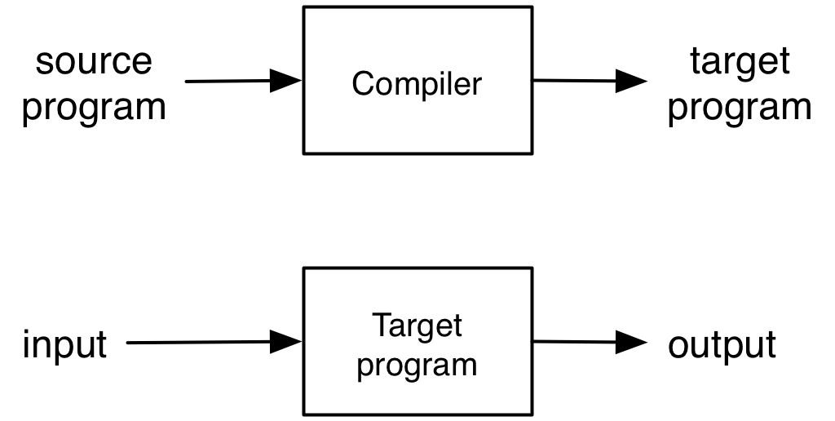
Compilation or Translation
Source program translated to another language
Often machine code, which can be directly executed
Notes:
The target program is object code- machine instructions.

Slide 27
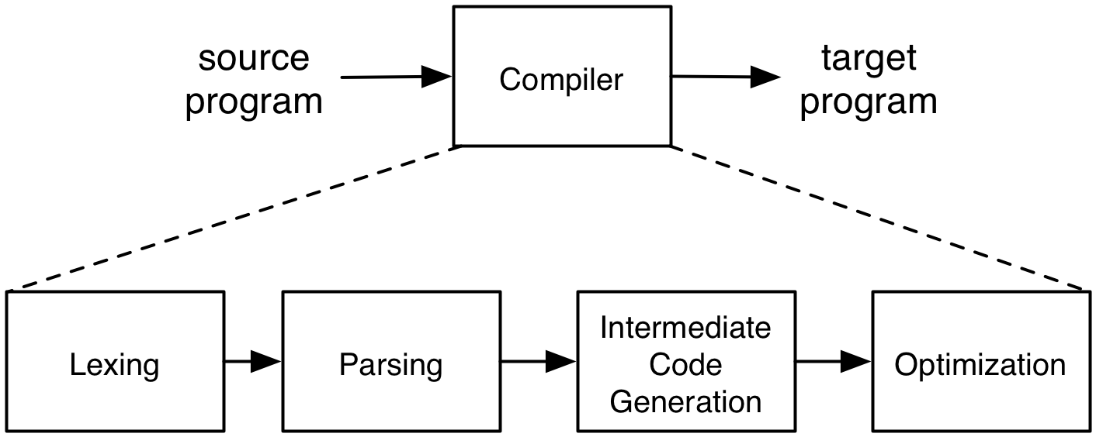
Steps of Compilation
1. Lexical analysis (scanning) – break up source code into tokens such as numbers, identifiers, keywords, and operators

Slide 28
Steps of Compilation
2. Parsing (syntax analysis) – group tokens together into higher-level language constructs (conditionals, assignment statements, functions, …)

Slide 29
Steps of Compilation
3. Intermediate code generation – verify that the source program is valid and translate it into an internal representation
May have more than one intermediate representation

Slide 30
Steps of Compilation
4. Optimization (optional) – improve the efficiency of the generated code
Eliminate dead code, redundant code, etc.
Notes:
The output of the optimizer (and compiler) is the final compiled code.

Slide 31
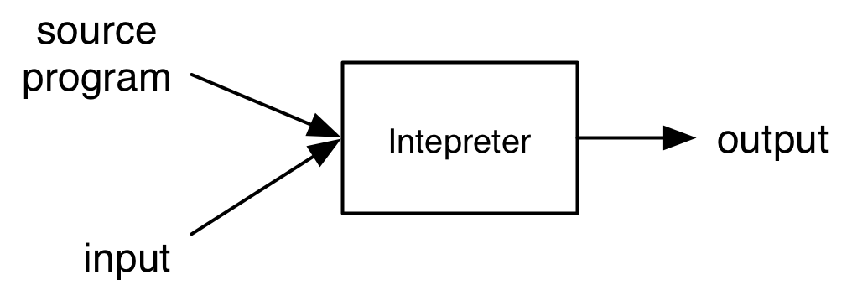
Interpretation
Interpreter executes each instruction in source program one step at a time
No separate executable
Advantages and disadvantages of compilation versus interpretation?
Notes:
Interpretation is becoming more common as processor speeds increase.

Slide 32
Compiler or Intepreter?
gcc
Compiler – C code translated to object code, executed directly on hardware
javac
Compiler – Java source code translated to Java byte code
tcsh/bash
Interpreter – commands executed by shell program
java
Interpreter – Java byte code executed by virtual machine
Notes:
javac- is a compiler but doesn't compile to object code.
java- is an interpreter but its source code is not the user-written program, but rather byte code.

