Slide 1
CMSC 330: Organization of Programming Languages
Ruby
Notes:
1
Ruby is an interpreted language.

Slide 2
Introduction
Ruby is an object-oriented, imperative scripting language
“I wanted a scripting language that was more powerful than Perl, and more object-oriented than Python. That's why I decided to design my own language.”
“I believe people want to express themselves when they program. They don't want to fight with the language. Programming languages must feel natural to programmers. I tried to make people enjoy programming and concentrate on the fun and creative part of programming when they use Ruby.”
– Yukihiro Matsumoto (“Matz”)
2
Notes:
2
What is the meaning of "powerful" and "feel natural"? "Feel natural"- it's appropriate for the task at hand; the code ends up looking like you'd expect.

Slide 3
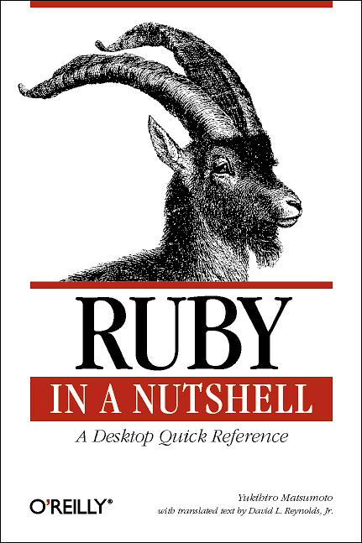
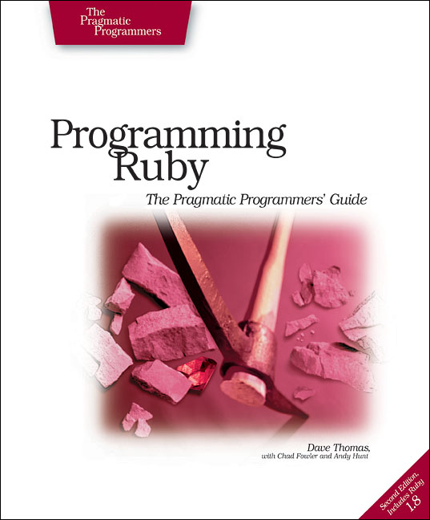
Books on Ruby
Earlier version of Thomas book available on web
See class webpage
3
Notes:
3
The one on the left is out of date a little bit, and is more of a reference when you already know Ruby.

Slide 4

Applications of Scripting Languages
Scripting languages have many uses
automating system administration
automating user tasks
quick-and-dirty development
Major application:
Text processing
4
Notes:
4
Two reasons it's natural:
it evolved from UNIX
LCD (?)
(Can't remember what the above was supposed to mean…)

Slide 5
Output from Command-Line Tool
% wc *
271 674 5323 AST.c
100 392 3219 AST.h
117 1459 238788 AST.o
1874 5428 47461 AST_defs.c
1375 6307 53667 AST_defs.h
371 884 9483 AST_parent.c
810 2328 24589 AST_print.c
640 3070 33530 AST_types.h
285 846 7081 AST_utils.c
59 274 2154 AST_utils.h
50 400 28756 AST_utils.o
866 2757 25873 Makefile
270 725 5578 Makefile.am
866 2743 27320 Makefile.in
38 175 1154 alloca.c
2035 4516 47721 aloctypes.c
86 350 3286 aloctypes.h
104 1051 66848 aloctypes.o
...
5
Notes:
5

Slide 6
Climate Data for IAD in August, 2005
================================================================================
1 2 3 4 5 6A 6B 7 8 9 10 11 12 13 14 15 16 17 18
AVG MX 2MIN
DY MAX MIN AVG DEP HDD CDD WTR SNW DPTH SPD SPD DIR MIN PSBL S-S WX SPD DR
================================================================================
1 87 66 77 1 0 12 0.00 0.0 0 2.5 9 200 M M 7 18 12 210
2 92 67 80 4 0 15 0.00 0.0 0 3.5 10 10 M M 3 18 17 320
3 93 69 81 5 0 16 0.00 0.0 0 4.1 13 360 M M 2 18 17 360
4 95 69 82 6 0 17 0.00 0.0 0 3.6 9 310 M M 3 18 12 290
5 94 73 84 8 0 19 0.00 0.0 0 5.9 18 10 M M 3 18 25 360
6 89 70 80 4 0 15 0.02 0.0 0 5.3 20 200 M M 6 138 23 210
7 89 69 79 3 0 14 0.00 0.0 0 3.6 14 200 M M 7 1 16 210
8 86 70 78 3 0 13 0.74 0.0 0 4.4 17 150 M M 10 18 23 150
9 76 70 73 -2 0 8 0.19 0.0 0 4.1 9 90 M M 9 18 13 90
10 87 71 79 4 0 14 0.00 0.0 0 2.3 8 260 M M 8 1 10 210
...
6
Notes:
6
From the National Weather Service website. Either a person or a script can read this.

Slide 7
Raw Census 2000 Data for DC
u108_S,DC,000,01,0000001,572059,72264,572059,12.6,572059,572059,572059,0,0,0,0,572059,175306,343213,2006,14762,383,21728,14661,572059,527044,158617,340061,1560,14605,291,1638,10272,45015,16689,3152,446,157,92,20090,4389,572059,268827,3362,3048,3170,3241,3504,3286,3270,3475,3939,3647,3525,3044,2928,2913,2769,2752,2933,2703,4056,5501,5217,4969,13555,24995,24216,23726,20721,18802,16523,12318,4345,5810,3423,4690,7105,5739,3260,2347,303232,3329,3057,2935,3429,3326,3456,3257,3754,3192,3523,3336,3276,2989,2838,2824,2624,2807,2871,4941,6588,5625,5563,17177,27475,24377,22818,21319,20851,19117,15260,5066,6708,4257,6117,10741,9427,6807,6175,572059,536373,370675,115963,55603,60360,57949,129440,122518,3754,3168,22448,9967,4638,14110,16160,165698,61049,47694,13355,71578,60875,10703,33071,35686,7573,28113,248590,108569,47694,60875,140021,115963,58050,21654,36396,57913,10355,4065,6290,47558,25229,22329,24058,13355,10703,70088,65737,37112,21742,12267,9475,9723,2573,2314,760,28625,8207,7469,738,19185,18172,1013,1233,4351,3610,741,248590,199456,94221,46274,21443,24831,47947,8705,3979,4726,39242,25175,14067,105235,82928,22307,49134,21742,11776,211,11565,9966,1650,86,1564,8316,54,8262,27392,25641,1751,248590,115963,4999,22466,26165,24062,16529,12409,7594,1739,132627,11670,32445,23225,21661,16234,12795,10563,4034,248590,115963,48738,28914,19259,10312,4748,3992,132627,108569,19284,2713,1209,509,218,125
...
7
Notes:
7
Can a person really effectively read input like this?

Slide 8
A Simple Example
Let’s start with a simple Ruby program
ruby1.rb:
# This is a ruby program
x = 37
y = x + 5
print(y)
print("\n")
% ruby -w ruby1.rb
42
%
8
Notes:
8
What do you see which is different compared to C or Java?

Slide 9
Language Basics
comments begin with #, go to end of line
# This is a ruby program
x = 37
y = x + 5
print(y)
print("\n")
variables need not
be declared
line break separates
expressions
(can also use “;”
If you want)
no special main()
function or
method
9
Notes:
9
Note you didn't need to include any libraries to use "print".

Slide 10
Run Ruby, Run
There are three ways to run a Ruby program
ruby -w filename – execute script in filename
tip: the -w will cause Ruby to print a bit more if something bad happens
irb – launch interactive Ruby shell
can type in Ruby programs one line at a time, and watch as each line is executed
irb(main):001:0> 3+4
=> 7
irb(main):002:0> print("hello\n")
hello
=> nil
10
Notes:
10
Make sure the students remember from the previous course what a shell is and does.
irb does the same thing the interpreter does, except the interpreter doesn't do any intermediate printing and doesn't read from the console (its input is not read from the console, but from the user program). irb is very good to use for testing and experimenting with things in Ruby, just to see how they work.

Slide 11
Run Ruby, Run (cont’d)
Suppose you want to run a Ruby script as if it were an executable
./filename # run program
the first line (“shebang”) tells the system where to find the program to interpret this text file
must chmod u+x filename first
or chmod a+x filename so everyone has exec permission
warning: not very portable
depends on location /usr/local/bin/ruby
#!/usr/local/bin/ruby -w
print("Hello, world!\n")
11
Notes:
11
Remind students of common UNIX locations for executables, from the previous course; this is where Ruby is on the Grace systems, but may not be on all systems.
The #! notation is not just for Ruby; it works for any UNIX program that's an interpreter.
Note that the "./" is not required if you have the current directory on your path (as is the case on the Grace machines), but is a good idea (can explain why if desired).

Slide 12
Explicit vs. Implicit Declarations
Java and C/C++ use explicit variable declarations
variables are named and typed before they are used
int x, y; x = 37; y = x + 5;
In Ruby, variables are implicitly declared
first use of a variable declares it and determines type
x = 37; y = x + 5;
x, y exist, will be integers
12
Notes:
12
Maybe show the students the use of an undefined variable, both on the left and the right of an assignment using irb, and what happens in each case.

Slide 13
Tradeoffs?
Explicit declarations | Implicit declarations
higher overhead | lower overhead
helps prevent typos | easy to mistype variable name
forces programmer to document types | figures out types of variables automatically
13
Notes:
13
"Higher overhead" and "lower overhead" mean higher or lower for you, the programmer.
Explicit declarations- involve redundancy. A mistake in one place or the other is more likely to be caught.
Implicit declarations- require less typing but it's more likely that a mistake won't be caught.

Slide 14
Methods in Ruby
Methods are declared with def...end
List parameters
at definition
def sayN(message, n)
i = 0
while i < n
puts message
i = i + 1
end
return i
end
x = sayN("hello", 3)
puts(x)
May omit parens
on call
Invoke method
(Methods must begin with a lowercase letter, and be defined before they
can be called, if being called in the same scope which they're defined in.)
14
Notes:
14
Ruby uses call-by-value, but for object references (like Java, references are passed by value). So there's no way to write a swap function swap(x, y) that will exchange the values of two objects.
Note that you list the names of parameters, but not their types.
What's the scope of i? Try printing it afterwards. (It has local scope.)
Note there is no main function.
puts can print integers and strings; it will convert integers to strings.
The loop ends with the "end".
The output is:
hello
hello
hello
3

Slide 15
Method (and Function) Terminology
Formal parameters – the parameters used in the body of the method
message, n in our example
Actual parameters – the arguments passed in to the method at a call
"hello", 3 in our example
15
Notes:
15
In introductory programming courses and texts the terms that are usually used are "parameter" and "argument", but in the programming language field, these terms are usually used instead.

Slide 16
More Control Statements in Ruby
A control statement is one that affects which statement is executed next
we’ve seen two so far in Ruby
while and function call
Example using Ruby conditionals:
if grade >= 90 then
puts "You got an A"
elsif grade >= 80 then
puts "You got a B"
elsif grade >= 70 then
puts "You got a C"
else
puts "You’re not doing so well"
end
16
Notes:
16
Parentheses aren't needed around the guard, but will it work if you use them? Yes- try it in irb.
The difference between "else if" and elsif? "else if" requires two end's- elsif is one construct.
All of Ruby's control statements end with "end".

Slide 17
What is True?
The guard of a conditional is the expression that determines which branch is taken
The true branch is taken if the guard evaluates to anything except
false
nil
Warning to C programmers: 0 is not false!
if grade >= 90 then
...
guard
17
Notes:
17
nil is like null in Java.
The guard can optionally be parenthesized, but it's not required like it is in Java, C, and other languages whose basic syntax is derived from C's.

Slide 18
Yet More Control Statements in Ruby
unless cond then stmt-f else stmt-t end
same as “if not cond then stmt-t else stmt-f end”
until cond body end
same as “while not cond body end”
unless grade < 90 then
puts "You got an A"
else unless grade < 80 then
puts "You got a B"
end
end
until i >= n
puts message
i = i + 1
end
18
Notes:
18

Slide 19
Using If and Unless as Modifiers
Can write if and unless after an expression
puts "You got an A" if grade >= 90
puts "You got an A" unless grade < 90
Why so many control statements?
Is this a good idea?
Advantages? Disadvantages?
19
Notes:
19
You can put an entire if..end on one line, but if you do you need a semicolon after the condition.

Slide 20
Other Useful Control Statements
for elt in [1, “math”, 3.4]
puts elt.to_s
end
while i>n
break
next
puts message
redo
end
generates a string (cf. to_i)
for i in (1..3)
puts i
end
IO.foreach(filename) {
|x|
puts x
}
case x
when 1, 3..5
when 2, 6..8
end
(1..3).each {
|elt|
puts elt
}
code block
does not need 'break'
Notes:
We'll explain what code blocks are soon; for now don't worry about it.

Slide 21
Using Ruby Control Statements
Ruby function to print all even numbers from 1 to some given value x
def even(x)
for i in (1..x)
if i % 2 == 0
puts i
end
end
end
def even(x)
(1..x).each{
|i|
if i % 2 == 0
puts i
end
}
end

Slide 22
Classes and Objects
Class names begin with an uppercase letter
The "new" method creates an object
s= String.new creates a new String and makes s refer to it
Every class inherits from Object
22

Slide 23
Everything is an Object
In Ruby, everything is in fact an object
(-4).abs
integers are instances of Fixnum
3 + 4
infix notation for “invoke the + method of 3 on argument 4”
"programming".length
strings are instances of String
(4.13).class
use the class method to get the class for an object
floating point numbers are instances of Float
String.new
classes are objects with a new method
23
Notes:
23
Some students may not know what infix means.
Ruby follows the Smalltalk model in that everything is an object- everything is uniform underneath.
Is this the case in C++ or Java? No- both have primitives.
Is a class itself an object in Java (that exists while a program is running)? No.
Maybe show some of these in irb during class.

Slide 24
Objects and Classes
Objects are items of data
Classes are types (the kind of data that things are)
But in Ruby, classes themselves are objects!
Fixnum, Float, String, etc., (including Class), are objects of type Class
Object | Class
10 | Fixnum
-3.30 | Float
"CMSC 330" | String
String.new | String
Fixnum | Class
String | Class
24
Notes:
24
String.new is a method invocation (on an object) in Ruby, but not in C++ or Java.
In Java, classes aren't objects, and don't have a new method (in other words, in Ruby there's a Class class, with a "new" method). Each class is an instance of Class.

Slide 25
Two Cool Things to Do with Classes
Since classes are objects, you can manipulate them however you like
if p then x = String else x = Time end # Time is
… # another class
y = x.new # creates a String or a Time,
# depending upon p
You can get names of all the methods of a class
Object.methods
=> ["send", "name", "class_eval", "object_id", "new", "autoload?", "singleton_methods", ... ]
25
Notes:
25
Because classes are objects you can manipulate them in ways you can't in other languages. x is a variable storing a Class type.
y will have a type, but what its type is will not be known until the program is running, the code is executed, and the new object comes into existence.
The Ruby API is online, on the class webpage and in the Ruby pickaxe book.

Slide 26
The nil Object
Ruby uses a special object nil
all uninitialized fields set to nil (@ refers to a class field)
irb(main):004:0> @x
=> nil
like NULL or 0 in C/C++ and null in Java
nil is an object of class NilClass
it’s a singleton object – there is only one instance of it
NilClass does not have a new method
nil has some methods (like to_s, which returns a string representation of an object) but not other methods that don’t make sense
irb(main):006:0> @x + 2
NoMethodError: undefined method `+' for nil:NilClass
26
Notes:
26
I used nil once before earlier, but I didn't explain it.
Everything in Ruby is an object, even nil.
Doing something like "@x + 2" in Java would give a NullPointerException, but you would never get this in Ruby-
you'll never get null fields or null pointer errors.
Ruby has no casting- we'll see why that is.
true and false are also class objects, of types TrueClass and FalseClass respectively.

Slide 27
What is a Program?
In C/C++, a program is...
a collection of declarations and definitions
with a distinguished function definition
int main(int argc, char *argv[]) { ... }
when you run a C/C++ program, it’s like the OS calls main(...)
In Java, a program is...
a collection of class definitions
with a class Cl that contains a method
public static void main(String[] args)
when you run java Cl, the main method of class Cl is invoked
27
Notes:
27

Slide 28
A Ruby Program is...
The class Object
when the class is loaded, any expressions not in method bodies are executed
def sayN(message, n)
i = 0
while i < n
puts message
i = i + 1
end
return i
end
x = sayN("hello", 3)
puts(x)
defines a method of Object
invokes self.sayN
invokes self.puts
(part of Object)
28
Notes:
28
In Ruby a program is a declaration of exactly one class, called Object.
This code is adding stuff to the Object clss- method definitions and expressions.
"self" refers to the current object ("this" in C++ or Java).
sayN must appear before code in the same scope calling it.
If you print Object.methods after writing methods you see them added to the Object class. In fact, you'd see them added to String and other classes, since all classes inherit from Object. Maybe show this in irb, by adding a method and trying Object.methods or String.methods.

Slide 29
Ruby is Dynamically Typed
Recall we don’t declare types of variables
but Ruby does keep track of types at runtime
x = 3; x.f
NoMethodError: undefined method 'f' for 3:Fixnum
We say that Ruby is dynamically typed
types are determined and checked at run time
Compare to C, which is statically typed
# Ruby
x = 3
x = "f" # gives x a
# new type
/* C */
int x;
x = 3;
x = "f"; /* not allowed */
29
Notes:
29
Dynamic refers to anything which happens during execution. Static refers to anything which happens at compilation. The issue of what happens during compilation vs. runtime is very important in programming languages, and the choices made as to what happens at which times in different languages greatly affects their behavior and capabilities.
You can't do this in C (it won't even compile).
Not only are types determined and checked at runtime, but Ruby allows something's type to be changed at runtime, by assigning something of a different type to it.
(Add a slide before this specifically defining static and dynamic??? Static- anything which occurs at compilation or translation time;
Dynamic- anything which occurs during execution.)

Slide 30
Types in Java and C++
Is Java statically or dynamically typed?
a little of both
many things are checked statically
Object x = new Object();
x.println(“hello”); // No such method error at compile time
but other things are checked dynamically
Object o = new Object();
String s = (String) o; // No compiler warning, fails at run time
// (Some Java compilers may be smart enough to warn about above cast)
30
Notes:
30
In Java, method calls are checked statically, casting dynamically.
In Ruby this fails at the last possible time.
(This is not a great example; come up with a better one?)

Slide 31
Tradeoffs?
Static types | Dynamic types
more work to do when writing code | less work when writing code
helps prevent some subtle errors | can use objects incorrectly and not realize until execution
fewer programs type check | more programs type check
31
Notes:
31
In C, since types are checked statically, you know no possible execution can cause a type error.
Make sure students realize what "type check" means.

