Slide 1
CMSC 330: Organization of Programming Languages
Finite Automata

Slide 2
Implementing Regular Expressions
We can implement regular expressions by turning them into a finite automaton
a “machine” for recognizing a language
Notes:
An r.e. is like a machine that says "yes" or "no" to an input string, as is a finite automaton.

Slide 3
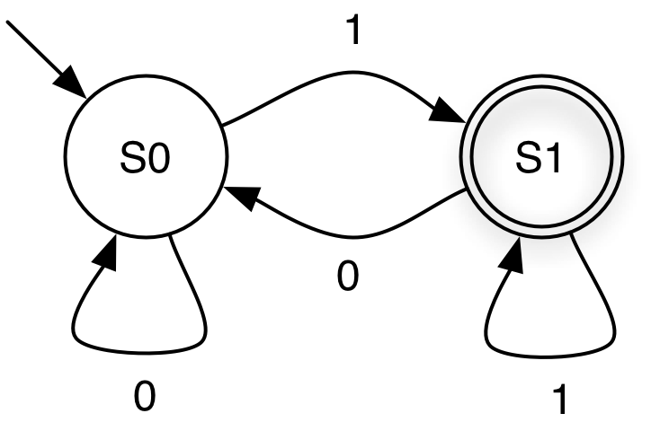
Example
Transition on 1
Start state
Final state
States
Machine starts in start or initial state as current state
Repeat until the end of the string is reached:
scan the next symbol s of the string
take transition edge from the current state labeled with s
The string is accepted if the automaton is in a final or accepting state when the end of the string is reached
Notes:
First we'll see an example intuitively, then some examples, and then a formal definition.
"Symbol" just means "character" for now.

Slide 4
Finite Automata: States
Start state
A state that has an incoming transition from no other state
Can have only 1 start state
Final state
State with double circle
Can have 0 or more final states
S1
S2

Slide 5
Example
0 0 1 0 1 1
accepted

Slide 6
Example
0 0 1 0 1 0
not accepted

Slide 7
What Language is This?
All strings over {0, 1} that end in 1
What is a regular expression for this language?
(0|1)*1

Slide 8
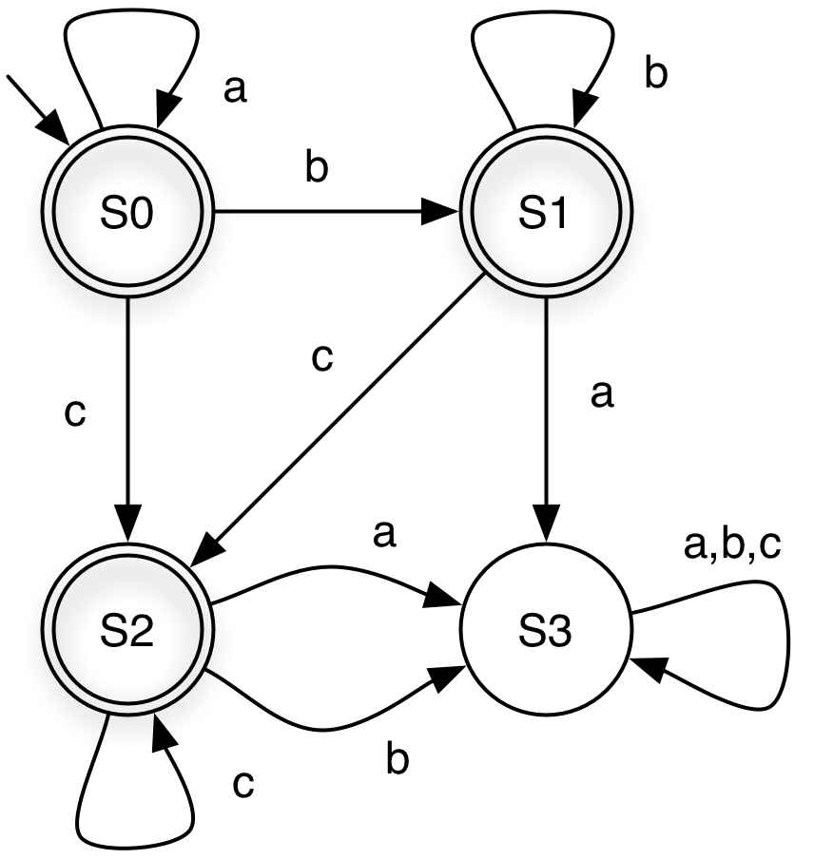
Another Example
string
state at end
accepts?
aabcc
S2
Y
acc
S2
Y
bbc
S2
Y
aabbb
S1
Y
aa
S0
Y
ε
S0
Y
acba
S3
N
(a,b,c notation shorthand for three self loops)
Notes:
Personally I don't like this shorthand notation (but it's too hard to draw the diagrams without it), so don't use it.

Slide 9
Another Example (cont’d)
What language does this
DFA accept?
a*b*c*
S3 is a dead state – a
nonfinal state with no
transition to another
state
Notes:
On the board, write a DFA and an r.e. (or get the students say how to do it) for two simple examples:
Strings with odd 1's over the alphabet {1}. 1(11)* (the DFA has two states, one is final, each goes to the other on a 1).
Strings with odd 1's over the alphabet {0, 1}. 0*10*(10*10*)* (the DFA is the same except each state has a self-transition on 0). Or 0*(10*10*)*10*. Or (0*10*10*) 0*10*.
For some languages an r.e. and a DFA might be of comparable complexity and difficulty, but for others one or the other might be much easier or harder to come up with or to understand.

Slide 10
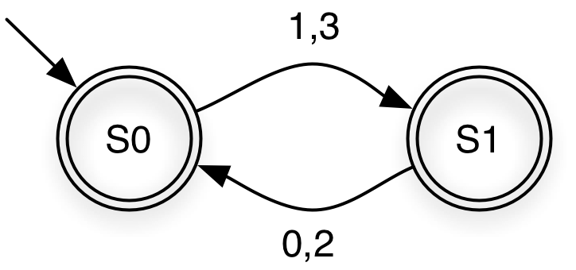
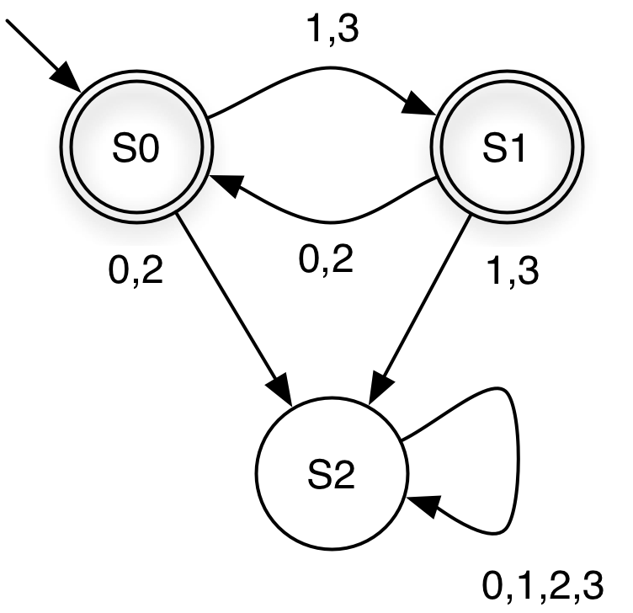
Shorthand Notation
If a transition is omitted, assume it goes to a dead state that is not shown
is short for
Language?
Strings over {0,1,2,3} with alternating even and odd digits, beginning with odd digit
Notes:
You should understand this notation because you'll sometimes see it used, but I don't like it so you should not use it.
Exercise: try writing an r.e. which describes the same language as this NFA.

Slide 11
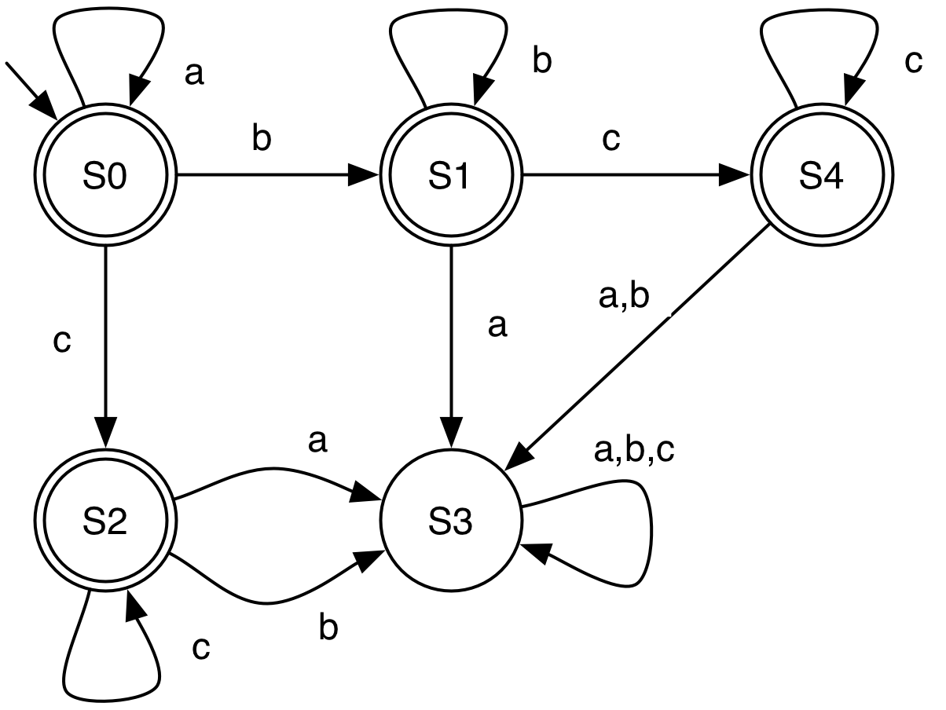
What Language Does This DFA Accept?
a*b*c* again, so DFAs are not unique

Slide 12
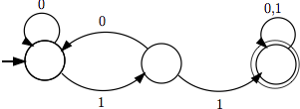
Practice
Give the English descriptions and the DFA or regular expression of the following languages:
((0|1)(0|1)(0|1)(0|1)(0|1))*
All strings of binary digits with length a multiple of 5
(01)*|(10)*|(01)*0|(10)*1
All alternating binary digit strings
All binary strings containing the substring “11”

Slide 13
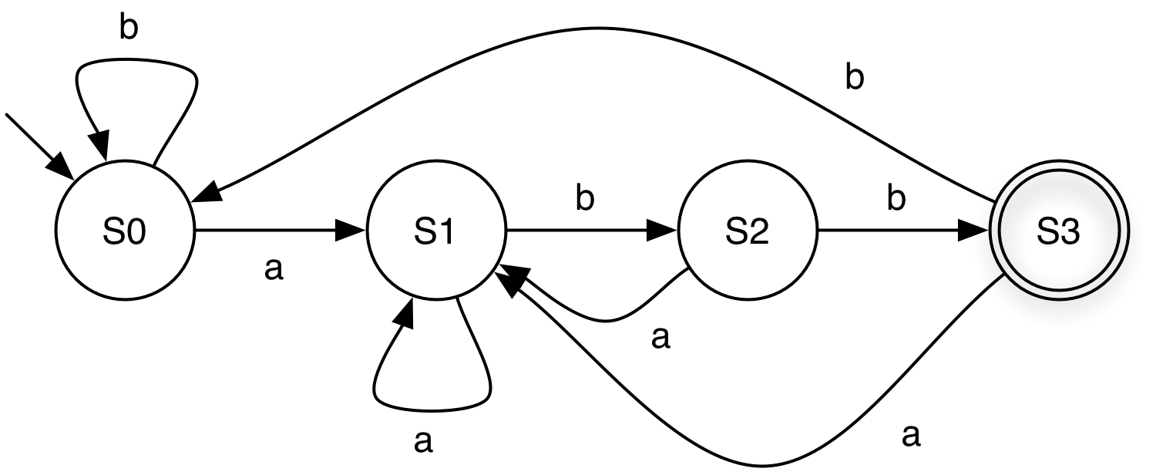
Example DFA
Language?
S0 = “Haven’t seen anything yet” OR “Seen zero or more b’s” OR “Last three symbols seen were abbb”
S1 = “Last symbol seen was an a”
S2 = “Last two symbols seen were ab”
S3 = “Last three symbols seen were abb”
(a|b)*abb
Notes:
S0 = “Haven’t seen anything yet” OR “seen zero or more b’s” OR “Last symbol seen was a b”

Slide 14
Formal Definition
A deterministic finite automaton (DFA) is a 5-tuple (Σ, Q, q₀, F, δ) where
Σ is an alphabet
the strings recognized by the DFA are over this set
Q is a nonempty set of states
q₀ ∊ ∈ Q is the start state
F ⊆ Q is the set of final states
how many can there be?
δ : Q x Σ → Q specifies the DFA's transitions
what's this definition saying that δ is?
Notes:
There may be 0, 1, or many final states.
What is δ? It's a function, mapping pairs (the cross product) of states and alphabet symbols, to (new) states.
It must be a total function (not sure if that was defined in CMSC 250 or not).
What about the definition of DFAs implies that the second diagram, in the example showing the shorthand notation of omitting the dead state, is what the DFA actually must look like, and the first one is just a shorthand representation for it? δ is a function, and by the definition of functions in CMSC 250 said that every element of the domain must map to some element of the codomain (sometimes we define partial functions which don't have this property, but by default "function" implies this property). Therefore every element of the domain of the transition function (every pair of state and alphabet symbols) must map to some element of the codomain (some new state, where the transition goes to).
So a complete DFA always has one outgoing transition from every state on every alphabet symbol, otherwise it's not a valid DFA

Slide 15
Our First Example, Formally
Σ = {0, 1}
Q = {S0, S1}
q₀ = S0
F = {S1}
δ | 0 | 1
S0 | S0 | S1
S1 | S0 | S1

Slide 16
DFA Requirements
Can't have more than one transition leaving a state on the same symbol
I.e., the transition function must be a valid function
Can't have transitions with empty labels
Each transition must be labeled by a single alphabet symbol
a
a

Slide 17
Nondeterministic Finite Automata (NFA)
An NFA is a 5-tuple (Σ, Q, q₀, F, δ) where
Σ is an alphabet
Q is a nonempty set of states
q₀ ∈ Q is the start state
F ⊆ Q is the set of final states
δ ⊆ Q x (Σ ∪ {ε}) x Q specifies the NFA's transitions
An NFA accepts a string s if there is at least one path from its start to final state on s
Notes:
ε is the empty string.
For an NFA, δ differs from a DFA in that:
transitions on ε are allowed – can optionally take these transitions without consuming any input (the middle component of any triple can be ε)
can have more than one transition for a given state and symbol (because any number of triples with the same first two components, but different third component, can be elements of δ)
What is this saying δ is for an NFA, and how does it differ from δ for a DFA? See if students realize. (Discuss the specification of δ). For an NFA δ is a relation (why)?

Slide 18
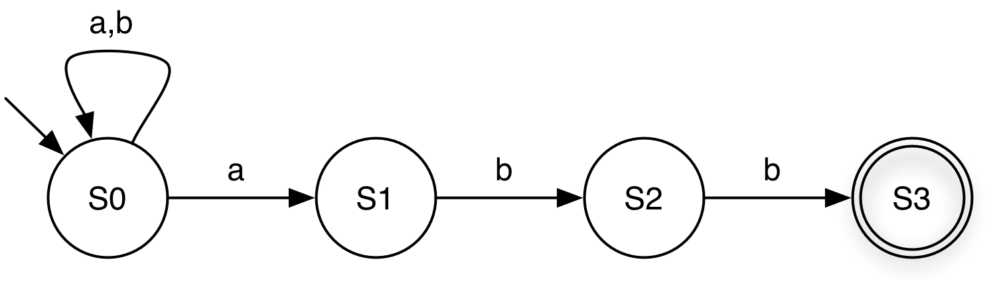
NFA for (a|b)*abb
ba
Has paths to either S0 or S1
neither is final, so rejected
babaabb
Has paths to different states
one leads to S3, so accepted

Slide 19
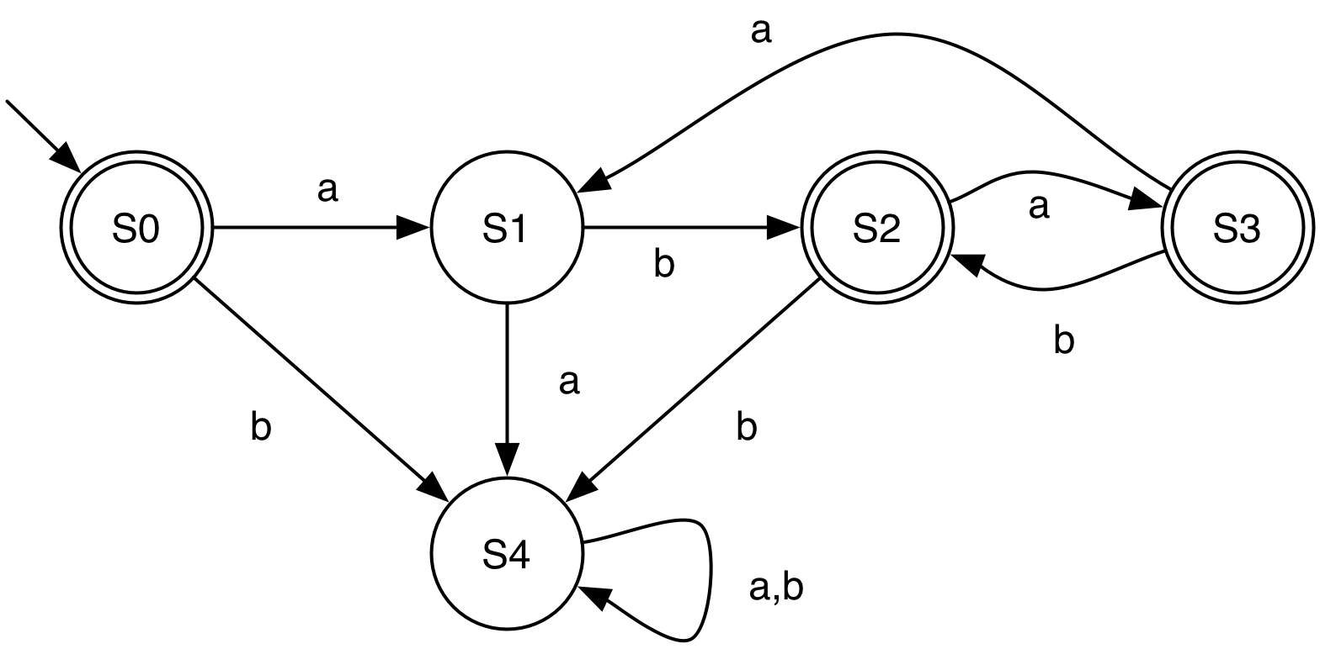
Another example DFA
Language?
(ab|aba)*

Slide 20
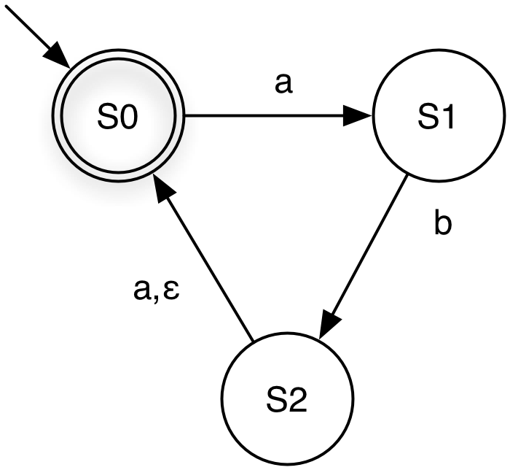
NFA for (ab|aba)*
aba
has paths to states S0, S1
ababa
has paths to S0, S1
need to use ε-transition
Notes:
NFAs must be more powerful than DFAs, right? No, NFAs, DFAs, and regular expressions can all recognize or accept the same class of languages, the regular languages.

Slide 21
Relating R.E.'s to DFAs and NFAs
Regular expressions, NFAs, and DFAs accept the same languages!
can
transform
DFA
NFA
can
transform
can
transform
r.e.
(we’ll discuss this next)
Notes:
We'll briefly discuss that it's easy to write a program to simulate a DFA, but hard to computationally implement an NFA or an r.e.

