Slide 1
CMSC 330: Organization of Programming Languages
Finite Automata, con't.

Slide 2
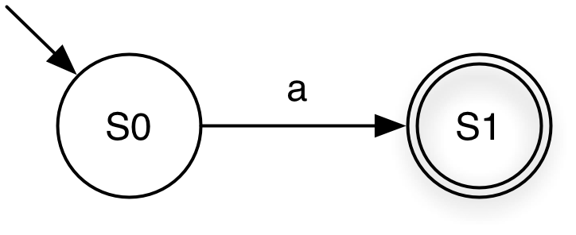
Reducing Regular Expressions to NFAs
Goal: Given regular expression e, construct NFA <e> = (Σ, Q, q₀, F, δ) that accepts the same language
invariant: |F| = 1 in our NFAs
Base case: a
<a> = ({a}, {S0, S1}, S0, {S1}, {(S0, a, S1)} )
Notes:
An automaton has an "algorithm" to simulate it- trace it through on a string, seeing if we end up at a final state. Intuitively you can probably see that it would be possible to code up a simulation of an automaton, while it's difficult to see how you'd simulate the action of an r.e. directly.
This is one reason we wanted to have a formal definition of regular expressions (review the 6 cases here that all r.e.'s can be expressed in terms of)- we want to be able to express this construction in a minimal number of cases. Even if we want to implement a Ruby r.e. we can first transform all of its extensions to these basic components, then do the transformation.
The invariant is just to make the cases easier to implement. If we had an NFA with n final states, how could we transform it to one with just one final state?

Slide 3
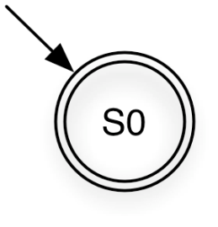
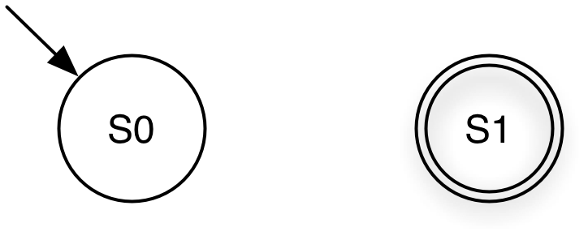
Reduction (cont’d)
Base case: ε
<ε> = ({ε}, {S0}, S0, {S0}, ∅)
Base case: ∅
<∅> = (∅, {S0, S1}, S0, {S1}, ∅)
Notes:
In both these cases the resulting NFA has no transitions. The second one needs to have a final state anyway, to preserve the invariant.
For the first one we could also have an NFA with a start state and an epsilon transition to a final state. NFAs aren't unique, so there's more than one way to write an NFA equivalent to the r.e. ε.

Slide 4
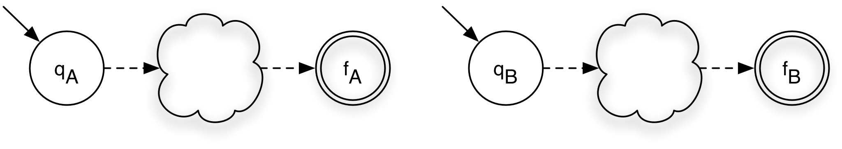
Reduction (cont’d)
Induction: AB
<A>
<B>

Slide 5
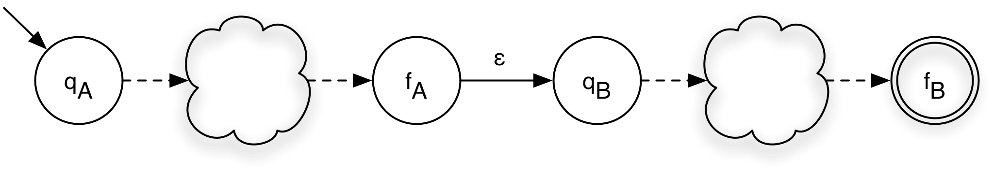
Reduction (cont’d)
Induction: AB
<A> = (Σ_{A}, Q_{A}, q_{A}, {f_{A}}, δ_{A})
<B> = (Σ_{B}, Q_{B}, q_{B}, {f_{B}}, δ_{B})
<AB> = (Σ_{A} ∪ Σ_{B}, Q_{A}∪ Q_{B}, q_{A}, {f_{B}}, δ_{A} ∪ δ_{B} ∪ {(f_{A}, ε, q_{B})})
<A>
<B>

Slide 6
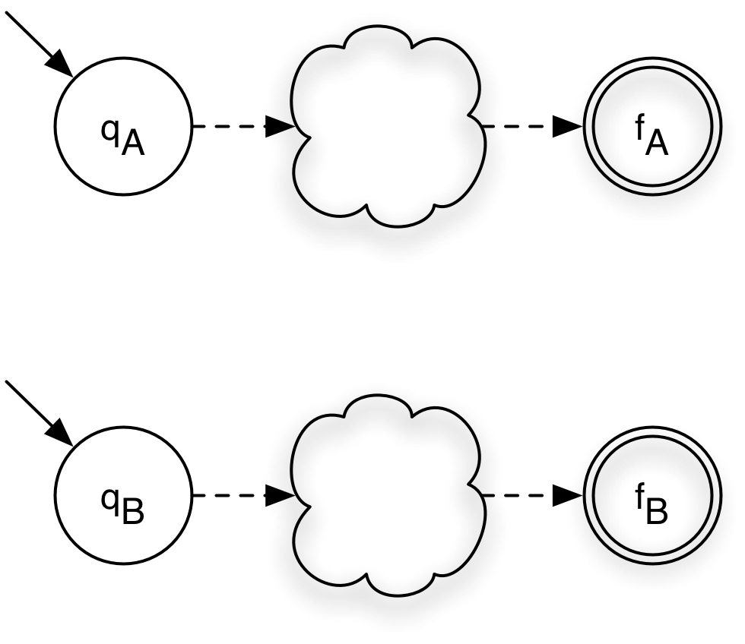
Reduction (cont’d)
Induction: (A|B)

Slide 7
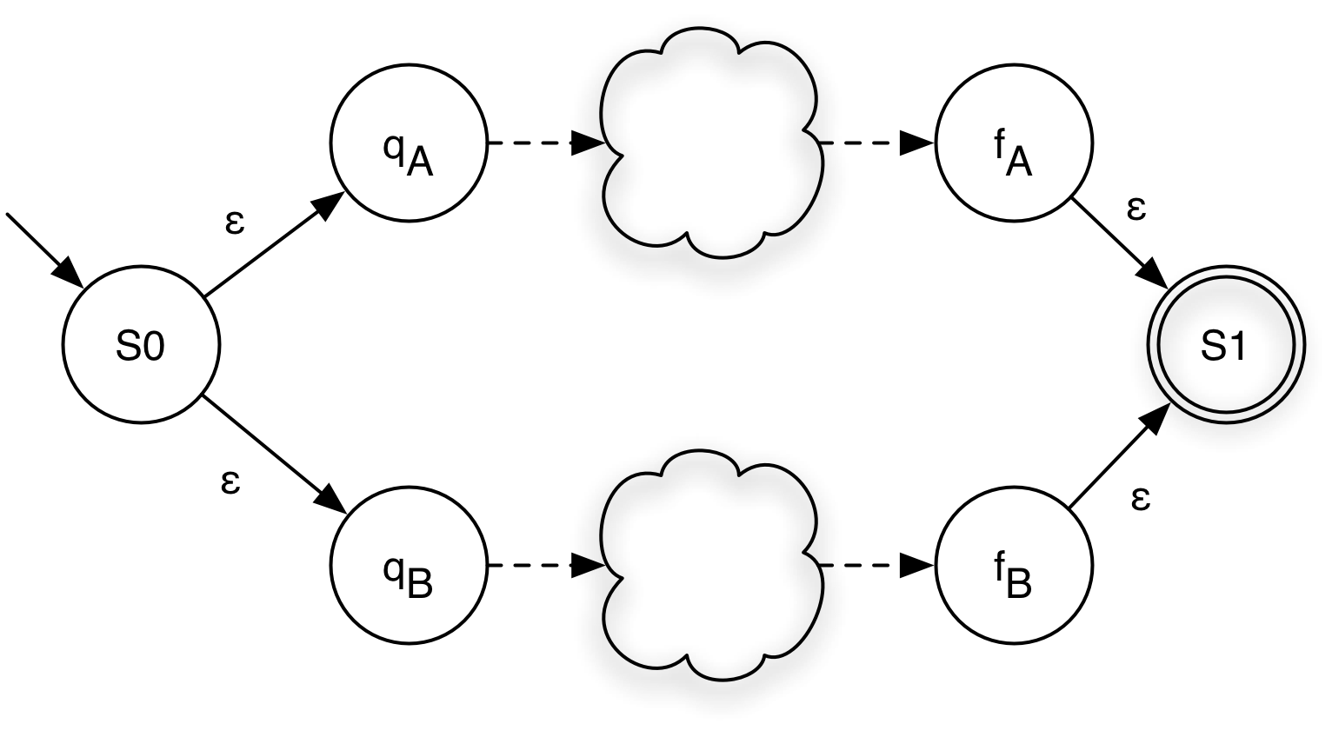
Reduction (cont’d)
Induction: (A|B)
<A> = (Σ_{A}, Q_{A}, q_{A}, {f_{A}}, δ_{A})
<B> = (Σ_{B}, Q_{B}, q_{B}, {f_{B}}, δ_{B})
<(A|B)> = (Σ_{A} ∪ Σ_{B}, Q_{A} ∪ Q_{B} ∪ {S0,S1}, S0, {S1},
δ_{A} ∪ δ_{B} ∪ {(S0,ε,q_{A}), (S0,ε,q_{B}), (f_{A},ε,S1), (f_{B},ε,S1)})

Slide 8
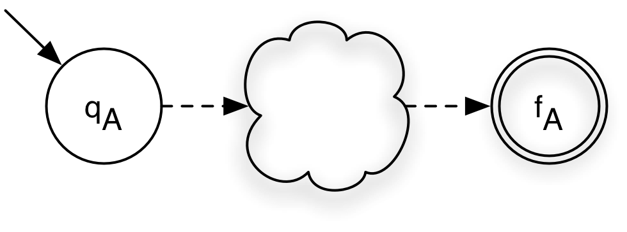
Reduction (cont’d)
Induction: A*

Slide 9
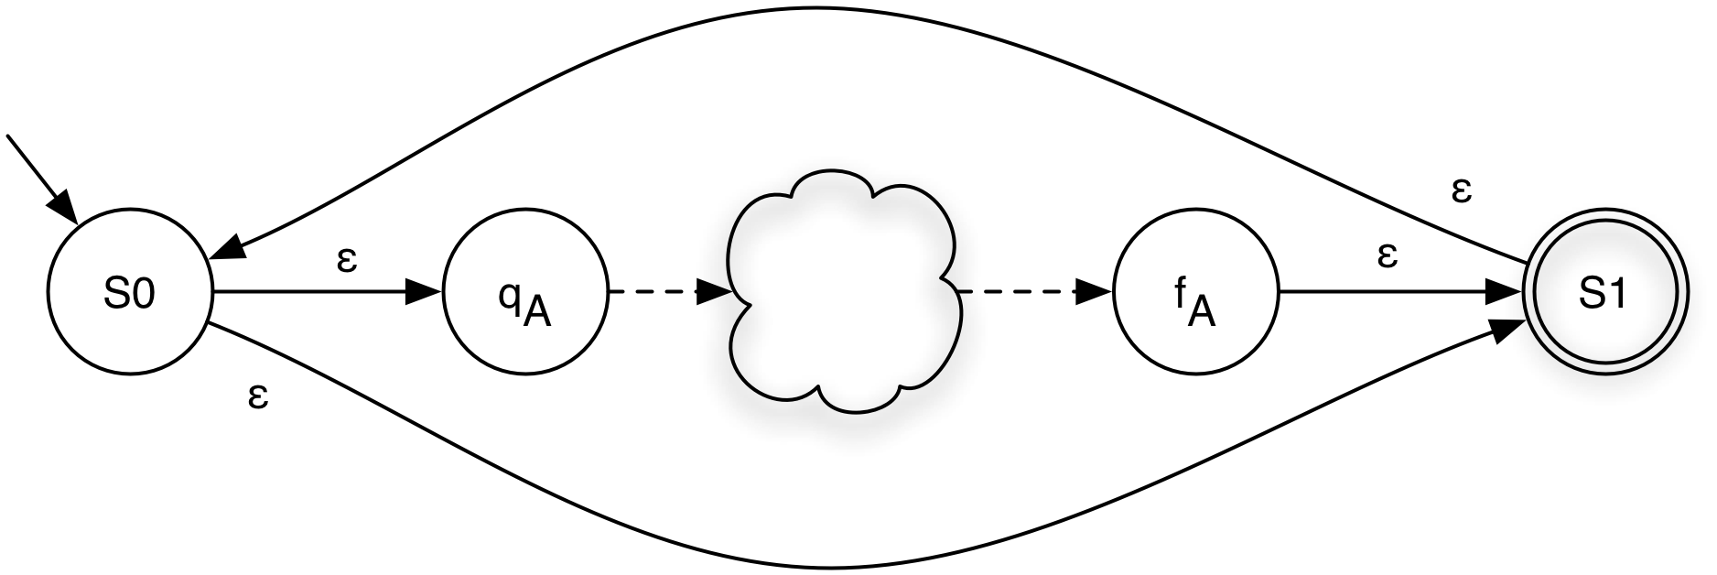
Reduction (cont’d)
Induction: A*
<A> = (Σ_{A}, Q_{A}, q_{A}, {f_{A}}, δ_{A})
<A*> = (Σ_{A}, Q_{A} ∪ {S0,S1}, S0, {S1},
δ_{A} ∪ {(f_{A},ε,S1), (S0,ε,q_{A}), (S0,ε,S1), (S1,ε,S0)})
Notes:
Without the ε-transition from S0 to S1 it would accept A⁺ rather than A*.
The two new states are needed because? (We can't just add epsilon transitions from the start to the final state, and vice versa?)
So this is an algorithm. We could write a program to do this. If we did this to any nontrivial r.e. we'd get a whole lot of states with ε-transitions, but we could also clean up the resulting NFA afterwards.

Slide 10
Reduction Complexity
Given a regular expression A of size n...
size = # of symbols + # of operations
How many states does <A> have?
O(n)
that’s pretty good!
NFA to DFA reduction
intuition: Build DFA where each DFA state represents a set of NFA states
given NFA with n states, DFA may have 2^{n} states
not so good, since DFAs are what we can implement easily
Notes:
So it's fine if we let our users write complex regular expressions using constructs like A⁺, because we can convert the r.e. internally to A* and everything gets converted to a DFA anyway, which we can clean up so it's efficient to execute.
If you look at the construction you see that at most two states and four transitions are added for each symbol or operation in the r.e., so this is O(n). In fact, you can't do better than O(n), since our algorithm needs to at least look at every symbol of the r.e.
So now we know how to convert an r.e. to an NFA. The only problem is that it's not so easy to computationally implement an NFA, since it can have multiple possible actions on a string (we would have to try to trace all possible paths). It seems easy to computationally implement a DFA- just start at the start state, and keep moving to new states based on the current state and next character of the string to be matched. If you end in a final state, the r.e. matches the string. But we can actually convert an NFA to a DFA, which is then easy to computationally simulate.
We can typically avoid 2^{n} states; it occurs only in extreme cases (which cases? When every state has a transition to every other state on every symbol.)

Slide 11
How an NFA Works
When an NFA processes a string it may be in several possible states
Multiple transitions with same label
ε-transitions
Example
After processing “a” NFA may be in states
S1
S2
S3
a
a
ε
S1
S2
S3
Notes:
Don't forget that this drawing of the DFA is just using one of the notational conveniences (omitting the dead state and transitions to it)- but they're really there. A DFA always has one and exactly one transition from every state on every alphabet symbol. The notational convenience just means we were lazy and didn't show the dead state, but you have to understand that it's really there.
(Note this NFA has no final state; this may be unclear….)

Slide 12
Reducing NFA to DFA
NFA may be reduced to DFA by explicitly tracking the set of NFA states
Intuition: build DFA where each DFA state represents a set of NFA states
Example
a
a
a
a
ε
S1
S2
S3
S1
S1, S2, S3
NFA
DFA

Slide 13
Reducing NFA to DFA (cont.)
Reduction applied using the subset algorithm
DFA state is a subset of set of all NFA states
Algorithm
Input
NFA (Σ, Q, q₀, F_{n}, δ_{n})
Output
DFA (Σ, R, r₀, F_{d}, δ_{d})
Using
ε-closure(p)
move(p, a)

Slide 14
ε-transitions and ε-closure
We say p → q if it is possible to go from state p to state q by taking only ε-transitions
If ∃ p, p₁, p₂, … p_{n}, q ∈ Q, such that {p,ε,p₁} ∈ δ, {p₁,ε,p₂} ∈ δ, … , {p_{n},ε,q} ∈ δ
ε-closure(p) is defined as the set of states reachable from p using ε-transitions alone
Set of states q such that p → q
ε-closure(p) = {q | p → q }
Note:
ε-closure(p) always includes p
ε-closure() may be applied to set of states (take union)
ε
ε
ε
Notes:
ε-closure is only defined for NFAs.

Slide 15
ε-closure: Example 1
Following NFA contains
S1 → S2
S2 → S3
S1 → S3
ε-closures
ε-closure(S1) =
ε-closure(S2) =
ε-closure(S3) =
ε-closure( { S1, S2 } ) =
ε
ε
ε
S1
S2
S3
ε
ε
a
{S1, S2, S3}
{S2, S3}
{S3}
{S1, S2, S3} ∪ {S2, S3}
Notes:
S1 → S3 indirectly (using two ε transitions).

Slide 16
ε-closure: Example 2
ε
Following NFA contains
S1 → S3
S3 → S2
S1 → S2
ε-closures
ε-closure(S1) =
ε-closure(S2) =
ε-closure(S3) =
ε-closure( { S2,S3 } ) =
a
b
ε
S1
S2
S3
ε
ε
ε
{S1, S2, S3}
{S2}
{S2, S3}
{S2} ∪ {S2, S3}

Slide 17
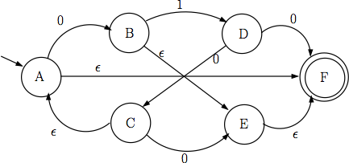
ε-closure: Practice
Find ε-closures for following NFA
Find ε-closures for the NFA you construct for the regular expression (0|1*)111(0*|1)

Slide 18
Calculating move(p, a)
move(p, a) is defined as the set of NFA states reachable from p using exactly one transition on a
Set of all states q such that {p, a, q} ∈ δ
move(p,a) = {q | {p, a, q} ∈ δ}
Note that move(p,a) may be empty Ø, if there is no transition from p with label a
Notes:
move(p, a) is the same as a transition for a DFA.

Slide 19
move(a,p) : Example 1
Following NFA
Σ = {a, b}
Move
move(S1, a) =
move(S1, b) =
move(S2, a) =
move(S2, b) =
move(S3, a) =
move(S3, b) =
a
b
S1
S2
S3
a
{S2, S3}
Ø
Ø
{S3}
Ø
Ø

Slide 20
move(a,p) : Example 2
ε
Following NFA
Σ = {a, b}
Move
move(S1, a) =
move(S1, b) =
move(S2, a) =
move(S2, b) =
move(S3, a) =
move(S3, b) =
a
a
S1
S2
S3
b
{S2}
{S3}
{S3}
Ø
Ø
Ø

Slide 21
NFA → DFA Reduction Algorithm
Input NFA (Σ, Q, q₀, F_{n}, δ_{n}), output DFA (Σ, R, r₀, F_{d}, δ_{d})
Algorithm
Let r₀ = ε-closure(q₀), add it to R // DFA start state
While ∃ an unmarked state r ∈ R // process DFA state r
Mark r // each state visited once
For each a ∈ Σ // for each letter a
Let S = {s | q ∈ r & move(q, a) = s} // states reached via a
Let e = ε-closure(S) // states reached via ε
If e ∉ R // if state e is new
Let R = e ∪ R // add e to R (unmarked)
Let δ_{d} = δ _{d} ∪ {r, a, e} // add transition r→e
Let F_{d} = {r | ∃ s ∈ r with s ∈ F_{n}} // final if include state in F_{n}
Notes:
Explain the intuition before showing the algorithm. You make a state of everyplace you can get to from a state in the NFA by following transitions on a symbol followed by ε transitions.
Continuing until there's an unmarked state is kind of like the graph algorthms (DFS, BFS, Dijkstra's) covered in CMSC 132.

Slide 22
NFA → DFA Example 1
Start = ε-closure(S1) = { {S1,S3} }
R = { {S1,S3} }
r ∈ R = {S1,S3}
Move({S1,S3}, a}) = {S2}
e = ε-closure({S2}) = {S2}
R = R ∪ {S2} = { {S1,S3}, {S2} }
δ = δ ∪ {{S1,S3}, a, {S2}}
Move({S1,S3}, b}) = Ø
NFA
a
b
S1
S2
S3
ε
DFA
{S1,
S3}
a
{S2}
Notes:
We're not done- we've marked or processed {S1, S3} so far, but we added S2 so there's still an unmarkied state.

Slide 23
NFA → DFA Example 1 (cont.)
R = { {S1,S3}, {S2} }
r ∈ R = {S2}
Move({S2}, a}) = Ø
Move({S2}, b}) = {S3}
e = ε-closure({S3}) = {S3}
R = R ∪ {S3} = { {S1,S3}, {S2}, {S3} }
δ = δ ∪ {{S2}, b, {S3}}
NFA
a
b
S1
S2
S3
ε
DFA
{S1,
S3}
a
b
{S2}
{S3}
Notes:
We're still not done- we processed S1 and S2, but we added S3, so it needs to be processed now too.

Slide 24
NFA → DFA Example 1 (cont.)
R = { {S1,S3}, {S2}, {S3} }
r ∈ R = {S3}
Move({S3}, a}) = Ø
Move({S3}, b}) = Ø
F_{d} = {{S1,S3}, {S3}}
Since S3 ∈ F_{n}
Done!
NFA
a
b
S1
S2
S3
ε
DFA
a
b
{1,3}
{2}
{3}

Slide 25
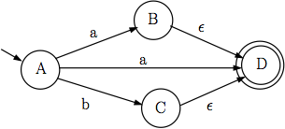
NFA → DFA Example 2
NFA
DFA
a
{B,D}
{A}
b
{C,D}
{B,D},
{C,D}
R = { {A}, }

