Slide 1
CMSC 330: Organization of Programming Languages
Finite Automata, con't.

Slide 2
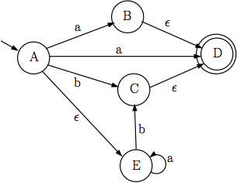
NFA → DFA Example 3
NFA
DFA
{B,D,E}
a
a
a
{A,E}
b
{E}
b
b
{C,D}
R = { {A,E}, }
{B,D,E},
{C,D},
{E}

Slide 3
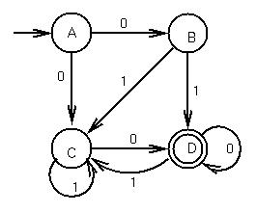
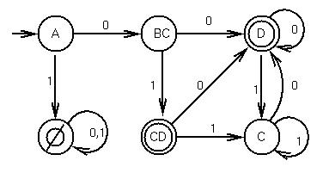
Equivalence of DFAs and NFAs
Any string from {A} to either {D} or {CD} represents a path from A to D in the original NFA
NFA
DFA

Slide 4
Equivalence of DFAs and NFAs (cont.)
Can reduce any NFA to a DFA using subset alg.
How many states in the DFA?
Each DFA state is a subset of the set of NFA states
Given NFA with n states, DFA may have 2^{n} states
Since a set with n items may have 2^{n} subsets
Corollary
Reducing a NFA with n states may be O(2^{n})

Slide 5
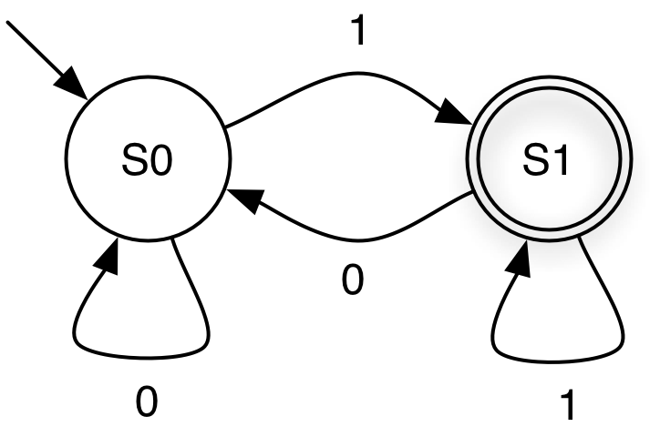
Implementing DFAs
cur_state= 0;
while (1) {
symbol= getchar();
switch (cur_state) {
case 0: switch (symbol) {
case '0': cur_state= 0; break;
case '1': cur_state= 1; break;
case '\n': printf("rejected\n"); return 0;
default: printf("rejected\n"); return 0;
}
break;
case 1: switch (symbol) {
case '0': cur_state= 0; break;
case '1': cur_state= 1; break;
case '\n': printf("accepted\n"); return 1;
default: printf("rejected\n"); return 0;
}
break;
default: printf("unknown state; I'm confused\n");
break;
}
}
It's easy to build a program which mimics a DFA
Notes:
Once you have a DFA, how do you "execute" or simulate it?
We could make this a subroutine in a program, returning 0 or 1.

Slide 6
Implementing DFAs (Alternative)
Alternatively, use generic table-driven DFA
q is just an integer
represent δ using arrays or hash tables
represent F as a set
given components (Σ, Q, q₀, F, δ) of a DFA:
q := q₀
while (there exists another symbol s of the input string)
q := δ(q, s)
if q∊F then
accept
else reject
Notes:
This is better than hand-coding (and also hardcoding) like the previous version.

Slide 7
Run Time of Algorithm
Given a string s, how long does algorithm take to decide whether s is accepted?
assume we can compute δ(q0, c) in constant time
then the time per string s to determine acceptance is O(|s|)
can’t get much faster!
But recall that constructing the DFA from the NFA constructed from the regular expression A may take O(2^{|A|}) time
but this is usually not the case in practice
So there’s the initial overhead, but then accepting strings is fast
Notes:
The initial overhead is for at compilation or translation time, when each r.e. is converted to an NFA and then a DFA.

Slide 8
Regular Expressions in Practice
Regular expressions are typically “compiled” into tables for the generic algorithm
can think of this as a simple byte code interpreter
but really just a representation of (Σ, Q_{A}, q_{A}, {f_{A}}, δ_{A}), the components of the DFA produced from the r.e.
Regular expression implementations often have extra constructs that are non-regular
i.e., can accept more than the regular languages
can be useful in certain cases
disadvantages: nonstandard, plus can have higher complexity
Notes:
The nonstandard extensions, like backreferences, if used, can mean it takes more than linear time to recognize strings.

Slide 9
Minimizing DFA
Result from CS theory
Every regular language is recognizable by a minimum-state DFA that is unique up to state names
In other words
For every DFA, there is a unique DFA with minimum number of states that accepts the same language
Two minimum-state DFAs have same underlying shape
c
a
b
S1
S2
S1
S2
S3
a
b
c
S3
Notes:
See if students remember what a regular language is.
In other words, if there's an isomorphism between them (if there's bijection, or a one-to-one and onto function from one to the other). Since a bijection always has an inverse the mapping goes the other way also. Show what the correspondence between components is in this example.

Slide 10
Minimizing DFA: Hopcroft Reduction
Intuition
Look for states that can be distinguish from each other
End up in different accept / non-accept state with identical input
Algorithm
Construct initial partition
Accepting and non-accepting states
Iteratively refine partitions (until partitions remain fixed)
Split a partition if members in partition have transitions to different partitions for same input
Two states x, y belong in same partition if and only if for all symbols in Σ they transition to the same partition
Update transitions and remove dead states
J. Hopcroft, “An n log n algorithm for minimizing states in a finite automaton,” 1971
Notes:
"Accepting" means "final", "non-accepting" means nonfinal.

Slide 11
Splitting Partitions
No need to split partition {S,T,U,V}
All transitions on a lead to identical partition P2
Even though transitions on a lead to different states
P1
P2
a
S
X
a
T
Y
U
a
a
V
Z

Slide 12
Splitting Partitions (cont.)
Need to split partition {S,T,U} into {S,T}, {U}
Transitions on a from S,T lead to partition P2
Transition on a from U lead to partition P3
P1
P2
a
S
X
a
T
Y
P4
b
U
a
P3
Z

Slide 13
Resplitting Partitions
Need to reexamine partitions after splits
Initially no need to split partition {S,T,U}
After splitting partition {X,Y} into {X}, {Y} need to split partition {S,T,U} into {S,T}, {U}
b
P1
P2
a
S
X
a
b
T
P4
a
Y
U
P3
Notes:
Why do we need to split P2? Because it has transitions to both P1 and P2 on a b.

Slide 14
DFA Minimization Algorithm (1)
Input DFA (Σ, Q, q₀, F_{n}, δ_{n}), output DFA (Σ, R, r₀, F_{d}, δ_{d})
Algorithm
Let p₀ = F_{n}, p₁ = Q – F // initial partitions = final, nonfinal states
Let R = { p | p ∈ {p₀, p₁} and p != Ø }, P = Ø // add p to R if nonempty
While P != R do // while partitions changed on prev iteration
Let P = R, R = Ø // P = prev partitions, R = current partitions
For each p ∈ P // for each partition from previous iteration
{p₀, p₁} = split(p,P) // split partition, if necessary
R = R ∪ { p | p ∈ {p₀,p₁} and p != Ø } // add p to R if nonempty
r₀ = p ∈ R where q₀ ∈ p // partition w/ starting state
F_{d} = { p | p ∈ R and ∃ s ∈ p such that s ∈ F_{n} } // partitions w/ final states
δ_{d} (p, c) = q when δ_{n}(s, c) = r where s ∈ p and r ∈ q // add transitions
Notes:
R is all pairs of partitions (pairs of sets of states), so this says "for all pairs of partitions…."
Why do we use R and not just iterate on P? Because we need to know when we're done, and we also would need to remove split partitions.

Slide 15
DFA Minimization Algorithm (2)
Algorithm for split(p,P)
Choose some r ∈ p, let q = p – {r}, m = { } // pick some state r in p
For each s ∈ q // for each state in p except for r
For each c ∈ Σ // for each symbol in alphabet
If δ_{d}(r ,c) = q₀ and δ_{d}(s, c) = q₁ and // q’s = states reached for c
there is no p₁ ∈ P such that q₀ ∈ p₁ and q₁ ∈ p₁ then
m = m ∪ {s} // add s to m if q’s not in same partition
Return p – m, m // m = states that behave differently than r
// m may be Ø if all states behave the same
// p – m = states that behave the same as r
Notes:
(q₀ looks like the start state; this is confusing….)
What's returned is a pair of sets of states.
P is all other states in the partition.
The "there is no…" stem peans as long as there is no partition such that both q₀ and q₁ are in it.

Slide 16
Minimizing DFA: Example 1
a
DFA
Initial partitions
Accept
Reject
Split partition?
move(S, a) – move(S, b)
move(T, a) – move(T, b)
P2
a
b
P1
S
T
R
b
After cleanup
a
{ R } → P1
b
P2
P1
{ S, T } → P2
→ Not required, minimization done
= T → P2
= R → P1
= T → P2
= R → P1
Notes:
Again, the dead state is implied.

Slide 17
Minimizing DFA: Example 2
DFA
Initial partitions
Accept
Reject
Split partition?
move(S, a) – move(S, b)
move(T, a) – move (T, b)
a
P2
a
b
P1
S
T
R
b
After cleanup
a
{ R } → P1
b
P2
P1
{ S, T } → P2
→ Not required, minimization done
= T → P2
= R → P1
= S → P2
= R → P1

Slide 18
Minimizing DFA: Example 3
DFA
Initial partitions
Accept
Reject
Split partition?
move(S, a) – move(S, b)
move(T, a) – move(T, b)
a
P2
a
b
P1
S
T
R
b
P3
DFA already minimal
{ R } → P1
{ S, T } → P2
→ Yes, different partitions for b
= T → P2
= T → P2
= T → P2
= R → P1

Slide 19
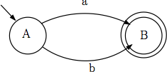
Complement of DFA
Given a DFA accepting language L, how can we create a DFA accepting its complement?
Example DFA
Σ = {a,b}
Notes:
Again the dead state is really there, just not shown.
What's the complement of a language? A language is just a set of strings, so the complement is just all strings over the alphabet that are not in the language. (Give an example of a language and its complement.)

Slide 20
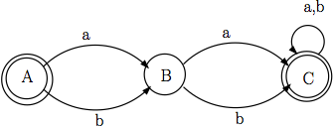
Complement of DFA (cont.)
Algorithm:
Add explicit transitions to a dead state
Change every final state to a nonfinal state and every nonfinal state to a final state
Note this only works with DFAs
Why not with NFAs?

Slide 21
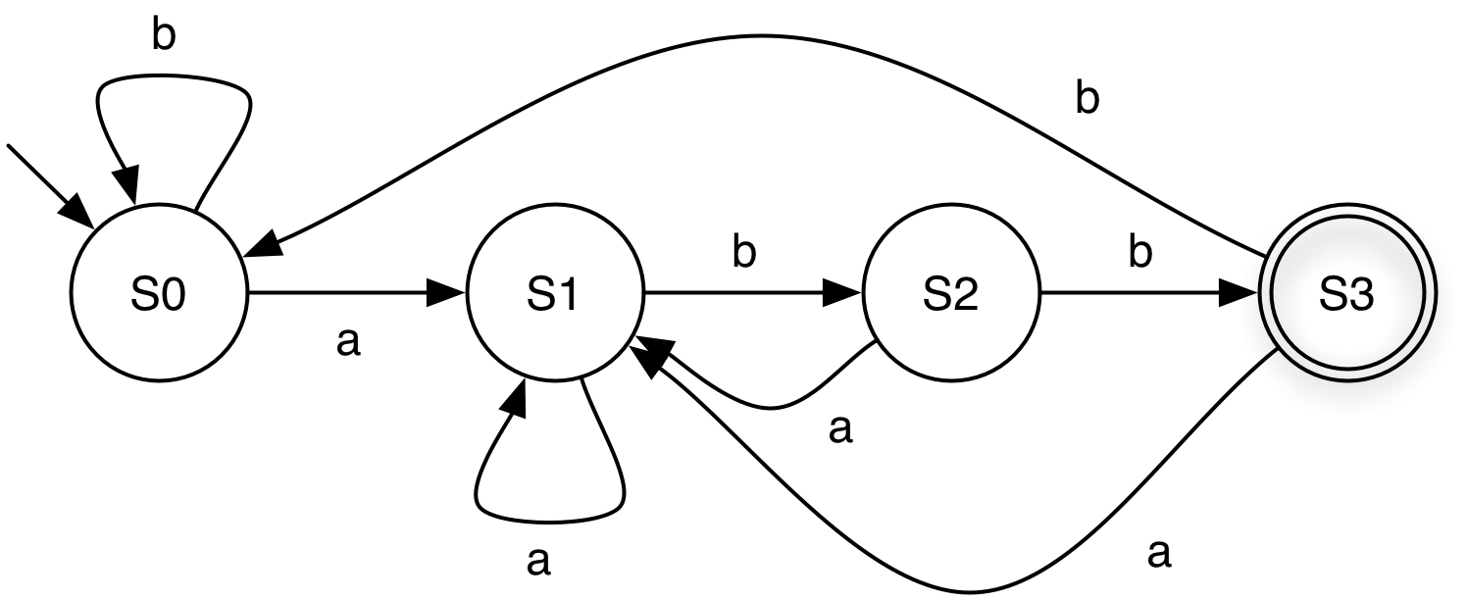
Practice
Make the DFA which accepts the complement of the language accepted by the DFA below.
S3

Slide 22
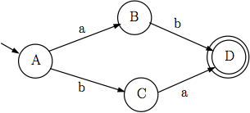

Reducing DFAs to REs
General idea
Remove states one by one, labeling transitions with regular expressions
When two states are left (start and final), the transition label is the regular expression for the DFA

Slide 23
Relating REs to DFAs and NFAs
Why do we want to convert between these?
Can make it easier to express ideas
Can be easier to implement

