Slide 1
CMSC 330: Organization of Programming Languages
Functional Programming with OCaml, con't.

Slide 2
Defining Functions
list parameters after function name
use let to define functions
let next x = x + 1;;
next 3;;
let plus (x, y) = x + y;;
plus (3, 4);;
no parentheses on function calls
no return statement
Notes:
Functions are the most important thing in OCaml (it's a functional language after all).
The body of any function is always just one single expression (but we'll see how you can put more than one expression anywhere that one expression can go, just like in C and Java you can use braces to put more than one statement anyplace where one statement can go).
Make sure students realize what an expression is (they often don't).

Slide 3
Local Variables
You can use let inside of functions for locals
and you can use as many lets as you want
let area r =
let pi = 3.14 in
pi *. r *. r
let area d =
let pi = 3.14 in
let r = d /. 2.0 in
pi *. r *. r
Notes:
pi *. r *. r is only one expression.
When functions are declared (or variables are bound using let) in a file you don't need the ;; as a terminator (although it can't hurt)- it's used only at the top-level.

Slide 4
Function Types
In OCaml, -> is the function type constructor
The type t1 -> t2 is a function with argument or domain type t1 and return or range type t2
Examples
let next x = x + 1 (* type int -> int *)
let fn x = (float_of_int x) *. 3.14
(* type int -> float *)
print_string (* type string -> unit *)
Type a function name at top level to get its type
Notes:
(float_of_int x) is a cast (in the form of a function applied to x).
Explain what first-order functions means again.

Slide 5
Type Annotations
The syntax (e : t) asserts that “e has type t”
this can be added anywhere you like
let (x : int) = 3
let z = (x : int) + 5
Use to give functions parameter and return types
let fn (x:int):float =
(float_of_int x) *. 3.14
note special position for return type
thus let g x:int = ... means g returns int
Very useful for debugging, especially for more complicated types
Notes:
Type annotations are additional information that gives the type of something, analogous to a declaration in C or Java, except they're optional in OCaml. The parentheses are used for scoping, to delimit what the annotation refers to (??????). If you use an annotation OCaml will complain if things are used inconsistently with their annotations
Define what type checking means- the language implementation's checking that a program follows the language's type rules. The type rules will vary widely from language to language. For example, in Java you can't put a String in a Vector, take it out, and cast it (since in Java 1.4 you just get an Object back) to an Integer- you'll get a ClassCastException. But in C you can cast anything to anything (almost).

Slide 6
;; versus ;
;; ends an expression in the top-level of OCaml
use it to say: “Give me the value of this expression”
not used in the body of a function
not needed after each function definition
though for now it won’t hurt if used there
e1; e2 evaluates e1 and then e2, and returns e2
let print_both (s, t) = print_string s; print_string t;
"Printed s and t."
notice no ; at end– it’s a separator, not a terminator
print_both ("Larry Herman ", "is amazing!")
Prints "Larry Herman is amazing!", and returns
"Printed s and t."
Notes:
The semicolon is for sequential evaluation. (The semicolon is also used to build lists.)
Why would we want to use e1; e2 if it just throws away the value of e1? Why in C would we want to use the comma operator, for example? Only when its subsidiary expressions change something, which is called having a side effect. I told you that OCaml has assignments but we haven’t seen them yet, so I can't show you a really good use of a side effect, but have you seen anything yet which causes side effects? Producing output is a side effect.
Make sure students know what a side effect is (they often don't).

Slide 7
Examples – Semicolon
Definition
e1 ; e2 (* evaluate e1, evaluate e2, return e2)
1 ; 2 ;;
(* 2 – value of 2nd expression is returned *)
(1 + 2) ; 4 ;;
(* 4 – value of 2nd expression is returned *)
1 + (2 ; 4) ;;
(* 5 – value of 2nd expression is returned to 1 + *)
1 + 2 ; 4 ;;
(* 4 – because + has higher precedence than ; *)

Slide 8
Lists in OCaml
The basic data structure in OCaml is the list
lists are written as [e1; e2; ...; en]
# [1;2;3];;
- : int list = [1;2;3]
notice int list – lists must be homogeneous
the empty list is []
# [];;
- : 'a list
the 'a means “a list containing anything”
we’ll see more about this later
warning: don’t use a comma instead of a semicolon (it means something different; we’ll see in a bit)
Notes:
Now we'll see data structures in OCaml. The two built-in data structures in most languages are something like an array, and something like a struct or a class (explain). OCaml has analogues to these.

Slide 9
Consider a Linked List in C
struct list {
int elt;
struct list *next;
};
…
struct list *l;
…
i= 0;
while (l != NULL) {
i++;
l= l->next;
}
Notes:
The thing to notice is that there are two kinds of lists: NULL, and nonempty lists, which have two parts- a data item and the next pointer to the rest of the list. This is a recursive structure.

Slide 10
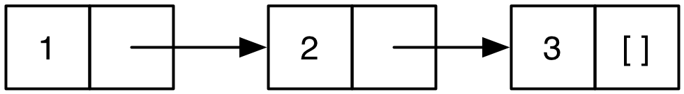
Lists in OCaml are Linked
[1;2;3] is represented above
a nonempty list is a pair (element, rest of list)
the element is the head of the list
the pointer is the tail or rest of the list- which is itself a list!
Thus in math a list is either
the empty list []
or a pair consisting of an element and a list
this recursive structure will come in handy shortly

Slide 11
Lists are Linked (cont’d)
:: prepends an element to a list
h::t is the list with h as the element at the beginning and t as the “rest”
:: is called a constructor, because it builds a list
although it’s not emphasized, :: does allocate memory
Examples
3::[] (* The list [3] *)
2::(3::[]) (* The list [2; 3] *)
1::(2::(3::[])) (* The list [1; 2; 3] *)

Slide 12
More Examples
# let y = [1;2;3] ;;
val y : int list = [1; 2; 3]
# let x = 4::y ;;
val x : int list = [4; 1; 2; 3]
# let z = 5::y ;;
val z : int list = [5; 1; 2; 3]
not modifying existing lists, just creating new lists
# let w = [1;2]::y ;;
This expression has type int list but is here used with type int list list
the left argument of :: is an element
can you construct a list y such that [1;2]::y is valid?
Notes:
w is not homogeneous, so it's incorrect.
Draw pictures: y: 1 -> 2 -> 3 []
x 4 ^
z 5 ^
Note lists are shared. Why might you not want this in C or Java? (Aliasing means changing one changes the other, but usually in a functional language like OCaml we return values without changing existing values.)
Why wouldn't we want to have sharing of lists like this in C or Java? Changing y would change x and z. But that doesn't happen in OCaml, because it doesn't have assignments (yet)- there's no way to change anything once it's created, only to create new things.
Some examples of lists y such that [1;2]::y makes sense are [1;2]::[[5;6]], which is the same thing as [1;2]::[5;6]::[], or [1;2]::[[1];[2;3]], which is the same thing as [[1;2];[1];[2;3]]- both are lists of int lists. Or [1;2]::[[]].

Slide 13
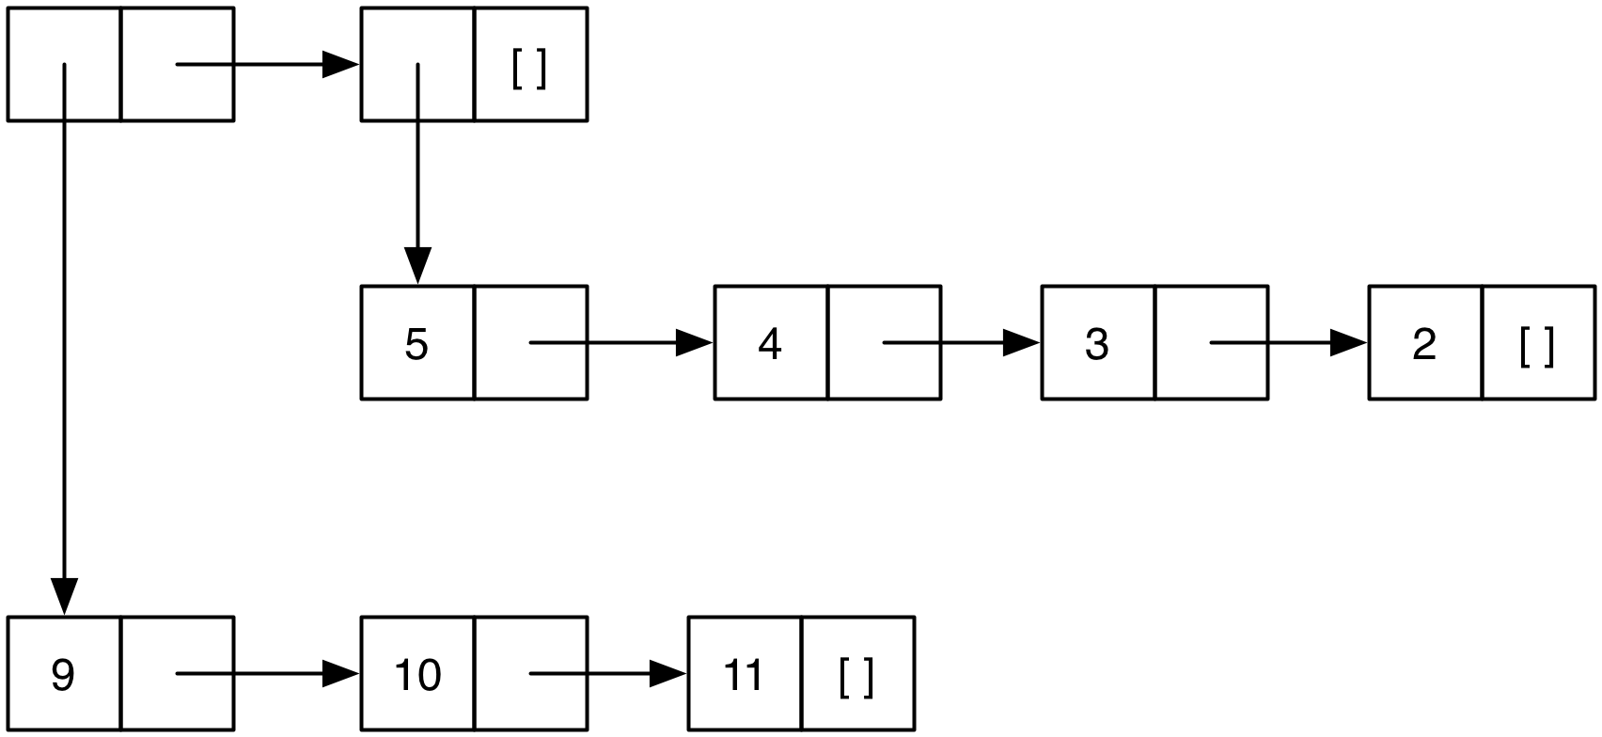
Lists of Lists
Lists can be nested arbitrarily
example: [ [9; 10; 11]; [5; 4; 3; 2] ]
(type int list list)
Notes:
You read "int list list" right-to-left, like "int **p" in C.
Think of how many instructions it would take to build this list in C or Java. It's very easy to build lists in OCaml.

Slide 14
Practice
What is the type of
[1;2;3]
[ [ [ ]; [ ]; [1.3;2.4] ] ]
let func x = x::(0::[ ])
int list
float list list list
int -> int list

Slide 15
Pattern Matching
To pull lists apart, use the match construct
match e with p₁ -> e₁ | ... | p_{n} -> e_{n}
p₁...p_{n} are patterns made up of [], ::, and pattern variables
match finds the first pattern p_{k} that matches the shape of e
Then the pattern variables in p_{k} are bound to the corresponding parts of e while e_{k} is evaluated and returned
An underscore (_) is a wildcard pattern that matches with anything, and doesn't bind the value of what it matches to (useful when you want to know something matches, but don't care what its value is)
Notes:
It's also easy to pull lists apart (extract their components) in OCaml.
match is also a binding construct, like let. each en can use the variable names in pn. The whole match is one expression, which produces the value of one of the pn's.
A match is attempted left-to-right and the first case that matches is the one performed (the value of its p_{n} is what's returned). It's sort of roughly analogous to a regular expression with backreferences matching a string, and then being able to refer to the parts of the string that matched parts of the regular expression, which are remembered in special variables- those are like the variables in the pattern.
This is called unification.

Slide 16
More on the match Construct
match e with p1 -> e1 | ... | pn -> en
let is_empty l = match l with
[] -> true
| (h::t) -> false
is_empty [] (* evaluates to true *)
is_empty [1] (* evaluates to false *)
is_empty [1;2;3] (* evaluates to false *)
Notes:
h and t are variable names.
You don't need to declare the pattern variables.
[1] matches the second pattern- 1::[]
Does this cover all cases of lists? Yes.
We could also write this as
let is_empty l = match l with
[] -> true
| _ -> false

Slide 17
Pattern Matching (cont’d)
let hd l = match l with (h::t) -> h
hd [1;2;3] (* evaluates to 1 *)
let hd l = match l with (h::_) -> h
hd [] (* error! no pattern matches *)
let tl l = match l with (h::t) -> t
tl [1;2;3] (* evaluates to [2; 3] *)
Notes:
e1 in the first one uses the variable h in p1. Note this one won't match the empty list.
Note the first two are just two different versions of the same thing; we just notice that we can use the underscore in the second one.
The underscore is like an anonymous variable- it matches with anything, and doesn't save its value.
Passing an empty list into a nonempty list isn't a type error (value vs. type) (?)

Slide 18
Pattern Matching, con't. – Wildcards
Code using _
let is_empty l = match l with
[] -> true | (_::_) -> false
let hd l = match l with (h::_) -> h
let tl l = match l with (_::t) -> t
Outputs
is_empty [1] (* evaluates to false *)
is_empty [] (* evaluates to true *)
hd [1;2;3] (* evaluates to 1 *)
tl [1;2;3] (* evaluates to [2;3] *)
hd [1] (* evaluates to 1 *)
tl [1] (* evaluates to [] *)

Slide 19
Missing Cases
Exceptions for inputs that don’t match any pattern
OCaml will warn you about non-exhaustive matches
Example:
# let hd l = match l with (h::_) -> h;;
Warning: this pattern-matching is not exhaustive.
Here is an example of a value that is not matched:
[]
# hd [];;
Exception: Match_failure ("", 1, 11).
Notes:
Note that even if a match doesn't match all cases you can use it all day without problems, as long as you don't ever call it on something which is one of the missing cases.
The "1, 11" is sort of mysterious; don't worry about what it means.

Slide 20
More Examples
let f l =
match l with (h1::(h2::_)) -> h1 + h2
f [1;4;8] (* evaluates to 5 *)
let g l =
match l with [h1; h2] -> h1 + h2
g [1; 2] (* evaluates to 3 *)
g [1; 2; 3] (* error! no pattern matches *)
Notes:
We don't need the extra parentheses in the first one, because the default associativity is right associative.
If the first one is called with a list with 0 or 1 elements it's an error. What if we pass in a list with more than two or three elements?
The first one works with any lists with two or more elements, the last one only with lists of exactly two elements.
We can use the convenient abbreviation [h1; h2] for h1::h2::[] (i.e., h1::(h2::[])).

Slide 21
An Abbreviation
let f p = e, where p is a pattern, is a shorthand for let f x = match x with p -> e
Examples
let hd (h::_) = h
let tl (_::t) = t
let f (x::y::_) = x + y
let g [x; y] = x + y
Useful if there’s only one acceptable input
Notes:
We can omit the explicit parameter and just move the pattern into the parameter's position.

Slide 22
Pattern Matching Lists of Lists
You can do pattern matching on these as well
Examples
let addFirsts ((x::_) :: (y::_) :: _) = x + y
addFirsts [ [1; 2; 3]; [4; 5]; [7; 8; 9] ] = 5
let addFirstSecond ((x::_)::(_::y::_)::_) = x + y
addFirstSecond [ [1; 3; 5]; [2; 4]; [9; 8; 7] ] = 5
Note: you probably won’t do this much or at all
you’ll mostly write recursive functions over lists
we’ll see that soon
Notes:
Change numbers from 1-9 to something where it's more clear which numbers are being used?
Finished going through slides here so far…

Slide 23
OCaml Functions Take One Argument
Recall this example
it looks like you’re passing in two arguments
actually, you’re passing in a tuple instead, and using pattern matching
Tuples are constructed using (e1, ..., en)
they’re like C structs but without field labels, and allocated on the heap
unlike lists, tuples do not need to be homogenous
e.g., (1, ["string1"; "string2"]) is a valid tuple
Tuples are deconstructed using pattern matching
let plus (x, y) = x + y;;
plus (3, 4);;
Notes:
The reason a tuple can just appear in a function's argument list is a consequence of the ability to put parentheses in the argument list, and pattern-matching on arguments.
Note that you can't have a tuple with only one component; the comma is the tuple "constructor".

