Slide 1
CMSC 330: Organization of Programming Languages
Functional Programming with OCaml, con't.

Slide 2
More Examples
(* convert a list of pairs to a list of all the
elements in the pairs *)
flatten_pairs l (* ('a * 'a) list -> 'a list *)
let rec flatten_pairs l = match l with
[] -> []
| ((a, b)::t) -> a :: b :: (flatten_pairs t)
(* return a list with the first n elements of l *)
take (n, l)
let rec take (n, l) =
if n = 0
then []
else
match l with
[] -> []
| (h::t) -> h :: (take (n-1, t))
Notes:
If n has fewer than n elements, all of its elements should be returned in the new list.
take is mixing if and pattern matching. This is how to count with recursion. If n is greater than the number of elements it should just return the whole list.

Slide 3
OCaml Data
So far, we’ve seen the following kinds of data:
basic types (int, float, char, string)
lists
one kind of data structure
a list is either [] or h::t, deconstructed with pattern matching
tuples
let you collect data together in fixed-size pieces
functions
How can we build other data structures?
building everything from lists and tuples is awkward
Notes:
How are functions data? We saw that they can be passed to functions or returned from functions.

Slide 4
Data Types
type shape =
Rect of float * float (* width * length *)
| Circle of float (* radius *)
let area s =
match s with
Rect (w, l) -> w *. l
| Circle r -> r *. r *. 3.14
area (Rect (3.0, 4.0))
area (Circle 3.0)
Rect and Circle are type constructors- here a shape is either a Rect or a Circle
Use pattern matching to deconstruct values, and do different things depending on constructor
Notes:
This is like a (tagged) union in C (although unions in C are untagged, you can put a union in a struct which has an enum for a tag).
The same pattern-matching which works for lists and tuples also works for data types.
area must be a shape if pattern-matching against Rect and Circle.
How do OCaml types differ from C unions? They're tagged, while unions are untagged (you can match and tell which variant is being stored).

Slide 5
Data Types, con't.
type shape =
Rect of float * float (* width * length *)
| Circle of float
let l = [Rect (3.0, 4.0) ; Circle 3.0; Rect (10.0, 22.5)]
What's the type of l?
What's the type of l's first element?
Notes:
let l = [(Circle 2.0); (Rect (1.5, 2.5))];;
val l : shape list = [Circle 2.; Rect (1.5, 2.5)]
match l with (h::t) -> h;;
shape = Rect (3., 4.)
So now I can have lists of ints, strings, or whatever.

Slide 6
Data Types (cont’d)
The arity of a constructor is the number of arguments it takes
a constructor with no arguments is nullary
constructors must begin with uppercase letter
type optional_int =
None
| Nbr of int
let add_with_default (a, o) =
match o with
None -> a + 1
| Nbr n -> a + n
add_with_default (3, None) (* 4 *)
add_with_default (3, (Nbr 4)) (* 7 *)
Notes:
Constructors are in uppercase, and functions are in lowercase, so OCaml knows that Rect (3.0, 4.0) is a constructor, not a function call on a tuple.
You can have tags without arguments to simulate default arguments to functions.
add_with_default has two arguments, an int and an optional_int. You can call it with one argument or with two arguments.

Slide 7
Polymorphic Data Types
type 'a option =
None
| Nbr of 'a
let add_with_default (a, o) =
match o with
None -> a + 1
| Nbr n -> a + n
add_with_default (3, None) (* 4 *)
add_with_default (3, (Nbr 4)) (* 7 *)
This option type can work with any kind of data
In fact, this option type is built-in to OCaml
Notes:
Functions can have optional arguments. An optional argument can be given without a default value, in this case it is considered in the body of the function as being of the type 'a option; None is its default value.
Some "abc";; is valid now also.

Slide 8
Recursive Data Types
Do you get the feeling we can build up lists this way?
Note: there's no nice [1; 2; 3] syntax for this kind of list
type 'a mylist =
Nil
| Node of 'a * 'a mylist
let rec length l =
match l with
Nil -> 0
| Node (_, t) -> 1 + (length t)
length (Node (10, Node (20, Node (30, Nil))))
Notes:
But note these lists are still polymorphic.

Slide 9
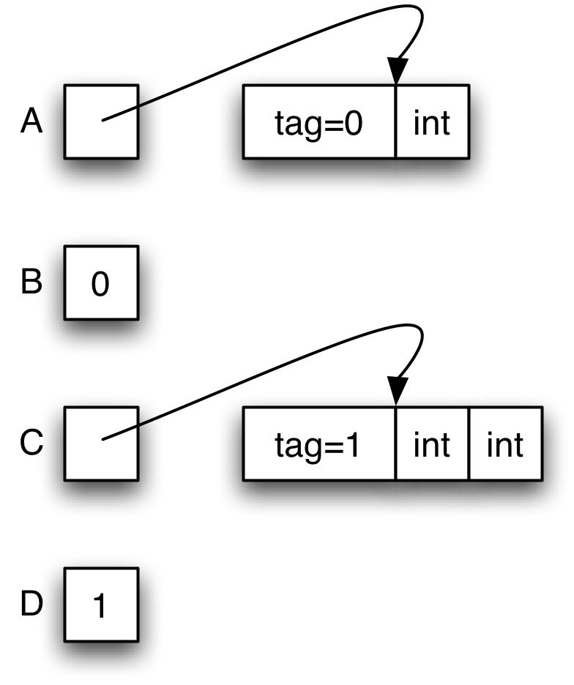
Data Type Representations
Values in a data type are stored either directly as integers or as pointers to blocks in the heap
type t =
A of int
| B
| C of int * int
| D
Notes:
Will B and D really have 0 and 1? Won't A, B, C and D all have 0, 1, 2, 3? Not exactly sure of internal representation….

Slide 10
Exceptions
Exceptions are declared with exception
They may appear in the signature as well
Exceptions may take arguments
Just like type constructors
May also be nullary
Catch exceptions with try...with...
Pattern-matching can be used in with
If an exception is uncaught, the current function exits immediately and control transfers up the call chain until the exception is caught, or until it reaches the top level

Slide 11
Exceptions, con't.
exception My_exception of int
let f m =
if m > 0 then
raise (My_exception m)
else
raise (Failure "some explanation of failure type")
let g n =
try
f n
with My_exception n ->
Printf.printf "Caught %d\n" n
| Failure s ->
Printf.printf "Caught %s\n" s
Notes:
Can be nullary or take arguments.
raise calls an exception.
Failure is a built-in exception.
with does pattern-matching against the type of exception thrown.
Note printf.
Change f to something which does something useful in one case???
Three of the exceptions in the OCaml core library are particularly useful for you to use in your own functions:
Not_found: a parameterless exception raised by search functions when the desired object couldn't be found
Invalid_argument: an exception raised by library functions to signal that the given arguments don't make sense; takes a parameter of type string that is typically an explanation.
Failure: an exception raised by library functions to signal that they are undefined on the given arguments; ; takes a parameter of type string that is typically an explanation.

Slide 12
Working with Lists
Several of the recursive list function examples have the same flavor:
walk through a list and do something to every element
walk through a list and keep track of something
Recall the following example code from Ruby:
here we passed a code block into the collect method
wouldn’t it be nice to do the same in OCaml?
a = [1,2,3,4,5]
b= a.collect { |x| -x }
Notes:
This is actually much more natural and easy in OCaml than in Ruby.

Slide 13
Higher-Order Functions
In OCaml you can pass functions as arguments, and return functions as results
let plus_three x = x + 3
let twice (f, z) = f (f z)
twice (plus_three, 5)
twice : ('a->'a) * 'a -> 'a
let plus_four x = x + 4
let pick_fn n =
if n > 0 then plus_three else plus_four
(pick_fn 5) 0
pick_fn : int -> (int -> int)
Notes:
The first example has a function with a function as a parameter, the second example has a function which returns a function.
('a -> 'a) is a function type. twice is a function which takes a tuple of a function (from 'a to 'a) and an 'a, and returns an 'a.
The comma in (plus_three, 5) means we're not calling plus_three on 5, we're passing both of them as a tuple of two arguments to twice. The parameter type of twice is a tuple of a function from 'a to 'a, and an 'a. (Why do we know that twice's first parameter is 'a->'a and not 'a->'b? Because we're able to call it on its return value.)
twice (plus_three 5) = plus_three (plus_three 5) = plus_three 8 = 11
pick_fn is just returning a function (one function or another). It's not calling either function, because note there's no arguments.
(pick_fn 5) 0 = (if 5 > 0 then plus_three else plus_four) 0 = plus_three 0 = 3 (the parentheses are optional in (pick_fn 5) 0 because function application is left-associative).

