Slide 1
CMSC 330: Organization of Programming Languages
Functional Programming with OCaml, con't.

Slide 2
The map Function
Let’s write the map function (just like Ruby's collect)
takes a function and a list, applies the function to each element of the list, and returns a list of the results
let add_one x = x + 1
let negate x = -x
map (add_one, [1; 2; 3])
map (negate, [9; -5; 0])
Type of map?
let rec map (f, l) = match l with
[] -> []
| (h::t) -> (f h)::(map (f, t))
Notes:
We want to be able to do the same thing as collect in Ruby.
What's the type of map? map : ('a -> 'b) * 'a list -> 'b list
(Actually this is a standard library function.)
map (add_one, [1; 2; 3]) (* returns [2; 3; 4] *)
map (negate, [9; -5; 0]) (* returns [-9; 5; 0] *)

Slide 3
Anonymous Functions
Passing functions around is very common, so we often don’t want to bother to give them names
Use fun to make a function with no name
map ((fun x -> x + 13), [1; 2; 3])
twice ((fun x -> x + 2), 4)
Parameter
Body
fun x -> x + 3
Notes:
We didn't need names for code blocks in Ruby, and we don't need names for functions we want to pass as arguments in OCaml.
You can use an anonymous function anywhere, but you can pass it to another function, just like code blocks in Ruby.
map ((fun x -> x + 13), [1; 2; 3]) (* [14; 15; 16] *)
twice ((fun x -> x + 2), 4) (* 8 *)

Slide 4
Pattern Matching with fun
match can be used within fun
map ((fun l -> match l with (h::_) -> h),
[ [1; 2; 3]; [4; 5; 6; 7]; [8; 9] ])
(* [1; 4; 8] *)
for complicated matches, though, use named functions
Standard pattern matching abbreviation can be used
map ((fun (x, y) -> x + y), [(1, 2); (3, 4)])
(* [3; 7] *)
Notes:
Anonymous functions defined with fun can't be recursive, since there's no name to call recursively.

Slide 5
All Functions Are Anonymous
Functions are first-class, so you can bind them to other names as you like
let f x = x + 3
let g = f
g 5 (* returns 8 *)
let for functions is just a shorthand
let f x = body stands for
let f = fun x -> body
Notes:
Describe what first-class means.
"let g = f" is "assigning", or giving a new name, for a function.

Slide 6
Examples
let next x = x + 1
short for let next = fun x -> x + 1
let plus (x, y) = x + y
short for let plus = fun (x, y) -> x + y
which is short for
let plus = fun z ->
(match z with (x, y) -> x + y)
let rec fact n =
if n = 0 then 1 else n * fact (n-1)
short for let rec fact = fun n ->
(if n = 0 then 1 else n * fact (n-1))
Notes:
let plus (x, y) = x + y is encapsulating three ideas: binding something, pattern matching, and defining a function.

Slide 7
More Higher-Order Functions- the fold Function
A common pattern is to iterate through a list and apply a function to each element, keeping track at the same time of the partial results computed so far
a = “accumulator”
this is usually called “fold left” to remind us that f takes the accumulator as its first argument
What's the type of fold?
let rec fold (f, a, l) = match l with
[] -> a
| (h::t) -> fold (f, f (a, h), t)
Notes:
Recall that map took two arguments.
fold : ('a * 'b -> 'a) * 'a * 'b list -> 'a

Slide 8
Example
let add (a, x) = a + x
fold (add, 0, [1; 2; 3; 4]) →
fold (add, 1, [2; 3; 4]) →
fold (add, 3, [3; 4]) →
fold (add, 6, [4]) →
fold (add, 10, []) →
10
We just built the sum function!
let rec fold (f, a, l) = match l with
[] -> a
| (h::t) -> fold (f, f (a, h), t)
Notes:
Ask students to guess what this does. It's the sum function over lists.

Slide 9
Another Example
let next (a, _) = a + 1
fold (next, 0, [2; 3; 4; 5]) →
fold (next, 1, [3; 4; 5]) →
fold (next, 2, [4; 5]) →
fold (next, 3, [5]) →
fold (next, 4, []) →
4
We just built the length function!
let rec fold (f, a, l) = match l with
[] -> a
| (h::t) -> fold (f, f (a, h), t)
Notes:
Ask students to guess what this one does also.
Of course we could have written length from scratch. But many functional programming problems follow this pattern, and rather than reinvent the wheel each time and write each one from scratch, we can just write the simple next function, and write the fold function once, and call fold with next and an appropriate initial accumulator, or any other appropriate function, more conveniently.

Slide 10
Using fold to Build rev
Can you build the reverse function with fold?
let prepend (a, x) = x::a
fold (prepend, [], [5; 6; 7; 8]) →
fold (prepend, [5], [6; 7; 8]) →
fold (prepend, [6; 5], [7; 8]) →
fold (prepend, [7; 6; 5], [8]) →
fold (prepend, [8; 7; 6; 5], []) →
[8; 7; 6; 5]
let rec fold (f, a, l) = match l with
[] -> a
| (h::t) -> fold (f, f (a, h), t)
Notes:
Ask students to figure out what the first two parameters (the function and the accumulator) would have to be for fold(?, ?, [5;6;7;8]).
prepend could be an anonymous function also.

Slide 11
The Call Stack in C/Java/etc.
void f(void) {
int x;
x = g(3);
}
x
<junk>
4
f
x
3
g
y
<junk>
4
int g(int x) {
int y;
y = h(x);
return y;
}
z
3
h
int h (int z) {
return z + 1;
}
int main(){
f();
return 0;
}
Notes:
How do higher-order functions work? What does OCaml have to do to get them to work?
What happens in C when you call f()?
Note the runtime stack often grows downward.
More than this has to be done in languages like Ruby and OCaml, which allow you to pass functions or code blocks around.
Note that the runtime stack is a stack– an activation record is pushed upon function call, and popped upon function exit.

Slide 12
Nested Functions
In OCaml, you can define functions anywhere, even inside of other functions
let sum list =
fold ((fun (a, x) -> a + x), 0, list)
let pick_one n =
if n > 0 then (fun x -> x + 1)
else (fun x -> x - 1)
(pick_one -5) 6 (* returns 5 *)
Notes:
The first example is like a Ruby code block being applied to an array (an anonymous function declared inside sum_list).

Slide 13
Nested Functions (cont’d)
You can also use let to define functions inside of other functions
let sum list =
let add (a, x) = a + x in
fold (add, 0, list)
let pick_one n =
let add_one x = x + 1 in
let sub_one x = x - 1 in
if n > 0 then add_one else sub_one

Slide 14
How About This?
(equivalent to...)
let add_n (n, list) =
let add x = n + x in
map (add, list)
Accessing variable
from outer scope
let add_n (n, list) =
map ((fun x -> n + x), list)
Notes:
This adds n to every element of a list.

Slide 15
Consider the Call Stack Again
let map (f, n) = match n with
[] -> []
| (h::t) -> (f h)::(map (f, t))
n
3
list
elements
let add_n (n, list) =
map (add, list)
add
code
let add x = n + x in
f
n
add_n (3, [1; 2; 3])
x
1
Uh oh...how does add know the value of n?
The wrong answer for OCaml: it reads it off the stack
The language could do this, but can be confusing (see above)
OCaml uses static scoping like C, C++, Java, and Ruby
Notes:
Just to be confusing, what about this?
Some languages would read the value of n off of the stack, but not ones like Ruby, C, C++, Java, or OCaml.

Slide 16
Static Scoping
In static or lexical scoping, (nonlocal) names refer to their nearest binding in the program text, going from inner to outer scope
In our example, add uses add_n’s n
C example:
Refers to the x at file scope – that’s the nearest x going from inner scope to outer scope in the source code
int x = 1;
void f() {
x++;
}
void g() {
int x = 2;
f();
}
Notes:
Ask students which n f() uses- the one in the caller g() (no), or the one at file scope (yes).
If g() is called, and it calls f(), f() doesn't look back into g() to use g()'s x, it uses the x at file scope (int x = 1).
Static scoping is called static because everything needed to determine the scope of a variable is available or known at compile time, and an identifier's scope doesn't depend upon the execution history of a program (which functions called which ones).

Slide 17
Returned Functions
As we saw, in OCaml a function can return another function as a result
So consider the following example
When the anonymous function is called, n isn’t even on the stack any more!
The language needs some way to keep n around after add_n returns
let add_n n = (fun x -> x + n)
(add_n 3) 4 (* returns 7 *)
Notes:
But there's a deeper problem, besides just which identifier with a given name is used when the name is used, when there’s a choice of more than one- will there even be one?
Ignore the type signature for now. (?)
This could be dynamically scoped.

Slide 18
Environments and Closures
An environment is a mapping from variable names to values, just like a stack frame
A closure is a pair (f, e) consisting of function code f and an environment e
When you invoke a closure, f is evaluated using e to look up variable bindings
Notes:
An environment is just like a stack frame, but lives in the heap.
When you return a function from a function what you get back is a closure- not just the function's code, but its environment also, capturing all the variables which were in existence as of the point where it was created.

Slide 19
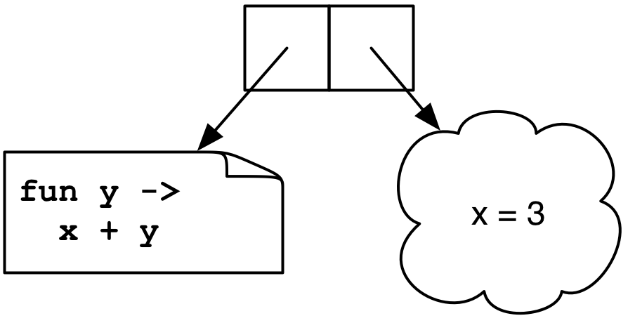
Example
let add x = (fun y -> x + y)
(add 3) 4
→ <closure> 4
→ 3 + 4
→ 7
Notes:
(add 3) returns the closure "<closure> 4".
The environment shown as the cloudy shape consists of all variables in scope at the time the closure was created. The other part of a closure is the function's code.
Add returns a function, which has one parameter, which adds its parameter to the value of x in existence when the closure was created. This is what's returned, and here then called on 4.

Slide 20
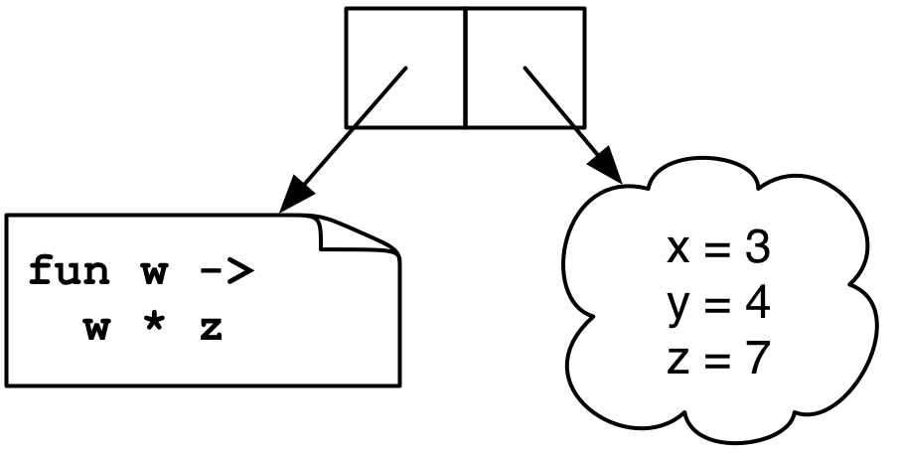
Another Example
let mult_sum (x, y) =
let z = x + y in
fun w -> w * z
(mult_sum (3, 4)) 5
→ <closure> 5
→ 5 * 7
→ 35
Notes:
The function we get back is a closure.
The closure’s environment won't actually contain x and y, since the closure's code doesn't use them.

Slide 21
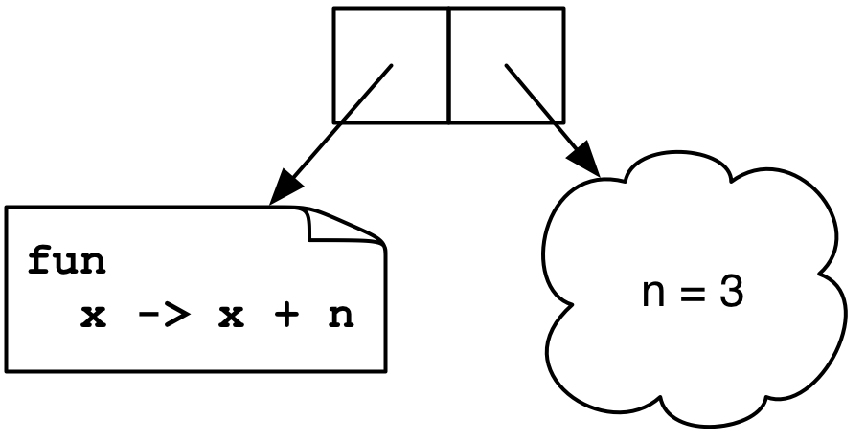
Yet Another Example
let twice (n, y) =
let f x = x + n in
f (f y)
twice (3, 4)
→ <closure> (<closure> 4)
→ <closure> 7
→ 10
Notes:
This code applies f twice.
<closure> (<closure> 4) is the same closure.
Here we only showed the variables used in the closure's environment.
Creating closures happens all the time in OCaml. Here declaring a function inside a function gives us a closure, which captures the surrounding environment.

Slide 22
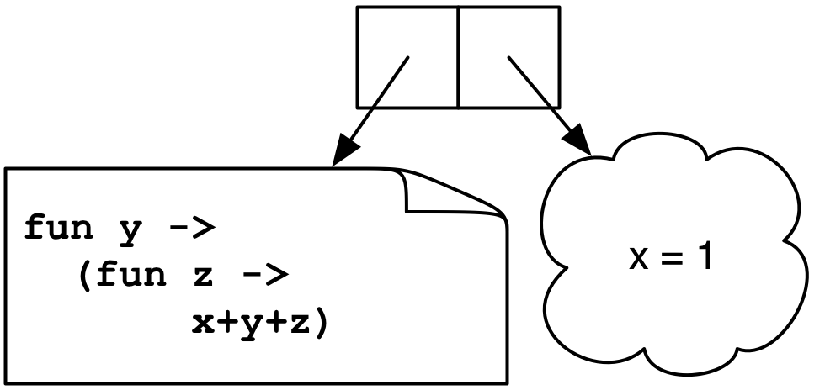
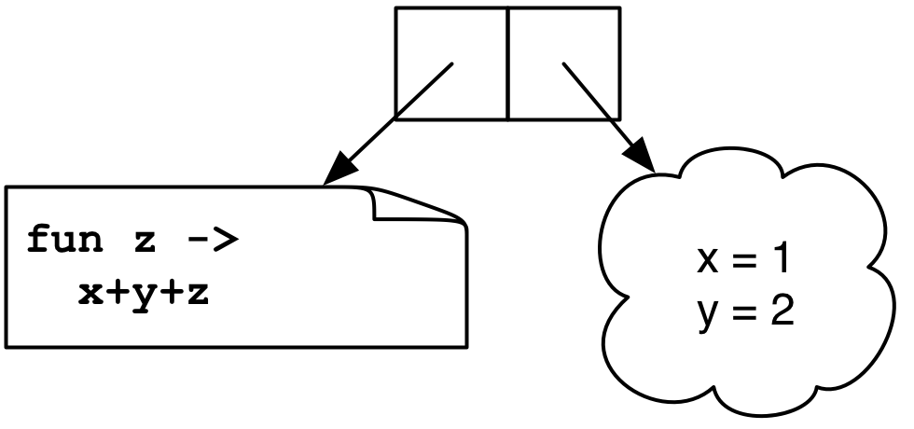
Still Another Example
let add x = (fun y -> (fun z -> x + y + z))
(((add 1) 2) 3)
→ ((<closure> 2) 3)
→ (<closure> 3)
→ 1+2+3
Notes:
Besides the "let add (x, y, z)= x + y + z" method of creating a function with multiple arguments in OCaml (passing a tuple) this is also a way. add is a function which takes an argument, and returns a function which takes a second argument, which returns a function which takes a third argument. This last function (both of them actually) is a closure, which captures the first two arguments, so giving it a third argument results in the sum of the three arguments.
Note the two closures have different enviroments.
What happens if you type (add 1) into Ocaml? You'll see it’s a function type.
The closure has a name.

Slide 23
Currying
We just saw another way for a function to take multiple arguments: the function consumes one argument at a time, creating closures until all the arguments are available
This is called currying the function
Named after the logician Haskell B. Curry
But Schönfinkel and Frege discovered it, so it should probably be called Schönfinkelizing or Fregging

Slide 24
Curried Functions in OCaml
OCaml has a really simple syntax for currying
This is identical to all of the following:
Thus:
add has type int -> (int -> int)
add 3 has type int -> int
add 3 is a function that adds 3 to its argument
(add 3) 4 = 7
This works for any number of arguments
let add x y = x + y
let add = (fun x -> (fun y -> x + y))
let add = (fun x y -> x + y)
let add x = (fun y -> x + y)
Notes:
Curried functions are so common in OCaml that they're built into the language. Every standard function uses currying.
The first form is identical to any and all of the three following forms.
Note that it's not really a function with multiple arguments, it's a function which takes an int and returns a function which takes an int and returns the sum of the two ints.
(CAN YOU DEFINE AN INFIX FUNCTION (OPERATOR) IN OCAML???)

Slide 25
Curried Functions in OCaml (cont’d)
Because currying is so common, OCaml uses the following conventions:
-> associates to the right
Thus int -> int -> int is the same as
int -> (int -> int)
Function application associates to the left
Thus add 3 4 is the same as
(add 3) 4
Notes:
-application of functions to arguments associates to the left.
let g = add 3
g 4;;
add x y z
add 3 4 5
add 3 4
apply to 5
apply to 5 6
(CONFUSING- EXAM QUESTION?)

Slide 26
Another Example of Currying
A curried add function with three arguments:
The same as
Then...
add_three has type int -> (int -> (int -> int))
add_three 4 has type int -> (int -> int)
add_three 4 5 has type int -> int
add_three 4 5 6 is 15
let add_three x y z = x + y + z
let add_three x = (fun y -> (fun z -> x+y+z))

Slide 27
Currying and the map Function
let rec map f l = match l with
[] -> []
| (h::t) -> (f h)::(map f t)
Examples
let negate x = -x
map negate [1; 2; 3] (* returns [-1; -2; -3 ] *)
let negate_list = map negate
negate_list [-1; -2; -3]
let sum_pairs_list = map (fun (a, b) -> a + b)
sum_pairs_list [(1, 2); (3, 4)] (* [3; 7] *)
What's the type of this form of map?
Notes:
Now map doesn't take a tuple any more.
"map negate" partially applies the function.
You can partcally evaluate functions, passing in some of their arguments, but not all.
What's the type of map now? map: ('a -> 'b) -> 'a list -> 'b list, which means ('a -> 'b) -> ('a list -> 'b list) – a function which takes a function (from 'a's to 'b's) and which returns a function from 'a list to 'b list.
So the type of negate_list is int list -> int list. We give map a function from int to int, and it gives back a function from int list to int list.
The type of sum_pairs_list is (int * int) list -> int list. We give map a function int * int -> int, and it gives back a function from (int * int) list to int list.

Slide 28
Currying and the fold Function
let rec fold f a l = match l with
[] -> a
| (h::t) -> fold f (f a h) t
let add x y = x + y
fold add 0 [1; 2; 3]
let sum = fold add 0
sum [1; 2; 3]
let next n _ = n + 1
let length = fold next 0 (* warning: not polymorphic *)
length [5; 6; 7; 8]
What's the type of this form of fold?
Notes:
The type of this form of fold is fold : ('a -> 'b -> 'a) -> 'a -> 'b list -> 'a, which means ('a -> 'b -> 'a) -> 'a -> ('b list -> 'a), which means ('a -> 'b -> 'a) -> ('a -> ('b list -> 'a))

Slide 29
Another Convention
Since functions are curried, function can often be used instead of match
function declares an anonymous function of one argument
Instead of
It could be written
let rec sum l = match l with
[] -> 0
| (h::t) -> h + (sum t)
let rec sum = function
[] -> 0
| (h::t) -> h + (sum t)
Notes:
If you look at the OCaml standard libraries they're all written in the curried style (such as nth).
Note: function declares an anonymous function of one argument, which does pattern-matching on that argument. Note that the match pattern doesn't appear in the parameter list.
"function" is a more fundamental function definition, it takes only one parameter, and immediately goes into pattern matching mode.
"fun" is a shorthand for creating functions with more than one parameter. It can be converted into an equivalent definition using "function"
In situations where you want to write a function in which you want to do pattern-matching on the last argument, "function" is very convenient.
You can't do the latter one with fun, because you need a function name to call recursively.
A function of one argument is good enough for anything. You can replace multiargument functions with functions of one argument, but optimization often avoids curring.

Slide 30
Another Convention (cont’d)
Instead of
It could be written
let rec map f l = match l with
[] -> []
| (h::t) -> (f h)::(map f t)
let rec map f = function
[] -> []
| (h::t) -> (f h)::(map f t)
Notes:
You'll see in these files.
The second example takes f (a function) and returns another function.
Note that here map takes an argument f and its body is a function which has an anonymous, unnamed argument, so map itself has two arguments, just like in the top form.

Slide 31
Currying is Standard in OCaml
Pretty much all functions are curried
Like the standard library map, fold, etc.
See /usr/local/ocaml/lib/ocaml on Grace
In particular, look at the file list.ml for standard list functions
Access these functions using List.<fn name>
E.g., List.hd, List.length, List.map
OCaml plays a lot of tricks to avoid creating closures and to avoid allocating on the heap
It's unnecessary much of the time, since functions are usually called with all arguments

Slide 32
Higher-Order Functions in C
C has function pointers but not closures
(gcc has closures)
typedef int (*int_func)(int);
void app(int_func f, int *a, int n) {
int i;
for (i = 0; i < n; i++)
a[i] = f(a[i]);
}
int add_one(int x) { return x + 1; }
int main() {
int a[] = {1, 2, 3, 4};
app(add_one, a, 4);
}
Notes:
gcc has the code part of closures, but not the environment part (because gcc has nested functions).
You see function pointers when simulating an object.
typedef int (*int_func)(int); is a function pointer type.
int_func is something which if you dereference it and call it, passing an int, you'll get an int. Therefore it must be pointer to a function which takes an int and returns an int.
Why isn't f void *? Then you couldn't call it without casting.
add_one matches the pointer type above.

Slide 33
Higher-Order Functions in Ruby
Use yield within a method to call a code block argument
def my_collect(a)
b = Array.new(a.length)
i = 0
while i < a.length
b[i] = yield(a[i])
i = i + 1
end
return b
end
b = my_collect([1, 2, 3, 4, 5]) { |x| -x }
Notes:
Any method can have a code block associated with it, and it can be automatically called using yield.
A function can check whether it's been passed a code block (HOW???) and decide whether it needs to call yield.
You can't have multiple code block arguments (EASILY OR AT ALL???)
a is the only explicit parameter
Instead of a loop, the function could use push and pop.
yield calls the code block.
collect is like map.
(DOES A HIGHER-ORDER FUNCTION (CODE BLOCK) CARRY AN ENVIRONMENT WITH IT IN RUBY? TRY AND SEE.)

Slide 34
Higher-Order Functions in Java/C++
An object in Java or C++ is kind of like a closure
it’s some data (like an environment)
along with some methods (i.e., function code)
So objects can be used to simulate closures
When we get to Java in the course, we’ll look at how to implement some functional programming patterns in OO languages
Notes:
Does Ruby have closures (which carry an environment)? Try it and see, or look it up.

Slide 35
Modules
So far, most everything we’ve defined has been at the “top-level” of OCaml
This is not good software engineering practice
A better idea: use modules to group associated types, functions, and data together
Avoid polluting the top-level with unnecessary stuff
For lots of sample modules, see the OCaml standard library

Slide 36
Creating a Module
module Shapes =
struct
type shape =
Rect of float * float (* width * length *)
| Circle of float (* radius *)
let area = function
Rect (w, l) -> w *. l
| Circle r -> 3.14 *. r *. r
let unit_circle = Circle 1.0
end;;
unit_circle;; (* not defined *)
Shapes.unit_circle;;
Shapes.area (Shapes.Rect (3.0, 4.0));;
open Shapes;; (* import all names into current scope *)
unit_circle;; (* now defined *)
Notes:
A structure contains an arbitrary sequence of definitions and is usually given a name using "module". Outside the structure, its components can be referred to using dot notation.
Shapes.unit_circle isn't an error.
Note that if you define at the top-level another unit_circle and then open Shapes, you can use unit_circle, which refers to the top-level one, and Shapes.unit_circle, which refers to the one in Shapes.

Slide 37
Modularity and Abstraction
Another reason for creating a module is so we can hide details
For example, we can build a binary tree module, but we may not want to expose our exact representation of binary trees
This is also good software engineering practice
Prevents clients from relying on details that may change
Hides unimportant information
Promotes local understanding (clients can’t inject arbitrary data structures, only ones our functions create)
Notes:
One benefit of modules is avoiding polluting the namespace, since good names are rare. Discuss abstraction and information hiding- key principles of software engineering.
Not exposing the exact representation makes it easier to structure complex software.
Local understanding makes it easier to analyze and reason about software.

Slide 38
Module Signatures
Entry in signature
Supply function types
module type MOD =
sig
val add : int -> int -> int
end;;
module MyModule : MOD =
struct
let add x y = x + y
let mult x y = x * y
end;;
MyModule.add 3 4;; (* OK *)
MyModule.mult 3 4;; (* not accessible *)
Give type to module
Notes:
Signatures are interfaces for structures. A signature specifies which components of a structure are accessible from the outside, and with which type. It can be used to hide some components of a structure (e.g. local function definitions) or export some components with a restricted type.
Shapes had the most general signature since it didn't have one.

Slide 39
Module Signatures (cont’d)
The convention is for signatures to be all capital letters
This isn't a strict requirement, though
Items can be omitted from a module signature
This provides the ability to hide values
The default signature for a module hides nothing
You’ll notice this is what OCaml gives you if you just type in a module with no signature at the top-level
Notes:
Not just hiding values, but functions and types also.

Slide 40
Abstract Types in Signatures
module type SHAPES =
sig
type shape
val area : shape -> float
val unit_circle : shape
val make_circle : float -> shape
val make_rect : float -> float -> shape
end;;
module Shapes : SHAPES =
struct
...
let make_circle r = Circle r
let make_rect x y = Rect (x, y)
end
Now the definition of shape is hidden
Notes:
"type shape" means it's abstract or hidden. Even "open SHAPES" doesn't give any visibility. The only way to create a shape is via the visible functions which return a shape. area is the only thing which uses a shape. E.g., Shapes.area(Shapes.unit_circle).

Slide 41
Abstract Types in Signatures
# Shapes.unit_circle
: Shapes.shape = <abstr> (* OCaml won’t show impl *)
# Shapes.Circle 1.0
Unbound Constructor Shapes.Circle
# Shapes.area (Shapes.make_circle 3.0)
: float = 29.5788
# open Shapes;;
# (* doesn’t make anything abstract accessible *)
How does this compare to modularity in...
C?
Java?
C++?
Notes:
Does C have modules? No, but it has separate compilation and header files which contain declarations. #include makes sure the signature of a function agrees with its definition.
To hide something in C- can you just omit it from the header file? No, if it's not in the header file a function can still be called, but static will give it file scope.
Can you hide types in C? There are a couple of ways, one uses constant function pointers.

Slide 42
.ml and .mli files
Put the signature in a my_module.mli file, the struct in a my_module.ml file
Use the same names
Omit the sig...end and struct...end parts
The OCaml compiler will make a MyModule module from these

Slide 43
Example
shapes.mli
type shape
val area : shape -> float
val unit_circle : shape
val make_circle : float -> shape
val make_rect : float -> float -> shape
shapes.ml
type shape =
Rect of ...
...
let make_circle r = Circle r
let make_rect x y = Rect (x, y)
% ocamlc shapes.mli # produces shapes.cmi
% ocamlc shapes.ml # produces shapes.cmo
ocaml
# #load "shapes.cmo" (* load Shapes module *)
Notes:
The .mli file is like a .h file in C, and the .ml file is like a .c file in C, except that in C you only compile .h files while compiling .c files (included in them), so the compiler sees needed definitions. Here, the .mli file is compiled and produces a .cmi file.

Slide 44
Functors
Modules can take other modules as arguments
Such a module is called a functor
You’re mostly on your own if you want to use these
Example: Set in standard library
module type OrderedType = sig
type t
val compare : t -> t -> int
end
module Make(Ord: OrderedType) =
struct ... end
module StringSet = Set.Make(String);;
(* works because String has type t, implements compare *)
Notes:
A functor is like a higher-order module.

Slide 45
So Far, only Functional Programming
You haven't seen any way so far to change something in memory
All you can do is create new values from old
This actually makes programming easier !
Don’t care whether data is shared in memory
Aliasing is irrelevant
Provides strong support for compositional reasoning and abstraction
Example: calling a function f with argument x always produces the same result
Notes:
Benefit – lists can share tails.

Slide 46
Imperative OCaml
There are three basic operations on memory:
ref : 'a -> 'a ref
Allocates an updatable reference
! : 'a ref -> 'a
Returns the value stored in a reference
:= : 'a ref -> 'a -> unit
Updates a reference
let x = ref 3 (* x : int ref *)
let y = !x
x := 4
Notes:
You can't assign a value of a different type to a ref.
let x = [ref 0; ref 1; ref 2];;
(List.hd x) := 4;;
let y = ref [];
y:= [3];;

Slide 47
Comparison to lvalues and rvalues
Recall that in Java or C, there’s a strong distinction between lvalues and rvalues
An rvalue refers to just a value, like an integer
An lvalue refers to a location that can be written
A variable's meaning depends on where it appears
In places like the right-hand side of an assignment, it’s an rvalue, and it refers to the contents of the variable
In places like the left-hand side of an assignment, it’s an lvalue, and it refers to the location the variable is stored in
Notes:
lvalues can be updated, rvalues can't.

Slide 48
Lvalues and rvalues (cont’d)
Store 3 in
location x
Read contents of x and store in location y
int x, y;
x = 3;
y = x;
3 = x;
Makes no sense
Notice that x, y, and 3 all have type int

Slide 49
Comparison to OCaml
int x, y;
x = 3;
y = x;
3 = x;
let x = ref 0;;
let y = ref 0;;
x := 3;; (* x : int ref *)
y := (!x);;
3 := x;; (* 3 : int; error *)
In OCaml, an updatable location and the contents of the location have different types
The location has a ref type
Notes:
They're the same type in C.
You have to initialize a reference when creating it in OCaml; it can't be created to point to nothing.

Slide 50
Capturing a ref in a Closure
We can use refs to make things like counters that produce a fresh number “everywhere”
let next =
let count = ref 0 in
function () ->
let temp = !count in
count := (!count) + 1;
temp;;
# next ();;
: int = 0
# next ();;
: int = 1
Notes:
Now a function called in two different places can give different results.
How does this compare to C?
What if we wanted a way to reset the counter also? It could be done a couple of ways. (SAY WHAT THEY ARE. THINK ABOUT IT? EXAM QUESTION?)

Slide 51
Semicolon Revisited; Side Effects
Now that we can update memory, we have a real use for ; and () : unit
e1; e2 means evaluate e1, throw away the result, and then evaluate e2, and return the value of e2
() means “no interesting result here”
It’s only interesting to throw away values or use () if computation does something besides return a result
A side effect is a visible state change
Modifying memory
Printing output or reading input
Writing to disk
Notes:
The only reason to do e1 ; e2 is if e1 has a side effect.

Slide 52
Grouping with begin...end
If you’re not sure about the scoping rules, use begin...end to group together statements with semicolons
let x = ref 0
let f () =
begin
print_string "hello";
x := (!x) + 1
end
Notes:
Now we have a reason to have functions with no arguments- they can still produce side effects.

Slide 53
The Trade-Off of Side Effects
Side effects are absolutely necessary
That’s usually why we run software! We want something to happen that we can observe
They also make reasoning harder
Order of evaluation now matters
Calling the same function in different places may produce different results
Aliasing is an issue
If we call a function with refs r1 and r2, it might do strange things if r1 and r2 are aliased
Notes:
We'll talk more about aliasing soon in our next topic. Aliasing refers to when two names refer to the same location in memory.
Haskell has no side effect at all, but monads have side effects.
You can do a lot in OCaml without side effects at all.

Slide 54
OCaml Language Choices
Implicit or explicit declarations?
Explicit – variables must be introduced with let before use
But you don’t need to specify types
Static or dynamic types?
Static – but you don’t need to state types
OCaml does type inference to figure out types for you
Good: less work to write programs
Bad: easier to make mistakes, harder to find errors
Notes:
Ask for definitions of each, and what Ruby has vs. OCaml.
Ruby- implicit declarations, OCaml explicit (but no types).
Ruby- dynamic types, OCaml static.

