Slide 1
CMSC 330: Organization of Programming Languages
Functional Programming with OCaml, con't.

Slide 2
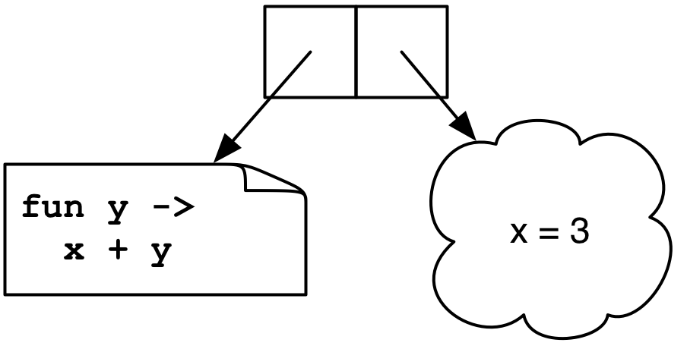
Example
let add x = (fun y -> x + y)
(add 3) 4
→ <closure> 4
→ 3 + 4
→ 7
Notes:
(add 3) returns the closure "<closure> 4".
The environment shown as the cloudy shape consists of all variables in scope at the time the closure was created. The other part of a closure is the function's code.
Add returns a function, which has one parameter, which adds its parameter to the value of x in existence when the closure was created. This is what's returned, and here then called on 4.

Slide 3
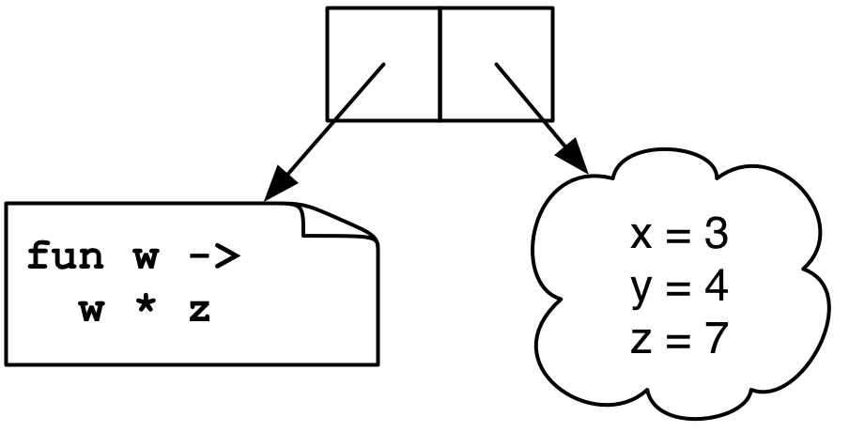
Another Example
let mult_sum (x, y) =
let z = x + y in
fun w -> w * z
(mult_sum (3, 4)) 5
→ <closure> 5
→ 5 * 7
→ 35
Notes:
The function we get back is a closure.
The closure’s environment won't actually contain x and y, since the closure's code doesn't use them.

Slide 4
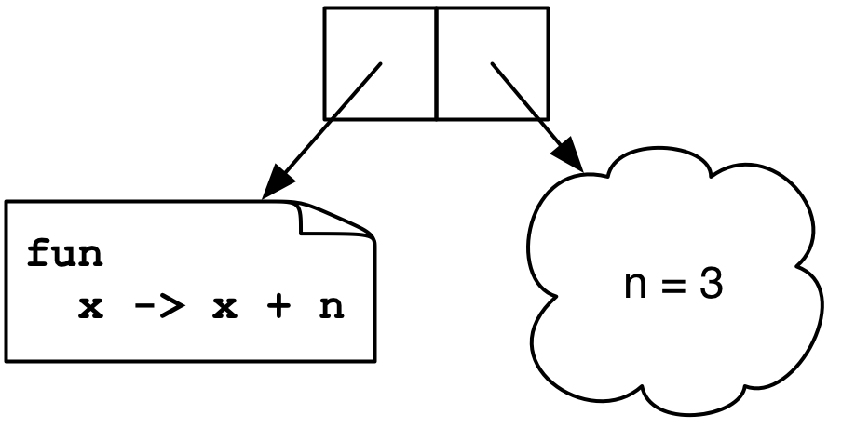
Yet Another Example
let twice (n, y) =
let f x = x + n in
f (f y)
twice (3, 4)
→ <closure> (<closure> 4)
→ <closure> 7
→ 10
Notes:
This code applies f twice.
<closure> (<closure> 4) is the same closure.
Here we only showed the variables used in the closure's environment.
Creating closures happens all the time in OCaml. Here declaring a function inside a function gives us a closure, which captures the surrounding environment.

Slide 5
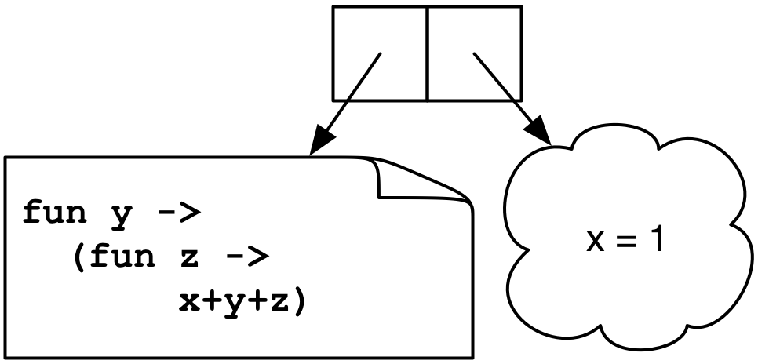
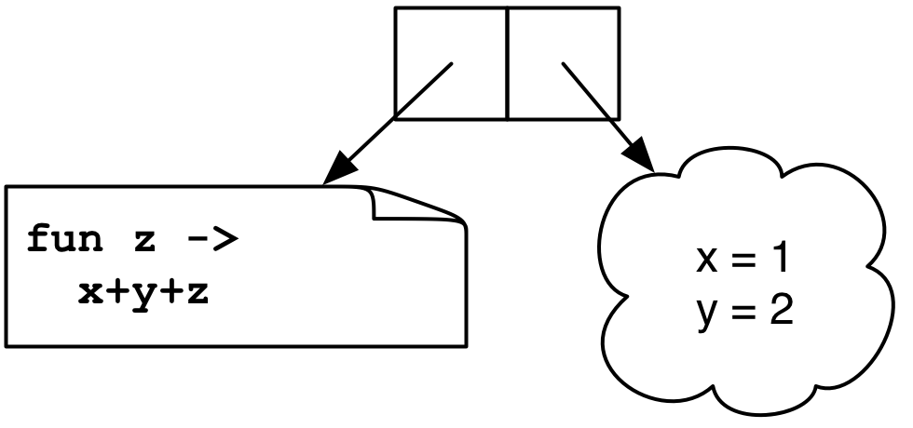
Still Another Example
let add x = (fun y -> (fun z -> x + y + z))
(((add 1) 2) 3)
→ ((<closure> 2) 3)
→ (<closure> 3)
→ 1+2+3
Notes:
Besides the "let add (x, y, z)= x + y + z" method of creating a function with multiple arguments in OCaml (passing a tuple) this is also a way. add is a function which takes an argument, and returns a function which takes a second argument, which returns a function which takes a third argument. This last function (both of them actually) is a closure, which captures the first two arguments, so giving it a third argument results in the sum of the three arguments.
Note the two closures have different enviroments.
What happens if you type (add 1) into Ocaml? You'll see it’s a function type.
The closure has a name.

Slide 6
Currying
We just saw another way for a function to take multiple arguments: the function consumes one argument at a time, creating closures until all the arguments are available
This is called currying the function
Named after the logician Haskell B. Curry
But Schönfinkel and Frege discovered it, so it should probably be called Schönfinkelizing or Fregging

Slide 7
Curried Functions in OCaml
OCaml has a really simple syntax for currying
This is identical to all of the following:
Thus:
add has type int -> (int -> int)
add 3 has type int -> int
add 3 is a function that adds 3 to its argument
(add 3) 4 = 7
This works for any number of arguments
let add x y = x + y
let add = (fun x -> (fun y -> x + y))
let add = (fun x y -> x + y)
let add x = (fun y -> x + y)
Notes:
Curried functions are so common in OCaml that they're built into the language. Every standard function uses currying.
The first form is identical to any and all of the three following forms.
Note that it's not really a function with multiple arguments, it's a function which takes an int and returns a function which takes an int and returns the sum of the two ints.
(CAN YOU DEFINE AN INFIX FUNCTION (OPERATOR) IN OCAML???)

Slide 8
Curried Functions in OCaml (cont’d)
Because currying is so common, OCaml uses the following conventions:
-> associates to the right
Thus int -> int -> int is the same as
int -> (int -> int)
Function application associates to the left
Thus add 3 4 is the same as
(add 3) 4
Notes:
-application of functions to arguments associates to the left.
let g = add 3
g 4;;
add x y z
add 3 4 5
add 3 4
apply to 5
apply to 5 6
(CONFUSING- EXAM QUESTION?)

Slide 9
Another Example of Currying
A curried add function with three arguments:
The same as
Then...
add_three has type int -> (int -> (int -> int))
add_three 4 has type int -> (int -> int)
add_three 4 5 has type int -> int
add_three 4 5 6 is 15
let add_three x y z = x + y + z
let add_three x = (fun y -> (fun z -> x+y+z))

Slide 10
Currying and the map Function
let rec map f l = match l with
[] -> []
| (h::t) -> (f h)::(map f t)
Examples
let negate x = -x
map negate [1; 2; 3] (* returns [-1; -2; -3 ] *)
let negate_list = map negate
negate_list [-1; -2; -3]
let sum_pairs_list = map (fun (a, b) -> a + b)
sum_pairs_list [(1, 2); (3, 4)] (* [3; 7] *)
What's the type of this form of map?
Notes:
Now map doesn't take a tuple any more.
"map negate" partially applies the function.
You can partcally evaluate functions, passing in some of their arguments, but not all.
What's the type of map now? map: ('a -> 'b) -> 'a list -> 'b list, which means ('a -> 'b) -> ('a list -> 'b list) – a function which takes a function (from 'a's to 'b's) and which returns a function from 'a list to 'b list.
So the type of negate_list is int list -> int list. We give map a function from int to int, and it gives back a function from int list to int list.
The type of sum_pairs_list is (int * int) list -> int list. We give map a function int * int -> int, and it gives back a function from (int * int) list to int list.

Slide 11
Currying and the fold Function
let rec fold f a l = match l with
[] -> a
| (h::t) -> fold f (f a h) t
let add x y = x + y
fold add 0 [1; 2; 3]
let sum = fold add 0
sum [1; 2; 3]
let next n _ = n + 1
let length = fold next 0 (* warning: not polymorphic *)
length [5; 6; 7; 8]
What's the type of this form of fold?
Notes:
The type of this form of fold is fold : ('a -> 'b -> 'a) -> 'a -> 'b list -> 'a, which means ('a -> 'b -> 'a) -> 'a -> ('b list -> 'a), which means ('a -> 'b -> 'a) -> ('a -> ('b list -> 'a))

Slide 12
Another Convention
Since functions are curried, function can often be used instead of match, function declares an anonymous function of one argument
Instead of
It could be written
let rec sum l = match l with
[] -> 0
| (h::t) -> h + (sum t)
let rec sum = function
[] -> 0
| (h::t) -> h + (sum t)
Notes:
If you look at the OCaml standard libraries they're all written in the curried style (such as nth).
Note: function declares an anonymous function of one argument, which does pattern-matching on that argument. Note that the match pattern doesn't appear in the parameter list.
"function" is a more fundamental function definition, it takes only one parameter, and immediately goes into pattern matching mode.
"fun" is a shorthand for creating functions with more than one parameter. It can be converted into an equivalent definition using "function"
In situations where you want to write a function in which you want to do pattern-matching on the last argument, "function" is very convenient.
You can't do the latter one with fun, because you need a function name to call recursively.
A function of one argument is good enough for anything. You can replace multiargument functions with functions of one argument, but optimization often avoids curring.

Slide 13
Another Convention (cont’d)
Instead of
It could be written
let rec map f l = match l with
[] -> []
| (h::t) -> (f h)::(map f t)
let rec map f = function
[] -> []
| (h::t) -> (f h)::(map f t)
Notes:
You'll see in these files.
The second example takes f (a function) and returns another function.
Note that here map takes an argument f and its body is a function which has an anonymous, unnamed argument, so map itself has two arguments, just like in the top form.

Slide 14
Currying is Standard in OCaml
Pretty much all functions are curried
Like the standard library map, fold, etc.
See /usr/local/ocaml/lib/ocaml on Grace
In particular, look at the file list.ml for standard list functions
Access these functions using List.<fn name>
E.g., List.hd, List.length, List.map
OCaml plays a lot of tricks to avoid creating closures and to avoid allocating on the heap
It's unnecessary much of the time, since functions are usually called with all arguments

Slide 15
Higher-Order Functions in C
C has function pointers but not closures
(gcc has closures)
typedef int (*int_func)(int);
void app(int_func f, int *a, int n) {
int i;
for (i = 0; i < n; i++)
a[i] = f(a[i]);
}
int add_one(int x) { return x + 1; }
int main() {
int a[] = {1, 2, 3, 4};
app(add_one, a, 4);
}
Notes:
gcc has the code part of closures, but not the environment part (because gcc has nested functions).
You see function pointers when simulating an object.
typedef int (*int_func)(int); is a function pointer type.
int_func is something which if you dereference it and call it, passing an int, you'll get an int. Therefore it must be pointer to a function which takes an int and returns an int.
Why isn't f void *? Then you couldn't call it without casting.
add_one matches the pointer type above.

Slide 16
Higher-Order Functions in Ruby
Use yield within a method to call a code block argument
def my_collect(a)
b = Array.new(a.length)
i = 0
while i < a.length
b[i] = yield(a[i])
i = i + 1
end
return b
end
b = my_collect([1, 2, 3, 4, 5]) { |x| -x }
Notes:
Any method can have a code block associated with it, and it can be automatically called using yield.
A function can check whether it's been passed a code block (HOW???) and decide whether it needs to call yield.
You can't have multiple code block arguments (EASILY OR AT ALL???)
a is the only explicit parameter
Instead of a loop, the function could use push and pop.
yield calls the code block.
collect is like map.
(DOES A HIGHER-ORDER FUNCTION (CODE BLOCK) CARRY AN ENVIRONMENT WITH IT IN RUBY? TRY AND SEE.)

Slide 17
Higher-Order Functions in Java/C++
An object in Java or C++ is kind of like a closure
it’s some data (like an environment)
along with some methods (i.e., function code)
So objects can be used to simulate closures
Later we’ll look at how to implement some functional programming patterns in OO languages
Notes:
Does Ruby have closures (which carry an environment)? Try it and see, or look it up.

