Slide 1
CMSC 330: Organization of Programming Languages
Context-Free Grammars

Slide 2
Motivation
Programs are just strings of text
But they’re strings that have a certain structure
A C program is a list of declarations and definitions
A function definition contains parameters and a body
A function body is a sequence of statements
A statement is either an expression, an if, a goto, etc.
An expression may be assignment, addition, subtraction, etc
We want to solve two problems
We want to describe programming languages precisely
We need to describe more than the regular languages
Recall that regular expressions, DFAs, and NFAs are limited in their expressiveness
Notes:
Programs have lots of nested entities, which regular languages can't describe.
Why do we want to be able to describe programming languages precisely? Because informal techniques are imprecise, and because we need formal techniques to be able to write programs which can read and understand and process programs, such as compilers, program testing systems, etc.

Slide 3
Context-Free Grammars (CFGs)
A way of generating sets of strings or languages
They subsume regular expressions (and DFAs and NFAs)
There is a CFG that generates any regular language
(But regular expressions are a better notation for languages that are regular.)
They can be used to describe programming languages
They describe the parsing process (mostly)

Slide 4
Formal Definition
A context-free grammar G is a 4-tuple:
Σ – a finite set of terminal or alphabet symbols
Often written in lowercase
N – a finite, nonempty set of nonterminal symbols
Often written in uppercase
It must be that N ∩ Σ = ∅
P – a set of productions of the form N → (Σ|N)*
Informally this means that the nonterminal can be replaced by the string of zero or more terminals or nonterminals to the right of the →
S ∈ N – the start symbol

Slide 5
Example: Arithmetic Expressions (Limited)
Σ = { +, -, *, (, ), a, b, c }, N = { E }
P = { E → a, E → b, E → c, E → E+E,
E → E-E, E → E*E, E → (E)}, S = E
An expression E is either a letter a, b, or c
Or an E followed by + followed by an E
etc.
This describes or generates a set of strings
{a, b, c, a+b, a+a, a*c, a-(b*a), c*(b + d),…}
Example strings not in the language
d, c(a), a+, b**c, etc.
Notes:
Show one string being generated.
Nonterminals represent parts of strings created by terminals.
You can't describe languages with balanced sets of parentheses with DFAs, NFAs, or regular expressions (recall earlier when discussing regular languages I said that arithmetic expressions aren't regular).

Slide 6
Notational Shortcuts
If not specified, assume the left-hand side of the first listed production is the start symbol
Usually productions with the same left-hand sides are combined with |
If a production has an empty right-hand side it means ε
Using these shortcuts we could instead write this grammar as
E → a | b | c | E+E | E-E | E*E | (E)

Slide 7
Another Example Grammar
S → aS | T
T → bT | U
U → cU | ε
Notes:
What are the nonterminals?
S, T, U
You can tell because they appear on the left-hand sides of some production.
What are the terminals?
a, b, c
They only appear on the right-hand sides of some production.
What is the start symbol?
Epsilon isn't a terminal symbol (it's not a symbol at all).

Slide 8
Sentential Forms and Derivations
A sentential form is a string of terminals and nonterminals produced from that grammar's start symbol
The start symbol is a sentential form for a grammar
If αAβ is a sentential form for a grammar, where (α and β ∊ (N|Σ)*), and A → γ is a production, then αγβ is a sentential form for the grammar
In this case, we say that αAβ derives αγβ in one step, which is written as αAβ ⇒ αγβ
⇒⁺ is used to indicate a derivation of one or more steps
⇒* indicates a derivation of zero or more steps
Notes:
A sentential form is something in the form of a sentence (another term used for a string).

Slide 9
Example
S → aS | T
T → bT | U
U → cU | ε
A derivation:
S ⇒ aS ⇒ aT ⇒ aU ⇒ acU ⇒ ac
Abbreviated as S ⇒⁺ ac
So S, aS, aT, aU, acU, ac are all sentential forms for this grammar
S ⇒ T ⇒ U ⇒ ε
Is there any derivation
S ⇒⁺ ccc ? S ⇒⁺ Sa ?
S ⇒⁺ bab ? S ⇒⁺ bU ?
Notes:
Show the derivations for ccc and bU.
Explain the only difference between ⇒⁺ and ⇒*

Slide 10
The Language Generated by a CFG
The language generated by a grammar G is
L(G) = { w | w ∊ Σ* and S ⇒⁺ w }
(where S is the start symbol of the grammar and Σ is the alphabet for that grammar)
I.e., all sentential forms with only terminals
I.e., all strings over Σ that can be derived from the grammar's start symbol by applying one or more productions

Slide 11
Example (cont’d)
S → aS | T
T → bT | U
U → cU | ε
Generates what language?
Do other grammars generate this language?
S → ABC
A → aA | ε
B → bB | ε
C → cC | ε
So grammars are not unique
Notes:
a*b*c*
This language and this grammar aren't like the arithmetic expression grammar, which we said generated a language which no regular expression, no NFA, and no DFA could ever describe. Here the grammar generates a language which could be described using an r.e.
Show a derivation of the same string (such as bcc) in both grammars. Note there's more than one way to do it in the second grammar, but only one way in the first grammar.

Slide 12
Parse Trees
A parse tree represents a derivation:
The root node is the start symbol
Each interior node is a nonterminal
The children of a node are the symbols on the right-hand side of the production applied to that nonterminal
The leaves are all terminal symbols
Reading the leaves left-to-right shows the string corresponding to the tree
Notes:
The order productions are applied in a derivation is unimportant, but what is important it what's replaced by what.

Slide 13
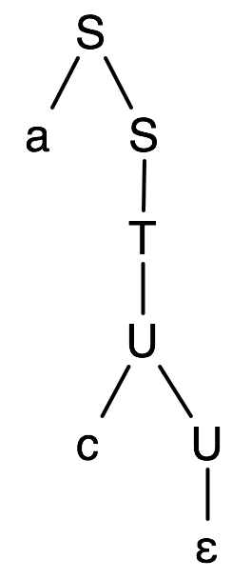
Example
S ⇒ aS ⇒ aT ⇒ aU ⇒ acU ⇒ ac
S → aS | T
T → bT | U
U → cU | ε

Slide 14

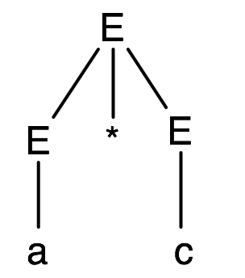
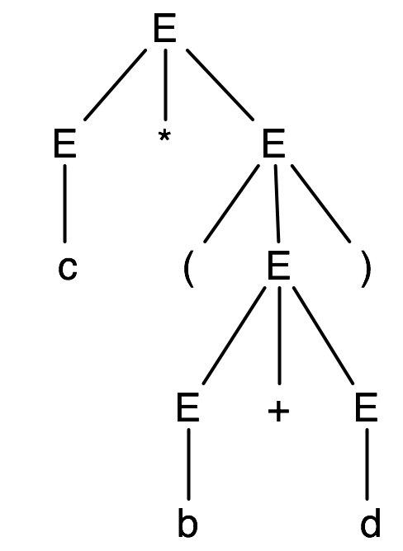
Parse Trees for Expressions
A parse tree shows the structure of an expression as it corresponds to a grammar
E → a | b | c | d | E+E | E-E | E*E | (E)
a
a*c
c*(b+d)

Slide 15
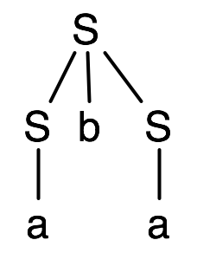
Another Example
Is a in the language generated by this grammar?
How about aba?
Yes, there are two possible derivations
S ⇒ SbS ⇒ abS ⇒ aba
This is a leftmost derivation
At every step, apply production to leftmost nonterminal
S ⇒ SbS ⇒ Sba ⇒ aba
This is a rightmost derivation
Both derivations have the same parse tree
A parse tree has a unique leftmost and a unique rightmost derivation
Parse trees don’t show the order productions were applied
S → a | SbS

Slide 16
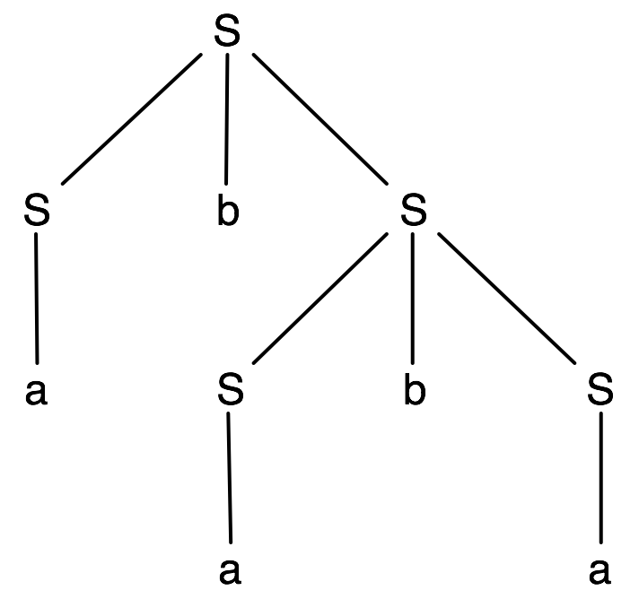
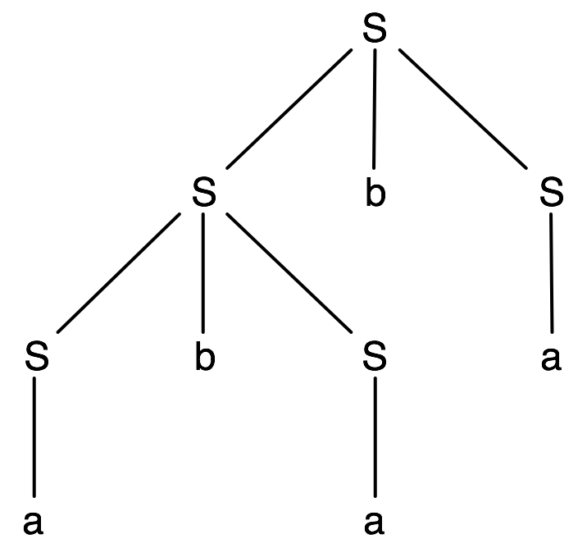
Another Example (cont’d)
S → a | SbS
Is ababa in this language?
A leftmost derivation
S ⇒ SbS ⇒ abS ⇒
abSbS ⇒ ababS ⇒ ababa
Another leftmost derivation
S ⇒ SbS ⇒ SbSbS ⇒
abSbS ⇒ ababS ⇒ ababa
Notes:
Also there's a non-leftmost and a non-rightmost derivation.

Slide 17
Ambiguity
A string is ambiguous for a grammar if it has more than one parse tree
Equivalent to more than one leftmost (or more than one rightmost) derivation
A grammar is ambiguous if it generates an ambiguous string
It can be hard to see this with manual inspection
Exercise: can you create an unambiguous grammar which generates the same language?
Notes:
Ambiguity means there's more than one way to parse a string.

Slide 18
Are these Grammars Ambiguous?
S → aS | T
T → bT | U
U → cU | ε
S → T | T
T → Tx | Tx | x | x
Notes:
In any derivations created using the first one, all sentential forms will only have one nonterminal since there's only one nonterminal in each production.
In the second one it's easy to see whether it's ambiguous by just writing it without repeated productions. Duplicating a production doesn't change the shape of the parse tree. The set of productions is a set, and there's no notion of duplicate elements in a set.
So neither one is ambiguous.

Slide 19
More on Leftmost/Rightmost Derivations
Is the following derivation leftmost or rightmost?
S ⇒ aS ⇒ aT ⇒ aU ⇒ acU ⇒ ac
There’s at most one nonterminal in each sentential form, so there's no choice between left or right nonterminals to expand
How about the following derivation?
S ⇒ SbS ⇒ SbSbS ⇒ SbabS ⇒ ababS ⇒ ababa
Notes:
The first one is both leftmost and rightmost.
The second one is neither leftmost nor rightmost. A derivation doesn't have to be leftmost or rightmost.

Slide 20
Tips for Designing Grammars
Use recursive productions to generate an arbitrary number of symbols
A → xA | ε Zero or more x’s
A → yA | y One or more y’s
Use separate nonterminals to generate disjoint parts of a language, and then combine in a production
G = S → AB
A → aA | ε
B → bB | ε
L(G) = a*b*
Notes:
The first two rules are similar to the r.e. operations * and +.

Slide 21
Tips for Designing Grammars (cont’d)
To generate languages with matching, balanced, or related numbers of symbols, write productions which generate strings from the middle
{a^{n}b^{n} | n ≥ 0} (not a regular language!)
S → aSb | ε
Example: S ⇒ aSb ⇒ aaSbb ⇒ aabb
{a^{n}b^{2n} | n ≥ 1}
S → aSbb | abb
Notes:
Languages have all sorts of balancing properties.
Note that this first grammar is extremely small but already can generate a language which no r.e., DFA, or NFA can recognize or describe.
Note the different base (nonrecursive) case in the second example, due to the fact that n ≥ 1, compared to n ≥ 0 in the prior example.

Slide 22
Tips for Designing Grammars (cont’d)
{a^{n}b^{m} | m ≥ 2n, n ≥ 0}
S → aSbb | B | ε
B → bB | b
The following grammar also works:
S → aSbb | B
B → bB | ε
How about the following?
S → aSbb | bS | ε
Notes:
The third one is wrong (does it generate every valid string?). Yes, it generates every valid string, but it generates invalid strings.
Show an example of the third one generating an invalid string, like ababbbb.
To say that a grammar generates a language, it must generate all, and only, valid strings in the language.

Slide 23
Tips for Designing Grammars (cont’d)
{a^{n}b^{m}a^{n+m} | n ≥ 0, m ≥ 0}
Rewrite as a^{n}b^{m}a^{m}a^{n}, which now has matching superscripts (two pairs)
Would this grammar work?
S → aSa | B
B → bBa | ba
Corrected:
S → aSa | B
B → bBa | ε
The outer a^{n}a^{n} are generated first,
then the inner b^{m}a^{m}
Notes:
The first one is wong. Do you see an invalid string which it generates? No, it only generates valid strings, but it can't generate some valid strings such as epsilon, aa, aaaa, etc.
This is like the r.e. question from last semester's Exam #1- (z|zz)(zzz)*. E.g., z^n = z^mz^p if n = m + p.

