Slide 1
CMSC 330: Organization of Programming Languages
Context-Free Grammars, con't.

Slide 2
Tips for Designing Grammars (cont’d)
For a language that’s the union of other languages, use separate nonterminals for each part of the union and then combine
{ a^{n}(b^{m}|c^{m}) | m > n ≥ 0}
Can be rewritten as
{ a^{n}b^{m} | m > n ≥ 0} ∪ { a^{n}c^{m} | m > n ≥ 0}

Slide 3
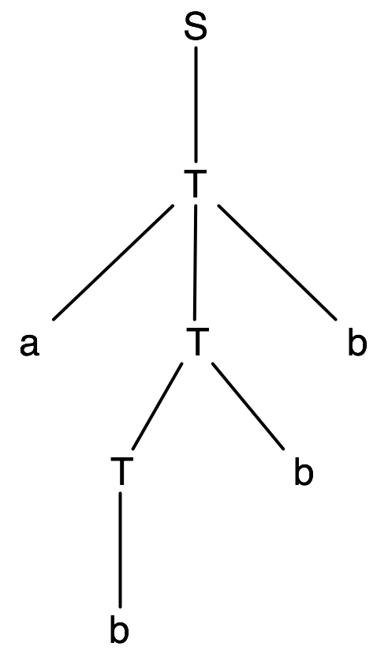
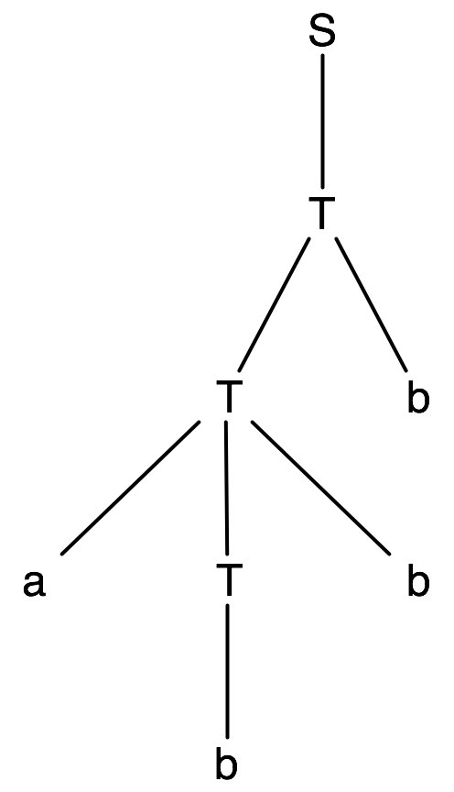
Tips for Designing Grammars (cont’d)
{ a^{n}b^{m} | m > n ≥ 0} ∪ { a^{n}c^{m} | m > n ≥ 0}
S → T | U
T → aTb | Tb | b T generates the first set of strings
U → aUc | Uc | c U generates the second set of strings
What about the string abbb?
Ambiguous!
Notes:
I claim something's wrong with this grammar. Does it generate any invalid stirngs? (No.) Does it fail to generate any valid strings? (Also no.) It generates all and only valid strings. Then what could be wrong with it?

Slide 4
Tips for Designing Grammars (cont’d)
{ a^{n}b^{m} | m > n ≥ 0} ∪ { a^{n}c^{m} | m > n ≥ 0}
Will this fix the ambiguity?
S → T | U
T → aTb | bT | b
U → aUc | cU | c
It's not ambiguous, but it can generate invalid strings such as babb

Slide 5
Tips for Designing Grammars (cont’d)
{ a^{n}b^{m} | m > n ≥ 0} ∪ { a^{n}c^{m} | m > n ≥ 0}
Unambiguous version
S → T | V
T → aTb | U
U → Ub | b
V → aVc | W
W → Wc | c

Slide 6
CFGs for Languages
Recall that our goal is to describe programming languages with CFGs
We had the following example which describes limited arithmetic expressions
E → a | b | c | E+E | E-E | E*E | (E)
What’s wrong with using this grammar?
It’s ambiguous!

Slide 7
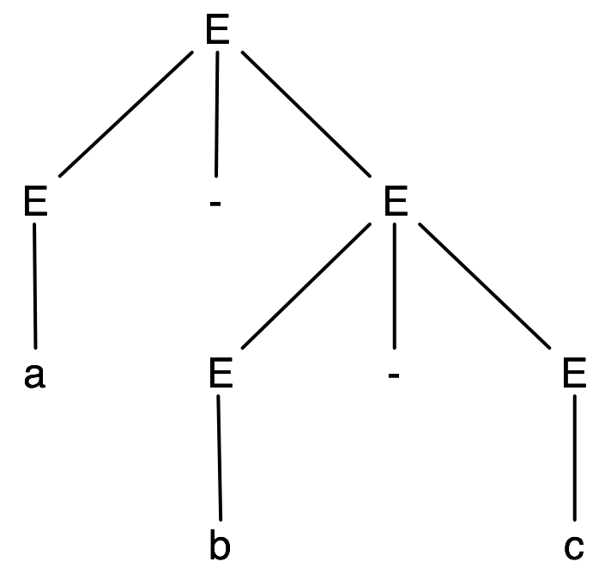
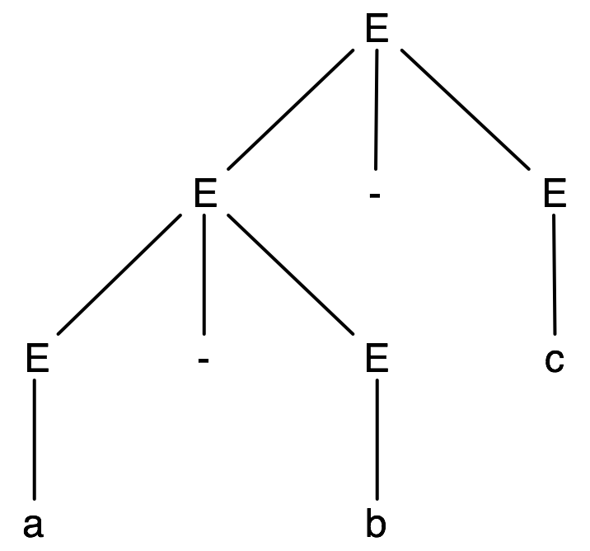
Example: a-b-c (E → a | b | c | E+E | E-E | E*E | (E))
E ⇒ E-E ⇒ a-E ⇒ a-E-E ⇒ a-b-E ⇒ a-b-c
E ⇒ E-E ⇒ E-E-E ⇒
a-E-E ⇒ a-b-E ⇒ a-b-c
Corresponds to a-(b-c)
Corresponds to (a-b)-c

Slide 8
The Issue: Associativity
Ambiguity is bad here because if a compiler needs to generate code for this expression, it doesn’t know what the programmer intended
So what do we mean when we write a-b-c?
In mathematics, this has only one meaning- it’s
(a-b)-c, since subtraction is left-associative
a-(b-c) would be the meaning if subtraction was right-associative
Two approaches to handle ambiguity:
Rewrite the grammar
Use special parsing rules, depending on the parsing method being used (covered in CMSC 430)
Notes:
A compiler uses CFGs to parse, but it also uses the derivations (parse trees) produced to generate code.
Ambiguity means that we can determine that (some) strings are valid (syntactically correct), but not what they mean (their semantics).

Slide 9
Another Example: If-Then-Else
<stmt> ::= <assignment> | <if-stmt> | ...
<if-stmt> ::= if (<expr>) <stmt> |
if (<expr>) <stmt> else <stmt>
(Here <>’s are used to denote nonterminals and ::= for productions)
Consider the following program fragment:
if (x > y)
if (x < z)
a = 1;
else a = 2;
Note: ignore spaces and newlines
Notes:
According to the indentation it means one thing, but what if it’s indented wrong? (Indentation isn't what controls the interpretation of program parts in many languages).
Parsing usually (in most languages) just skips and ignores whitespace, except that it's used to delimit some tokens (e.g., adjacent identifiers).

Slide 10
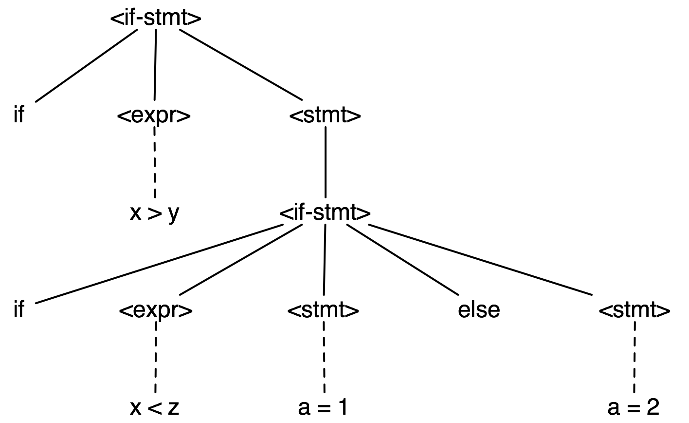
Parse Tree #1
else belongs to inner if

Slide 11
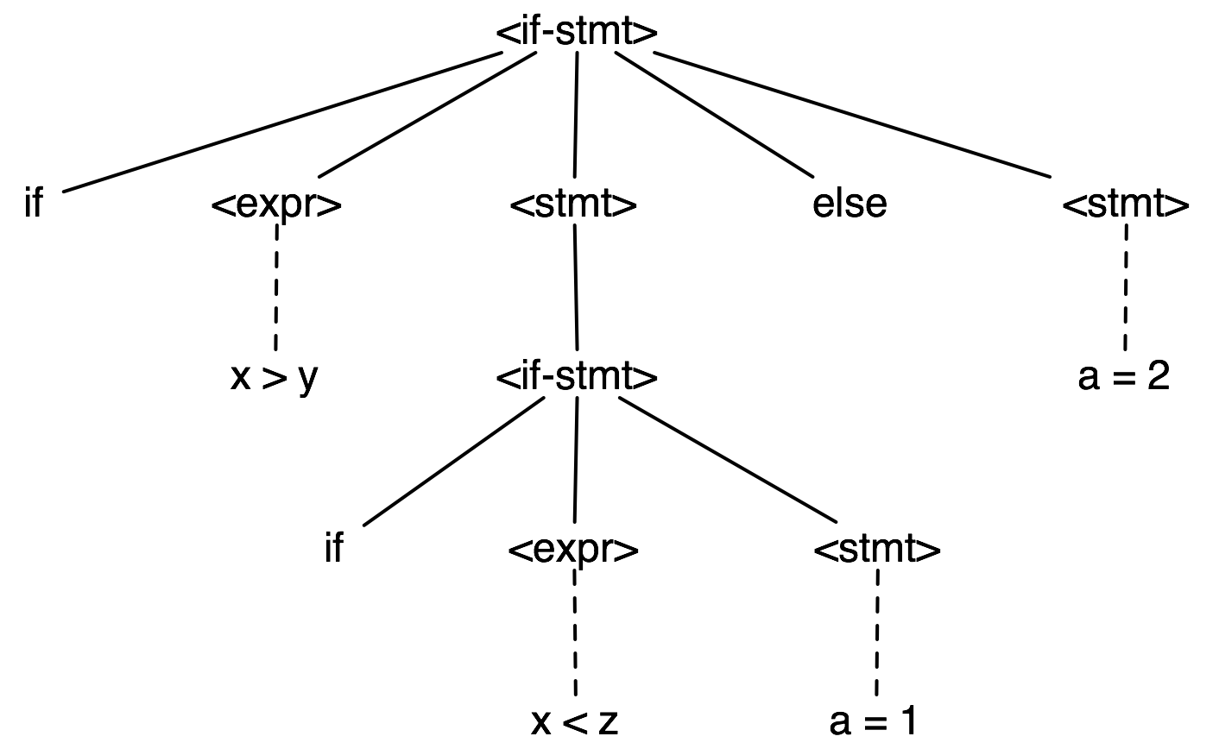
Parse Tree #2
else belongs to outer if

Slide 12
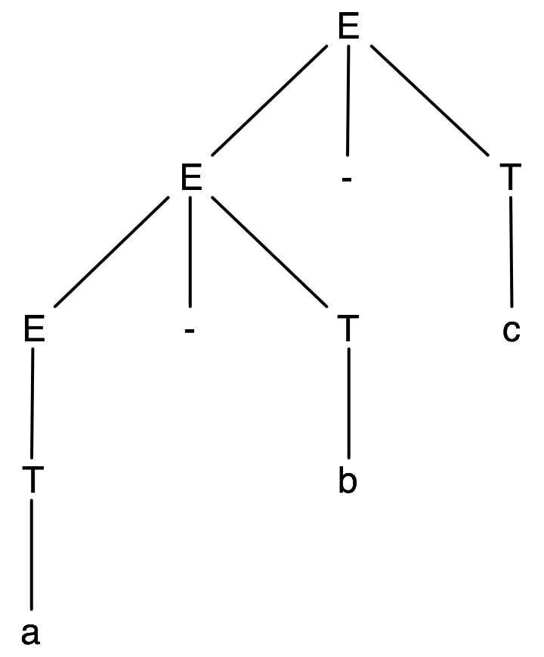
Fixing the Expression Grammar
Idea: Require that the right operand of all of the operators is not a bare expression
E → E+T | E-T | E*T | T
T → a | b | c | (E)
Now there's only one parse
tree for a-b-c
Exercise: Give a derivation
in this grammar for the string a-(b-c)
Notes:
Why does the problem happen? In the production E -> E – E you don't want the second E to be something which has an E.
By changing the grammar in this way we haven't changed the language the grammar generates.

Slide 13
What if We Wanted Right-Associativity?
Left-recursive productions are used for left-associative operators
Right-recursive productions are used for right-associative operators
Left:
E → E+T | E-T | E*T | T
T → a | b | c | (E)
Right:
E → T+E | T-E | T*E | T
T → a | b | c | (E)

Slide 14
Parse Tree Shape
The kind of recursion/associativity determines the shape of the parse tree
Exercise: draw a parse tree for a-b-c in the prior grammar in which subtraction is right-associative
left recursion
right recursion

Slide 15

A Different Problem
How about the string a+b*c?
The grammar was
E → E+T | E-T | E*T | T
T → a | b | c | (E)
Doesn’t have correct
precedence for *
When a nonterminal has productions for several operators, they effectively have the same precedence
How can we fix this?
Notes:
If we changed the grammar to T * E it fixes this expression but not a * b + c * a.
This isn't a question of ambiguity.
We can construct a hierarchy of productions, similar to what we did before to avoid ambiguity.

Slide 16
Final Expression Grammar
E → E+T | E-T | T lowest precedence operators
T → T*P | P higher precedence
P → a | b | c | (E) highest precedence (parentheses)
Exercises:
Construct tree and left and and right derivations for
a+b*c a*(b+c) a*b+c a-b-c
See what happens if you change the last set of productions to P → a | b | c | E | (E)
See what happens if you change the first set of productions to E → E +T | E-T | T | P
Notes:
Discuss how the hierarchy now forces all + and – operators (those with lowest precedence) to be done firs and be highest in or at the top of a parse tree, with higher precedence operators below them (so they're applied to the results of higher precedence operators). You can't go backwards in the hierarchy unless you generate parentheses.
The grammar now:
Generates every valid string.
Generates only valid strings.
Captures the desired associativity of the operators (left-associative for these operators).
Captures the operators' precedence.
Is unambiguous.

Slide 17
Regular expressions and CFGs
 | Description | Machine
regular languages | regular expressions | DFAs, NFAs
context-free languages | context-free grammars | pushdown automata (PDAs)
Programming languages are neither regular nor context-free
Usually almost context-free, with some hacks
Notes:
Context-free languages are just the languages which can be generated using context-free grammars.
2DPDAs are stronger (can generate more languages than) CFGs and PDAs.

Slide 18
Context-free Grammars in Practice
Regular expressions are used to turn raw text into a string of tokens
E.g., “if”, “then”, “identifier”, etc.
Whitespace and comments are simply skipped
These tokens are the input for the next phase of compilation
Standard tools used are lex and flex
CFGs are used to turn tokens into parse trees
This process is called parsing
Standard tools used are yacc and bison
Those trees are then analyzed by the compiler, which eventually produces object code
Notes:
Move this slide to the beginning of grammars next time?

