Slide 1
CMSC 330: Organization of Programming Languages
Parsing
Notes:
1

Slide 2
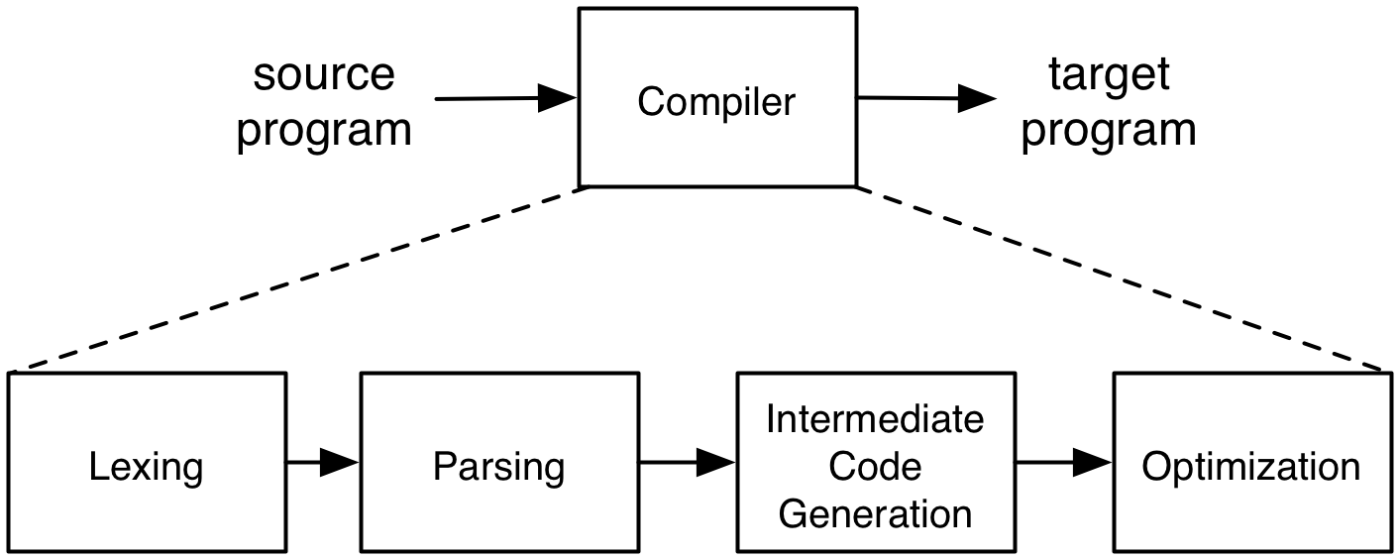
Steps of Compilation

Slide 3
Parsing
There are many efficient techniques for parsing, i.e., turning strings into parse trees
Examples:
LL(k), SLR(k), LR(k), LALR(k)…
Take CMSC 430 for more details
One simple technique is recursive descent parsing
This is a “top-down” parsing algorithm

Slide 4
Recursive Descent Parsing
Goal: determine if we can produce the string to be parsed from the grammar's start symbol
Approach: recursively replace nonterminals with right-hand sides of their productions
At each step, we'll keep track of two facts:
What tree node are we trying to match?
What is the lookahead (the next token of the input string)?
The lookahead helps guide the selection of the production used to replace a nonterminal

Slide 5
Recursive Descent Parsing (cont.)
At each step there are three possible cases:
If we’re trying to match a terminal, and the lookahead is that token, then succeed, advance the lookahead, and continue
If we’re trying to match a nonterminal, pick which production to apply based on the lookahead
Otherwise fail with a parsing error

Slide 6
Parsing Example
E → id = n | {L}
L → E ; L | ε
Here n is an integer and id is an identifier
One input might be {x = 3; {y = 4;};}
This would get turned into a list of tokens
{ x = 3 ; { y = 4 ; } ; }
And we want to turn it into a parse tree

Slide 7
Parsing Example (cont.)
E
E → id = n | {L}
L → E ; L | ε
{x = 3 ; {y = 4 ;} ;}
{
L
}
E
;
L
x
=
3
E
;
L
lookahead
{
L
}
ε
E
;
L
y
=
4
ε

Slide 8
Recursive Descent Parsing (cont.)
The key step is choosing which production should be selected
Two approaches are:
Backtracking:
Choose some production
If it fails, try a different production
The parse fails if all choices fail
Predictive parsing:
Analyze the grammar to find FIRST sets for productions
Compare with lookahead to decide which production to select
The parse fails if the lookahead does not match FIRST

Slide 9
First Sets
Motivating example:
The lookahead is x
Given the grammar S → xyz | abc
Select S → xyz since 1st terminal in RHS matches x
Given the grammar S → A | B A → x | y B → z
Select S → A, since A can derive string beginning with x
In general:
Choose a production that can derive a sentential form beginning with the lookahead
Need to know what terminal may be first in any sentential form derived from a nonterminal / production

Slide 10
First Sets
Definition: First(γ), for any terminal or nonterminal γ, is the set of initial terminals of all strings that γ may expand to
We’ll use this to decide what production to apply
Examples:
Given the grammar S → xyz | abc
First(xyz) = {x}, First(abc) = {a}
First(S) = First(xyz) U First(abc) = {x, a}
Given the grammar S → A | B A → x | y B → z
First(x) = {x}, First(y) = {y}, First(A) = {x, y}
First(z) = {z}, First(B) = {z}
First(S) = {x, y, z}

Slide 11
Calculating First(γ)
For a terminal a, First(a) = {a}
For a nonterminal N
If N → ε, then add ε to First(N)
If N → α₁ α₂ ... α_{n}, then (note the α_{i} are all the symbols on the right side of one single production):
Add First(α₁α₂ ... α_{n}) to First(N), where First(α₁ α₂ ... α_{n}) is defined as
First(α₁) if ε ∉ First(α₁)
Otherwise (First(α₁) – ε) ⋃ First(α₂ ... α_{n})
If ε ∈ First(α_{i}) for all i, 1 ≤ i ≤ k, then add ε to First(N)

Slide 12
First() Examples
E → id = n | {L}
L → E ; L | ε
First(id) = {id}
First("=") = {"="}
First(n) = {n}
First("{")= {"{"}
First("}")= {"}"}
First(";")= {";"}
First(E) = {id, "{" }
First(L) = {id, "{", ε}
E → id = n | {L} | ε
L → E ; L
First(id) = {id}
First("=") = {"="}
First(n) = {n}
First("{")= {"{"}
First("}")= {"}"}
First(";")= {";"}
First(E) = {id, "{", ε}
First(L) = {id, "{", ";"}

Slide 13
Recursive Descent Parser Implementation
For terminals, create a function match(a)
If the lookahead is a it consumes the lookahead by advancing the lookahead to the next token, and returns
Otherwise fails with a parse error if lookahead is not a
For each nonterminal N, create a function parse_N
Called when we’re trying to parse a part of the input which corresponds to (or can be derived from) N
parse_S for the start symbol S begins the parse
Notes:
In algorithm descriptions, consider parse_a and parse_term(a) to be aliases for match(a) (but don't think these are ever used anywhere….).

Slide 14
Parser Implementation (cont.)
The body of parse_N for a nonterminal N does the following:
Let N → β₁ | ... | β_{k} be the productions of N
Here β_{i} is the entire right side of a production- a sequence of terminals and nonterminals
Pick the production N → β_{i} such that the lookahead is in First(β_{i})
It must be that First(β_{i}) ∩ First(β_{j}) = ∅ for i ≠ j
If there is no such production, but N → ε then return
Otherwise fail with a parse error
Suppose β_{i} = α₁ α₂ ... α_{n}. Then call parse_α₁(); ... ; parse_α_{n}() to match the expected right-hand side, and return

Slide 15
Parser Implementation (cont.)
The parse is built on procedure calls
Procedures may be (mutually) recursive

Slide 16
Recursive Descent Parser
Given grammar S → xyz | abc
First(xyz) = {x}, First(abc) = {a}
Parser:
parse_S() {
if (lookahead == “x”) {
match(“x”); match(“y”); match(“z”); // S → xyz
} else if (lookahead == “a”) {
match(“a”); match(“b”); match(“c”); // S → abc
} else error();
}

Slide 17
Recursive Descent Parser
Given grammar S → A | B A → x | y B → z
First(A) = {x, y}, First(B) = {z}
Parser:
parse_S() {
if (lookahead == “x”) ||
lookahead == “y”)
parse_A(); // S → A
else
if (lookahead == “z”)
parse_B(); // S → B
else error();
}
parse_A() {
if (lookahead == “x”)
match(“x”); // A → x
else
if (lookahead == “y”)
match(“y”); // A → y
else error();
}
parse_B() {
if (lookahead == “z”)
match(“z”); // B → z
else error();
}

