Slide 1
CMSC 330: Organization of Programming Languages
Parsing, con't.
Notes:
1

Slide 2
Example
E → id = n | {L}
L → E ; L | ε
First(E) = { id, "{" }
parse_E() {
if (lookahead == “id”) {
match(“id”);
match(“=”); // E → id = n
match(“n”);
} else
if (lookahead == “{“) {
match(“{“);
parse_L(); // E → {L}
match(“}”);
} else error();
}
parse_L() {
if (lookahead == “id” ||
lookahead == “{”) {
parse_E();
match(“;”); // L → E ; L
parse_L();
} else ; // L → ε
}

Slide 3
Things to Notice
If you draw the execution trace of the parser, you get the parse tree
Examples
Grammar
S → xyz
S → abc
String “xyz”
parse_S()
match(“x”)
match(“y”)
match(“z”)
Grammar
S → A | B
A → x | y
B → z
String “x”
parse_S()
parse_A()
match(“x”)
S
|
A
|
x
S
/|\
x y z

Slide 4
Things to Notice (cont.)
This is a predictive parser, because the lookahead determines exactly which production to use
This parsing strategy may fail on some grammars
Possible infinite recursion
Production First sets overlap
Production First sets contain ε
This does not mean the grammar is not usable- it just means this parsing method is not powerful enough
You may be able to change the grammar

Slide 5
Left Factoring
Consider parsing the grammar E → ab | ac
First(ab) = a
First(ac) = a
The parser cannot choose between right-hand sides based on the lookahead!
A recursive descent parser fails whenever A → α₁ | α₂ and First(α₁) ∩ First(α₂) != ε or ∅
Solution: rewrite the grammar using left factoring

Slide 6
Left Factoring Algorithm
Given grammar:
A → xα₁ | xα₂ | … | xα_{n} | β
Rewrite it as:
A → xL | β
L → α₁ | α₂ | … | α_{n}
Repeat as necessary
Examples:
S → ab | ac ⇨ S → aL L → b | c
S → abcA | abB | a ⇨ S → aL L → bcA | bB | ε
L → bcA | bB | ε ⇨ L → bL’ | ε L’ → cA | B
Notes:
The examples don't include any recursive productions!!!

Slide 7
Left Recursion
Consider grammar S → Sa | ε
First(Sa) = a, so we’re ok as far as which production
Try writing parser:
Body of parse_S() has an infinite loop:
if (lookahead = "a") then parse_S()
Infinite loop occurs in grammar with left recursion
parse_S() {
if (lookahead == “a”) {
parse_S();
match(“a”); // S → Sa
} else {}
}

Slide 8
Right Recursion
Consider grammar S → aS | ε
Again, First(aS) = a
Try writing parser:
Will parse_S() infinite loop?
Invoking match() will advance the lookahead, eventually stop
Top down parsers handles grammars with right recursion
parse_S() {
if (lookahead == “a”) {
match(“a”);
parse_S(); // S → aS
} else {}
}

Slide 9
Algorithm To Eliminate Left Recursion
Given grammar A → Aα₁ | Aα₂ | … | Aα_{n} | β
(Why must β exist?)
Rewrite the grammar as:
A → βL
L → α₁L | α₂ L | … | α_{n} L | ε
Replaces left recursion with right recursion
Repeat as necessary

Slide 10
Eliminating Left Recursion (cont.)
Examples
S → Sa | ε ⇨ S → L L → aL | ε
S → Sa | Sb | c ⇨ S → cL L → aL | bL | ε
May need more powerful algorithms to eliminate mutual recursion leading to left recursion
S → Aa | b
A → Sb

Slide 11
Expression Grammar for Top-Down Parsing
E → T E'
E' → ε | + E
T → P T'
T' → ε | * T
P → n | (E)
Notice we can always decide what production to choose with only one symbol of lookahead

Slide 12
Tradeoffs with Other Approaches
Recursive descent parsers are easy to write
The formal definition is a little clunky, but if you follow the code then it’s almost what you might have done if you weren't told about grammars formally
They're unable to handle certain kinds of grammars
Recursive descent is good for a simple parser
Though tools can be fast if you’re familiar with them
Can implement top-down predictive parsing as a table-driven parser, by maintaining an explicit stack to track progress

Slide 13
Tradeoffs with Other Approaches
More powerful techniques need tool support
Can take time to learn tools
The main alternative is a bottom-up, shift-reduce parser
Replaces RHS of production with LHS (nonterminal)
Example grammar: S → aA, A → Bc, B → b
Example parse: abc ⇒ aBc ⇒ aA ⇒ S
The derivation happens in reverse
Something to look forward to in CMSC 430

Slide 14
Usage of Parse Trees
CMSC 330
14
Parse trees contain too much information
E.g., they have parentheses and they have extra nonterminals for precedence
This extra stuff is needed for parsing
But when we want to reason about languages, it gets in the way (it’s too much detail)
Notes:
14

Slide 15
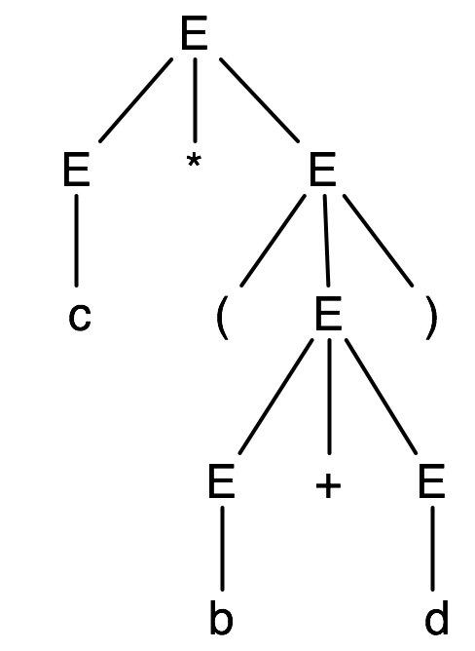
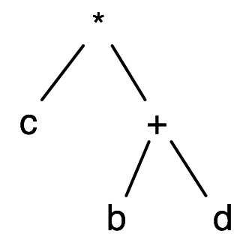
Abstract Syntax Trees (ASTs)
parse
tree
AST
CMSC 330
15
An abstract syntax tree is a more compact, abstract representation of a parse tree, with only the essential parts
Notes:
15
A parse tree is a representation of a derivation in a grammar, while an AST is a representation of a string in a language.
The AST is for the same expression as the parse tree is.
A compiler really produces an AST, not a parse tree.

Slide 16
ASTs (cont’d)
Intuitively, ASTs correspond to the data structure you’d use to represent strings in a language
Note that grammars describe trees, and so do OCaml datatypes
This example uses the first expression grammar,
E → a | b | c | E+E | E-E | E*E | (E), for simplicity
type ast =
Letter of char
| Plus of ast * ast
| Minus of ast * ast
| Times of ast * ast
CMSC 330
16
Notes:
16
Just to be simple, this example uses the first (ambiguous) form of the expression grammar.

Slide 17
Producing an AST
To produce an AST, we can modify the parse() functions to construct the AST along the way
match(a) returns an AST node (leaf) for a
Parse_A returns an AST node for A
AST nodes for RHS of production become children of LHS node
Example
S → aA
Node parse_S() {
Node n1, n2;
if (lookahead == “a”) {
n1 = match(“a”);
n2 = parse_A();
return new Node(n1, n2);
}
}
S
/ \
a
A
|

Slide 18
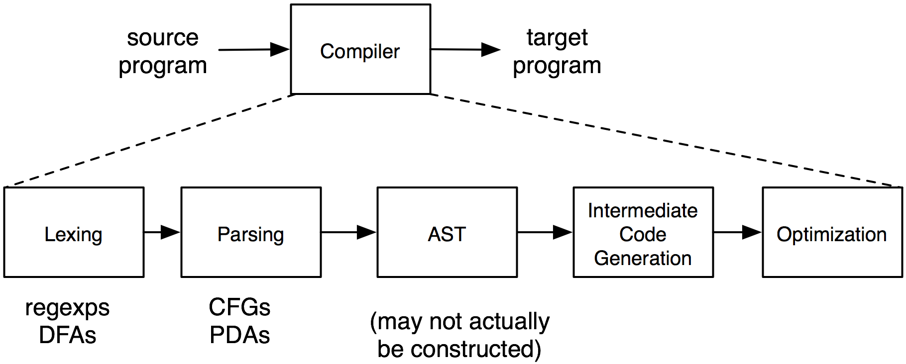
The Compilation Process
CMSC 330
18
Notes:
18
The lexer just breaks long strings (programs) up into shorter strings.

