Slide 1
CMSC 330: Organization of Programming Languages
Type Systems, More on Scoping, and Parameter Passing, con't.
Notes:
1

Slide 2
Static vs. Dynamic Types
With static typing the types of all expressions are determined before a program is run (usually by the compiler)
Disallowed operations cause compile-time error
Static types may be manifest or inferred
Manifest – specified in text (at variable declaration)
C, C++, Java, C#
Inferred – compiler determines type based on usage
ML, OCaml

Slide 3
Static vs. Dynamic Types (cont.)
With dynamic typing the types of all expressions are determined while a program is running
Disallowed operations cause run-time exception
Values maintain a tag indicating their type
Dynamic types are not manifest (obviously)
Examples
Ruby, Python, Javascript, Lisp

Slide 4
Type Safety
Determined by extent programming language allows type errors
Language should only allow operations on values that are permitted by their type
Non-type safe code example:
printf(“%d”, 3.12) // Allows float to be printed as int
Definitions
Type-safe language → strong type system
Non-type safe language → weak type system

Slide 5
Weak vs. Strong Typing
Weak typing allows one type to be treated as another or provides (many) implicit casts
Example (int treated as boolean)
C int i = 1;
if (i) // checks for 0
printf(“%d”, i);
Ruby i = 1
if i // checks for nil
puts(i)
end
Example languages
C, C++, Ruby, Perl, Javascript

Slide 6
Weak vs. Strong Typing (cont.)
Strong typing prevents one type from being treated as another (also known as type-safe)
Example (int not treated as boolean)
Java int i = 1;
if (i) // error, not boolean
System.out.println(i);
OCaml let i = 1 in
if i then // error, not boolean
print_int i
Example languages
Java (rare exceptions), OCaml

Slide 7
Weak/Strong vs. Static/Dynamic Types
How do these properties interact?
Weak/strong & static/dynamic are orthogonal
Some literature confuse strong & static type
Strong / static types
More work for programmer
Catches more errors at compile time
Weak / dynamic types
Less work for programmer
More errors occur at run time

Slide 8
Names and Binding
Programs use names to refer to things
E.g., in x = x + 1, x refers to a variable
A binding is an association between a name and what it refers to
int x; /* x is bound to a stack location containing an int */
int f (int i) { ... } /* f is bound to a function */
class C { ... } /* C is bound to a class */
let x = e1 in e2 (* x is bound to e1 *)
Notes:
8
We used the term binding before, now let's define it and discuss some choices languages make for bindings.
Aren’t these all backwards- wouldn’t that be “e1 is bound to x”, etc.?

Slide 9
Name Restrictions
Languages often have various restrictions on names to make lexing and parsing easier
Names cannot be the same as keywords in the language
OCaml function names must be lowercase
OCaml type constructor and module names must be uppercase
Names cannot include special characters like ; , : etc
Usually names are upper- and lowercase letters, digits, and _ (where the first character can’t be a digit)
Some languages also allow more symbols like ! or -
Notes:
9
In PL/I names can be the same as keywords.

Slide 10
Names and Scopes
Good names are a precious commodity
They help document your code
They make it easy to remember what names correspond to what entities
We want to be able to reuse names in different, non-overlapping regions of the code
Notes:
10

Slide 11
Names and Scopes, con't.
A scope is the region of a program where a binding is active
The same name in a different scope can refer to a different binding (refer to a different program object)
A name is in scope if it's bound to something within the particular scope we’re referring to
Notes:
11

Slide 12
Example
void w(int i) {
...
}
void x(float j) {
...
}
void y(float i) {
...
}
void z(void) {
int j;
char *i;
...
}
i is in scope
in the body of w, the body of y, and after the declaration of j in z
but all those i’s are different
j is in scope
in the body of x and z
these are different j's
Notes:
12

Slide 13
Ordering of Bindings
Languages make various choices for when declarations of things are in scope
Notes:
13

Slide 14
Order of Bindings – OCaml
let x = e1 in e2 – x is bound to e1 in scope of e2
let rec x = e1 in e2 – x is bound in e1 and in e2
let x = 3 in
let y = x + 4 in... (* x is in scope here *)
let x = 3 + x in ... (* error, x not in scope *)
let rec length = function
[] -> 0
| (h::t) -> 1 + (length t) (* ok, length in scope *)
in ...
Notes:
14

Slide 15
Order of Bindings – C
All declarations are in scope from the declaration onward
int i;
int j = i; /* ok, i is in scope */
i = 3; /* also ok */
void f(...) { ... }
int i;
int j = j + 3; /* error */
f(...); /* ok, f declared */
Notes:
15
This is because the designers of C wanted to be able to have a one-pass compiler.

Slide 16
Order of Bindings – Java
Declarations are in scope from the declaration onward, except for methods and fields, which are in scope throughout the class
class C {
void f(){
...g()... // OK
}
void g(){
...
}
}
Notes:
16
The designers of Java didn't feel bound to require that the language have properties which would allow a one-pass compiler, since computers are much faster now.

Slide 17
Shadowing Names
Shadowing is rebinding a name in an inner scope to have a different meaning
May or may not be allowed by the language
C
int i;
void f(float i) {
{
char *i = NULL;
...
}
}
OCaml
let g = 3;;
let g x = x + 3;;
Java
void h(int i) {
{
float i; // not allowed
...
}
}
Notes:
17
Shadowing names is not necessarily a good thing.
Why doesn't Java allow this? Shadowing names leads to confusion. What if both i's were floats?
You can shadow names in some places in Java.
Will a language allow shadowing, and if so where? It depends on the language.

Slide 18
Namespaces
Languages have a “top-level” or outermost scope
Many things go in this scope; hard to control collisions
Common solution seems to be to add a hierarchy
OCaml: Modules
List.hd, String.length, etc.
open adds names into current scope
Java: Packages
java.lang.String, java.awt.Point, etc.
import adds names into current scope
C++: Namespaces
namespace f { class g { ... } }, f::g b, etc.
using namespace adds names to current scope
Notes:
18
For example, many modules in OCaml can have a length function, and there won't be any collision.
Namespaces are hierarchical.
All three languages have similar mechanisms.
In Java, the names of classes are at the toplevel scope.
In C, all extern declarations are at the toplevel scope.
It's hard to avoid collisions when you put together different peoples' code, unless you're using a mechanism like this.

Slide 19
Mangled Names
What happens when these names need to be seen by other languages?
What if a C program wants to call a C++ method? C doesn’t know about C++’s naming conventions
For multilingual communication, names are often mangled into some flat form
E.g., class C { int f(int *x, int y) { ... } } becomes symbol __ZN1C3fEPii in g++
E.g., native valueOf(int) in java.lang.String corresponds to the C function Java_java_lang_String_valueOf__I
Notes:
19
The OS or other languages don't know about the namespace hierarchy which some language have via namespsaces.
What about Java calling C?

Slide 20
Static Scope Recall
In static scoping, a name refers to its closest binding, going from inner to outer scope in the program text
Languages like Java, C, C++, Ruby, and OCaml are statically scoped
int i;
{
int j;
{
float i;
j= (int) i;
}
}
Notes:
20

Slide 21
Free and Bound Variables
The bound variables of a scope are those names that are declared in it
If a variable is not bound in a scope, it is free
The bindings of variables which are free in a scope are "inherited" from declarations of those variables in outer scopes in static scoping
{ /* 1 */
int j;
{ /* 2 */
float i;
j= (int) i;
}
}
j is bound in
scope 1
i is bound in
scope 2
j is free in
scope 2
Notes:
21
Free and bound variables are like the difference between
x ∨ y
and
(forall x)[x ∨ y]
The truth of the second one depends on the value of y.
Change “variables” to “identifiers”?

Slide 22
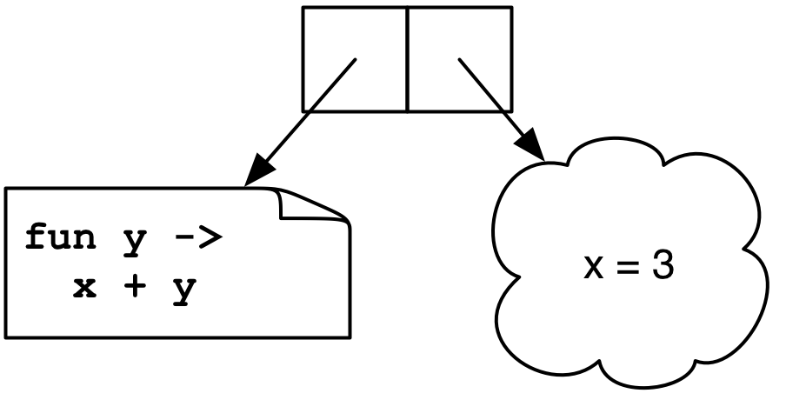
Static Scoping and Nested Functions
To allow arbitrary nested functions with higher-order functions and static scoping, we needed closures
let add x = (fun y -> x + y)
(add 3) 4
→ <closure> 4
→ 3 + 4
→ 7
Notes:
22
In OCaml, since functions can be returned from functions ???
with higher-order functions ???

Slide 23
Nested Functions, con't.
We need closures for upward funargs
Functions that are returned by other functions
If we only have downward funargs, then we don’t need full closures
These are functions that are only passed inward (as parameters)
So when they’re called, any nonlocal variables they access from outer scopes are still around
Notes:
23

Slide 24
Example
x
let f x =
let g y = x + y in
g 3
g y = x + y
y
When g is called, x is still on the stack
Notes:
24

Slide 25
Example
x
let app f z = f z
let f x =
let g y = x + y in
app g 3
app f z = f z
f
z
g y = x + y
y
When g is called, x is still on the stack
Notes:
25
The x which g needs is still on the stack when it executes.
f returns a closure.

Slide 26
Downward Funargs
It turns out that if we only pass functions downward, there are cheaper implementation strategies for static scoping than closures
They're called static links and displays, and they're used by
Pascal and Algol-family languages
gcc nested functions
We won’t go into details
Notes:
26
Closures result in allocating memory.
gcc will let you return a function, but it just does the wrong thing scopewise when you call it.
Most languages today which have function pointers either have only raw function pointers, or have full closures. What features you want to have in your language affects its implementation and affects efficiency.

Slide 27
Dynamic Scope
In a language with dynamic scoping, a name refers to its closest binding at runtime
LISP was the common example
Scheme (top-level scope only is dynamic)
; define a no-argument function which returns a
(define f (lambda () a))
(define a 3) ; bind a to 3
; calls f and returns 3
(define a 4)
(f) ; calls f and returns 4
Notes:
27
Mostly static unless you specifically declare things to be dynamic (????)
Scheme uses Cambridge Polish notation in which a function name appears before its arguments, all enclosed in parentheses.
A function like f above would be invalid in static scoping- the problem is that no a exists where it's defined.
Shouldn’t this be “bind 3 to a”?

Slide 28
Nested Dynamic Scopes
Full dynamic scopes can be nested
Static scope relates to the program text
Dynamic scope relates to program execution trace
Perl (the keyword local introduces dynamic scope)
$l = "global";
sub A {
local $l = "local";
B();
}
sub B { print "$l\n"; }
B(); A(); B();
Notes:
28
Note in Perl a variable name with $ isn't necessarily a global variable like in Ruby.
B looks backward into A and sees A's $l. If $l was declared using "my", or if this was OCaml, this would never happen.
How would you implement dynamic scoping? Explain how it's done- during execution you keep a table of all variables in existence, where each entry is a stack of variables with that name. When you enter a scope you push its variables in the table, and when you leave it you pop them. You search for the topmost occurrence of a variable by name when it's used. There are some variations, but this is the basic idea. Another option is just searching down the runtime stack for the first variable with that name.
This prints global, local, global.

Slide 29
Static vs. Dynamic Scope
Static scoping
Local understanding of function behavior
Know at compile-time what each name refers to
A bit trickier to implement
Dynamic scoping
Can be hard to understand behavior of functions
Requires finding name bindings at runtime
Easier to implement (just keep a global table of stacks of variable/value bindings )
Notes:
29
Static scoping promotes local understanding of function behavior, but you can still use nonlocals.
Dynamic scoping is useful in situations where you ever have to pass parameters too far from one function to another etc. until where you actually need to use them.
It turns out that static scoping doesn’t require search for variables at runtime (runtime overhead), while dynamic scoping does.

