Slide 1
CMSC 330: Organization of Programming Languages
Threads, con't.

Slide 2
Parallelizable Applications of Interest
Knowledge discovery: mine and analyze massive amounts of distributed data
Discovering social networks
Real-time, highly-accurate common operating picture, on small, power-constrained devices
Simulations (games?)
Data processing
NLP, vision, rendering, in real-time
Commodity applications
Parallel testing, compilation, typesetting, …

Slide 3
Multithreading (Java threads, pthreads)
Portable, high degree of control
Low-level and unstructured
Thread management, synchronization via locks and signals essentially manual
Blocking synchronization is not compositional, which inhibits nested parallelism
Easy to get wrong, hard to debug
Data races, deadlocks all too common

Slide 4
Parallel Language Extensions
MPI – expressive, portable, but
Hard to partition data and get good performance
Temptation is to hardcode data locations, number of processors
Hard to write the program correctly
Little relation to the sequential algorithm
OpenMP, HPF – parallelizes certain code patterns (e.g., loops), but
Limited to built-in types (e.g., arrays)
Code patterns, scheduling policies brittle

Slide 5
Two Directions To A Solution
Start with clean, but limited, languages/abstractions and generalize
MapReduce (Google)
StreamIt (MIT)
Cilk (MIT)
Start with full-featured languages and add cleanliness
Software transactional memory
Static analyzers (Locksmith, Chord, …)
Threaded Building Blocks (Intel)

Slide 6
Space of Solutions
MapReduce
Dryad
most clean
Yet to come?
StreamIt
CML
Cilk
Cleanliness
TBB+threads
STM+threads
OpenMP
Research
Used in practice
MPI
POSIX threads
most flexible
Flexibility

Slide 7
Kinds of Parallelism
Data parallelism
Can divide parts of the data between different tasks and perform the same action on each part in parallel
Task parallelism
Different tasks running on the same data
Hybrid data/task parallelism
A parallel pipeline of tasks, each of which might be data parallel
Unstructured
Ad hoc combination of threads with no obvious top-level structure

Slide 8
MapReduce: Programming the Pipeline
Pattern inspired by Lisp, ML, etc.
Many problems can be phrased this way
Results in clean code
Easy to program / debug / maintain
Simple programming model
Nice retry/failure semantics
Efficient and portable
Easy to distribute across nodes
Thanks to Google, Inc. for some of the slides that follow

Slide 9
Map & Reduce in Lisp / Scheme
Unary operator
(map f list)
(map square ‘(1 2 3 4))
(1 4 9 16)
(reduce + ‘(1 4 9 16) 0)
(+ 1 (+ 4 (+ 9 (+ 16 0) ) ) )
30
(reduce + (map square ‘(1 2 3 4)) 0)
Binary operator

Slide 10
MapReduce a la Google
map(key, val) is run on each item in set, emits new-key / new-val pairs
reduce(key, vals) is run for each unique key emitted by map(), emits final output

Slide 11
Count Words in Documents
Input consists of (url, contents) pairs
map(key=url, val=contents):
For each word w in contents, emit (w, "1")
reduce(key=word, values=uniq_counts):
Sum all '1's in values list
Emit result "(word, sum)"

Slide 12
Count, Illustrated
map(key=url, val=contents):
For each word w in contents, emit (w, “1”)
reduce(key=word, values=uniq_counts):
Sum all “1”s in values list
Emit result “(word, sum)”
see 1
bob 1
run 1
see 1
spot 1
throw 1
bob 1
run 1
see 2
spot 1
throw 1
see bob throw
see spot run

Slide 13
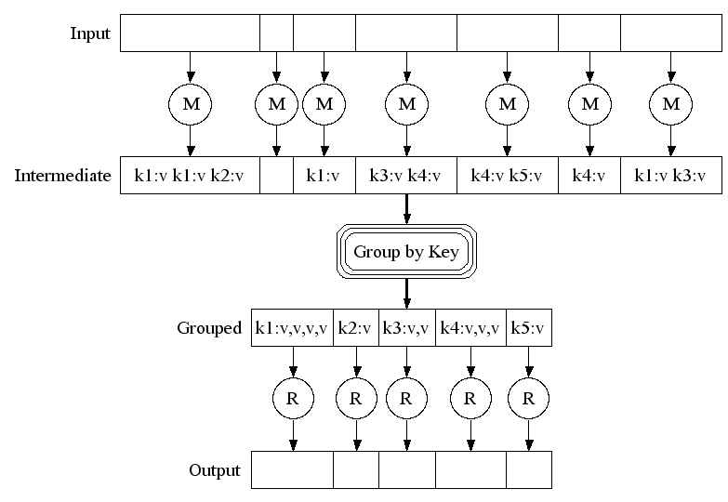
Execution

Slide 14
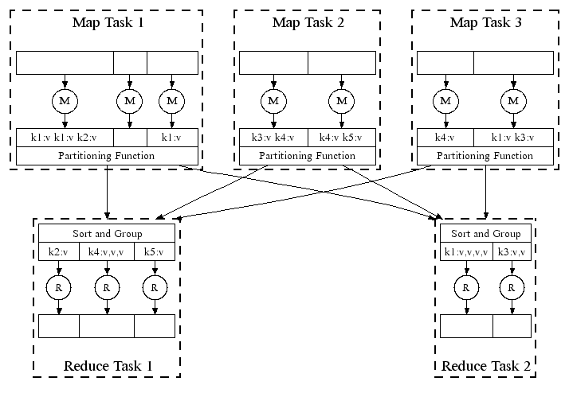
Parallel Execution
data
parallelism
pipeline
parallelism
Key: no implicit dependencies between map or reduce tasks

Slide 15
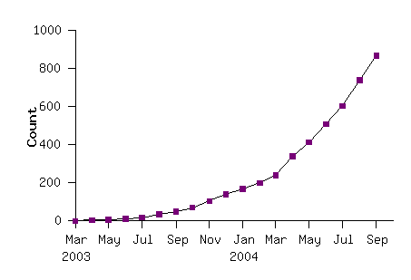
Model is Widely Applicable MapReduce Programs In Google Source Tree 2004
Example uses:
distributed grep |  | distributed sort |  | web link-graph reversal
term-vector / host |  | web access log stats |  | inverted index construction
document clustering |  | machine learning |  | statistical machine translation
... |  | ... |  | ...

Slide 16
The Programming Model Is Key
Simple control makes dependencies evident
Can automate scheduling of tasks and optimization
Map, reduce for different keys, embarassingly parallel
Pipeline between mappers, reducers evident
map and reduce are pure functions
Can rerun them to get the same answer
In the case of failure, or
To use idle resources toward faster completion
No worry about race conditions, deadlocks, etc. since there is no shared state

Slide 17
Compare to Dedicated Supercomputers
According to Wikipedia, in 2006 Google uses
450,000 servers from 533 MHz Celeron to dual 1.4GHz Pentium III
80GB drive per server, at least
2-4GB memory per machine
Jobs processing 100 terabytes of distributed data
More computing power than even the most powerful supercomputer

