Slide 1
Course Overview and Introduction
CS 3251: Computer Networking I
Nick Feamster
Spring 2013

Slide 2
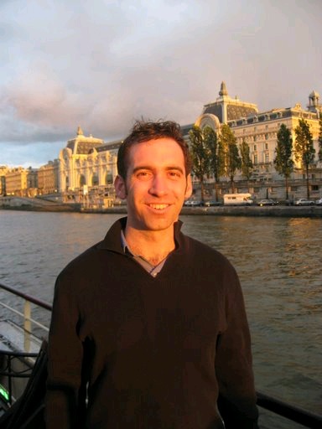
Who Am I?
Nick Feamster
  Associate Professor
  Networking: Operations and Security
Office: Klaus 3348
Email address: on web page;
use subject “CS 3251”
Office Hours: Monday, 3:30 p.m. or by appt

Slide 3

Your TAs
Abhinav Narain
nabhinav3@gatech.edu
Lakshmi Anathakrishnan
lakshmi3@gatech.edu

Slide 4
What is a Network?
Collection of nodes and links that connect them
This is vague. Why? Consider different networks:
  Internet
  Postal network
  Resnet/LAWN
  Telephone
  Your house
  Others – sensor nets, cell phones, …
Focus on Internet, but understand important common issues and challenges

Slide 5
Challenges for Networks
Geographic scope
Scale
  Tens of thousands of networks, billions of hosts
Heterogeneity
  Many different types of applications
Administration and Trust

Slide 6

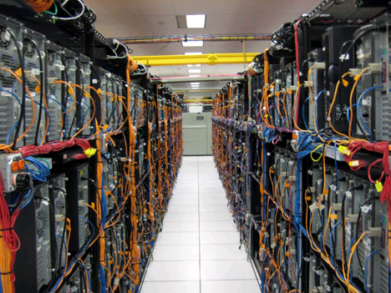




Goals
Learn the fundamentals of communications networks.
Why learn about networking?
  Communications networks are central to almost every modern computer system.
You will be designing the
next applications
(maybe the next network)!

Slide 7
Course Goals
Learn the basics of computer networking
Develop proficiency with/understanding of
  Basic principles of network design
    Resource sharing
    Discovery
    Etc.
  Network tools and systems
  Network programming
    Basic sockets programming
    Android programming
Learn about the state of the art
Have fun!

Slide 8
Course Goals
Beyond the Basics, to Insights
  Internet was based on design priorities
    Applications and requirements have changed
    You will gain experience re-evaluating design decisions and changing protocols
  Many recurring design “tricks”
    Tree forming
    Layering
    Resource allocation and sharing
    Naming

Slide 9
Networking is Fun
A chance to apply many different “tools”
  Theoretical foundations
  Statistics, machine learning, signal processing, data mining, etc.
A chance to build cool systems
  Real, working systems that people want and need
  Solving real problems (network management, anti-censorship, fighting spam, etc.)
A chance to measure and explore
  Internet measurement puts the “science” in computer science

Slide 10
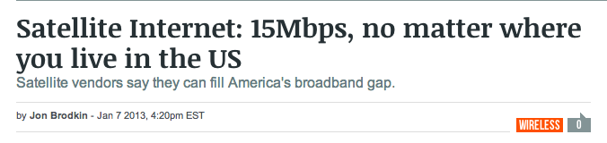
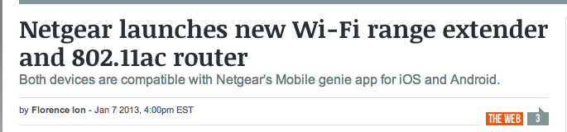
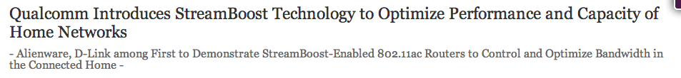
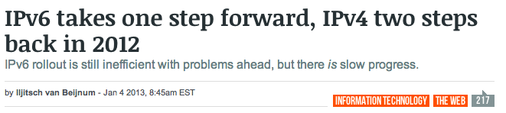
Networking in the News

Slide 11
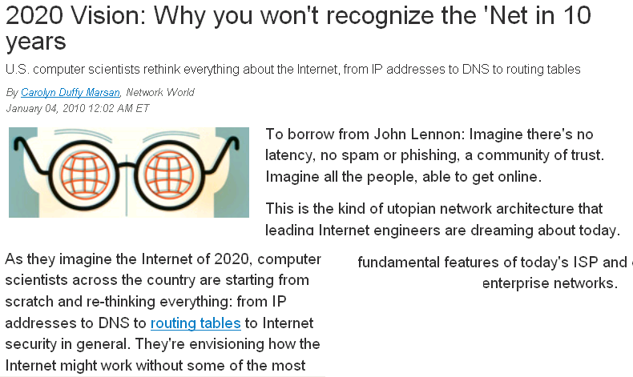

Slide 12
It’s an Exciting Time
More people will use the Internet
  Today: 1.7 billion users
  2020: 5 billion users
The Internet will become more global
  Penetration rate in Africa is only 6.8%
The Internet will become a network of “things”
The Internet will carry more traffic
  44 exabytes by 2012
The Internet will be wireless

Slide 13
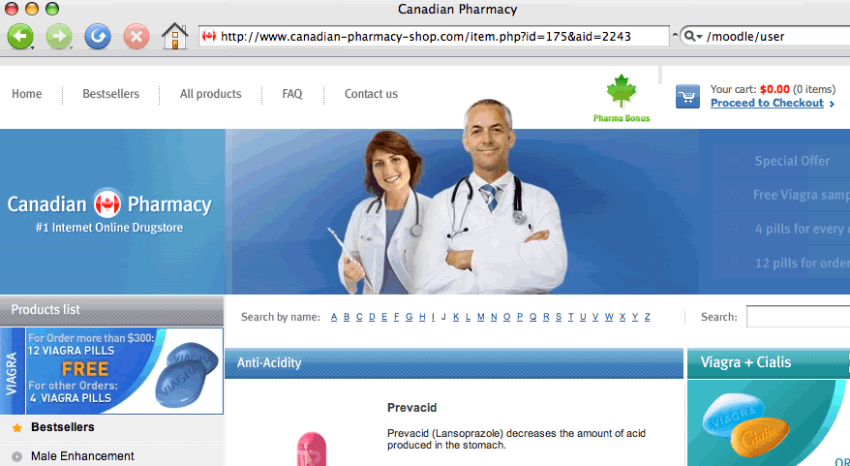
More Predictions
More services “in the cloud”
The Internet will be greener
The Internet will attract more hackers

Slide 14
Logistics
Course Web page
  http://gtnoise.net/classes/cs3251/spring_2013/
  Check this page regularly for updates to the syllabus, assignments, readings, etc.
Piazza
  Sign up now/today if you are not already there
  https://piazza.com/class#spring2013/cs3251a
Course mailing list (Discouraged)
  Run through T-Square
  cs3251a@t-square.gatech.edu

Slide 15
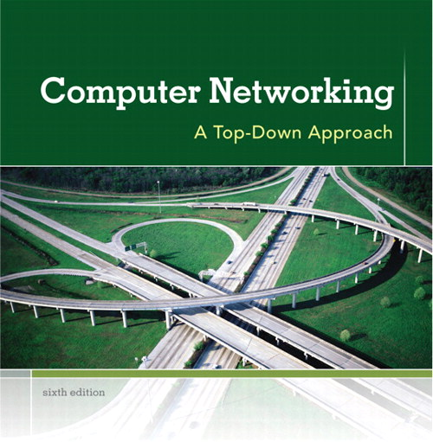
Overview of Lectures
Holistic approach
  I want you to learn concepts
  Protocols will change, but networks
  are going to be around!
Some “old”, some “new”
  Initial lectures organized by layer
  Later lectures organized by “real networks” in the wild
Textbook reading, videos, “current events”
  Read the readings before class!
  Historically, many things covered in class that are not in texts
  We will do some experimentation with flipped classroom

Slide 16
Things You’ll Learn
How does your Web browser find a Web site?
How does the Internet regulate its traffic to prevent congestion?
How do ISPs connect to one another?
  Protocols, Economics, …
How does the design of the Internet differ from communication networks that preceded it?

Slide 17
More Things You’ll Learn
How to write programs that allow hosts to communicate with one another?
How do hosts “bootstrap” when they get onto the network?
What’s a “router”? What’s inside of it, how does it work, how does it know where to send your traffic?

Slide 18
More Things You’ll Learn
How does BitTorrent find your file?
How does the Georgia Tech wireless network allow you to “roam” across campus with the same IP address?
How do ISPs connect to one another?
  Protocols, Economics, …
What could you do with two (or more) Internet connections at home?

Slide 19
Still More Things You’ll Learn
How many bits can you push over a physical channel?
  How can you use encoding to increase this?
What’s inside a router?
  Function, power issues, trends (e.g., programmability)
Performance guarantees (e.g., telephony, video)?
How can a network’s resources be subdivided?

Slide 20
Still More Things You’ll Learn
Are we running out of IP addresses? Who cares, and how can we combat this?
How do we reduce power utilization in data centers?
What are the bad guys doing?
Can we stop unwanted traffic?
How do we make it easier to run the network?
How do we make the network go faster?
Why is it so hard to figure out what’s wrong?
Social networks…?

Slide 21
Class Components and Grading
Problem sets (20%)
  Paper and pencil
  First assignment: September 3
Hands-on/Programming Assignments (30%)
  Experience with tools and traces
2 Quizzes (30%)
  Quiz: March 6
  Final: April 24 (or April 17)
1 Project (20%)
  TBD. Work in groups. Programming/analysis/etc.
  Most likely: Pick from a list, or propose your own
Late policy: Maximum of 72 hours late throughout the term

Slide 22
Lateness
Late policy: Maximum of 72 hours late throughout the term.
All problem sets and projects will be due at 11:59 p.m. on the due date.
All problem sets and projects will be turned in on T-Square.

Slide 23
Collaboration Policy
See the Georgia Tech Honor Code
Working together on assignments is fine, but you must
  turn in your own assignments,
  write your own code, analysis
  acknowledge your collaborators

Slide 24
Who are you?
Why are you taking this class?
What do you hope to learn?

