Slide 1
Bumps in the Wire:
NAT and DHCP
Nick Feamster
CS 3251Computer Networking I
Spring 2013

Slide 2
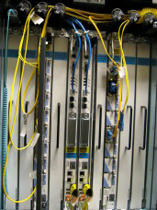

Interconnection: “Gateways”
Interconnect heterogeneous networks
No state about ongoing connections
  Stateless packet switches
Generally, router == gateway
But, we can think of your home router/NAT as also performing the function of a gateway
192.168.1.51
68.211.6.120:50878
Home
Network
Internet
192.168.1.52
68.211.6.120:50879

Slide 3
NATs and Tunnels
NATs originally invented as a way to help migrate to a hybrid IPv4 IPv6 world
  Took on a life of their own
  May have substantially delayed IPv6 deployment by reducing address pressure!
  You probably encounter them every day
Tunnels: Coming up after NATs.

Slide 4
Network Address Translation
NAT maps (private source IP, source port) onto (public source IP, unique source port)
  reverse mapping on the way back
  destination host does not know that this process is happening
Very simple working solution.
  NAT functionality fits well with firewalls
A
Priv A IP
B IP
B IP
Priv A IP
A Port
B Port
B Port
A Port
Publ A IP
B IP
B IP
Publ A IP
B
A Port’
B Port
B Port
A Port’

Slide 5
Types of NATs
Bi-directional NAT: 1 to 1 mapping between internal and external addresses.
  E.g., 128.237.0.0/16 -> 10.12.0.0/16
  External hosts can directly contact internal hosts
  Why use?
    Flexibility. Change providers, don’t change internal addrs.
    Need as many external addresses as you have hosts - can use sparse address space internally.
“Traditional” NAT: Unidirectional
  Basic NAT: Pool of external addresses
    Translate source IP address (+checksum,etc) only
  Network Address Port Translation (NAPT): What most of us use
    Also translate ports.
      E.g., map (10.0.0.5 port 5555 -> 18.31.0.114 port 22) to (128.237.233.137 port 5931 -> 18.31.0.114 port 22)
    Lets you share a single IP address among multiple computers

Slide 6
NAT Considerations
NAT has to be consistent during a session.
  Set up mapping at the beginning of a session and maintain it during the session
    Recall high-level goal of Internet: Continue despite loss of networks or gateways
    What happens if your NAT reboots?
  Recycle the mapping that the end of the session
    May be hard to detect
NAT only works for certain applications.
  Some applications (e.g. ftp) pass IP information in payload
  Need application level gateways to do a matching translation
  Breaks a lot of applications.
    Example: Let’s look at FTP
NAT is loved and hated
  - Breaks many apps (FTP)
  - Inhibits deployment of new applications like p2p (but so do firewalls!)
  + Little NAT boxes make home networking simple.
  + Saves addresses. Makes allocation simple.

Slide 7
Network Address Translation
For outbound traffic, the gateway:
  Creates a table entry for computer's local IP address and port number
  Replaces the sending computer's non-routable IP address with the gateway IP address.
  replaces the sending computer's source port
For inbound traffic, the gateway:
  checks the destination port on the packet
  rewrites the destination address and destination port those in the table and forwards traffic to local machine

Slide 8

NAT Traversal
Problem: Machines behind NAT not globally addressable or routable. Can’t initiate inbound conenctions.
One solution: Signalling and Tunneling through UDP-Enabled NAT Devices (STUN)
  STUN client contacts STUN server
  STUN server tells client which IP/Port the NAT mapped it to
  STUN client uses that IP/Port for call establishment/incoming messages
Home
Network 1
Home
Network 2
Relay node

Slide 9
DHCP
DHCPDISCOVER - broadcast
DHCPOFFER
DHCPREQUEST
DHCPACK
DHCPOFFER
  IP addressing information
  Boot file/server information (for network booting)
  DNS name servers
  Lots of other stuff - protocol is extensible; half of the options reserved for local site definition and use.

Slide 10
DHCP Features
Lease-based assignment
  Clients can renew. Servers really should preserve this information across client & server reboots.
Provide host configuration information
  Not just IP address stuff.
  NTP servers, IP config, link layer config,
  X window font server (wow)
Use:
  Generic config for desktops/dialin/etc.
    Assign IP address/etc., from pool
  Specific config for particular machines
    Central configuration management

Slide 11
Dynamic Host Configuration Protocol
Commonly used to automatically
  assign IP addresses to clients
  set various configuration parameters
Useful for managing IP address space where
  the total number of users outstrips the total number of concurrent users
Operators can
  dynamically assign IP addresses to clients and
  reclaim IP addresses when clients leave

Slide 12
DHCP: Operation and Lease Times
DISCOVER
OFFER
REQUEST
ACK
Renew at ½
the lease time
REQUEST
Lease Time: the time interval after which a server can reclaim an IP address
  Configurable at server (universal or per-client)

Slide 13
Lease-Time Optimization
Tradeoff: Utilization vs. Scalability, Convenience
  Too long: Address space can be exhausted
  Too short: Clients must reauthenticate, increase in broadcast traffic
Problem: Determine the appropriate lease time setting (and strategy) that
  Minimizes inconvenience and unnecessary traffic
  Avoids address-space exhaustion

Slide 14
Outline
Measurement study of DHCP utilization on the Georgia Tech wireless network (LAWN)
  Largest known public DHCP study: 6,000 users/day
  Study of on-times and off-times
Emulation tool for evaluating the effects of longer lease times on utilization
Evaluation of alternative lease time strategies
  Single adaptation
  Exponential

Slide 15
Environment and Data
Environment: Georgia Tech Local-Area Walkup/Wireless Network (“LAWN”)
  6,000 unique users per day
  2,500 concurrent users at peak
  4,000 IP addresses
  1,000 access points
  2,800 network ports
  Single VLAN
Data: DHCP Server logs from Feb 12-17, 2007
  Used MAC addresses to identify individual clients
  Current lease-time setting: 30 minutes

Slide 16
Estimating Duration of Client Activity
Clients issue DHCP “Renew” messages
  One message every half-lease-time interval
Idea: Use DHCP messages to estimate client presence/departure
  Estimate client departure at time of last-seen renew plus one-fourth the lease time

Slide 17
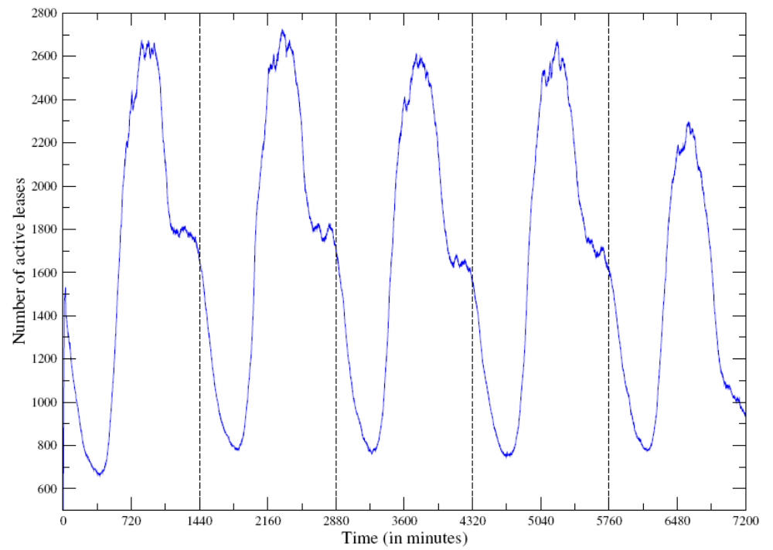
DHCP Utilization on GT LAWN
Monday
Tuesday
Wednesday
Thursday
Friday
Students returning to dorms
Number of Active Leases
Wired machines
Time

Slide 18
Individual Client Dynamics
On-Time: The duration of time a client is active
  (last request - first request) + ¼(lease time)
  20% of sessions: 30 minutes or less
  59% of sessions: 90 minutes or less
  Implication: increasing lease time to 90 min could save renewals
Off-time: Duration between a new lease and the time of the last expired lease
  time of request – (time of last renew + lease time)
  70% of off-times: less than 210 minutes
  30% of off-times: less than 30 minutes

Slide 19
Emulating Longer Lease Times
DISCOVER and RELEASE remain unchanged
Some DISCOVER messages become renew REQUEST messages
On-Time
(22.5 min)
Off-time
(37.5 min)
On-time
(22.5 min)
30-min
Lease
60-min
Lease

Slide 20
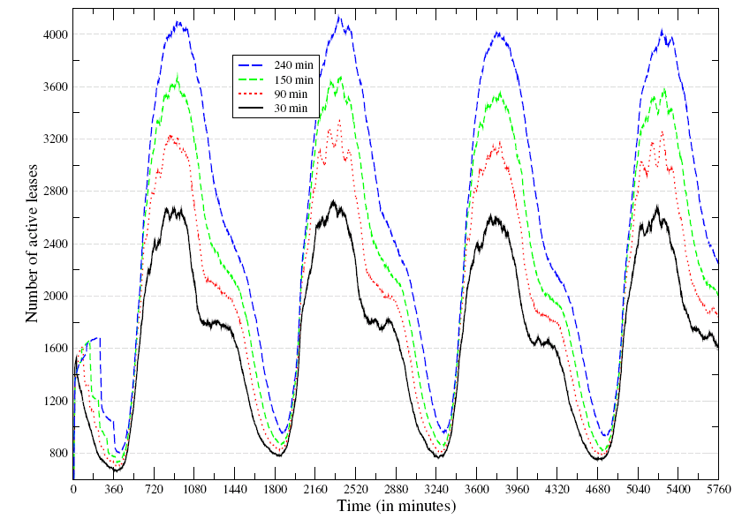
Emulating Longer Lease Times
Number of active leases
Time (min)

Slide 21
Effects of Longer Lease Times
Increased address space utilization
  30-minute lease time: 67% utilization
  90-minute lease time: 80% utilization
  240-minute lease time: exhaustion
Reduced renewals and expirations
  90-minute lease time saves
    70% of renewal messages
    23% of expirations

Slide 22
Alternative Lease-Time Strategies
Single adaptation: Set initial lease time, then smaller lease time upon renewal
  Example: 90-minute initial lease time, 30-min renewal
  Intuition: Optimize for class time interval
Exponential: Exponentially increase lease time upon each renewal
  Intuition: Clients that have been present on the network longer are likely to persist

Slide 23
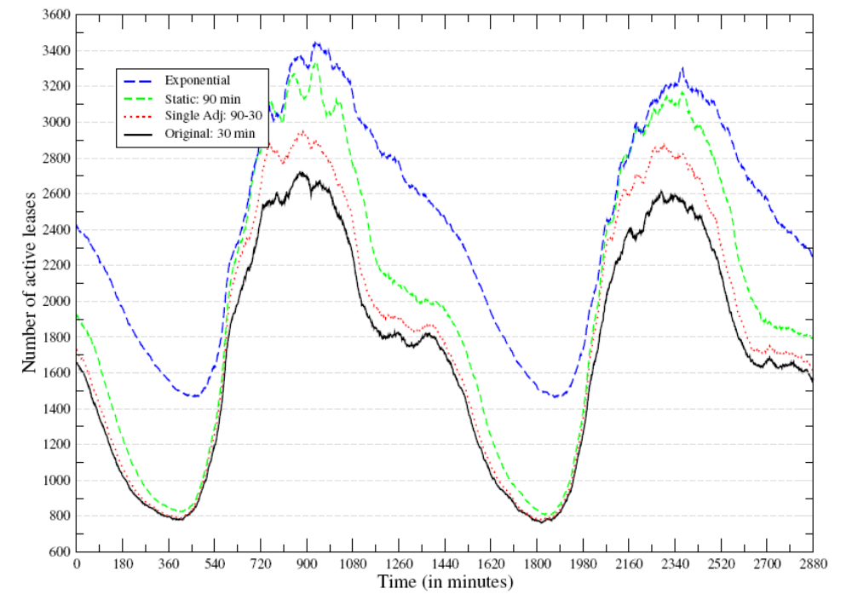
Effects of Alternative Strategies
Renewals Saved
77%
Number of active leases
71%
30%
Time (min)

Slide 24
Summary
Measurement study of DHCP utilization on the Georgia Tech wireless network (LAWN)
  Largest known public DHCP study: 6,000 users/day
  Study of on-times and off-times
Emulation tool for evaluating the effects of longer lease times on utilization
Evaluation of alternative lease time strategies
  Single adjustment
  Exponential

