Slide 1
HTTP and the Web
Nick Feamster
CS 3251: Computer Networking I
Spring 2013

Slide 2
This Lecture
Main ingredients of the Web
  URL, HTML, and HTTP
  HTTP: the protocol and its stateless property
Web Systems Components
  Clients
  Servers
  DNS (Domain Name System)
Interaction with underlying network protocol: TCP
Scalability and performance enhancement
  Server farms
  Web Proxy
  Content Distribution Network (CDN)

Slide 3
Web History
Before the 1970s-1980s
  Internet used mainly by researchers and academics
  Log in remote machines, transfer files, exchange e-mail
Internet growth and commercialization
  1988: ARPANET gradually replaced by the NSFNET
  Early 1990s: NSFNET begins to allow commercial traffic
Initial proposal for the Web by Berners-Lee in 1989
Enablers for the success of the Web
  1980s: Home computers with graphical user interfaces
  1990s: Power of PCs increases, and cost decreases

Slide 4
Main ingredients of the Web
URL
  Denotes the global unique location of the web resource
  Formatted string
  e.g., http://www.princeton.edu/index.html
  Protocol for communicating with server (e.g., http)
  Name of the server (e.g., www.princeton.edu)
  Name of the resource (e.g., index.html)
HTML
  Actual content of web resource, represented in ASCII

Slide 5
Main ingredients of the Web: HTML
HyperText Markup Language (HTML)
  Format text, reference images, embed hyperlinks
  Representation of hypertext documents in ASCII format
  Interpreted by Web browsers when rendering a page
Web page
  Base HTML file
  referenced objects (e.g., images), Each object has its own URL
Straight-forward and easy to learn
  Simplest HTML document is a plain text file
  Automatically generated by authoring programs

Slide 6
Main ingredients of the Web
URL
  Denotes the global unique location of the web resource
  Formatted string
  e.g., http://www.princeton.edu/index.html
  Protocol for communicating with server (e.g., http)
  Name of the server (e.g., www.princeton.edu)
  Name of the resource (e.g., index.html)
HTML
  Actual content of web resource, represented in ASCII
HTTP
  Protocol for client/server communication

Slide 7


Main ingredients of the Web: HTTP
Client program
  E.g., Web browser
  Running on end host
  Requests service
Server program
  E.g., Web server
  Provides service
GET /index.html
“Site under construction”

Slide 8
Outline: Web Content Distribution
Main ingredients of the Web
  URL, HTML, and HTTP
  HTTP: the protocol and its stateless property
Web Systems Components
  Clients
  Servers
  DNS (Domain Name System)
Interaction with underlying network protocol: TCP
Scalability and performance enhancement
  Server farms
  Web Proxy
  Content Distribution Network (CDN)

Slide 9
Request and Response Message
GET / HTTP/1.1
Host: www.cc.gatech.edu
User-Agent: Firefox 3.0.18
<CRLF>
Request
HTTP/1.1 200 OK
Date: Mon, 6 Mar 2010 13:09:03 GMT
Server: Apache …
Last-Modified: Mon, 6 Mar 2010 11:12:23 GMT
Content-Length: 21
<CRLF>
Site under construction
Response

Slide 10
HTTP Request Message
Request message sent by a client
  Request line: method, resource, and protocol version
  Request headers: provide information or request
  Body: optional data (e.g., to “POST” data to the server)
request line
(GET, POST,
HEAD commands)
GET /somedir/page.html HTTP/1.1
Host: www.someschool.edu
User-agent: Mozilla/4.0
Connection: close
Accept-language:fr
(extra carriage return, line feed)
header
lines
Carriage return,
line feed
indicates end
of message

Slide 11
HTTP Response Message
Response message sent by a server
  Status line: protocol version, status code, status phrase
  Response headers: provide information
  Body: optional data
status line
(protocol
status code
status phrase)
HTTP/1.1 200 OK
Connection close
Date: Thu, 06 Aug 1998 12:00:15 GMT
Server: Apache/1.3.0 (Unix)
Last-Modified: Mon, 22 Jun 1998 …...
Content-Length: 6821
Content-Type: text/html
data data data data data ...
header
lines
data, e.g.,
requested
HTML file

Slide 12
HTTP: Request Methods and Response Codes
Request methods include
  GET: return current value of resource, …
  HEAD: return the meta-data associated with a resource
  POST: update a resource, provide input to a program, …
  Etc.
Response code classes
  1xx: informational (e.g., “100 Continue”)
  2xx: success (e.g., “200 OK”)
  3xx: redirection (e.g., “304 Not Modified”)
  4xx: client error (e.g., “404 Not Found”)
  5xx: server error (e.g., “503 Service Unavailable”)

Slide 13
HTTP is a Stateless Protocol
Stateless
  Each request-response exchange treated independently
  Clients and servers not required to retain state
Statelessness to improve scalability
  Avoids need for the server to retain info across requests
  Enables the server to handle a higher rate of requests

Slide 14
Outline: Web Content Distribution
Main ingredients of the Web
  URL, HTML, and HTTP
  HTTP: the protocol and its stateless property
Web Systems Components
  Clients
  Servers
  DNS (Domain Name System)
Interaction with underlying network protocol: TCP
Scalability and performance enhancement
  Server farms
  Web Proxy
  Content Distribution Network (CDN)

Slide 15
Web Systems Components
Clients
  Send requests and receive responses
  Browsers, spiders, and agents
Servers
  Receive requests and send responses
  Store or generate the responses
DNS (Domain Name System)
  Distributed network infrastructure
  Transforms site name -> IP address
  Direct clients to servers

Slide 16
Web Browser
Generating HTTP requests
  User types URL, clicks a hyperlink, or selects bookmark
  User clicks “reload”, or “submit” on a Web page
  Automatic downloading of embedded images
Layout of response
  Parsing HTML and rendering the Web page
  Invoking helper applications (e.g., Acrobat, PowerPoint)
Maintaining a cache
  Storing recently-viewed objects
  Checking that cached objects are fresh

Slide 17
Typical Web Transaction
User clicks on a hyperlink
  http://www.cnn.com/index.html
Browser learns the IP address of the server
  Invokes gethostbyname(www.cnn.com)
  And gets a return value of 64.236.16.20
Browser establishes a TCP connection
  Selects an ephemeral port for its end of the connection
  Contacts 64.236.16.20 on port 80
Browser sends the HTTP request
  “GET /index.html HTTP/1.1
  Host: www.cnn.com”

Slide 18
Typical Web Transaction (Continued)
Browser parses the HTTP response message
  Extract the URL for each embedded image
  Create new TCP connections and send new requests
  Render the Web page, including the images
Opportunities for caching in the browser
  HTML file
  Each embedded image
  IP address of the Web site

Slide 19
Web Systems Components
Clients
  Send requests and receive responses
  Browsers, spiders, and agents
Servers
  Receive requests and send responses
  Store or generate the responses
DNS (Domain Name System)
  Distributed network infrastructure
  Transforms site name -> IP address
  Direct clients to servers

Slide 20
Web Server
Web site vs. Web server
  Web site: collections of Web pages associated with a particular host name
  Web server: program that satisfies client requests for Web resources
Handling a client request
  Accept the TCP connection
  Read and parse the HTTP request message
  Translate the URL to a filename
  Determine whether the request is authorized
  Generate and transmit the response

Slide 21
Web Server: Generating a Response
Returning a file
  URL corresponds to a file (e.g., /www/index.html)
  … and the server returns the file as the response
  … along with the HTTP response header
Returning meta-data with no body
  Example: client requests object “if-modified-since”
  Server checks if the object has been modified
  … and simply returns a “HTTP/1.1 304 Not Modified”
Dynamically-generated responses
  URL corresponds to a program the server needs to run
  Server runs the program and sends the output to client

Slide 22
Hosting: Multiple Sites Per Machine
Multiple Web sites on a single machine
  Hosting company runs the Web server on behalf of multiple sites (e.g., www.foo.com and www.bar.com)
Problem: returning the correct content
  www.foo.com/index.html vs. www.bar.com/index.html
  How to differentiate when both are on same machine?
Solution: multiple servers on the same machine
  Run multiple Web servers on the machine
  Have a separate IP address for each server

Slide 23
Hosting: Multiple Machines Per Site
Replicating a popular Web site
  Running on multiple machines to handle the load
  … and to place content closer to the clients
Problem: directing client to a particular replica
  To balance load across the server replicas
  To pair clients with nearby servers
Solution:
  Takes advantage of Domain Name System (DNS)

Slide 24
Web Systems Components
Clients
  Send requests and receive responses
  Browsers, spiders, and agents
Servers
  Receive requests and send responses
  Store or generate the responses
DNS (Domain Name System) and the Web
  Distributed network infrastructure
  Transforms site name -> IP address
  Direct clients to servers

Slide 25
DNS Query in Web Download
User types or clicks on a URL
  E.g., http://www.cnn.com/2006/leadstory.html
Browser extracts the site name
  E.g., www.cnn.com
Browser calls gethostbyname() to learn IP address
  Triggers resolver code to query the local DNS server
Eventually, the resolver gets a reply
  Resolver returns the IP address to the browser
Then, the browser contacts the Web server
  Creates and connects socket, and sends HTTP request

Slide 26
Multiple DNS Queries
Often a Web page has embedded objects
  E.g., HTML file with embedded images
Each embedded object has its own URL
  … and potentially lives on a different Web server
  E.g., http://www.myimages.com/image1.jpg
Browser downloads embedded objects
  Usually done automatically, unless configured otherwise
  Requires learning the address for www.myimages.com

Slide 27
Directing Web Clients to Replicas
Typical approach: different IP addresses
  Single name (e.g., www.cnn.com), multiple addresses
  E.g., 64.236.16.20, 64.236.16.52, 64.236.16.84, …
Authoritative DNS server returns many addresses
  And the local DNS server selects one address
  Authoritative server may vary the order of addresses

Slide 28
Clever Load Balancing Schemes
Selecting the “best” IP address to return
  Based on server performance
  Based on geographic proximity
  Based on network load
  …
Example policies
  Round-robin scheduling to balance server load
  U.S. queries get one address, Europe another
  Tracking the current load on each of the replicas

Slide 29
Outline: Web Content Distribution
Main ingredients of the Web
  URL, HTML, and HTTP
  HTTP: the protocol and its stateless property
Web Systems Components
  Clients
  Servers
  DNS (Domain Name System)
Interaction with underlying network protocol: TCP
Scalability and performance enhancement
  Server farms
  Web Proxy
  Content Distribution Network (CDN)

Slide 30
TCP Interaction: Multiple Transfers
Most Web pages have multiple objects
  E.g., HTML file and multiple embedded images
Serializing the transfers is not efficient
  Sending the images one at a time introduces delay
  Cannot start retrieving second images until first arrives
Parallel connections
  Browser opens multiple TCP connections (e.g., 4)
  … and retrieves a single image on each connection
Performance trade-offs
  Multiple downloads sharing the same network links
  Unfairness to other traffic traversing the links

Slide 31

TCP Interaction: Short Transfers
Most HTTP transfers are short
  Very small request message (e.g., a few hundred bytes)
  Small response message
  (e.g., a few kilobytes)
TCP overhead may be big
  Three-way handshake to establish connection
  Four-way handshake to tear down the connection
initiate TCP
connection
RTT
request
file
time to
transmit
file
RTT
file
received
time
time

Slide 32
TCP Interaction: Short Transfers
Round-trip time estimation
  Maybe large at the start of a connection (e.g., 3 seconds)
  Leads to latency in detecting lost packets
Congestion window
  Small value at beginning of connection (e.g., 1 MSS)
  May not reach a high value before transfer is done
Detecting packet loss
  Timeout: slow
  duplicate ACK
    requires many packets in flight
    which doesn’t happen for very short transfers

Slide 33
TCP Interaction: Persistent Connections
Handle multiple transfers per connection
  Maintain the TCP connection across multiple requests
  Either the client or server can tear down the connection
  Added to HTTP after the Web became very popular
Performance advantages
  Avoid overhead of connection set-up and tear-down
  Allow TCP to learn a more accurate RTT estimate
  Allow the TCP congestion window to increase

Slide 34
Outline: Web Content Distribution
Main ingredients of the Web
  URL, HTML, and HTTP
  HTTP: the protocol and its stateless property
Web Systems Components
  Clients
  Servers
  DNS (Domain Name System)
Interaction with underlying network protocol: TCP
Scalability and performance enhancement
  Server farms
  Proxy
  Content Distribution Network (CDN)

Slide 35
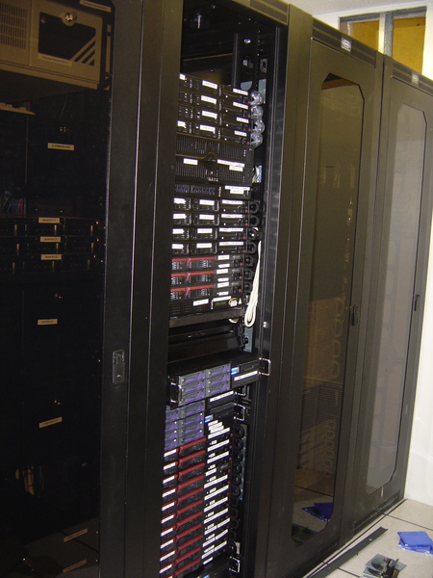
Server Farms
Definition
  a collection of computer servers to accomplish server needs far beyond the capacity of one machine.
  Often have both a primary and backup server allocated to a single task (for fault tolerance)
Web Farms
  Common use of server farms is for web hosting

Slide 36

Web Proxies: Intermediaries
Proxies play both roles
  A server to the client
  A client to the server
www.google.com
Proxy
www.cnn.com

Slide 37
Proxy Caching
Client #1 requests http://www.foo.com/fun.jpg
  Client sends “GET fun.jpg” to the proxy
  Proxy sends “GET fun.jpg” to the server
  Server sends response to the proxy
  Proxy stores the response, and forwards to client
Client #2 requests http://www.foo.com/fun.jpg
  Client sends “GET fun.jpg” to the proxy
  Proxy sends response to the client from the cache
Benefits
  Faster response time to the clients
  Lower load on the Web server
  Reduced bandwidth consumption inside the network

Slide 38
Getting Requests to the Proxy
Explicit configuration
  Browser configured to use a proxy
  Directs all requests through the proxy
  Problem: requires user action
Transparent proxy (or “interception proxy”)
  Proxy lies in path from the client to the servers
  Proxy intercepts packets en route to the server
  … and interposes itself in the data transfer
  Benefit: does not require user action

Slide 39
Other Functions of Web Proxies
Anonymization
  Server sees requests coming from the proxy address
  … rather than the individual user IP addresses
Transcoding
  Converting data from one form to another
  E.g., reducing the size of images for cell-phone browsers
Prefetching
  Requesting content before the user asks for it
Filtering
  Blocking access to sites, based on URL or content

Slide 40
Motivation for CDN
Providers want to offer content to consumers
  Efficiently
  Reliably
  Securely
  Inexpensively
The server and its link can be overloaded
Peering points between ISPs can be congested
Alternative solution: Content Distribution Networks
  Geographically diverse servers serving content from many sources

Slide 41
CDN Architecture
Proactively replicate data by caching static pages
Architecture
  Backend servers
  Geographically distributed surrogate servers
  Redirectors (according to network proximity, balancing)
  Clients
Redirector Mechanisms
  Augment DNS to return different server addresses
  Server-based redirection: based on HTTP redirect feature

Slide 42
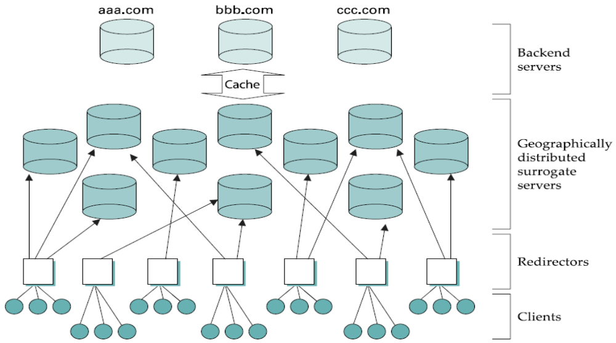
CDN Architecture

