Slide 1
Multimedia and Streaming
CS 3251: Computer Networks I
Spring 2010
Nick Feamster
(Slides courtesy of Jennifer Rexford)

Slide 2
Goals of Today’s Lecture
Digital audio and video data
  Sampling, quantizing, and compressing
Multimedia applications
  Streaming audio and video for playback
  Live, interactive audio and video
Multimedia transfers over a best-effort network
  Tolerating packet loss, delay, and jitter
  Forward error correction and playout buffers
A network offering quality-of-service guarantees
  Marking, policing, scheduling, and admission control

Slide 3
Digital Audio and Video Data

Slide 4
Challenges for Media Streaming
Large volume of data
  Each sample is a sound or an image
  Many samples per second
Volume of data may vary over time
  Due to compression of the data
Cannot tolerate much variation in delay
  Once playout starts, need to keep playing
Sometimes cannot tolerate much delay, period
  For interactive applications (e.g., VoIP and gaming)
Though some loss is acceptable

Slide 5
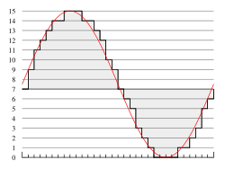
Digital Audio
Sampling the analog signal
  Sample at some fixed rate
  Each sample is an arbitrary real number
Quantizing each sample
  Round each sample to one of a finite number of values
  Represent each sample in a fixed number of bits
4 bit representation
(values 0-15)

Slide 6


Audio Examples
Speech
  Sampling rate: 8000 samples/second
  Sample size: 8 bits per sample
  Rate: 64 kbps
Compact Disc (CD)
  Sampling rate: 44,100 samples/second
  Sample size: 16 bits per sample
  Rate: 705.6 kbps for mono,
  1.411 Mbps for stereo

Slide 7
Audio Compression
Audio data requires too much bandwidth
  Speech: 64 kbps is too high for a dial-up modem user
  Stereo music: 1.411 Mbps exceeds most access rates
Compression to reduce the size
  Remove redundancy
  Remove details that human tend not to perceive
Example audio formats
  Speech: GSM (13 kbps), G.729 (8 kbps), and G.723.3 (6.4 and 5.3 kbps)
  Stereo music: MPEG 1 layer 3 (MP3) at 96 kbps, 128 kbps, and 160 kbps

Slide 8
Digital Video
Sampling the analog signal
  Sample at some fixed rate (e.g., 24 or 30 times per sec)
  Each sample is an image
Quantizing each sample
  Representing an image as an array of picture elements
  Each pixel is a mixture of colors (red, green, and blue)
  E.g., 24 bits, with 8 bits per color

Slide 9



Video Compression: Within an Image
Image compression
  Exploit spatial redundancy (e.g., regions of same color)
  Exploit aspects humans tend not to notice
Common image compression formats
  Joint Pictures Expert Group (JPEG)
  Graphical Interchange Format (GIF)
Uncompressed: 167 KB
Good quality: 46 KB
Poor quality: 9 KB

Slide 10
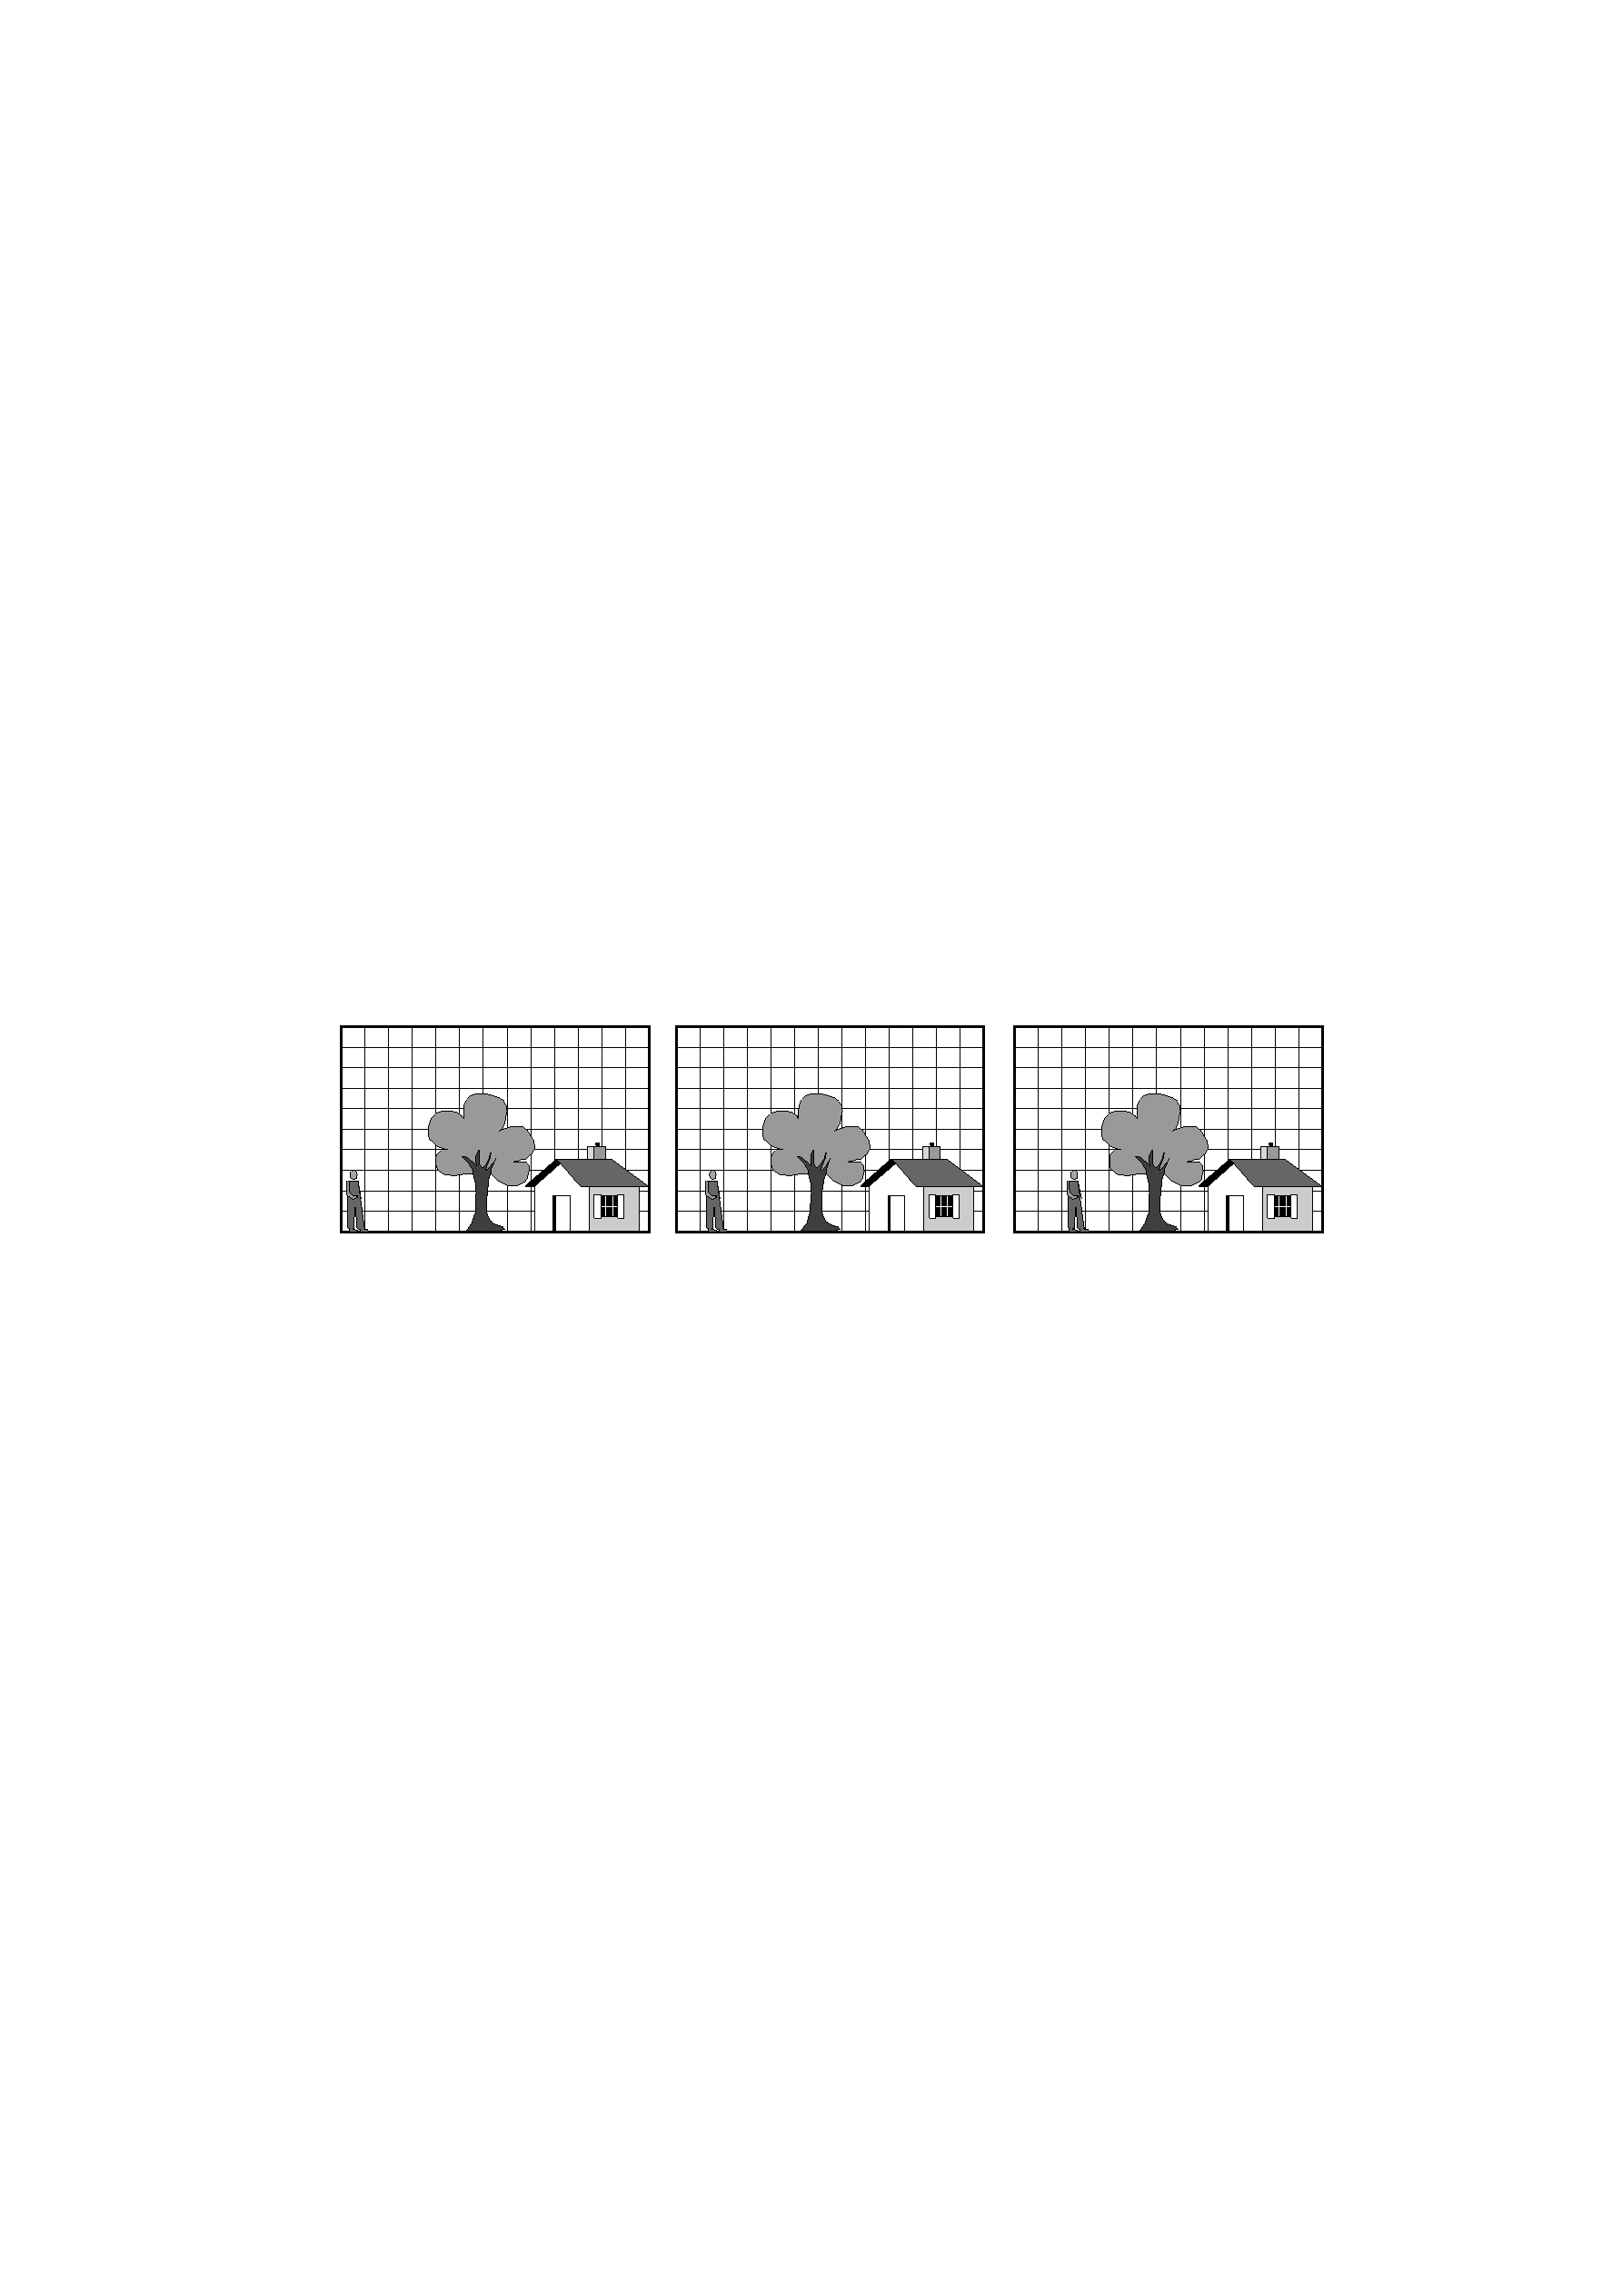
Video Compression: Across Images
Compression across images
  Exploit temporal redundancy across images
Common video compression formats
  MPEG 1: CD-ROM quality video (1.5 Mbps)
  MPEG 2: high-quality DVD video (3-6 Mbps)
  Proprietary protocols like QuickTime and RealNetworks

Slide 11
Streaming Over the Internet

Slide 12
Transferring Audio and Video Data
Simplest case: just like any other file
  Audio and video data stored in a file
  File downloaded using conventional protocol
  Playback does not overlap with data transfer
A variety of more interesting scenarios
  Live vs. pre-recorded content
  Interactive vs. non-interactive
  Single receiver vs. multiple receivers
Examples
  Streaming audio and video data from a server
  Interactive audio in a phone call

Slide 13

Streaming Stored Audio and Video
Client-server system
  Server stores the audio and video files
  Clients request files, play them as they download, and perform VCR-like functions (e.g., rewind and pause)
Playing data at the right time
  Server divides the data into segments
  … and labels each segment with timestamp or frame id
  … so the client knows when to play the data
Avoiding starvation at the client
  The data must arrive quickly enough
  … otherwise the client cannot keep playing

Slide 14
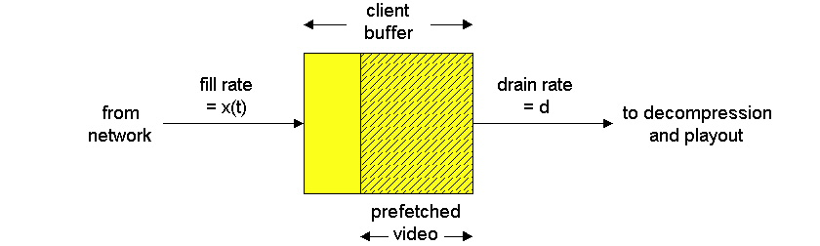
Playout Buffer
Client buffer
  Store the data as it arrives from the server
  Play data for the user in a continuous fashion
Playout delay
  Client typically waits a few seconds to start playing
  … to allow some data to build up in the buffer
  … to help tolerate some delays down the road

Slide 15
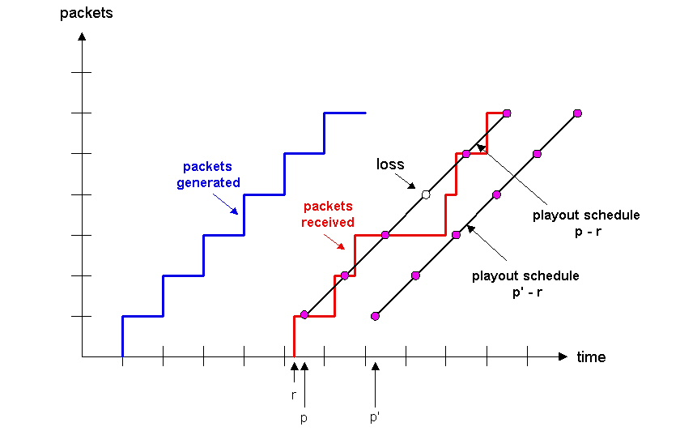
Influence of Playout Delay

Slide 16
Requirements for Data Transport
Delay
  Some small delay at the beginning is acceptable
  E.g., start-up delays of a few seconds are okay
Jitter
  Variability of packet delay within the same packet stream
  Client cannot tolerate high variation if the buffer starves
Loss
  Small amount of missing data does not disrupt playback
  Retransmitting a lost packet might take too long anyway

Slide 17
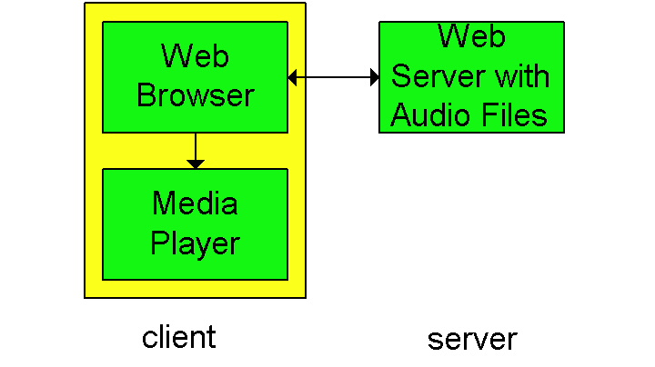
Streaming From Web Servers
Data stored in a file
  Audio: an audio file
  Video: interleaving of audio and images in a single file
HTTP request-response
  TCP connection between client and server
  Client HTTP request and server HTTP response
Client invokes the media player
  Content-type indicates the encoding
  Browser launches the media player
  Media player then renders the file

Slide 18
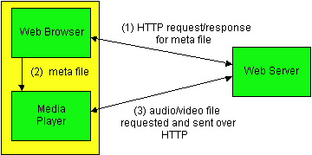
Initiating Streams from Web Servers
Avoid passing all data through the Web browser
  Web server returns a meta file describing the object
  Browser launches media player and passes the meta file
  The player sets up its own connection to the Web server

Slide 19
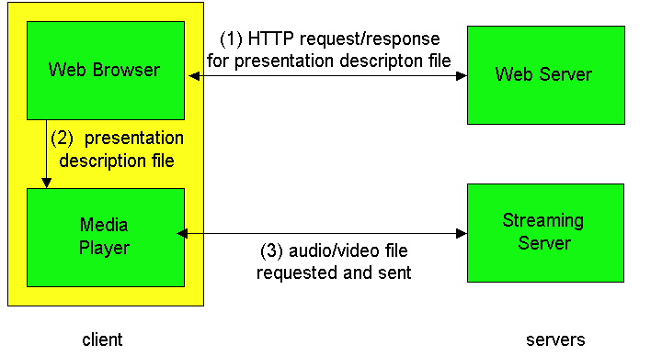
Using a Streaming Server
Avoiding the use of HTTP (and perhaps TCP, too)
  Web server returns a meta file describing the object
  Player requests the data using a different protocol

Slide 20
TCP is Not a Good Fit
Reliable delivery
  Retransmission of lost packets
  … even though retransmission may not be useful
Adapting the sending rate
  Slowing down after a packet loss
  … even though it may cause starvation at the client
Protocol overhead
  TCP header of 20 bytes in every packet
  … which is large for sending audio samples
  Sending ACKs for every other packet
  … which may be more feedback than needed

Slide 21
Better Ways of Transporting Data
User Datagram Protocol (UDP)
  No automatic retransmission of lost packets
  No automatic adaptation of sending rate
  Smaller packet header
UDP leaves many things to the application
  When to transmit the data
  How to encapsulate the data
  Whether to retransmit lost data
  Whether to adapt the sending rate
  … or adapt quality of the audio/video encoding

Slide 22
Recovering From Packet Loss
Loss is defined in a broader sense
  Does a packet arrive in time for playback?
  A packet that arrives late is as good as lost
  Retransmission is not useful if deadline passed
Selective retransmission
  Sometimes retransmission is acceptable
  E.g., if client has not already started playing data
  Data can be retransmitted within time constraint
Could do Forward Error Correction (FEC)
  Send redundant info so receiver can reconstruct

Slide 23
YouTube: HTTP, TCP, and Flash
Flash videos
  All uploaded videos converted to Flash format
  Nearly every browser has a Flash plug-in
  … avoids need for users to install players
HTTP/TCP
  Implemented in every browser
  Easily gets through most firewalls
Keep It Simple, Stupid
  Simplicity more important than video quality

Slide 24
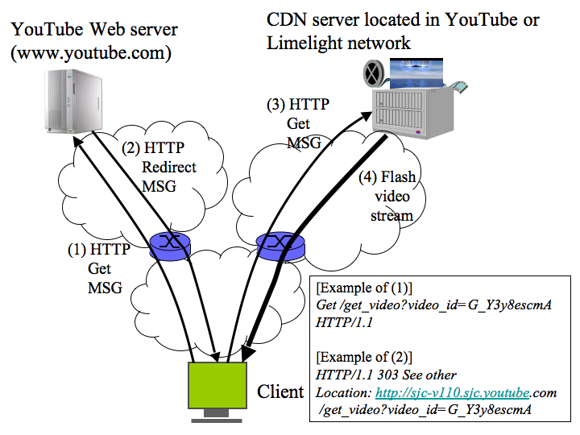
YouTube Load-Balancing Architecture

Slide 25
Interactive Applications

Slide 26
Interactive Audio and Video
Two or more users interacting
  Telephone call
  Video conference
  Video game
Strict delay constraints
  Delays over 150-200 msec are very noticeable
  … delays over 400 msec are a disaster for voice
Much harder than streaming applications
  Receiver cannot introduce much playout delay
  Difficult if network doesn’t guarantee performance

Slide 27
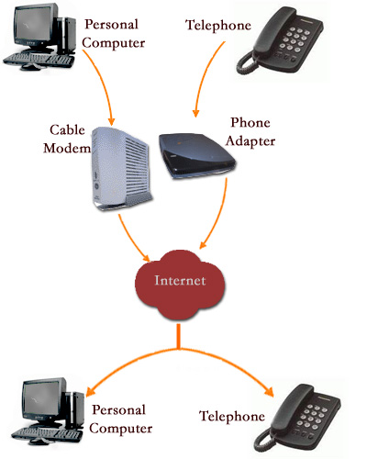
Voice Over IP (VoIP)
Delivering phone calls over IP
  Computer to computer
  Analog phone to/from computer
  Analog phone to analog phone
Motivations for VoIP
  Cost reduction
  Simplicity
  Advanced applications
    Web-enabled call centers
    Collaborative white boarding
    Do Not Disturb, Locate Me, etc.
    Voicemail sent as e-mail

Slide 28



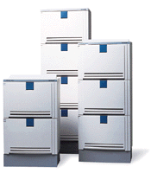



Traditional Telecom Infrastructure
7040
External line
212-8538080
7041
Corporate/Campus
Private Branch
Exchange
Telephone
switch
Another
switch
7042
7043
Corporate/Campus LAN
Internet

Slide 29





VoIP Gateways
Corporate/Campus
Another campus
7040
8151
External line
8152
7041
PBX
PBX
8153
7042
VoIP Gateway
VoIP Gateway
8154
7043
LAN
Internet
LAN
IP Phone Client

Slide 30
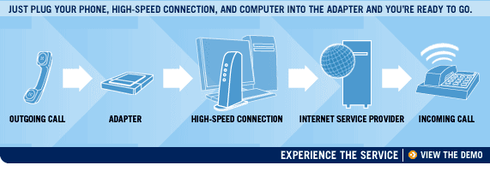
VoIP With an Analog Phone
Adapter
  Converts between analog and digital
  Sends and receives data packets
  Communicates with the phone in standard way

Slide 31
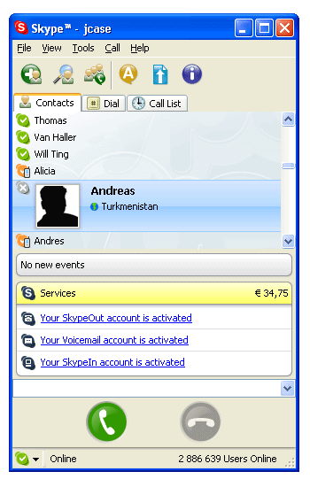

Skype
Niklas Zennström and Janus Friis in 2003
Developed by KaZaA
Instant Messenger (IM) with voice support
Based on peer-to-peer (P2P) networking technology

Slide 32
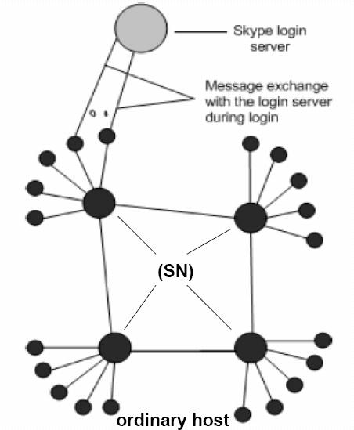
Skype Network Architecture
Login server is the only central server (consisting of multiple machines)
Both ordinary host and super nodes are Skype clients
Any node with a public IP address and having sufficient resources can become a super node

Slide 33
Challenges of Firewalls and NATs
Firewalls
  Often block UDP traffic
  Usually allow hosts to initiate connections on port 80 (HTTP) and 443 (HTTPS)
Network Address Translation (NAT)
  Cannot easily initiate traffic to a host behind a NAT
  … since there is no unique address for the host
Skype must deal with these problems
  Discovery: client exchanges messages with super node
  Traversal: sending data through an intermediate peer

Slide 34
Data Transfer
UDP directly between the two hosts
  Both hosts have public IP addresses
  Neither host’s network blocks UDP traffic
  Easy: the hosts can exchange UDP packets directly
UDP between an intermediate peer
  One or both hosts with a NAT
  Neither host’s network blocks UDP traffic
  Solution: direct UDP packets through another node
TCP between an intermediate peer
  Hosts behind NAT and UDP-restricted firewall
  Solution: direct TCP connections through another node

Slide 35
Silence Suppression
What to transfer during quiet periods?
  Could save bandwidth by reducing transmissions
  E.g., send nothing during silence periods
Skype does not appear to do silence suppression
  Maintain the UDP bindings in the NAT boxes
  Provide background noise to play at the receiver
  Avoid drop in the TCP window size
Skype sends data when call is “on hold”
  Send periodic messages as a sort of heartbeat
  Maintain the UDP bindings in the NAT boxes
  Detect connectivity problems on the network path

Slide 36
Skype Data Transfer
Audio compression
  Voice packets around 67 bytes
  Up to 140 packets per second
  Around 5 KB/sec (40 kbps) in each direction
Encryption
  Data packets are encrypted in both directions
  To prevent snooping on the phone call
  … by someone snooping on the network
  … or by the intermediate peers forwarding data

Slide 37
VoIP Quality
The application can help
  Good audio compression algorithms
  Avoiding hops through far-away hosts
  Forward error correction
  Adaptation to the available bandwidth
But, ultimately the network is a major factor
  Long propagation delay?
  High congestion?
  Disruptions during routing changes?
Leads to an interest in Quality of Service

Slide 38
Quality of Service (QoS)

Slide 39
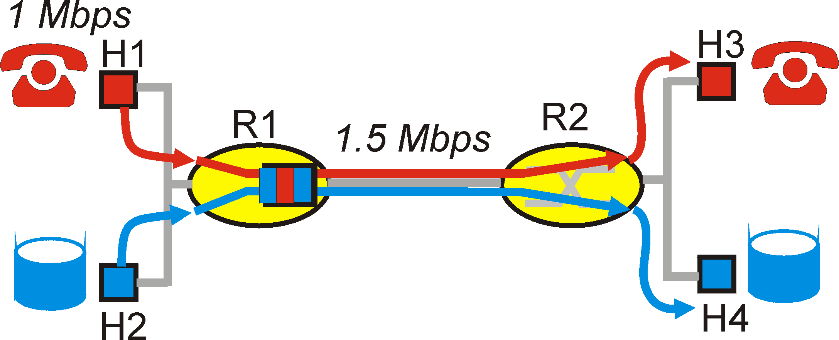
Principles for QoS Guarantees
Applications compete for bandwidth
  Consider a 1 Mbps VoIP application and an FTP transfer sharing a single 1.5 Mbps link
  Bursts of FTP traffic can cause congestion and losses
  We want to give priority to the audio packets over FTP
Principle 1: Packet marking
  Marking of packets is needed for the router
  To distinguish between different classes

Slide 40
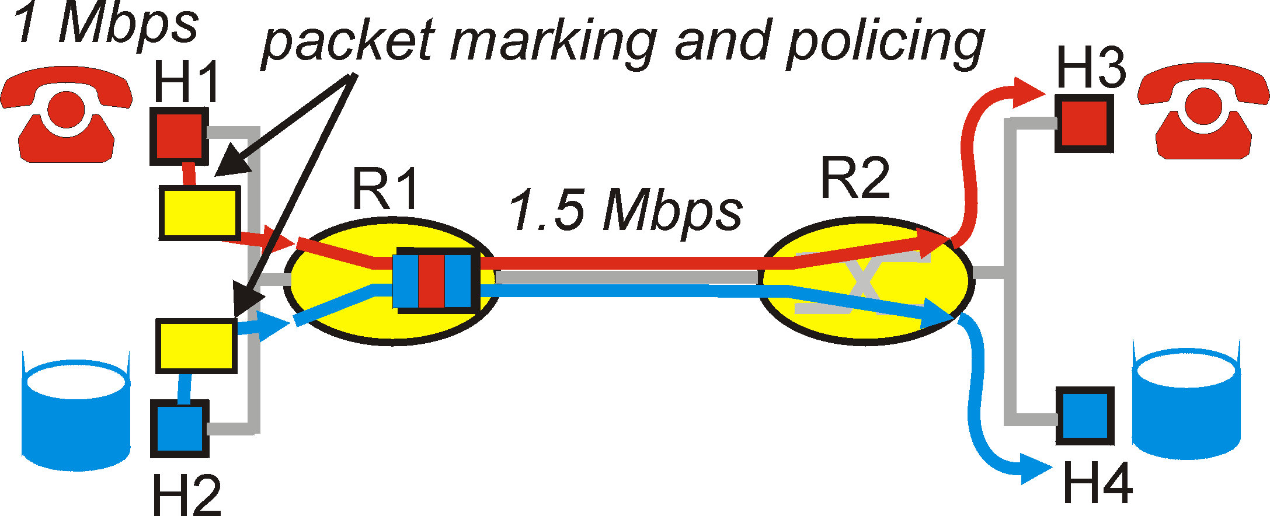
Principles for QoS Guarantees
Applications misbehave
  Audio sends packets at a rate higher than 1 Mbps
Principle 2: Policing
  Provide protection for one class from other classes
  Ensure sources adhere to bandwidth restrictions
  Marking and policing need to be done at the edge

Slide 41
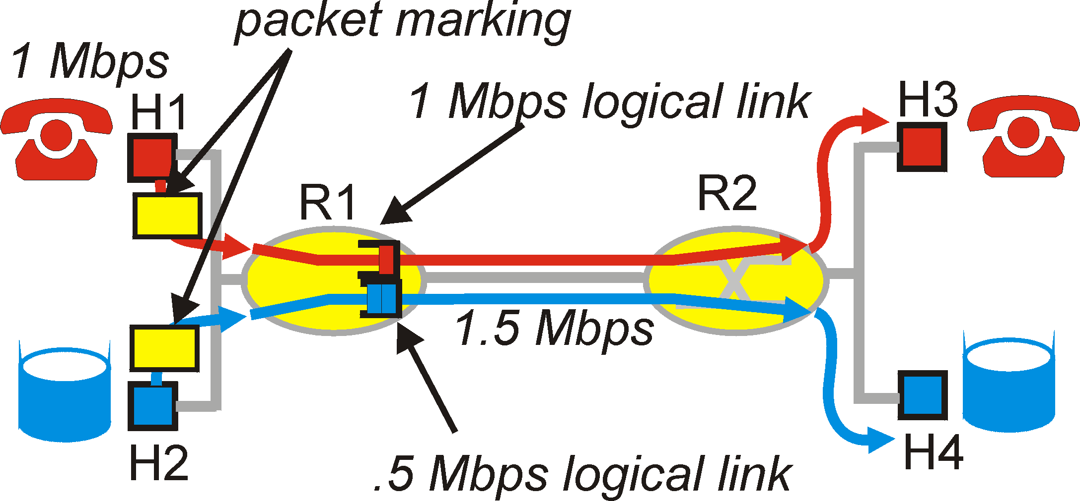
Principles for QoS Guarantees
Alternative to marking and policing
  Allocate fixed bandwidth to each application flow
  But, this can lead to inefficient use of bandwidth
  … if one of the flows does not use its allocation
Principle 3: Link scheduling
  While providing isolation, it is desirable to use resources as efficiently as possible
  E.g., weighted fair queuing or round-robin scheduling

Slide 42
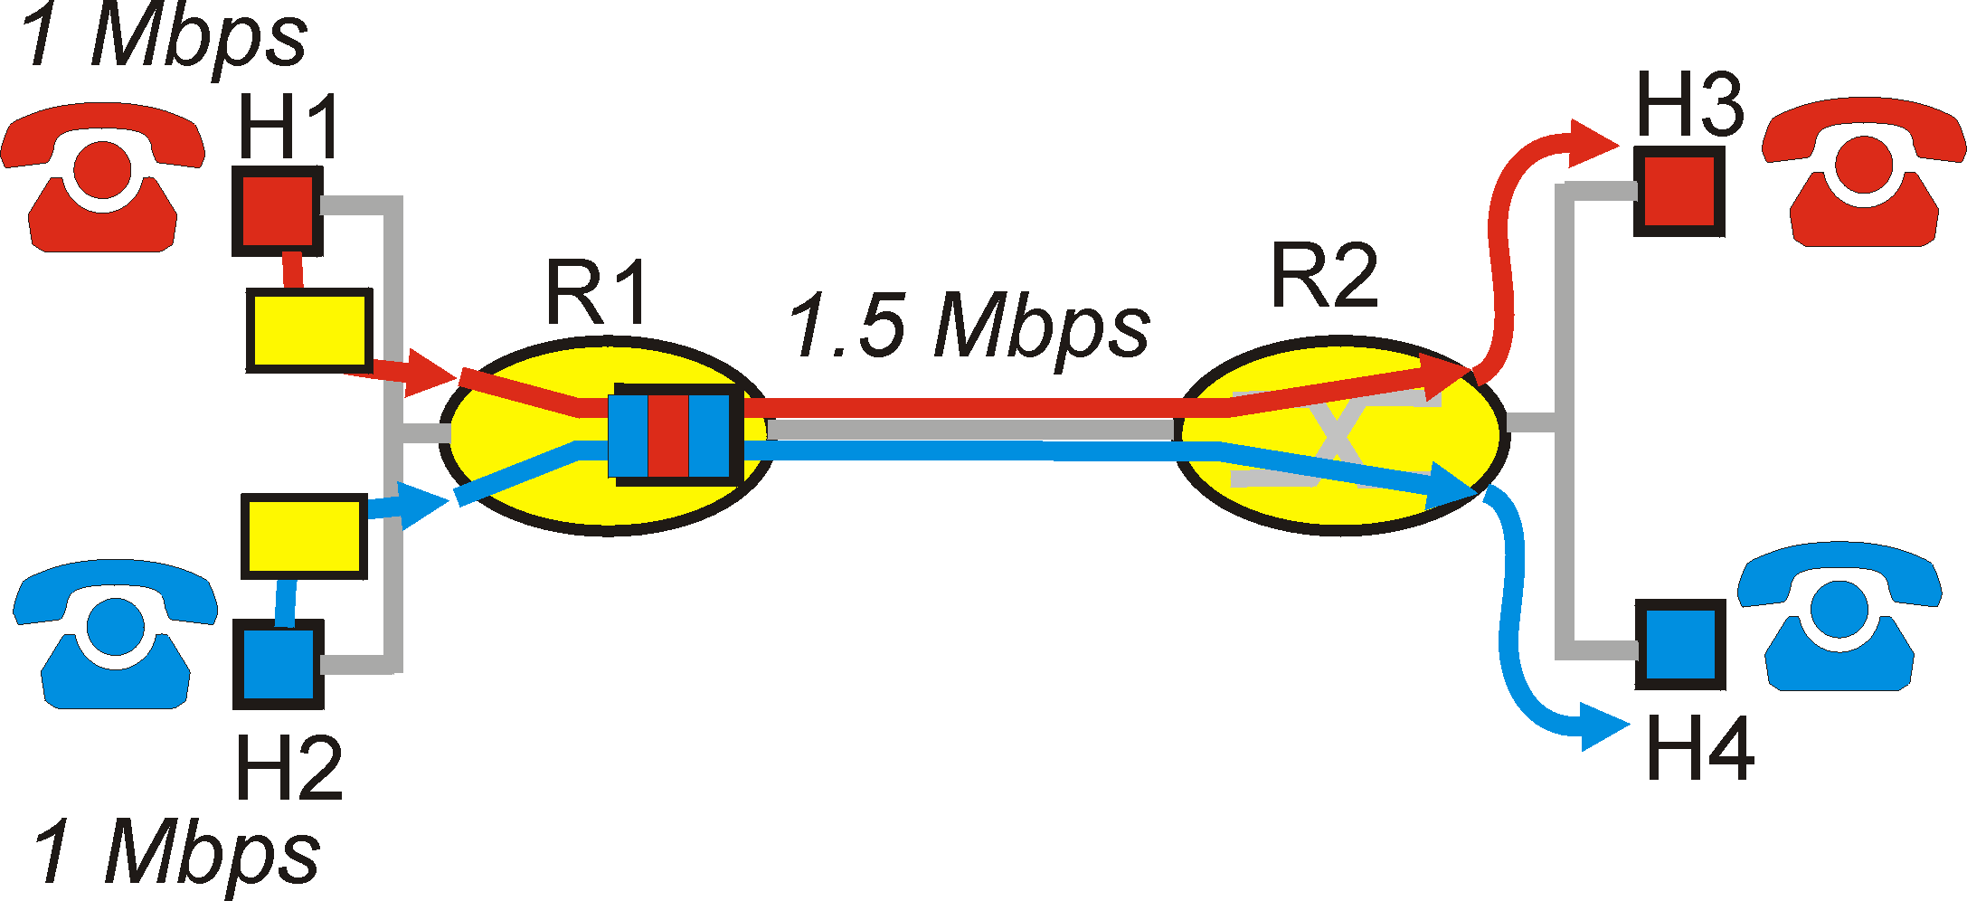
Principles for QoS Guarantees
Cannot support traffic beyond link capacity
  If total traffic exceeds capacity, you are out of luck
  Degrade the service for all, or deny someone access
Principle 4: Admission control
  Application flow declares its needs in advance
  The network may block call if it cannot satisfy the needs

Slide 43
Quality of Service
Significant change to Internet architecture
  Guaranteed service rather than best effort
  Routers keeping state about the traffic
A variety of new protocols and mechanisms
  Reserving resources along a path
  Identifying paths with sufficient resources
  Link scheduling and buffer management
  Packet marking with the Type-of-Service bits
  Packet classifiers to map packets to ToS classes
  …
Seeing some deployment within individual ASes
  E.g., corporate/campus networks, and within an ISP

Slide 44
Conclusions
Digital audio and video
  Increasingly popular media on the Internet
  Video on demand, VoIP, online gaming, IPTV…
Interaction with the network
  Adapt to delivering data over best-effort network
  Adapt network to offer better quality-of-service

