Slide 1
An Overview of Network Security
Nick Feamster
CS 3251: Computer Networking I
Spring 2010

Slide 2
Internet’s Design: Insecure
Designed for simplicity
“On by default” design
Readily available zombie machines
Attacks look like normal traffic
Internet’s federated operation obstructs cooperation for diagnosis/mitigation

Slide 3
Security: Definition
Security is a state of well-being of information and infrastructures in which the possibility of successful yet undetected theft, tampering, and disruption of information and services is kept low or tolerable
Security rests on confidentiality, authenticity, integrity, and availability

Slide 4
Basic Components
Confidentiality is the concealment of information or resources
Authenticity is the identification and assurance of the origin of information
Integrity refers to the trustworthiness of data or resources in terms of preventing improper and unauthorized changes
Availability refers to the ability to use the information or resource desired

Slide 5
Security Threats and Attacks
A threat is a potential violation of security
  Flaws in design, implementation, and operation
An attack is any action that violates security
  Active vs. passive attacks

Slide 6
Eavesdropping - Message Interception (Attack on Confidentiality)
Unauthorized access to information
Packet sniffers and wiretappers
Illicit copying of files and programs
A
B
Eavesdropper

Slide 7
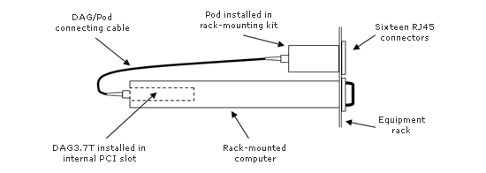
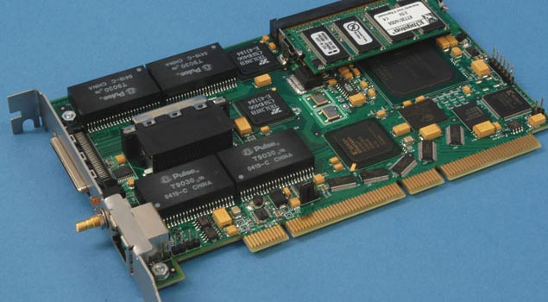
Full Packet Capture (Passive)
Example: Georgia Tech OC3Mon
Rack-mounted PC
Optical splitter
Data Acquisition and Generation (DAG) card
Source: endace.com

Slide 8
Eavesdropping Attack: Example
tcpdump with promiscuous network interface
  On a switched network, what can you see?
What might the following traffic types reveal about communications?
  DNS lookups (and replies)
  IP packets without payloads (headers only)
  Payloads

Slide 9
Integrity Attack - Tampering
Stop the flow of the message
Delay and optionally modify the message
Release the message again
A
B
Perpetrator

Slide 10
Authenticity Attack - Fabrication
Unauthorized assumption of other’s identity
Generate and distribute objects under this identity
A
B
Masquerader: from A

Slide 11
Attack on Availability
Destroy hardware (cutting fiber) or software
Modify software in a subtle way (alias commands)
Corrupt packets in transit
Blatant denial of service (DoS):
  Crashing the server
  Overwhelm the server (use up its resource)
A
B

Slide 12
Impact of Attacks
Theft of confidential information
Unauthorized use of
  Network bandwidth
  Computing resource
Spread of false information
Disruption of legitimate services
All attacks can be related and are dangerous!

Slide 13
Security Policy and Mechanism
Policy: a statement of what is, and is not allowed
Mechanism: a procedure, tool, or method of enforcing a policy
Security mechanisms implement functions that help prevent, detect, and respond to recovery from security attacks
Security functions are typically made available to users as a set of security services through APIs or integrated interfaces
Cryptography underlies many security mechanisms.

Slide 14
Security Services
Confidentiality: protection of any information from being exposed to unintended entities
  Information content
  Parties involved
  Where they are, how they communicate, how often, etc.

Slide 15
Security Services - Cont’d
Authentication: assurance that an entity of concern or the origin of a communication is authentic - it’s what it claims to be or from
Integrity: assurance that the information has not been tampered with
Non-repudiation: offer of evidence that a party indeed is the sender or a receiver of certain information

Slide 16
Security Services - Cont’d
Access control: facilities to determine and enforce who is allowed access to what resources, hosts, software, network connections
Monitor & response: facilities for monitoring security attacks, generating indications, surviving (tolerating) and recovering from attacks

Slide 17
Security Services - Cont’d
Security management: facilities for coordinating users’ service requirements and mechanism implementations throughout the enterprise network and across the Internet
  Trust model
  Trust communication protocol
  Trust management infrastructure

Slide 18


Firewalls
firewall
isolates organization’s internal net from larger Internet, allowing some packets to pass, blocking others
administered
network
public
Internet
trusted “good guys”
untrusted “bad guys”
firewall
Network Security

Slide 19
Firewalls: why
prevent denial of service attacks:
  SYN flooding: attacker establishes many bogus TCP connections, no resources left for “real” connections
prevent illegal modification/access of internal data
  e.g., attacker replaces CIA’s homepage with something else
allow only authorized access to inside network
  set of authenticated users/hosts
three types of firewalls:
  stateless packet filters
  stateful packet filters
  application gateways
Network Security

Slide 20
Stateless packet filtering
Should arriving packet be allowed in? Departing packet let out?
internal network connected to Internet via router firewall
router filters packet-by-packet, decision to forward/drop packet based on:
  source IP address, destination IP address
  TCP/UDP source and destination port numbers
  ICMP message type
  TCP SYN and ACK bits
Network Security

Slide 21
Stateless packet filtering: example
example 1: block incoming and outgoing datagrams with IP protocol field = 17 and with either source or dest port = 23
  result: all incoming, outgoing UDP flows and telnet connections are blocked
example 2: block inbound TCP segments with ACK=0.
  result: prevents external clients from making TCP connections with internal clients, but allows internal clients to connect to outside.
Network Security

Slide 22
Stateless packet filtering: more examples
Policy | Firewall Setting
No outside Web access. | Drop all outgoing packets to any IP address, port 80
No incoming TCP connections, except those for institution’s public Web server only. | Drop all incoming TCP SYN packets to any IP except 130.207.244.203, port 80
Prevent Web-radios from eating up the available bandwidth. | Drop all incoming UDP packets - except DNS and router broadcasts.
Prevent your network from being used for a smurf DoS attack. | Drop all ICMP packets going to a “broadcast” address (e.g. 130.207.255.255).
Prevent your network from being tracerouted | Drop all outgoing ICMP TTL expired traffic
Network Security

Slide 23
Access Control Lists
ACL: table of rules, applied top to bottom to incoming packets: (action, condition) pairs
action | source address | dest address | protocol | source port | dest port | flag bit
allow | 222.22/16 | outside of 222.22/16 | TCP | > 1023 | 80 | any
allow | outside of 222.22/16 | 222.22/16 | TCP | 80 | > 1023 | ACK
allow | 222.22/16 | outside of 222.22/16 | UDP | > 1023 | 53 | ---
allow | outside of 222.22/16 | 222.22/16 | UDP | 53 | > 1023 | ----
deny | all | all | all | all | all | all
Network Security

Slide 24
Stateful packet filtering
stateless packet filter: heavy handed tool
  admits packets that “make no sense,” e.g., dest port = 80, ACK bit set, even though no TCP connection established:
action | source address | dest address | protocol | source port | dest port | flag bit
allow | outside of 222.22/16 | 222.22/16 | TCP | 80 | > 1023 | ACK
stateful packet filter: track status of every TCP connection
  track connection setup (SYN), teardown (FIN): determine whether incoming, outgoing packets “makes sense”
  timeout inactive connections at firewall: no longer admit packets
Network Security

Slide 25
Stateful packet filtering
ACL augmented to indicate need to check connection state table before admitting packet
action | source address | dest address | proto | source port | dest port | flag bit | check conxion
allow | 222.22/16 | outside of 222.22/16 | TCP | > 1023 | 80 | any
allow | outside of 222.22/16 | 222.22/16 | TCP | 80 | > 1023 | ACK | x
allow | 222.22/16 | outside of 222.22/16 | UDP | > 1023 | 53 | ---
allow | outside of 222.22/16 | 222.22/16 | UDP | 53 | > 1023 | ---- | x
deny | all | all | all | all | all | all
Network Security

Slide 26

Application gateways
gateway-to-remote
host telnet session
host-to-gateway
telnet session
filters packets on application data as well as on IP/TCP/UDP fields.
example: allow select internal users to telnet outside.
application
gateway
router and filter
1. require all telnet users to telnet through gateway.
2. for authorized users, gateway sets up telnet connection to dest host. Gateway relays data between 2 connections
3. router filter blocks all telnet connections not originating from gateway.
Network Security

Slide 27
Application gateways
filter packets on application data as well as on IP/TCP/UDP fields.
example: allow select internal users to telnet outside
host-to-gateway
telnet session
application
gateway
router and filter
gateway-to-remote
host telnet session
1. require all telnet users to telnet through gateway.
2. for authorized users, gateway sets up telnet connection to dest host. Gateway relays data between 2 connections
3. router filter blocks all telnet connections not originating from gateway.
Network Security

Slide 28
Limitations of firewalls, gateways
IP spoofing: router can’t know if data “really” comes from claimed source
if multiple app’s. need special treatment, each has own app. gateway
client software must know how to contact gateway.
  e.g., must set IP address of proxy in Web browser
filters often use all or nothing policy for UDP
tradeoff: degree of communication with outside world, level of security
many highly protected sites still suffer from attacks
Network Security

Slide 29
Intrusion detection systems
packet filtering:
  operates on TCP/IP headers only
  no correlation check among sessions
IDS: intrusion detection system
  deep packet inspection: look at packet contents (e.g., check character strings in packet against database of known virus, attack strings)
  examine correlation among multiple packets
    port scanning
    network mapping
    DoS attack
Network Security

Slide 30
Intrusion detection systems
multiple IDSs: different types of checking at different locations
firewall
internal
network
Internet
IDS
sensors
Web
server
DNS
server
FTP
server
demilitarized
zone
Network Security

Slide 31
The Security Life Cycle
Threats
Policy
Specification
Design
Implementation
Operation and maintenance

Slide 32
Taxonomy of Threats
Taxonomy – a way to classify and refer to threats (and attacks) by names/categories
  Benefits – avoid confusion
  Focus/coordinate development efforts of security mechanisms
No standard yet
One possibility: by results/intentions first, then by techniques, then further by targets, etc.
  Associate severity/cost to each threat

Slide 33
A Taxonomy Example
By results first, then by (high-level) techniques:
  Illegal root
    Remote, e.g., buffer-overflow a daemon
    Local, e.g., buffer-overflow a “root” program
  Illegal user
    Single, e.g., guess password
    Multiple, e.g., via previously installed back-door
  Denial-of-Service
    Crashing, e.g., teardrop, ping-of-death, land
    Resource consumption, e.g., syn-flood
  Probe
    Simple, e.g., fast/regular port-scan
    Stealth, e.g., slow/”random” port-scan

Slide 34
Threat Examples - IP Spoofing
A common first step to many threats
Source IP address cannot be trusted!
SRC: source
DST: destination
IP Header
IP Payload
SRC: 18.31.10.8
DST: 130.207.7.237
Is it really from MIT?

Slide 35

Similar to US Mail (or E-mail)
From:
Nick Feamster
Georgia Tech
To:
William Smith
M.I.B. Corp.
US mail maybe better in the sense that there is a stamp put on the envelope at the location (e.g., town) of collection...

Slide 36
Most Routers Only Care About Destination Address
src:128.59.10.8
dst:130.207.7.237
128.59.10.xx
Rtr
Columbia
130.207.xx.xx
Rtr
Georgia Tech
36.190.0.xx
Rtr
src:128.59.10.8
dst:130.207.7.237
Stanford

Slide 37
Why Should I Care?
Attack packets with spoofed IP address help hide the attacking source.
A smurf attack launched with your host IP address could bring your host and network to their knees.
Higher protocol layers (e.g., TCP) help to protect applications from direct harm, but not enough.

Slide 38
Current IPv4: IP Spoofing
No authentication for the source
Various approaches exist to address the problem:
  Router/firewall filtering
  TCP handshake

Slide 39
Router Filtering
Decide whether this packet, with certain source IP address, should come from this side of network.
Local policy
Hey, you shouldn’t be here!
36.190.0.xx
Rtr
src:128.59.10.8
dst:130.207.7.237
Stanford

Slide 40
Filtering at Routers
Very effective for some networks (ISP should always do that!)
  At least be sure that this packet is from some particular subnet
Problems
  Hard to handle frequent add/delete hosts/subnets or mobile IP
  Upsets customers should legitimate packets get discarded
  Need to trust other routers

Slide 41
TCP Handshake
client
server
SYN seq=x
SYN seq=y, ACK x+1
ACK y+1
connection
established

Slide 42
TCP Handshake
seq=y, ACK x+1
128.59.10.xx
Rtr
Columbia
130.207.xx.xx
Rtr
Georgia Tech
36.190.0.xx
Rtr
x
The handshake prevents the attacker
from establishing a TCP connection
pretending to be 128.59.10.8
src:128.59.10.8
dst:130.207.7.237
Stanford

Slide 43
TCP Handshake
Very effective for stopping most such attacks
Problems
  The attacker can succeed if “y” can be predicted
  Other DoS attacks are still possible (e.g., TCP SYN-flood)

Slide 44
IP Spoofing & SYN Flood
X establishes a TCP connection with B assuming A’s IP address
(4)
SYN(seq=n)ACK(seq=m+1)
A
B
(2) predict B’s
TCP seq. behavior
(1) SYN
Flood
SYN(seq=m),src=A
(3)
(5)
ACK(seq=n+1)
X

Slide 45
Denial of Service: What is it?
Attacker
Victim
Attempt to exhaust resources
  Network: Bandwidth
  Transport: TCP connections
  Application: Server resources
Typically high-rate attacks, but not always

Slide 46
Pre-2000 Denial of Service
  DoS Tools
    Single-source, single target tools
    IP source address spoofing
    Packet amplification (e.g., smurf)
  Deployment
    Widespread scanning and exploitation via scripted tools
    Hand-installed tools and toolkits on compromised hosts (unix)
  Use
    Hand executed on source host

Slide 47
TCP: 3-Way Handshake
C
S
SYN_{C}
Listening
Store data
SYN_{S}, ACK_{C}
Wait
ACK_{S}
Connected

Slide 48
TCP handshake
Each arriving SYN stores state at the server
  TCP Control Block (TCB)
  ~ 280 bytes
    FlowID, timer info, Sequence number, flow control status, out-of-band data, MSS, other options agreed to
  Half-open TCB entries exist until timeout
  Fixed bound on half-open connections
Resources exhausted ⇒ requests rejected

Slide 49
TCP SYN flooding
Problem: No client authentication of packets before resources allocated
Attacker sends many connection requests
  Spoofed source addresses
  RSTs quickly generated if source address exists
  No reply for non-existent sources
    Attacker exhausts TCP buffer to w/ half-open connections

Slide 50
SYN Flooding
C
S
SYN_{C1}
Listening
SYN_{C2}
Store data
SYN_{C3}
SYN_{C4}
SYN_{C5}

Slide 51
Idea #1: Ingress Filtering
Drop all packets with source address other than 204.69.207.0/24
Internet
204.69.207.0/24
RFC 2827: Routers install filters to drop packets from networks that are not downstream
Feasible at edges
Difficult to configure closer to network “core”

Slide 52
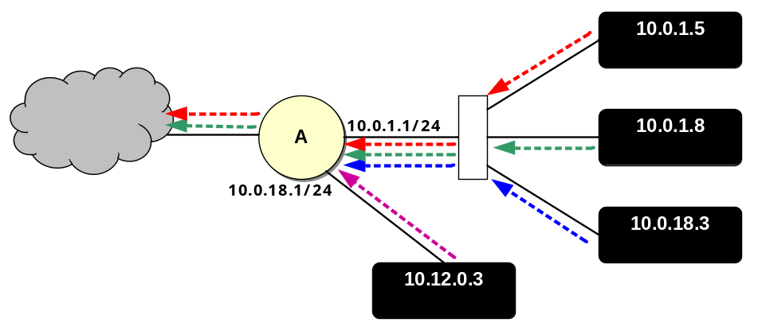
Idea #2: uRPF Checks
Accept packet from interface only if forwarding table entry for source IP address matches ingress interface
Strict Mode
uRPF Enabled
10.0.18.3 from wrong interface
“A” Routing Table
Destination Next Hop
10.0.1.0/24 Int. 1
10.0.18.0/24 Int. 2
Unicast Reverse Path Forwarding
  Cisco: “ip verify unicast reverse-path”
Requires symmetric routing

Slide 53
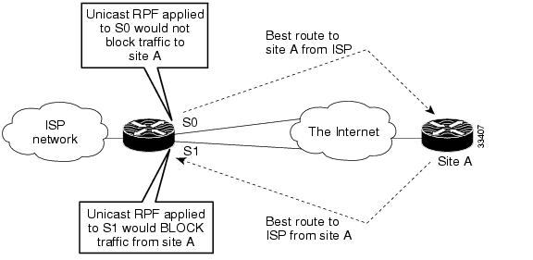
Problems with uRPF
Asymmetric routing

Slide 54
Idea #3: TCP SYN cookies
General idea
  Client sends SYN w/ ACK number
  Server responds to Client with SYN-ACK cookie
    sqn = f(src addr, src port, dest addr, dest port, rand)
    Server does not save state
  Honest client responds with ACK(sqn)
  Server checks response
  If matches SYN-ACK, establishes connection

Slide 55
TCP SYN cookie
TCP SYN/ACK seqno encodes a cookie
  32-bit sequence number
    t mod 32: counter to ensure sequence numbers increase every 64 seconds
    MSS: encoding of server MSS (can only have 8 settings)
    Cookie: easy to create and validate, hard to forge
      Includes timestamp, nonce, 4-tuple
32
0
t mod 32
MSS
Cookie=HMAC(t, N_{s}, SIP, SPort, DIP, DPort)
5 bits
3 bits

Slide 56
SYN Cookies
client
  sends SYN packet and ACK number to server
  waits for SYN-ACK from server w/ matching ACK number
server
  responds w/ SYN-ACK packet w/ initial SYN-cookie sequence number
  Sequence number is cryptographically generated value based on client address, port, and time.
client
  sends ACK to server w/ matching sequence number
server
  If ACK is to an unopened socket, server validates returned sequence number as SYN-cookie
  If value is reasonable, a buffer is allocated and socket is opened
SYN
ack-number
SYN-ACK
seq-number as SYN-cookie,
ack-number
NO BUFFER ALLOCATED
ACK
seq_number
ack-number+data
SYN-ACK
seq-number, ack-number
TCP BUFFER ALLOCATED

Slide 57
TCP SYN cookies
General idea
  Client sends SYN w/ ACK number
  Server responds to Client with SYN-ACK cookie
    sqn = f(src addr, src port, dest addr, dest port, rand)
    Server does not save state
  Honest client responds with ACK(sqn)
  Server checks response
  If matches SYN-ACK, establishes connection

Slide 58
TCP SYN cookie
TCP SYN/ACK seqno encodes a cookie
  32-bit sequence number
    t mod 32: counter to ensure sequence numbers increase every 64 seconds
    MSS: encoding of server MSS (can only have 8 settings)
    Cookie: easy to create and validate, hard to forge
      Includes timestamp, nonce, 4-tuple
32
0
t mod 32
MSS
Cookie=HMAC(t, N_{s}, SIP, SPort, DIP, DPort)
5 bits
3 bits

Slide 59
Vulnerability
A vulnerability (or security flaw) is a specific failure of the security controls
Using the failure to violate the site security: exploiting the vulnerability; the person who does this: an attacker
It can be due to
  Lapses in design, implementation, and operation procedures.
  Even security algorithms/systems are not immune!
    We will go over some examples in this course

Slide 60
Example: IP Protocol-related Vulnerabilities
Authentication based on IP source address
  But no effective mechanisms against IP spoofing
Consequences (possible exploits)
  Denial of Service attacks on infrastructures, e.g.
    IP Spoofing and SYN Flood
    Redirection attacks

