Slide 1
Link-Layer Addressing and Forwarding
Nick Feamster
Computer Networking I
Spring 2013

Slide 2

The Internet Protocol Stack
Need to interconnect many existing networks
Hide underlying technology from applications
Decisions
  Network provides minimal functionality
  IP as the “Narrow waist”
email WWW phone...
SMTP HTTP RTP...
TCP UDP…
IP
ethernet PPP…
CSMA async sonet...
copper fiber radio...
Applications
Technology

Slide 3
Layering
Helps manage complexity
Each layer:
  Relies on services from layer below
  Provides services to layer above
For example: IP (network) layer
  IP relies on connectivity to next hop, access to medium
  IP provides a datagram service
    Best effort delivery
    Packets may be lost, corrupted, reordered, etc.
  Layers on top of IP (e.g., TCP) may guarantee reliable, in-order delivery

Slide 4
Layering Mechanism: Encapsulation
User A
User B
Application
(message)
Transport
(segment)
Network
(datagram)
Link (frame)
Get index.html
Connection ID
Source/Destination
Link Address
This can be more complex
Example: Network layers can be encapsulated within another network layer

Slide 5
The “Narrow Waist”
Facilitates interconnection and interoperability
IP over anything, anything over IP
  Has allowed for much innovation both above and below the IP layer of the stack
  Any device with an IP stack can “get on the Internet”
Drawback: very difficult to make changes to IP

Slide 6
From Signals to Packets
Analog Signal
“Digital” Signal
Bit Stream
0 0 1 0 1 1 1 0 0 0 1
Packets
0100010101011100101010101011101110000001111010101110101010101101011010111001
Header/Body
Header/Body
Header/Body
Packet
Transmission
Sender
Receiver

Slide 7
Analog versus Digital Encoding
Digital transmissions.
  Interpret the signal as a series of 1’s and 0’s
  E.g. data transmission over the Internet
Analog transmission
  Do not interpret the contents
  E.g broadcast radio
Why digital transmission?

Slide 8
Non-Return to Zero (NRZ)
0
1
0
0
0
1
1
0
1
.85
V
0
-.85
1 -> high signal; 0 -> low signal
Long sequences of 1’s or 0’s can cause problems:
  Sensitive to clock skew, i.e. hard to recover clock
  Difficult to interpret 0’s and 1’s

Slide 9
Ethernet Manchester Encoding
0
1
1
0
.85
V
0
-.85
.1μs
Positive transition for 0, negative for 1
Transition every cycle communicates clock (but need 2 transition times per bit)
DC balance has good electrical properties

Slide 10
The Link Layer
LAN/Physical/MAC address
  Flat structure
  Unique to physical interface (no two alike)…how?
datagram
link layer protocol
receiver
sender
frame
frame
adapter
adapter
Frames can be sent to a specific MAC address or to the broadcast MAC address
What are the advantages to separating network layer from MAC layer?

Slide 11
Services Provided by the Link Layer
Framing: Encapsulation of a network-layer datagram
Link Access: Sharing of broadcast links and shared media
Reliable Delivery: Guarantee to deliver the frame to the other end of the link without error.
Flow Control: The link layer can provide mechanisms to avoid overflowing the buffer
Error Correction: Determining where errors have occurred and then correcting those errors.

Slide 12
Local Area Networks
Benefits of being “local”:
  Lower cost
  Short distance = faster links, low latency
    Efficiency less pressing
  One management domain
  More homogenous
Examples:
  Ethernet
  Token ring, FDDI
  802.11 wireless

Slide 13
Life of a Packet: On a Subnet
Packet destined for outgoing IP address arrives at network interface
  Packet must be encapsulated into a frame with the destination MAC address
Frame is sent on LAN segment to all hosts
Hosts check destination MAC address against MAC address that was destination IP address of the packet

Slide 14
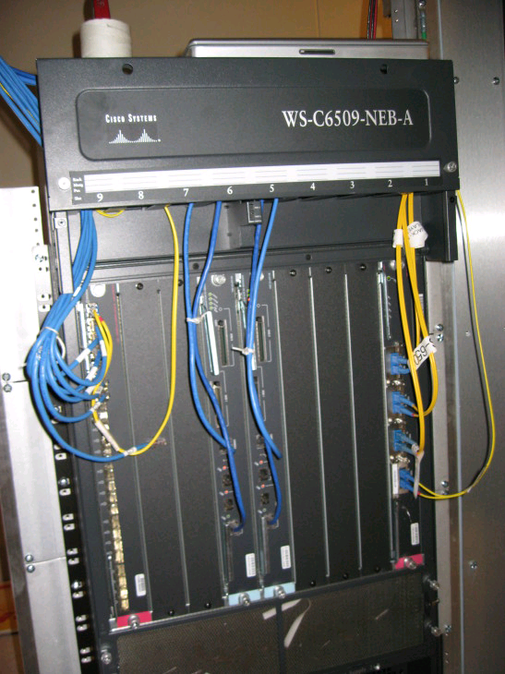
Interconnecting LANs
Receive & broadcast (“hub”)
Learning switches
Spanning tree (RSTP, MSTP, etc.) protocols

Slide 15

Interconnecting LANs with Hubs
All packets seen everywhere
  Lots of flooding, chances for collision
Can’t interconnect LANs with heterogeneous media (e.g., Ethernets of different speeds)
hub
hub
hub
hub

Slide 16
Problems with Hubs: No Isolation
Scalability
Latency
  Avoiding collisions requires backoff
  Possible for a single host to hog the medium
Failures
  One misconfigured device can cause problems for every other device on the LAN

Slide 17
Improving on Hubs: Switches
Link-layer
  Stores and forwards Ethernet frames
  Examines frame header and selectively forwards frame based on MAC dest address
  When frame is to be forwarded on segment, uses CSMA/CD to access segment
Transparent
  Hosts are unaware of presence of switches
Plug-and-play, self-learning
  Switches do not need to be configured

Slide 18
Switch: Traffic Isolation
Switch breaks subnet into LAN segments
Switch filters packets
  Same-LAN-segment frames not usually forwarded onto other LAN segments
  Segments become separate collision domains
switch
collision
domain
hub
hub
hub
collision domain
collision domain

Slide 19
Filtering and Forwarding
Occurs through switch table
Suppose a packet arrives destined for node with MAC address x from interface A
  If MAC address not in table, flood (act like a hub)
  If MAC address maps to A, do nothing (packet destined for same LAN segment)
  If MAC address maps to another interface, forward
How does this table get configured?
LAN B
A
B
C
LAN A
LAN C

Slide 20
Advantages vs. Hubs
Better scaling
  Separate collision domains allow longer distances
Better privacy
  Hosts can “snoop” the traffic traversing their segment
  … but not all the rest of the traffic
Heterogeneity
  Joins segments using different technologies

Slide 21
Limitations on Topology
Switches sometimes need to broadcast frames
  Unfamiliar destination: Act like a hub
  Sending to broadcast
Flooding can lead to forwarding loops and broadcast storms
  E.g., if the network contains a cycle of switches
  Either accidentally, or by design for higher reliability
Worse yet, packets can be duplicated and proliferated!

Slide 22
Limitations on Topology
Switches sometimes need to broadcast frames
  Unfamiliar destination: Act like a hub
  Sending to broadcast
Flooding can lead to forwarding loops and broadcast storms
  E.g., if the network contains a cycle of switches
  Either accidentally, or by design for higher reliability
Worse yet, packets can be duplicated and proliferated!

Slide 23
Solution: Spanning Trees
Ensure the topology has no loops
  Avoid using some of the links when flooding
  … to avoid forming a loop
Spanning tree
  Sub-graph that covers all vertices but contains no cycles
  Links not in the spanning tree do not forward frames

Slide 24
Constructing a Spanning Tree
Elect a root
  The switch with the smallest identifier
Each switch identifies if its interface
is on the shortest path from the root
  And it exclude from the tree if not
  Also exclude from tree if same distance,
  but higher identifier
Message Format: (Y, d, X)
  From node X
  Claiming Y as root
  Distance is d
root
One hop
Three hops

Slide 25
Steps in Spanning Tree Algorithm
Initially, every switch announces itself as the root
  Example: switch X announces (X, 0, X)
Switches update their view of the root
  Upon receiving a message, check the root id
  If the new id is smaller, start viewing that switch as root
Switches compute their distance from the root
  Add 1 to the distance received from a neighbor
  Identify interfaces not on a shortest path to the root and exclude those ports from the spanning tree

Slide 26
Example From Switch #4’s Viewpoint
Switch #4 thinks it is the root
  Sends (4, 0, 4) message to 2 and 7
Switch #4 hears from #2
  Receives (2, 0, 2) message from 2
  … and thinks that #2 is the root
  And realizes it is just one hop away
Switch #4 hears from #7
  Receives (2, 1, 7) from 7
  And realizes this is a longer path
  So, prefers its own one-hop path
  And removes 4-7 link from the tree
1
3
5
2
4
6
7

Slide 27

Ethernet Frame Structure
Sending adapter encapsulates IP datagram (or other network layer protocol packet) in Ethernet frame

Slide 28
Ethernet Frame Structure (cont.)
Preamble: 8 bytes
  101010…1011
  Used to synchronize receiver, sender clock rates
CRC: 4 bytes
  Checked at receiver, if error is detected, the frame is simply dropped

Slide 29
Ethernet Frame Structure (cont.)
Each protocol layer needs to provide some hooks to upper layer protocols
  Demultiplexing: identify which upper layer protocol packet belongs to
  E.g., port numbers allow TCP/UDP to identify target application
  Ethernet uses Type field
Type: 2 bytes
  Indicates the higher layer protocol, mostly IP but others may be supported such as Novell IPX and AppleTalk)

Slide 30
Addressing Alternatives
Broadcast media → all nodes receive all packets
  Addressing determines which packets are kept and which are packets are thrown away
  Packets can be sent to:
    Unicast – one destination
    Multicast – group of nodes (e.g. “everyone playing Quake”)
    Broadcast – everybody on wire
Dynamic addresses (e.g. Appletalk)
  Pick an address at random
  Broadcast “is anyone using address XX?”
  If yes, repeat
Static address (e.g. Ethernet)

Slide 31
Ethernet Frame Structure (cont.)
Addresses: 6 bytes
  Each adapter is given a globally unique address at manufacturing time
    Address space is allocated to manufacturers
      24 bits identify manufacturer
      E.g., 0:0:15:* → 3com adapter
    Frame is received by all adapters on a LAN and dropped if address does not match
  Special addresses
    Broadcast – FF:FF:FF:FF:FF:FF is “everybody”
    Range of addresses allocated to multicast
      Adapter maintains list of multicast groups node is interested in

Slide 32

LAN Switching
Extend reach of a single shared medium
Connect two or more “segments” by copying data frames between them
  Switches only copy data when needed → key difference from repeaters
LAN 1
LAN 2

Slide 33
Switched Network Advantages
Higher link bandwidth
  Point to point electrically simpler than bus
Much greater aggregate bandwidth
  Separate segments can send at once
Improved fault tolerance
  Redundant paths
Challenge (next lecture)
  Learning which packets to copy across links
  Avoiding forwarding loops

Slide 34
Disadvantages vs. Hubs
Delay in forwarding frames
  Bridge/switch must receive and parse the frame
  … and perform a look-up to decide where to forward
  Storing and forwarding the packet introduces delay
  Solution: cut-through switching
Need to learn where to forward frames
  Bridge/switch needs to construct a forwarding table
  Ideally, without intervention from network administrators
  Solution: self-learning

Slide 35

Motivation For Self-Learning
Switches forward frames selectively
  Forward frames only on segments that need them
Switch table
  Maps destination MAC address to outgoing interface
  Goal: construct the switch table automatically
B
A
C
switch
D

Slide 36
(Self)-Learning Bridges
Switch is initially empty
For each incoming frame, store
  The incoming interface from which the frame arrived
  The time at which that frame arrived
  Delete the entry if no frames with a particular source address arrive within a certain time
B
Switch learns how to reach A.
A
C
D

Slide 37
ARP: IP Addresses to MAC addresses
Query is IP address, response is MAC address
Query is sent to LAN’s broadcast MAC address
Each host or router has an ARP table
  Checks IP address of query against its IP address
  Replies with ARP address if there is a match
Potential problems with this approach?
Caching on hosts is really important
  Try arp –a to see an ARP table

Slide 38
Switches vs. Routers
Switches
Switches are automatically configuring
Forwarding tends to be quite fast, since packets only need to be processed through layer 2
Routers
Router-level topologies are not restricted to a spanning tree
  Can even have multipath routing

Slide 39
Medium Access Control

Slide 40
Problem: Sharing a Wire
Learned how to connect hosts
… But what if we want more hosts?
Expensive! How can we share a wire?
Switches
Wires for everybody!

Slide 41
Random Access Protocols
When node has packet to send
  Transmit at full channel data rate R
  No a priori coordination among nodes
Two or more transmitting nodes → “collision”
Random access MAC protocol specifies:
  How to detect collisions
  How to recover from collisions (e.g., via delayed retransmissions)
Examples of random access MAC protocols:
  Slotted ALOHA and ALOHA
  CSMA and CSMA/CD
8

Slide 42
Aloha – Basic Technique
First random MAC developed
  For radio-based communication in Hawaii (1970)
Basic idea:
  When you are ready, transmit
  Receivers send ACK for data
  Detect collisions by timing out for ACK
  Recover from collision by trying after random delay
    Too short → large number of collisions
    Too long → underutilization
9

Slide 43

Slotted Aloha
Time is divided into equal size slots
  Equal to packet transmission time
Node (w/ packet) transmits at beginning of next slot
If collision: retransmit pkt in future slots with probability p, until successful
Success (S), Collision (C), Empty (E) slots
10

Slide 44

Pure (Unslotted) ALOHA
Unslotted Aloha: simpler, no synchronization
Pkt needs transmission:
  Send without awaiting for beginning of slot
Collision probability increases:
  Pkt sent at t₀ collide with other pkts sent in [t₀-1, t₀+1]
11

Slide 45
Random Access MAC Protocols
Non-Carrier-Sense protocols: doesn’t “listen” to the channel before transmitting
  ALOHA
Carrier-Sense protocols: senses the channel before transmitting
  CSMA (Carrier Sense Multiple Access): does not detect collision.
  CSMA/CD (Ethernet): A node “listens” before/while transmitting to determine whether a collision happens.

Slide 46
ALOHA
Radio-based communication network
  Developed in 1970s at the Univ of Hawaii
Basic idea: transmit when a node has data to be sent.
  Receiver sends ACK for data
  Detect collisions by timing out for ACK
  Recover from collision by trying after random delay
Too short: large number of collisions
Too long: underutilization

Slide 47
Ethernet MAC
If line is idle (no carrier sensed) send packet immediately
If line is busy (carrier sensed) wait until idle and transmit packet immediately
If collision detected
  Stop sending and jam signal
  Jam signal: make sure all other transmitters are aware of collision
  Wait a random time (Exponential backoff), and try again

Slide 48
Questions
How does sender detect collision?
How long does it take?

Slide 49
Ethernet Performance
Ethernets work best under light loads
  Utilization over 30% is considered heavy
Peak throughput worse with
  More hosts
    More collisions needed to identify single sender
  Smaller packet sizes
    More frequent arbitration
  Longer links
    Collisions take longer to observe, more wasted bandwidth

Slide 50
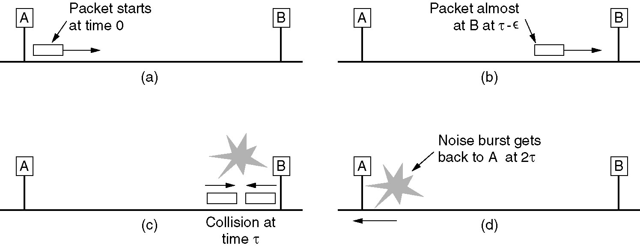
Ethernet MAC Protocol

Slide 51
Error Detection and Correction

Slide 52

Error Detection
EDC= Error Detection and Correction bits (redundancy)
D = Data protected by error checking, may include header fields
Error detection not 100% reliable!
  protocol may miss some errors, but rarely
  larger EDC field yields better detection and correction

Slide 53


Parity Checking
Single Bit Parity:
Detect single bit errors
Two Dimensional Bit Parity:
Detect and correct single bit errors
0
0

Slide 54
Internet checksum
Goal: detect “errors” (e.g., flipped bits) in transmitted segment (note: used at transport layer only)
Sender:
treat segment contents as sequence of 16-bit integers
checksum: addition (1’s complement sum) of segment contents
sender puts checksum value into UDP checksum field
Receiver:
compute checksum of received segment
check if computed checksum equals checksum field value:
  NO - error detected
  YES - no error detected. But maybe errors nonetheless? More later ….

Slide 55

Checksumming: Cyclic Redundancy Check
view data bits, D, as a binary number
choose r+1 bit pattern (generator), G
goal: choose r CRC bits, R, such that
  <D,R> exactly divisible by G (modulo 2)
  receiver knows G, divides <D,R> by G. If non-zero remainder: error detected!
  can detect all burst errors less than r+1 bits
widely used in practice (ATM, HDCL)

Slide 56

CRC Example
Want:
  D.2^{r} XOR R = nG
equivalently:
  D.2^{r} = nG XOR R
equivalently:
if we divide D.2^{r} by G, want remainder R
D.2^{r}
G
R = remainder[ ]

Slide 57
The Design Goals of Internet, v1
Interconnection/Multiplexing (packet switching)
Resilience/Survivability (fate sharing)
Heterogeneity
  Different types of services
  Different types of networks
Distributed management
Cost effectiveness
Ease of attachment
Accountability
Decreasing
Priority
These goals were prioritized for a military network. Should priorities change as the network evolves?

Slide 58
Fundamental Goal: Sharing
Packet Switching
No connection setup
Forwarding based on destination address in packet
Efficient sharing of resources
Tradeoff: Resource management more difficult.

Slide 59
Fundamental Goal: Interconnection
Need to interconnect many existing networks
Hide underlying technology from applications
Decisions:
  Network provides minimal functionality
  “Narrow waist”
email WWW phone...
SMTP HTTP RTP...
TCP UDP…
IP
ethernet PPP…
CSMA async sonet...
copper fiber radio...
Applications
Technology
Tradeoff: No assumptions, no guarantees.

Slide 60
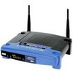
Interconnection: “Gateways”
Interconnect heterogeneous networks
No state about ongoing connections
  Stateless packet switches
Generally, router == gateway
But, we can think of a NAT as also performing the function of a gateway
192.168.1.51
68.211.6.120:50878
Home
Network
Internet
192.168.1.52
68.211.6.120:50879

Slide 61
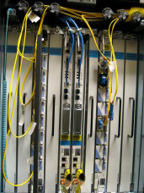
Gateways: Routers and Switches
Interconnect nodes to nodes
  And networks to networks
No state about ongoing connections
  Stateless packet switches
We can also think of your home router/NAT as performing the function of a gateway
192.168.1.51
68.211.6.120:50878
Home
Network
Internet
192.168.1.52
68.211.6.120:50879
(more on NATs in lecture 17)

Slide 62
Goal #2: Survivability
Two Options
Replication
  Keep state at multiple places in the network, recover when nodes crash
Fate-sharing
  Acceptable to lose state information for some entity if the entity itself is lost
Reasons for Fate Sharing
Can support arbitrarily complex failure scenarios
Engineering is easier
Recent reversals of this trend: NAT (Wednesday), Routing Control Platform (Lecture 4)
Notes:
Is fate sharing still satisfied today?

Slide 63
Goal #3: Heterogeneous Services
TCP/IP designed as a monolithic transport
  TCP for flow control, reliable delivery
  IP for forwarding
Became clear that not every type of application would need reliable, in-order delivery
  Example: Voice and video over networks
  Example: DNS
    Why doesn’t DNS require reliable, in-order delivery?

Slide 64
Goal #3b: Heterogeneous Networks
Build minimal functionality into the network
  No need to re-engineering for each type of network
“Best effort” service model.
  Lost packets
  Out-of-order packets
  No quality guarantees
  No information about failures, performance, etc.
Tradeoff: Network management more difficult

Slide 65
Goal #4: Distributed Management
Many examples:
Addressing (ARIN, RIPE, APNIC, etc.)
  (Though this was recently threatened.)
Naming (DNS)
Routing (BGP)
No single entity in charge.
Allows for organic growth, scalable management.
Tradeoff: No one party has visibility/control.

Slide 66
No Owner, No Responsible Party
“Some of the most significant problems with the Internet today relate to lack of sufficient tools for distributed management, especially in the area of routing.”
Hard to figure out who/what’s causing a problem
Worse yet, local actions have global effects…

Slide 67
Goal #5: Cost Effectiveness
Packet headers introduce high overhead
End-to-end retransmission of lost packets
  Potentially wasteful of bandwidth by placing burden on the edges of the network
Arguably a good tradeoff. Current trends are to exploit redundancy even more.

Slide 68
Goal #6: Ease of Attachment
IP is “plug and play” Anything with a working IP stack can connect to the Internet (hourglass model)
A huge success!
  Lesson: Lower the barrier to innovation/entry and people will get creative (e.g., Cerf and Kahn probably did not think about IP stacks on phones, sensors, etc.)
But….
Tradeoff: Burden on end systems/programmers.

Slide 69
Goal #7: Accountability
Note: Accountability mentioned in early papers on TCP/IP, but not prioritized
Datagram networks make accounting tricky.
  The phone network has had an easier time figuring out billing
  Payments/billing on the Internet is much less precise
  (More on this in Lecture 4)
Tradeoff: Broken payment models and incentives.

