Slide 1
Addressing: IPv4, IPv6, and Beyond
CS 3251: Computer Networking I
Nick Feamster
Spring 2013

Slide 2
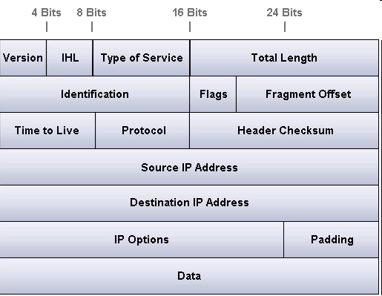
IP Header

Slide 3
IPv4 Addresses: Networks of Networks
Topological Addressing
32-bit number in “dotted-quad” notation
  www.cc.gatech.edu --- 130.207.7.36
130
207
7
36
10000010
11001111
00000111
00100100
Network (16 bits)
Host (16 bits)
Problem: 2³² addresses is a lot of table entries
Solution: Routing based on network and host
  130.207.0.0/16 is a 16-bit prefix with 2¹⁶ IP addresses

Slide 4
Pre-1994: Classful Addressing
8
16
24
32
Class A
Network ID
0
Host ID
    /8 blocks (e.g., MIT has 18.0.0.0/8)
Class B
10
    /16 blocks (e.g., Georgia Tech has 130.207.0.0/16)
Class C
110
    /24 blocks (e.g., AT&T Labs has 192.20.225.0/24)
Class D
Multicast Addresses
1110
Class E
Reserved for experiments
1111
Simple Forwarding: Address range specifies network ID length

Slide 5
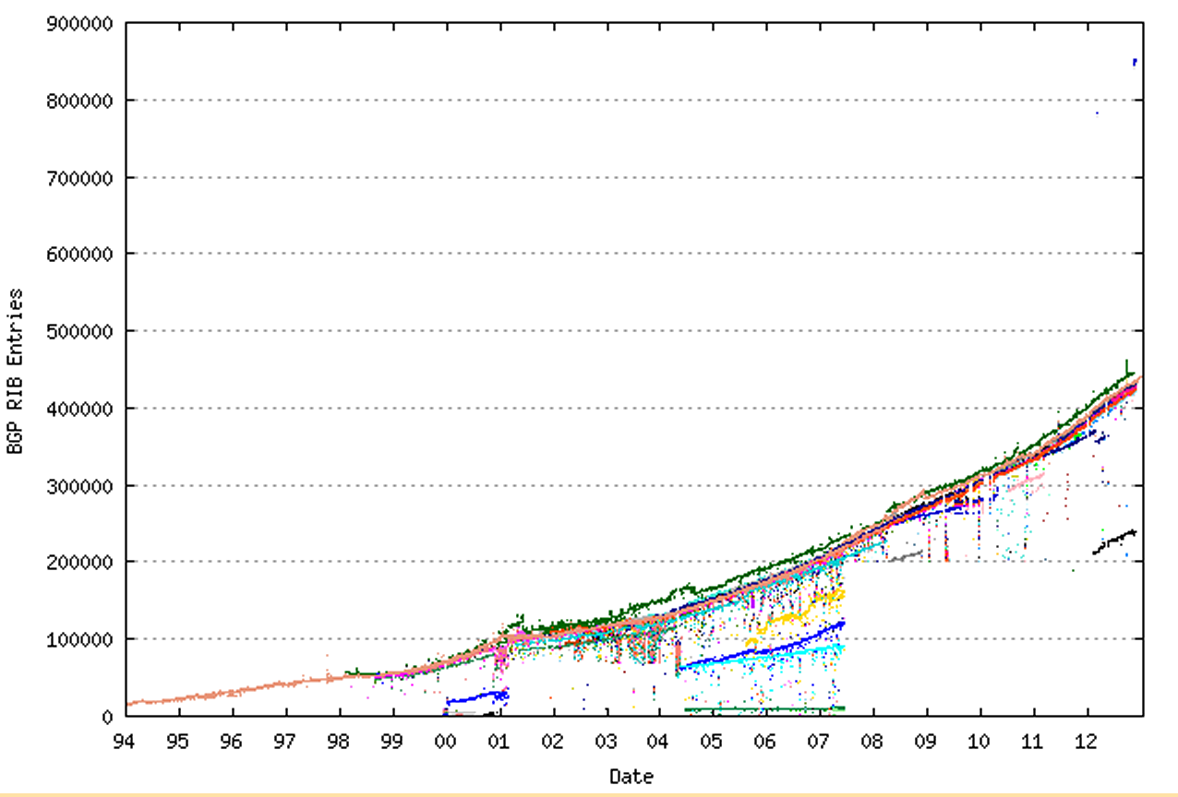
Address Tables are Large

Slide 6
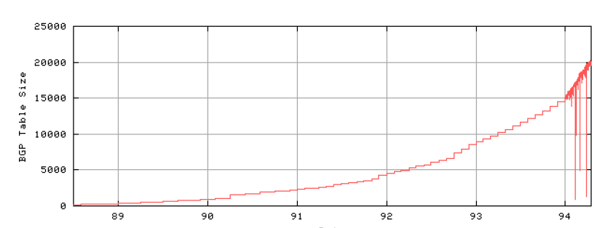
Problem: Routing Table Growth
Source: Geoff Huston
Growth rates exceeding advances in hardware and software capabilities
Primarily due to Class C space exhaustion
Exhaustion of routing table space was on the horizon

Slide 7
Routing Table Growth: Who Cares?
On pace to run out of allocations entirely
Memory
  Routing tables
  Forwarding tables
“Churn”: More prefixes, more updates

Slide 8
Possible Solutions
Get rid of global addresses
  NAT
Get more addresses
  IPv6
Different aggregation strategy
  Classless Interdomain routing

Slide 9
Classless Interdomain Routing (CIDR)
Use two 32-bit numbers to represent a network.
Network number = IP address + Mask
Example: BellSouth Prefix: 65.14.248.0/22
01000001
00001110
11111000
00000000
11111111
11111111
11111100
00000000
IP Address: 65.14.248.0 “Mask”: 255.255.252.0
Address no longer specifies network ID range.
New forwarding trick: Longest Prefix Match

Slide 10
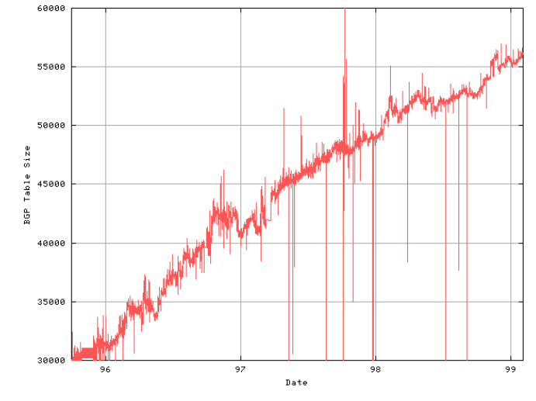
1994-1998: Linear Growth
Source: Geoff Huston
About 10,000 new entries per year
In theory, less instability at the edges (why?)

Slide 11
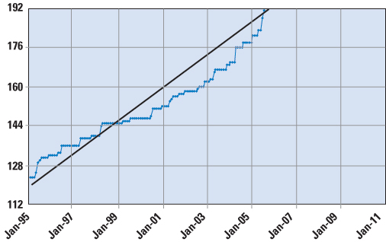
Around 2000: Fast Growth Resumes
T. Hain, “A Pragmatic Report on IPv4 Address Space Consumption”, Cisco IPJ, September 2005
Claim: remaining /8s will be exhausted within the next 5-10 years.

Slide 12
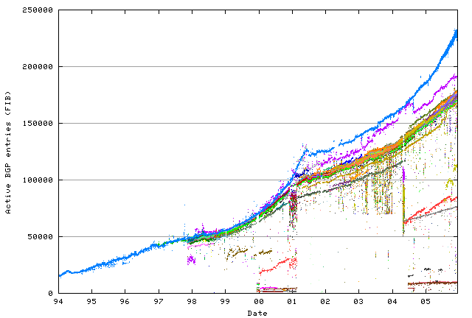
Fast growth resumes
Significant contributor: Multihoming
Dot-Bomb Hiccup
Rapid growth in routing tables
Source: Geoff Huston

Slide 13
The Address Allocation Process
IANA
http://www.iana.org/assignments/ipv4-address-space
AfriNIC
APNIC
ARIN
LACNIC
RIPE
Georgia Tech
Allocation policies of RIRs affect pressure on IPv4 address space

Slide 14
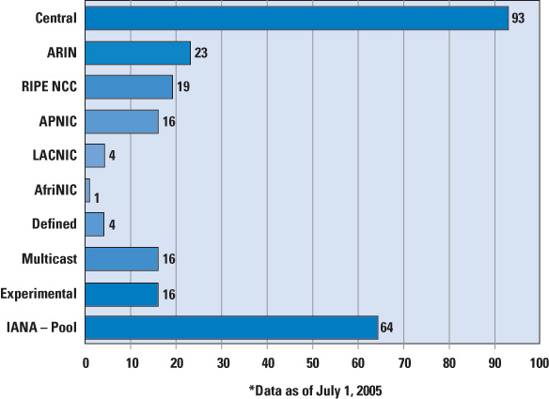
/8 Allocations from IANA
MIT, Ford, Halliburton, Boeing, Merck
Reclaiming space is difficult. A /8 is a bargaining chip!

Slide 15
Address Space Ownership
% whois -h whois.arin.net 130.207.7.36
[Querying whois.arin.net]
[whois.arin.net]
OrgName: Georgia Institute of Technology
OrgID: GIT
Address: 258 Fourth St NW
Address: Rich Building
City: Atlanta
StateProv: GA
PostalCode: 30332
Country: US
NetRange: 130.207.0.0 - 130.207.255.255
CIDR: 130.207.0.0/16
NetName: GIT
NetHandle: NET-130-207-0-0-1
Parent: NET-130-0-0-0-0
NetType: Direct Assignment
NameServer: TROLL-GW.GATECH.EDU
NameServer: GATECH.EDU
Comment:
RegDate: 1988-10-10
Updated: 2000-02-01
RTechHandle: ZG19-ARIN
RTechName: Georgia Institute of TechnologyNetwork Services
RTechPhone: +1-404-894-5508
RTechEmail: hostmaster@gatech.edu
OrgTechHandle: NETWO653-ARIN
OrgTechName: Network Operations
OrgTechPhone: +1-404-894-4669
- Regional Internet Registries (“RIRs”)
  - Public record of address allocations
  - ISPs should update when delegating address space
  - Often out-of-date

