Slide 1
Domain Name System
CS 3251: Computer Networking I
Nick Feamster
Spring 2013

Slide 2
What is DNS?
DNS (Domain Name Service) is primarily used to translate human readable names into machine usable addresses, e.g., IP addresses.
DNS goal:
  Efficiently locate resources.
  E.g., Map name → IP address
  Scale to many users over a large area
  Scale to many updates

Slide 3
What is DNS?
DNS (Domain Name Service) is primarily used to translate human readable names into machine usable addresses, e.g., IP addresses.
DNS goal:
  Efficiently locate resources.
  E.g., Map name → IP address
  Scale to many users over a large area
  Scale to many updates

Slide 4
Obvious Solutions (1)
Why not centralize DNS?
Single point of failure
Traffic volume
Distant centralized database
Single point of update
Doesn’t scale!

Slide 5
Obvious Solutions (2)
Why not use /etc/hosts?
Original Name to Address Mapping
  Flat namespace
  /etc/hosts
  SRI kept main copy
  Downloaded regularly
Mid 80’s this became untenable. Why?
Count of hosts was increasing: machine per domain → machine per user
  Many more downloads
  Many more updates
/etc/hosts still exists.

Slide 6
Domain Name System Goals
Basically a wide-area distributed database
(The biggest in the world!)
Scalability
Decentralized maintenance
Robustness
Global scope
  Names mean the same thing everywhere
Don’t need all of ACID
  Atomicity
  Strong consistency
Do need: distributed update/query & Performance
Notes:
ACID
Atomic
Consistent
Isolated
Durable

Slide 7
Programmer’s View of DNS
Conceptually, programmers can view the DNS database as a collection of millions of host entry structures:
  in_addr is a struct consisting of 4-byte IP addr
Functions for retrieving host entries from DNS:
  gethostbyname: query key is a DNS host name.
  gethostbyaddr: query key is an IP address.
/* DNS host entry structure */
struct hostent {
char *h_name; /* official domain name of host */
char **h_aliases; /* null-terminated array of domain names */
int h_addrtype; /* host address type (AF_INET) */
int h_length; /* length of an address, in bytes */
char **h_addr_list; /* null-termed array of in_addr structs */
};

Slide 8
DNS Message Format
Identification
Flags
12 bytes
No. of Questions
No. of Answer RRs
No. of Authority RRs
No. of Additional RRs
Name, type fields for a query
Questions (variable number of answers)
RRs in response to query
Answers (variable number of resource records)
Records for authoritative servers
Authority (variable number of resource records)
Additional Info (variable number of resource records)
Additional “helpful info that may be used

Slide 9
DNS Header Fields
Identification
  Used to match up request/response
Flags
  1-bit to mark query or response
  1-bit to mark authoritative or not
  1-bit to request recursive resolution
  1-bit to indicate support for recursive resolution

Slide 10
DNS Design: Zone Definitions
Zone = contiguous section of name space
  E.g., Complete tree, single node or subtree
A zone has an associated set of name servers
  Must store list of names and tree links
root
org
net
edu
com
uk
gwu
ucb
cmu
bu
mit
cs
ece
Subtree
crcl
Single node
Complete Tree

Slide 11
DNS Design: Cont.
Zones are created by convincing owner node to create/delegate a subzone
  Records within zone stored in multiple redundant name servers
  Primary/master name server updated manually
  Secondary/redundant servers updated by zone transfer of name space
    Zone transfer is a bulk transfer of the “configuration” of a DNS server – uses TCP to ensure reliability
Example:
  CS.CMU.EDU created by CMU.EDU admins
  Who creates CMU.EDU or .EDU?

Slide 12
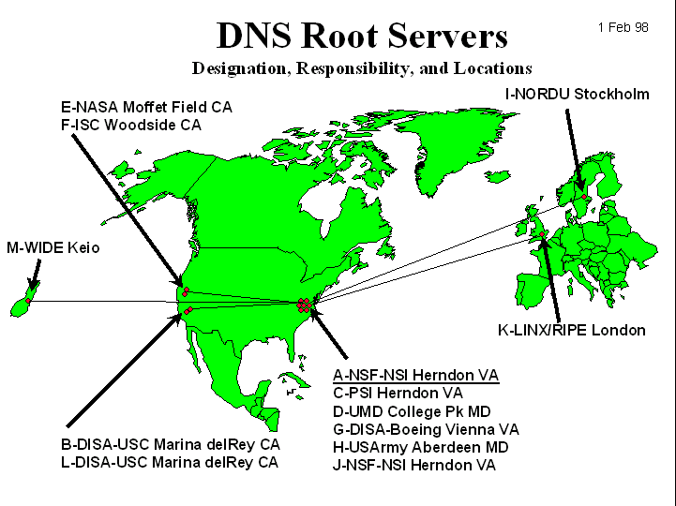
DNS: Root Name Servers
Responsible for “root” zone
13 root name servers
  Currently
  {a-m}.root-servers.net
Local name servers contact root servers when they cannot resolve a name
Why 13?

Slide 13
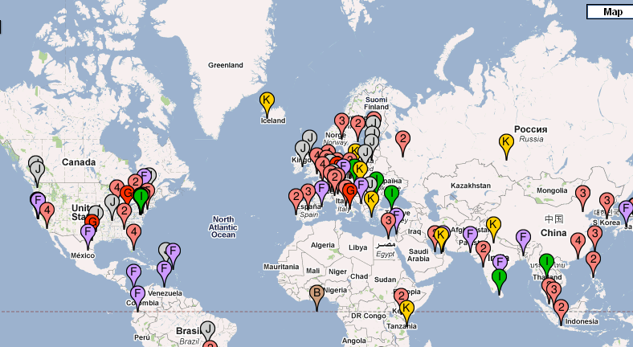
More than 13 Root Servers
Notes:
15-745 Lecture 4b
© Seth Copen Goldstein 2001-2

Slide 14

DNS: Mapping Names to Addresses
www.cc.gatech.edu
root, .edu
www.cc.gatech.edu
NS troll-gw.gatech.edu
NS burdell.cc.gatech.edu
troll-gw.gatech.edu
Client
Local
DNS resolver
A 130.207.7.36
Recursive query
burdell.cc.gatech.edu
Iterative queries
Note the diversity of Georgia Tech’s authoritative nameservers

Slide 15
DNS Resource Records
DNS: distributed db storing resource records (RR)
RR format: (name, value, type, ttl)
Type=A
  name is hostname
  value is IP address
Type=CNAME
  name is alias name for some “canonical” (the real) name
  www.ibm.com is really
  servereast.backup2.ibm.com
  value is canonical name
Type=NS
  name is domain (e.g. foo.com)
  value is hostname of authoritative name server for this domain
Type=MX
  value is name of mailserver associated with name

Slide 16

DNS Protocol
DNS protocol : query and reply messages, both with same message format
Message header
Identification: 16 bit # for query, reply to query uses same #
Flags:
  Query or reply
  Recursion desired
  Recursion available
  Reply is authoritative

Slide 17
Some Record Types
A
NS
MX
CNAME
TXT
PTR
AAAA
SRV

Slide 18
Caching
Resolvers cache DNS responses
  Quick response for repeated translations
  Other queries may reuse some parts of lookup
    NS records for domains typically cached for longer
  Negative responses also cached
    Typos, “localhost”, etc.
Cached data periodically times out
  Lifetime (TTL) of data controlled by owner of data
  TTL passed with every record
What if DNS entries get corrupted?

Slide 19
Root Zone
Generic Top Level Domains (gTLD)
  .com, .net, .org,
Country Code Top Level Domain (ccTLD)
  .us, .ca, .fi, .uk, etc…
Root server ({a-m}.root-servers.net) also used to cover gTLD domains
  Increased load on root servers
  August 2000: .com, .net, .org moved off root servers onto gTLDs

Slide 20
Some gTLDs
.info → general info
.biz → businesses
.name → individuals
.aero → air-transport industry
.coop → business cooperatives
.pro → accountants, lawyers, physicians
.museum → museums

Slide 21
Do you trust the TLD operators?
Wildcard DNS record for all .com and .net domain names not yet registered by others
  September 15 – October 4, 2003
  February 2004: Verisign sues ICANN
Redirection for these domain names to Verisign web portal
What services might this break?

Slide 22
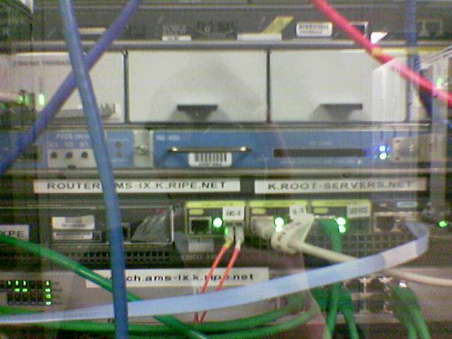
Protecting the Root Nameservers
Sophisticated?
Why did nobody notice?
gatech.edu. 13759 NS trollgw.gatech.edu.
Defense Mechanisms
Redundancy: 13 root nameservers
IP Anycast for root DNS servers {c,f,i,j,k}.root-servers.net
  RFC 3258
  Most physical nameservers lie outside of the US

Slide 23
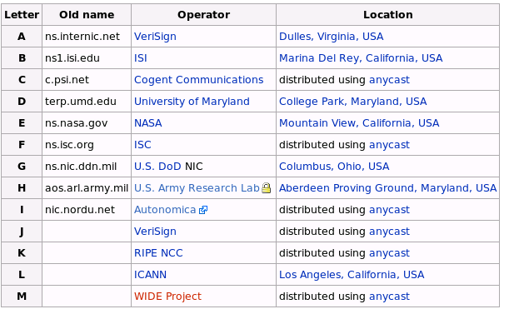
Defense: Replication and Caching
source: wikipedia

Slide 24
DNS Caching
Performing all these queries take time
  And all this before the actual communication takes place
  E.g., 1-second latency before starting Web download
Caching can substantially reduce overhead
  The top-level servers very rarely change
  Popular sites (e.g., www.cnn.com) visited often
  Local DNS server often has the information cached
How DNS caching works
  DNS servers cache responses to queries
  Responses include a “time to live” (TTL) field
  Server deletes the cached entry after TTL expires

Slide 25
Negative Caching
Remember things that don’t work
  Misspellings like www.cnn.comm and www.cnnn.com
  These can take a long time to fail the first time
  Good to remember that they don’t work
  … so the failure takes less time the next time around

Slide 26
Reliability
DNS servers are replicated
  Name service available if at least one replica is up
  Queries can be load balanced between replicas
UDP used for queries
  Need reliability: must implement this on top of UDP
Try alternate servers on timeout
  Exponential backoff when retrying same server
Same identifier for all queries
  Don’t care which server responds

Slide 27
Inserting Resource Records into DNS
Example: just created startup “FooBar”
Register foobar.com at Network Solutions
  Provide registrar with names and IP addresses of your authoritative name server (primary and secondary)
  Registrar inserts two RRs into the com TLD server:
    (foobar.com, dns1.foobar.com, NS)
    (dns1.foobar.com, 212.212.212.1, A)
Put in authoritative server dns1.foobar.com
  Type A record for www.foobar.com
  Type MX record for foobar.com
Play with “dig” on UNIX

Slide 28
DNS Hack #1: Reverse Lookup
Method
  Hierarchy based on IP addresses
  130.207.7.36
    Query for PTR record of 36.7.207.130.in-addr.arpa.
Managing
  Authority manages IP addresses assigned to it

Slide 29
DNS Hack #2: Load Balance
Server sends out multiple A records
Order of these records changes per-client

Slide 30
DNS Hack #3: Blackhole Lists
First: Mail Abuse Prevention System (MAPS)
  Paul Vixie, 1997
Today: Spamhaus, spamcop, dnsrbl.org, etc.
Different addresses refer to different reasons for blocking
% dig 91.53.195.211.bl.spamcop.net
;; ANSWER SECTION:
91.53.195.211.bl.spamcop.net. 2100 IN A 127.0.0.2
;; ANSWER SECTION:
91.53.195.211.bl.spamcop.net. 1799 IN TXT "Blocked - see http://www.spamcop.net/bl.shtml?211.195.53.91"

