Slide 1
Intradomain Routing
Computer Networking I
Nick Feamster
Spring 2010

Slide 2
Internet Routing Overview
Autonomous Systems (ASes)
Abilene
Comcast
Georgia
Tech
AT&T
Cogent
Today: Intradomain (i.e., “intra-AS”) routing
Next Time: Interdomain routing

Slide 3
Today: Routing Inside an AS
Intra-AS topology
  Nodes and edges
  Example: Abilene
Intradomain routing protocols
  Distance Vector
    Split-horizon/Poison-reverse
    Example: RIP
  Link State
    Example: OSPF, ISIS

Slide 4
Topology Design
Where to place “nodes”?
  Typically in dense population centers
    Close to other providers (easier interconnection)
    Close to other customers (cheaper backhaul)
  Note: A “node” may in fact be a group of routers, located in a single city. Called a “Point-of-Presence” (PoP)
Where to place “edges”?
  Often constrained by location of fiber

Slide 5
Node Clusters: Point-of-Presence (PoP)
A “cluster” of routers in a single physical location
Inter-PoP links
  Long distances
  High bandwidth
Intra-PoP links
  Cables between racks or floors
  Aggregated bandwidth
PoP

Slide 6
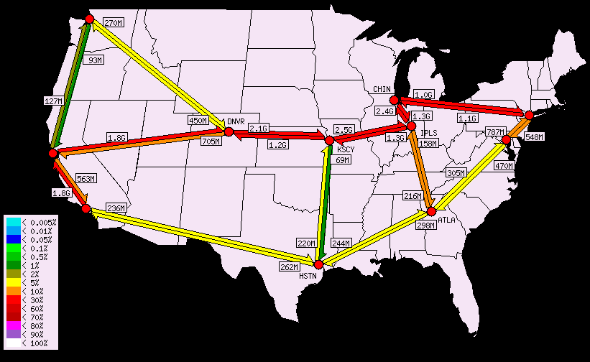
Example: Abilene Network Topology

Slide 7
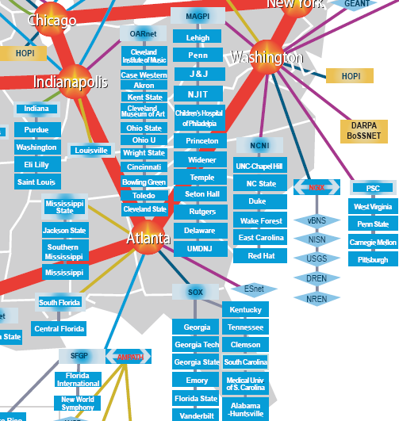
Where’s Georgia Tech?
10GigE (10GbpS uplink)
Southeast Exchange
(SOX) is at 56 Marietta Street

Slide 8
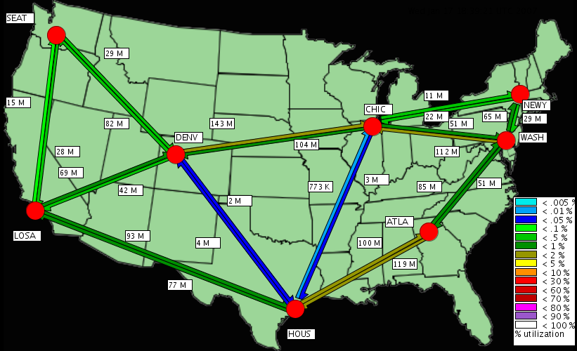
Another Example Backbone

Slide 9
Problem: Routing
Routing: the process by which nodes discover where to forward traffic so that it reaches a certain node
Within an AS: there are two “styles”
  Distance vector: iterative, asynchronous, distributed
  Link State: global information, centralized algorithm

Slide 10
Forwarding vs. Routing
Forwarding: data plane
  Directing a data packet to an outgoing link
  Individual router using a forwarding table
Routing: control plane
  Computing paths the packets will follow
  Routers talking amongst themselves
  Individual router creating a forwarding table

Slide 11
Distance-Vector Routing
 | x | y | z
x
y | 1 | 0 | 2
z
y
 | x | y | z
x | 0 | 1 | 5
y
z
1
2
 | x | y | z
x
y
z | 5 | 2 | 0
x
z
5
Routers send routing table copies to neighbors
Routers compute costs to destination based on shortest available path
Based on Bellman-Ford Algorithm
  d_{x}(y) = min_{v}{ c(x,v) + d_{v}(y) }
  Solution to this equation is x’s forwarding table

Slide 12
Distance Vector Algorithm
Iterative, asynchronous: each local iteration caused by:
Local link cost change
Distance vector update message from neighbor
Distributed:
Each node notifies neighbors only when its DV changes
Neighbors then notify their neighbors if necessary
Each node:
wait for (change in local link cost or message from neighbor)
recompute estimates
if DV to any destination has changed, notify neighbors

Slide 13
Good News Travels Quickly
 | x | y | z
x | 0 | 1 | 3
y | 1 | 0 | 2
z | 3 | 2 | 0
y
 | x | y | z
x | 0 | 1 | 3
y | 1 | 0 | 2
z | 3 | 2 | 0
1
2
 | x | y | z
x | 0 | 1 | 3
y | 1 | 0 | 2
z | 3 | 2 | 0
x
z
5
When costs decrease, network converges quickly

Slide 14
Problem: Bad News Travels Slowly
 | x | y | z
x | 0 | 60 | 50
y | 5 | 0 | 2
z | 3 | 2 | 0
60
y
1
2
 | x | y | z
x | 0 | 60 | 50
y | 5 | 0 | 2
z | 7 | 2 | 0
x
z
50

Slide 15
It Gets Worse
 | x | y | z
x | 0 | 60 | 50
y | 5 | 0 | 2
z | 3 | 2 | 0
60
y
1
2
 | x | y | z
x | 0 | 60 | 50
y | 5 | 0 | 2
z | 7 | 2 | 0
x
z
50
Question: How long does this continue?
Answer: Until z’s path cost to x via y is greater than 50.

Slide 16
“Solution”: Poison Reverse
 | x | y | z
x | 0 | 1 | X
y | 1 | 0 | 2
z | X | 2 | 0
y
 | x | y | z
x | 0 | 1 | 3
y | 1 | 0 | 2
z | 3 | 2 | 0
1
2
 | x | y | z
x | 0 | 1 | 3
y | 1 | 0 | 2
z | 3 | 2 | 0
x
z
5
If z routes through y to get to x, z advertises infinite cost for x to y
Does poison reverse always work?

Slide 17
Does Poison Reverse Always Work?
60
y
1
3
1
w
1
x
z
50

Slide 18
Routing Information Protocol (RIP)
Distance vector protocol
  Nodes send distance vectors every 30 seconds
  … or, when an update causes a change in routing
Link costs in RIP
  All links have cost 1
  Valid distances of 1 through 15
  … with 16 representing infinity
  Small “infinity” → smaller “counting to infinity” problem

Slide 19
Link-State Routing
Keep track of the state of incident links
  Whether the link is up or down
  The cost on the link
Broadcast the link state
  Every router has a complete view of the graph
Compute Dijkstra’s algorithm
Examples:
  Open Shortest Path First (OSPF)
  Intermediate System – Intermediate System (IS-IS)

Slide 20
Link-State Routing
Idea: distribute a network map
Each node performs shortest path (SPF) computation between itself and all other nodes
Initialization step
  Add costs of immediate neighbors, D(v), else infinite
  Flood costs c(u,v) to neighbors, N
For some D(w) that is not in N
  D(v) = min( c(u,w) + D(w), D(v) )

Slide 21
Detecting Topology Changes
Beaconing
  Periodic “hello” messages in both directions
  Detect a failure after a few missed “hellos”
Performance trade-offs
  Detection speed
  Overhead on link bandwidth and CPU
  Likelihood of false detection
“hello”

Slide 22
Broadcasting the Link State
Flooding
  Node sends link-state information out its links
  The next node sends out all of its links except the one where the information arrived
X
A
X
A
C
B
D
C
B
D
(a)
(b)
X
A
X
A
C
B
D
C
B
D
(c)
(d)

Slide 23
Broadcasting the Link State
Reliable flooding
  Ensure all nodes receive the latestlink-state information
Challenges
  Packet loss
  Out-of-order arrival
Solutions
  Acknowledgments and retransmissions
  Sequence numbers
  Time-to-live for each packet

Slide 24
When to Initiate Flooding
Topology change
  Link or node failure
  Link or node recovery
Configuration change
  Link cost change
Periodically
  Refresh the link-state information
  Typically (say) 30 minutes
  Corrects for possible corruption of the data

Slide 25
Scaling Link-State Routing
Message overhead
  Suppose a link fails. How many LSAs will be flooded to each router in the network?
    Two routers send LSA to A adjacent routers
    Each of A routers sends to A adjacent routers
    …
  Suppose a router fails. How many LSAs will be generated?
    Each of A adjacent routers originates an LSA …

Slide 26
Scaling Link-State Routing
Two scaling problems
  Message overhead: Flooding link-state packets
  Computation: Running Dijkstra’s shortest-path algorithm
Introducing hierarchy through “areas”
Area 0
area
border
router

Slide 27
Link-State vs. Distance-Vector
Convergence
  DV has count-to-infinity
  DV often converges slowly (minutes)
  DV has timing dependences
  Link-state: O(n²) algorithm requires O(nE) messages
Robustness
  Route calculations a bit more robust under link-state
  DV algorithms can advertise incorrect least-cost paths
  In DV, errors can propagate (nodes use each others tables)
Bandwidth Consumption for Messages
  Messages flooded in link state

Slide 28
Open Shortest Paths First (OSPF)
Area 0
Key Feature: hierarchy
Network’s routers divided into areas
Backbone area is area 0
Area 0 routers perform SPF computation
  All inter-area traffic travles through Area 0 routers (“border routers”)

Slide 29
Another Example: IS-IS
Originally: ISO Connectionless Network Protocol
  CLNP: ISO equivalent to IP for datagram delivery services
  ISO 10589 or RFC 1142
Later: Integrated or Dual IS-IS (RFC 1195)
  IS-IS adapted for IP
  Doesn’t use IP to carry routing messages
OSPF more widely used in enterprise, IS-IS in large service providers

Slide 30

Hierarchical Routing in IS-IS
Backbone
Area 49.001
Area 49.0002
Level-1
Routing
Level-2
Routing
Level-1
Routing
Like OSPF, 2-level routing hierarchy
  Within an area: level-1
  Between areas: level-2
  Level 1-2 Routers: Level-2 routers may also participate in L1 routing

Slide 31
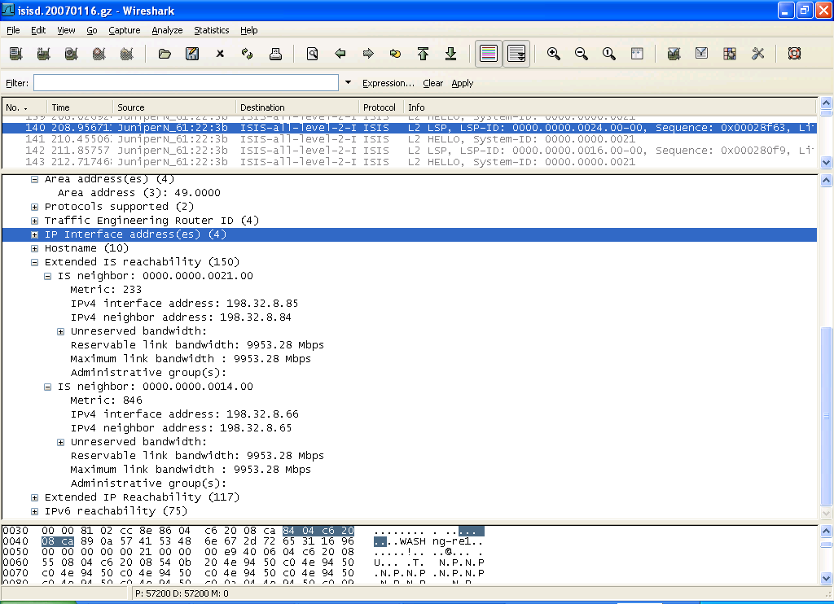
ISIS on the Wire…

Slide 32
IS-IS Configuration on Abilene (atlang)
lo0 {
unit 0 {
….
family iso {
address 49.0000.0000.0000.0014.00;
}
….
}
isis {
level 2 wide-metrics-only;
/* OC192 to WASHng */
interface so-0/0/0.0 {
level 2 metric 846;
level 1 disable;
}
}
ISO Address Configured on Loopback Interface
Only Level 2 IS-IS in Abilene

