Slide 2
IPv6 and Address Space Scarcity
128-bit addresses
Top 48-bits: Public Routing Topology (PRT)
3 bits for aggregation
13 bits for TLA (like “tier-1 ISPs”)
8 reserved bits
24 bits for NLA
16-bit Site Identifier: aggregation within an AS
64-bit Interface ID: 48-bit Ethernet + 16 more bits
Pure provider-based addressing
Changing ISPs requires renumbering

Slide 3
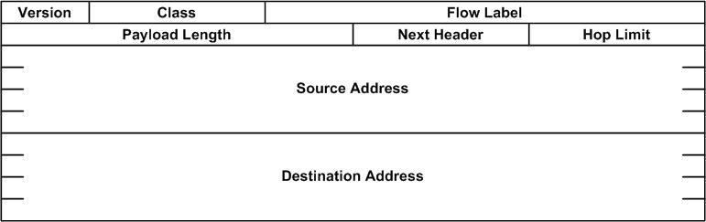
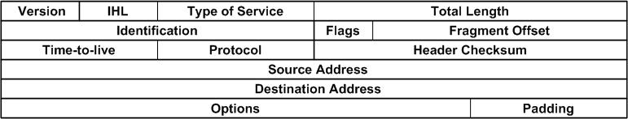
Header Formats
IPv4
Notes:
Remove GPN from headers

Slide 4
Summary of Fields
Version (4 bits) – only field to keep same position and name
Class (8 bits) – new field
Flow Label (20 bits) – new field
Payload Length (16 bits) – length of data, slightly different from total length
Next Header (8 bits) – type of the next header, new idea
Hop Limit (8 bits) – was time-to-live, renamed
Source address (128 bits)
Destination address (128 bits)
Notes:
Michael suggestted having descriptions display when cursor is over field in previous page

Slide 5
IPv6: Claimed Benefits
Larger address space
Simplified header
Deeper hierarchy and policies for network architecture flexibility
Support for route aggregation
Easier renumbering and multihoming
Security (e.g., IPv6 Cryptographic Extensions)

Slide 6
IPv6 Flows
Traffic can be labeled with particular flow identifier for which a sender can expect special handling (e.g., different priority level)

Slide 7
IPv6: Deployment Options
Routing Infrastructure
IPv4 Tunnels
Dual-stack
Dedicated Links
MPLS
Applications
IPv6-to-IPv4 NAPT
Dual-stack servers

Slide 8
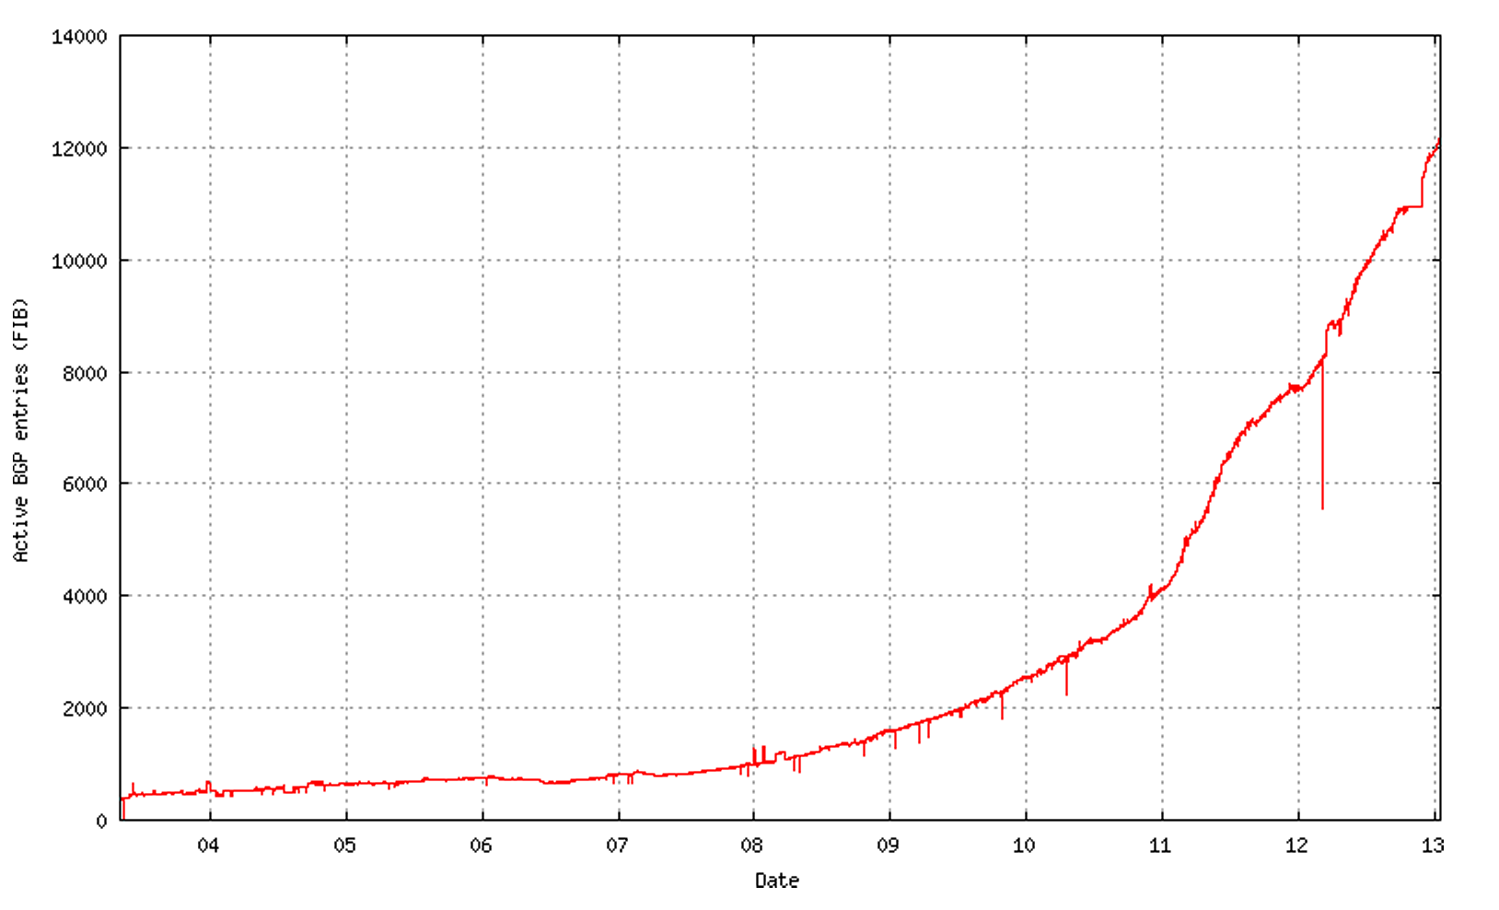
IPv6 Deployment Status
Big users: EU, Japan, Australia

Slide 9
Transitioning #1: Dual-Stack
Dual-Stack Approach: Some nodes can send both IPv4 and IPv6 packets
Dual-stack nodes must determine whether a node is IPv6-capable or not
When communicating with an IPv4 node, an IPv4 datagram must be used

Slide 10
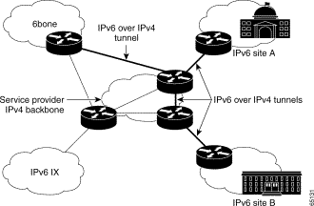
Transitioning #2: IPv6 over IPv4 Tunnels
One trick for mapping IPv6 addresses: embed the IPv4 address in low bits
http://www.cisco.com/en/US/tech/tk872/technologies_white_paper09186a00800c9907.shtml

Slide 11
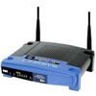
NAT: Network Address Translation
Translates internal addresses to “public” Internet addresses
For inbound traffic (to the home): Uses port numbers to map the public address to internal addresses
For outbound traffic: Private addresses are mapped to the public IP + port
Creates state in the router
192.168.1.51
68.211.6.120:50878
Home Network
Internet
192.168.1.52
68.211.6.120:50879

Slide 12
NATs and Tunnels
NATs originally invented as a way to help migrate to a hybrid IPv4 IPv6 world
Took on a life of their own
May have substantially delayed IPv6 deployment by reducing address pressure!
You probably encounter them every day
Tunnels: Coming up after NATs.

Slide 13
Network Address Translation
NAT maps (private source IP, source port) onto (public source IP, unique source port)
reverse mapping on the way back
destination host does not know that this process is happening
Very simple working solution.
NAT functionality fits well with firewalls
A
Priv A IP
B IP
B IP
Priv A IP
A Port
B Port
B Port
A Port
Publ A IP
B IP
B IP
Publ A IP
B
A Port’
B Port
B Port
A Port’

Slide 14
Types of NATs
Bi-directional NAT: 1 to 1 mapping between internal and external addresses.
E.g., 128.237.0.0/16 -> 10.12.0.0/16
External hosts can directly contact internal hosts
Why use?
Flexibility. Change providers, don’t change internal addrs.
Need as many external addresses as you have hosts - can use sparse address space internally.
“Traditional” NAT: Unidirectional
Basic NAT: Pool of external addresses
Translate source IP address (+checksum,etc) only
Network Address Port Translation (NAPT): What most of us use
Also translate ports.
E.g., map (10.0.0.5 port 5555 -> 18.31.0.114 port 22) to (128.237.233.137 port 5931 -> 18.31.0.114 port 22)
Lets you share a single IP address among multiple computers

Slide 15
NAT Considerations
NAT has to be consistent during a session.
Set up mapping at the beginning of a session and maintain it during the session
Recall high-level goal of Internet: Continue despite loss of networks or gateways
What happens if your NAT reboots?
Recycle the mapping that the end of the session
May be hard to detect
NAT only works for certain applications.
Some applications (e.g. ftp) pass IP information in payload
Need application level gateways to do a matching translation
Breaks a lot of applications.
Example: Let’s look at FTP
NAT is loved and hated
- Breaks many apps (FTP)
- Inhibits deployment of new applications like p2p (but so do firewalls!)
+ Little NAT boxes make home networking simple.
+ Saves addresses. Makes allocation simple.

Slide 16
Network Address Translation
For outbound traffic, the gateway:
Creates a table entry for computer's local IP address and port number
Replaces the sending computer's non-routable IP address with the gateway IP address.
replaces the sending computer's source port
For inbound traffic, the gateway:
checks the destination port on the packet
rewrites the destination address and destination port those in the table and forwards traffic to local machine

Slide 17
NAT Traversal
Problem: Machines behind NAT not globally addressable or routable. Can’t initiate inbound conenctions.
One solution: Signalling and Tunneling through UDP-Enabled NAT Devices (STUN)
STUN client contacts STUN server
STUN server tells client which IP/Port the NAT mapped it to
STUN client uses that IP/Port for call establishment/incoming messages
Home Network 1
Home Network 2
Relay node

Slide 18
DHCP
DHCPDISCOVER - broadcast
DHCPOFFER
DHCPREQUEST
DHCPACK
DHCPOFFER
IP addressing information
Boot file/server information (for network booting)
DNS name servers
Lots of other stuff - protocol is extensible; half of the options reserved for local site definition and use.

Slide 19
DHCP Features
Lease-based assignment
Clients can renew. Servers really should preserve this information across client & server reboots.
Provide host configuration information
Not just IP address stuff.
NTP servers, IP config, link layer config,
X window font server (wow)
Use:
Generic config for desktops/dialin/etc.
Assign IP address/etc., from pool
Specific config for particular machines
Central configuration management

Slide 20
Dynamic Host Configuration Protocol
Commonly used to automatically
assign IP addresses to clients
set various configuration parameters
Useful for managing IP address space where
the total number of users outstrips the total number of concurrent users
Operators can
dynamically assign IP addresses to clients and
reclaim IP addresses when clients leave

Slide 21
DHCP: Operation and Lease Times
DISCOVER
OFFER
REQUEST
ACK
Renew at ½ the lease time
REQUEST
Lease Time: the time interval after which a server can reclaim an IP address
Configurable at server (universal or per-client)

Slide 22
Router Design

