Slide 1
Course Overview and Internet Architecture
CS 7260
Nick Feamster
January 8, 2007

Slide 2
Who Am I?
Nick Feamster
  Assistant Professor in CoC
    Ph.D from MIT, Sept. 2005
    Thesis: Internet Routing Correctness, Predictability
  How to reach me
    feamster at cc.gatech.edu
    ( please include “CS7260” in subject line)
    KACB 3348
  Office hours: Before class on Mondays
  (and by appointment)

Slide 3
Primary Goal of This Course
Provide a survey of the necessary tools, techniques, and concepts to perform research in computer communications
This course is project-based (not just paper reading)
  Emphasis on hands-on experience
  Realization is key!
More in-depth coverage of networking topics
  Focus on network-layer and above
Crash-course in available tools for research
  You may use one or more of these in the project
Check the course Web page frequently!
http://www.cc.gatech.edu/classes/AY2007/cs7260_spring/

Slide 4
What This Course is About
Lecture: Learning about cutting-edge research problems in computer networking, and coming up with your own
  We’ll pick up basics along the way as necessary
  The course topics are (1) breadth-first and (2) not comprehensive
Problem Sets: Developing proficiency with tools and techniques for following through on your research ideas
  Tons of exciting tools out there!
  Problem sets will help you with this goal
  Thinking about network design
These two components should help you develop great projects.

Slide 5
Toolkit for the Networking Researcher
Exposure to various “hammers”
  Networking is a domain that draws on many disciplines
Measurement and deployment experience
  Realism is key
Development of design skills
  How and why the Internet works the way it does
  Experience thinking about design alternatives

Slide 6
What This Course is Not About
An introduction to networking
  Examples of topics that won’t be covered:
    TCP basics
    Socket programming basics
    etc.
An introduction to programming
  Knowledge of scripting languages will help.
    If some programming language, don’t worry if you don’t know a scripting language. There’s time to learn, since deadlines are spread out.
Follow the “spirit” of the pre-requisites.

Slide 7
How: Course Structure (and Grading)
One semester-long project (50%)
Two in-class “quizzes” (30% total)
  February 22 and March 17
  Should be relatively easy if you’ve been coming to class and keeping up with readings
Three problem sets (20% total)
  PS1 will be assigned on 1/17 (Wednesday)
    A handful of “paper and pencil” problems
    “Analysis” question, which will require scripting
  PS2: Experimentation
    More programming required. Experimentation with traces and scripts
  PS3: Design
    Experimentation on Click, Planetlab, etc.

Slide 8
Project Expectations
Aim high!
  A good project can become the basis for:
    Publication
      Internet Measurement Conference deadline mid-May, Infocom mid-summer…
    Ph.D Thesis
Your project need not be SIGCOMM-quality by the end-of-term, but it should be something that could be conference-worthy with a bit more effort
I am here to help you
New project ideas posted in a few weeks

Slide 9
Project Logistics: Five Milestones
January 22: Project Groups
  3 person groups. 2-person groups by rare exception
February 7: Project Proposal
  1-2 page writeup
  Problem statement, evaluation strategy,
  metrics for “success”
March 26: Interim Report and Mini-presentations
April 23 & 25: Project Presentations (In Class)
April 27: Writeups Due
  8-10 pages. Research paper-style.
Meeting deadlines early is encouraged! I’m happy to look at your progress before these dates.

Slide 10
Lecture Structure
~ 55 minutes lecture, ~ 25 minutes discussion
Read the required paper before class
My plan: Thought questions posted at least the day before class.
  Hopefully will help stimulate discussion.
I will try to post optional readings, in case you are interested in reading more about some topic.
  If I don’t do so for a topic you’re interested in, ask me!

Slide 11
Differences from Last Year
New and different themes and topics
  Multipath routing
  Network virtualization
  Strategies for reducing unwanted traffic
New papers
Focus on “tool sharpening”
  Optimization
  Game theory
  Network coding
  Machine learning

Slide 12
Topic Highlights
Essentials
  Naming and Addressing: DNS, IPv6, NAT, Flat Names
  Routing: BGP, MPLS, VPNs, etc.
  Multihoming and reliability
Measurement and Operations
  Testbeds: Emulab, PlanetLab, VINI
  Techniques and tools
  Network monitoring
  Troubleshooting

Slide 13
Topic Highlights
Abstractions (“Networks on networks”)
  Overlay routing
  Network virtualization: techniques and applications
Security
  Worms, spam, botnets, etc.
  Routing security
  Anomaly detection
Wireless and “Challenged” Networks
  Networking in developing regions

Slide 14
For the Rest of Today
We will review today’s reading and put it in the context of some of the topics we’ll be covering through this term.

Slide 15
Today’s Reading
Design Philosophy of the DARPA Internet Protocols. Dave Clark, 1988.
Conceptual Lessons
  Design principles/priorities were designed for a certain type of network. As the Internet evolves, we feel the sting of some of these choices.
  Examples: Commercialization
  Engineering/Realization is key to testing an idea.
Technical Lessons
  Packet switching
  Fate Sharing/Soft state

Slide 16
Fundamental Goal
“technique for multiplexed utilization of existing interconnected networks”
Multiplexing (sharing)
  Shared use of a single communications channel
Existing networks (interconnection)

Slide 17
Fundamental Goal: Sharing
Packet Switching
No connection setup
Forwarding based on destination address in packet
Efficient sharing of resources
Tradeoff: Resource management potentially more difficult.

Slide 18
Type of Packet Switching: Datagrams
Information for forwarding traffic is contained in destination address of packet
No state established ahead of time (helps fate sharing)
Basic building block
Minimal assumption about network service
Alternatives (More on Wednesday)
Circuit Switching: Signaling protocol sets up entire path out-of-band. (cf. the phone network)
Virtual Circuits: Hybrid approach. Packets carry “tags” to indicate path, forwarding over IP
Source routing: Complete route is contained in each data packet

Slide 19
An Age-Old Debate
Circuit Switching
Resource control, accounting, ability to “pin” paths, etc.
Packet Switching
Sharing of resources, soft state (good resilience properties), etc.
It is held that packet switching was one of the Internet’s greatest design choices.
Of course, there are constant attempts to shoehorn the best aspects of circuits into packet switching.
Examples: Capabilities (Lecture 21), MPLS (Lecture 15),
ATM, IntServ QoS, etc.

Slide 20
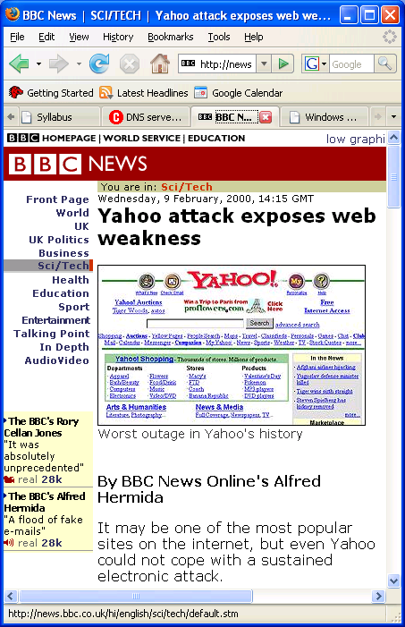
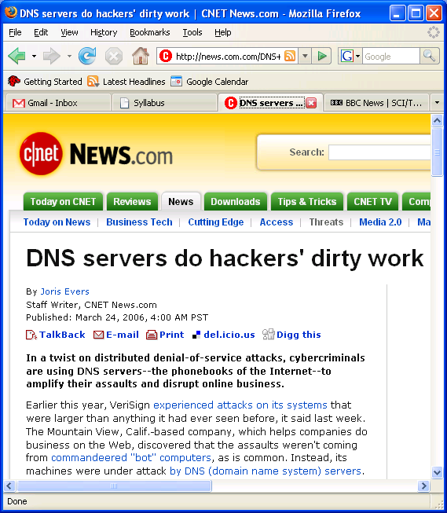
Stopping Unwanted Traffic is Hard
February 2000
March 2006

Slide 21
Research: Stopping Unwanted Traffic
Datagram networks: easy for anyone to send traffic to anyone else…even if they don’t want it!
cnn.com
Possible Defenses
Monitoring + Filtering: Detect DoS attack and install filters to drop traffic.
Capabilities: Only accept traffic that carries a “capability”
Stay tuned. More detail in Lecture 21.

Slide 22
The Design Goals of Internet, v1
Interconnection/Multiplexing (packet switching)
Resilience/Survivability (fate sharing)
Heterogeneity
  Different types of services
  Different types of networks
Distributed management
Cost effectiveness
Ease of attachment
Accountability
Decreasing
Priority
“This set of goals might seem to be nothing more than a checklist of all the desirable network features. It is important to understand that these goals are in order of importance, and an entirely different network architecture would result if the order were changed.”
These goals were prioritized for a military network.
Should priorities change as the network evolves?

Slide 23

Fundamental Goal: Interconnection
Need to interconnect many existing networks
Hide underlying technology from applications
Decisions:
  Network provides minimal functionality
  “Narrow waist”
email WWW phone...
SMTP HTTP RTP...
TCP UDP…
IP
ethernet PPP…
CSMA async sonet...
copper fiber radio...
Applications
Technology
Tradeoff: No assumptions, no guarantees.

Slide 24
The “Curse of the Narrow Waist”
IP over anything, anything over IP
  Has allowed for much innovation both above and below the IP layer of the stack
  An IP stack gets a device on the Internet
Drawback: very difficult to make changes to IP
  But…people are trying
  NSF GENI project: http://www.geni.net/

Slide 25
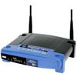
Interconnection: “Gateways”
Interconnect heterogeneous networks
No state about ongoing connections
  Stateless packet switches
Generally, router == gateway
But, we can think of your home router/NAT as also performing the function of a gateway
192.168.1.51
68.211.6.120:50878
Home
Network
Internet
192.168.1.52
68.211.6.120:50879

Slide 26
Network Address Translation
For outbound traffic, the gateway:
  Creates a table entry for computer's local IP address and port number
  Replaces the sending computer's non-routable IP address with the gateway IP address.
  replaces the sending computer's source port
For inbound traffic, the gateway:
  checks the destination port on the packet
  rewrites the destination address and destination port those in the table and forwards traffic to local machine

Slide 27

NAT Traversal
Problem: Machines behind NAT not globally addressable or routable. Can’t initiate inbound conenctions.
One solution: Signalling and Tunneling through UDP-Enabled NAT Devices (STUN)
  STUN client contacts STUN server
  STUN server tells client which IP/Port the NAT mapped it to
  STUN client uses that IP/Port for call establishment/incoming messages
Home
Network 1
Home
Network 2
Relay node
More on Wednesday.

Slide 28
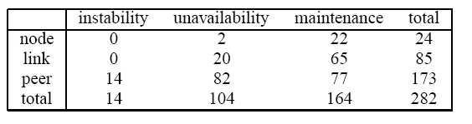
Goal #2: Survivability
Network should continue to work, even if some devices fail, are compromised, etc.
Failures on the Abilene (Internet 2) backbone network over the course of 6 months
Thanks to Yiyi Huang
How well does the current Internet support survivability?

Slide 29
Goal #2: Survivability
Two Options
Replication
  Keep state at multiple places in the network, recover when nodes crash
Fate-sharing
  Acceptable to lose state information for some entity if the entity itself is lost
Reasons for Fate Sharing
Can support arbitrarily complex failure scenarios
Engineering is easier
Some reversals of this trend:
NAT (Wednesday), Routing Control Platform (Lecture 4)
Notes:
Is fate sharing still satisfied today?

Slide 30
Goal #3: Heterogeneous Services
TCP/IP designed as a monolithic transport
  TCP for flow control, reliable delivery
  IP for forwarding
Became clear that not every type of application would need reliable, in-order delivery
  Example: Voice and video over networks
  Example: DNS
  Why don’t these applications require reliable, in-order delivery?
  Narrow waist: allowed proliferation of transport protocols

Slide 31
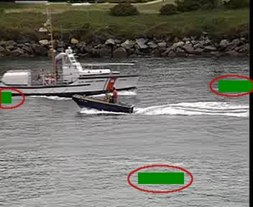
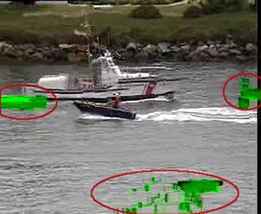
Topic: Voice and Video over Networks
Deadlines: Timeliness more important than 100% reliability.
Propagation of errors: Some losses more devastating than others
Loss in “Anchor” Frame (I-Frame)
Propagates to “Dependent” Frames
(P and B-Frames)
More in Lecture 16.

Slide 32
Goal #3b: Heterogeneous Networks
Build minimal functionality into the network
  No need to re-engineering for each type of network
“Best effort” service model.
  Lost packets
  Out-of-order packets
  No quality guarantees
  No information about failures, performance, etc.
Tradeoff: Network management more difficult

Slide 33
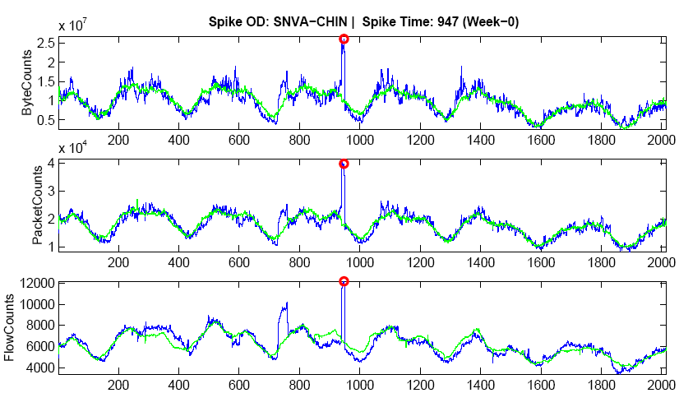
Research: Network Anomaly Detection
Operators want to detect when a traffic flow from ingress to egress generates a “spike”.
Problem: Today’s protocols don’t readily expose this information.
Management/debuggability not initially a high priority!
More in Lecture 12.

Slide 34
Goal #4: Distributed Management
Many examples:
Addressing (ARIN, RIPE, APNIC, etc.)
  Though this was recently threatened.
Naming (DNS)
Routing (BGP)
No single entity in charge.
Allows for organic growth, scalable management.
Tradeoff: No one party has visibility/control.

Slide 35
No Owner, No Responsible Party
“Some of the most significant problems with the Internet today relate to lack of sufficient tools for distributed management, especially in the area of routing.”
Hard to figure out who/what’s causing a problem
Worse yet, local actions have global effects…

Slide 36
Local Actions, Global Consequences
“…a glitch at a small ISP… triggered a major outage in Internet access across the country. The problem started when MAI Network Services...passed bad router information from one of its customers onto Sprint.” -- news.com, April 25, 1997
UUNet
Sprint
Florida Internet
Barn

Slide 37
Goal #5: Cost Effectiveness
Packet headers introduce high overhead
End-to-end retransmission of lost packets
  Potentially wasteful of bandwidth by placing burden on the edges of the network
Arguably a good tradeoff. Current trends are to exploit redundancy even more.

Slide 38
Goal #6: Ease of Attachment
IP is “plug and play” Anything with a working IP stack can connect to the Internet (hourglass model)
A huge success!
  Lesson: Lower the barrier to innovation/entry and people will get creative (e.g., Cerf and Kahn probably did not think about IP stacks on phones, sensors, etc.)
But….
Tradeoff: Burden on end systems/programmers.

Slide 39
Goal #7: Accountability
Note: Accountability mentioned in early papers on TCP/IP, but not prioritized
Datagram networks make accounting tricky.
  The phone network has had an easier time figuring out billing
  Payments/billing on the Internet is much less precise
  (More on this in Lectures 4 and 10)
Tradeoff: Broken payment models and incentives.

Slide 40
What’s Missing?
Security
Availability
Accountability (the other kind)
Support for disconnected/intermittent operation
Mobility
Scaling
…

Slide 41
Today’s Reading
Design Philosophy of the DARPA Internet Protocols. Dave Clark, 1988.
Conceptual Lessons
  Design principles/priorities were designed for a certain type of network. As the Internet evolves, we feel the sting of some of these choices.
  Examples: Commercialization,
  Engineering/Realization is key to testing an idea.
Technical Lessons
  Packet switching
  Fate Sharing/Soft state

Slide 42
Design Goal Shakeup
Cost of bandwidth is dropping. IP networks are becoming a commodity.
Management == Human intervention
  Costly!!
  Human error a leading cause of downtime
More bandwidth: are 40-byte headers still “big”?

Slide 43
Today’s Reading
Design Philosophy of the DARPA Internet Protocols. Dave Clark, 1988.
Conceptual Lessons
  Design principles/priorities were designed for a certain type of network. As the Internet evolves, we feel the sting of some of these choices.
  Examples: Commercialization,
  Engineering/Realization is key to testing an idea.
Technical Lessons
  Packet switching
  Fate Sharing/Soft state

Slide 44
Clark’s Paper and This Course
Flexible architectures (Good Thing) leave a lot of "wiggle room".
To determine whether something's going to work, it needs to be implemented/engineered.

Slide 45
So You’ve Got an Idea…
This course will help you figure out how to test it out, measure it, etc..
Test environments
  Emulab
  Planetlab
  VINI: Virtual Network Infrastructure
Data Sources
  Datapository
  Routeviews
  Abilene Observatory
Networking Software
  Click Modular Router (for forwarding in user-level)
  XORP Software Router (for routing)
Details available on course Web site
Come talk to me.

