Slide 1
Traffic: Monitoring, Estimation, and Engineering
Nick Feamster
CS 7260
February 14, 2007

Slide 2
Administrivia
Syllabus redux
  More time for traffic monitoring/engineering
  Simulation vs. emulation pushed back (Feb. 21)
Workshop deadlines (6-page papers)
  Reducing unwanted traffic: April 17
  Large scale attacks: April 21
  Network management: April 26
  Include in your proposal whether you will aim for one of these.

Slide 3
End-to-End Routing Behavior
Characterization study. We should be asking why these observations occur and whether they may have changed.
Major Findings
Prevalence: Likelihood of seeing a route
  Most paths dominated by a single prevalent route
Persistence: Likelihood that a route stays same
  Persistence of routes was variable
  2/3 of paths had routes persisting for days or weeks
Observed doubling in pathologies over the course of a year.

Slide 4
Method
Centralized controller launches distributed traceroutes
Pairwise traceroutes across sites
  First dataset has interval of 1-2 days
  Second dataset has some measurements in bursts
  Second dataset has paired measurements
(Mostly) poisson distribution of observations across paths
  PASTA principle: fraction of observations implies fraction of overall time

Slide 5
Arguing “Representativeness”
Always tricky business…
This paper: fraction of ASes traversed by the pairwise paths (8% “cross section”)
D1: ~ 7k traceroutes; D2: ~38k traceroutes
Assigning pathologies to a particular AS is challenging
Limitations
No explanation of why or where.
Centralized controller limits flexibility
Traceroute issues

Slide 6
Routing Loops
Loops: about 0.1% of all observations
  Two modes: under three hours, more than 12 hours
  Loops come in clusters
  Loops can affect nearby routers
  5 observations of multiple AS loops
  (how can this happen? Examples…)
3
1
1

Slide 7
Erroneous Routing
Packets clearly taking wrong path
(e.g., through Israel)
One example of erroneous routing

Slide 8
Changing Paths
Connectivity altered mid-stream
  Between 0.16% and 0.44%
  Recovery times bimodal
  Cause
Fluttering
  Rapidly oscillating routing
    Load balance/splitting
  Distinct from fluttering caused by routing oscillations?

Slide 9
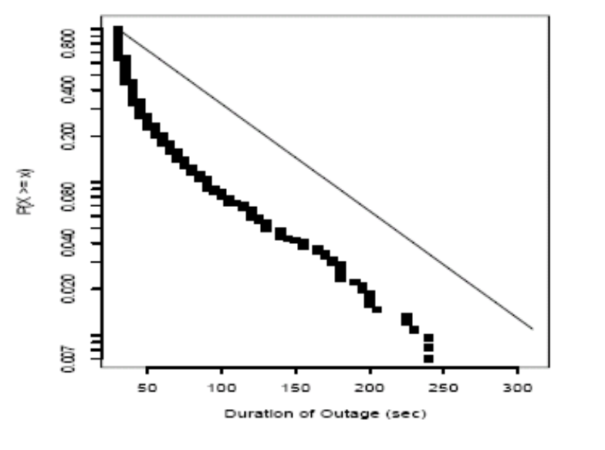
Failures and Unreachability
Availability rate of infrastructure about 99.5% - 99.8% (about 2.5 “nines”)
  Assumes representative measurements
  Assumes that other times paths were actually usable
  Neglects times when infrastructure could not drive the measurement
Most path lengths:
about 15-16 hops
Some diurnal patterns
Small number of ASes
responsible for most of
outages

Slide 10
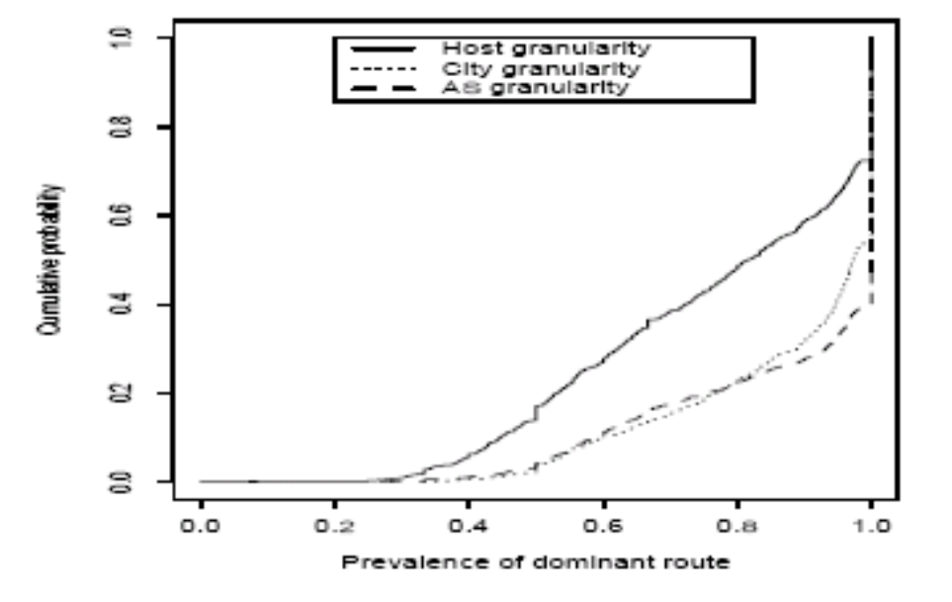
Routing Stability: Prevalence
Do routes change often?
Are they stable over time?
Half of paths always select the same set of ASes

Slide 11
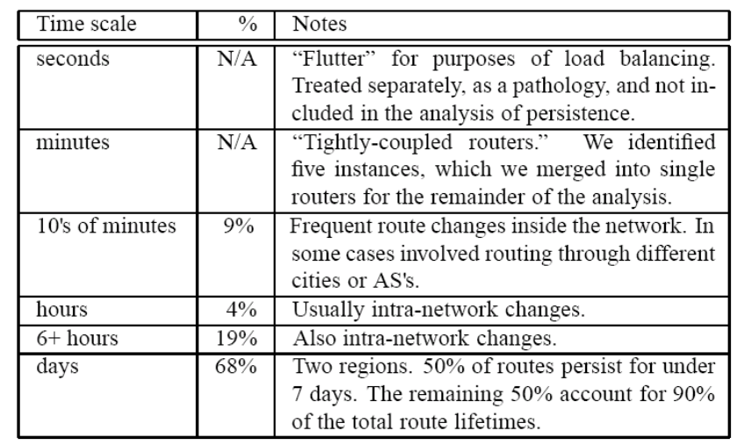
Routing Stability: Persistence
Difficult to measure given the probing strategy
Different timescales
  Rapid route alternation
    All 60 traceroute measurements made within a minute were the same…
    Changes over 10 minutes much more frequent
  Medium-scale route alternation
  Large-scale route alternation

Slide 12
Routing Symmetry
Finding: 49% of measurements exhibit path asymmetry
Causes
  Hot-potato routing
  Policy routing
Hypothesis: Multihoming has increased the degree of routing symmetry

Slide 13
Related Routing Pathology:
Path Exploration
Routing pathologies: Paxson’s paper from a few lectures ago: 3.3% of routes had “serious problems
Slow convergence: BGP can take a long time to converge
  Up to 30 minutes!
  10% of routes available < 95% of the time [Labovitz]

Slide 14

BGP Convergence Example
R
AS2
AS3
AS0
AS1
*B R via AS3
B R via AS1,AS3
B R via AS2,AS3
*B R via AS3
B R via AS0,AS3
B R via AS2,AS3
*B R via AS3
B R via AS0,AS3
B R via AS1,AS3
*
*
*
*B R via 013
*B R via 203
AS0
AS1
AS2

Slide 15
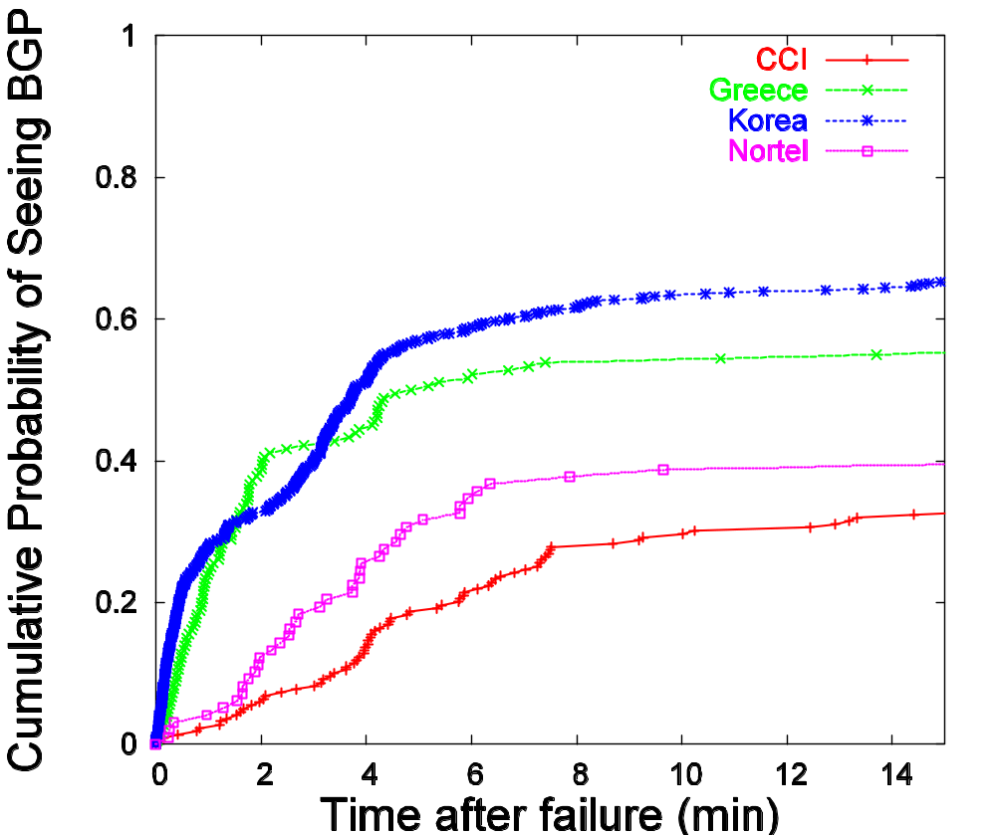
Slow Convergence in BGP
Given a failure, can take up to 15 minutes to see BGP.
Sometimes, not at all.

Slide 16
Intuition for Delayed BGP Convergence
  There exists a message ordering for which BGP will explore all possible AS paths
    Convergence is O(N!), where N number of default-free BGP speakers in a complete graph
    In practice, exploration can take 15-30 minutes
    Question: What typically prevents this exploration from happening in practice?
  Question: Why can’t BGP simply eliminate all paths containing a subpath when the subpath is withdrawn?

Slide 17
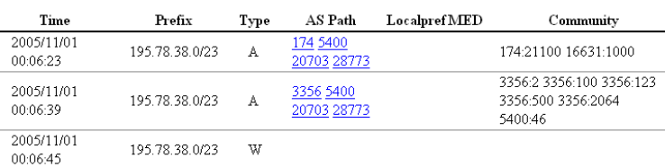
Routing Convergence in Practice
Route withdrawn, but stub cycles through backup path…

Slide 18
Passive Measurement

Slide 19
Two Main Approaches
Packet-level Monitoring
  Keep packet-level statistics
  Examine (and potentially, log) variety of packet-level statistics. Essentially, anything in the packet.
  Timing
Flow-level Monitoring
  Monitor packet-by-packet (though sometimes sampled)
  Keep aggregate statistics on a flow

Slide 20
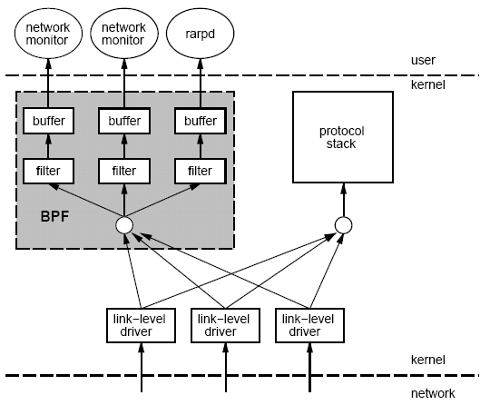
Packet Capture: tcpdump/bpf
Put interface in promiscuous mode
Use bpf to extract packets of interest
Accuracy Issues
Packets may be dropped by filter
  Failure of tcpdump to keep up with filter
  Failure of filter to keep up with dump speeds
Question: How to recover lost information from packet drops?

Slide 21
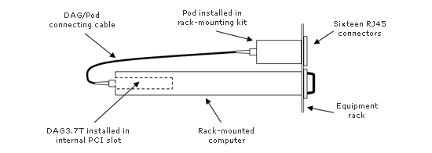
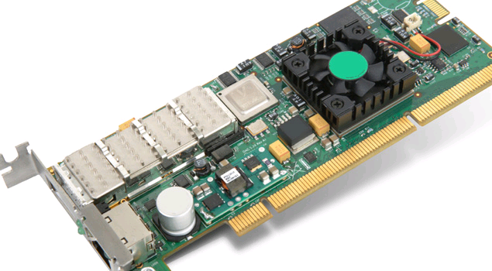
Packet Capture on High-Speed Links
Example: Georgia Tech “OC3Mon”
Rack-mounted PC
Optical splitter
Data Acquisition and Generation (DAG) card
Source: endace.com

Slide 22
Characteristics of Packet Capture
Allows inpsection on every packet on 10G links
Disadvantages
  Costly
  Requires splitting optical fibers
  Must be able to filter/store data

Slide 23
Traffic Flow Statistics
Flow monitoring (e.g., Cisco Netflow)
  Statistics about groups of related packets (e.g., same IP/TCP headers and close in time)
  Recording header information, counts, and time
More detail than SNMP, less overhead than packet capture
  Typically implemented directly on line card

Slide 24
What is a flow?
Source IP address
Destination IP address
Source port
Destination port
Layer 3 protocol type
TOS byte (DSCP)
Input logical interface (ifIndex)

Slide 25

Cisco Netflow
Basic output: “Flow record”
  Most common version is v5
  Latest version is v10 (RFC 3917)
Current version (10) is being standardized in the IETF (template-based)
  More flexible record format
  Much easier to add new flow record types
Core Network
Collector
(PC)
Collection and Aggregation
Approximately 1500 bytes
20-50 flow records
Sent more frequently if traffic increases

Slide 26
Flow Record Contents
Basic information about the flow…
Source and Destination, IP address and port
Packet and byte counts
Start and end times
ToS, TCP flags
…plus, information related to routing
Next-hop IP address
Source and destination AS
Source and destination prefix

Slide 27
Aggregating Packets into Flows
flow 1
flow 2
flow 3
flow 4
Criteria 1: Set of packets that “belong together”
  Source/destination IP addresses and port numbers
  Same protocol, ToS bits, …
  Same input/output interfaces at a router (if known)
Criteria 2: Packets that are “close” together in time
  Maximum inter-packet spacing (e.g., 15 sec, 30 sec)
  Example: flows 2 and 4 are different flows due to time

Slide 28
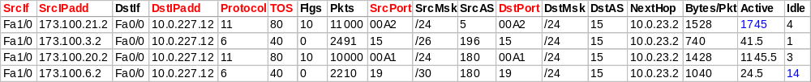

Netflow Processing
Create and update flows in NetFlow Cache
Inactive timer expired (15 sec is default)
Active timer expired (30 min (1800 sec) is default)
NetFlow cache is full (oldest flows are expired)
RST or FIN TCP Flag
Expiration
Aggregation?
No
Yes
e.g. Protocol-Port Aggregation Scheme becomes
Export Version
Non-Aggregated Flows – export Version 5 or 9
Aggregated Flows – export Version 8 or 9
Transport Protocol
Export
Packet
Payload
(flows)
Header

Slide 29
Reducing Measurement Overhead
Filtering: on interface
  destination prefix for a customer
  port number for an application (e.g., 80 for Web)
Sampling: before insertion into flow cache
  Random, deterministic, or hash-based sampling
  1-out-of-n or stratified based on packet/flow size
  Two types: packet-level and flow-level
Aggregation: after cache eviction
  packets/flows with same next-hop AS
  packets/flows destined to a particular service

Slide 30
Packet Sampling
Packet sampling before flow creation (Sampled Netflow)
  1-out-of-m sampling of individual packets (e.g., m=100)
  Create of flow records over the sampled packets
Reducing overhead
  Avoid per-packet overhead on (m-1)/m packets
  Avoid creating records for a large number of small flows
Increasing overhead (in some cases)
  May split some long transfers into multiple flow records
  … due to larger time gaps between successive packets
time
not sampled
timeout
two flows

Slide 31
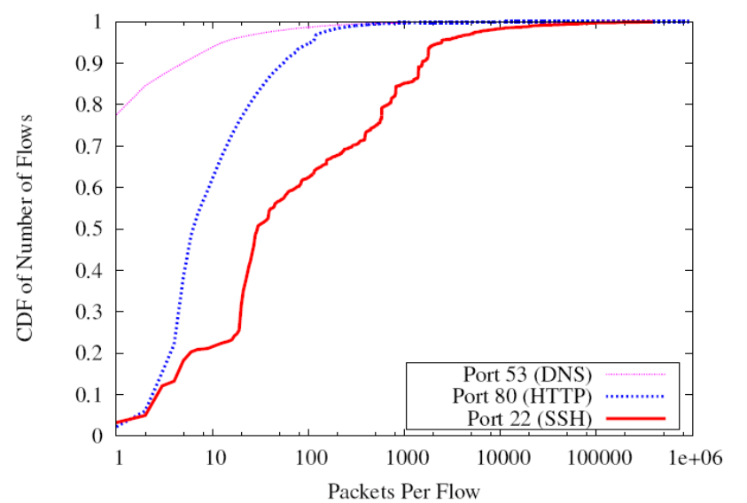
Problems with Packet Sampling
Determining size of original flows is tricky
  For a flow originally of size n, the size of the sampled flow follows a binomial distribution
  Extrapoliation can result in big errors
  Much research in reducing such errors
  (upcoming lectures)
Flow records can be lost
Small flows may be eradicated entirely

Slide 32
Sampling: Flow-Level Sampling
Sampling of flow records evicted from flow cache
  When evicting flows from table or when analyzing flows
Stratified sampling to put weight on “heavy” flows
  Select all long flows and sample the short flows
Reduces the number of flow records
  Still measures the vast majority of the traffic
Flow 1, 40 bytes
Flow 2, 15580 bytes
Flow 3, 8196 bytes
Flow 4, 5350789 bytes
Flow 5, 532 bytes
Flow 6, 7432 bytes
sample with 0.1% probability
sample with 100% probability
sample with 10% probability

Slide 33
Accuracy Depends on Phenomenon
Even naïve random sampling probably decent for capturing the existence of large flows
Accurately measuring other features may require different approaches
  Sizes of large flows
  Distribution of flow sizes
  Existence of small flows (coupon collection)
  Size of small flows
  Traffic “matrix”

Slide 34
Routing Data
IGP
BGP
  Collection methods
    eBGP (typically “multihop”)
    iBGP
  Table dumps: Periodic, complete routing table state (direct dump from router)
  Routing updates: Continuous, incremental, best route only
iBGP session

Slide 35
Evaluation Strategies and Platforms

Slide 36
Other Measurement Tools
Scriptroute (http://www.scriptroute.org/)
  Write new probing tools/techniques, etc.
  More on PS 2

Slide 37
Evaluation Strategies
Simulation
  Ns2, SSFNet
  Advantages: Control
Emulation
  Emulab
  Advantages: Real software, more realistic conditions
Wide-area Deployment
  VINI
  Simultaneous operation, sharing
  Advantages: Ability to carry real traffic
Next Lecture: Comparisons of these different evaluation strategies

Slide 38
PlanetLab: Distributed Services
Key challenge: Isolation
Slice: Set of VMs are treated as a single entity (distributed virtualization)
Isolation at system call level (vservers)
  Shared filesystem, memory, etc.
Network virtualization: safe raw sockets
  Must be bound to a specific port

Slide 39
Virtualization
Advantages
  Simultaneous access to shared physical resources
Disadvantages
  Requires scheduling
  Not running on “raw” hardware. May not see similar performance as the “real” network/system

Slide 40
PlanetLab for Network Measurement
Nodes are largely at academic sites
  Other alternatives: RON testbed (disadvantage: difficult to run long running measurements)
Repeatability of network experiments is tricky
  Proportional sharing
    Minimum guarantees provided by limiting the number of outstanding shares
  Work-conserving CPU scheduler means experiment could get more resources if there is less contention

Slide 41
PlanetLab for Network Architecture
New components must be virtualized
  Interfaces
  Links
Support for forwarding traffic over virtual links
Stock and custom routing software

