Slide 1
Traffic Monitoring, Estimation, and Engineering
Nick Feamster
CS 7260
February 19, 2007

Slide 2
Administrivia
Turn in project proposals by midnight tonight
If you are still at a loss for project ideas, come see me at office hours today

Slide 3
Today’s Topics
Traffic monitoring
  Flow monitoring
    Mechanics
    Limitations
  Estimation / Problem formulation
Traffic engineering
  Intradomain (today’s paper)
  Interdomain

Slide 4
Traffic Flow Statistics
Flow monitoring (e.g., Cisco Netflow)
  Statistics about groups of related packets (e.g., same IP/TCP headers and close in time)
  Recording header information, counts, and time
More detail than SNMP, less overhead than packet capture
  Typically implemented directly on line card

Slide 5
What is a flow?
Source IP address
Destination IP address
Source port
Destination port
Layer 3 protocol type
TOS byte (DSCP)
Input logical interface (ifIndex)

Slide 6

Cisco Netflow
Basic output: “Flow record”
  Most common version is v5
  Latest version is v10 (RFC 3917)
Current version (10) is being standardized in the IETF (template-based)
  More flexible record format
  Much easier to add new flow record types
Core Network
Collector
(PC)
Collection and Aggregation
Approximately 1500 bytes
20-50 flow records
Sent more frequently if traffic increases

Slide 7
Flow Record Contents
Basic information about the flow…
Source and Destination, IP address and port
Packet and byte counts
Start and end times
ToS, TCP flags
…plus, information related to routing
Next-hop IP address
Source and destination AS
Source and destination prefix

Slide 8
Aggregating Packets into Flows
flow 1
flow 2
flow 3
flow 4
Criteria 1: Set of packets that “belong together”
  Source/destination IP addresses and port numbers
  Same protocol, ToS bits, …
  Same input/output interfaces at a router (if known)
Criteria 2: Packets that are “close” together in time
  Maximum inter-packet spacing (e.g., 15 sec, 30 sec)
  Example: flows 2 and 4 are different flows due to time

Slide 9
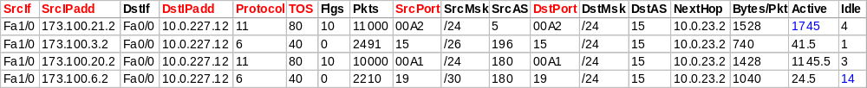

Netflow Processing
Create and update flows in NetFlow Cache
Inactive timer expired (15 sec is default)
Active timer expired (30 min (1800 sec) is default)
NetFlow cache is full (oldest flows are expired)
RST or FIN TCP Flag
Expiration
Aggregation?
No
Yes
e.g. Protocol-Port Aggregation Scheme becomes
Export Version
Non-Aggregated Flows – export Version 5 or 9
Aggregated Flows – export Version 8 or 9
Transport Protocol
Export
Packet
Payload
(flows)
Header

Slide 10
Reducing Measurement Overhead
Filtering: on interface
  destination prefix for a customer
  port number for an application (e.g., 80 for Web)
Sampling: before insertion into flow cache
  Random, deterministic, or hash-based sampling
  1-out-of-n or stratified based on packet/flow size
  Two types: packet-level and flow-level
Aggregation: after cache eviction
  packets/flows with same next-hop AS
  packets/flows destined to a particular service

Slide 11
Packet Sampling
Packet sampling before flow creation (Sampled Netflow)
  1-out-of-m sampling of individual packets (e.g., m=100)
  Create of flow records over the sampled packets
Reducing overhead
  Avoid per-packet overhead on (m-1)/m packets
  Avoid creating records for a large number of small flows
Increasing overhead (in some cases)
  May split some long transfers into multiple flow records
  … due to larger time gaps between successive packets
time
not sampled
timeout
two flows

Slide 12
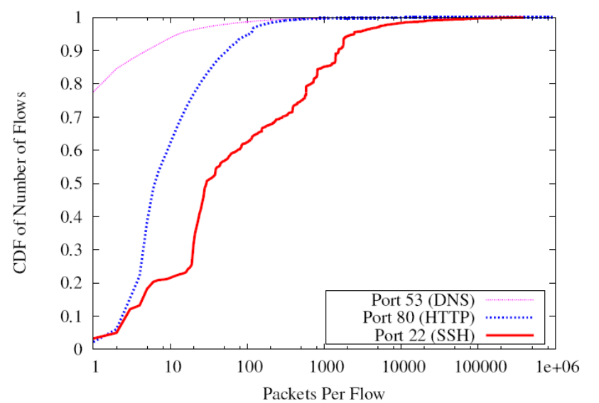
Problems with Packet Sampling
Determining size of original flows is tricky
  For a flow originally of size n, the size of the sampled flow follows a binomial distribution
  Extrapoliation can result in big errors
  Much research in reducing such errors
  (upcoming lectures)
Flow records can be lost
Small flows may be eradicated entirely

Slide 13
Flow-Level Sampling
Sampling of flow records evicted from flow cache
  When evicting flows from table or when analyzing flows
Stratified sampling to put weight on “heavy” flows
  Select all long flows and sample the short flows
Reduces the number of flow records
  Still measures the vast majority of the traffic
Flow 1, 40 bytes
Flow 2, 15580 bytes
Flow 3, 8196 bytes
Flow 4, 5350789 bytes
Flow 5, 532 bytes
Flow 6, 7432 bytes
sample with 0.1% probability
sample with 100% probability
sample with 10% probability

Slide 14
Accuracy Depends on Phenomenon
Even naïve random sampling probably decent for capturing the existence of large flows
Accurately measuring other features may require different approaches
  Sizes of large flows
  Distribution of flow sizes
  Existence of small flows (coupon collection)
  Size of small flows
  Traffic “matrix”

Slide 15
Recent Work: Targeted Sampling
Set sampling rates based on estimate of flow sizes or classes
Flow sampling: Size-dependent flow sampling (Duffield)
Packet sampling: Sketch-Guided Sampling (Kumar), Flexible Sampling (Ramachandran)

Slide 16
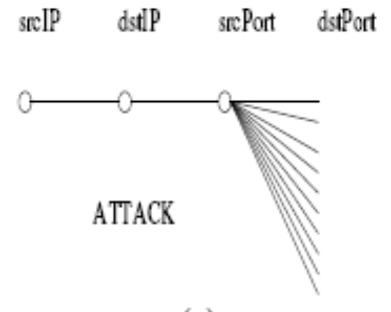
Motivation: Recover Structure
Structure of “who’s ralking to whom” can reveal helpful information about traffic patterns
Can be difficult to get this from sampled flow records if the flows themselves are small
“BLINC: Multi-level Traffic Classification in the Dark”, SIGCOMM 2004

Slide 17
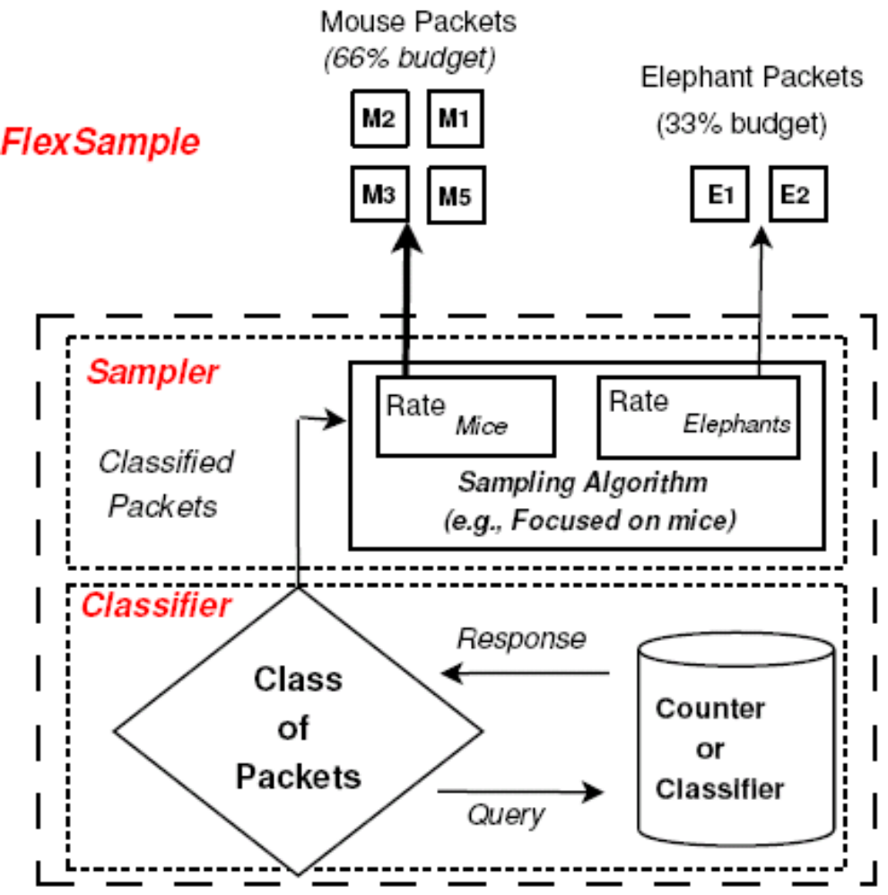
Idea: Augment Sampling with Counting
Estimate, online, the type/size of a flow to which a packet belongs
Adjust sampling rate according to corresponding class

Slide 18
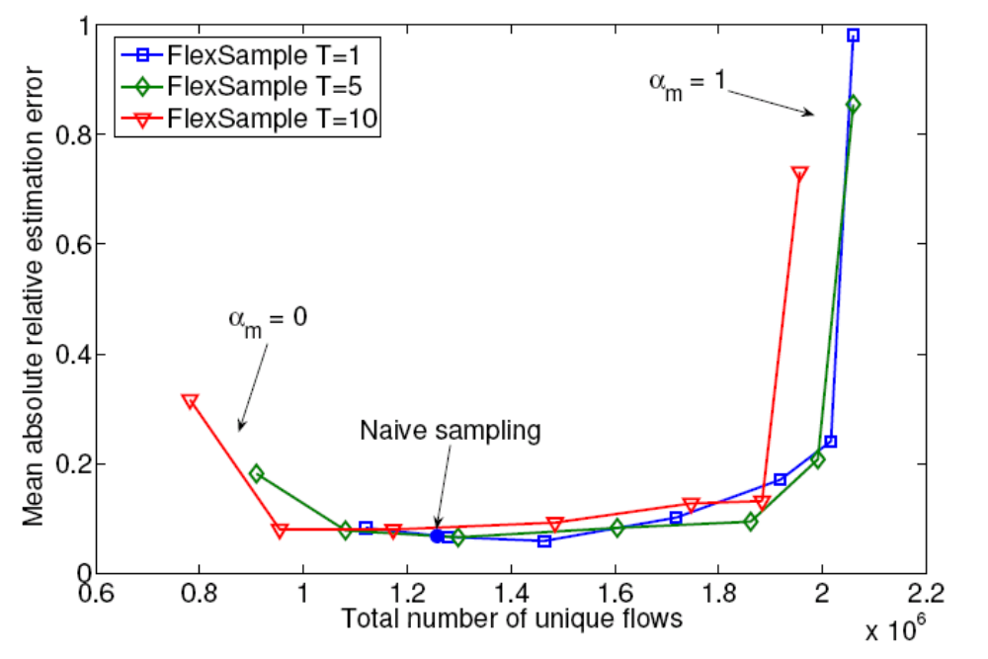
Stealing Packets from Large Flows
Some packet samples can be “stolen” from large flows without incurring much estimation error
Reallocating to small flows means more unique “conversations” captured

Slide 19
Traffic Engineering

Slide 20
Traffic Engineering Motivation
Efficient use of resources (capacity, etc.)
Response to dynamic network conditions
  Changes in offered traffic load
  Changes in capacity
  Link failures, etc.
Routing protocols do not (typically) automatically adapt to these changing conditions

Slide 21
Traffic Engineering Formulation
Routing
configuration
Topology
Routing
model
Offered
traffic
eBGP
routes
Traffic flow through the network

Slide 22
Two Types of Traffic Engineering
Intradomain: Within a single AS
  More “traditional” optimization problem
  Challenges are in updating link weights
Interdomain: Between multiple ASes
  Ill-formed problem
  Many more unknowns

Slide 23
Challenge: Dynamic Conditions
Link state updates
  High update rate leads to high overhead
  Low update rate leads to oscillation
Many connections are short
  Average Web transfer is just 10 packets
  Requires high update rates to ensure stability
Information goes stale as network conditions change. Approaches for dealing with this?

Slide 24
Challenge: Cost of Reconfiguration
Minimize number of changes to the network
  Changing just 1 or 2 link weights is often enough
Limit frequency of changes to the weights
  Joint optimization for day & night traffic matrices
Tolerate failure of network equipment
  Weights settings usually remain good after failure
  … or can be fixed by changing one or two weights
Limit dependence on accuracy and dynamics

Slide 25
“Traditional” Intradomain TE
Routers flood information to learn topology
  Determine “next hop” to reach other routers…
  Compute shortest paths based on link weights
Link weights configured by network operator
2
3
1
1
3
2
1
5
4
3

Slide 26
Approaches: Local vs. Network-Wide
Local
  Proportional to physical distance
    Cross-country links have higher weights
    Minimizes end-to-end propagation delay
  Inversely proportional to link capacity
    Smaller weights for higher-bandwidth links
    Attracts more traffic to links with more capacity
Network-Wide
  Network-wide optimization of the link weights
  Directly minimizes metrics like max link utilization
  Assumes accesss to network-wide information

Slide 27
Approaches: Offline vs. Dynamic
Offline
  Monitor trends and macro patterns in utilization
  Perform offline optimization
  Advantage: No protocol modification. No stability issues. Flexibility
  Disadvantage: Perhaps less reactive.
Dynamic
  Routers themselves monitor link utilization
  Distributed/local reoptimization of link weights and route selection
  Advantage: More reactive.
  Disadvantage: Protocol modifications, stability issues, etc.

Slide 28
Traffic Engineering Approaches
 | Offline | Dynamic
Centralized | Intradomain: Fortz/Rexford02 Interdomain: Feamster03 | Routing control platform (Open questions in this area)
Distributed |  | Intradomain: Katabi (TeXCP) Interdomain: Mahajan (NP, nexit)

Slide 29
Formalization
Input: Graph G with unidirectional links l and capacities for each link
Input: Objective function
Input: traffic matrix
  M_{i,j}: traffic load from source i to destination j
  For intradomain TE, source/destination are routers
Output: setting of the link weights
  W_{l}: weight on unidirectional link l
  P_{i,j,l}: fraction of traffic from i to j traversing link l

Slide 30
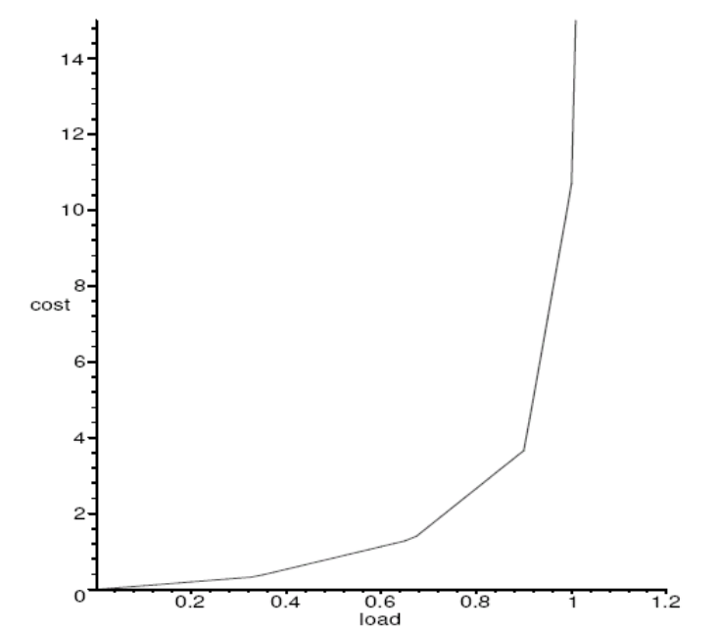
Objective Functions
Take 1: Minimize maximum utilization
  Individual bottleneck links may impose unrealistic/overly strong constraints
Take 2: Fractional relation between load and total capacity

Slide 31
Traffic Matrix Estimation
From link counts to the traffic matrix
Sources
5Mbps
3Mbps
4Mbps
4Mbps
Destinations

Slide 32
Formalization
Source-destination pairs
  p is a source-destination pair (of nodes)
  x_{p} is the (unknown) traffic volume for this pair
Links in the network
  l is a unidirectional edge
  y_{l} is the observed traffic volume on this link
Routing
  R_{lp} = 1 if link l is on the path for src-dest pair p
  Or, R_{lp} is the proportion of p’s traffic that traverses l
y = Rx (now work backwards to get x)

Slide 33
Estimation is Under-Constrained
Linear system is underdetermined
  Number of nodes n
  Number of links e is around O(n)
  Number of src-dest pairs c is O(n²)
  Dimension of solution sub-space at least c - e
Multiple observations can help
  k independent observations (over time)
  Stochastic model with src-dest counts Poisson & i.i.d
  Maximum likelihood estimation to infer traffic matrix
  Use NetFlow to augment byte counts can help constrain the problem
Lots of recent work on traffic matrix estimation

Slide 34
Questions for Intra-Domain TE
Is the objective function reasonable? What about:
  Resilience to failure?
  Use of available capacity?
How stable/fragile is the resulting optimal solution when traffic demands change?
  Fluctuating traffic demands
Setting link weights in this fashion is unintuitive and often not used in practice? Is there a better way to set link weights?

Slide 35
Interdomain Traffic Engineering

Slide 36
Interdomain Traffic Engineering
Why?
  Alleviating congestion on edge links
  Adapting to provisioning changes
  Achieving good end-to-end performance
How?
  Directing traffic to a different neighbor AS
  Directing traffic to different links to the same neighbor

Slide 37
Overview of Method (Outbound)
Change outbound traffic using BGP import policy
Requirements
  Minimal overhead (management and messages)
  Predictable changes in traffic
  No effect on neighboring ASes’ routing decisions

Slide 38
Why Interdomain TE is Hard
Scale: Can’t set independent policy for 200k+ prefixes
  Configuration overhead
  Traffic instability
Predictability: Policy-based adjustments are indirect
Control: Neighbors’ behavior can affect traffic volumes in unpredictable and uncontrollable ways

Slide 39
Why Interdomain TE with BGP is Hard
Protocol problems
  No performance metrics in advertisement attributes
Configuration problems
  Not possible to express conjunction between attributes
  Indirect influence
Route selection problems
  One best route per prefix per router
  Can’t split traffic to a prefix over paths of different lengths
  Interaction with IGP
Commercial relationship problems

Slide 40
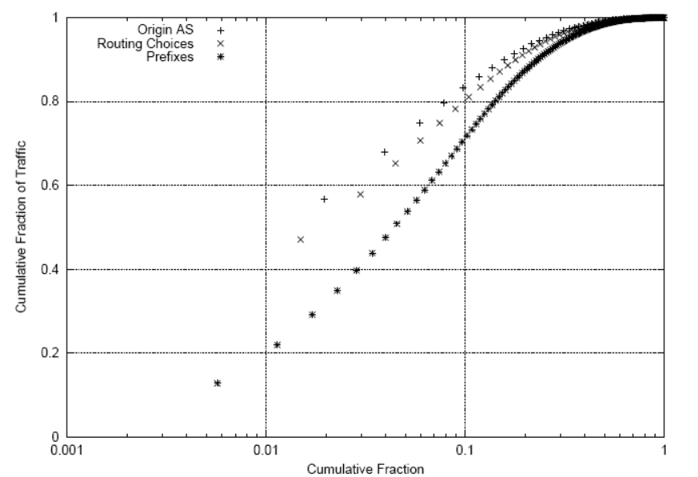
Managing Scale
Problem: Large number of prefixes
Solution: Change policies for small fraction of prefixes that are responsible for most traffic
10% of prefixes responsible for 70% of traffic
More concentrated for origin ASes.

Slide 41
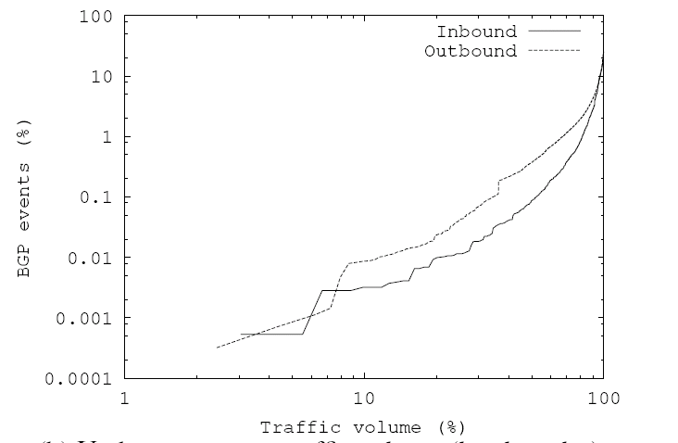
Achieving Predictability
Problem: Traffic volumes change over time
Solution: Change policies for prefxes that have more stable traffic volumes.
Origin ASes responsible for 10% of inbound traffic don’t fluctuate by more than a factor or two between weeks.

Slide 42
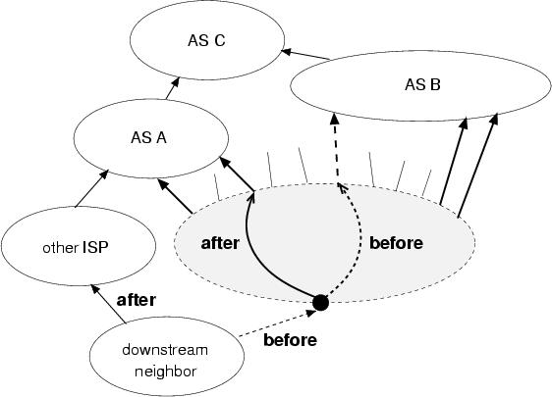
Acheving Predictability
Problem: Internal changes that are externally visible can change inbound traffic volumes
Solution: Shift traffic among paths
  To the same AS
  To a different AS, but one with the same path length

