Slide 1
Evaluation Strategies
Nick Feamster
CS 7260
February 26, 2007

Slide 2
Evaluation Strategies
Many ways to evaluate new protocols, systems, implementations
  Mathematical analysis
  Simulation (ns, SSFNet, etc.)
  Emulation (emulab)
  Trace-driven evaluation
  Wide-area deployment (VINI)
Interplay between these areas is not obvious!
Various tradeoffs in “realism”, control, etc.
A combination may be appropriate

Slide 3
Why Network Simulation?
Can capture complexity that analytical models miss
Protocol validation
  Quantitative results
  Exploration of dynamics
Controlled experimental conditions
Low cost/barrier to entry
  Time
  Collaboration
  Complexity

Slide 4
Simulation: ns
ns:discrete-event network simulator for Internet systems
  protocol design, large scale systems studies, prototyping, education
Why ns?
  Protocols: TCP, UDP, HTTP, etc.
  Traffic Models: Web Traffic, CBR,
  Topology Generation tools
  Visualization tools

Slide 5
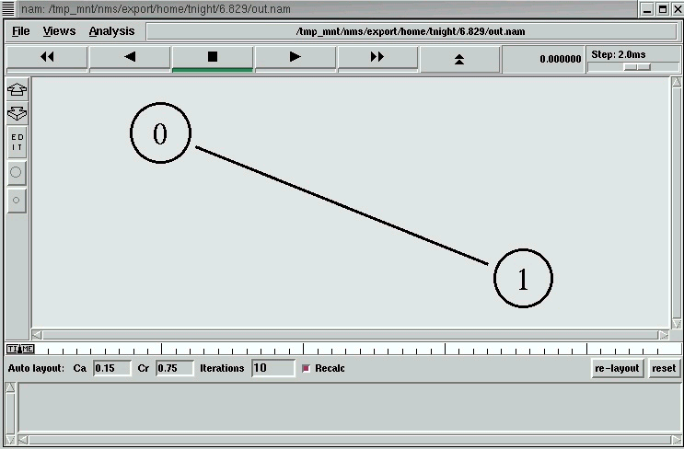
Step 1: Topology
# Create simulation object
set ns [new Simulator]
# Ask ns for nodes
set n0 [$ns node]
set n1 [$ns node]
# Create a duplex link b/w n0 & n1
$ns duplex-link $n0 $n1 1Mb 10ms DropTail
# Schedule End
$ns at 5.0 "exit 0"
# Run Simulation
$ns run

Slide 6
Step 2: Attaching Agents
Purpose: Transport connections between nodes
Various types: TCP, UDP, etc.
UDP
TCP
# Create a UDP agent
set udp1 [new Agent/UDP]
# Create a Null agent
set sink1 [new Agent/Null]
# Attach agent udp1 to node n0
$ns attach-agent $n0 $udp1
# Attach agent sink1 to node n1
$ns attach-agent $n1 $sink1
# Connect the agents
$ns connect $udp1 $sink1
# Create a TCP agent
set tcp1 [new Agent/TCP]
# Create a Null agent
set sink1 [new Agent/TCPSink]
# Attach agent tcp1 to node n0
$ns attach-agent $n0 $tcp1
# Attach agent sink1 to node n1
$ns attach-agent $n1 $sink1
# Connect the agents
$ns connect $tcp1 $sink1

Slide 7
Step 3: Creating Traffic
Purpose: Send traffic over links/transport
# Create Source
set cbr1 [new Application/Traffic/CBR]
# Configure Source
$cbr1 set packetSize_ 500 $cbr1 set interval_ 0.005
# Attach source to agent
$cbr1 attach-agent $udp1
# Schedule cbr on
$ns at 0.5 "$cbr1 start"
# Schedule cbr off
$ns at 4.5 "$cbr1 stop"

Slide 8
Simulation: Advantages and Disadvantages
Advantages
Disadvantages
Ease of use
Often possible to achieve large scale (federation, etc.)
Low cost in time, money, etc.
Many “accepted” models available
Models may be (and have previously been shown to be) incorrect
Doesn’t run actual protocols, software implementations, etc.
Parameter exploration creep

Slide 9
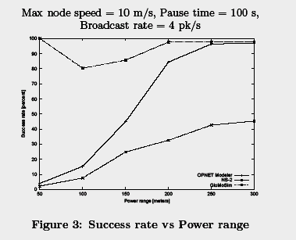
Crisis of Credibility
Ns-2
From: Cavin, Sasson and Schiper – On the accuracy of MANET Simulators
Opnet
Glomosim

Slide 10
Case Study: Internet
Heterogeneity
  Link media (fiber, copper, wireless, etc.)
  Link rates
  Transport protocol implementations
Scale
  When is it OK to draw conclusions from small-scale experiments?
Drastic rates of change
“Difficulties in Simulating the Internet”, IEEE/ACM ToN, August 2001

Slide 11
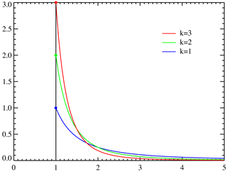
Coping Strategy: Invariants
Diurnal traffic patterns
Self-similarity/Long-range dependence
Heavy-tailed distributions
Pareto Distributions
Speed of light

Slide 12
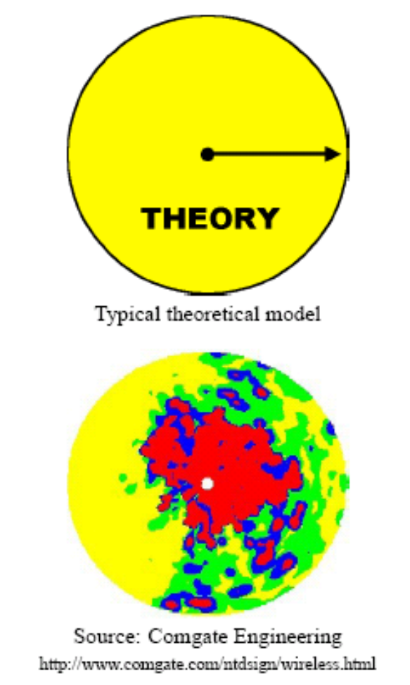
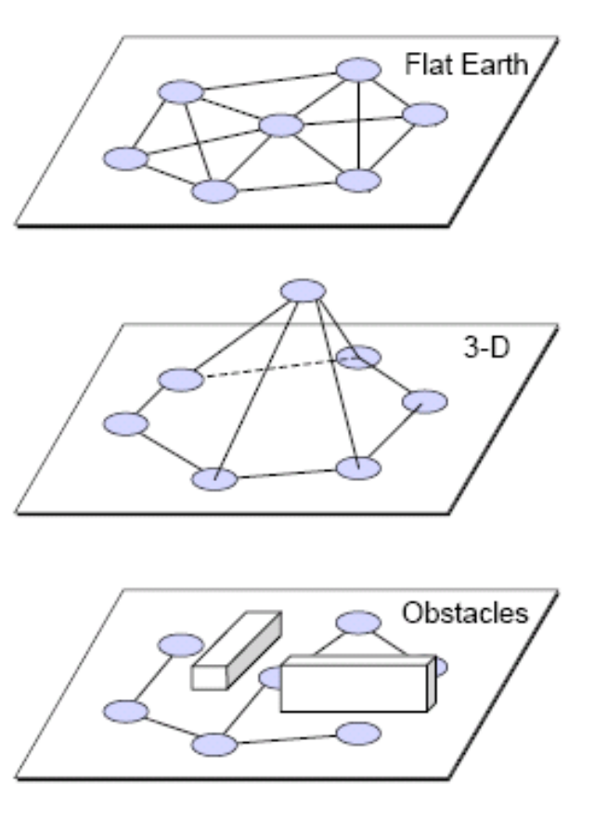
Case Study: Wireless
The earth is not flat
Radio transmission range is not circular
Radios have unequal ranges
Communication is asymmetric
Reachability does not imply perfect communication
Signal strength is not only a function of distance
“Mistaken Axioms of Wireless Networking Research”, Dartmouth TR

Slide 13
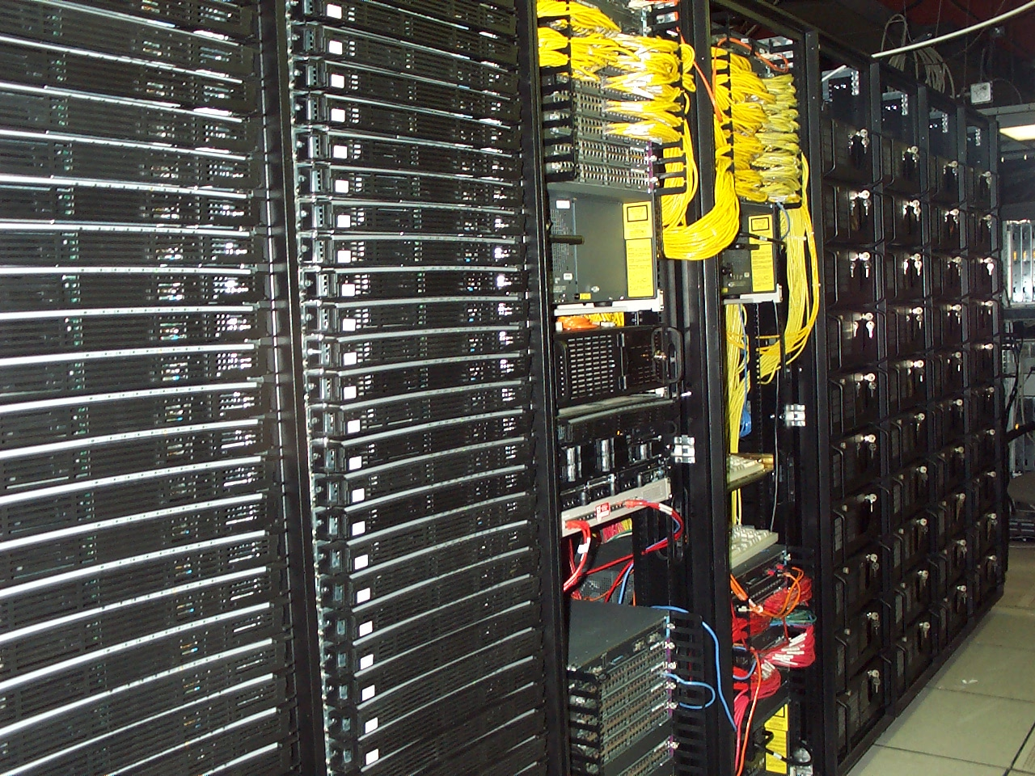
Emulation: Emulab
http://www.emulab.net/

Slide 14
Why?
“We evaluated our system on five nodes.”
  job talk from university with 300-node cluster
“We evaluated our Web proxy design with 10 clients on 100Mbit ethernet.”
“Simulation results indicate ...”
“Memory and CPU demands on the individual nodes were not measured, but we believe will be modest.”
“The authors ignore interrupt handling overhead in their evaluation, which likely dominates all other costs.”
“Resource control remains an open problem.”

Slide 15
Emulab Design Features
Allow experimenter complete control
… but provide fast tools for common cases
  OS’s, disk loading, state mgmt tools, IP, traffic generation, batch, ...
Virtualization
  of all experimenter-visible resources
  node names, network interface names, network addresses
  Allows swapin/swapout

Slide 16
Design Aspects (cont’d)
Flexible, extensible, powerful allocation algorithm
Persistent state maintenance:
  none on nodes
  all in database
  leverage node boot time: only known state!
Separate control network
Familiar, powerful, extensible configuration language: ns

Slide 17
More Unique Characteristics
Capture of low-level node behavior such as interrupt load and memory bandwidth
User-replaceable node OS software
User-configurable physical link topology
  User-configurable control of “physical” characteristics:
    shaping of link latency/bandwidth/drops/errors
    (via invisibly interposed “shaping nodes”),
    router processing power,
    buffer space, …
Configurable by external researchers, including node power cycling

Slide 18
Example Topology and Configuration
30Mb
50ms
set ns [new Simulator]
source tb_compat.tcl
set nodeA [$ns node]
set nodeB [$ns node]
set nodeC [$ns node]
set nodeD [$ns node]
set link0 [$ns duplex-link $nodeA $nodeB 30Mb 50ms DropTail]
set link1 [$ns duplex-link $nodeA $nodeC 30Mb 50ms DropTail]
set link2 [$ns duplex-link $nodeC $nodeD 30Mb 50ms DropTail]
set link3 [$ns duplex-link $nodeB $nodeD 30Mb 50ms DropTail]
$ns rtproto Static
$ns run

Slide 19
Demonstration

Slide 20
What Is It Not Good For?
Packet-level expts. across many nodes
  Clock synchronization good, but not perfect
  Non-determinism in the real world
Experiments that require real routers
  All nodes are PCs
    But, we can use a few different queuing strategies
    And, you can reprogram them all you want
Experiments that require gigabit links
  None yet, but we hope to add some
Experiments that need 1000s of links/nodes
  ModelNet, coming soon, will help

Slide 21
Challenges for Emulation and
Wide-Area Deployment
Mapping and embedding
  Resource management
  Scheduling experiments
Scaling
Validation
Security
Artifact detection and control
User interface issues
Notes:
(network, memory, bus, interrupt, card, driver, cpu)

Slide 22
Network Embedding Problem
Given: virtual network and physical network
  Topology, constraints, etc.
Problem: find the appropriate mapping onto available physical resources (nodes and edges)
Many possible formulations
  Specific nodes mapping to certain physical nodes
  Generic requirements: “three diverse paths from SF to LA with 100 MBps throughput”
  Traffic awareness, dynamic remapping, etc.

Slide 23
VINI Overview
Bridge the gap between “lab experiments”
and live experiments at scale.
?
Emulation
VINI
Simulation
Small-scale
experiment
Live
deployment
Runs real routing software
Exposes realistic network conditions
Gives control over network events
Carries traffic on behalf of real users
Is shared among many experiments

Slide 24

Goal: Control and Realism
Traffic
Real clients, servers
Synthetic or traces
Topology
Control
  Reproduce results
  Methodically change or relax constraints
Realism
  Long-running services attract real users
  Connectivity to real Internet
  Forward high traffic volumes (Gb/s)
  Handle unexpected events
Arbitrary, emulated
Actual network
Traffic
Synthetic or traces
Real clients, servers
Network Events
Inject faults, anomalies
Observed in operational network
Notes:
Scientifically, what’s the point of such an infrastructure?

Slide 25
Network Virtualization: Characteristics
Sharing
Multiple logical routers on a single platform
Resource isolation in CPU, memory, bandwidth, forwarding tables, …
Customizability
Customizable routing and forwarding software
General-purpose CPUs for the control plane
Network processors and FPGAs for data plane

Slide 26
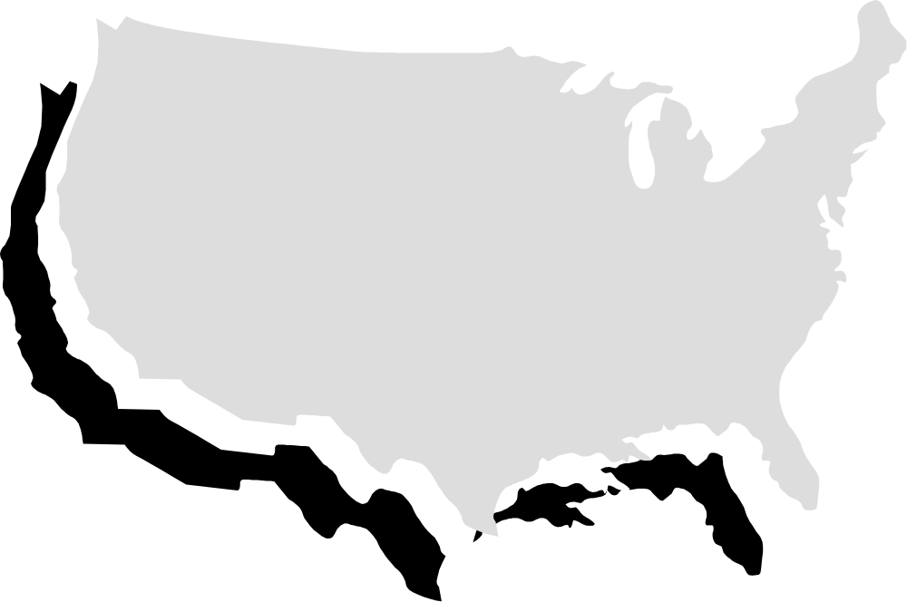
Fixed Physical Infrastructure
Notes:
Concretely, what is VINI
Overlays!
Aggregate Gb/s
Topology, IP address, BGP peering

Slide 27
Shared By Many Parties
Notes:
Virtual nodes
Isolation between experiments (e.g., CPU reservation)

Slide 28
Supports Arbitrary Virtual Topologies
Notes:
P2P connectivity
Unique interfaces visible to each virtual node

Slide 29
Why Is This Difficult?
Creation of virtual nodes
  Sharing of resources
  Creating the appearance of multiple interfaces
  Arbitrary software
Creation of virtual links
  Expose underlying failures of links
  Controlled link failures
  Arbitrary forwarding paradigms
Embedding virtual topologies
  Support for simultaneous virtual experiments
  Must map onto available resources, account, etc.

Slide 30
PL-VINI: Prototype on PlanetLab
First experiment: Internet In A Slice
  XORP open-source routing protocol suite
  Click modular router
Expose issues that VINI must address
  Unmodified routing (and other) software on a virtual topology
  Forwarding packets at line speed
  Illusion of dedicated hardware
  Injection of faults and other events

Slide 31
PL-VINI: Prototype on PlanetLab
PlanetLab: testbed for planetary-scale services
Simultaneous experiments in separate VMs
  Each has “root” in its own VM, can customize
Can reserve CPU, network capacity per VM
Node
Mgr
Local
Admin
VM₁
VM₂
VM_{n}
…
PlanetLab node
Virtual Machine Monitor (VMM)
(Linux++)

Slide 32
Internet In A Slice
XORP
Run OSPF
Configure FIB
Click
FIB
Tunnels
Inject faults
OpenVPN & NAT
Connect clients and servers
Notes:
Talk about flexible routing and forwarding here

Slide 33
XORP: Control Plane
BGP, OSPF, RIP, PIM-SM, IGMP/MLD
Goal: run real routing protocols on virtual network topologies
XORP
(routing protocols)

Slide 34
User-Mode Linux: Environment
UML
PlanetLab limitation:
  Slice cannot create new interfaces
Run routing software in UML environment
Create virtual network interfaces in UML
Challenge: Map these interfaces to the right tunnels
XORP
(routing protocols)
eth0
eth1
eth2
eth3

Slide 35
Click: Data Plane
UML
Performance
  Avoid UML overhead
  Move to kernel, FPGA
Interfaces ⇨ tunnels
  Click UDP tunnels correspond to UML network interfaces
Filters
  “Fail a link” by blocking packets at tunnel
XORP
(routing protocols)
eth0
eth1
eth2
eth3
Control
Data
Packet
Forward
Engine
UmlSwitch
element
Tunnel table
Click
Filters

Slide 36
Demonstration
planetlab6.csail.mit.edu
planetlab1.csail.mit.edu
planetlab4.csail.mit.edu
1
2
1
3
planetlab3.csail.mit.edu

Slide 37
Questions to Ask

