Slide 1
Routing Overlays and Virtualization
Nick Feamster
CS 7260
March 7, 2007

Slide 2
Today’s Lecture
Routing Overlays: Resilient Overlay Networks
  Motivation
  Basic Operation
  Problems: scaling, syncrhonization, etc.
  Other applications: security
Other Kinds of Network Virtualization (e.g, BGP/MPLS VPNs)

Slide 3
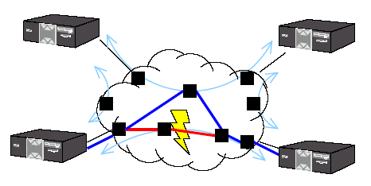
The Internet Ideal
Dynamic routing routes around failures
End-user is none the wiser

Slide 4
Lesson from Routing Overlays
End-hosts are often better informed about performance, reachability problems than routers.
End-hosts can measure path performance metrics on the (small number of) paths that matter
Internet routing scales well, but at the cost of performance

Slide 5
Reality
Routing pathologies: Paxson’s paper from a few lectures ago: 3.3% of routes had “serious problems
Slow convergence: BGP can take a long time to converge
  Up to 30 minutes!
  10% of routes available < 95% of the time [Labovitz]
“Invisible” failures: about 50% of prolonged outages not visible in BGP [Feamster]

Slide 6
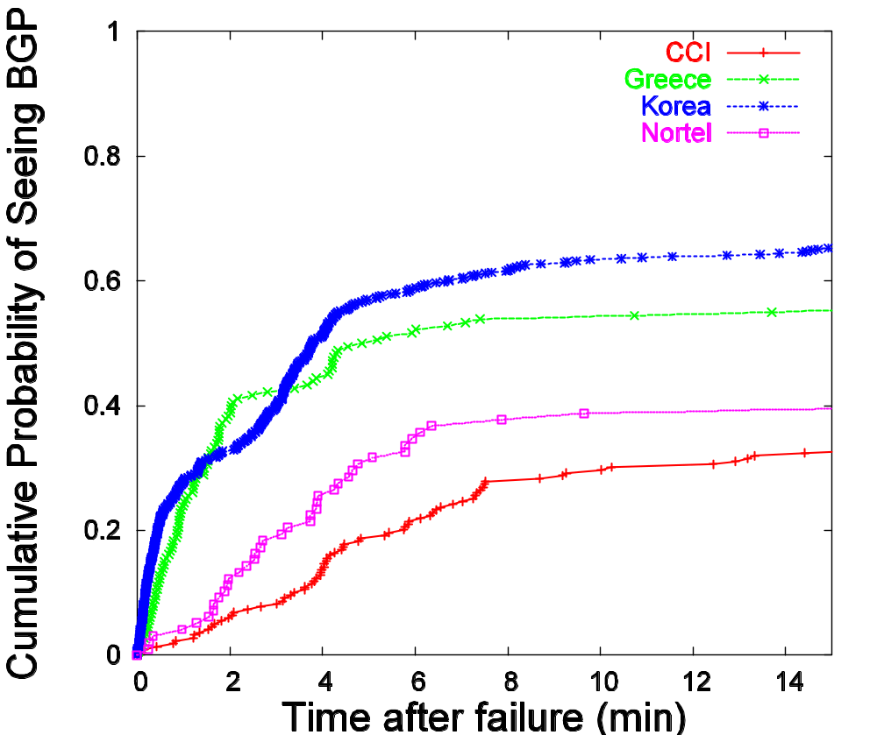
Slow Convergence in BGP
Given a failure, can take up to 15 minutes to see BGP.
Sometimes, not at all.

Slide 7
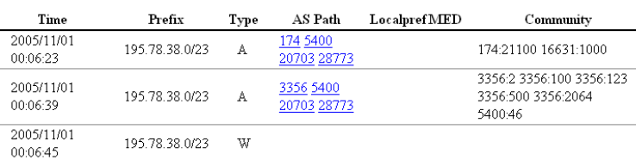
Routing Convergence in Practice
Route withdrawn, but stub cycles through backup path…

Slide 8
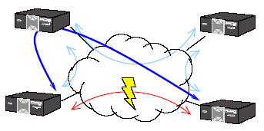
Resilient Overlay Networks: Goal
Increase reliability of communication for a small (i.e., < 50 nodes) set of connected hosts
Main idea: End hosts discover network-level path failure and cooperate to re-route.

Slide 9
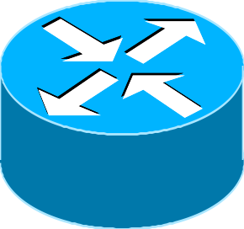
BGP Convergence Example
R
AS2
AS3
AS0
AS1
*B R via AS3
B R via AS1,AS3
B R via AS2,AS3
*B R via AS3
B R via AS0,AS3
B R via AS2,AS3
*B R via AS3
B R via AS0,AS3
B R via AS1,AS3
*
*
*
*B R via 013
*B R via 203
AS0
AS1
AS2

Slide 10
Intuition for Delayed BGP Convergence
  There exists a message ordering for which BGP will explore all possible AS paths
    Convergence is O(N!), where N number of default-free BGP speakers in a complete graph
    In practice, exploration can take 15-30 minutes
    Question: What typically prevents this exploration from happening in practice?
  Question: Why can’t BGP simply eliminate all paths containing a subpath when the subpath is withdrawn?

Slide 11
The RON Architecture
Outage detection
  Active UDP-based probing
    Uniform random in [0,14]
    O(n²)
  3-way probe
    Both sides get RTT information
    Store latency and loss-rate information in DB
Routing protocol: Link-state between overlay nodes
Policy: restrict some paths from hosts
  E.g., don’t use Internet2 hosts to improve non-Internet2 paths

Slide 12
Main results
RON can route around failures in ~ 10 seconds
Often improves latency, loss, and throughput
Single-hop indirection works well enough
  Motivation for second paper (SOSR)
  Also begs the question about the benefits of overlays

Slide 13
When (and why) does RON work?
Location: Where do failures appear?
  A few paths experience many failures, but many paths experience at least a few failures (80% of failures on 20% of links).
Duration: How long do failures last?
  70% of failures last less than 5 minutes
Correlation: Do failures correlate with BGP instability?
  BGP updates often coincide with failures
  Failures near end hosts less likely to coincide with BGP
  Sometimes, BGP updates precede failures (why?)
Feamster et al., Measuring the Effects of Internet Path Faults on Reactive Routing, SIGMETRICS 2003

Slide 14
Location of Failures
Why it matters: failures closer to the edge are more difficult to route around, particularly last-hop failures
  RON testbed study (2003): About 60% of failures within two hops of the edge
  SOSR study (2004): About half of failures potentially recoverable with one-hop source routing
    Harder to route around broadband failures (why?)

Slide 15
Benefits of Overlays
Access to multiple paths
  Provided by BGP multihoming
Fast outage detection
  But…requires aggressive probing; doesn’t scale
Question: What benefits does overlay routing provide over traditional multihoming + intelligent routing (e.g., RouteScience)?

Slide 16
Open Questions
Efficiency
  Requires redundant traffic on access links
Scaling
  Can a RON be made to scale to > 50 nodes?
  How to achieve probing efficiency?
Interaction of overlays and IP network
Interaction of multiple overlays

Slide 17

Efficiency
Problem: traffic must traverse bottleneck link both inbound and outbound
Upstream ISP
Solution: in-network support for overlays
  End-hosts establish reflection points in routers
    Reduces strain on bottleneck links
    Reduces packet duplication in application-layer multicast (next lecture)

Slide 18
Scaling
Problem: O(n²) probing required to detect path failures. Does not scale to large numbers of hosts.
Solution: ?
  Probe some subset of paths (which ones)
  Is this any different than a routing protocol, one layer higher?
BGP
???
Scalability
Routing overlays (e.g., RON)
Performance (convergence speed, etc.)

Slide 19
Interaction of Overlays and IP Network
Supposed outcry from ISPs: “Overlays will interfere with our traffic engineering goals.”
  Likely would only become a problem if overlays became a significant fraction of all traffic
  Control theory: feedback loop between ISPs and overlays
  Philosophy/religion: Who should have the final say in how traffic flows through the network?
End-hosts
observe conditions, react
Traffic matrix
ISP measures traffic matrix,
changes routing config.
Changes in end-to-end paths

Slide 20
Interaction of multiple overlays
End-hosts observe qualities of end-to-end paths
Might multiple overlays see a common “good path”
Could these multiple overlays interact to create increase congestion, oscillations, etc.?
“Selfish routing” problem.

Slide 21
The “Price of Anarchy”
cost of worst Nash equilibrium
“socially optimum” cost
A directed graph G = (V,E)
source–sink pairs si,ti for i=1,..,k
rate ri ≥ 0 of traffic between si and ti for each i=1,..,k
For each edge e, a latency function le(•)

Slide 22
Flows and Their Cost
Traffic and Flows:
A flow vector f specifies a traffic pattern
  f_{P} = amount routed on s_{i}-t_{i} path P
.5
P
x
1
s
0
t
l_{P}(f) = .5 + 0 + 1
1
x
.5
The Cost of a Flow:
ℓ_{P}(f) = sum of latencies of edges along P (w.r.t. flow f)
C(f) = cost or total latency of a flow f: Σ_{P} f_{P} • ℓ_{P}(f)

Slide 23
Example
Flow = .5
x
s
t
Cost of flow = .5•.5 +.5•1 =.75
1
Flow = .5
Traffic on lower edge is “envious”.
An envy free flow:
x
Cost of flow = 1•1 +0•1 =1
s
Flow = 1
t
1
Flow = 0

Slide 24
Flows and Game Theory
Flow: routes of many noncooperative agents
  each agent controlling infinitesimally small amount
    cars in a highway system
    packets in a network
The toal latency of a flow represents social welfare
Agents are selfish, and want to minimize their own latency

Slide 25
Flows at Nash Equilibrium
A flow is at Nash equilibrium (or is a Nash flow) if no agent can improve its latency by changing its path
  Assumption: edge latency functions are continuous, and non-decreasing
Lemma: a flow f is at Nash equilibrium if and only if all flow travels along minimum-latency paths between its source and destination (w.r.t. f)
Theorem: The Nash equilibrium exists and is unique

Slide 26
Braess’s Paradox
Traffic rate: r = 1
x
1
.5
.5
s
t
1
.5
.5
x
Cost of Nash flow = 1.5
x
1
1
0
s
0
1
t
1
0
1
x
Cost of Nash flow = 2
All the flows have increased delay

Slide 27
Existing Results and Open Questions
Theoretical results on bounds of the price of anarchy: 4/3
Open question: study of the dynamics of this routing game
  Will the protocol/overlays actually converge to an equilibrium, or will the oscillate?
Current directions: exploring the use of taxation to reduce the cost of selfish routing.

Slide 28
Overlays on IP Networks

Slide 29
MPLS Overview
Main idea: Virtual circuit
  Packets forwarded based only on circuit identifier
Source 1
Destination
Source 2
Router can forward traffic to the same destination on different interfaces/paths.

Slide 30
Circuit Abstraction: Label Swapping
D
A
1
2
Tag Out New
3
A
2
D
Label-switched paths (LSPs): Paths are “named” by the label at the path’s entry point
At each hop, label determines:
  Outgoing interface
  New label to attach
Label distribution protocol: responsible for disseminating signalling information

Slide 31
Layer 3 Virtual Private Networks
Private communications over a public network
A set of sites that are allowed to communicate with each other
Defined by a set of administrative policies
  determine both connectivity and QoS among sites
  established by VPN customers
  One way to implement: BGP/MPLS VPN mechanisms (RFC 2547)

Slide 32
Building Private Networks
Separate physical network
  Good security properties
  Expensive!
Secure VPNs
  Encryption of entire network stack between endpoints
Layer 2 Tunneling Protocol (L2TP)
  “PPP over IP”
  No encryption
Layer 3 VPNs
Privacy and interconnectivity (not confidentiality, integrity, etc.)

Slide 33
Layer 2 vs. Layer 3 VPNs
Layer 2 VPNs can carry traffic for many different protocols, whereas Layer 3 is “IP only”
More complicated to provision a Layer 2 VPN
Layer 3 VPNs: potentially more flexibility, fewer configuration headaches

Slide 34





Layer 3 BGP/MPLS VPNs
VPN A/Site 2
10.2/16
VPN B/Site 1
10.2/16
CE¹_{B1}
CE_{A2}
10.1/16
CE_{B2}
VPN B/Site 2
P₁
PE₂
CE²_{B1}
P₂
BGP to exchange routes
MPLS to forward traffic
PE₁
PE₃
CE_{A1}
P₃
CE_{A3}
10.3/16
CE_{B3}
10.1/16
VPN A/Site 3
VPN A/Site 1
10.4/16
VPN B/Site 3
Isolation: Multiple logical networks over a single, shared physical infrastructure
Tunneling: Keeping routes out of the core

Slide 35
High-Level Overview of Operation
IP packets arrive at PE
Destination IP address is looked up in forwarding table
Datagram sent to customer’s network using tunneling (i.e., an MPLS label-switched path)

Slide 36
BGP/MPLS VPN key components
Forwarding in the core: MPLS
Distributing routes between PEs: BGP
Isolation: Keeping different VPNs from routing traffic over one another
  Constrained distribution of routing information
  Multiple “virtual” forwarding tables
Unique addresses: VPN-IP4 Address extension

Slide 37
Virtual Routing and Forwarding
Separate tables per customer at each router
Customer 1
10.0.1.0/24
10.0.1.0/24
RD: Green
Customer 1
Customer 2
10.0.1.0/24
Customer 2
10.0.1.0/24
RD: Blue

Slide 38
Routing: Constraining Distribution
Performed by Service Provider using route filtering based on BGP Extended Community attribute
  BGP Community is attached by ingress PE route filtering based on BGP Community is performed by egress PE
BGP
Site 2
Static route, RIP, etc.
RD:10.0.1.0/24
Route target: Green
Next-hop: A
Site 1
A
10.0.1.0/24
Site 3

Slide 39
BGP/MPLS VPN Routing in Cisco IOS
Customer A
Customer B
ip vrf Customer_A
rd 100:110
route-target export 100:1000
route-target import 100:1000
!
ip vrf Customer_B
rd 100:120
route-target export 100:2000
route-target import 100:2000

Slide 40
Forwarding
PE and P routers have BGP next-hop reachability through the backbone IGP
Labels are distributed through LDP (hop-by-hop) corresponding to BGP Next-Hops
Two-Label Stack is used for packet forwarding
  Top label indicates Next-Hop (interior label)
  Second level label indicates outgoing interface or VRF (exterior label)
Corresponds to LSP of
BGP next-hop (PE)
Corresponds to VRF/interface at exit
Layer 2 Header
Label
1
Label
2
IP Datagram

Slide 41
Forwarding in BGP/MPLS VPNs
Step 1: Packet arrives at incoming interface
  Site VRF determines BGP next-hop and Label #2
Label
2
IP Datagram
Step 2: BGP next-hop lookup, add corresponding LSP (also at site VRF)
Label
1
Label
2
IP Datagram

