Slide 1
Denial-of-Service and Resource Exhaustion
Nick Feamster
CS 7260
April 2, 2007

Slide 2
Today’s Lecture
What is Denial of Service?
Attacks and Defenses
  Packet-flooding attacks
    Attack: SYN Floods
    Defenses: Ingress Filtering, SYN Cookies, Client puzzles
  Low-rate attacks
    Detection: Single-packet IP Traceback
Network-level defenses: sinkholes and blackholes
Inferring Denial of Service Activity
Distributed Denial of Service
Worms
Other resource exhaustion: spam

Slide 3
Denial of Service: What is it?
Attacker
Victim
Attempt to exhaust resources
  Network: Bandwidth
  Transport: TCP connections
  Application: Server resources
Typically high-rate attacks, but not always

Slide 4
Pre-2000 Denial of Service
  DoS Tools
    Single-source, single target tools
    IP source address spoofing
    Packet amplification (e.g., smurf)
  Deployment
    Widespread scanning and exploitation via scripted tools
    Hand-installed tools and toolkits on compromised hosts (unix)
  Use
    Hand executed on source host

Slide 5
TCP: 3-Way Handshake
C
S
SYN_{C}
Listening
Store data
SYN_{S}, ACK_{C}
Wait
ACK_{S}
Connected

Slide 6
TCP handshake
Each arriving SYN stores state at the server
  TCP Control Block (TCB)
  ~ 280 bytes
    FlowID, timer info, Sequence number, flow control status, out-of-band data, MSS, other options agreed to
  Half-open TCB entries exist until timeout
  Fixed bound on half-open connections
Resources exhausted ⇒ requests rejected

Slide 7
TCP SYN flooding
Problem: No client authentication of packets before resources allocated
Attacker sends many connection requests
  Spoofed source addresses
  RSTs quickly generated if source address exists
  No reply for non-existent sources
    Attacker exhausts TCP buffer to w/ half-open connections

Slide 8
SYN Flooding
C
S
SYN_{C1}
Listening
SYN_{C2}
Store data
SYN_{C3}
SYN_{C4}
SYN_{C5}

Slide 9
Idea #1: Ingress Filtering
Drop all packets with source address other than 204.69.207.0/24
Internet
204.69.207.0/24
RFC 2827: Routers install filters to drop packets from networks that are not downstream
Feasible at edges
Difficult to configure closer to network “core”

Slide 10
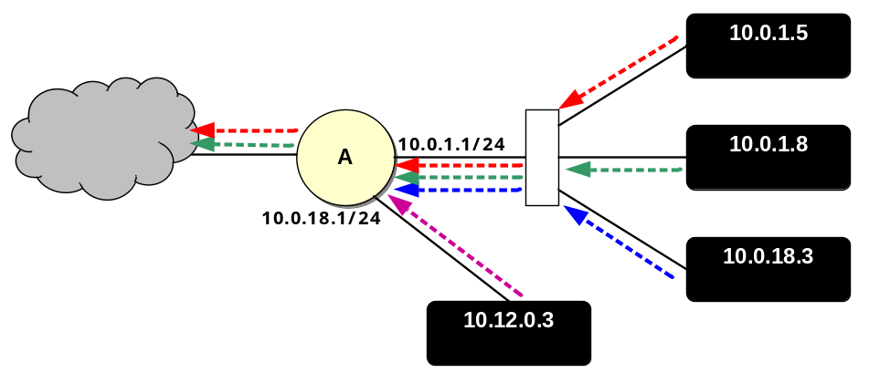
Idea #2: uRPF Checks
Accept packet from interface only if forwarding table entry for source IP address matches ingress interface
Strict Mode
uRPF Enabled
10.0.18.3 from wrong interface
“A” Routing Table
Destination Next Hop
10.0.1.0/24 Int. 1
10.0.18.0/24 Int. 2
Unicast Reverse Path Forwarding
  Cisco: “ip verify unicast reverse-path”
Requires symmetric routing

Slide 11
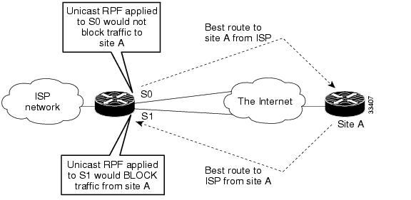
Problems with uRPF
Asymmetric routing

Slide 12
Idea #3: TCP SYN cookies
General idea
  Client sends SYN w/ ACK number
  Server responds to Client with SYN-ACK cookie
    sqn = f(src addr, src port, dest addr, dest port, rand)
    Server does not save state
  Honest client responds with ACK(sqn)
  Server checks response
  If matches SYN-ACK, establishes connection

Slide 13
TCP SYN cookie
TCP SYN/ACK seqno encodes a cookie
  32-bit sequence number
    t mod 32: counter to ensure sequence numbers increase every 64 seconds
    MSS: encoding of server MSS (can only have 8 settings)
    Cookie: easy to create and validate, hard to forge
      Includes timestamp, nonce, 4-tuple
32
0
t mod 32
MSS
Cookie=HMAC(t, N_{s}, SIP, SPort, DIP, DPort)
5 bits
3 bits

Slide 14
SYN Cookies
client
  sends SYN packet and ACK number to server
  waits for SYN-ACK from server w/ matching ACK number
server
  responds w/ SYN-ACK packet w/ initial SYN-cookie sequence number
  Sequence number is cryptographically generated value based on client address, port, and time.
client
  sends ACK to server w/ matching sequence number
server
  If ACK is to an unopened socket, server validates returned sequence number as SYN-cookie
  If value is reasonable, a buffer is allocated and socket is opened
SYN
ack-number
SYN-ACK
seq-number as SYN-cookie,
ack-number
NO BUFFER ALLOCATED
ACK
seq_number
ack-number+data
SYN-ACK
seq-number, ack-number
TCP BUFFER ALLOCATED

Slide 15
IP Traceback
R
R
A
R
R
R
R₇
R
R₄
R₅
R₆
R
R₃
R₁
R₂
V
Notes:
Find an attack graph
Routers record packet forwarding events.
Victim walks the network in reverse order querying routers

Slide 16
Logging Challenges
Attack path reconstruction is difficult
  Packet may be transformed as it moves through the network
Full packet storage is problematic
  Memory requirements are prohibitive at high line speeds (OC-192 is ~10Mpkt/sec)
Extensive packet logs are a privacy risk
  Traffic repositories may aid eavesdroppers

Slide 17
Single-Packet Traceback: Goals
Trace a single IP packet back to source
  Asymmetric attacks (e.g., Fraggle, Teardrop,
  ping-of-death)
Minimal cost (resource usage)
One solution: Source Path Isolation Engine (SPIE)
Notes:
Fraggle sends UDP packet to known broadcast addresses
Teardrop exploits TCP/IP fragmentation bugs
Ping of death sends ICMP echo request to broadcast address

Slide 18
Packet Digests
Compute hash(p)
  Invariant fields of p only
  28 bytes hash input, 0.00092% WAN collision rate
  Fixed sized hash output, n-bits
Compute k independent digests
  Increased robustness
  Reduced collisions, reduced false positive rate
Notes:
Robustness -> lower false positivies

Slide 19
Hash input: Invariant Content
Ver
HLen
TOS
Total Length
Identification
D
F
M
F
Fragment Offset
TTL
Protocol
Checksum
28
bytes
Source Address
Destination Address
Options
First 8 bytes of Payload
Remainder of Payload

Slide 20
Hashing Properties
Each hash function
  Uniform distribution of input -> output
  H1(x) = H1(y) for some x,y -> unlikely
Use k independent hash functions
  Collisions among k functions independent
  H1(x) = H2(y) for some x,y -> unlikely
Cycle k functions every time interval, t
Notes:
Collisions independent -> false positives will be independent across routers
Cycle every time period -> false positives independent across time intervals

Slide 21
Digest Storage: Bloom Filters
Fixed structure size
  Uses 2^{n} bit array
  Initialized to zeros
Insertion
  Use n-bit digest as indices into bit array
  Set to ‘1’
Membership
  Compute k digests, d₁, d₂, etc…
  If (filter[d_{i}]=1) for all i, router forwarded packet
n bits
1
H₁(P)
1
H(P)
H₂(P)
2^{n}
bits
H₃(P)
1
. . .
1
H_{k}(P)

Slide 22
Other In-Network Defenses
Automatic injection of blackhole routes
Rerouting through traffic “scrubbers”

Slide 23
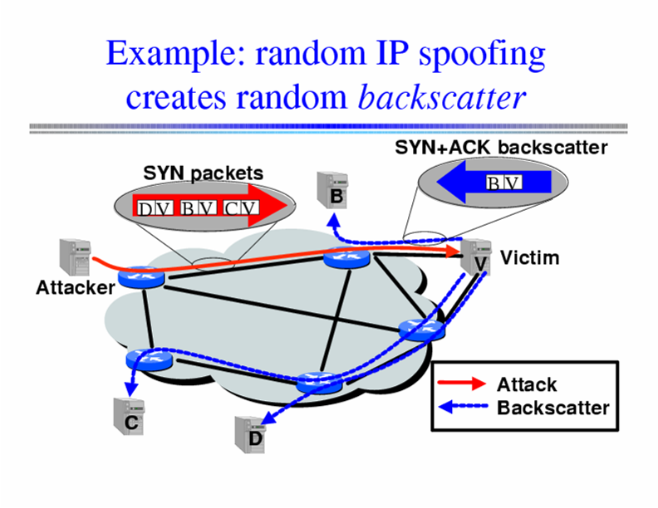
Inferring DoS Activity
IP address spoofing creates random backscatter.

Slide 24
Backscatter Analysis
Monitor block of n IP addresses
Expected # of backscatter packets given an attack of m packets:
  E(X) = nm / 2³²
  Hence, m = x * (2³² / n)
Attack Rate R >= m/T = x/T * (2³² / n)

Slide 25
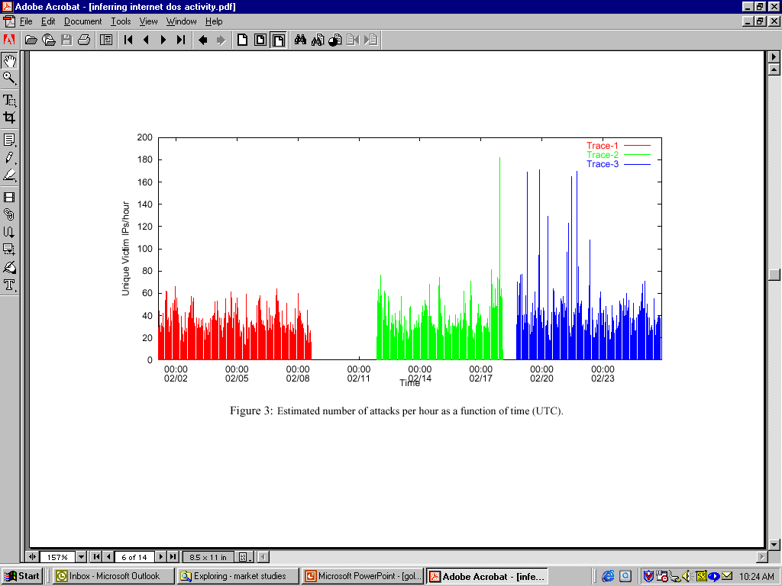
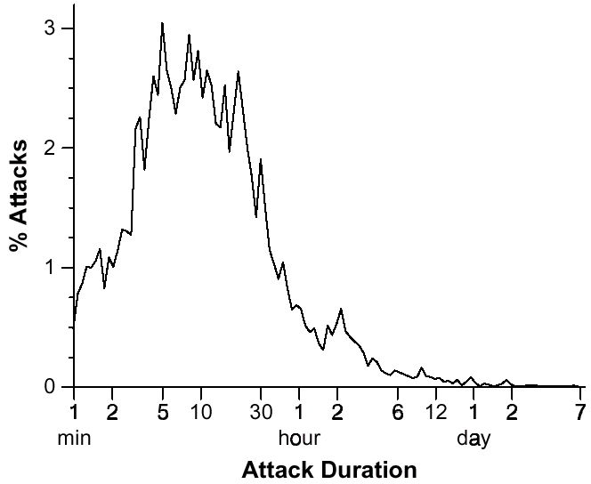
Inferred DoS Activity
Over 4000 DoS/DDoS attacks per week
Short duration: 80% last less than 30 minutes
Moore et al. Inferring Internet Denial of Service Activity

Slide 26
DDoS: Setting up the Infrastructure
Zombies
  Slow-spreading installations can be difficult to detect
  Can be spread quickly with worms
Indirection makes attacker harder to locate
  No need to spoof IP addresses

Slide 27
What is a Worm?
Code that replicates and propagates across the network
  Often carries a “payload”
Usually spread via exploiting flaws in open services
  “Viruses” require user action to spread
First worm: Robert Morris, November 1988
  6-10% of all Internet hosts infected (!)
Many more since, but none on that scale until July 2001

Slide 28
Example Worm: Code Red
Initial version: July 13, 2001
Exploited known ISAPI vulnerability in Microsoft IIS Web servers
1st through 20th of each month: spread
20th through end of each month: attack
Payload: Web site defacement
Scanning: Random IP addresses
Bug: failure to seed random number generator

Slide 29
Code Red: Revisions
Released July 19, 2001
Payload: flooding attack on www.whitehouse.gov
  Attack was mounted at the IP address of the Web site
Bug: died after 20th of each month
Random number generator for IP scanning fixed

Slide 30
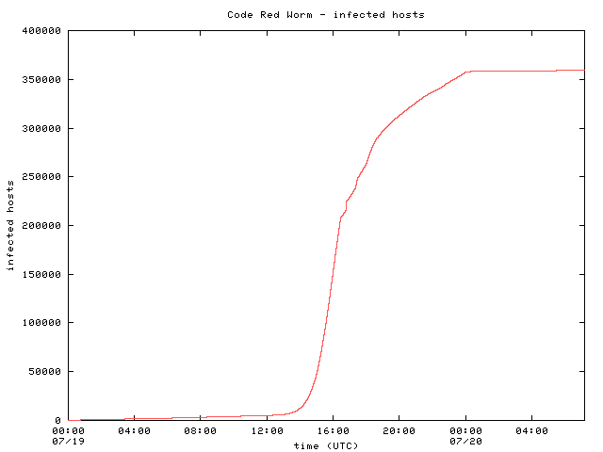
Code Red: Host Infection Rate
Measured using backscatter technique
Exponential infection rate

Slide 31

Modeling the Spread of Code Red
Random Constant Spread model
  K: initial compromise rate
  N: number of vulnerable hosts
  a: fraction of vulnerable machines already compromised
Newly infected machines in dt
Machines already infected
Rate at which uninfected machines are compromised

Slide 32
Bristling Pace of Innovation
Various improvements to increase the infection rate
Code Red 2: August 2001
  Localized scanning
  Same exploit, different codebase
  Payload: root backdoor
Nimda: September 2001
  Spread via multiple exploits (IIS vulnerability, email, CR2 root backdoor, copying itself over network shares, etc.)
  Firewalls were not sufficient protection

Slide 33
Designing Fast-Spreading Worms
Hit-list scanning
  Time to infect first 10k hosts dominates infection time
  Solution: Reconnaissance (stealthy scans, etc.)
Permutation scanning
  Observation: Most scanning is redundant
  Idea: Shared permutation of address space. Start scanning from own IP address. Re-randomize when another infected machine is found.
Internet-scale hit lists
  Flash worm: complete infection within 30 seconds

Slide 34
Recent Advances: Slammer
February 2003
Exploited vulnerability in MS SQL server
Exploit fit into a single UDP packet
  Send and forget!
Lots of damage
  BofA, Wash. Mutual ATMs unavailable
  Continental Airlines ticketing offline
  Seattle E911 offline

Slide 35
Scary recent advances: Witty
March 19, 2004
Single UDP packet exploits flaw in the passive analysis of Internet Security Systems products.
“Bandwidth-limited” UDP worm ala’ Slammer.
Initial spread seeded via a hit-list.
All 12,000 vulnerable hosts infected within 45 mins
Payload: slowly corrupt random disk blocks

Slide 36
Why does DDoS work?
Simplicity
“On by default” design
Readily available zombie machines
Attacks look like normal traffic
Internet’s federated operation obstructs cooperation for diagnosis/mitigation

Slide 37
Resource Exhaustion: Spam
Unsolicited commercial email
As of about February 2005, estimates indicate that about 90% of all email is spam
Common spam filtering techniques
  Content-based filters
  DNS Blacklist (DNSBL) lookups: Significant fraction of today’s DNS traffic!
Can IP addresses from which spam is received be spoofed?

Slide 38
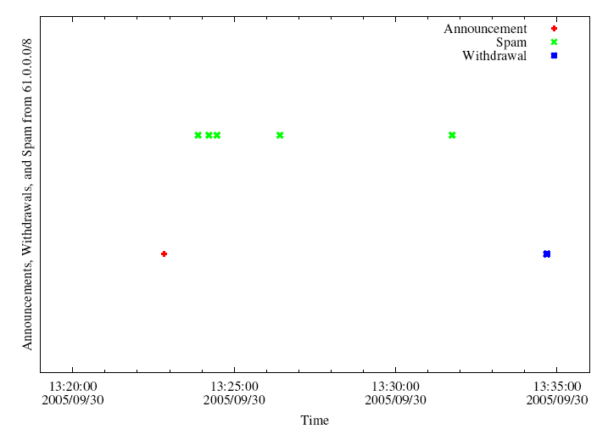
BGP Spectrum Agility
Log IP addresses of SMTP relays
Join with BGP route advertisements seen at network where spam trap is co-located.
A small club of persistent players appears to be using this technique.
Common short-lived prefixes and ASes
~ 10 minutes
61.0.0.0/8 4678
66.0.0.0/8 21562
82.0.0.0/8 8717
Somewhere between 1-10% of all spam (some clearly intentional, others might be flapping)

Slide 39
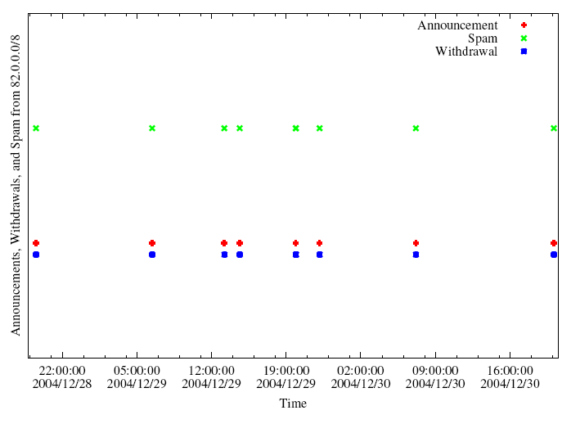
A Slightly Different Pattern

Slide 40
Why Such Big Prefixes?
Flexibility: Client IPs can be scattered throughout dark space within a large /8
  Same sender usually returns with different IP addresses
Visibility: Route typically won’t be filtered (nice and short)

Slide 41
Characteristics of IP-Agile Senders
IP addresses are widely distributed across the /8 space
IP addresses typically appear only once at our sinkhole
Depending on which /8, 60-80% of these IP addresses were not reachable by traceroute when we spot-checked
Some IP addresses were in allocated, albeing unannounced space
Some AS paths associated with the routes contained reserved AS numbers

Slide 42
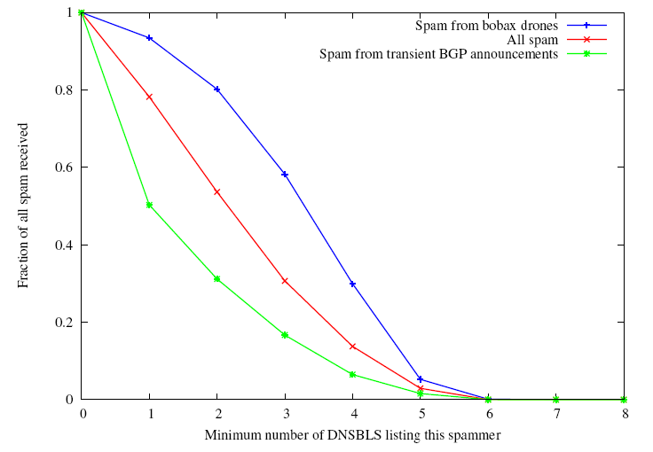
Some evidence that it’s working
Spam from IP-agile senders tend to be listed in fewer blacklists
Vs. ~80% on average
Only about half of the IPs spamming from short-lived BGP are listed in any blacklist

