Slide 1
Defenses, Application-Level Attacks, etc.
Nick Feamster
CS 7260
April 4, 2007

Slide 2
IP Traceback
R
R
A
R
R
R
R₇
R
R₄
R₅
R₆
R
R₃
R₁
R₂
V
Notes:
Find an attack graph
Routers record packet forwarding events.
Victim walks the network in reverse order querying routers

Slide 3
Logging Challenges
Attack path reconstruction is difficult
  Packet may be transformed as it moves through the network
Full packet storage is problematic
  Memory requirements are prohibitive at high line speeds (OC-192 is ~10Mpkt/sec)
Extensive packet logs are a privacy risk
  Traffic repositories may aid eavesdroppers

Slide 4
Single-Packet Traceback: Goals
Trace a single IP packet back to source
  Asymmetric attacks (e.g., Fraggle, Teardrop,
  ping-of-death)
Minimal cost (resource usage)
One solution: Source Path Isolation Engine (SPIE)
Notes:
Fraggle sends UDP packet to known broadcast addresses
Teardrop exploits TCP/IP fragmentation bugs
Ping of death sends ICMP echo request to broadcast address

Slide 5
Packet Digests
Compute hash(p)
  Invariant fields of p only
  28 bytes hash input, 0.00092% WAN collision rate
  Fixed sized hash output, n-bits
Compute k independent digests
  Increased robustness
  Reduced collisions, reduced false positive rate
Notes:
Robustness -> lower false positivies

Slide 6
Hash input: Invariant Content
Ver
HLen
TOS
Total Length
Identification
D
F
M
F
Fragment Offset
TTL
Protocol
Checksum
28
bytes
Source Address
Destination Address
Options
First 8 bytes of Payload
Remainder of Payload

Slide 7
Hashing Properties
Each hash function
  Uniform distribution of input -> output
  H1(x) = H1(y) for some x,y -> unlikely
Use k independent hash functions
  Collisions among k functions independent
  H1(x) = H2(y) for some x,y -> unlikely
Cycle k functions every time interval, t
Notes:
Collisions independent -> false positives will be independent across routers
Cycle every time period -> false positives independent across time intervals

Slide 8
Digest Storage: Bloom Filters
Fixed structure size
  Uses 2^{n} bit array
  Initialized to zeros
Insertion
  Use n-bit digest as indices into bit array
  Set to ‘1’
Membership
  Compute k digests, d₁, d₂, etc…
  If (filter[d_{i}]=1) for all i, router forwarded packet
n bits
1
H₁(P)
1
H(P)
H₂(P)
2^{n}
bits
H₃(P)
1
. . .
1
H_{k}(P)

Slide 9
Other In-Network Defenses
Automatic injection of blackhole routes
Rerouting through traffic “scrubbers”

Slide 10
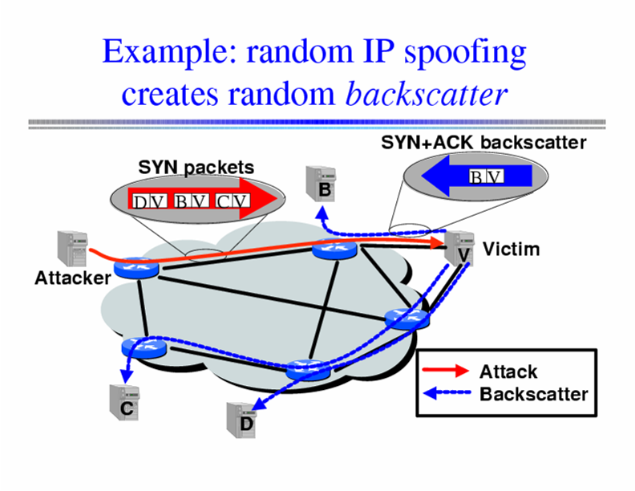
Inferring DoS Activity
IP address spoofing creates random backscatter.

Slide 11
Backscatter Analysis
Monitor block of n IP addresses
Expected # of backscatter packets given an attack of m packets:
  E(X) = nm / 2³²
  Hence, m = x * (2³² / n)
Attack Rate R >= m/T = x/T * (2³² / n)

Slide 12
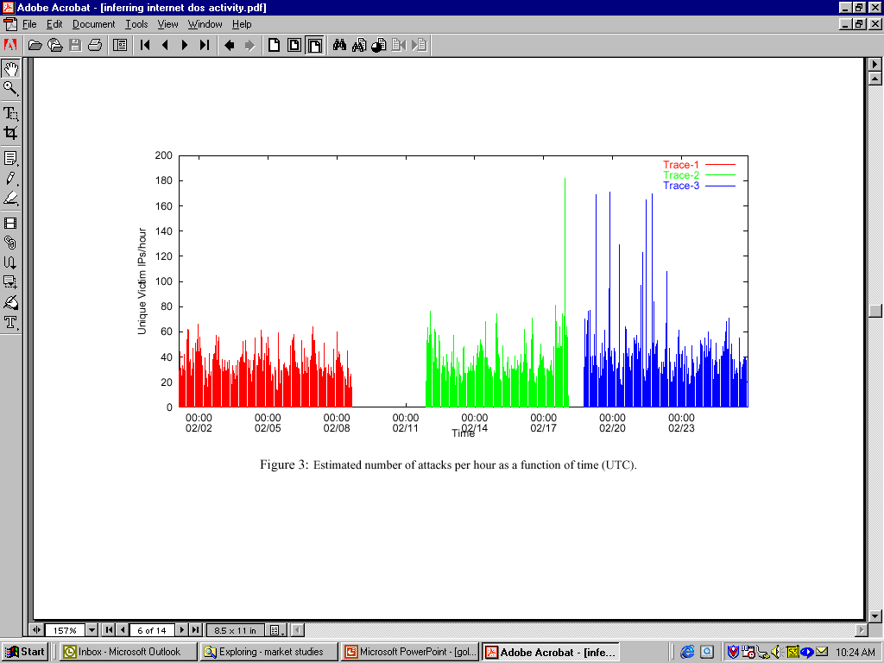
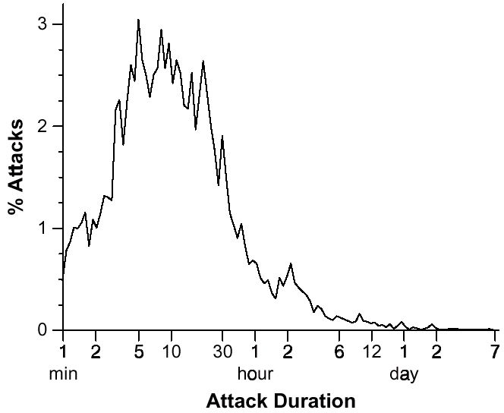
Inferred DoS Activity
Over 4000 DoS/DDoS attacks per week
Short duration: 80% last less than 30 minutes
Moore et al. Inferring Internet Denial of Service Activity

Slide 13
DDoS: Setting up the Infrastructure
Zombies
  Slow-spreading installations can be difficult to detect
  Can be spread quickly with worms
Indirection makes attacker harder to locate
  No need to spoof IP addresses

Slide 14
What is a Worm?
Code that replicates and propagates across the network
  Often carries a “payload”
Usually spread via exploiting flaws in open services
  “Viruses” require user action to spread
First worm: Robert Morris, November 1988
  6-10% of all Internet hosts infected (!)
Many more since, but none on that scale until July 2001

Slide 15
Example Worm: Code Red
Initial version: July 13, 2001
Exploited known ISAPI vulnerability in Microsoft IIS Web servers
1st through 20th of each month: spread
20th through end of each month: attack
Payload: Web site defacement
Scanning: Random IP addresses
Bug: failure to seed random number generator

Slide 16
Code Red: Revisions
Released July 19, 2001
Payload: flooding attack on www.whitehouse.gov
  Attack was mounted at the IP address of the Web site
Bug: died after 20th of each month
Random number generator for IP scanning fixed

Slide 17
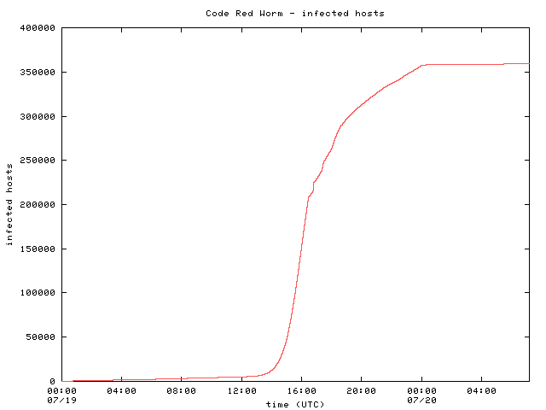
Code Red: Host Infection Rate
Measured using backscatter technique
Exponential infection rate

Slide 18

Modeling the Spread of Code Red
Random Constant Spread model
  K: initial compromise rate
  N: number of vulnerable hosts
  a: fraction of vulnerable machines already compromised
Newly infected machines in dt
Machines already infected
Rate at which uninfected machines are compromised

Slide 19
Bristling Pace of Innovation
Various improvements to increase the infection rate
Code Red 2: August 2001
  Localized scanning
  Same exploit, different codebase
  Payload: root backdoor
Nimda: September 2001
  Spread via multiple exploits (IIS vulnerability, email, CR2 root backdoor, copying itself over network shares, etc.)
  Firewalls were not sufficient protection

Slide 20
Designing Fast-Spreading Worms
Hit-list scanning
  Time to infect first 10k hosts dominates infection time
  Solution: Reconnaissance (stealthy scans, etc.)
Permutation scanning
  Observation: Most scanning is redundant
  Idea: Shared permutation of address space. Start scanning from own IP address. Re-randomize when another infected machine is found.
Internet-scale hit lists
  Flash worm: complete infection within 30 seconds

Slide 21
Recent Advances: Slammer
February 2003
Exploited vulnerability in MS SQL server
Exploit fit into a single UDP packet
  Send and forget!
Lots of damage
  BofA, Wash. Mutual ATMs unavailable
  Continental Airlines ticketing offline
  Seattle E911 offline

Slide 22
Scary recent advances: Witty
March 19, 2004
Single UDP packet exploits flaw in the passive analysis of Internet Security Systems products.
“Bandwidth-limited” UDP worm ala’ Slammer.
Initial spread seeded via a hit-list.
All 12,000 vulnerable hosts infected within 45 mins
Payload: slowly corrupt random disk blocks

Slide 23
Why does DDoS work?
Simplicity
“On by default” design
Readily available zombie machines
Attacks look like normal traffic
Internet’s federated operation obstructs cooperation for diagnosis/mitigation

Slide 24
Resource Exhaustion: Spam
Unsolicited commercial email
As of about February 2005, estimates indicate that about 90% of all email is spam
Common spam filtering techniques
  Content-based filters
  DNS Blacklist (DNSBL) lookups: Significant fraction of today’s DNS traffic!
Can IP addresses from which spam is received be spoofed?

Slide 25
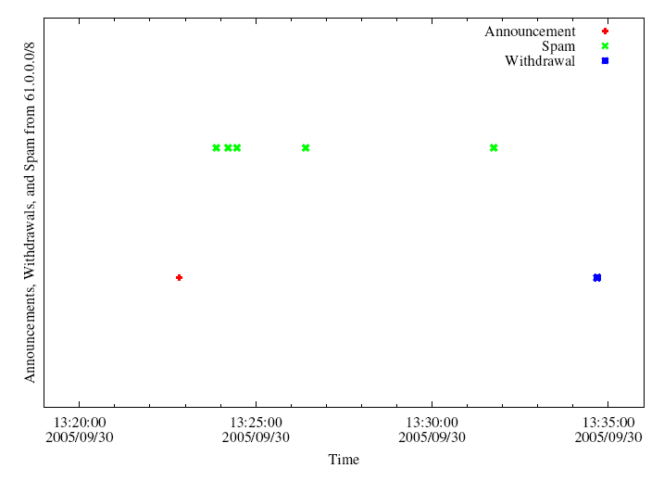
BGP Spectrum Agility
Log IP addresses of SMTP relays
Join with BGP route advertisements seen at network where spam trap is co-located.
A small club of persistent players appears to be using this technique.
Common short-lived prefixes and ASes
~ 10 minutes
61.0.0.0/8 4678
66.0.0.0/8 21562
82.0.0.0/8 8717
Somewhere between 1-10% of all spam (some clearly intentional, others might be flapping)

Slide 26
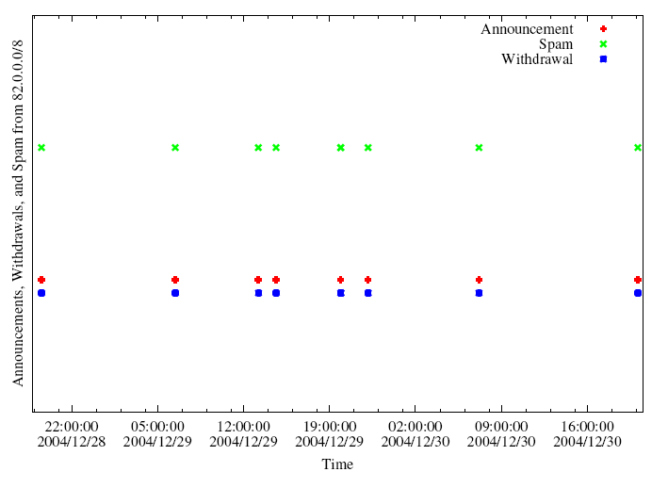
A Slightly Different Pattern

Slide 27
Why Such Big Prefixes?
Flexibility: Client IPs can be scattered throughout dark space within a large /8
  Same sender usually returns with different IP addresses
Visibility: Route typically won’t be filtered (nice and short)

Slide 28
Characteristics of IP-Agile Senders
IP addresses are widely distributed across the /8 space
IP addresses typically appear only once at our sinkhole
Depending on which /8, 60-80% of these IP addresses were not reachable by traceroute when we spot-checked
Some IP addresses were in allocated, albeing unannounced space
Some AS paths associated with the routes contained reserved AS numbers

Slide 29
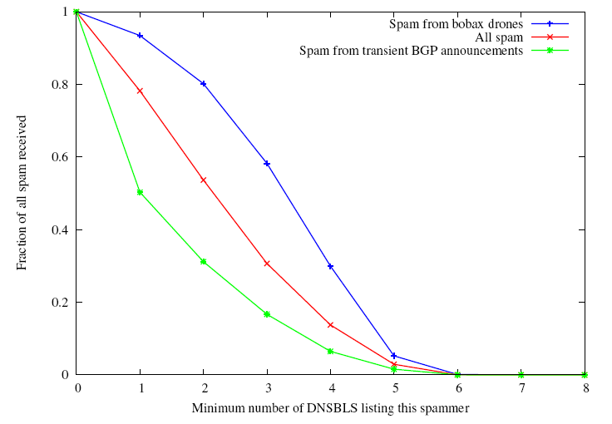
Some evidence that it’s working
Spam from IP-agile senders tend to be listed in fewer blacklists
Vs. ~80% on average
Only about half of the IPs spamming from short-lived BGP are listed in any blacklist

Slide 30
Botnets
Bots: Autonomous programs performing tasks
Plenty of “benign” bots
  e.g., weatherbug
Botnets: group of bots
  Typically carries malicious connotation
  Large numbers of infected machines
  Machines “enlisted” with infection vectors like worms (last lecture)
Available for simultaneous control by a master
Size: up to 350,000 nodes (from today’s paper)

Slide 31
“Rallying” the Botnet
Easy to combine worm, backdoor functionality
Problem: how to learn about successfully infected machines?
Options
  Email
  Hard-coded email address

Slide 32
Botnet Control
Dynamic
DNS
Infected Machine
Botnet
Controller
(IRC server)
Botnet master typically runs some IRC server on a well-known port (e.g., 6667)
Infected machine contacts botnet with pre-programmed DNS name (e.g., big-bot.de)
Dynamic DNS: allows controller to move about freely

Slide 33
Botnet History: How we got here
Early 1990s: IRC bots
  eggdrop: automated management of IRC channels
1999-2000: DDoS tools
  Trinoo, TFN2k, Stacheldraht
1998-2000: Trojans
  BackOrifice, BackOrifice2k, SubSeven
2001- : Worms
  Code Red, Blaster, Sasser
Fast spreading capabilities pose big threat
Put these pieces together and add a controller…

Slide 34
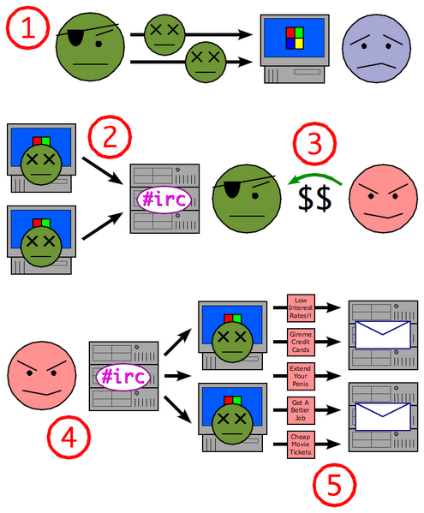
Putting it together
Miscreant (botherd) launches worm, virus, or other mechanism to infect Windows machine.
Infected machines contact botnet controller via IRC.
Spammer (sponsor) pays miscreant for use of botnet.
Spammer uses botnet to send spam emails.

Slide 35
Botnet Detection and Tracking
Network Intrusion Detection Systems (e.g., Snort)
  Signature: alert tcp any any -> any any (msg:"Agobot/Phatbot Infection Successful"; flow:established; content:"221
Honeynets: gather information
  Run unpatched version of Windows
  Usually infected within 10 minutes
  Capture binary
    determine scanning patterns, etc.
  Capture network traffic
    Locate identity of command and control, other bots, etc.

Slide 36
Detection: In-Protocol
Snooping on IRC Servers
Email (e.g., CipherTrust ZombieMeter)
  > 170k new zombies per day
  15% from China
Managed network sensing and anti-virus detection
  Sinkholes detect scans, infected machines, etc.
Drawback: Cannot detect botnet structure

Slide 37
Using DNS Traffic to Find Controllers
Different types of queries may reveal info
  Repetitive A queries may indicate bot/controller
  MX queries may indicate spam bot
  PTR queries may indicate a server
Usually 3 level: hostname.subdomain.TLD
Names and subdomains that just look rogue
  (e.g., irc.big-bot.de)

Slide 38
DNS Monitoring
Command-and-control hijack
  Advantages: accurate estimation of bot population
  Disadvantages: bot is rendered useless; can’t monitor activity from command and control
Complete TCP three-way handshakes
  Can distinguish distinct infections
  Can distinguish infected bots from port scans, etc.

Slide 39
Traffic Monitoring
Goal: Recover communication structure
  “Who’s talking to whom”
Tradeoff: Complete packet traces with partial view, or partial statistics with a more expansive view

Slide 40
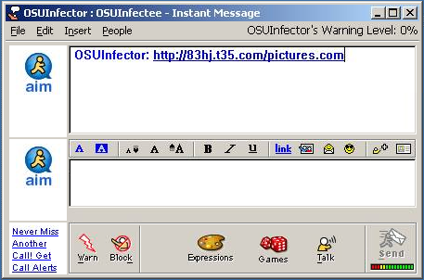
New Trend: Social Engineering
Bots frequently spread through AOL IM
  A bot-infected computer is told to spread through AOL IM
  It contacts all of the logged in buddies and sends them a link to a malicious web site
  People get a link from a friend, click on it, and say “sure, open it” when asked

Slide 41
Early Botnets: AgoBot (2003)
Drops a copy of itself as svchost.exe or syschk.exe
Propagates via Grokster, Kazaa, etc.
Also via Windows file shares

Slide 42
Botnet Operation
General
  Assign a new random nickname to the bot
  Cause the bot to display its status
  Cause the bot to display system information
  Cause the bot to quit IRC and terminate itself
  Change the nickname of the bot
  Completely remove the bot from the system
  Display the bot version or ID
  Display the information about the bot
  Make the bot execute a .EXE file
IRC Commands
  Cause the bot to display network information
  Disconnect the bot from IRC
  Make the bot change IRC modes
  Make the bot change the server Cvars
  Make the bot join an IRC channel
  Make the bot part an IRC channel
  Make the bot quit from IRC
  Make the bot reconnect to IRC
Redirection
  Redirect a TCP port to another host
  Redirect GRE traffic that results to proxy PPTP VPN connections
DDoS Attacks
  Redirect a TCP port to another host
  Redirect GRE traffic that results to proxy PPTP VPN connections
Information theft
  Steal CD keys of popular games
Program termination

Slide 43
PhatBot (2004)
Direct descendent of AgoBot
More features
  Harvesting of email addresses via Web and local machine
  Steal AOL logins/passwords
  Sniff network traffic for passwords
Control vector is peer-to-peer (not IRC)

Slide 44
Botnet Application: Phishing
“Phishing attacks use both social engineering and technical subterfuge to steal consumers' personal identity data and financial account credentials.” -- Anti-spam working group
Social-engineering schemes
  Spoofed emails direct users to counterfeit web sites
  Trick recipients into divulging financial, personal data
Anti-Phishing Working Group Report (Oct. 2005)
  15,820 phishing e-mail messages 4367 unique phishing sites identified.
  96 brand names were hijacked.
  Average time a site stayed on-line was 5.5 days.
Question: What does phishing have to do with botnets?

Slide 45
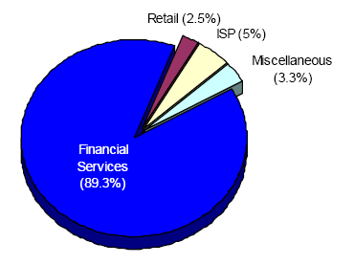
Which web sites are being phished?
Source: Anti-phishing working group report, Dec. 2005
Financial services by far the most targeted sites
New trend: Keystroke logging…

Slide 46
Botnet Application: Click Fraud
Pay-per-click advertising
  Publishers display links from advertisers
  Advertising networks act as middlemen
    Sometimes the same as publishers (e.g., Google)
Click fraud: botnets used to click on pay-per-click ads
Motivation
  Competition between advertisers
  Revenue generation by bogus content provider

Slide 47
Open Research Questions
Botnet membership detection
  Existing techniques
    Require special privileges
    Disable the botnet operation
  Under various datasets (packet traces, various numbers of vantage points, etc.)
Click fraud detection
Phishing detection

