Slide 1
Internet Addressing and Naming
CS 7260
Nick Feamster
January 10, 2007

Slide 2
Announcements
Course mailing list
  cs7260-course at mailman.cc.gatech.edu
  https://mailman.cc.gatech.edu/mailman/listinfo/cs7260-course
Wiki should be up soon (we hope)
TA: Keshav Attrey (attrey@cc.gatech.edu)

Slide 3
Today: Addressing and Naming
Internet Addressing
  Step 1: Connecting a single network
  Step 2: Connecting networks of networks
    IPv4 Addressing
      Structure
      Scaling problems and CIDR (1994)
      Allocation and ownership
      Longest prefix match and Traffic Engineering
      Issues and design questions
  More scaling problems and solutions
Internet Naming
  Today: DNS and the naming hierarchy
  Research: Flat names
Paper discussion: Jung et al.

Slide 4
Bootstrapping: Networks of Interfaces
LAN/Physical/MAC address
  Unique to physical interface (no two alike)
  Flat structure
datagram
link layer protocol
receiver
sender
frame
frame
adapter
adapter
Frames can be sent to a specific MAC address or to the broadcast MAC address
What are the advantages to separating network layer from MAC layer?

Slide 5
ARP: IP Addresses to MAC addresses
Query is IP address, response is MAC address
Query is sent to LAN’s broadcast MAC address
Each host or router has an ARP table
  Checks IP address of query against its IP address
  Replies with ARP address if there is a match
Potential problems with this approach?
Caching is key!
  Try arp –a to see an ARP table

Slide 6
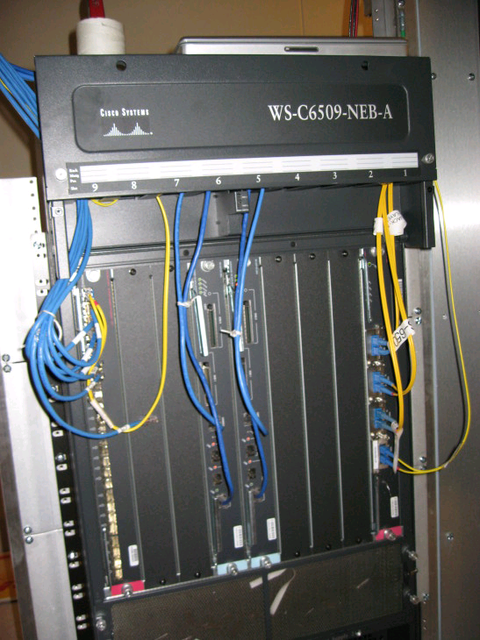
Interconnecting LANs: Bridging
Receive & broadcast (“hub”)
Learning
Spanning tree (RSTP, MSTP, etc.)

Slide 7
Learning Bridges
Bridge builds mapping of which port to forward packets for a certain MAC address
If has entry, forward on appropriate port
If no entry, flood packet
LAN B
A
B
C
Potential problems with this approach?
LAN C
LAN A

Slide 8
Virtual LANs (VLANs)
A single switched LAN can be partitioned into multiple “colors”
Each color behaves as a separate LAN
Better scaling properties
  Reduce the scope of broadcast storms
  Spanning tree algorithms scale better
Better security properties

Slide 9
IPv4 Addresses: Networks of Networks
Topological Addressing
32-bit number in “dotted-quad” notation
  www.cc.gatech.edu --- 130.207.7.36
130
207
7
36
10000010
11001111
00000111
00100100
Network (16 bits)
Host (16 bits)
Problem: 2³² addresses is a lot of table entries
Solution: Routing based on network and host
  130.207.0.0/16 is a 16-bit prefix with 2¹⁶ IP addresses

Slide 10
Pre-1994: Classful Addressing
8
16
24
32
Class A
Network ID
0
Host ID
    /8 blocks (e.g., MIT has 18.0.0.0/8)
Class B
10
    /16 blocks (e.g., Georgia Tech has 130.207.0.0/16)
Class C
110
    /24 blocks (e.g., AT&T Labs has 192.20.225.0/24)
Class D
Multicast Addresses
1110
Class E
Reserved for experiments
1111
Simple Forwarding: Address range specifies network ID length

Slide 11
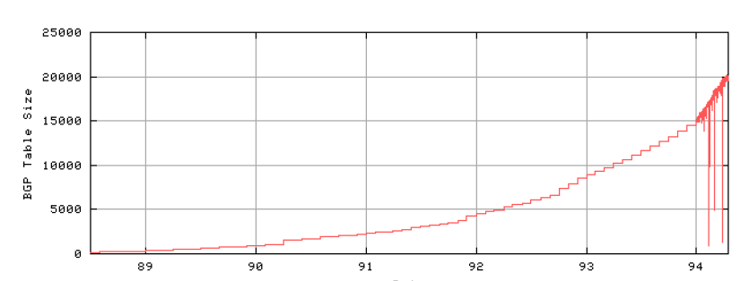
Problem: Routing Table Growth
Source: Geoff Huston
Growth rates exceeding advances in hardware and software capabilities
Primarily due to Class C space exhaustion
Exhaustion of routing table space was on the horizon

Slide 12
Routing Table Growth: Who Cares?
On pace to run out of allocations entirely
Memory
  Routing tables
  Forwarding tables
“Churn”: More prefixes, more updates

Slide 13
Possible Solutions
Get rid of global addresses
  NAT
Get more addresses
  IPv6
Different aggregation strategy
  Classless Interdomain routing

Slide 14
Classless Interdomain Routing (CIDR)
Use two 32-bit numbers to represent a network.
Network number = IP address + Mask
Example: BellSouth Prefix: 65.14.248.0/22
01000001
00001110
11111000
00000000
11111111
11111111
11111100
00000000
IP Address: 65.14.248.0 “Mask”: 255.255.252.0
Address no longer specifies network ID range.
New forwarding trick: Longest Prefix Match

Slide 15
Benefits of CIDR
Efficiency: Can allocate blocks of prefixes on a finer granularity
Hierarchy: Prefixes can be aggregated into supernets. (Not always done. Typically not, in fact.)
Customer 1
12.20.231.0/24
12.0.0.0/8
AT&T
Internet
Customer 2
12.20.249.0/24

Slide 16
Forwarding: Longest Prefix Match
Forwarding tables in IP routers
  Maps each IP prefix to next-hop link(s)
Destination-based forwarding
  Each packet has a destination address
  Router identifies longest-matching prefix
forwarding table
…
68.208.0.0/12
68.211.0.0/17
68.211.128.0/19
68.211.160.0/19
68.211.192.0/18
…
destination address
68.211.6.120
More on construction of forwarding tables in next lecture.

Slide 17
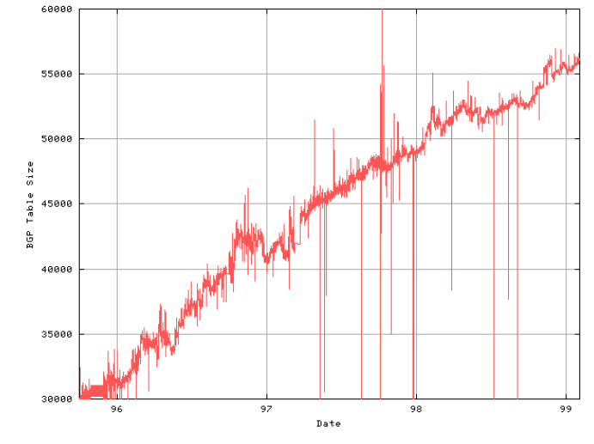
1994-1998: Linear Growth
Source: Geoff Huston
About 10,000 new entries per year
In theory, less instability at the edges (why?)

Slide 18
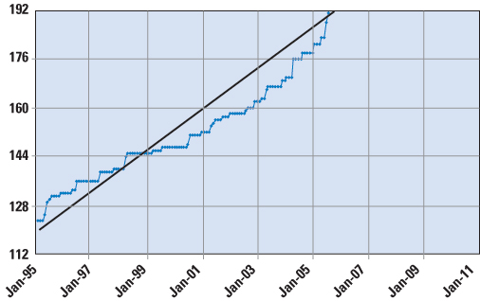
Around 2000: Fast Growth Resumes
T. Hain, “A Pragmatic Report on IPv4 Address Space Consumption”, Cisco IPJ, September 2005
Claim: remaining /8s will be exhausted within the next 5-10 years.

Slide 19
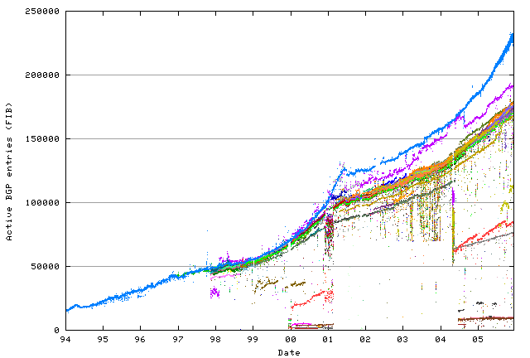
Fast growth resumes
Significant contributor: Multihoming
Dot-Bomb Hiccup
Rapid growth in routing tables
Source: Geoff Huston

Slide 20
Multihoming Can Stymie Aggregation
Verizon does not “own” 10.0.0.0/16. Must advertise the more-specific route.
12.20.249.0/24
AT&T
Verizon
12.20.249.0/24
12.20.249.0/24
Mid-Atlantic Corporate Federal Credit Union
(AS 30308)
“Stub AS” gets IP address space from one of its providers
One (or both) providers cannot aggregate the prefix

Slide 21
Hacky Hack: LPM to Control Traffic
B
10.1.0.0/16
10.1.0.0/16
10.1.0.0/17
10.1.0.0/17
Traffic for 10.1.0.0/17
A
D
10.1.0.0/16
10.1.0.0/16
10.1.128.0/17
10.1.128.0/17
C
Traffic for 10.1.0.0/17

Slide 22
The Address Allocation Process
IANA
http://www.iana.org/assignments/ipv4-address-space
AfriNIC
APNIC
ARIN
LACNIC
RIPE
Georgia Tech
Allocation policies of RIRs affect pressure on IPv4 address space

Slide 23
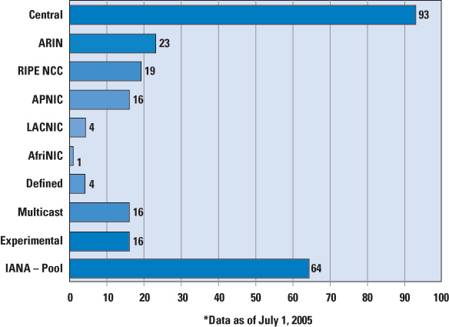
/8 Allocations from IANA
MIT, Ford, Halliburton, Boeing, Merck
Reclaiming space is difficult. A /8 is a bargaining chip!

Slide 24
Address Space Ownership
% whois -h whois.arin.net 130.207.7.36
[Querying whois.arin.net]
[whois.arin.net]
OrgName: Georgia Institute of Technology
OrgID: GIT
Address: 258 Fourth St NW
Address: Rich Building
City: Atlanta
StateProv: GA
PostalCode: 30332
Country: US
NetRange: 130.207.0.0 - 130.207.255.255
CIDR: 130.207.0.0/16
NetName: GIT
NetHandle: NET-130-207-0-0-1
Parent: NET-130-0-0-0-0
NetType: Direct Assignment
NameServer: TROLL-GW.GATECH.EDU
NameServer: GATECH.EDU
Comment:
RegDate: 1988-10-10
Updated: 2000-02-01
RTechHandle: ZG19-ARIN
RTechName: Georgia Institute of TechnologyNetwork Services
RTechPhone: +1-404-894-5508
RTechEmail: hostmaster@gatech.edu
OrgTechHandle: NETWO653-ARIN
OrgTechName: Network Operations
OrgTechPhone: +1-404-894-4669
- Regional Internet Registries (“RIRs”)
  - Public record of address allocations
  - ISPs should update when delegating address space
  - Often out-of-date

Slide 25
Do Prefixes Reflect Topology?
Date: Sat, 11 May 2002 17:34:39 -0400 (EDT)
Subject: BGP and aggregation
To: nanog@merit.edu
I have transit in 2 cities...I've been using non-contiguous IPs, so there's been no opportunity for aggregation. Having just received my /20 from ARIN, I'm trying to plan my network. Let’s say I split the /20 into 2 /21's, one for each city…
Missed opportunities for aggregation: non-contiguous prefixes
Multiple geographic locations within the same prefix

Slide 26
Two Problems
10.1.0.0/16
10.1.0.0/16
10.1.0.0/16
192.168.0.0/16
IP space Geography Problem
Close/Identical Far Too Coarse-grained
Far Close/Identical Too Fine-grained
Case #1 [coarse-grained]: single prefix, multiple locations
contiguous prefixes, multiple locations
Case #2 [fine-grained]: discontiguous prefixes, same location
Notes:
Thus, the correlation between distance in IP space and distance in geography can help us decide whether prefixes are too fine grained or coarse-grained. For example, if prefixes are far in IP space but close geographically, they tend to be too fine grained to serve as routing handles. So we ask the question ‘How often…’. On the other hand, if they are close in IP space and far geographically, they are too coarse-grained to express routing policy. So another question we investigate is ‘how often do..’. Thus, in this paper we try to quantify the correlation between locality in IP space and geographic locality in understand if IP prefixes are the right granularity for routing or not.

Slide 27
Method
GOAL: Associate an IP prefix with a set of locations
CoralCDN^{[1]}
Web clients
Content servers
DNS names
Location(PoP)
IPs
undns^{[2]}
IP Prefix
Uses naming conventions of routers – city names embedded in DNS names
IPs from
Routeviews
Routeviews^{[3]}
traceroute
[1] http://www.coralcdn.org
[2] http://www.scriptroute.org
[3] http://www.routeviews.org

Slide 28
Case #1: Coarse-Grained Prefixes
Location 1
Traffic for Location 1
10.1.0.0/16
10.1.0.0/17
10.1.0.0/16
A
10.1.0.0/16
B
C
10.1.128.0/17
10.1.0.0/16
Location 2
Traffic does not enter AS as intended.
Routing table entries map poorly to reachability.
Notes:
Now consider a case when a prefix might be too coarse-grained as a routing handle. Supppose an AS has contiguous prefixes in wide apart locations. Aggregating these prefixes might limit an ISP’s ability to engineer traffic across its network. Hence these prefixes are left de-aggregated in the routing tables. There is an opportunity to aggregate here that we are unable to make use of, since the granularity of a prefix is too coarse grained here.

Slide 29
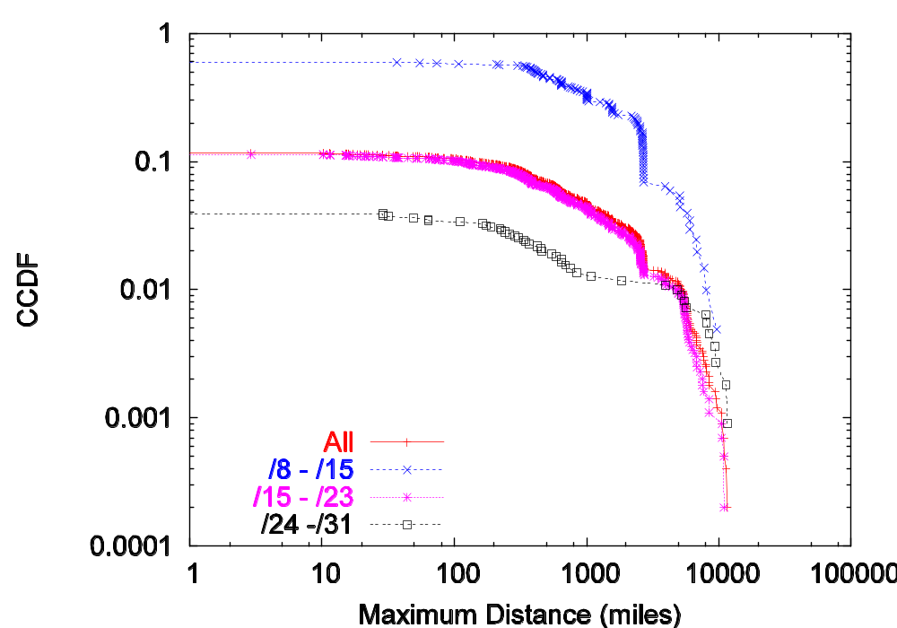
One Prefix May Span Large Distances
50% of prefixes in /8-/15 span >100 miles
CCDF
Maximum Distance (miles)
AS 4637: many /24s spanning more than 10,000 miles

Slide 30
Case #1: Coarse-Grained Prefixes
25% of contiguous prefix pairs had hosts from different locations
Location 1
Traffic for Location 1
10.1.0.0/17
10.1.0.0/16
A
B
C
10.1.128.0/17
10.1.0.0/16
Location 2
Traffic does not enter AS as intended.
Routing table entries map poorly to reachability.
Notes:
Now consider a case when a prefix might be too coarse-grained as a routing handle. Supppose an AS has contiguous prefixes in wide apart locations. Aggregating these prefixes might limit an ISP’s ability to engineer traffic across its network. Hence these prefixes are left de-aggregated in the routing tables. There is an opportunity to aggregate here that we are unable to make use of, since the granularity of a prefix is too coarse grained here.

Slide 31
Case #2: Fine-Grained Prefixes
10.1.0.0/16
10.3.0.0/16
10.5.0.0/16
10.1.0.0/16
10.3.0.0/16
10.5.0.0/16
A
B
Single geographic location
Inflation of routing table size.
Increased routing table churn.
Notes:
One example of when prefixes could be too fine grained. Suppose an AS has multiple discontiguous prefixes in the same location. Then reachability to that single site is announced by multiple prefixes. Also, prefixes in a single location (eg: pop of ISP) are more likely to share fate. So when a link goes down, multiple entries need to be updated in routing tables. Thus prefixes that are close in geography but far away in IP space are a problem.

Slide 32
Take-home lessons
Case #1: Coarse-grained prefixes
  Negative effects on traffic control
  Poor correlation with actual reachability
  Finding: Single prefixes and contiguous prefixes can span very large distances
  Potential for aggregation overstated
Case #2: Fine-grained prefixes
  Causes many routing table updates
  Inflates routing table size
  Finding: 70% of discontiguous prefix pairs from common AS and location
  Changes to routing granularity warranted
10.1.0.0/16
10.1.0.0/16
10.1.0.0/16
192.168.0.0/16

Slide 33
IPv6 and Address Space Scarcity
128-bit addresses
  Top 48-bits: Public Routing Topology (PRT)
    3 bits for aggregation
    13 bits for TLA (like “tier-1 ISPs”)
    8 reserved bits
    24 bits for NLA
  16-bit Site Identifier: aggregation within an AS
  64-bit Interface ID: 48-bit Ethernet + 16 more bits
  Pure provider-based addressing
    Changing ISPs requires renumbering
Question: How else might you make use of these bits?

Slide 34
IPv6: Claimed Benefits
Larger address space
Simplified header
Deeper hierarchy and policies for network architecture flexibility
Support for route aggregation
Easier renumbering and multihoming
Security (e.g., IPv6 Cryptographic Extensions)

Slide 35
IPv6: Deployment Options
Routing Infrastructure
IPv4 Tunnels
Dual-stack
Dedicated Links
MPLS
Applications
IPv6-to-IPv4 NAPT
Dual-stack servers

Slide 36
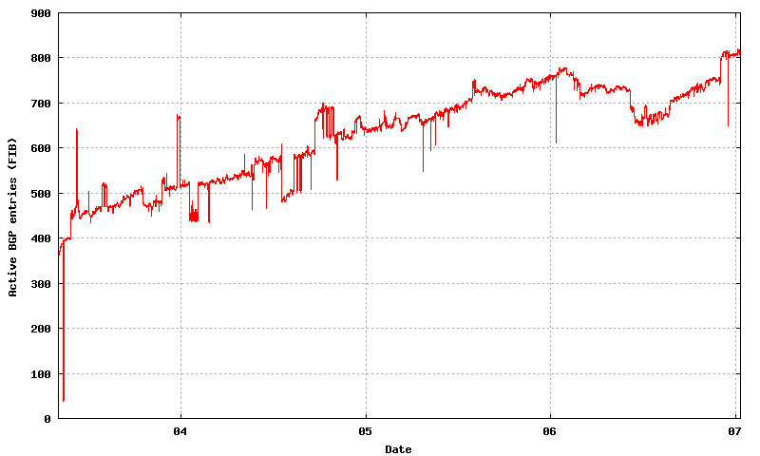
IPv6 Deployment Status
Big users: Germany (33%), EU (24%), Japan (16%), Australia (16%)

Slide 37
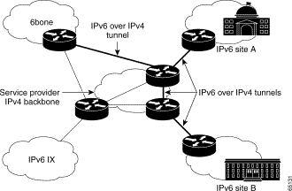
IPv6 over IPv4 Tunnels
One trick for mapping IPv6 addresses: embed the IPv4 address in low bits
http://www.cisco.com/en/US/tech/tk872/technologies_white_paper09186a00800c9907.shtml

Slide 38

DNS: Mapping Names to Addresses
www.cc.gatech.edu
root, .edu
www.cc.gatech.edu
NS troll-gw.gatech.edu
NS burdell.cc.gatech.edu
troll-gw.gatech.edu
Client
Local
DNS resolver
A 130.207.7.36
Recursive query
burdell.cc.gatech.edu
Iterative queries
Note the diversity of Georgia Tech’s authoritative nameservers

Slide 39
Some Record Types
A
NS
MX
CNAME
TXT
PTR
AAAA
SRV

Slide 40
Caching
Resolvers cache DNS responses
  Quick response for repeated translations
  Other queries may reuse some parts of lookup
    NS records for domains typically cached for longer
  Negative responses also cached
    Typos, “localhost”, etc.
Cached data periodically times out
  Lifetime (TTL) of data controlled by owner of data
  TTL passed with every record
What if DNS entries get corrupted?

Slide 41
Root Zone
Generic Top Level Domains (gTLD)
  .com, .net, .org,
Country Code Top Level Domain (ccTLD)
  .us, .ca, .fi, .uk, etc…
Root server ({a-m}.root-servers.net) also used to cover gTLD domains
  Increased load on root servers
  August 2000: .com, .net, .org moved off root servers onto gTLDs

Slide 42
Some Recent gTLDs
.info → general info
.biz → businesses
.name → individuals
.aero → air-transport industry
.coop → business cooperatives
.pro → accountants, lawyers, physicians
.museum → museums

Slide 43
Do you trust the TLD operators?
Wildcard DNS record for all .com and .net domain names not yet registered by others
  September 15 – October 4, 2003
  February 2004: Verisign sues ICANN
Redirection for these domain names to Verisign web portal
What services might this break?

Slide 44
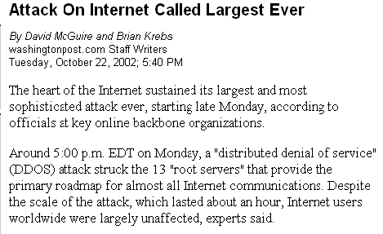
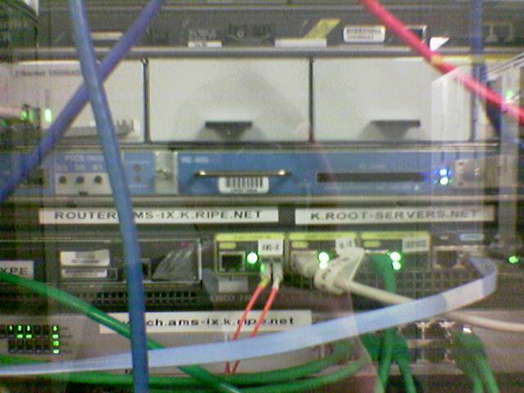
Protecting the Root Nameservers
Sophistocated?
Why did nobody notice?
gatech.edu. 13759 NS trollgw.gatech.edu.
Defense Mechanisms
Redundancy: 13 root nameservers
IP Anycast for root DNS servers {c,f,i,j,k}.root-servers.net
  RFC 3258
  Most physical nameservers lie outside of the US

Slide 45
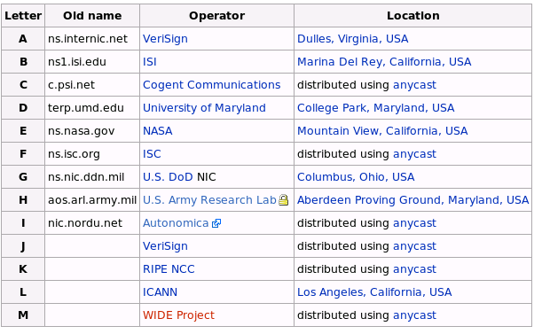
Defense: Replication and Caching
source: wikipedia

Slide 46
DNS Hack #1: Reverse Lookup
Method
  Hierarchy based on IP addresses
  130.207.7.36
    Query for PTR record of 36.7.207.130.in-addr.arpa.
Managing
  Authority manages IP addresses assigned to it

Slide 47
DNS Hack #2: Load Balance
Server sends out multiple A records
Order of these records changes per-client

Slide 48
DNS Hack #3: Blackhole Lists
First: Mail Abuse Prevention System (MAPS)
  Paul Vixie, 1997
Today: Spamhaus, spamcop, dnsrbl.org, etc.
Different addresses refer to different reasons for blocking
% dig 91.53.195.211.bl.spamcop.net
;; ANSWER SECTION:
91.53.195.211.bl.spamcop.net. 2100 IN A 127.0.0.2
;; ANSWER SECTION:
91.53.195.211.bl.spamcop.net. 1799 IN TXT "Blocked - see http://www.spamcop.net/bl.shtml?211.195.53.91"

Slide 49
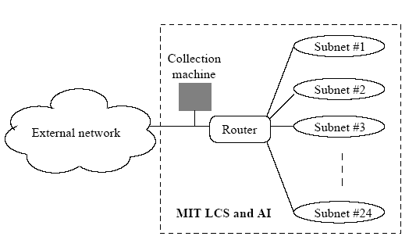
Highlights from Today’s Paper
Jung et al., DNS Performance and the Effectiveness of Caching, ACM IMC, 2001
Three different traces: One from MIT, Two from KAIST
  Joint analysis of DNS and TCP
What types of queries will this miss?

Slide 50
Highlights and Thought Questions
Load-balancing with A-records does not incur penalty
  Lower TTLs for A records do not affect performance
  Wide-area traffic not greatly affected by short TTLs on A records
  DNS performance relies more on NS-record caching
  Sharing of caches among clients not effective. Why?
Referrals responsible for client-perceived latency
50% of Lookups not associated with any TCP connection
  10% follow from a TCP connection. Why?
Negative response caching doesn’t appear to be effective
  What effect do DNSBLs have on this?
Lots of junk DNS traffic
  23% of all DNS queries received no answer
  Half of DNS traffic is for these unanswered queries
  15%-27% of traffic at the root is bogus

