Slide 1
Application-Level Attacks,
Network-Level Defenses
Nick Feamster
CS 7260
April 9, 2007

Slide 2
Resource Exhaustion: Spam
Unsolicited commercial email
As of about February 2005, estimates indicate that about 90% of all email is spam
Common spam filtering techniques
  Content-based filters
  DNS Blacklist (DNSBL) lookups: Significant fraction of today’s DNS traffic!
Can IP addresses from which spam is received be spoofed?

Slide 3
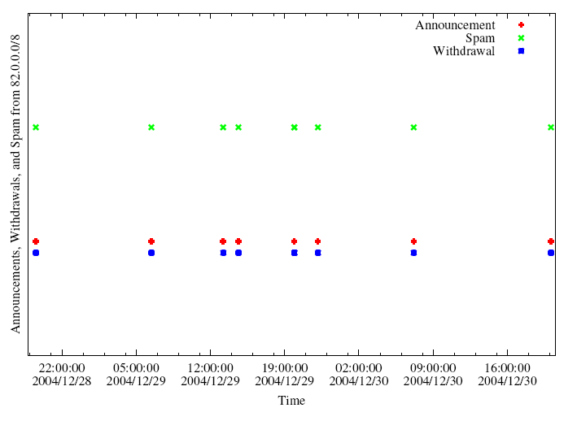
A Slightly Different Pattern

Slide 4
Botnets
Bots: Autonomous programs performing tasks
Plenty of “benign” bots
  e.g., weatherbug
Botnets: group of bots
  Typically carries malicious connotation
  Large numbers of infected machines
  Machines “enlisted” with infection vectors like worms (last lecture)
Available for simultaneous control by a master
Size: up to 350,000 nodes (from today’s paper)

Slide 5
“Rallying” the Botnet
Easy to combine worm, backdoor functionality
Problem: how to learn about successfully infected machines?
Options
  Email
  Hard-coded email address

Slide 6
Botnet Control
Dynamic
DNS
Infected Machine
Botnet
Controller
(IRC server)
Botnet master typically runs some IRC server on a well-known port (e.g., 6667)
Infected machine contacts botnet with pre-programmed DNS name (e.g., big-bot.de)
Dynamic DNS: allows controller to move about freely

Slide 7
Botnet Operation
General
  Assign a new random nickname to the bot
  Cause the bot to display its status
  Cause the bot to display system information
  Cause the bot to quit IRC and terminate itself
  Change the nickname of the bot
  Completely remove the bot from the system
  Display the bot version or ID
  Display the information about the bot
  Make the bot execute a .EXE file
IRC Commands
  Cause the bot to display network information
  Disconnect the bot from IRC
  Make the bot change IRC modes
  Make the bot change the server Cvars
  Make the bot join an IRC channel
  Make the bot part an IRC channel
  Make the bot quit from IRC
  Make the bot reconnect to IRC
Redirection
  Redirect a TCP port to another host
  Redirect GRE traffic that results to proxy PPTP VPN connections
DDoS Attacks
  Redirect a TCP port to another host
  Redirect GRE traffic that results to proxy PPTP VPN connections
Information theft
  Steal CD keys of popular games
Program termination

Slide 8
PhatBot (2004)
Direct descendent of AgoBot
More features
  Harvesting of email addresses via Web and local machine
  Steal AOL logins/passwords
  Sniff network traffic for passwords
Control vector is peer-to-peer (not IRC)

Slide 9
Botnet Application: Phishing
“Phishing attacks use both social engineering and technical subterfuge to steal consumers' personal identity data and financial account credentials.” -- Anti-spam working group
Social-engineering schemes
  Spoofed emails direct users to counterfeit web sites
  Trick recipients into divulging financial, personal data
Anti-Phishing Working Group Report (Oct. 2005)
  15,820 phishing e-mail messages 4367 unique phishing sites identified.
  96 brand names were hijacked.
  Average time a site stayed on-line was 5.5 days.
Question: What does phishing have to do with botnets?

Slide 10
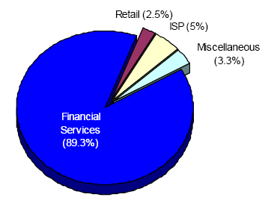
Which web sites are being phished?
Source: Anti-phishing working group report, Dec. 2005
Financial services by far the most targeted sites
New trend: Keystroke logging…

Slide 11
Botnet Application: Click Fraud
Pay-per-click advertising
  Publishers display links from advertisers
  Advertising networks act as middlemen
    Sometimes the same as publishers (e.g., Google)
Click fraud: botnets used to click on pay-per-click ads
Motivation
  Competition between advertisers
  Revenue generation by bogus content provider

Slide 12
Botnet History: How we got here
Early 1990s: IRC bots
  eggdrop: automated management of IRC channels
1999-2000: DDoS tools
  Trinoo, TFN2k, Stacheldraht
1998-2000: Trojans
  BackOrifice, BackOrifice2k, SubSeven
2001- : Worms
  Code Red, Blaster, Sasser
Fast spreading capabilities pose big threat
Put these pieces together and add a controller…

Slide 13
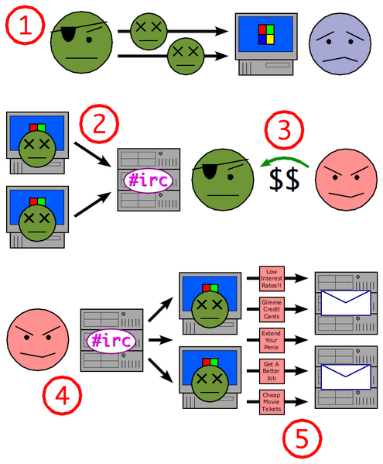
Putting it together
Miscreant (botherd) launches worm, virus, or other mechanism to infect Windows machine.
Infected machines contact botnet controller via IRC.
Spammer (sponsor) pays miscreant for use of botnet.
Spammer uses botnet to send spam emails.

Slide 14
Botnet Detection and Tracking
Network Intrusion Detection Systems (e.g., Snort)
  Signature: alert tcp any any -> any any (msg:"Agobot/Phatbot Infection Successful"; flow:established; content:"221
Honeynets: gather information
  Run unpatched version of Windows
  Usually infected within 10 minutes
  Capture binary
    determine scanning patterns, etc.
  Capture network traffic
    Locate identity of command and control, other bots, etc.

Slide 15
Defense: DNS-Based Blackhole Lists
First: Mail Abuse Prevention System (MAPS)
  Paul Vixie, 1997
Today: Spamhaus, spamcop, dnsrbl.org, etc.
Different addresses refer to different reasons for blocking
% dig 91.53.195.211.bl.spamcop.net
;; ANSWER SECTION:
91.53.195.211.bl.spamcop.net. 2100 IN A 127.0.0.2
;; ANSWER SECTION:
91.53.195.211.bl.spamcop.net. 1799 IN TXT "Blocked - see http://www.spamcop.net/bl.shtml?211.195.53.91"

Slide 16
A Model of Responsiveness
Possible Detection
Opportunity
Infection
Time
S-Day
RBL Listing
Response Time
Lifecycle of a spamming host
Response Time
  Difficult to calculate without “ground truth”
  Can still estimate lower bound

Slide 17
Measuring Responsiveness
Data
  1.5 days worth of packet captures of DNSBL queries from a mirror of Spamhaus
  46 days of pcaps from a hijacked C&C for a Bobax botnet; overlaps with DNSBL queries
Method
  Monitor DNSBL for lookups for known Bobax hosts
    Look for first query
    Look for the first time a query response had a ‘listed’ status

Slide 18
Responsiveness
Observed 81,950 DNSBL queries for 4,295 (out of over 2 million) Bobax IPs
Only 255 (6%) Bobax IPs were blacklisted through the end of the Bobax trace (46 days)
  88 IPs became listed during the 1.5 day DNSBL trace
  34 of these were listed after a single detection opportunity
Both responsiveness and completeness appear to be low.
Much room for improvement.

Slide 19
Extra Slides…
We didn’t have time to cover the rest of this in class, but it is here for your benefit
These mainly summarize the readings from L20
You are still responsible for the readings on the syllabus that relate to this material…

Slide 20
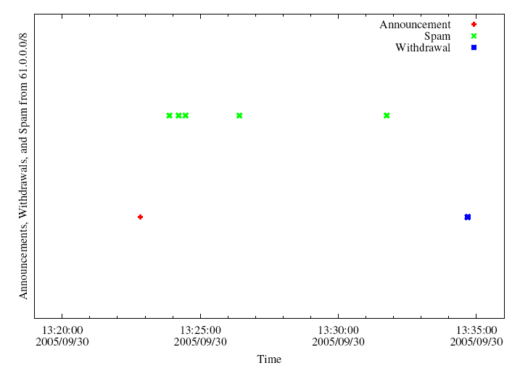
BGP Spectrum Agility
Log IP addresses of SMTP relays
Join with BGP route advertisements seen at network where spam trap is co-located.
A small club of persistent players appears to be using this technique.
Common short-lived prefixes and ASes
~ 10 minutes
61.0.0.0/8 4678
66.0.0.0/8 21562
82.0.0.0/8 8717
Somewhere between 1-10% of all spam (some clearly intentional, others might be flapping)

Slide 21
Why Such Big Prefixes?
Flexibility: Client IPs can be scattered throughout dark space within a large /8
  Same sender usually returns with different IP addresses
Visibility: Route typically won’t be filtered (nice and short)

Slide 22
Characteristics of IP-Agile Senders
IP addresses are widely distributed across the /8 space
IP addresses typically appear only once at our sinkhole
Depending on which /8, 60-80% of these IP addresses were not reachable by traceroute when we spot-checked
Some IP addresses were in allocated, albeing unannounced space
Some AS paths associated with the routes contained reserved AS numbers

Slide 23
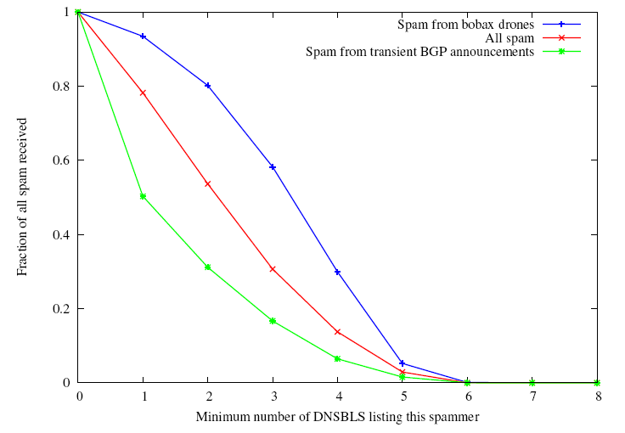
Some evidence that it’s working
Spam from IP-agile senders tend to be listed in fewer blacklists
Vs. ~80% on average
Only about half of the IPs spamming from short-lived BGP are listed in any blacklist

Slide 24
Defenses
Effective spam filtering requires a better notion of end-host identity (e.g., persistent identifiers)
Detection based on network-wide, aggregate behavior
Two critical pieces of the puzzle
  Routing security
  Detection/Response:
  Need better monitoring techniques
Mitigation techniques (Walfish et al.)

Slide 25
Detection: In-Protocol
Snooping on IRC Servers
Email (e.g., CipherTrust ZombieMeter)
  > 170k new zombies per day
  15% from China
Managed network sensing and anti-virus detection
  Sinkholes detect scans, infected machines, etc.
Drawback: Cannot detect botnet structure

Slide 26
Using DNS(BL) Traffic to Find Controllers and Bots
Different types of queries may reveal info
  Repetitive A queries may indicate bot/controller
  MX queries may indicate spam bot
Usually 3 level: hostname.subdomain.TLD
Names and subdomains that look rogue
  (e.g., irc.big-bot.de)

Slide 27
DNS Monitoring
Command-and-control hijack
  Advantages: accurate estimation of bot population
  Disadvantages: bot is rendered useless; can’t monitor activity from command and control
Complete TCP three-way handshakes
  Can distinguish distinct infections
  Can distinguish infected bots from port scans, etc.

Slide 28
DNSBL Monitoring: Legit Queries vs. Reconnaissance
Legitimate queriers are also the targets of queries
Reconnaissance queriers are ususally not queried themselves
DNS-Based
Blacklist
DNS-Based
Blacklist
lookup
mx.b.com
lookup
mx.a.com
Legit Mail Server A
mx.a.com
email to mx.b.com
Legit Mail Server B
mx.b.com
email to mx.a.com
Reconnaissance host

Slide 29
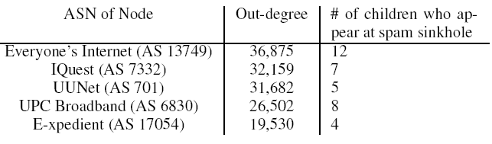
Who’s Doing the Lookups?
The botmaster, on behalf of the bots
The bots, on behalf of themselves
The bots, on behalf of each other
Known bobax drone!
Spam Sinkhole
Implication: Use a “seed” set to bootstrap?

Slide 30
Traffic Monitoring
Goal: Recover communication structure
  “Who’s talking to whom”
Tradeoff: Complete packet traces with partial view, or partial statistics with a more expansive view

Slide 31
Mitigation: Network Monitoring
In-network filtering
  Requires the ability to detect botnets
Question: Can we detect botnets by observing communication structure among hosts?
Example: Migration between command and control hosts
New type of problem: essentially coupon collection
How good are current traffic sampling techniques at exposing these patterns?

Slide 32
Traffic Anomaly Detection: Motivation
Many “actionable” changes to traffic patterns
DDoS attacks
Routing anomalies
Link failures
Flash crowds
…

Slide 33
Traditional Network Traffic Analysis
Gap between Capabilities and Goals
What ISPs Care About
Focus on
  Long, nonstationary timescales
  Traffic on all links simultaneously
Principal goals
  Anomaly detection
  Traffic engineering
  Capacity planning
Focus on
  Short ‘stationary’ timescales
  Traffic on a single link in isolation
Principal results
  Scaling properties
  Packet delays and losses

Slide 34
Network-Wide Traffic Analysis
Anomaly Detection: Which links show unusual traffic?
Traffic Engineering: How does traffic move throughout the network?
Capacity planning: How much and where in network to upgrade?

Slide 35
This is Complicated
Measuring and modeling traffic on all links simultaneously is challenging.
  Even single link modeling is difficult
  100s of links in large IP networks
  High-Dimensional timeseries
Significant correlation in link traffic

Slide 36

Origin-Destination Flows
total traffic on the link
traffic
time
Link traffic arises from the superposition of Origin-Destination (OD) flows
A fundamental primitive for whole-network analysis
Notes:
OD flows account for routing and link failures. A fundamental primitive to study
MARK: I will replace that cartoon plot with a real data plot.

Slide 37
Dimensionality Reduction
Look for good low-dimensional representations
A high-dimensional structure can be explained by a small number of independent variables
A commonly used technique:
Principal Component Analysis (PCA)
(aka KL-Transform, SVD, …)

Slide 38
Summary
Measure complete sets of OD flow timeseries from two backbone networks
Use PCA to understand their structure
  Decompose OD flows into simpler features
  Characterize individual features
  Reconstruct OD flows as sum of features
Call this structural analysis
Notes:
Our work is the first to study the properties of OD flows. We collect data from two backbone networks, the European portion of the Sprint Tier-1 backbone network and the Abilene backbone network. We then use a technique called Principal Component Analysis to understand the structure of OD flows.
To give some intuition here, our general strategy is to take the set of all OD flows from a network and decompose it systematically into a smaller set of primitive features, which are easier to understand. And then, armed with an understanding of these features, to re-assemble all the OD flows. Such a methodology can actually yield significant insight into the structure of all OD flows, which number in the hundreds.

Slide 39
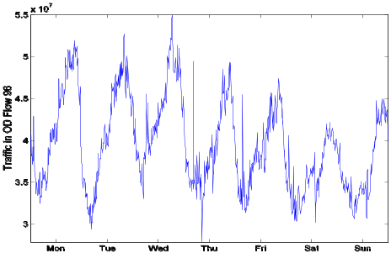
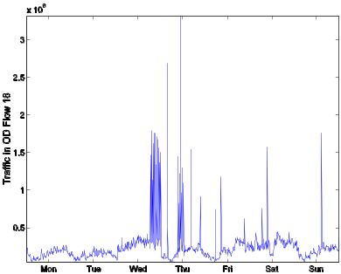
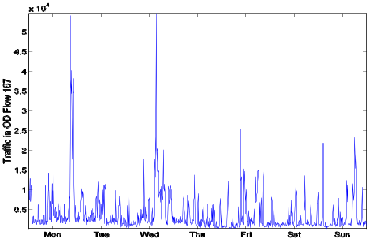
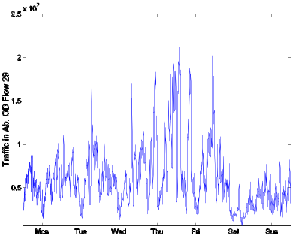
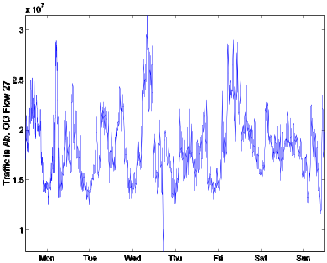
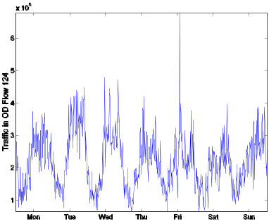
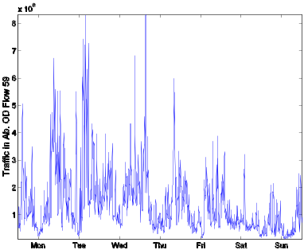
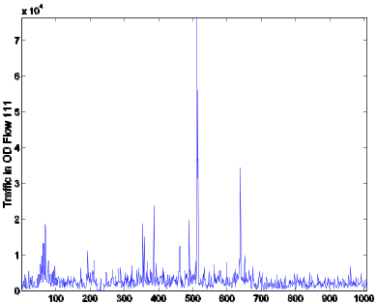
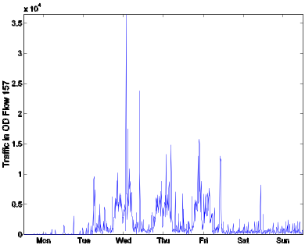
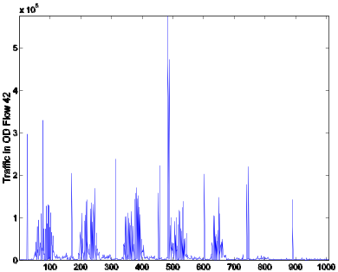
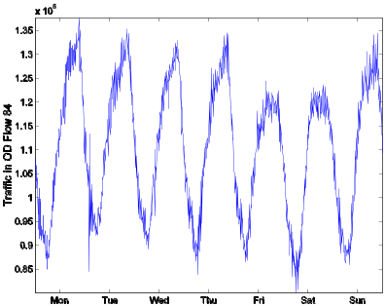
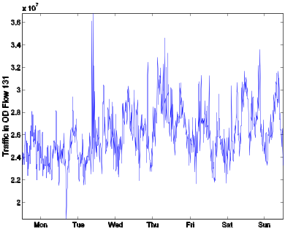
Example OD Flows
Some have visible structure, some less so…
Notes:
So having done all this data processing, here are example of some sample OD flows.

Slide 40
Structural Analysis
Are there low dimensional representations for a set of OD flows?
Do OD flows share common features?
What do the features look like?
Can we get a high-level understanding of a set of OD flows in terms of these features?
Notes:
netflow

Slide 41
Principal Component Analysis
Coordinate transformation method
Original Data
Transformed Data
PC2
PC1
x2
PC2
x2
u2
u1
u2
PC1
u1
x1
x1
x1 , x2
u1 , u2
Notes:
At its heart PCA is a coordinate transformation method, best shown by an example.
On the left we have some data in their original axis representation, an XY axis. The data is a set of correlated rv as defined by this ellipse here.
PCA works by finding a new set of axis to describe this data, called the pc axis.
These axis have two special properties:
First, each PC axis captured the max energy in the data. And second, they are orthogonal to each other.
Ex, PC1 here basically amounts to a linear regression of the 2d data.
Once these axis are formed, each ponit x1 x2 in the original data can be now described in the new coordinate space, formed by the pc axis, as u1 u2.
All we’ve done therefore is to find a new set of axis and map the original data in the new axis.

Slide 42
Properties of Principle Components
Each PC in the direction of maximum (remaining) energy in the set of OD flows
  Ordered by amount of energy they capture
Eigenflow: set of OD flows mapped onto a PC; a common trend
  Ordered by most common to least common
Notes:
Generalizinig this to OD flows is as follows.
Each PC captures the maximum energy in the data.
In this way, the PCs are ordered by the amount of energy they capture.
The transformed points, the u1 u2 in the last slide, are what we call eigenflows now. Each eigenflow is a mapping of the OD flows onto a PC. Therefore, each eigenflow is a timeseries that captures a trend common across all OD flows.
Because the PCs are ordered by their energy, the eigenflows are also ordered by importance – from the trend that’s most common to the trend that is least common in all the OD flows.

Slide 43
PCA on OD flows
# OD pairs
# OD pairs
# OD pairs
time
time
# OD pairs
OD flow
Eigenflow
PC
X:
V:
Principal
matrix
OD flow
matrix
U:
Eigenflow
matrix

Slide 44
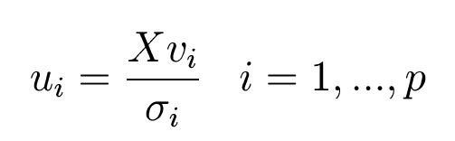



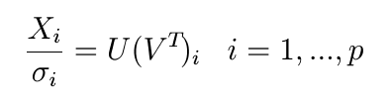
PCA on OD flows (2)
Each eigenflow is a weighted sum of all OD flows
Eigenflows are orthonormal
=
Singular values indicate the energy attributable to a principal component
;
Each OD flow is weighted sum of all eigenflows
=
+
+

Slide 45
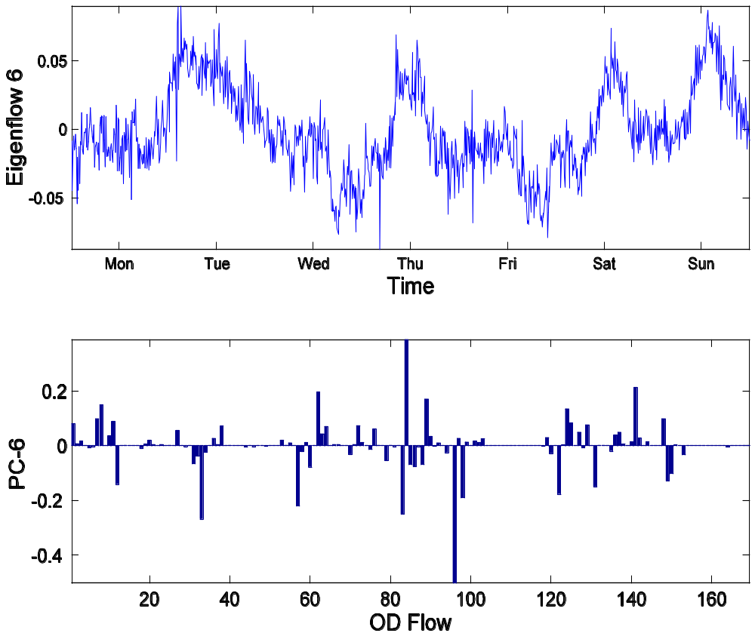
An Example Eigenflow and PC
OD Flow 167
OD Flow 94

Slide 46
Reasons for Low Dimensionality
Generally, traffic on different links is dependent
Link traffic is the superposition of origin-destination flows (OD flows)
  The same OD flow passes over multiple links, inducing correlation among links
  All OD flows tend to vary according to
  common daily and weekly cycles, and so are themselves correlated
Notes:
But, even though there are hundreds of links, each with their own varied structure, there is a case to be made that link traffic really can be well described by fewer dimensions.
Two reasons
1) flows induced correlation.
2) OD flows

Slide 47
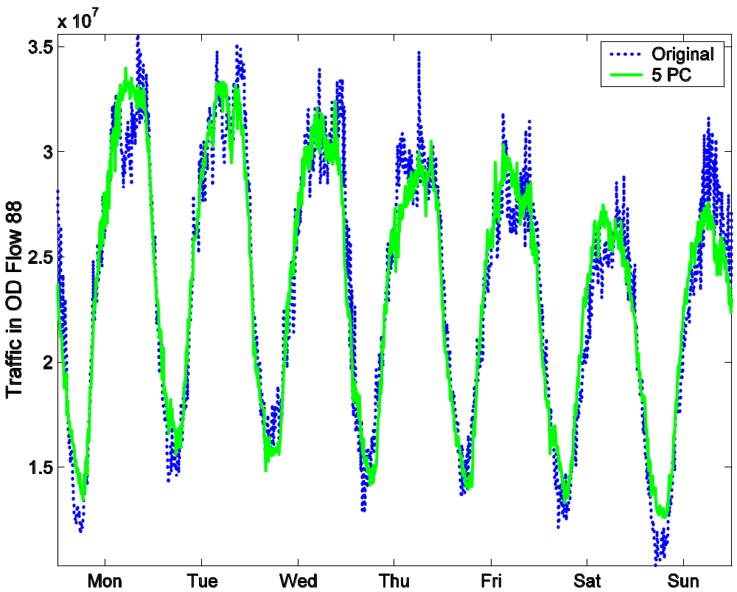
Approximating With Top 5 Eigenflows

Slide 48
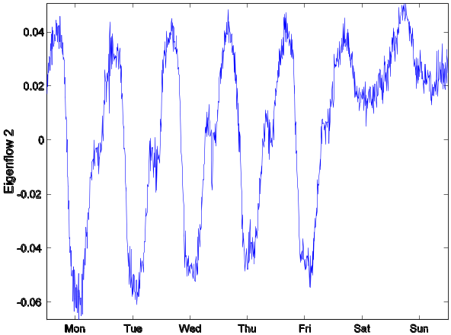
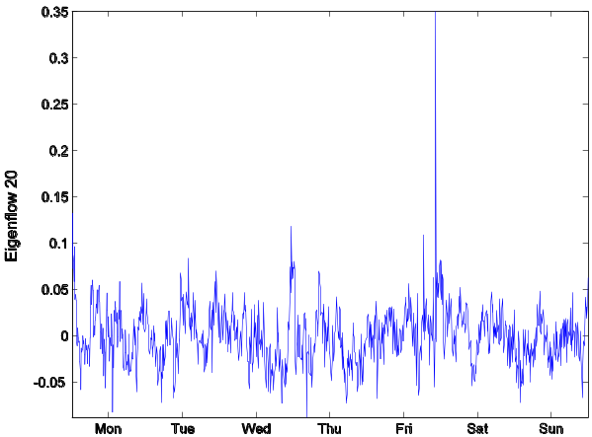
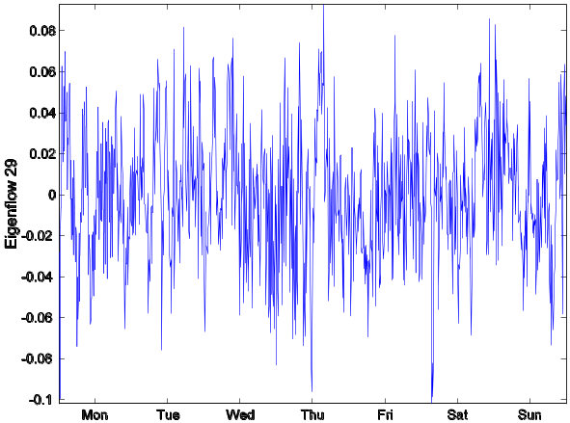
Kinds of Eigenflows
Deterministic
d-eigenflows
Spike
s-eigenflows
Noise
n-eigenflows
Periodic trends
Sudden, isolated spikes and drops
Roughly stationary and Gaussian

Slide 49
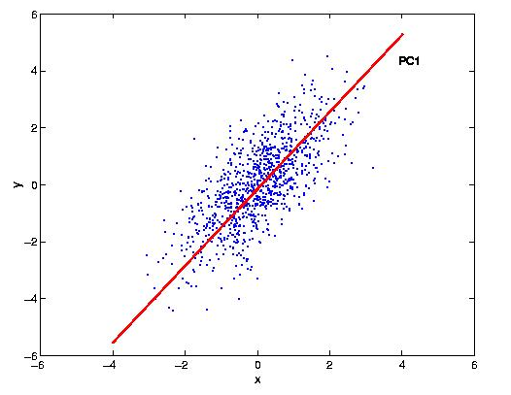

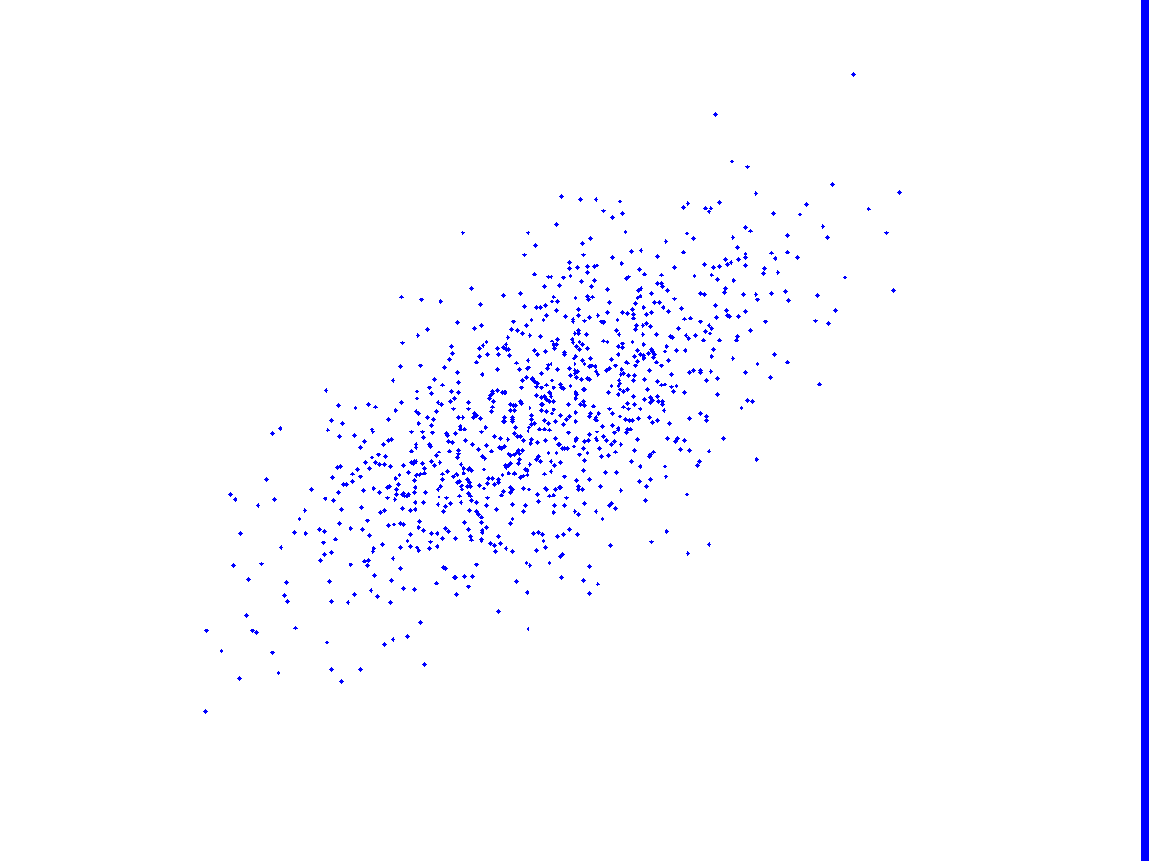



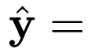
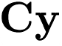
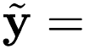
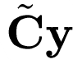
The Subspace Method, Geometrically
In general, anomalous traffic results in a large value of
Traffic on Link 2
y
Traffic on Link 1
Notes:
So here is a geometric illustration of how the subspace method works. Simplest possible case, 2 links. Each point on the picture bytes falling on link 1 and link 2 at some instance. Look they are correlated because if one is high, the other is high. And this is why its ellipsoid. If we had to approximate this using 1 dimension, here is: S. So we would treat S as the best one dimensional representation of network-wide traffic. OK then put up y. Why is it anomalous because its far from some time. And how can we capture this? (Bring up text). This plot here shows the traffic on links plotted against one another. So on the x-axis you have traffic on link 1 and on the y-axis, traffic on link 2. Now, the green and red lines corresponds to the principal axis as obtained from PCA. What PCA basically does is find a new coordinate space to describe this data so that the maximum variability in the data is captured in the minimum set of axis. So for instance, the green line corresponds to the first principal axis, which captures the maximum energy in this data. And the red line, is orthogonal to the green and captures the remaining energy. So the subspace method, in this 2D example, would take S to be the normal subspace spanned by the first PC and S-tilde as the anomalous subspace, spanned by the second PCs. Now lets look at this yellow point, which we denote by y. It is the traffic on both links at a specific time. Note that by combining information from both links, this point becomes an outlier. So we can write y as the sum of the projections on the two subspaces, i.e. y-hat and y-tilde. And in general, we will see that anomalous values will result in large values of y-tilde. Therefore, by examining y-tilde for large values, we will be able to detect such outliers.

Slide 50
Diagnosing Volume Anomalies
A volume anomaly is a sudden change in an OD flow’s traffic (i.e., point to point traffic)
Problem: Given link traffic measurements, diagnose the volume anomalies
Notes:
So let me begin by introducing volume anomalies and the problem of diagnosing volume anomalies.
Now given that OD flows are not easily available, we want to actually diagnose anomalies in OD flows by inspecting link traffic alone.
If it helps, you can think of this as the problem of finding aberrations in the traffic matrix, from link traffic measurements.
I should point out here that the subspace method is not specific to volume anomalies, and this problem really serves as a first application of the subspace method.

Slide 51
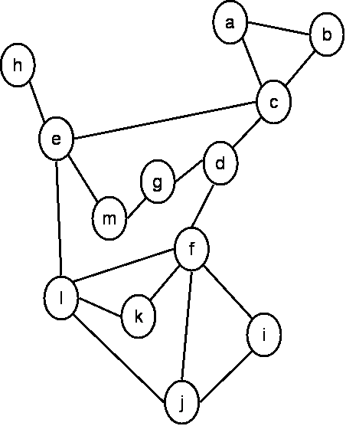
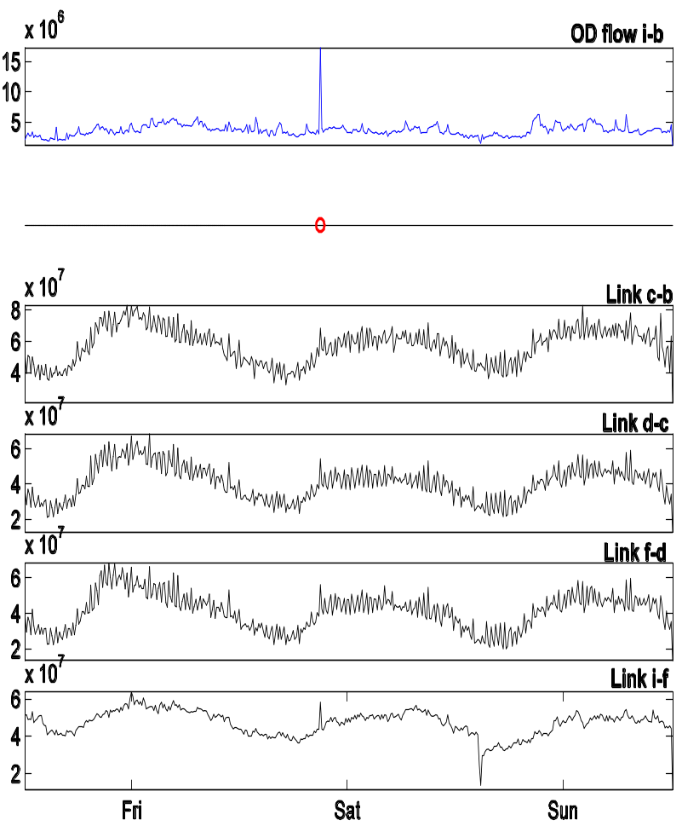
An Illustration
Sprint-Europe Backbone Network
The Diagnosis Problem requires analyzing traffic on all links to:
1) Detect the time of the anomaly
2) Identify the source & destination
3) Quantify the size of the anomaly

