Slide 1
Wireless (and Wrap-up)
Nick Feamster
CS 7260
April 16, 2007

Slide 2
Today’s Lecture
Overview
  What’s different about wireless networks?
  Challenges
Media Access Control (MAC)
  Hidden terminal and Exposed terminal
  CSMA/CD
  Reservation-based MAC: RTS/CTS
Routing
  Traditional routing protocols
  Biswas et al., Opportunistic Routing in
  Multi-hop Wireless Networks

Slide 3
What is a Wireless Network?
Wireless: without wires
Many ways to communicate without wires
  Optical
  Acoustic
  Radio Frequency (RF)
Many possible configurations
  Point-to-point (e.g., microwave communications links)
  Point-to-multipoint (e.g., cellular communications)
  Ad-hoc, (e.g., sensor networks)

Slide 4
Wireless Communications Networks
Wireless LANs: 802.11
Cellular Networks
  2G, 3G, 4G Networks
  Voice and data (e.g., EVDO)
Point-to-Point Microwave Networks
Satellite Communications
Short-Range: Bluetooth, etc.
Ultra-wideband Networks

Slide 5
Differences from the Wired Network
Sharing and resource management
  Wired network: no interference below network layer
  Wireless networks: interference can occur at the physical layer
Closest analog in the wired network: Ethernet on a hub-based network
  Difference: Collision detection easier in wireless network

Slide 6
Challenges in Wireless Networking
Resource sharing
Routing
  Challenge: coping with probabilistic packet reception
Achieving high throughput
  Challenge: determining capacity of a wireless network
Mobility
TCP performance
Energy-efficiency

Slide 7
Carrier Sense Multiple Access (CSMA)
Listen to medium and wait until it is free
(no one else is talking)
Wait a random backoff time
Advantage: Simple to implement
Disadvantage: Cannot recover from a collision

Slide 8
Wireless Interference
Two transmitting stations interfere with each other at the receiver
Receiver gets garbage
A
B
C

Slide 9
Carrier Sense Multiple Access with Collision Detection (CSMA-CD)
Procedure
  Listen to medium and wait until it is free
  Start talking, but listen to see if someone else starts talking too
  If collision, stop; start talking after a random backoff time
Used for hub-based Ethernet
Advantage: More efficient than basic CSMA
Disadvantage: Requires ability to detect collisions
  More difficult in wireless scenario

Slide 10
Collision Detection in Wireless
No “fate sharing” of the link
  High loss rates
  Variable channel conditions
Radios are not full duplex
  Cannot simultaneously transmit and receive
  Transmit signal is stronger than received signal

Slide 11
Solution: Link-Layer Acknowledgments
Absence of ACK from receiver signals packet loss to sender
Sender interprets packet loss as being caused by collision
Problem: Does not handle hidden terminal cases.

Slide 12
Carrier Sense Multiple Access with Collision Avoidance (CSMA-CA)
Similar to CSMA but control frames are exchanged instead of data packets
  RTS: request to send
  CTS: clear to send
  DATA: actual packet
  ACK: acknowledgement

Slide 13
Carrier Sense Multiple Access with Collision Avoidance (CSMA-CA)
Small control frames lessen the cost of collisions (when data is large)
RTS + CTS provide “virtual carrier sense”
    protects against hidden terminal
A
B

Slide 14
Random Contention Access
Slotted contention period
  Used by all carrier sense variants
  Provides random access to the channel
Operation
  Each node selects a random backoff number
  Waits that number of slots monitoring the channel
  If channel stays idle and reaches zero then transmit
  If channel becomes active wait until transmission is over then start counting again

Slide 15
Virtual Carrier Sense
Provided by RTS & CTS
Prevents hidden terminal collisions
Typically unnecessary
RTS
CTS
A
B
C

Slide 16
Physical Carrier Sense Range
Carrier can be sensed at lower levels than packets can be received
  Results in larger carrier sense range than transmission range
  More than double the range in NS2 802.11 simulations
Long carrier sense range helps protect from interference
Receive Range
Carrier Sense Range

Slide 17
Hidden Terminal Revisited
Virtual carrier sense no longer needed in this situation
RTS
CTS
A
B
C
Physical Carrier Sense

Slide 18
Ad Hoc Routing
Every node participates in routing: no distinction between “routers” and “end nodes”
No external network setup: “self-configuring”
Useful when network topology is dynamic

Slide 19
Learning Routes
Source routing
  Source specifies entire route: places complete path to destination in message header
  Intermediate nodes just forward to specified next hop: D would look at path in header, forward to F
Destination-based routing
  Source specifies only destination in message header
  Intermediate nodes look at destination in header, consult internal tables to determine appropriate next hop

Slide 20
Comparison
Source routing
  Moderate source storage (entire route for each desired dest.)
  No intermediate node storage
  Higher routing overhead (entire path in message header, route discovery messages)
Destination routing
  No source storage
  High intermediate node storage (table w/ routing instructions for all possible dests.)
  Lower routing overhead (just dest in header, only routers need deal w/ route discovery)
Examples: DSR, AODV
Example: DSDV

Slide 21
DSDV
Just like distance vector routing protocols
Nodes learn paths that have a metric and a sequence number
  Prefer route with highest sequence number
  Among routes with equal sequence numbers, prefer route with lowest metric
Weighted settling time to prevent nodes from advertising a bad path too fast
Question: What change did ETX make to the DSDV implementation with regard to WST?

Slide 22
Key Question: Link Metric
Appropriate metric for computing paths?
What metric to assign for link costs?

Slide 23
Design goals
Find high throughput paths
Account for lossy links
Account for asymmetric links
Account for inter-link interference
Independent of network load (don’t incorporate congestion)

Slide 24
Minimum Hop Count
Basic Problem: Assumes links either work or don’t work
Consequences
  Maximize the distance traveled by each hop
  Minimizes signal strength -> Maximizes the loss ratio
  Uses a higher Tx power -> Increases interference
Arbitrarily chooses among same length paths
  Paper shows that paths of same length can have wildly varying throughputs

Slide 25
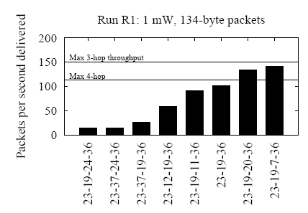
Throughput of Various Paths
Paths of the same length can have very different throughputs
Fewer hops does not mean better throughput

Slide 26
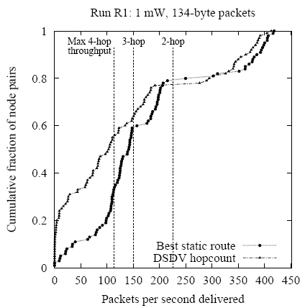
Throughputs Using Hop Count
Single-hop paths

Slide 27
Other Possible Metrics
Remove links according to a threshold loss rate
  Can create disconnections
Product of link delivery ratio along path
  Does not account for inter-hop interference
Bottleneck link (highest-loss-ratio link)
  Same as above
End-to-end delay
  Depends on interface queue lengths

Slide 28


ETX: Expected # of Transmissons
ETX: Expected number of transmissions to send packet over link or path (including retransmissions)
ETX (link) =
ETX(link)
  Measured in periodic probe packets
  Reverse ratio piggybacked in periodic probe packets
ETX (path) = ∑ ETX(link)

Slide 29
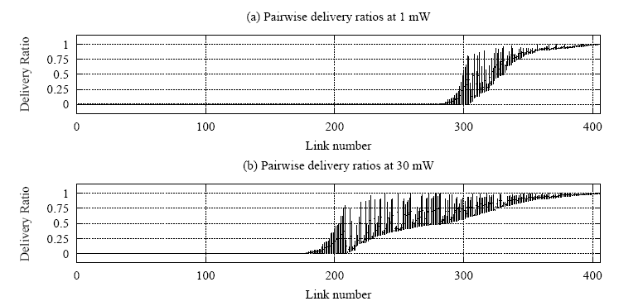
Measure Both Forward and Reverse
Link loss rates are highly asymmetric
Loss rate must be low in both directions to avoid retransmission

Slide 30
Caveats
Probe size ≠ Data/Ack size: ETX estimates are based on measurements of a single link probe size (134 bytes)
  Underestimates data loss ratios
  Overestimates ACK loss ratios
Assumes all links run at one bit-rate
Assumes radios have a fixed transmit power
Notes:
ETX link probes are susceptible to MAC unfairness and hidden terminals
Route ETX measurements change under load

Slide 31
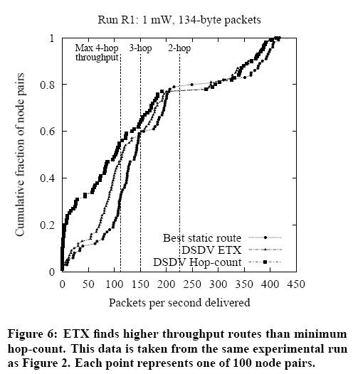
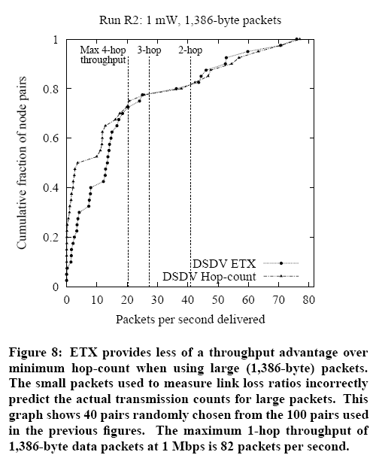
Evaluation: ETX vs. Hop Count

Slide 32
ETX Redux
Advantages
  ETX performs at least as well as hop count
    Accounts for bi-directional loss rates
  Can easily be incorporated into routing protocols
Disadvantages
  Must estimate forward and reverse loss rates
  May not be best metric for all types of networks

Slide 33
DSR Protocol Operation
Route discovery
  When source needs a route to a destination
Route maintenance
  When a link breaks, rendering path unusable
Routing

Slide 34
Route Discovery
Step #1: Source sends Route Request
  Source broadcasts Route Request message for specified destination
  Intermediate node
    Adds itself to path in message
    Forwards (broadcasts) message toward destination
Step #2: Destination sends Route Reply
  Destination unicasts Route Reply message to source
    will contain complete path built by intermediate nodes

Slide 35
Route Discovery: Route Request
B
<A,B>
<A,C,E>
<A>
E
G
<A,C,E,G>
<A,C>
<A>
source
A
C
H
destination
<A>
D
<A,D,F>
F
<A,D>

Slide 36
Route Discovery: Route Reply
B
E
G
A
C
H
<A,D,F>
<A,D,F>
D
F
<A,D,F>
Question: What change did ETX make to the DSR’s route reply?

Slide 37
Details
Problem: Overhead of route discovery
  Intermediate nodes cache overheard routes
  “Eavesdrop” on routes contained in headers
  Intermediate node may return Route Reply to source if it already has a path stored
Problem: Destination may need to discover route to source (to deliver Route Reply)
  Piggyback New Route Request onto Route Reply

Slide 38
Route Maintenance
Used when links break
  Detected using link-layer ACKs, etc.
Route Error message sent to source of message being forwarded when break detected
  Intermediate nodes “eavesdrop”, adjust cached routes
Source deletes route; tries another if one cached, or issues new Route Request

Slide 39
Initial approach: Traditional routing
packet
packet
A
B
packet
src
dst
C
Identify a route, forward over links
Abstract radio to look like a wired link
ExOR Slides adapted from http://pdos.csail.mit.edu/papers/roofnet:exor-sigcomm05/
Notes:
just say picks a route, fwd over that route

Slide 40
Radios aren’t wires
A
B
1
2
src
dst
2
2
3
3
3
4
4
4
5
5
5
6
6
1
6
1
2
3
4
5
6
1
C
Every packet is broadcast
Reception is probabilistic
Notes:
what’s really going on is we’re abstracting → as youall know, radios don’t work like links

Slide 41
ExOR: Probabilistic Broadcast
packet
packet
packet
packet
A
B
src
dst
packet
packet
packet
packet
packet
C
Decide who forwards after reception
Goal: only closest receiver should forward
Challenge: agree efficiently and avoid duplicate transmissions
Notes:
say there’s an opportunity here, take advantage of bcast. spell it out: closest node should reduce the number of tx to get to dest. challenge:: key failure is that two people should not forward. make sure only one guy forwards

Slide 42
Why ExOR might increase throughput
src
N1
N2
N3
N4
N5
dst
75%
50%
25%
Best traditional route over 50% hops: 3(¹/_{0.5}) = 6 tx
Throughput ≅ ¹/_{# transmissions}
ExOR exploits lucky long receptions: 4 transmissions
Assumes probability falls off gradually with distance
Notes:
new slide earlier, assume figured out design. explore why exor might improve throughput/develop a feel title -> why exor might beat trad routing.
inverse prop to #trans, up to 4 hops

Slide 43
Why ExOR might increase throughput
N1
25%
100%
N2
25%
100%
src
dst
25%
N3
100%
25%
100%
N4
Traditional routing: ¹/_{0.25} + 1 = 5 tx
ExOR: ¹/(1 – (1 – 0.25)⁴) + 1 = 2.5 transmissions
Assumes independent losses
Notes:
say this is a contrived example

Slide 44
Batch Maps
rx: 40
rx: 0
rx: 57
rx: 85
tx: 0
N2
N4
tx: 100
tx: 57 -23
≅ 24
rx: 22
tx: ≅ 9
rx: 0
src
dst
rx: 88
rx: 99
rx: 23
N1
N3
rx: 53
tx: ≅ 8
tx: 23
Challenge: finding the closest node to have rx’d
Send batches of packets for efficiency
Node closest to the dst sends first
  Other nodes listen, send remaining packets in turn
Repeat schedule until dst has whole batch
Notes:
add circle for source, then some more circles showing next iteration (no rx/tx numbers). say at the end, packets go through multiple iteration. add source, add n4.

Slide 45
Reliable summaries
tx: {2, 4, 10 ... 97, 98}
summary: {1,2,6, ... 97, 98, 99}
N2
N4
src
dst
N1
N3
tx: {1, 6, 7 ... 91, 96, 99}
summary: {1, 6, 7 ... 91, 96, 99}
Repeat summaries in every data packet
Cumulative: what all previous nodes rx’d
This is a gossip mechanism for summaries
Notes:
just say we incude a summary in every packet
repeated
cumulative
simplify: every node is listening, include list to make it more robust

Slide 46
Priority ordering
N2
N4
src
dst
N1
N3
Goal: nodes “closest” to the destination send first
Sort by ETX metric to dst
  Nodes periodically flood ETX “link state” measurements
  Path ETX is weighted shortest path (Dijkstra’s algorithm)
Source sorts, includes list in ExOR header
Details in the paper
Notes:
source calculates path etx for each node to dest, talk about dijkstra, sort by lowest etx

Slide 47
ExOR Evaluation
Does ExOR increase throughput?
When/why does it work well?

Slide 48
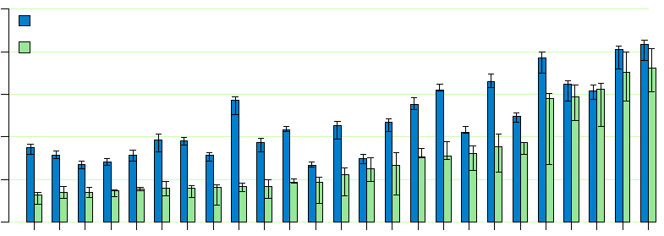
25 Highest throughput pairs
3 Traditional Hops
2.3x
2 Traditional Hops
1.7x
1 Traditional Hop
1.14x
1000
ExOR
800
Traditional Routing
600
Throughput (Kbits/sec)
400
200
0
Node Pair
Notes:
for the two hop, say we can have more intermediate hops like ex 2 or make it all the way

Slide 49
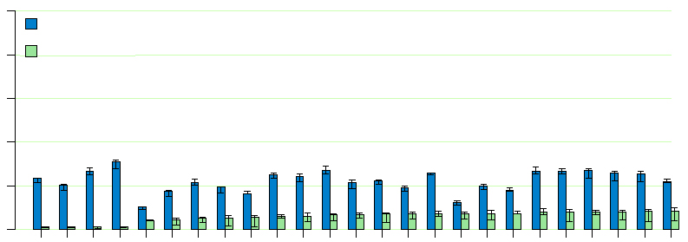
25 Lowest throughput pairs
1000
ExOR
4 Traditional Hops
3.3x
800
Traditional Routing
600
Throughput (Kbits/sec)
400
200
0
Node Pair
Longer Routes
Notes:
etx was forced to use asymmetric links. robust batch maps.

Slide 50
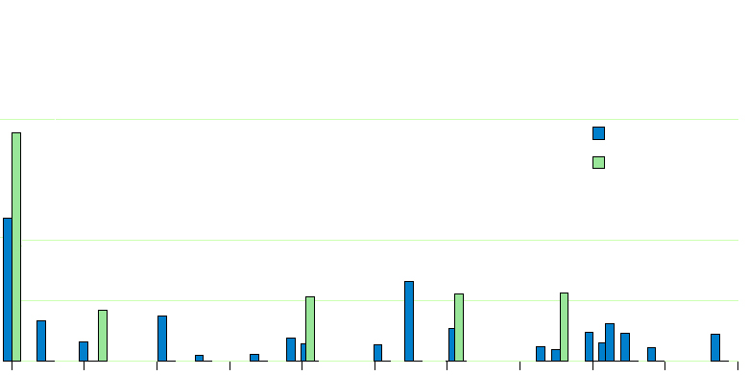
ExOR moves packets farther
58% of Traditional Routing transmissions
0.6
ExOR
Traditional Routing
Fraction of Transmissions
0.2
25% of ExOR transmissions
0.1
0
0
100
200
300
400
500
600
700
800
900
1000
Distance (meters)
ExOR average: 422 meters/transmission
Traditional Routing average: 205 meters/tx
Notes:
lower is better. right circle – using lots of longer links, sum them up and it’s 25%. so, like ex 1, using lots of long links. zeros: before many packets made no progress, with exor at least some.

Slide 51

ExOR In Practice
See http://www.meraki.net/ for details
Low power mesh radios, ExOR as the basis

Slide 52
Writing Tips

Slide 53
Writing Tips
How to Increase the Chances Your Paper is Accepted at SIGCOMM, Craig Partridge

Slide 54
General Writing Advice
Start writing early
Summarize and cite previous work
Keep within the page limits
Be complete
Write a good abstract
  My dad once told me: “Pick a good title for your dissertation. Most people won’t read further.”
Avoid buzzwords
  Some are now the kiss of death (e.g., “multicast”, “active network”, …, even “DHT” in some cases)

Slide 55
Some More General Tips (from me)
Problem Statement
  What problem are you solving?
    Paper should have an “elevator pitch” early on
  Why is it important? (i.e., Why should I read on?)
  Why is it challenging? (i.e., Why should I read on?)
Solution
  Clearly state the key intellectual contribution(s)
  If someone were to sum up your paper in one sentence, what would they say?
These points should all be clear by the end of the introduction.

Slide 56
Measurement and Systems Papers
Measurement papers
  How was the data collected?
  Why is the dataset reasonable (and accurate)?
  Refine graphs and explanations
    Don’t do mere data reporting
    Explain why you’re seeing some phenomenon
Systems papers
  Easier to write a paper on a smaller system that solves a complete problem

Slide 57
Wrap-Up

Slide 58
The Design Goals of Internet, v1
Interconnection/Multiplexing (packet switching)
Resilience/Survivability (fate sharing)
Heterogeneity
  Different types of services
  Different types of networks
Distributed management
Cost effectiveness
Ease of attachment
Accountability
Decreasing
Priority
Should priorities change as the network evolves?

Slide 59
What’s the Problem?
A syllabus redux…
Address space exhaustion Routing problems
  Convergence
  Manageability
  Security
Measurement problems
  Hard to capture full packets at line rate
  Security-related challenges
Security threats
    Worms and Botnets
    Identity (e.g., phishing)
Scalable distribution of content

Slide 60
How Did We Get Here?
Internet design came from a different era
  Single group of cooperative designers
  Cohesive network
  Trusted group of users
The reality today is much different
  Independently operated networks
  Business realities (remember depeering)
  Untrusted parties, often with competing goals

Slide 61
Problem: Insecurity
Can’t trust the control plane
  BGP: Route hijacks (intentional and unintentional)
  DNS: Insecure name resolution
Can’t trust the data plane
  No guarantee for where packets will go
No accountability or auditing capabilities
No strong forms of identity

Slide 62
Problem: Manageability

Slide 63
Problem: Scale
Increasing number of users, end hosts, etc.
The network is becoming a commodity
  Network providers must keep adding customers
  Cost of bandwidth, equipment is plummeting
  Management costs begin to dominate!
  At the same time, the network is becoming more difficult to manage.

Slide 64
Design for Scale
Location 1
Traffic for Location 1
10.1.0.0/16
10.1.0.0/17
10.1.0.0/16
A
B
C
10.1.0.0/16
10.1.128.0/17
10.1.0.0/16
Location 2
Example: Aggregation
  compromises correctness
  makes traffic control more difficult
How to design an architecture that satisfies
route validity/path visibility
and scales to millions of routes?

Slide 65
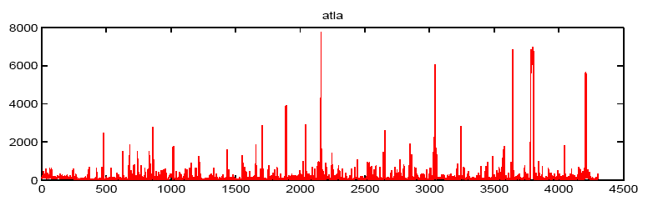
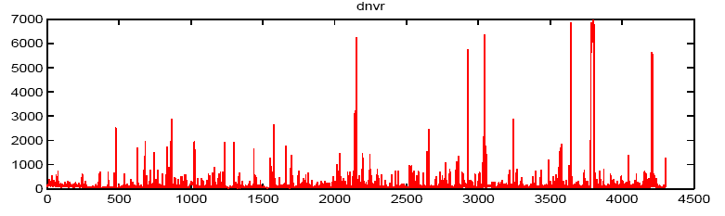
Design for Manageability
Security and robustness go hand-in-hand
How can we combine proactive and reactive techniques?
  Prevent unexpected/unwanted behavior
  Detect when reality does not meet expectations
Proactive
Proactive Techniques
rcc
Configure
Detect
Faults
Predict
Traffic Flow
Deploy
Reactive

Slide 66
Problem: Selfishness
The Internet’s design was not designed to handle competing business interests.
The “tiered” Internet
“Net neutrality”: Network service providers should not be able to enforce how the network is used
Related to the end-to-end principle
"How do you think they're going to get to customers? Through a broadband pipe. Cable companies have them. We have them. Now what they would like to do is use my pipes free, but I ain't going to let them do that because we have spent this capital and we have to have a return on it. So there's going to have to be some mechanism for these people who use these pipes to pay for the portion they're using. Why should they be allowed to use my pipes?“ -- AT&T CEO Edward Whitacre, 11/07/05

Slide 67
Designing for Selfishness: Goals
Providers, producers and consumers must benefit from participating
  Without “eyeballs”, content has no value
  Without content, the “eyeballs” will bail out
  Without a network, eyeballs can’t meet content
  Without content or eyeballs, no need for a network
Ideally, we could do this without regulation.

Slide 68
Biggest Threats to the Internet
Competing business interests threaten
  Stability
  Connectivity
Malicious hosts and network entities threaten
  Trust
  Resource allocation
Growing scale threatens
  Robust, secure, efficient network operations
Governments and governance bodies threaten
  Free speech
  Privacy
  Efficiency

Slide 69
Purists vs. Pluralists
Purists: One architecture to rule them all
  Architecture specified by universal protocol (e.g., IP)
  Goal: holy grail Internet architecture
  Challenge: foreseeing future needs
Pluralists: Let 1,000 architectures bloom
  IP is just one component of the Internet “system”
  “Architecture” arises from union of overlays, etc.
  Goal: meet short-term needs to attract users
  Challenges:
    Coping with diversity
    Making efficient use of physical resources
Notes:
Before I end, I wanted to leave with three questions….

Slide 70
Possible Outcome: Pluralist Scenario
Run many different network architectures simultaneously
  No clear distinction between architecture and services
  Develop specialized “architectures” for specialized applications
Virtualization of physical resources as a key to new architectures
  Virtual link establishment and virtual routers
  Substrate for deploying overlays is new “waist”
  This substrate is the new Internet
Virtualization becomes an end in itself

Slide 71
Picking Good Networking Problems
The hardest part of networking research is asking the right questions!
How to find the right problems: Stay relevant!
  Life is too short to work on imaginary problems!
  Read: The Economist, Tech Review, etc.
  Visit the trenches
    Good resources right here at Georgia Tech:
    Russ Clark, Matt Sanders, etc.
    NANOG, MAAWG, APWG, etc.

Slide 73
How to give a bad talk
Based on slides from
David A. Patterson, circa 1997

Slide 74
1. Thou shalt not waste space
Transparencies and hard-discs are expensive.
If you can save five slides in each talks per year, you save 7.00/year in transparencies!
This is equivalent to 350 kB precious memory!
2. Thou shalt not be neat
3. Thou shalt not covet brevity
Do you want to continue the stereotype that engineers can't write? Always use complete sentences, never just key words. If possible, use whole paragraphs and read every word.
4. Thou shalt cover thy naked slides
You need the suspense! Overlays are too flashy.
5. Thou shalt not write large
Be humble -- use a small font. Important people sit in front. Who cares about the riff-raff?
6. Thou shalt not use color
Flagrant use of color indicates uncareful research. It's also unfair to emphasize some words over others.
7. Thou shalt not illustrate
Confucius says ``A picture = 10K words,'' but Dijkstra says ``Pictures are for weak minds.'' Who are you going to believe? Wisdom from the ages or the person who first counted goto's?
8. Thou shalt not make eye contact
You should avert eyes to show respect. Blocking screen can also add mystery.
9. Thou shalt not skip slides in a long talk
You prepared the slides; people came for your whole talk; so just talk faster. Skip your summary and conclusions if necessary.
10. Thou shalt not practice

Slide 75
1. Thou shalt not be neat
Why vaste research time on prepare slides?
Ignore spell’g, grammer and legibility.
Who cares what 30 people think?

Slide 76
2. Thou shalt not waste space
Transparencies and hard-disks are expensive.
If you can save five slides in each talks per year, you save $7.00/year in transparencies
This is equivalent to 350 kB precious memory!

Slide 77
3. Thou Shalt Not Covet Brevity
Never use keywords as memory joggers
Only use complete sentences
If possible, use whole paragraphs and read each word to the audience because they can not be expected to read anything for themselves. What do you think you’re paid for?

Slide 78
4. Thou Shalt Cover Thy Naked Slides
Overwhelm them with content
Don’t lead people to logical conclusions
Let them search among the points
Leave them wondering where you’re up to

Slide 79
5. Thou shalt not write large
Be humble -- use a small font…
…especially for the relevant part.
Important people sit in the front. Who cares about the riff-raff?

Slide 80
6. Thou shalt not use color
Flagrant use of color indicates uncareful research
It's also unfair to emphasize some words over others

Slide 81
7. Thou shalt not illustrate
Confucius says
  ``A picture is a 1000 words,''
but Dijkstra says
  ``Pictures are for weak minds.'‘
Who are you going to believe?
  Wisdom from the ages or
  the person who first counted goto's?

Slide 82
8. Thou shalt not make eye contact
You should avert eyes to show respect.
Blocking the screen can also add mystery.

Slide 83
9. Thou shalt not skip slides in a long talk
You prepared the slides and suffered, make them suffer too.
People came for your whole talk; don’t cheat them out of anything
So just talk faster
Skip your summary and conclusions if necessary.

Slide 84
10. Thou shalt not practice
Why waste research time practicing a talk?
  It could take several hours out of your two years of research.
  How can you appear spontaneous if you practice?
If you do practice, argue with any suggestions you get and make sure your talk is longer than the time you have to present it.
Commandment 10 is most important. Even if you break the other nine, this one can save you.

