Slide 1
Intradomain Topology and Routing
Nick Feamster
CS 7260
January 17, 2007

Slide 2
Administrivia
Problem Set 1: Slight delay
Project groups: Next week
Project ideas will go up over the weekend

Slide 3
Internet Routing Overview
Autonomous Systems (ASes)
Abilene
Comcast
Georgia
Tech
AT&T
Cogent
Today: Intradomain (i.e., “intra-AS”) routing
Monday: Interdomain routing

Slide 4
Today: Routing Inside an AS
Intra-AS topology
  Nodes and edges
  Example: Abilene
Intradomain routing protocols
  Distance Vector
    Split-horizon/Poison-reverse
    Example: RIP
  Link State
    Example: OSPF

Slide 5
Key Questions
Where to place “nodes”?
  Typically in dense population centers
    Close to other providers (easier interconnection)
    Close to other customers (cheaper backhaul)
  Note: A “node” may in fact be a group of routers, located in a single city. Called a “Point-of-Presence” (PoP)
Where to place “edges”?
  Often constrained by location of fiber

Slide 6
Point-of-Presence (PoP)
A “cluster” of routers in a single physical location
Inter-PoP links
  Long distances
  High bandwidth
Intra-PoP links
  Cables between racks or floors
  Aggregated bandwidth
PoP

Slide 7
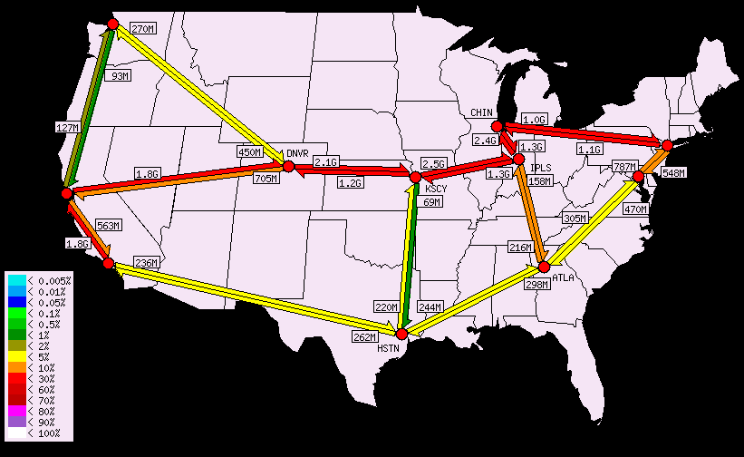
Example: Abilene Network Topology
Problem Set 1 will have a problem dealing with Abilene router configurations/topology.

Slide 8
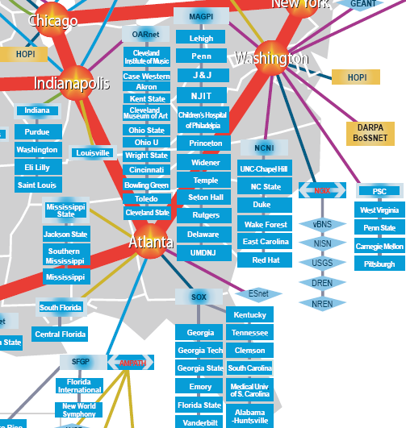
Where’s Georgia Tech?
10GigE (10GbpS uplink)
Southeast Exchange
(SOX) is at 56 Marietta Street

Slide 9
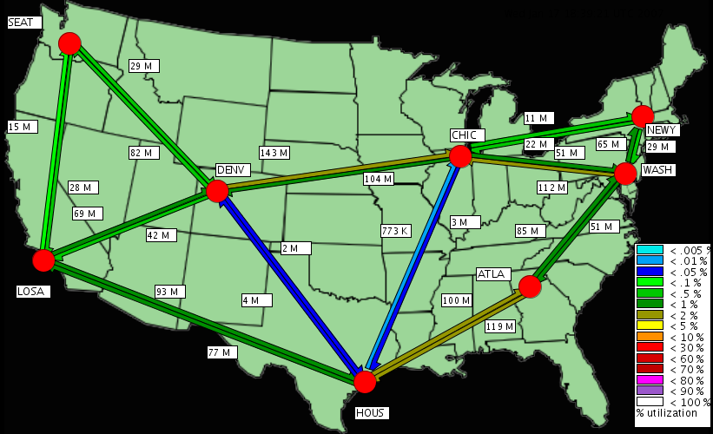
Recent Development: NLR Packet Net

Slide 10
Problem: Routing
Routing: the process by which nodes discover where to forward traffic so that it reaches a certain node
Within an AS: there are two “styles”
  Distance vector
  Link State

Slide 11
Distance-Vector Routing
 | x | y | z
x
y | 1 | 0 | 2
z
y
 | x | y | z
x | 0 | 1 | 5
y
z
1
2
 | x | y | z
x
y
z | 5 | 2 | 0
x
z
5
Routers send routing table copies to neighbors
Routers compute costs to destination based on shortest available path
Based on Bellman-Ford Algorithm
  d_{x}(y) = min_{v}{ c(x,v) + d_{v}(y) }
  Solution to this equation is x’s forwarding table

Slide 12
Good News Travels Quickly
 | x | y | z
x | 0 | 1 | 3
y | 1 | 0 | 2
z | 3 | 2 | 0
y
 | x | y | z
x | 0 | 1 | 3
y | 1 | 0 | 2
z | 3 | 2 | 0
1
2
 | x | y | z
x | 0 | 1 | 3
y | 1 | 0 | 2
z | 3 | 2 | 0
x
z
5
When costs decrease, network converges quickly

Slide 13
Problem: Bad News Travels Slowly
 | x | y | z
x | 0 | 60 | 50
y | 5 | 0 | 2
z | 3 | 2 | 0
60
y
1
2
 | x | y | z
x | 0 | 60 | 50
y | 5 | 0 | 2
z | 7 | 2 | 0
x
z
50
Note also that there is a forwarding loop between y and z.

Slide 14
It Gets Worse
 | x | y | z
x | 0 | 60 | 50
y | 5 | 0 | 2
z | 3 | 2 | 0
60
y
1
2
 | x | y | z
x | 0 | 60 | 50
y | 5 | 0 | 2
z | 7 | 2 | 0
x
z
50
Question: How long does this continue?
Answer: Until z’s path cost to x via y is greater than 50.

Slide 15
“Solution”: Poison Reverse
 | x | y | z
x | 0 | 1 | X
y | 1 | 0 | 2
z | X | 2 | 0
y
 | x | y | z
x | 0 | 1 | 3
y | 1 | 0 | 2
z | 3 | 2 | 0
1
2
 | x | y | z
x | 0 | 1 | 3
y | 1 | 0 | 2
z | 3 | 2 | 0
x
z
5
If z routes through y to get to x, z advertises infinite cost for x to y
Does poison reverse always work?

Slide 16
Does Poison Reverse Always Work?
60
y
1
3
1
w
1
x
z
50

Slide 17
Example: Routing Information Protocol
Earliest IP routing protocol (1982 BSD)
  Version 1: RFC 1058
  Version 2: RFC 2453
Features
  Edges have unit cost
  “Infinity” = 16
Sending Updates
  Router listens for updates on UDP port 520
  Message can contain up to 25 table entries

Slide 18
RIP Updates
Initial
  When router first starts, asks for copy of table for every neighbor
  Uses it to iteratively generate own table
Periodic
  Table refresh every 30 seconds
Triggered
  When every entry changes, send copy of entry to neighbors
    Except for one causing update (split horizon rule)
  Neighbors use to update their tables

Slide 19
RIP: Staleness and Oscillation Control
Small value for Infinity
  Count to infinity doesn’t take very long
Route Timer
  Every route has timeout limit of 180 seconds
    Reached when haven’t received update from next hop for 6 periods
  If not updated, set to infinity
  Soft-state
Behavior
  When router or link fails, can take minutes to stabilize
Notes:
Lots of subtlety to get good implementation (RFC 1058).

Slide 20
Link-State Routing
Idea: distribute a network map
Each node performs shortest path (SPF) computation between itself and all other nodes
Initialization step
  Add costs of immediate neighbors, D(v), else infinite
  Flood costs c(u,v) to neighbors, N
For some D(w) that is not in N
  D(v) = min( c(u,w) + D(w), D(v) )

Slide 21
Link-State vs. Distance-Vector
Convergence
  DV has count-to-infinity
  DV often converges slowly (minutes)
  Odd timing dependencies in DV
Robustness
  Route calculations a bit more robust under link-state.
  DV algorithms can advertise incorrect least-cost paths
Bandwidth Consumption for Messages
Computation
Security

Slide 22
OSPF: Salient Features
Dijkstra, plus some additional features
Equal-cost multipath
Support for hierarchy: Inter-Area Routing

Slide 23
Example: Open Shortest Paths First (OSPF)
Area 0
Key Feature: hierarchy
Network’s routers divided into areas
Backbone area is area 0
Area 0 routers perform SPF computation
  All inter-area traffic travles through Area 0 routers (“border routers”)

Slide 24
Example: IS-IS
Originally: ISO Connectionless Network Protocol (CLNP) .
  CLNP: ISO equivalent to IP for datagram delivery services
  ISO 10589 or RFC 1142
Later: Integrated or Dual IS-IS (RFC 1195)
  IS-IS adapted for IP
  Doesn’t use IP to carry routing messages
OSPF more widely used in enterprise, IS-IS in large service providers

Slide 25

Hierarchical Routing in IS-IS
Backbone
Area 49.001
Area 49.0002
Level-1
Routing
Level-2
Routing
Level-1
Routing
Like OSPF, 2-level routing hierarchy
  Within an area: level-1
  Between areas: level-2
  Level 1-2 Routers: Level-2 routers may also participate in L1 routing

Slide 26
Level-1 vs. Level-2 Routing
Level 1 routing
  Routing within an area
  Level 1 routers track links, routers, and end systems within L1 area
  L1 routers do not know the identity of destinations outside their area.
  A L 1 router forwards all traffic for destinations outside its area to the nearest L2 router within its area.
Level 2 routing
  Routing between areas
  Level 2 routers know the level 2 topology and know which addresses are reachable via each level 2 router.
  Level 2 routers track the location of each level 1 area.
  Level 2 routers are not concerned with the topology within any level 1 area (for example, the details internal to each level 1 area).
  Level 2 routers can identify when a level 2 router is also a level 1 router within the same area.
  Only a level 2 router can exchange packets with external routers located outside its routing domain.

Slide 27
CLNS Addressing: “NSAPs”
Area ID
Sys ID
NSEL
AFI
Variable length
Area address
System ID
NSEL
1 byte
1 - 12 bytes
6 bytes
1 byte
NSAP: Network-Service Attachment Point (a network-layer address)
All routers in the same area must have a common Area ID
System ID constraints
  Each node in an area must have a unique System ID
  All level 2 routers in a domain must have unique System IDs
  All NSAPs on the same router must have the same system ID.
  All systems belonging to a given domain must have System IDs of the same length in their NSAP addresses

Slide 28
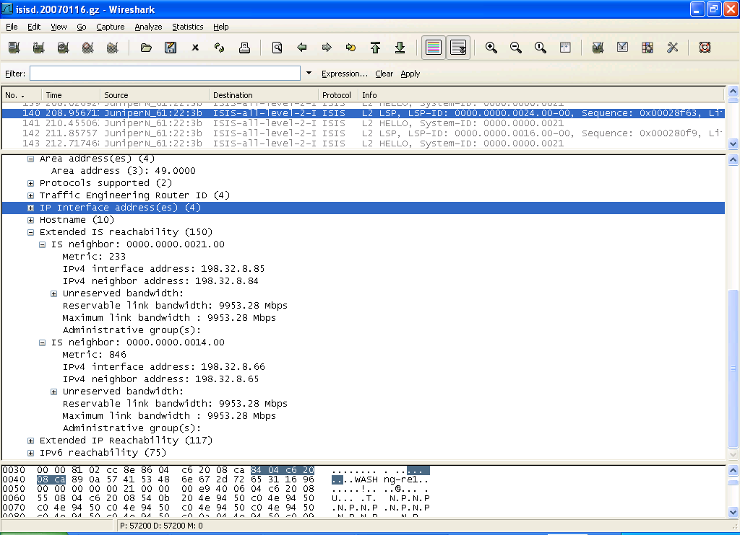
ISIS on the Wire…

Slide 29
IS-IS Configuration on Abilene (atlang)
lo0 {
unit 0 {
….
family iso {
address 49.0000.0000.0000.0014.00;
}
….
}
isis {
level 2 wide-metrics-only;
/* OC192 to WASHng */
interface so-0/0/0.0 {
level 2 metric 846;
level 1 disable;
}
}
ISO Address Configured on Loopback Interface
Only Level 2 IS-IS in Abilene

Slide 30
IS-IS vs. OSPF
Cisco ships OSPF in 1991
Cisco ships dual IS-IS in 1992
Circa 1995: ISPs need to run IGPs, IS-IS is recommended due to the recent rewrite
IS-IS became very popular in late 1990s
  Deployed in most large ISPs (also Abilene)
  Some ISPs (e.g., AOL backbone) even switched

Slide 31
Monitoring OSPF
Challenge: How to get the OSPF Link State Advertisements (LSAs)?

Slide 32
Challenge #1: Capturing LSAs
Wire-tap mode
  Invasive
  Dependent on Layer-2
Host mode
  Distribute LSAs over multicast
  LSAR joins multicast group
Full adjacency mode
  Form high-cost adjacency with network
Partial adjacency mode

Slide 33
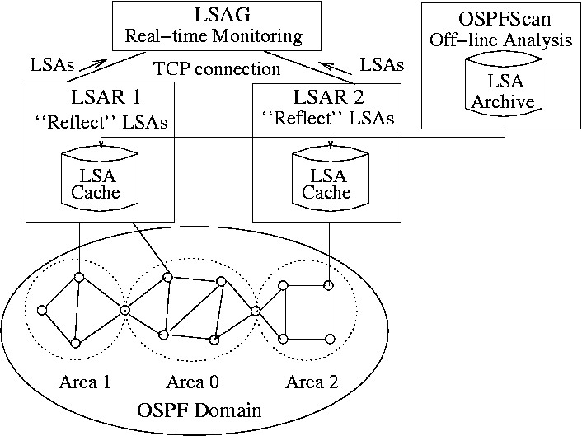
Challenge #2: Dealing with Areas
Problem: OSPF LSAs not advertised across area boundaries.

Slide 34
Today’s Papers: Alternative Intradomain Routing Mechanisms
A Key Question: How to set weights in a shortest-path routing protocol?
Problem: Link cost becomes a protocol knob, not a reflection of the topology
Options:
  Link-weight tuning
  Set up circuits (MPLS, and route on different circuits)
  Random perturbations on link weights
  …

Slide 35
Valiant Load Balanced Networks
Problem: Impossible to have the perfectly tuned network
  Traffic matrix hard to estimate
    …and it’s always changing
  Links and nodes fail, and the failure mode scenario may not be desirable
  Networks continually growing, changing, etc.
Idea: Valiant load-balanced networks

Slide 36
Valiant Load-Balancing
Suppose each node has capacity r
How much capacity for each link?
What if a node fails?
r
r
1
2
N
3
r
r
2
…
4
r
r
Notes:
We establish a full mesh of circuits over the underlying physical topology.
Routing is done in two stages on the full mesh.
…
This means, with a total link capacity of 2r at each node, we can serve all traffic matrices. I believe this is only possible with load balancing, and the scheme has been proved to be optimal by Keslassy.
This also means, if we size the rate r correctly, the network can handle any traffic, including flash crowds. DDoS attacks are just a type of flash crowd, so the network is resilient against DDoS attacks.

Slide 37
Thought Questions
How might you use VLB types of routing to reduce per-router routing table state?
Is there an alternate constrained VLB design that might put better bounds on latency increases?
What would an internet of all VLB-routed ISPs look like? (How might traffic flow, etc.?)
What other ways can you think of to design an intradomain routing protocol that handles traffic dynamism and failures and yet still scales well?

