Slide 1
Multihoming and
Multi-path Routing
CS 7260
Nick Feamster
January 29. 2007

Slide 2
Today’s Topic
IP-Based Multihoming
  What is it?
  What problem is it solving? (Why multihome?)
  How is it implemented today (in IP)?
  Traffic Engineering
  How many upstream ISPs are enough?
Problems with IP-based multihoming
  Inbound route control
  Routing table growth
Another approach: host-based multihoming

Slide 3
What is Multihoming?
The use of redundant network links for the purposes of external connectivity
Can be achieved at many layers of the protocol stack and many places in the network
  Multiple network interfaces in a PC
  An ISP with multiple upstream interfaces
Can refer to having multiple connections to
  The same ISP
  Multiple ISPs

Slide 4
Why Multihome?
Redundancy
Availability
Performance
Cost
Interdomain traffic engineering: the process by which a multihomed network configures its network to achieve these goals

Slide 5
Redundancy
Maintain connectivity in the face of:
  Physical connectivity problems (fiber cut, device failures, etc.)
  Failures in upstream ISP

Slide 6
Performance
Use multiple network links at once to achieve higher throughput than just over a single link.
Allows incoming traffic to be load-balanced.
30% of traffic
70% of traffic

Slide 7
Multihoming in IP Networks Today
Stub AS: no transit service for other ASes
  No need to use BGP
Multi-homed stub AS: has connectivity to multiple immediate upstream ISPs
  Need BGP
  No need for a public AS number
  No need for IP prefix allocation
Multi-homed transit AS: connectivity to multiple ASes and transit service
  Need BGP, public AS number, IP prefix allocation

Slide 8
BGP or no?
Advantages of static routing
  Cheaper/smaller routers (less true nowadays)
  Simpler to configure
Advantages of BGP
  More control of your destiny (have providers stop announcing you)
  Faster/more intelligent selection of where to send outbound packets.
  Better debugging of net problems (you can see the Internet topology now)

Slide 9
Same Provider or Multiple?
If your provider is reliable and fast, and affordably, and offers good tech-support, you may want to multi-home initially to them via some backup path (slow is better than dead).
Eventually you’ll want to multi-home to different providers, to avoid failure modes due to one provider’s architecture decisions.

Slide 10
Multihomed Stub: One Link
Multiple links between same pair of routers.
Default routes to “border”
Upstream
ISP
“Stub”
ISP
Downstream ISP’s routers configure default (“static”) routes pointing to border router.
Upstream ISP advertises reachability

Slide 11
Multihomed Stub: Multiple Links
Multiple links to different upstream routers
BGP for load balance at edge
“Stub”
ISP
Upstream
ISP
Internal routing for “hot potato”
Use BGP to share load
Use private AS number (why is this OK?)
As before, upstream ISP advertises prefix

Slide 12
Multihomed Stub: Multiple ISPs
Upstream
ISP 1
“Stub”
ISP
Upstream
ISP 2
Many possibilities
  Load sharing
  Primary-backup
  Selective use of different ISPs
Requires BGP, public AS number, etc.

Slide 13
Multihomed Transit Network
ISP 1
Transit
ISP
ISP 3
ISP 2
BGP everywhere
Incoming and outcoming traffic
Challenge: balancing load on intradomain and egress links, given an offered traffic load

Slide 14
Interdomain Traffic Engineering
The process by which a network operator configures the network to achieve
  Traffic load balance
  Redundancy (primary/backup), etc.
Two tasks
  Outbound traffic control
  Inbound traffic control
Key Problems: Predictability and Scalability

Slide 15
Outbound Traffic Control
Easier to control than inbound traffic
  Destination-based routing: sender determines where the packets go
Control over next-hop AS only
  Cannot control selection of the entire path
Provider 1
Provider 2
Control with local preference

Slide 16
Outbound Traffic: Load Balancing
Control routes to provider per-prefix
  Assign local preference across destination prefixes
  Change the local preference assignments over time
Useful inputs to load balancing
  End-to-end path performance data
  Outbound traffic statistics per destination prefix
Challenge: Getting from traffic volumes to groups of prefixes that should be assigned to each link
Premise of “intelligent route control” preoducts.

Slide 17
Traffic Engineering Goals
Predictability
  Ensure the BGP decision process is deterministic
  Assume that BGP updates are (relatively) stable
Limit overhead introduced by routing changes
  Minimize frequency of changes to routing policies
  Limit number of prefixes affected by changes
Limit impact on how traffic enters the network
  Avoid new routes that might change neighbor’s mind
  Select route with same attributes, or at least path length

Slide 18
Managing Scale
Destination prefixes
  More than 90,000 destination prefixes
    Don’t want to have per-prefix routing policies
  Small fraction of prefixes contribute most of the traffic
    Focus on the small number of heavy hitters
  Define routing policies for selected prefixes
Routing choices
  About 27,000 unique “routing choices”
    Help in reducing the scale of the problem
  Small fraction of “routing choices” contribute most traffic
    Focus on the very small number of “routing choices”
  Define routing policies on common attributes

Slide 19
Achieving Predictability
Route prediction with static analysis
  Helpful to know effects before deployment
  Static analysis can help
BGP policy
configuration
Topology
BGP routing
model
eBGP
routes
Offered
traffic
Flow of traffic through the network

Slide 20
Challenges to Predictability
For transit ISPs: effects on incoming traffic
  Lack of coordination strikes again!

Slide 21
Inter-AS Negotiation
Destination 1
Coordination aids predictability
  Negotiate where to send
  Inbound and outbound
  Mutual benefits
How to implement?
  What info to exchange?
  Protecting privacy?
  How to prioritize choices?
  How to prevent cheating?
Provider B
multiple
peering
points
“Hot Potato”
routing
Provider A
Destination 2

Slide 22
Outbound: Multihoming Goals
Redundancy
  Dynamic routing will failover to backup link
Performance
  Select provider with best performance per prefix
  Requires active probing
Cost
  Select provider per prefix over time to minimize the total financial cost

Slide 23
Inbound Traffic Control
More difficult: no control over neighbors’ decisions.
Three common techniques (previously discussed)
  AS path prepending
  Communities and local preference
  Prefix splitting
How does today’s paper (MONET) control inbound traffic?

Slide 24
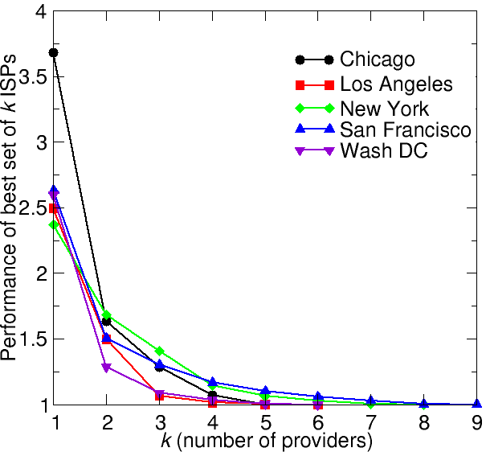
How many links are enough?
K upstream ISPs
Not much benefit beyond 4 ISPs
Akella et al., “Performance Benefits of Multihoming”, SIGCOMM 2003

Slide 25
Problems with Multihoming in IPv4
Routing table growth
  Provider-based addressing
  Advertising prefix out multiple ISPs – can’t aggregate
Poor control over inbound traffic
  Existing mechanisms do not allow hosts to control inbound traffic

Slide 26
Today’s Reading
Source Selectable Path Diversity via Routing Deflections, Yang et al.
Main idea: Sources can detect and react to failures more quickly than the routing protocols often can.
Source routing is appealing, but…
  Scaling problems
  Routers designed to forward on destination address

Slide 27
Benefits
No need for coordination across ISPs
No need for additional machinery (simple tweaks to shortest path routing work well)

Slide 28
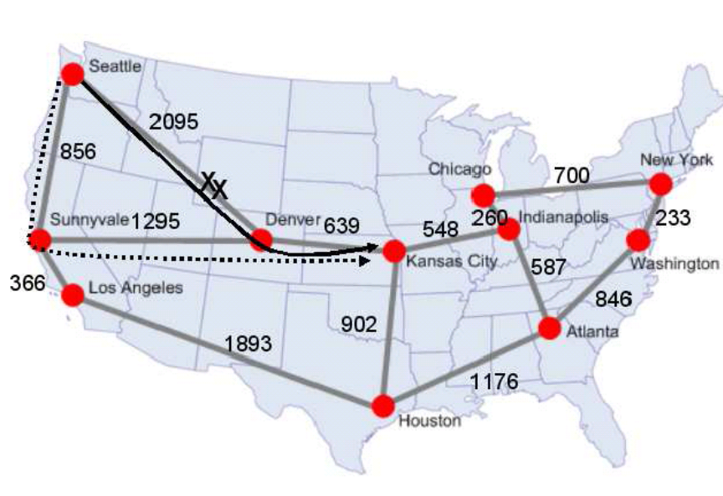
Two Key Components
Deflection Rules
  Needed to prevent loops when packets are deflected
  Simple idea: deflect packets only to hopes that are closer to the destination
  Complication: may not expose enough path diversity
    Deflections may come straight back

Slide 29
Enhancement #1: Two Hops Down
Rule: Packet can be forwarded to any intermediate node for which the length of the path decreases along a two-hop sequence
Question: Why will this not cause loops?
Answer: 2-hop sequence always decreases cost.
Additional cost: Forwarding decisions also depend on incoming link

Slide 30
Enhancement #2: Two Hops Forward
Same as previous rule, but remove the incoming link used to reach the node in question
Can cause more roundabout paths

Slide 31
Discussion Questions
How does it work with BGP?
Who’s responsible for tagging packets?
Is this enough diversity?
Is it too much? (i.e., is latency too high?)
Overload?
  Opposite: Better balancing/QoS?
Stability problems?
Selfish behavior?
How good is random?

