Slide 1
Management: Fault Detection and Troubleshooting
Nick Feamster
CS 7260
February 5, 2007

Slide 2
Today’s Lecture
Routing Stability
  Gao and Rexford, Stable Internet Routing without Global Coordination
  Major results
  Business model assumptions (validity of)
Network Management
  “State-of-the-art”: SNMP
  Research challenges for network management
  Routing configuration correctness
    Detecting BGP Configuration Faults with Static Analysis

Slide 3

Is management really that important?

Slide 4
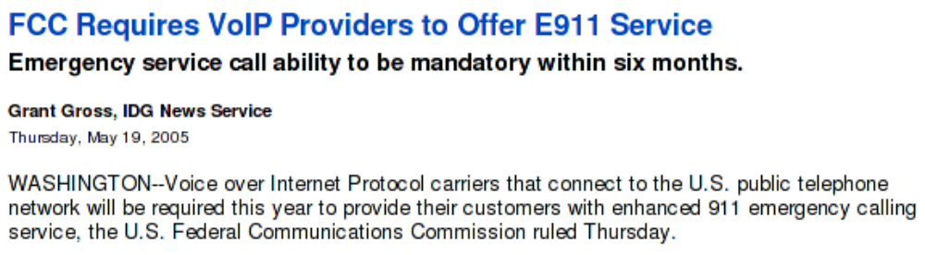
Is management really that important?
The Internet is increasingly becoming part of the mission-critical Infrastructure (a public utility!).
Big problem: Very poor understanding
of how to manage it.

Slide 5
Simple Network Management Protocol
Version 1: 1988
(RFC 1065-1067)
Management Information Base (MIB)
  Information store
  Unique variables named by OIDs
  Accessed with SNMP
Three components
  Manager: queries the MIB (“client”)
  Master agent: the network element being managed
  Subagent: gathers information from managed objects to store in MIB, generate alerts, etc.
SNMP
Manager
Agent
Managed
Objects
DB

Slide 6
Naming MIB Objects
Each object has a distinct object identifier (OID)
  Hierarchical Namespace
Example
  BGP: 1.3.6.1.2.1.15 (RFC 1657)
    bgpVersion: "1.3.6.1.2.1.15.1"
    bgpLocalAs: "1.3.6.1.2.1.15.2"
    bgpPeerTable: "1.3.6.1.2.1.15.3"
    bgpIdentifier: "1.3.6.1.2.1.15.4"
    bgpRcvdPathAttrTable: "1.3.6.1.2.1.15.5“
    bgp4PathAttrTable: "1.3.6.1.2.1.15.6"
MIB Structure
root
iso (1)
org (3)
Tables are sequences of other types
dod (6)
internet (1)

Slide 7
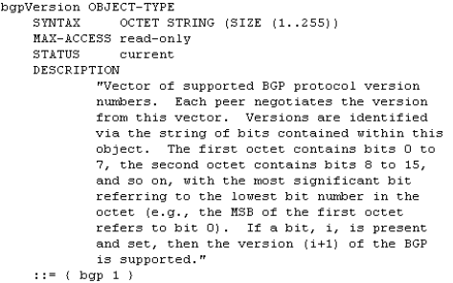
MIB Definitions
Example from RFC 1657
“1.3.6.1.2.15.1”

Slide 8
MIB Definitions: Lots of Them!
ADSL RFC 2662
ATM Multiple
AppleTalk RFC 1742
BGPv4 RFC 1657
Bridge RFC 1493
Character Stream RFC 1658
CLNS RFC 1238
DECnet Phase IV RFC 1559
DOCSIS Cable Modem Multiple
…

Slide 9
Interacting with the MIB
Four basic message types
  Get: retrieving information about some object
  Get-Next: iterative retrieval
  Set: setting variable values
  Trap: used to report
Queries on UDP port 161, Traps on port 162
Enabling SNMP on a Cisco Router for BGP
# snmp-server enable traps bgp
# snmp-server host myhost.cisco.com informs version 2c public
Notifications about state changes, etc.

Slide 10
SNMPv2c (1993)
Expanded data types: 64-bit counters
Improved efficiency and performance: get-bulk
Confirmed event notifications: inform operator
Richer error handling: errors and exceptions
Improved sets: especially row creation/deletion
Transport independence: IP, Appletalk, IPX
Not widely-adopted: security considerations
  Compromise: SNMPv2u (commercial deployment)

Slide 11
Common Use of SNMP: Traffic
Routers have various counters that keep byte counts for traffic passing over a given link
  Periodic polling of MIBs for traffic monitoring
Problem: these measurements are device-level, not flow-level
  Detect a DoS attack by polling SNMP?!
  Trend: end-to-end statistics

Slide 12
More Problems with SNMP
Can’t handle large data volumes
  SNMP “walks” take very long on large tables, especially when network delay is high
Imposes significant CPU load
Device-level, not network-level
Sometimes, implementation issues
  Counter bugs
  Loops on SNMP walks
http://www.statseeker.com/pdf/snmp.pdf

Slide 13
Management Research Problems
Organizing diverse data to consider problems across different time scales and across different sites
  Correlations in real time and event-based
  How is data normalized?
Changing the focus: from data to information
  Which information can be used to answer a specific management question?
  Identifying root causes of abnormal behavior (via data mining)
  How can simple counter-based data be synthesized to provide information eg. “something is now abnormal”?
  View must be expanded across layers and data providers

Slide 14
Research Problems (continued)
Automation of various management functions
  Expert annotation of key events will continue to be necessary
Identifying traffic types with minimal information
Design and deployment of measurement infrastructure (both passive and active)
  Privacy, trust, cost limit broad deployment
  Can end-to-end measurements ever be practically supported?
Accurate identification of attacks and intrusions
  Security makes different measurements important

Slide 15
Overcoming Problems
Convince customers that measurement is worth additional cost by targeting their problems
Companies are motivated to make network management more efficient (i.e., reduce headcount)
Portal service (high level information on the network’s traffic) is already available to customers
  This has been done primarily for security services
  Aggregate summaries of passive, netflow-based measures

Slide 16
Long-Term Goals
Programmable measurement
  On network devices and over distributed sites
  Requires authorization and safe execution
Synthesis of information at the point of measurement and central aggregation of minimal information
Refocus from measurement of individual devices to measurement of network-wide protocols and applications
  Coupled with drill down analysis to identify root causes
  This must include all middle-boxes and services

Slide 17
Why does routing go wrong?
Complex policies
  Competing / cooperating networks
  Each with only limited visibility
Large scale
  Tens of thousands networks
  …each with hundreds of routers
  …each routing to hundreds of thousands of IP prefixes

Slide 18
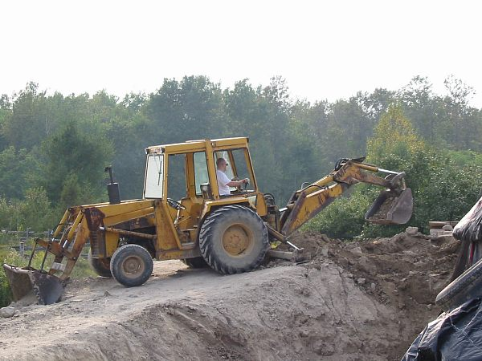
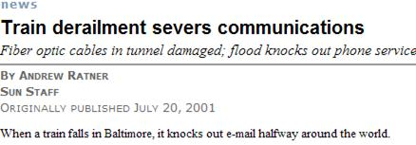
What can go wrong?
Some things are out of the hands of networking research
But…
Two-thirds of the problems are caused by configuration of the routing protocol

Slide 19
Complex configuration!
Flexibility for realizing goals in
complex business landscape
Which neighboring networks can send traffic
Where traffic enters and leaves the network
How routers within the network learn routes to external destinations
Traffic
Route
No Route
Flexibility
Complexity
Notes:
Primary route selection
Talk about customers and competitors; economic/business landscape
Goal: ensure that customers have reachability to rest of internet, etc.

Slide 20
Configuration Semantics
Filtering: route advertisement
Ranking: route selection
Customer
Primary
Competitor
Backup
Dissemination: internal route advertisement
Notes:
External filtering vs. internal dissemination
(external vs. internal)
What makes distributed configuration hard?
Filtering: Who gets what
Dissemination: how they get it (the path by which they get it)
Ranking: what they get
Not much else in terms of complicated side effects –
Verifying distributed program’s correctness

Slide 21
What types of problems does configuration cause?
Persistent oscillation (last time)
Forwarding loops
Partitions
“Blackholes”
Route instability
…

Slide 22
Real Problems: “AS 7007”
“…a glitch at a small ISP… triggered a major outage in Internet access across the country. The problem started when MAI Network Services...passed bad router information from one of its customers onto Sprint.” -- news.com, April 25, 1997
UUNet
Sprint
Florida Internet
Barn

Slide 23
Real, Recurrent Problems
“…a glitch at a small ISP… triggered a major outage in Internet access across the country. The problem started when MAI Network Services...passed bad router information from one of its customers onto Sprint.” -- news.com, April 25, 1997
“Microsoft's websites were offline for up to 23 hours...because of a [router] misconfiguration…it took nearly a day to determine what was wrong and undo the changes.” -- wired.com, January 25, 2001
“WorldCom Inc…suffered a widespread outage on its Internet backbone that affected roughly 20 percent of its U.S. customer base. The network problems…affected millions of computer users worldwide. A spokeswoman attributed the outage to "a route table issue."
-- cnn.com, October 3, 2002
"A number of Covad customers went out from 5pm today due to, supposedly, a DDOS (distributed denial of service attack) on a key Level3 data center, which later was described as a route leak (misconfiguration).”
-- dslreports.com, February 23, 2004

Slide 24
January 2006: Route Leak, Take 2
Con Ed 'stealing' Panix routes (alexis) Sun Jan 22 12:38:16 2006
All Panix services are currently unreachable from large portions of the Internet (though not all of it). This is because Con Ed Communications, a competence-challenged ISP in New York, is announcing our routes to the Internet. In English, that means that they are claiming that all our traffic should be passing through them, when of course it should not. Those portions of the net that are "closer" (in network topology terms) to Con Ed will send them our traffic, which makes us unreachable.
“Of course, there are measures one can take against this sort of thing; but it's hard to deploy some of them effectively when the party stealing your routes was in fact once authorized to offer them, and its own peers may be explicitly allowing them in filter lists (which, I think, is the case here). “

Slide 25
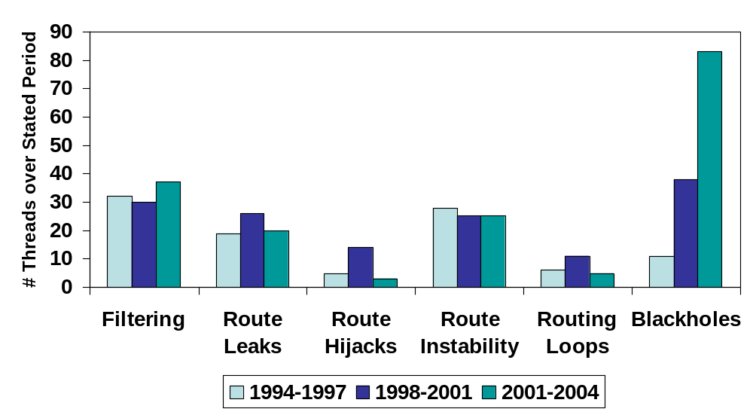
Several “Big” Problems a Week
Notes:
Informal analysis (collected from a mailing list archive): by no means a complete list
Be careful: incidents not decreasing. With larger scale, these incidents could be further reaching.
Statistical analysis just shows that there are a lot of these incidents. Don’t want to make the statement that 1 fire is not important.
Do we need to make the point about ‘fires’?
83 power outages, 1 fire
“Two rats crawled through an underground cable conduit into a cabinet of power switching gear adjacent to the Stanford University cogeneration plant, and caused an explosion that cut off power to the Stanford area.” (October 12, 1996)

Slide 26
Why is routing hard to get right?
Defining correctness is hard
Interactions cause unintended consequences
  Each network independently configured
  Unintended policy interactions
Operators make mistakes
  Configuration is difficult
  Complex policies, distributed configuration
Notes:
Say:
Talk is about the first
upcoming sigcomm paper
Note: mistakes are not the only thing
Prevents two endpoints from *being able* to communicate with each other
Unintended consequence: why is this a real problem in practice?
(maybe a concrete example here…or with the quotes)

Slide 27

Correctness Specification
Safety
The protocol converges to a stable path assignment for every possible initial state and message ordering
The protocol does not oscillate
Notes:
Explanation of path visibility wasn’t obvious.
Need to make a simpler explanation of the property
Give some more informal language here: explicitly call out the problems that result when these things are violated. “if you don’t have path visibility, then…”

Slide 28
What about properties of resulting paths, after the protocol has converged?
We need additional correctness properties.

Slide 29
Correctness Specification
Safety
The protocol converges to a stable path assignment for every possible initial state and message ordering
The protocol does not oscillate
Path Visibility
Every destination with a usable path has a route advertisement
If there exists a path,
then there exists a route
Example violation: Network partition
Route Validity
Every route advertisement corresponds to a usable path
If there exists a route,
then there exists a path
Example violation: Routing loop
Notes:
Explanation of path visibility wasn’t obvious.
Need to make a simpler explanation of the property
Give some more informal language here: explicitly call out the problems that result when these things are violated. “if you don’t have path visibility, then…”

Slide 30
Path Visibility: Internal BGP (iBGP)
“iBGP”
Default: “Full mesh” iBGP.
Doesn’t scale.
Large ASes use “Route reflection”
Route reflector:
non-client routes over client sessions;
client routes over all sessions
Client: don’t re-advertise iBGP routes.
Notes:
Put “RR” and “C” in the bubbles to make clear what’s a route reflector
What problem arises?
If the client receives something from a route reflector, it doesn’t re-advertise it

Slide 31
iBGP Signaling: Static Check
Theorem.
Suppose the iBGP reflector-client relationship graph contains no cycles. Then, path visibility is satisfied if, and only if, the set of routers that are not route reflector clients forms a clique.
Condition is easy to check with static analysis.
Notes:
Dina’s question about more complex example.

Slide 32
How do we guarantee these additional properties in practice?

Slide 33

Today: Reactive Operation
What happens if I tweak this policy…?
Revert
No
Desired
Effect?
Yes
Wait for
Next Problem
Configure
Observe
Problems cause downtime
Problems often not immediately apparent
Notes:
Workflow!! Away from sr towards operation with tool can be used prior to deployment
PICTURE
Problems may be masked
Not just mistakes
What are the kinds of things that people are likely to want to change:
For example: link provision, flash crowd (simple example)

Slide 34
Goal: Proactive Operation
Idea: Analyze configuration before deployment
rcc
Configure
Detect
Faults
Deploy
Many faults can be detected with static analysis.

Slide 35
rcc Overview
Distributed router
configurations
(Single AS)
“rcc”
Correctness
Specification
Constraints
Faults
Normalized
Representation
Challenges
Analyzing complex, distributed configuration
Defining a correctness specification
Mapping specification to constraints
Notes:
Somehow include the theory on this slide. Say “local correctness specification”
Play up the fact that normalized representation is *not easy*!
Interesting engineering sidenote: difficult to parse
Scientific side note: had to come up with a normalized references so that testing constraints is easy
Com,piler guys try to do this for multiple languages (cf)

Slide 36
rcc Implementation
Preprocessor
Parser
Distributed router
configurations
Relational
Database
(mySQL)
(Cisco, Avici, Juniper, Procket, etc.)
Constraints
Verifier
Faults
Notes:
How many lines of code for each one of these modules
Complexity of verifier. (could also talk about this at the beginning)
Advantages of sql: extensible
Talk about the *complexity* of the database and verifier operations
Extensible…
Do it quickly!
Declarative language to run deductive queries

Slide 37
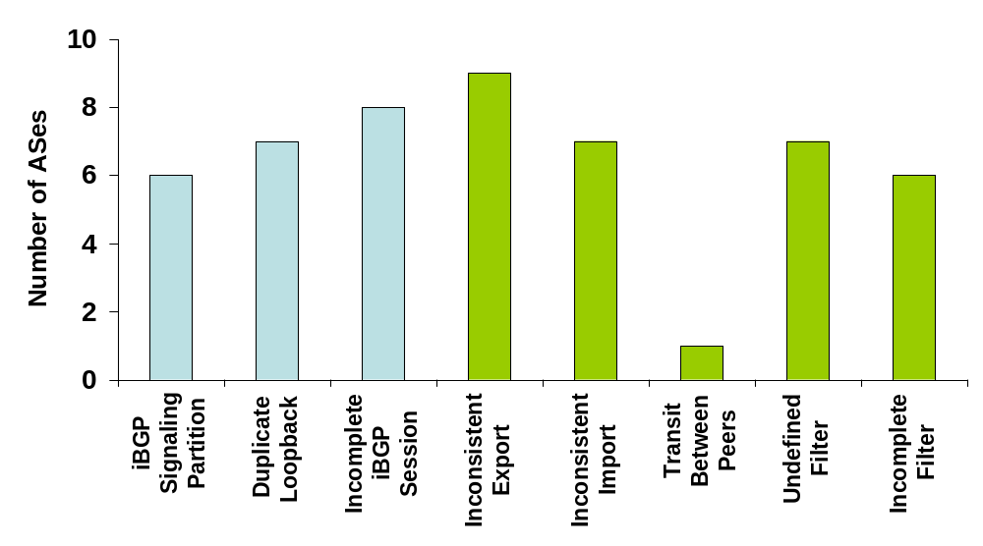
Summary: Faults across 17 ASes
Every AS had faults, regardless of network size
Most faults can be attributed to distributed configuration
Route Validity
Path Visibility
Notes:
Good level of detail
Most of these stem from the fact that these are distributed
Every AS had errors, independent of size of the network
What about correlation with network size?
Faults in every AS
2. How many faults? How many were latent?
3. How many downloads? There is a need for this tool!

Slide 38
rcc: Take-home lessons
Static configuration analysis uncovers many errors
Major causes of error:
  Distributed configuration
  Intra-AS dissemination is too complex
  Mechanistic expression of policy
Notes:
WORKFLOW
Say something about routing as a distributed program. Approach still likely to be useful.

Slide 39
Two Philosophies
The “rcc approach”: Accept the Internet as is. Devise “band-aids”.
Another direction: Redesign Internet routing to guarantee safety, route validity, and path visibility

Slide 40
Problem 1: Other Protocols
Static analysis for MPLS VPNs
  Logically separate networks running over single physical network: separation is key
  Security policies maybe more well-defined (or perhaps easier to write down) than more traditional ISP policies

Slide 41
Problem 2: Limits of Static Analysis
Problem: Many problems can’t be detected from static configuration analysis of a single AS
Dependencies/Interactions among multiple ASes
  Contract violations
  Route hijacks
  BGP “wedgies” (RFC 4264)
  Filtering
Dependencies on route arrivals
  Simple network configurations can oscillate, but operators can’t tell until the routes actually arrive.

Slide 42
BGP Wedgie Example
AS 1 implements backup link by sending AS 2 a “depref me” community.
AS 2 sets localpref to smaller than that of routes from its upstream provider (AS 3 routes)
AS 3
AS 4
AS 2
“Depref”
Backup
Primary
AS 1

Slide 43
Failure and “Recovery”
AS 3
AS 4
AS 2
“Depref”
Backup
Primary
AS 1
Requires manual intervention

Slide 44
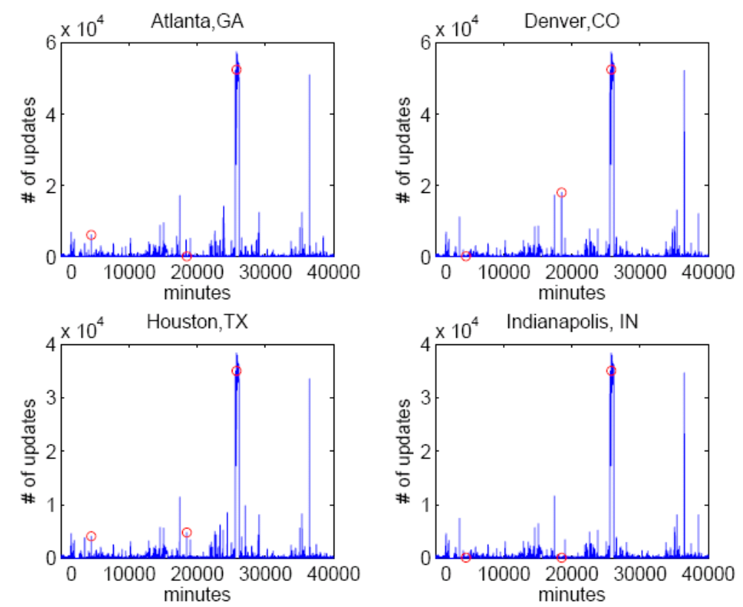
Detection Using Routing Dynamics
Large volume of data
Lack of semantics in a single stream of routing updates
Idea: Can we improve detection by mining network-wide dependencies across routing streams?
Notes:
The figure provides an example of BGP update timeseries from different routers in the Abilene network during January 2006. The red circle means a documented disruption. Not all disruptions are circled. We can easily find there are mainly two challenges in using bgp updates. The first is how to deal with the large volume of data. The second challenge is each stream of routing updates has a lot of noise and lacking of semantics.
Previous work usually addresses these two challenges by grouping updates with prefixes in a single routing stream and report only on the “loud” events, i.e. events involve large volume of routing messages.
However, We find many network disruptions are not large spikes but has dependencies across routing streams. (see the graph)
This makes sense because a single disruption may affect many different routers in shifting a small number of routes. Here we improve the detection method by mining network-wide dependencies across routing streams .

Slide 45
Problem 3: Preventing Errors
Before: conventional iBGP
eBGP
iBGP
After: RCP gets “best” iBGP routes (and IGP topology)
RCP
iBGP
Caesar et al., “Design and Implementation of a Routing Control Platform”, NSDI, 2005

